Slide 1

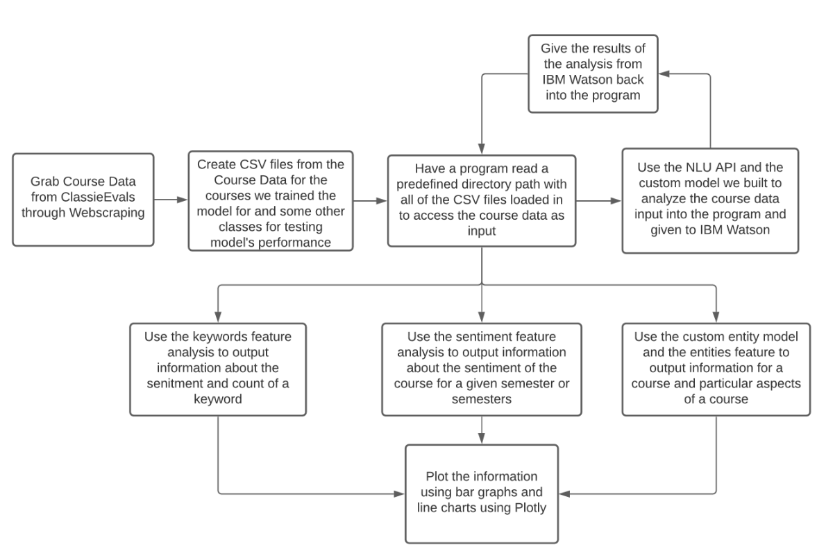
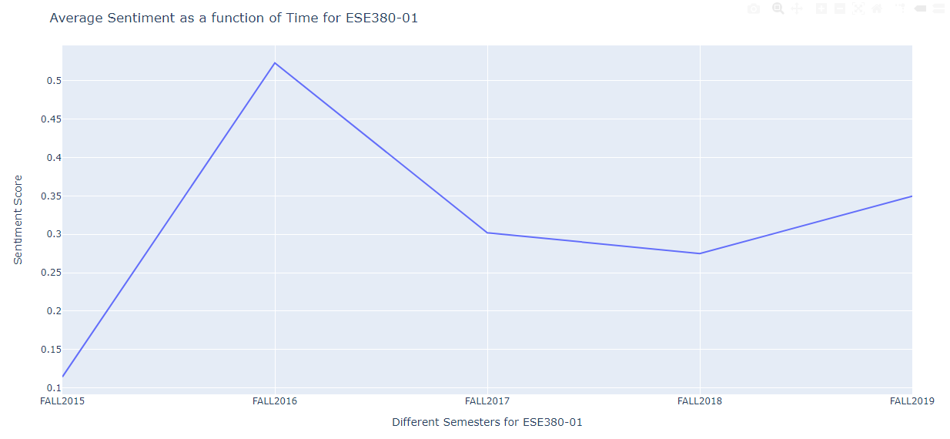
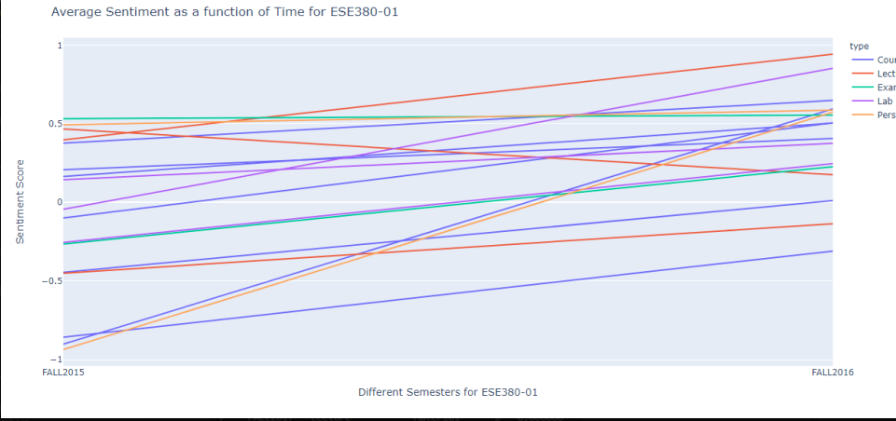
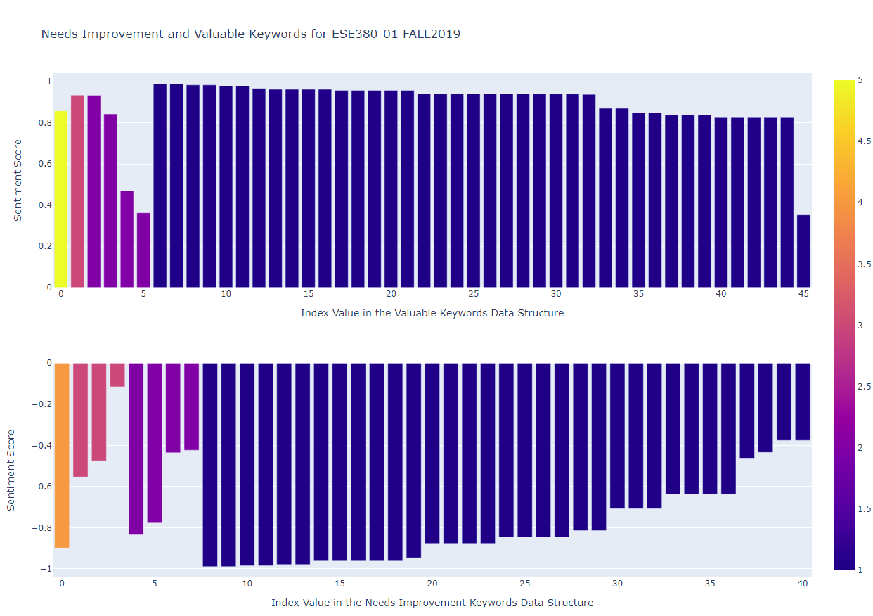
Course Evolution Evaluation with Sentiment Analysis Mentor(s): Wendy Tang Team Members: Aaron Varghese, Richard Ma, Ervin Wong
Problem Statement
SOL was founded to address the issues with:
Time
Professors need to read through many students’ reviews of a course thoroughly to understand what students are saying, and it may be hard for them to understand what students are saying because language is constantly evolving.
Conveniency of reviewing courses:
Data for student evaluations is spread out through multiple links for each specific section and semester, making it harder for professors to browse and gather information on their course.
Finding patterns and classifying text:
It is hard for professors to understand if students give good or bad reviews for a course, or parts of a course (due to the large amount of course reviews that students give per semester and the amount of overwhelming information students give, or the lack of information thereof).
Solution Description
To solve the problems addressed above, SOL decided to:
Scrape course reviews from the Classie Evals webpage for specific classes based on department code and class number
Analyze course reviews using IBM Watson’s NLU API
Compute and output a generalized sentiment score for a course and semester specified by the user
Provide concrete overall sentiment for the professor to have a solid statistical summary of different course evaluations
Load scraped data into a custom IBM Watson entity type model to identify entity keywords in each class
Produce a user interactive graph which displays an over arching review of a course over time, based on the entities sorted
Software Design
Our program is a terminal-based program that uses Plotly to
output user-interactive graphs. This is done to make it
easy for users to interact with the graphs without being tied
to a clunky user interface.
Results
Since professors are usually interested in the types of words
that students use to describe their course, we decided to
use the NLU API to output words that are seen as important
by the API, along with the number of times students use the
Keywords and their sentiment.
Results Continued
The following graph represents the average sentiment score
for a course over a period (2015-2019).
We were also able to show how a class evolves in different
categories we defined over a passage of time.
Glossary
NLU: Natural Language Understanding
API: Application Programming Interface
Classie-Evals: Stony Brook University’s student course review database
Plotly: Python library like Matplotlib used for generating user-interactive graphs
Acknowledgements
We would like to thank Professor Tang for her outstanding
guidance and advice throughout our project, and for the department for putting up with us for 4 years.
SOL

