Slide 1
Team Name: TechXploit Member Details :- Anurag Mondal (LEAD) Souvik Pramanik Alisha Parvin Avinandan Panda
HACKODISHA
Our Theme : Open Innovation (Network Security)

Slide 2
Problem Statement :
HACKODISHA
In computer networking, a port is a communication endpoint. At the software level, within an operating system, a port is a logical construct that identifies a specific process or a type of network service. The most common transport protocols that use port numbers are the Transmission Control Protocol (TCP) and the User Datagram Protocol (UDP). Port scanning refers to the surveillance of computer ports, done by us when we are trying to communicate with a certain computer. To be able to check whether a service is currently running on a port or how many services are running or to scan number of hosts alive in a network, where we need to ping every single IP of the network and wait for the response, seems hectic. For this particular reason, a network automation tool will come very handy for the user and as a solution to this and a lot more, we bring Carnage - a Powerful, Clever and Flexible Network Automation & Port Scanning tool.

Slide 3
Approach Details/ Proposed Solution :
HACKODISHA
Carnage is a Cross-Platform Network automation tool which will be packed with lots of features to make the life of Network Admins easier. It can also be used by Security Professionals / Ethical Hackers / Police personnel to find loopholes in systems all across the wide Internet as well as in their Intranet. It can also be used by police personnel to monitor malicious domains/targets automatically and keep a log of them to analyze their behavior over time.
There are other port-scanning tools out there in the market but each has their fair share of pros and cons.
Carnage will be built with ease to use and convenience in mind. It will be easy to learn and catchup even for beginners in cybersecurity. It will contain clean code and act as a foundation step for others to learn about socket programming, networking and ethical hacking. It will be especially made for the newcomers in cybersecurity. It will also be visually very attractive and will have geeky hacker aesthetics to it.

Slide 4
Technology Highlights :
HACKODISHA
Carnage is a one of it’s kind modular and flexible Network Automation Engine/Framework packed with lots of useful features. It has lots of use cases and the possibilities of ways of automating a workflow using carnage are limitless.
Here are some of the major highlights of carnage :-
Cross-Platform (Seamless support for Windows, Android, Linux)
Can be used for information/intelligence gathering on malicious websites/servers both on Dark-Web as well as Surface-Web
Also acts as a Network Automation as a Service (NAaaS) tool through web-api calls which can be used on demand from anywhere in the world without need of any platform.
Is clever & flexible. Multiple scanning options can be combined based on requirements.
Has a very intuitive and user-friendly Command-Line Interface.
It has the ability to run autonomously and generate reports of scans which can be used for logging and monitoring of a target, which can be further used for behavioral analysis of a target over time.
Easy to install, deploy and use as a service in private servers.
It outputs the data/scan results in a useful format which can fed into other tools for further processing/visualizing.

Slide 5
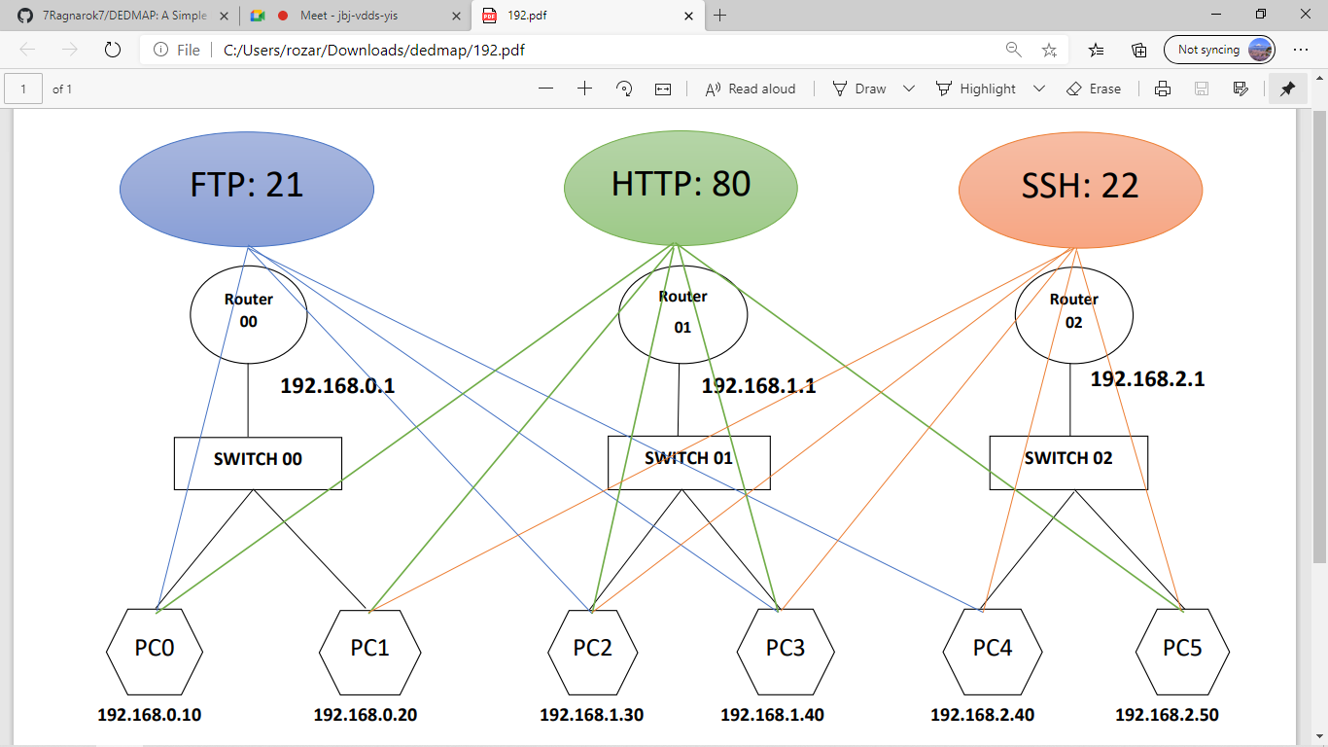
Depiction of working of Carnage:
HACKODISHA
Carnage Installed
The figure above shows a virtual network containing 3 different networks with 2 PCs in each. Each pc is running some kind of a server (FTP server, HTTP server or SSH server). Now lets say Carnage is installed in any one of these PC’s, PC2 for example. Carnage will have the ability to find the network services running in the host pc (PC2), in any other pc in its local network (PC3), any pc in any other network (PC0, PC1, PC4, PC5) and any Internet-Facing server in the World. It will also have the ability to detect and count the number of devices (Including itself) present in it’s own network as well as other networks.

Slide 6
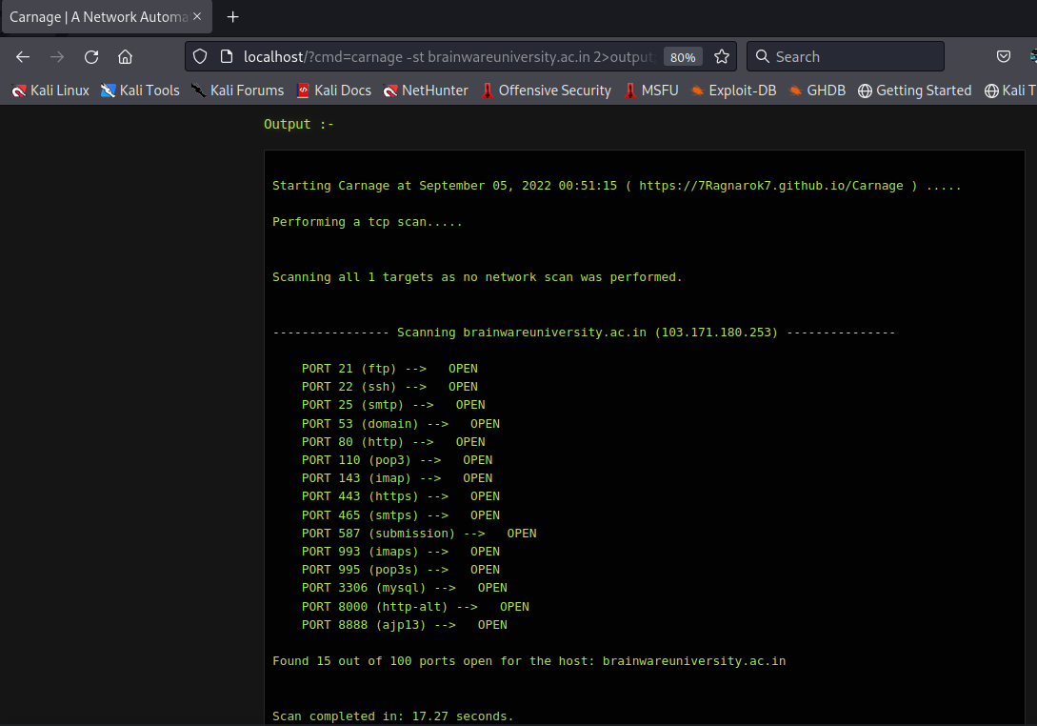
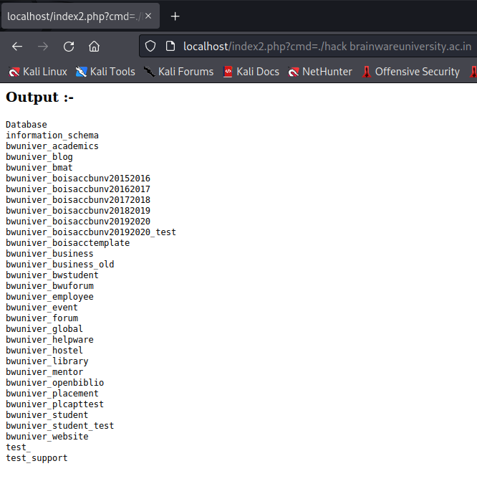
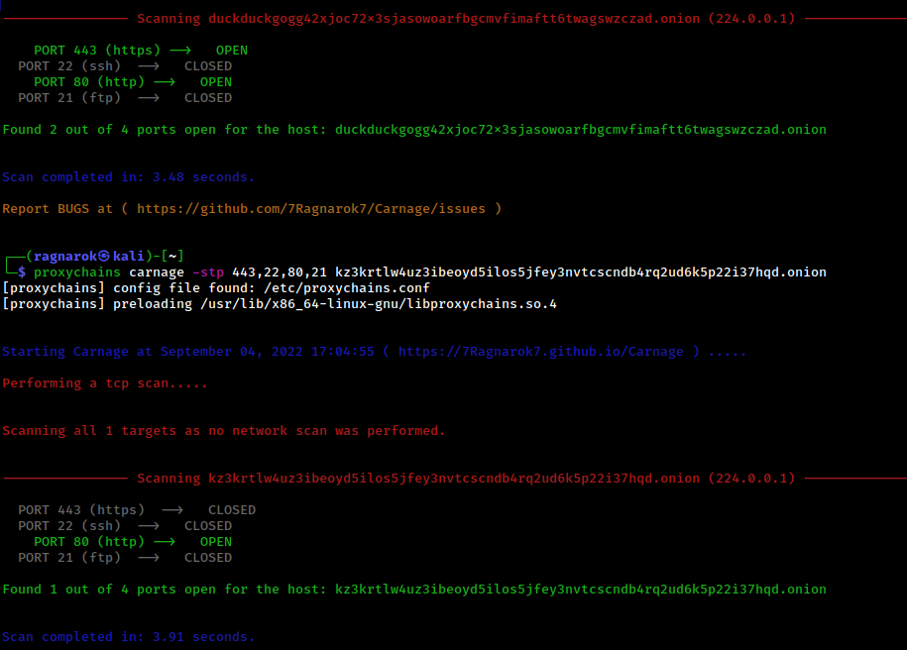
Examples :
HACKODISHA
Basic Carnage CLI Usage
Carnage running as Network Automation as a Service platform
Hacking the database of a server after the information gathering phase
Using carnage to get details of Dark-Net CC markets/onion sites

Slide 7
Scalability of our solution
HACKODISHA
Carnage will be easy to download and install and get started in a minute.
All the features will be well-documented
Carnage is like a Swiss-army knife will many useful tools and use cases at our disposal in need.
Being open-source in nature, it comes with absolute transparency and anybody can go through the code to find out how it’s built. (We would love for people to do that ☺)
Being modular in nature, it can be also published as a python package/library and imported in your personal projects
It can also be hosted in the cloud. By using server-less functions as api’s and adding a web frontend to the tool, it can be made accessible globally to everyone without installing it locally.
With integration of twilio api, it can also me made available as a bot for chat applications like whatsapp and telegram.
Being dependency-independent, it can be used as a portable tool to map and pivot around a private network upon getting a foothold on the public-facing server / edge-device.

Slide 8
Tech Stack :
HACKODISHA
Python and some core python libraries.
Yup, right. There’s nothing more in the Technology Stack.
Carnage will be built entirely just using Python.
It will be an Independent bare-metal tool and would not depend upon any other third-party tools or frameworks.
All the features that Carnage will contain will be hard-coded and written from scratch only using Python.
Future Scope :
We are building Carnage for the Cybersecurity community. Carnage will be a Free and Open-Source software with a GPL License and will always remain to be so. We do not plan to make any revenue out of it. However, our project will be open to donations. We believe in Open-Source software is the Future and support the cause.
We have plans to make Carnage available for chat applications like WhatsApp and Telegram as well in near future which will allow a user to use all the features of Carnage in a mobile phone right from a chat application.
We will also be adding a small honeypot feature in Carnage which will be very useful for monitoring a server for incoming traffic which can be further used as an IDS system.
We will use multithreading to drastically improve the performance of the tool.
We also plan to add a web-based front-end for the application for users who are not comfortable with using the terminal.

Slide 9

Thank You for your Time Please visit: carnage.7ragnarok7.tech
HACKODISHA
LET THERE BE
!!!!!!!

