Slide 1
Team Name: 7Ragnarok7 Member Details :- Anurag Mondal (SOLO)
DEVBHOOMI
Our Theme : Open Innovation (Network Security)

Slide 2
Problem Statement :
DEVBHOOMI
In computer networking, a port is a communication endpoint. At the software level, within an operating system, a port is a logical construct that identifies a specific process or a type of network service. The most common transport protocols that use port numbers are the Transmission Control Protocol (TCP) and the User Datagram Protocol (UDP). Port scanning refers to the surveillance of computer ports, done by us when we are trying to communicate with a certain computer. To be able to check whether a service is currently running on a port or how many services are running or to scan number of hosts alive in a network, where we need to ping every single IP of the network and wait for the response, seems hectic. For this particular reason, a network automation tool will come very handy for the user and as a solution to this and a lot more, we bring Carnage - a Powerful, Clever and Flexible Network Automation & Port Scanning tool.

Slide 3
Approach Details/ Proposed Solution :
DEVBHOOMI
Carnage is a Cross-Platform Network automation tool which will be packed with lots of features to make the life of Network Admins easier. It can also be used by Security Professionals / Ethical Hackers / Police personnel to find loopholes in systems all across the wide Internet as well as in their Intranet. It can also be used by police personnel to monitor malicious domains/targets automatically and keep a log of them to analyze their behavior over time.
There are other port-scanning tools out there in the market but each has their fair share of pros and cons.
Carnage will be built with ease to use and convenience in mind. It will be easy to learn and catchup even for beginners in cybersecurity. It will contain clean code and act as a foundation step for others to learn about socket programming, networking and ethical hacking. It will be especially made for the newcomers in cybersecurity. It will also be visually very attractive and will have geeky hacker aesthetics to it.

Slide 4
USE CASES :
DEVBHOOMI
The use cases of CARNAGE are enlisted below:
It tries to scan a target IP, target domain or range of IP’s and find services that are running and listening on some ports.
It can also scan a range of hosts to find live hosts.
It performs both DNS and rDNS lookup of any domain names.
It can perform a network scan on a network to find out live hosts.
Full Support for Windows, Linux and Android without any Elevated/Root privileges.
Provides colored event-based visual responses.
Is flexible. Multiple scanning options can be combined based on requirements.
Is clever. Scans only the live targets if a network scan is combined with other scans.
Support logging and exporting scan results in a report for security audits.
Can be also used as an Automation engine and imported in other projects as a library.
Indefinite possibilities. Totally depends upon the capabilities of end-users and their skills on how well they can use Carnage to automate the boring stuff
It outputs the data/scan results in a useful format which can fed into other tools for processing.
It can be used for automatically monitoring group of targets, generating logs and analyzing their behavior over time.

Slide 5
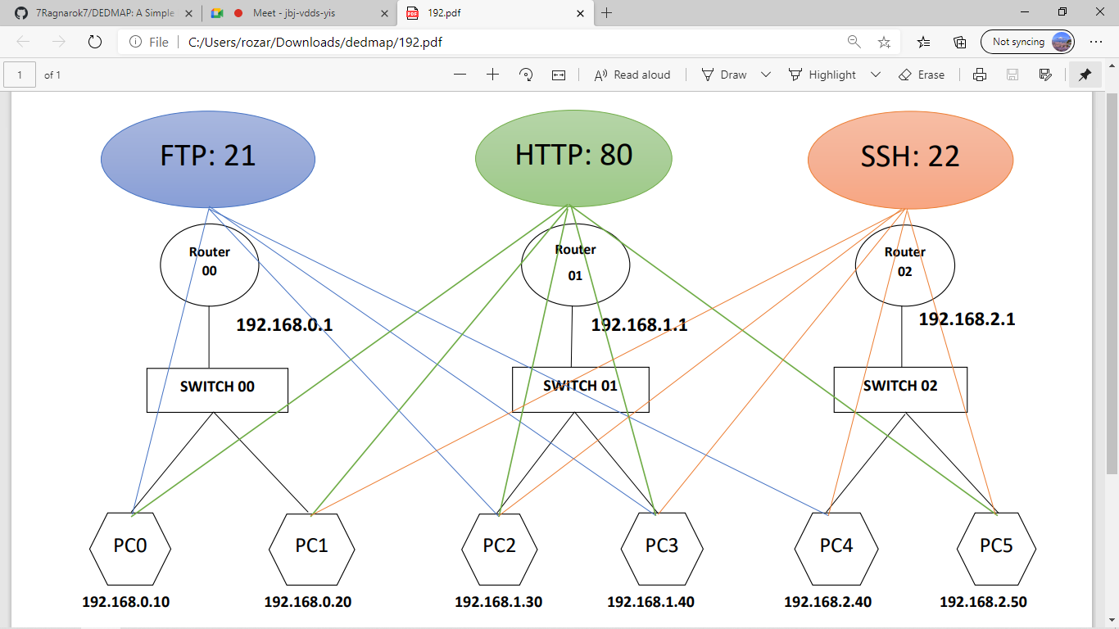
Depiction of working of Carnage:
DEVBHOOMI
Carnage Installed
The figure above shows a virtual network containing 3 different networks with 2 PCs in each. Each pc is running some kind of a server (FTP server, HTTP server or SSH server). Now lets say Carnage is installed in any one of these PC’s, PC2 for example. Carnage will have the ability to find the network services running in the host pc (PC2), in any other pc in its local network (PC3), any pc in any other network (PC0, PC1, PC4, PC5) and any Internet-Facing server in the World. It will also have the ability to detect and count the number of devices (Including itself) present in it’s own network as well as other networks.

Slide 6
Tech Stack :
DEVBHOOMI
Python and some core python libraries.
Yup, right. There’s nothing more in the Technology Stack.
Carnage will be built entirely just using Python.
It will be an Independent bare-metal tool and would not depend upon any other third-party tools or frameworks.
All the features that Carnage will contain will be hard-coded and written from scratch only using Python.
Future Scope :
We are building Carnage for the Cybersecurity community. Carnage will be a Free and Open-Source software with a GPL License and will always remain to be so. We do not plan to make any revenue out of it. However, our project will be open to donations. We believe in Open-Source software is the Future and support the cause.
We have plans to make Carnage available for chat applications like WhatsApp and Telegram as well in near future which will allow a user to use all the features of Carnage in a mobile phone right from a chat application.
We will also be adding a small honeypot feature in Carnage which will be very useful for monitoring a server for incoming traffic which can be further used as an IDS system.
We will use multithreading to drastically improve the performance of the tool.
We also plan to add a web-based front-end for the application for users who are not comfortable with using the terminal.

Slide 7
Scalability of our solution
DEVBHOOMI
Carnage will be easy to download and install and get started in a minute.
All the features will be well-documented
Carnage is like a Swiss-army knife will many useful tools and use cases at our disposal in need.
Being open-source in nature, it comes with absolute transparency and anybody can go through the code to find out how it’s built. (We would love for people to do that.)
Being modular in nature, it can be also published as a python package/library and imported in your personal projects to make use of it like an Automation Framework/Engine
It can also be hosted in the cloud. By using server-less functions as api’s and adding a web frontend to the tool, it can be made accessible globally to everyone without installing it locally.
With integration of twilio api, it can also me made available as a bot for chat applications like whatsapp and telegram.

Slide 8

Thank You for your Time
DEVBHOOMI
LET THERE BE
!!!!!!!

