Slide 1
vulnerable_lambda
디포팀플최강팀 (BestDigitialForensicTeamProjectTeam)

Slide 2
Contents of table
Introduce about “vulnerable_lambda” scenario
What is lambda of AWS?
Exploit!
Analyze CloudTrail log of this scenario
Conclusion

Slide 3
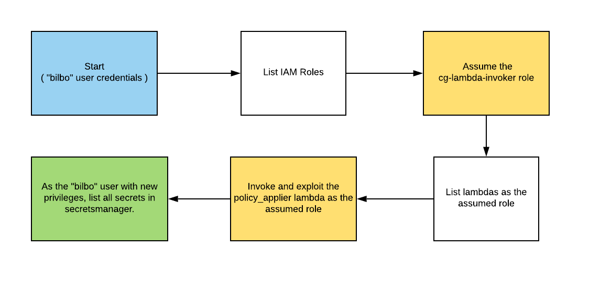
Introduce about “vulnerable_lambda” scenario
Resources
1 IAM User
1 IAM Role
1 Lambda
1 Secret
Goal
Find the scenario’s secret using IAM User “bilbo”

Slide 4
What is lambda of AWS?
lambda
Code execution service.
Without server management and instance creation.
lambda commands required to implement the scenario.
list-functions
get-function
invoke

Slide 5
Exploit - Get permissions for the 'bilbo' user(1)

Slide 6
Exploit - Get permissions for the 'bilbo' user(2)

Slide 7
Exploit - Get target IAM Role

Slide 8
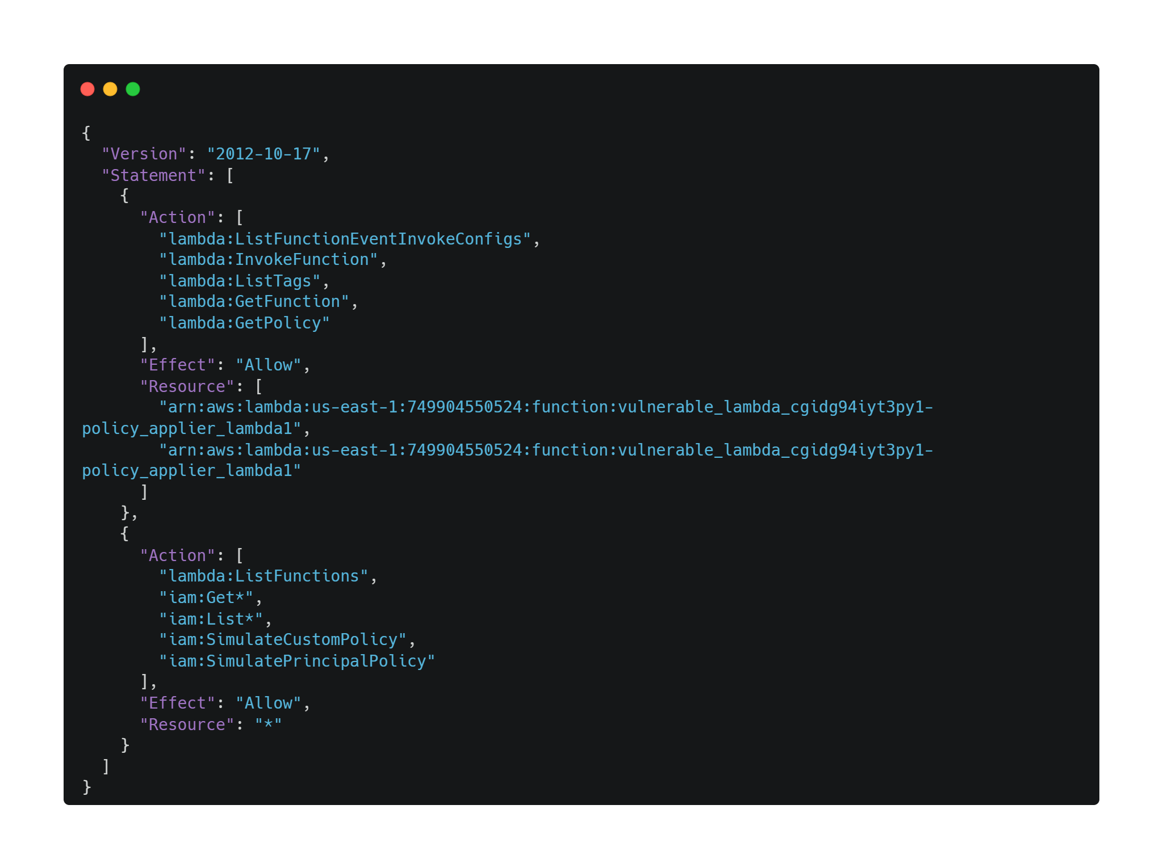
Exploit – lambda-invoker of RolePolicy

Slide 9
Exploit – Assume target IAM Role

Slide 10
Exploit - Get list of lambda function

Slide 11
Exploit - Get target lambda function

Slide 12
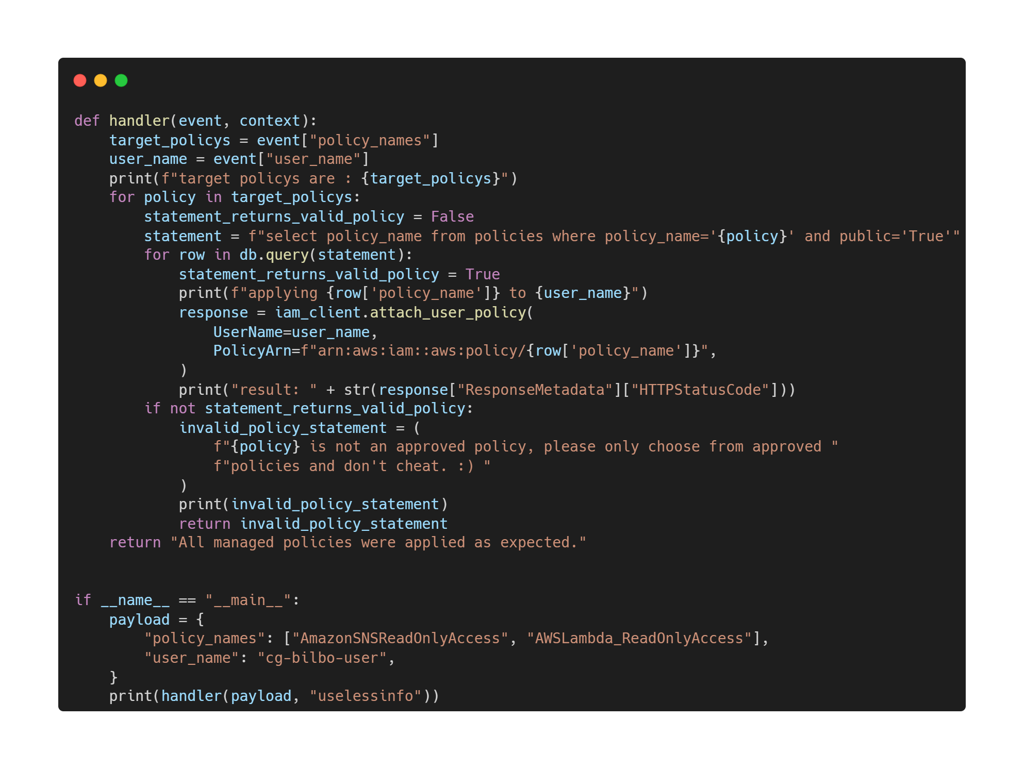
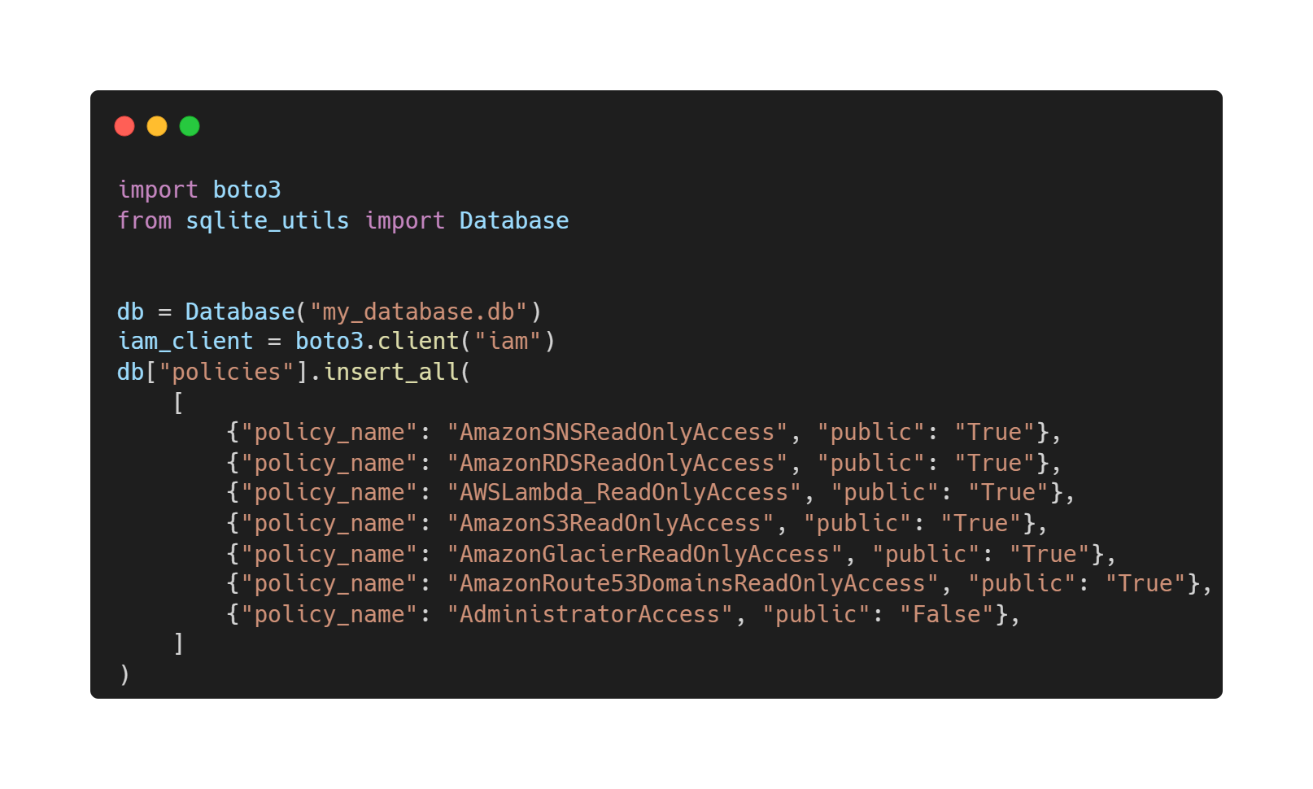
Exploit – Find vulnerability of lambda function

Slide 13
Exploit – Try exploit!
'{"policy_names": ["AdministratorAccess'"'"' --"], "user_name": "cg-bilbo-vulnerable_lambda_cgidg94iyt3py1"}'
SELECT policy_name FROM policies WHERE policy_name='AdministratorAccess'--' AND public='True'

Slide 14
Exploit – Get list of secrets

Slide 15
Exploit – Get target secret

Slide 16
Analyze CloudTrail log of this scenario(1)

Slide 17
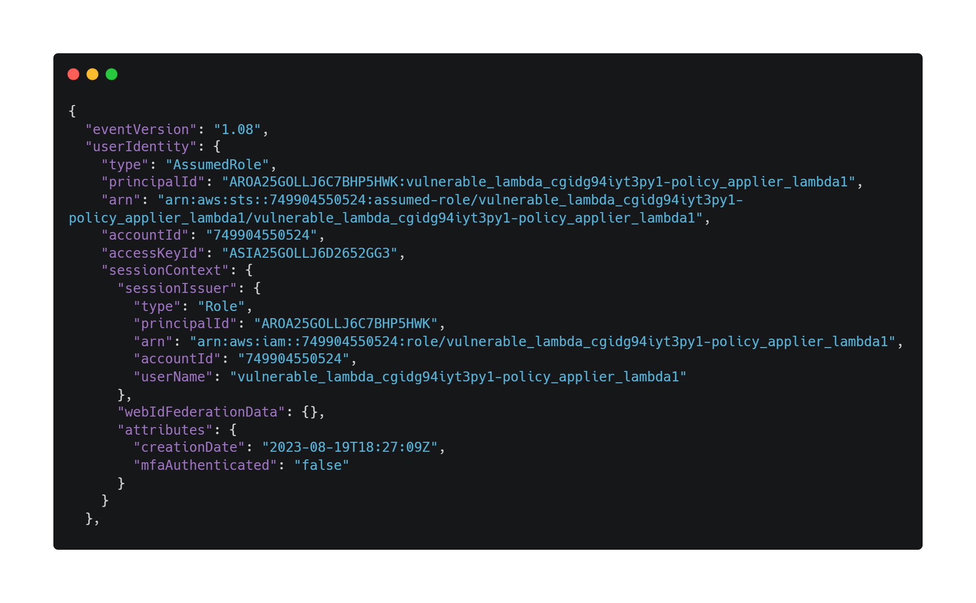
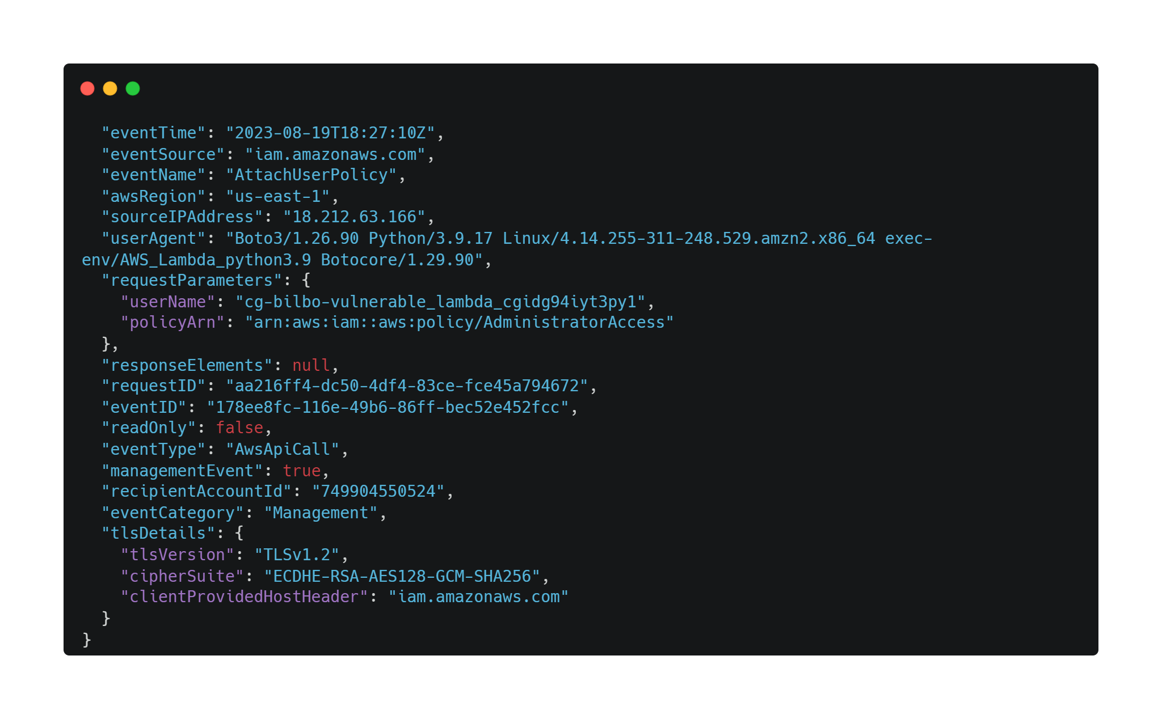
Analyze CloudTrail log of this scenario(2)

Slide 18
Conclusion
When using the lambda function, you need to verify the security of the source code.
Consider setting the "sts:AssumeRole" policy for public accounts.
Consider setting policies related to 'lambda' for public accounts.

