Slide 1
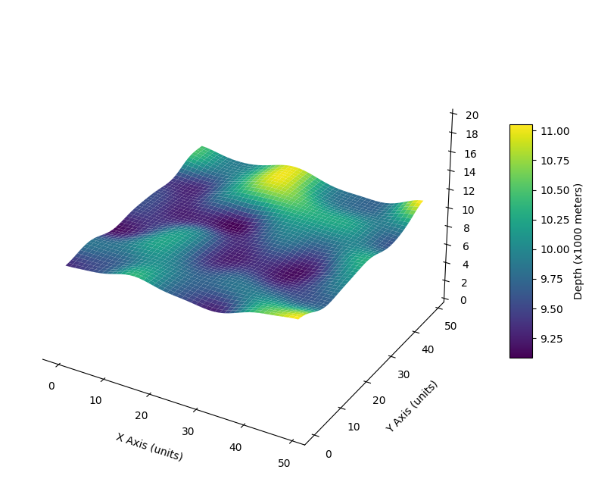
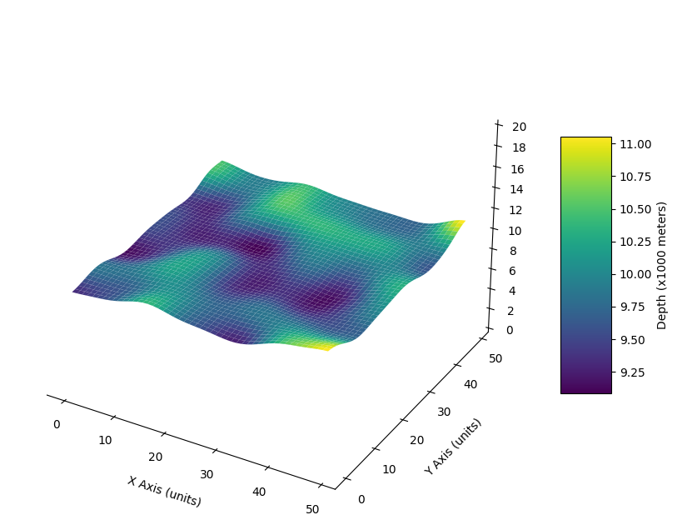

Prompt:
“I noticed a new coral reef that's about 0.12 meters high at the south of our ocean bed at (location x). Can you adjust the depth in that region and smoothen out the surrounding area?”
Updated ocean depth matrix
[n…. ]
Coral coordinate-depth
Feed layered data into
Llama 3.1 8b-Instruct
Sea surface temperature
Ocean bed depth
Layered Data
Model fine-tuning

Slide 2
This is a gradiex
This is a gradient text box

Slide 3
This is a gradient text box

