Slide 1
CSE4001 – Parallel and Distributed Computing
Module 2: Parallel Architectures - Introduction to OpenMP Programming

Slide 2
Reference Books:
Introduction to Parallel Computing, Second Edition by Ananth Grama, Anshul Gupta, George Karypis, Vipin Kumar.
Computer Architecture: A Quantitative Approach, Fifth Edition by John L. Hennessy, David A. Patterson
Computer Architecture & Parallel Processing by Kai Hwang & Briggs

Slide 3
Module 2:
Introduction to OpenMP Programming - Instruction Level Support for Parallel Programming- SIMD – Vector Processing - GPUs

Slide 4
Instruction Level Support for Parallel Programming

Slide 5
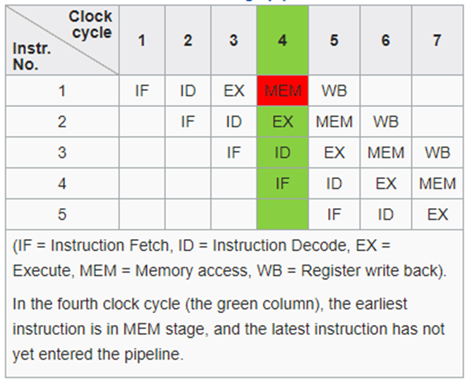
Basic Five – Stage Pipeline

Slide 6
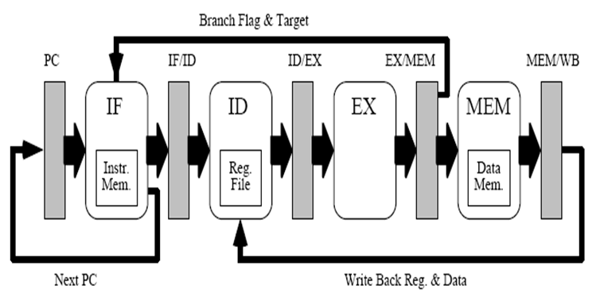
Pipeline Structure

Slide 7
Pipeline Hazards
Structural Hazards
Data Hazards
Control Hazards

Slide 8
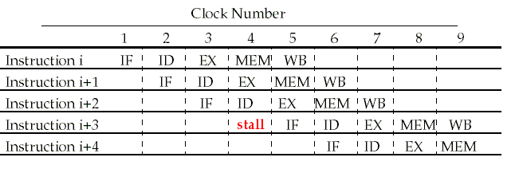
Structural Hazards
Structural hazards:
Structural hazards are those that occur because of resource conflicts.

Slide 9
Data Hazards
DADD R1,R2,R3 (D in the front means double, add double data)
DSUB R4,R1,R5
AND R6,R1,R7
OR R8,R1,R9
XOR R10,R1,R11
Dependency on data that stalls the pipeline execution is called data hazard
Output of R1 needed for Executing Sub

Slide 10
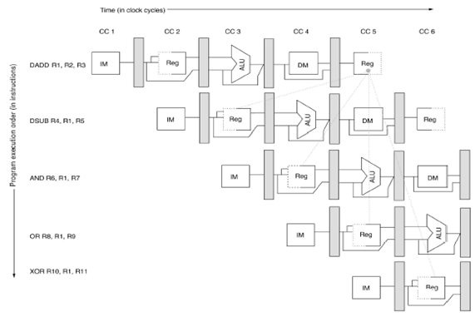
Data Hazards
R1 in DADD(Write) and DSUB (Read) and AND (Read), OR(Read), XOR(Read)

Slide 11
Control Hazards
Instructions that disrupt the sequential flow of control present problems for pipelines.
Unconditional branches.
Conditional branches.
Indirect branches.
Procedure calls.
Procedure returns.

Slide 12

Performance Evaluation
Amdahl's Law and parallel efficiency
Speedup of one enhancement is given by:
$$\frac{1}{(\left(1−F\right)+\left(\frac{F}{N}\right))}$$
F = fraction of instruction that are parallelized
N = No of Processors
Efficiency is given by:
E = S/N

Slide 13
Processor Performance Equation
CPU time = CPU clock cycles for a program × Clock cycle time
CPU time =CPU clock cycles for a program/Clock rate
CPI = CPU clock cycles for a program/ Instruction count
CPU time = Instruction count × Cycles per instruction × Clock cycle time

Slide 14
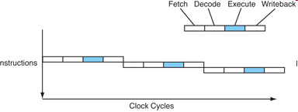
Instruction Level Parallelism

Slide 15
Instruction Level Parallelism
ILP is a measure of the number of instructions that can be performed during a single clock cycle.
Parallel instructions are a set of instructions that do not depend on each other to be executed.
Hierarchy
Bit level Parallelism
16 bit add on 8 bit processor
Instruction level Parallelism
Loop level Parallelism
for (i=1; i<=1000; i= i+1) x[i] = x[i] + y[i];
Thread level Parallelism (SMT, multi-core computers)

Slide 16
Making Computers Think Parallel
Human
Write code yourself, directly controlling each processor
Compiler
Let the compiler convert your sequential code into parallel instructions.
Hardware

Slide 17
Two basic approach
Rely on hardware to discover and exploit parallelism dynamically, and
Rely on software to restructure programs to statically facilitate parallelism.

Slide 18
Program Challenges and Opportunities to ILP
Basic Block: a straight-line code sequence with a single entry point and a single exit point. Remember, the average branch frequency is 15%–25%; thus there are only 3–6 instructions on average between a pair of branches.
Loop level parallelism: the opportunity to use multiple iterations of a loop to expose additional parallelism. Example techniques –
to exploit loop level parallelism: vectorization, data parallel, loop unrolling.

Slide 19
Dependencies and Hazards
3 types of dependencies:
data dependencies (or true data dependencies),
name dependencies and
control dependencies.
Dependencies are artifacts of programs; hazards are artifacts of pipeline organization.
Not all dependencies become hazards in the pipeline.
That is, dependencies may turn into hazards within the pipeline depending on the architecture of the pipeline.

Slide 20
Data Dependencies
Data Dependencies
An instruction j is data dependent on instruction i if:
instruction i produces a result that may be used by instruction j; or
instruction j is data dependent on instruction k, and instruction k is data dependent on instruction i.

Slide 21
Name Dependencies (not true dependencies)
Occurring when two instructions use the same register or memory location, but there is no flow in data between the instructions associated with that name.
There are 2 types of name dependencies between an instruction i that precedes instruction j in the execution order:
antidependence: when instruction j writes a register or memory location that instruction i reads.
output dependence: when instruction i and instruction j write the same register or memory location.
Because these are not true dependencies, the instructions i and j could potentially be executed in parallel if these dependencies are some how removed (by using distinct register or memory locations).

Slide 22
Data Hazards
A hazard exists whenever there is a name or data dependence between two instructions and they are close enough that their overlapped execution would violate the program’s order of dependency.
Possible data hazards:
RAW (read after write)
WAW (write after write)
WAR (write after read)
RAR (read after read) is not a hazard.

Slide 23
Control Dependencies
Dependency of instructions to the sequential flow of execution and preserves branch (or any flow altering operation) behavior of the program.
In general, two constraints are imposed by control dependencies:
An instruction that is control dependent on a branch cannot be moved before the branch so that its execution is no longer controlled by the branch.
An instruction that is not control dependent on a branch cannot be moved after the branch so that the execution is controlled by the branch.

Slide 24
Compiler Techniques for Exposing ILP
loop unrolling
instruction scheduling

Slide 25
Advanced Branch Prediction
Correlating branch predictors (or two-level predictors):
make use of outcome of most recent branches to make prediction.
Tournament predictors: run multiple predictors and run a tournament between them; use the most successful.

Slide 26
Dynamic Scheduling
Designing the hardware so that it can dynamically rearrange instruction execution to reduce stalls while maintaining data flow and exception behavior.
Two techniques:
Scoreboarding, centralized scoreboard
Tomasulo’s Algorithm , distributed reservation stations

Slide 27
Dynamic Scheduling
Instructions are issued to the pipeline in-order but executed and completed out-of-order.
out-of-order execution leading to the possibility of out-of-order completion.
out-of-order execution introduces the possibility of WAR and WAW hazards which do not occur in statically scheduled pipelines.
out-of-order completion creates major complications in exception handling

Slide 28
The Limits of ILP
Consider the ideal processor:
1. Infinite number of registers for register renaming.
2. Perfect branch prediction
3. Perfect jump prediction
4. Perfect memory address analysis
5. All memory accesses occur in one cycle
Effectively removes all control dependencies and all but true data dependencies. That is, all instructions can be scheduled as early as their data dependency allows.

Slide 29
Limits
1) pipelined clock rate: at some point, each increase in clock rate has corresponding CPI increase (branches, other hazards)
2) instruction fetch and decode: at some point, its hard to fetch and decode more instructions per clock cycle
3) cache hit rate: some long-running (scientific) programs have very large data sets accessed with poor locality; others have continuous data streams (multimedia) and hence poor locality

Slide 30
Introduction to OpenMP Programming

Slide 31

OpenMP
An abbreviation for: Open Multi-Processing
An Application Program Interface (API) that may be used to explicitly direct multi-threaded, shared memory parallelism.
Comprised of three primary API components:
Compiler Directives
Runtime Library Routines
Environment Variables

Slide 32
Goals of OpenMP:
Standardization:
Provide a standard among a variety of shared memory architectures/platforms
Jointly defined and endorsed by a group of major computer hardware and software vendors
Lean and Mean:
Establish a simple and limited set of directives for programming shared memory machines.
Significant parallelism can be implemented by using just 3 or 4 directives.
This goal is becoming less meaningful with each new release, apparently.

Slide 33
Goals of OpenMP:
Ease of Use:
Provide capability to incrementally parallelize a serial program, unlike message-passing libraries which typically require an all or nothing approach
Provide the capability to implement both coarse-grain and fine-grain parallelism
Portability:
The API is specified for C/C++ and Fortran
Public forum for API and membership
Most major platforms have been implemented including Unix/Linux platforms and Windows

Slide 34
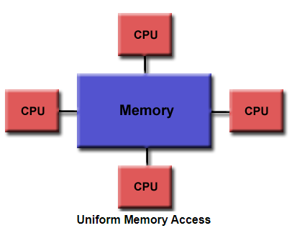
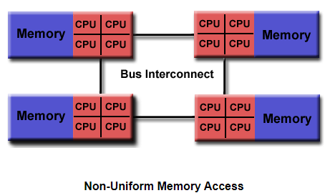
OpenMP Programming Model
Shared Memory Model:
OpenMP is designed for multi-processor/core, shared memory machines. The underlying architecture can be shared memory UMA or NUMA.
Because OpenMP is designed for shared memory parallel programming, it largely limited to single node parallelism. Typically, the number of processing elements (cores) on a node determine how much parallelism can be implemented.

Slide 35
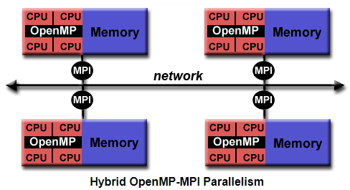
Motivation for Using OpenMP in HPC:
OpenMP parallelism is limited to a single node.
For High Performance Computing (HPC) applications, OpenMP is combined with MPI for the distributed memory parallelism. This is often referred to as Hybrid Parallel Programming.
OpenMP is used for computationally intensive work on each node
MPI is used to accomplish communications and data sharing between nodes
This allows parallelism to be implemented to the full scale of a cluster.

Slide 36
Thread Based Parallelism:
OpenMP programs accomplish parallelism exclusively through the use of threads.
A thread of execution is the smallest unit of processing that can be scheduled by an operating system. The idea of a subroutine that can be scheduled to run autonomously might help explain what a thread is.
Threads exist within the resources of a single process. Without the process, they cease to exist.
Typically, the number of threads match the number of machine processors/cores. However, the actual use of threads is up to the application.

Slide 37
Explicit Parallelism:
OpenMP is an explicit (not automatic) programming model, offering the programmer full control over parallelization.
Parallelization can be as simple as taking a serial program and inserting compiler directives.
Or as complex as inserting subroutines to set multiple levels of parallelism, locks and even nested locks.

Slide 38
Fork - Join Model:
All OpenMP programs begin as a single process: the master thread. The master thread executes sequentially until the first parallel region construct is encountered.
FORK: the master thread then creates a team of parallel threads.
The statements in the program that are enclosed by the parallel region construct are then executed in parallel among the various team threads.
JOIN: When the team threads complete the statements in the parallel region construct, they synchronize and terminate, leaving only the master thread.
The number of parallel regions and the threads that comprise them are arbitrary.

Slide 39
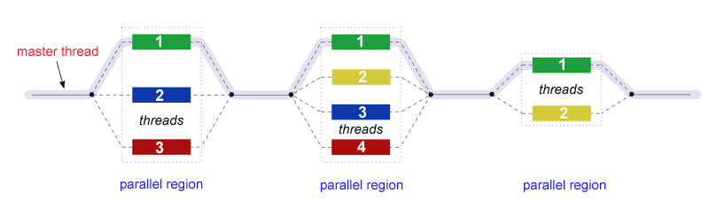
Fork - Join Model:

Slide 40
Data Scoping:
Because OpenMP is a shared memory programming model, most data within a parallel region is shared by default.
All threads in a parallel region can access this shared data simultaneously.
OpenMP provides a way for the programmer to explicitly specify how data is "scoped" if the default shared scoping is not desired.

Slide 41
Nested Parallelism:
The API provides for the placement of parallel regions inside other parallel regions.
Implementations may or may not support this feature.

Slide 42
Dynamic Threads:
The API provides for the runtime environment to dynamically alter the number of threads used to execute parallel regions. Intended to promote more efficient use of resources, if possible.
Implementations may or may not support this feature.

Slide 43
I/O:
OpenMP specifies nothing about parallel I/O. This is particularly important if multiple threads attempt to write/read from the same file.
If every thread conducts I/O to a different file, the issues are not as significant.
It is entirely up to the programmer to ensure that I/O is conducted correctly within the context of a multi-threaded program.

Slide 44
Three Components of OpenMP:
The OpenMP 3.1 API is comprised of three distinct components:
Compiler Directives (19)
Runtime Library Routines (32)
Environment Variables (9)
Later APIs include the same three components, but increase the number of directives, runtime library routines and environment variables.
The application developer decides how to employ these components. In the simplest case, only a few of them are needed.
Implementations differ in their support of all API components.

Slide 45
Compiler Directives:
Compiler directives appear as comments in your source code and are ignored by compilers unless you tell them otherwise - usually by specifying the appropriate compiler flag.
OpenMP compiler directives are used for various purposes:
Spawning a parallel region
Dividing blocks of code among threads
Distributing loop iterations between threads
Serializing sections of code
Synchronization of work among threads

Slide 46
Run-time Library Routines:
The OpenMP API includes an ever-growing number of run-time library routines.
These routines are used for a variety of purposes:
Setting and querying the number of threads
Querying a thread's unique identifier (thread ID), a thread's ancestor's identifier, the thread team size
Setting and querying the dynamic threads feature
Querying if in a parallel region, and at what level
Setting and querying nested parallelism
Setting, initializing and terminating locks and nested locks
Querying wall clock time and resolution

Slide 47
Environment Variables:
OpenMP provides several environment variables for controlling the execution of parallel code at run-time.
These environment variables can be used to control such things as:
Setting the number of threads
Specifying how loop iterations are divided
Binding threads to processors
Enabling/disabling nested parallelism; setting the maximum levels of nested parallelism
Enabling/disabling dynamic threads
Setting thread stack size
Setting thread wait policy

Slide 48
OpenMP Code Structure: Example
#include <omp.h>
main () {
int var1, var2, var3;
Serial code
.
.
.
Beginning of parallel region. Fork a team of threads.
Specify variable scoping
#pragma omp parallel private(var1, var2) shared(var3)
{
Parallel region executed by all threads
.
Other OpenMP directives
.
Run-time Library calls
.
All threads join master thread and disband
}
Resume serial code
.
.
.
}

Slide 49
OpenMP Programming Model
The clause list is used to specify conditional parallelization, number of threads, and data handling.
Conditional Parallelization: The clause if (scalar expression) determines whether the parallel construct results in creation of threads.
Degree of Concurrency: The clause num_threads(integer expression) specifies the number of threads that are created.
Data Handling: The clause private (variable list) indicates variables local to each thread. The clause firstprivate (variable list) is similar to the private, except values of variables are initialized to corresponding values before the parallel directive. The clause shared (variable list) indicates that variables are shared across all the threads.

Slide 50
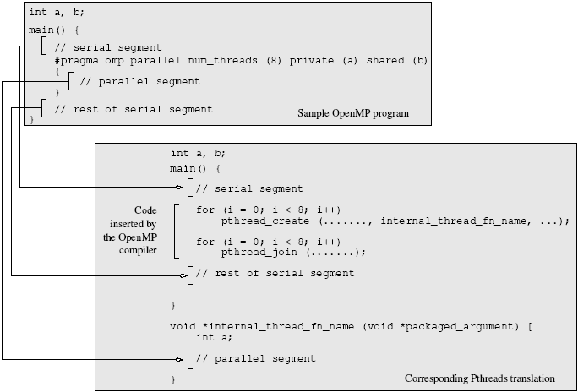
OpenMP Programming Model
A sample OpenMP program along with its Pthreads translation that might be performed by an OpenMP compiler.

Slide 51
OpenMP Programming Model
#pragma omp parallel if (is_parallel== 1) num_threads(8) \
private (a) shared (b) firstprivate(c) {
/* structured block */
}
If the value of the variable is_parallel equals one, eight threads are created.
Each of these threads gets private copies of variables a and c, and shares a single value of variable b.
The value of each copy of c is initialized to the value of c before the parallel directive.
The default state of a variable is specified by the clause default (shared) or default (none).

Slide 52
Reduction Clause in OpenMP
The reduction clause specifies how multiple local copies of a variable at different threads are combined into a single copy at the master when threads exit.
The usage of the reduction clause is reduction (operator: variable list).
The variables in the list are implicitly specified as being private to threads.
The operator can be one of +, *, -, &, |, ^, &&, and ||.
#pragma omp parallel reduction(+: sum) num_threads(8) {
/* compute local sums here */
}
/*sum here contains sum of all local instances of sums */

Slide 53
OpenMP Programming: Example
/* ******************************************************
An OpenMP version of a threaded program to compute PI.
****************************************************** */
#pragma omp parallel default(private) shared (npoints) \
reduction(+: sum) num_threads(8)
{
num_threads = omp_get_num_threads();
sample_points_per_thread = npoints / num_threads;
sum = 0;
for (i = 0; i < sample_points_per_thread; i++) {
rand_no_x =(double)(rand_r(&seed))/(double)((2<<14)-1);
rand_no_y =(double)(rand_r(&seed))/(double)((2<<14)-1);
if (((rand_no_x - 0.5) * (rand_no_x - 0.5) +
(rand_no_y - 0.5) * (rand_no_y - 0.5)) < 0.25)
sum ++;
}
}

Slide 54
Specifying Concurrent Tasks in OpenMP
The parallel directive can be used in conjunction with other directives to specify concurrency across iterations and tasks.
OpenMP provides two directives - for and sections - to specify concurrent iterations and tasks.
The for directive is used to split parallel iteration spaces across threads. The general form of a for directive is as follows:
#pragma omp for [clause list]
/* for loop */
The clauses that can be used in this context are: private, firstprivate, lastprivate, reduction, schedule, nowait, and ordered.

Slide 55
Specifying Concurrent Tasks in OpenMP: Example
#pragma omp parallel default(private) shared (npoints) \
reduction(+: sum) num_threads(8)
{
sum = 0;
#pragma omp for
for (i = 0; i < npoints; i++) {
rand_no_x =(double)(rand_r(&seed))/(double)((2<<14)-1);
rand_no_y =(double)(rand_r(&seed))/(double)((2<<14)-1);
if (((rand_no_x - 0.5) * (rand_no_x - 0.5) +
(rand_no_y - 0.5) * (rand_no_y - 0.5)) < 0.25)
sum ++;
}
}

Slide 56
Assigning Iterations to Threads
The schedule clause of the for directive deals with the assignment of iterations to threads.
The general form of the schedule directive is schedule(scheduling_class[, parameter]).
OpenMP supports four scheduling classes: static, dynamic, guided, and runtime.

Slide 57
Assigning Iterations to Threads: Example
/* static scheduling of matrix multiplication loops */
#pragma omp parallel default(private) shared (a, b, c, dim) \
num_threads(4)
#pragma omp for schedule(static)
for (i = 0; i < dim; i++) {
for (j = 0; j < dim; j++) {
c(i,j) = 0;
for (k = 0; k < dim; k++) {
c(i,j) += a(i, k) * b(k, j);
}
}
}

Slide 58
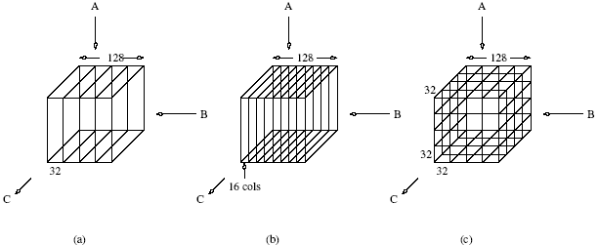
Assigning Iterations to Threads: Example
Three different schedules using the static scheduling class of OpenMP.

Slide 59
Parallel For Loops
Often, it is desirable to have a sequence of for-directives within a parallel construct that do not execute an implicit barrier at the end of each for directive.
OpenMP provides a clause - nowait, which can be used with a for directive.

Slide 60
Parallel For Loops: Example
#pragma omp parallel
{
#pragma omp for nowait
for (i = 0; i < nmax; i++)
if (isEqual(name, current_list[i])
processCurrentName(name);
#pragma omp for
for (i = 0; i < mmax; i++)
if (isEqual(name, past_list[i])
processPastName(name);
}

Slide 61
The sections Directive
OpenMP supports non-iterative parallel task assignment using the sections directive.
The general form of the sections directive is as follows:
#pragma omp sections [clause list]
{
[#pragma omp section
/* structured block */
]
[#pragma omp section
/* structured block */
]
...
}

Slide 62
The sections Directive: Example
#pragma omp parallel
{
#pragma omp sections
{
#pragma omp section
{
taskA();
}
#pragma omp section
{
taskB();
}
#pragma omp section
{
taskC();
}
}
}

Slide 63
Nesting parallel Directives
Nested parallelism can be enabled using the OMP_NESTED environment variable.
If the OMP_NESTED environment variable is set to TRUE, nested parallelism is enabled.
In this case, each parallel directive creates a new team of threads.

Slide 64
Synchronization Constructs in OpenMP
OpenMP provides a variety of synchronization constructs:
#pragma omp barrier
#pragma omp single [clause list]
structured block
#pragma omp master
structured block
#pragma omp critical [(name)]
structured block
#pragma omp ordered
structured block

Slide 65
OpenMP Library Functions
In addition to directives, OpenMP also supports a number of functions that allow a programmer to control the execution of threaded programs.
/* thread and processor count */
void omp_set_num_threads (int num_threads);
int omp_get_num_threads ();
int omp_get_max_threads ();
int omp_get_thread_num ();
int omp_get_num_procs ();
int omp_in_parallel();

Slide 66
OpenMP Library Functions
/* controlling and monitoring thread creation */
void omp_set_dynamic (int dynamic_threads);
int omp_get_dynamic ();
void omp_set_nested (int nested);
int omp_get_nested ();
/* mutual exclusion */
void omp_init_lock (omp_lock_t *lock);
void omp_destroy_lock (omp_lock_t *lock);
void omp_set_lock (omp_lock_t *lock);
void omp_unset_lock (omp_lock_t *lock);
int omp_test_lock (omp_lock_t *lock);
In addition, all lock routines also have a nested lock counterpart
for recursive mutexes.

Slide 67
Environment Variables in OpenMP
OMP_NUM_THREADS: This environment variable specifies the default number of threads created upon entering a parallel region.
OMP_SET_DYNAMIC: Determines if the number of threads can be dynamically changed.
OMP_NESTED: Turns on nested parallelism.
OMP_SCHEDULE: Scheduling of for-loops if the clause specifies runtime

Slide 68
Explicit Threads versus Directive Based Programming
Directives layered on top of threads facilitate a variety of thread-related tasks.
A programmer is rid of the tasks of initializing attributes objects, setting up arguments to threads, partitioning iteration spaces, etc.
There are some drawbacks to using directives as well.
An artifact of explicit threading is that data exchange is more apparent. This helps in alleviating some of the overheads from data movement, false sharing, and contention.
Explicit threading also provides a richer API in the form of condition waits, locks of different types, and increased flexibility for building composite synchronization operations.
Finally, since explicit threading is used more widely than OpenMP, tools and support for Pthreads programs are easier to find.

Slide 69
SIMD – Vector Processing - GPUs

Slide 70
Data Level Parallelism
SIMD
Matrix oriented computations, Media, sound processing
Energy efficiency
Three main classes
Vector processors
Multimedia SIMD extensions
●
●
MMX, SSE, AVX
●
– GPU

Slide 71
VECTOR PROCESSORS
A processor can operate on an entire vector in one instruction
Work done automatically in parallel (simultaneously)
The operand to the instructions are complete vectors instead of one element
Reduce the fetch and decode bandwidth
Data parallelism
Tasks usually consist of:
Large active data sets
Long run times

Slide 72
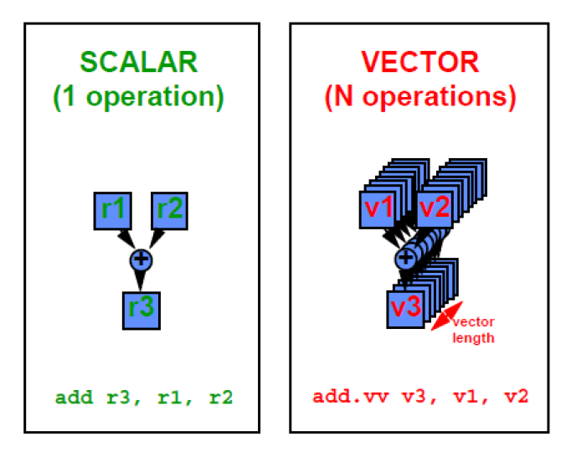

Slide 73
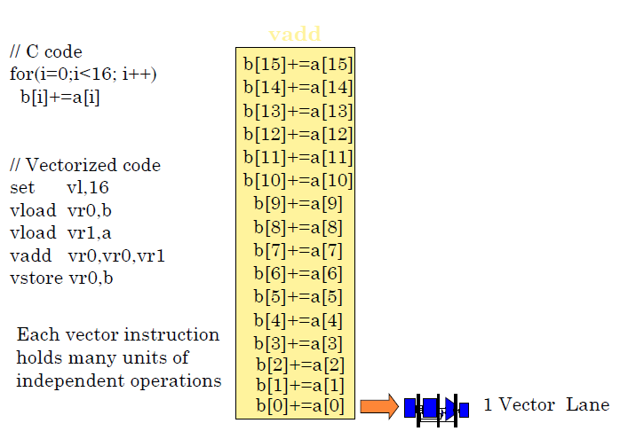
VECTOR PROCESSORS ….

Slide 74
Vector Architecture
●
Grab sets of data elements scattered about memory
Place data in sequential register files Operate on these register files
Write results back into the memory Hide memory latency
Leverage memory bandwidth
●
●
●
●
●

Slide 75
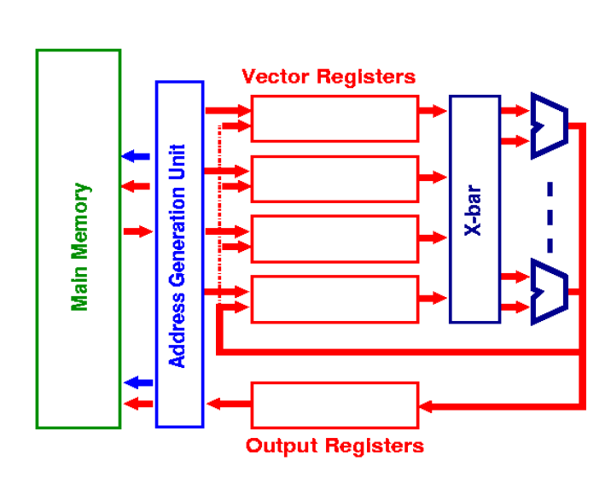

Slide 76
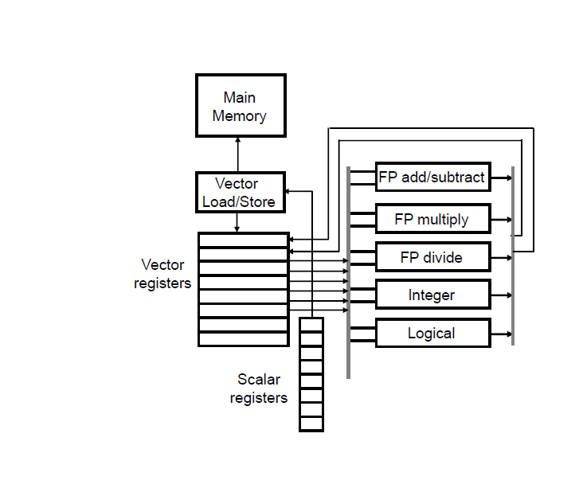

Slide 77
Vector Programming Model
Scalar Registers
Vector Registers
R31
.
.
.
V15
.
.
.
R0
V0
[0]
[1]
[2] . . .
Vector Length Register
[VLRMAX-1]
VLR

Slide 78
Vector Arithmetic Instructions
ADDVV V2, V0, V1
[0]
[1]
[2]
. . .
[VLR-1]
V1
V0
+ + + +
+ + + +
V2
[0]
[1]
[2]
. . .
[VLR-1]
Vector Length Register
VLR

Slide 79
Vector Load/Store Instructions
LV V1, R1, R2
[0]
[1]
[2]
. . .
[VLR-1]
V1
Memory
 | R2 (Stride) |  |  |  | R2 (Stride)
. . .
R1 (Base)
Vector Length Register
VLR

Slide 80



Interleaved Vector Memory System
Vector Registers
Base
Stride
Address Generator
0 | 1 | 2 | 3 | 4 | 5 | 6 | 7 | 8 | 9 | A | B | C | D | E | F
Memory Banks

Slide 81
Vector Memory System
Multiple loads/stores per clock
Memory bank cycle time is larger than processor clock time
Multiple banks to control addresses from different loads/stores independently
Non-sequential word accesses
Memory system sharing

Slide 82
Example
Cray T90 has 32 processors. Each processor generates 4 loads and 2 stores per clock. Clock cycle = 2.167 ns. SRAM cycle time = 15 ns.
Calculate minimum no. of memory banks required to allow all processors to run at full memory bandwidth.
Max memory references per clock cycle = 32 * 6 = 192
No. of processor cycles SRAM bank is busy per request = 15/2.167
= 7 cycles.
No. of banks in SRAM to service every request from the processor at every cycle = 7 * 192 = 1344 banks.

Slide 83
Example
Total banks = 8. Bank busy time = 6 clock cycles. Memory latency = 12 cycles. How long does it take to complete a 64 element vector load with (a) stride = 1, (b) stride = 32 ?
Stride = 1
0 | 1 | 2 | 3 | 4 | 5 | 6 | 7
0 | 1 | 2 | 3 | 4 | 5 | 6 | 7
Stride = 32
Case 1: 12 + 64 = 76 clock cycles, 1.2 cycles per element
Case 2: 12 + 1 + 6 * 63 = 391 cycles, 6.1 clock cycles per element

Slide 84



Example Vector Microarchitecture
SRF
X0
VRF
L0
L1
D
R
W
F
F
F
F
S0
S1
Y0
Y1
Y2
Y3

Slide 85
Vector Architecture – Chaining
Vector version of Register bypassing
– Introduced with Cray-1
●
V1
V2
V3
V4
V5
LV MULVV ADDVV
V1
V3, V1, V2 V5, V3, V4
CONVOY
Load Unit
CHIME
MEMORY

Slide 86
Vector Execution Time
●
Time = f(Vector length, Data dependences, Structural Hazards)
Initiation rate: Rate that FU consumes vector elements (= number of lanes)
Convoy: Set of vector instructions that can begin execution in same clock (no struct. or data hazards)
Chime: approx. time for a vector operation
Start-up time: pipeline latency time (depth of FU pipeline)
●
●
●
●

Slide 87
Vector Instruction Execution
C = A + B
Single Functional Unit
A[15]
A[14]
...
...
A[3]
A[2]
A[1]
B[15]
B[14]
...
...
B[3]
B[2]
B[1]
C[0]

Slide 88
Vector Instruction Execution
C = A + B
Multiple Functional Units
A[12]
A[8]
A[4]
B[12]
B[8]
B[4]
A[13]
A[9]
A[5]
B[13]
B[9]
B[5]
A[14]
A[10]
A[6]
B[14]
B[10]
B[6]
A[15]
A[11]
A[7]
B[15]
B[11]
B[7]
C[0]
C[1]
C[2]
C[3]
Element Group

Slide 89
Vector Architecture - Lane
●
Element N of A operates with element N of B
LANE 0 LANE 1 LANE 2 LANE 3
Vector Registers: Elements: 0, 4, 8, ...
Vector Registers: Elements:
1, 5, 9, ...
Vector Registers: Elements:
2, 6, 10, ...
Vector Registers: Elements:
3, 7, 11, ...
Vector Load – Store Unit

Slide 90
Vector Microarchitecture – Two Lanes
SRF
VRF
X0
L0
L1
D
R
W
F
F
F
F
S0
S1
Y0
Y1
Y2
Y3
X0
L0
L1
S0
S1
Y0
Y1
Y2
Y3

Slide 91

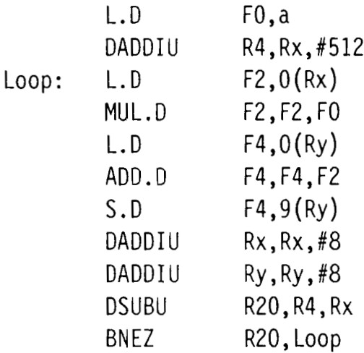
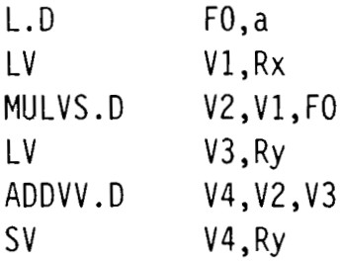
Y =a× X +Y
DAXPY
X and Y are vectors. Scalar: a
●
C Code
●
●
Single/Double precision
VMIPS
Code
MIPS Code

Slide 92
DAXPY
Instruction bandwidth has decreased Individual loops are independent
They are vectorizable
They do not have loop-carried dependences
Reduced pipeline interlocks in VMIPS
MIPS: ADD.D waits for MUL.D, S.D waits for ADD.D
●
●
●

Slide 93
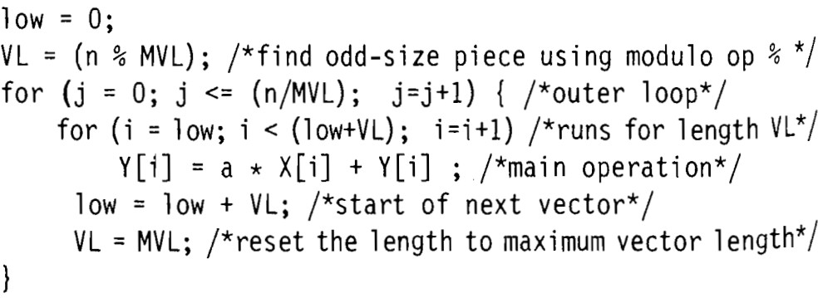
Vector Stripmining
What if n is not a multiple of VLRMAX (or MVL)?
Use VLR to set the correct subset of registers to be used from the vector.
●
●

Slide 94
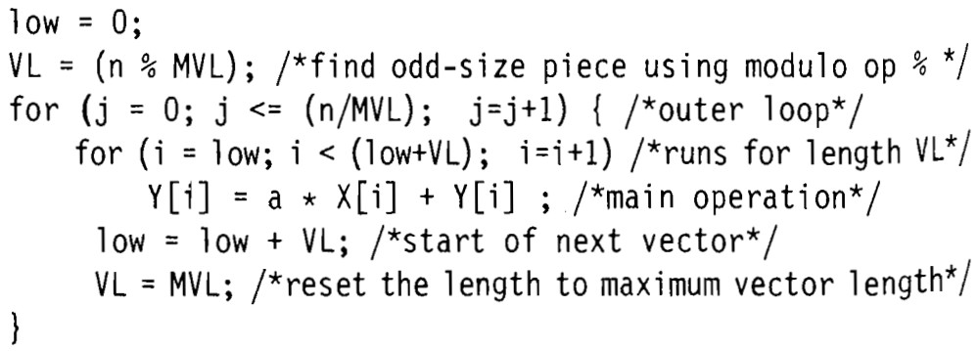
Vector Stripmining
MVL: 16. n = 166.
(16 * 10) + (6 * 1)
Value of j 0
1
2
3
...
...
...
...
...
10
Range of i 0 - 5
6 - 21 22 - 37 134-149 150-165
VLR = 6
VLR = 16

Slide 95
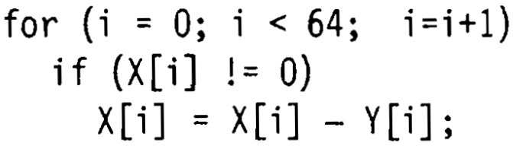
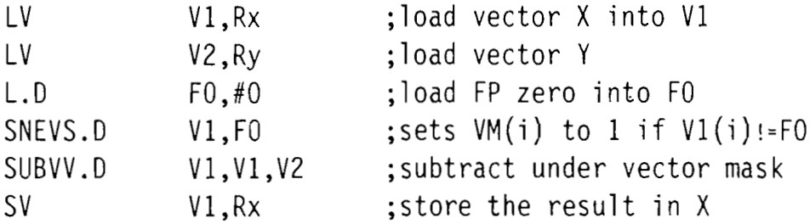
Vector Conditional Execution
Vectorizing loop with conditional code Mask Registers
●
●

Slide 96
Masked Vector Instructions
Simple Implementation
Density – Time Implementation
M[15]=1
M[14]=1
...
...
M[3]=0
M[2]=1
M[1]=0
A[15]
A[14]
...
...
A[3]
A[2]
A[1]
B[15]
B[14]
...
...
B[3]
B[2]
B[1]
M[15]=1
M[14]=1
...
...
M[3]=0
M[2]=1
M[1]=0
A[15]
A[14]
A[9]
A[4]
A[2]
B[15]
B[14]
B[9]
B[4]
B[2]
M[0]=1
C[0]
M[0]=1
C[0]
Write Enable
Write Enable

Slide 97
Vector Load Store Units
Startup time
Time to get the first word from the memory into the register
Multiple banks for higher memory bandwidth Multiple loads and stores per clock cycle
Memory bank cycle time is larger than processor cycle time
Independent bank addressing for non-sequential loads/stores
Multiple processes access memory at the same time.
●
●
●
●
●

Slide 98
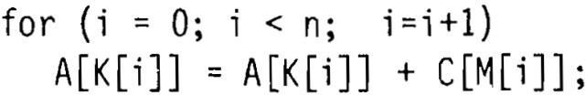
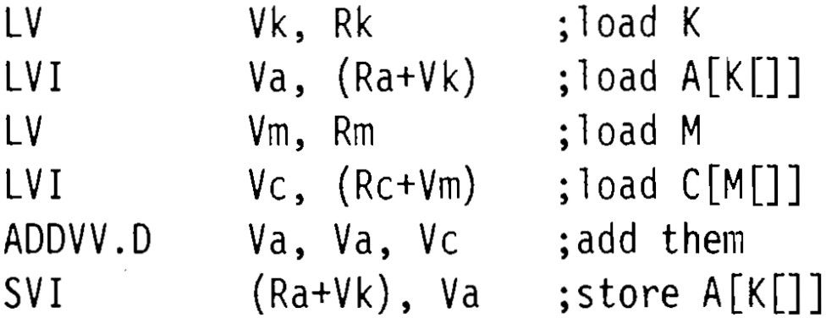
Gather–Scatter
Used for sparse matrices Load/Store Vector Index (LVI/SVI)
– Slower than non-indexed memory load/store
●
●

Slide 99
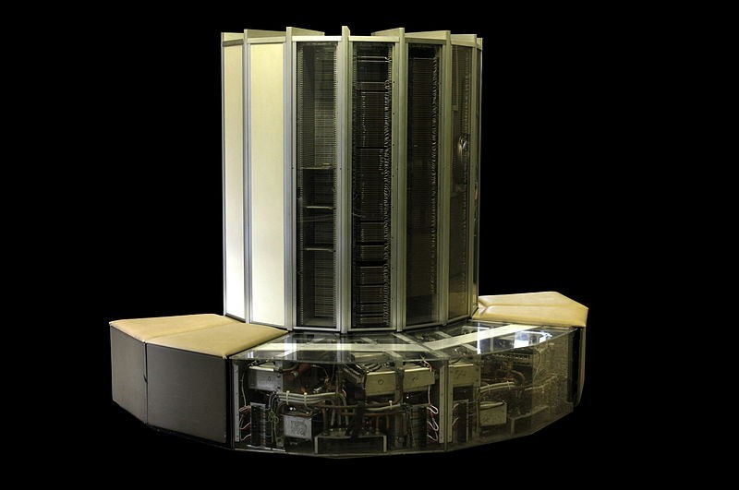
Cray 1 (1976)

Slide 100
Vector Processor Limitations
●
Complex central vector register files(VRF) - With N vector functional units, the register file needs approximately 3N access ports.
VRF area, power consumption and latency are proportional to O(N*N), O(log N) and O(N).
For in-order commit, a large ROB is needed with at least one vector register per VFU
In order to support virtual memory, large TLB is needed so that TLB has enough entries to translate all virtual addresses generated by a vector instruction
Vector processors need expensive on-chip memory for low latency.
●
●
●
●

Slide 101
Applications of Vector Processing
Multimedia Processing (compress., graphics, audio synth, image proc.) Standard benchmark kernels (Matrix Multiply, FFT, Convolution, Sort) Lossy Compression (JPEG, MPEG video and audio)
Lossless Compression (Zero removal, RLE, Differencing, LZW) Cryptography (RSA, DES/IDEA, SHA/MD5)
Speech and handwriting recognition
Operating systems/Networking (memcpy, memset, parity, checksum) Databases (hash/join, data mining, image/video serving)
Language run-time support (stdlib, garbage collection)
●
●
●
●
●
●
●
●
●

Slide 102
SIMD Instruction Set for Multimedia
Lincoln Tabs TX-2 (1957)
– 36b datapath: 2 x 18b or 4 x 9b
MMX (1996), Streaming SIMD Extensions (SSE) (1999), Advanced Vector Extensions (AVX)
Single instruction operates on all elements within the register
●
●
●
64b
32b
32b
16b | 16b | 16b | 16b
8b | 8b | 8b | 8b | 8b | 8b | 8b | 8b

Slide 103
MMX Instructions
Move 32b, 64b
Add, Subtract in parallel: 8 8b, 4 16b, 2 32b
Shifts (sll,srl, sra), And, And Not, Or, Xor in parallel: 8 8b, 4 16b, 2 32b
Multiply, Multiply-Add in parallel: 4 16b Compare =,> in parallel: 8 8b, 4 16b, 2 32b
sets field to 0s (false) or 1s (true); removes branches
Pack/Unpack
– Convert 32b<–> 16b, 16b <–> 8b
Pack saturates (set to max) if number is too large
●
●
●
●
●
●

Slide 104
Multimedia Extensions vs. Vectors
Fixed number of operands No Vector Length Register
No strided accesses, no gather-scatter accesses
No mask register
●
●
●
●

Slide 105
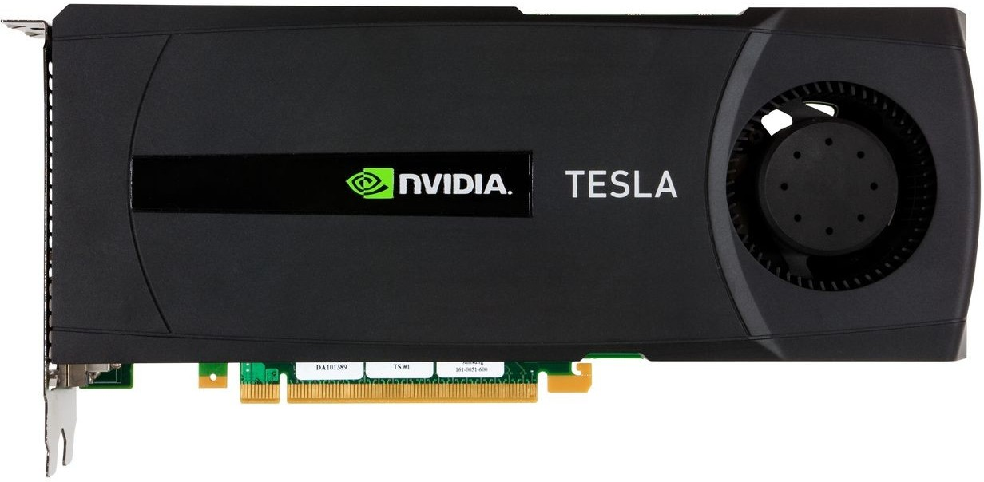
GPU

Slide 106
Graphics Processing Units
●
Optimized for 2D/3D graphics, video, visual computing, and display.
It is highly parallel, highly multithreaded multiprocessor optimized for visual computing.
It serves as both a programmable graphics processor and a scalable parallel computing platform.
Heterogeneous Systems: combine a GPU with a CPU
●
●
●

Slide 107
Graphics Processing Units
Do graphics well.
GPUs exploit Multithreading, MIMD, SIMD, ILP
SIMT
Programming environment for development of applications on GPUs
NVIDIA's “Compute Unified Device Architecture”
OpenCL
●
●
●

Slide 108
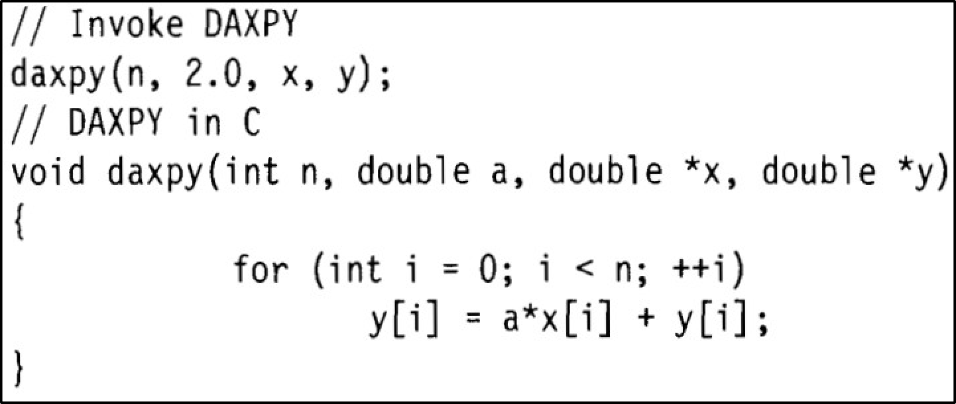
Introduction to CUDA
_device_ and _host_
name<<<dimGrid, dimBlock>>>(... parameter list ...)
●
●

Slide 109
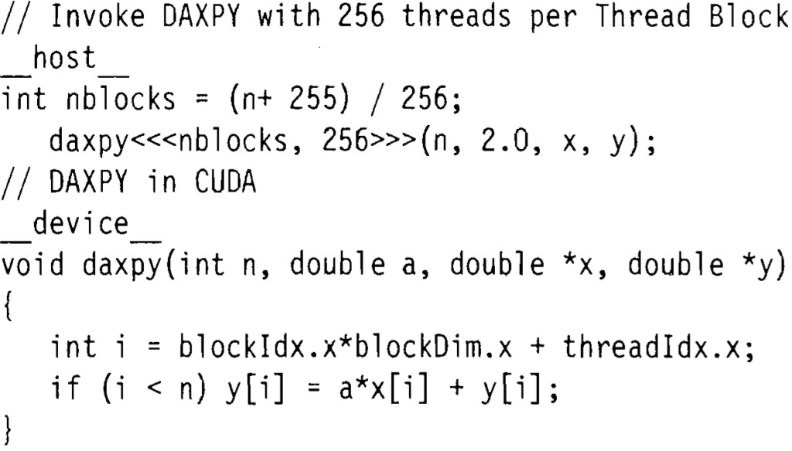
Introduction to CUDA
GRID

Slide 110
NVIDIA GPU Computational Structures
Grid, Thread blocks
Entire Grid sent over to the GPU
●
Elementwise multiplication of 2 vectors of 8192 elements each
512 threads per Thread Block
8192 ∕ 512 = 16 Thread Blocks
Thread Block 0
Thread Block 1
Grid
.......
Thread Block 15

Slide 111
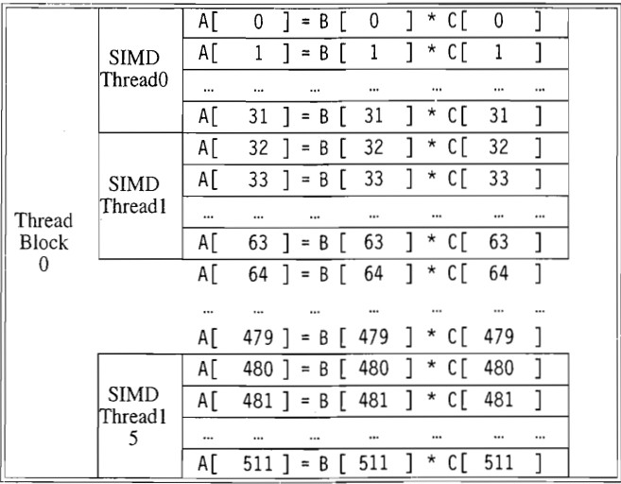
NVIDIA GPU Computational Structures
One Thread Block is scheduled per multithreaded SIMD processor by the Thread Block Scheduler
Thread Block 0
Thread Block 1
Grid
.......
Thread Block 15

Slide 112
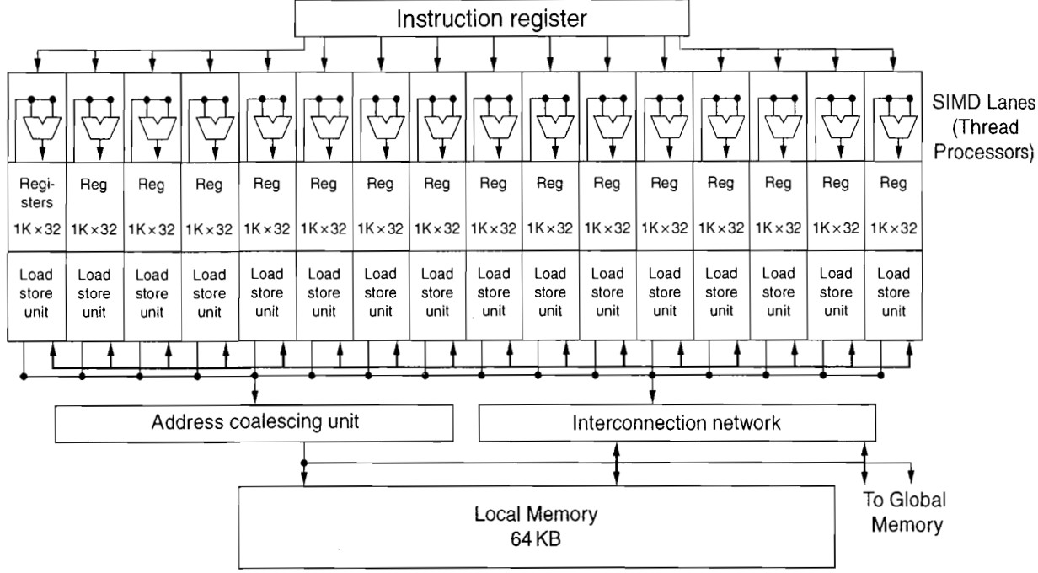
Multithreaded SIMD Processor
Warp Scheduler (Thread scheduler)
Instruction Cache

Slide 113
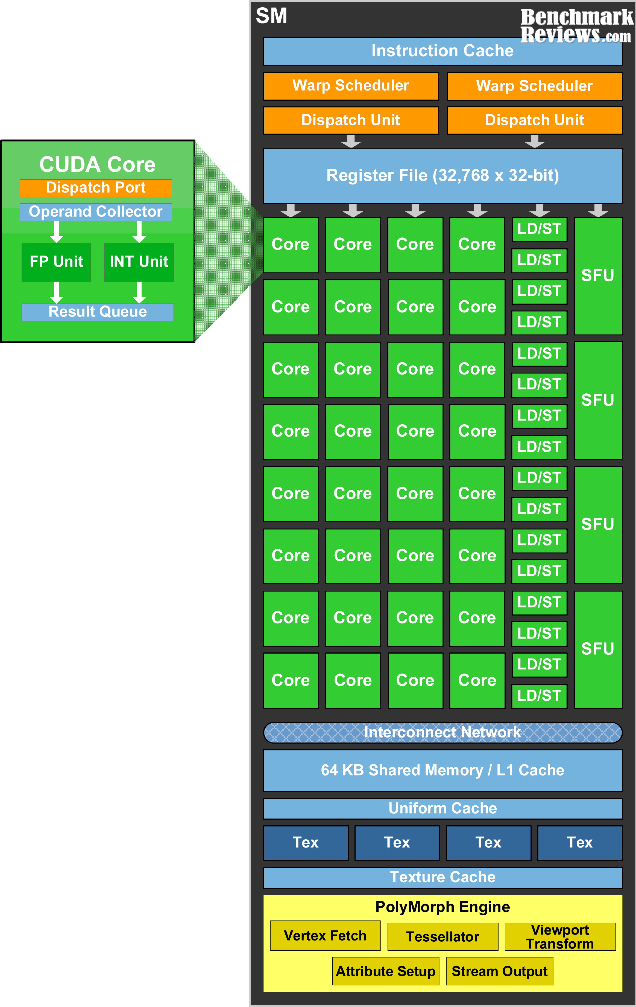
Fermi “Streaming Processor” Core
Streaming Multiprocessor (SM): composed by 32 CUDA cores.
GigaThread globlal scheduler: Distributes thread blocks to SM thread schedulers and manages the context switches between threads during execution Host interface: connects the GPU to the CPU via a PCI-Express v2 bus (peak transfer rate of 8GB/s).
DRAM: Supported up to 6GB of GDDR5 DRAM memory
Clock frequency: 1.5GHz Peak performance: 1.5 TFlops. Global memory clock: 2GHz.
DRAM bandwidth: 192GB/s.
Image Credit: NVIDIA

Slide 114
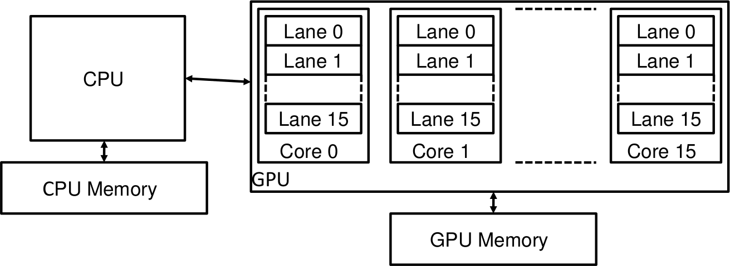
Hardware Execution Model
Multiple multithreaded SIMD cores form a GPU No scalar processor
●
●

Slide 115
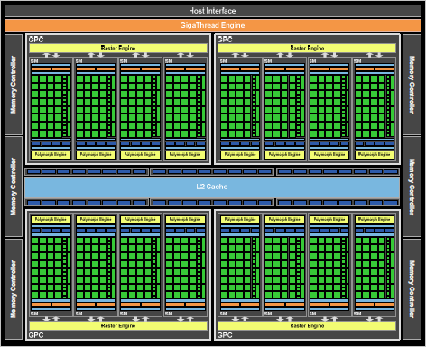
NVIDIA Fermi

Slide 116









Comparison between CPU and GPU
Nemo-3D, written by the CalTech Jet Propulsion Laboratory NEMO-3D simulates quantum phenomena.
These models require a lot of matrix operations on very large matrices.
Modified matrix operation functions to use CUDA instead of CPU.
Simulation
Visualization
NEMO-3D
VolQD
Computation Module
CUDA
kernel
Slides from W. Cheng, Kent State University, http://www.cs.kent.edu/~wcheng/Graphics%20Processing%20Unit.ppt

Slide 117
Comparison between CPU and GPU
Test: Matrix Multiplication
1. Create two matrices with random floating point values. 2. Multiply
Dimensions | CUDA | CPU
64x64 | 0.417465 ms | 18.0876 ms
128x128 | 0.41691 ms | 18.3007 ms
256x256 | 2.146367 ms | 145.6302 ms
512x512 | 8.093004 ms | 1494.7275 ms
768x768 | 25.97624 ms | 4866.3246 ms
1024x1024 | 52.42811 ms | 66097.1688 ms
2048x2048 | 407.648 ms | Didn’t finish
4096x4096 | 3.1 seconds | Didn’t finish

