Slide 1
Parallel Computing
Notes:
CS258 S99

Slide 2
Parallelism
Motivating Parallelism
The Computational Power Argument - from Transistors to FLOPS
The Memory/Disk Speed Argument
The Data Communication Argument

Slide 3
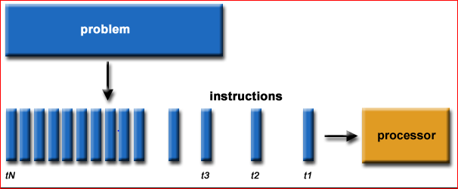
Serial Computing:
Traditionally, software has been written for serial computation: A problem is broken into a discrete series of instructions
Instructions are executed sequentially one after another
Executed on a single processor
Only one instruction may execute at any moment in time

Slide 4
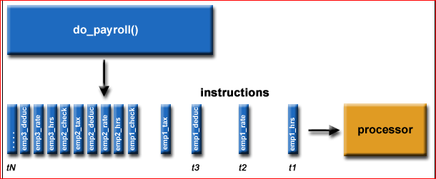
For example:

Slide 5
Parallel Computing:
In the simplest sense, parallel computing is the simultaneous use of multiple compute resources to solve a computational problem: A problem is broken into discrete parts that can be solved concurrently
Each part is further broken down to a series of instructions
Instructions from each part execute simultaneously on different processors
An overall control/coordination mechanism is employed

Slide 6
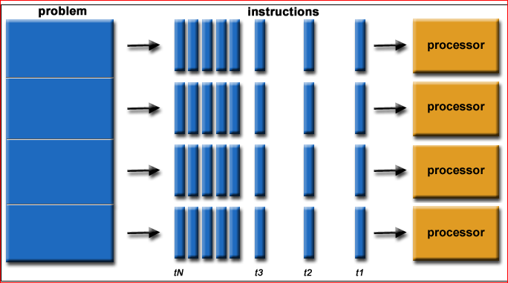
Parallel computing…

Slide 7
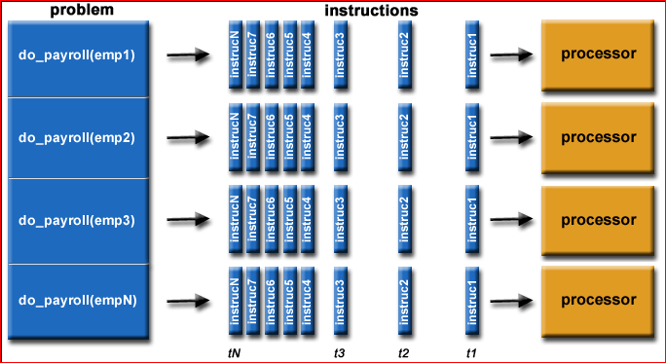
For example:

Slide 8
Parallel computing …
The computational problem should be able to: Be broken apart into discrete pieces of work that can be solved simultaneously;
Execute multiple program instructions at any moment in time;
Be solved in less time with multiple compute resources than with a single compute resource.
The compute resources are typically: A single computer with multiple processors/cores
An arbitrary number of such computers connected by a network

Slide 9
Parallel Computers:
Virtually all stand-alone computers today are parallel from a hardware perspective: Multiple functional units (L1 cache, L2 cache, branch, prefetch, decode, floating-point, graphics processing (GPU), integer, etc.)
Multiple execution units/cores
Multiple hardware threads
Ex: IBM BG/Q Compute Chip with 18 cores (PU) and 16 L2 Cache units (L2)

Slide 10
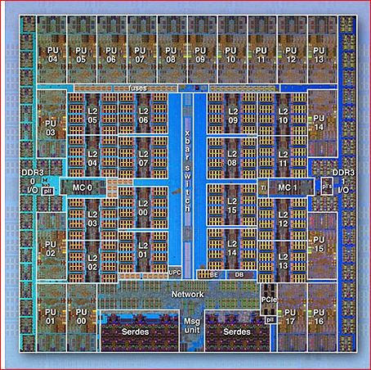
IBM BG/Q Compute Chip

Slide 11
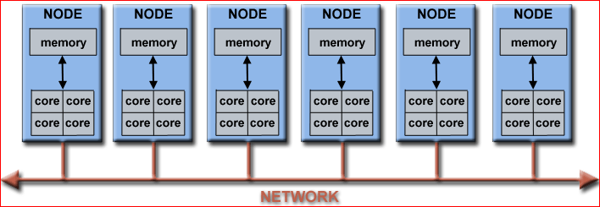
Parallel computer clusters

Slide 12
Why Use Parallel Computing?
The Real World is Massively Parallel:
In the natural world, many complex, interrelated events are happening at the same time.
Compared to serial computing, parallel computing is much better suited for modeling, simulating and understanding complex, real world phenomena.

Slide 13
Main Reasons:
SAVE TIME AND/OR MONEY:
  In theory, throwing more resources at a task will shorten its time to completion, with potential cost savings.
  Parallel computers can be built from cheap, commodity components.

Slide 14
SOLVE LARGER / MORE COMPLEX PROBLEMS:
Many problems are so large and/or complex that it is impractical or impossible to solve them on a single computer, especially given limited computer memory.
Example: "Grand Challenge Problems" (en.wikipedia.org/wiki/Grand_Challenge) requiring PetaFLOPS and PetaBytes of computing resources.
Example: Web search engines/databases processing millions of transactions every second

Slide 15
PROVIDE CONCURRENCY:
A single compute resource can only do one thing at a time. Multiple compute resources can do many things simultaneously.
Example: Collaborative Networks provide a global venue where people from around the world can meet and conduct work "virtually".

Slide 16
TAKE ADVANTAGE OF NON-LOCAL RESOURCES:
Using compute resources on a wide area network, or even the Internet when local compute resources are scarce or insufficient.
Example: SETI@home (setiathome.berkeley.edu) has over 1.6 million users in nearly every country in the world.
Example: Folding@home (folding.stanford.edu) over 1.8 million contributors globally.

Slide 17
MAKE BETTER USE OF UNDERLYING PARALLEL HARDWARE:
Modern computers, even laptops, are parallel in architecture with multiple processors/cores.
Parallel software is specifically intended for parallel hardware with multiple cores, threads, etc.
In most cases, serial programs run on modern computers "waste" potential computing power.

Slide 18
The Future:
During the past 20+ years, the trends indicated by ever faster networks, distributed systems, and multi-processor computer architectures (parallelism is the future of computing)
In this same time period, there has been a greater than 500,000x increase in supercomputer performance, with no end currently in sight.
The race is already on for Exascale Computing!
  Exaflop = 10¹⁸ calculations per second

Slide 19
Who is Using Parallel Computing?
Historically, parallel computing has been considered to be "the high end of computing”.
Physics - applied, nuclear, particle, condensed matter, high pressure, fusion, photonics
Bioscience, Biotechnology, Genetics
Chemistry, Molecular Sciences
Geology, Seismology
Mechanical Engineering - from prosthetics to spacecraft
Electrical Engineering, Circuit Design, Microelectronics
Computer Science, Mathematics
Defense, Weapons

Slide 20
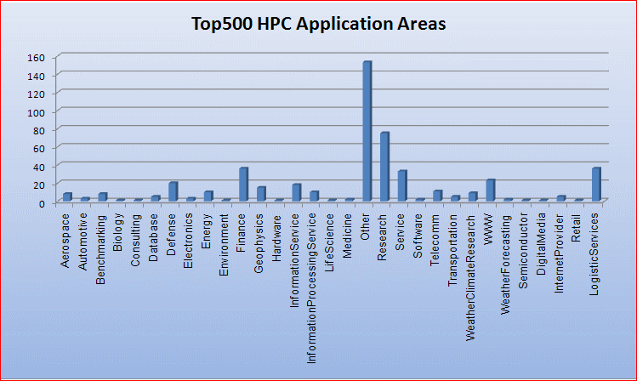
Global Applications:

Slide 21
Speedup
Speedup (p processors) =
For a fixed problem size (input data set), performance = 1/time
Speedup fixed problem (p processors) =
Performance (p processors)
Performance (1 processor)
Time (1 processor)
Time (p processors)

Slide 22
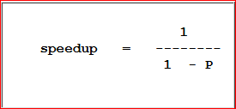
Amdahl's Law
States that potential program speedup is defined by the fraction of code (P) that can be parallelized:

Slide 23
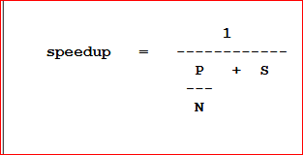
Speedup …
Introducing the number of processors performing the parallel fraction of work, the relationship can be modeled by:

Slide 24
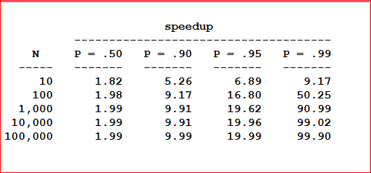
Scalability of parallelism

Slide 25
Complexity:
Costs of complexity are measured in programmer time
Design
Coding
Debugging
Tuning
Maintenance

Slide 26
Scalability
Strong scaling:
The total problem size stays fixed as more processors are added.
Goal is to run the same problem size faster
Perfect scaling means problem is solved in 1/P time (compared to serial)

Slide 27
Scalability …
Weak scaling:
The problem size per processor stays fixed as more processors are added.
Goal is to run larger problem in same amount of time
Perfect scaling means problem Px runs in same time as single processor run

Slide 28
Hardware factors play a significant role in scalability
Memory-cpu bus bandwidth on an SMP machine
Communications network bandwidth
Amount of memory available on any given machine or set of machines
Processor clock speed

Slide 29
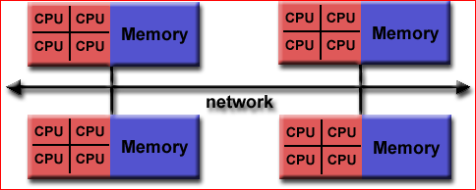
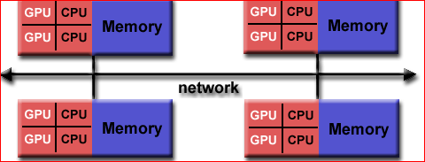
Hybrid Distributed-Shared Memory
The largest and fastest computers in the world today employ both shared and distributed memory architectures.

Slide 30
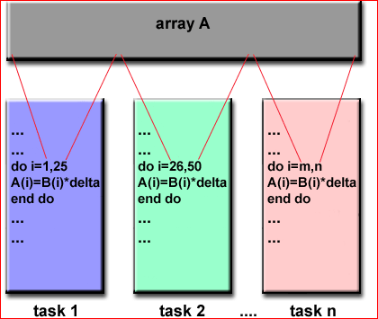
Parallel Programming Models
Data Parallel Model (Partitioned Global Address Space (PGAS) model)
Most of the parallel work focuses on performing operations on a data set. The data set is typically organized into a common structure, such as an array.
A set of tasks work collectively on the same data structure, however, each task works on a different partition of the same data structure.

Slide 31
Implementations:
Coarray Fortran: a small set of extensions to Fortran 95 for SPMD parallel programming.
Unified Parallel C (UPC): an extension to the C programming language for SPMD parallel programming
Global Arrays: provides a shared memory style programming environment in the context of distributed array data structures
Chapel: an open source parallel programming language

Slide 32
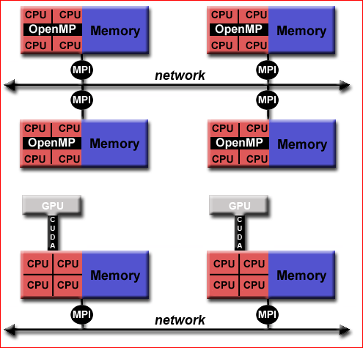
Hybrid Model

Slide 33
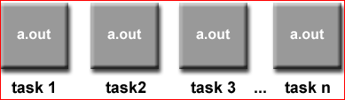
Single Program Multiple Data (SPMD):
SINGLE PROGRAM: All tasks execute their copy of the same program simultaneously. This program can be threads, message passing, data parallel or hybrid.
MULTIPLE DATA: All tasks may use different data

Slide 34
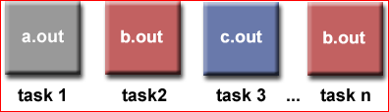
Multiple Program Multiple Data (MPMD):
MULTIPLE PROGRAM: Tasks may execute different programs simultaneously. The programs can be threads, message passing, data parallel or hybrid.
MULTIPLE DATA: All tasks may use different data.

Slide 35
Designing Parallel Programs
Automatic vs. Manual Parallelization
Fully Automatic
The compiler analyzes the source code and identifies opportunities for parallelism.
Whether or not the parallelism would actually improve performance.
Loops (do, for) are the most frequent target for automatic parallelization.

Slide 36
Manual
Programmer Directed
Using "compiler directives" or possibly compiler flags, the programmer explicitly tells the compiler how to parallelize the code.

Slide 37
Designing Parallel Programs
Example of an easy to parallelize problem:
Calculate the potential energy for each of several thousand independent conformations of a molecule. When done, find the minimum energy conformation.
Example of a problem no parallelism:
Calculation of the Fibonacci series (0,1,1,2,3,5,8,13,21,...) by use of the formula: F(n) = F(n-1) + F(n-2)

Slide 38
Summary of Application Trends
Transition to parallel computing has occurred for scientific and engineering computing
In rapid progress in commercial computing
  Database and transactions as well as financial
Desktop also uses multithreaded programs
Demand for improving throughput on sequential workloads
  Greatest use of small-scale multiprocessors
Solid application demand exists and will increase

Slide 39
Summary: Why Parallel Architecture?
Increasingly attractive
  Economics, technology, architecture, application demand
Increasingly central and mainstream
Parallelism exploited at many levels
  Instruction-level parallelism
  Multiprocessor servers
  Large-scale multiprocessors (“MPPs”)
Story from memory system perspective
  Increase bandwidth, reduce average latency with many local memories
Spectrum of parallel architectures make sense
  Different cost, performance and scalability

