Slide 1

Parallel and Distributed Computing Module 1-Parallelism Fundamentals

Slide 2
Outline
Motivation
Key Concepts
Challenges
Parallel computing
Flynn‘s Taxonomy
Multi-core Processors,
Shared vs Distributed memory.

Slide 3
Motivation
To address computationally intensive problems and increase their response time
Weather Forecasting
Genome Sequencing
Crash Simulation Testing

Slide 4
Moore’s Law
Transistor count on a integrated chip doubles every 24 months independent of technology used
@Gordon Moore, Co-founder of Intel Corp (1965)

Slide 5
Moore’s Law
Pipelined functional units: instruction level parallelism
Superscalar architecture
Out-of-order execution
Larger Caches

Slide 6
Moore’s Law
More complexity will not lead to more efficiency
More functional units are packed into CPU
The higher probability that the “average” code will not be able to use them
As the number of independent instructions in a sequential instruction stream is limited.
Faster clock boosts power dissipation making idling transistors useless

Slide 7
Power-Performance Dilemma
Simplify processor design
Additional transistors for larger cache
So, multi-core processors came into existence

Slide 8
Parallelization
Misconception: More hardware →Faster Response Time
Billions of CPU hours wasted
Supercomputer users have no idea about limitations of parallel execution

Slide 9
Classes of Parallelism
Data-Level Parallelism (DLP) : Huge data can be operated in parallel
Task-Level Parallelism (TLP) : independent and large tasks in parallel on at the same time.

Slide 10
Ways to exploit parallelism
Instruction-Level Parallelism:
Exploit data-level parallelism
Pipelining
Vector Architectures and Graphic Processor Units (GPUs)
Exploit data-level parallelism
Applies a single instruction to a collection of data in parallel.

Slide 11
Ways to exploit parallelism
Thread-Level Parallelism
Exploits either data-level parallelism or task-level parallelism
Allows for interaction among parallel threads.
Request-Level Parallelism
Exploits parallelism among largely decoupled tasks
Specified by the programmer or the operating system.

Slide 12
Flynn’s Taxonomy
These 4 ways to support the data-level parallelism and task-level parallelism for hardware [50 years back].
When Michael Flynn [1966] found a simple classification whose abbreviations we still use today.
SISD
SIMD
MISD
MIMD

Slide 13
Single instruction stream, single data stream (SISD)
This category is the uniprocessor.
No exploitation of parallelism
Can have concurrent processing
Pipelined and super scalar processors
INSTRUCTION
STREAM
DATA
STREAM
Processing Unit

Slide 14
Single instruction stream, multiple data streams (SIMD)
INSTRUCTION STREAM
DATA
DATA
STREAM1
Processing Unit
DATA
STREAM 2
Processing Unit
DATA
STREAM 3
Processing Unit

Slide 15
Multiple instruction streams, single data stream (MISD)
INSTRUCTION STREAM
InstructionStream1
InstructionStream2
InstructionStream3
DATA
STREAM
Processing Unit
Processing Unit
Processing Unit

Slide 16
MIMD
INSTRUCTION STREAM
InstructionStream1
InstructionStream2
InstructionStream3
DATA
DATA
STREAM1
Processing Unit
DATA
STREAM 2
Processing Unit
DATA
STREAM 3
Processing Unit

Slide 17
Parallel Scalability
Factors limit parallel execution
Scalability metrics
Scalability Laws:
Amdahl’s Law
Gustafson’s Law
Parallel efficiency

Slide 18
Factors that limit parallelism
1
2
3
4
5
6
7
8
9
10
11
12
Time
W1
1
2
3
4
Top: Sequence of tasks that needs to be parallelized
Bottom: 3 workers (W1,W2,W3) are used to parallelize the tasks with the time reduction
W2
5
6
7
8
W3
9
10
11
12
Time

Slide 19
But it will not be true and the factor is load imbalance
Some of the resources will be under utilized
Communication between co-workers
Tools to be shared by the co-workers
These factors will add overhead which will serialize some part of parallel execution

Slide 20

Load imbalance
Tasks will be executed by the workers at different speeds because of load imbalance
Regions indicate that unused regions
W1
1
2
3
4
W2
5
6
7
8
W3
9
10
11
12
Time

Slide 21
Scalability Metrics
Algorithmic limitations because of mutual dependencies
Bottlenecks because of shared resources
Startup Overhead
Communication

Slide 22
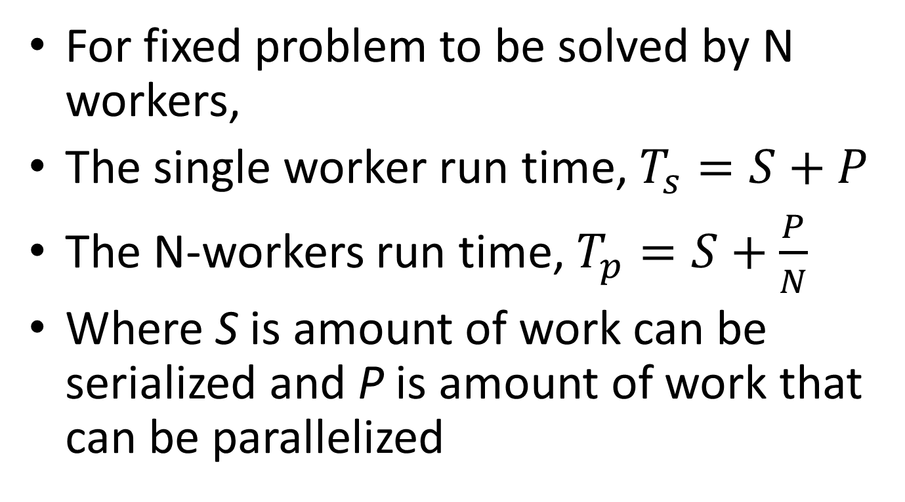
Run-time
For fixed problem to be solved by N workers,
The single worker run time, $T_{s}=S+P$
The N-workers run time, $T_{p}=S+\frac{P}{N}$
Where S is amount of work can be serialized and P is amount of work that can be parallelized

Slide 23
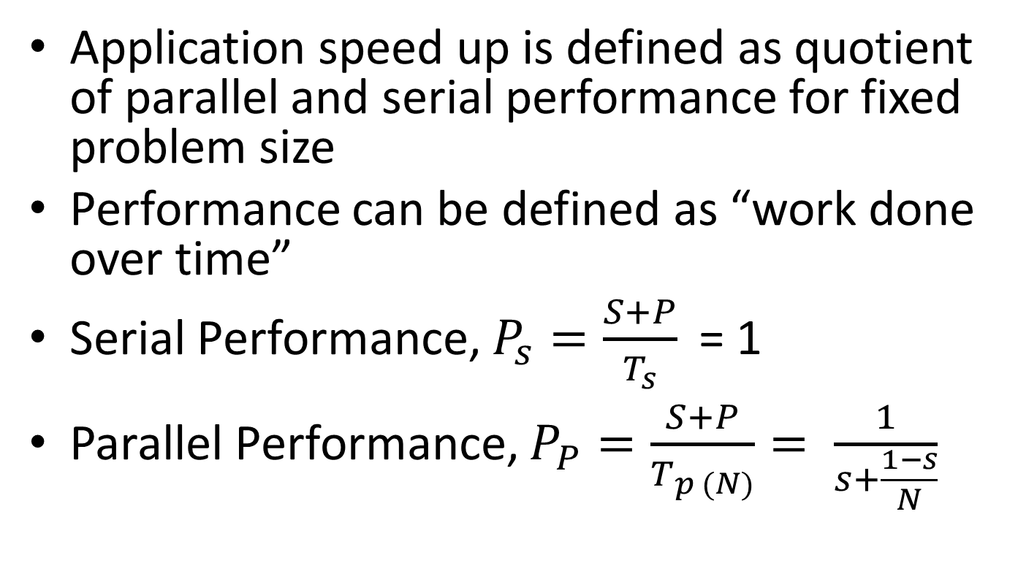
Scalability Laws
Application speed up is defined as quotient of parallel and serial performance for fixed problem size
Performance can be defined as “work done over time”
Serial Performance, ${P_{s}=\frac{S+P}{T_{s}}}_{ }$ = 1
Parallel Performance, ${P_{P}=\frac{S+P}{T_{p (N)}}= \frac{1}{s+\frac{1−s}{N}}}_{ }$

Slide 24
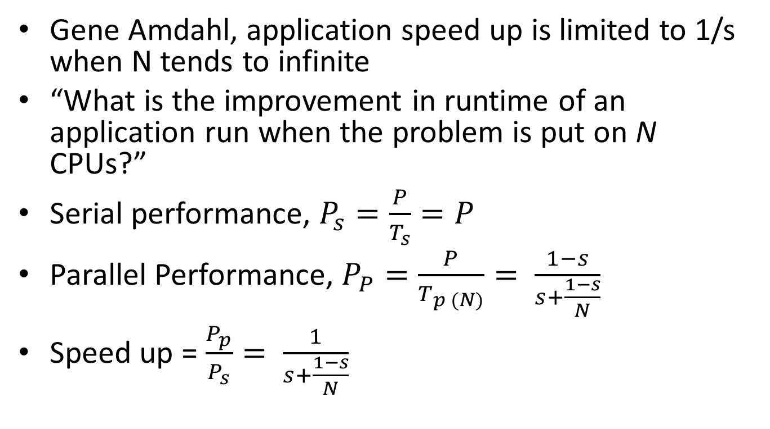
Amdahl’s Law
Gene Amdahl, application speed up is limited to 1/s when N tends to infinite
“What is the improvement in runtime of an application run when the problem is put on N CPUs?”
Serial performance, ${P_{s}=\frac{P}{T_{s}}=P}_{ }$
Parallel Performance, ${P_{P}=\frac{P}{T_{p (N)}}= \frac{1−s}{s+\frac{1−s}{N}}}_{ }$
Speed up = $\frac{P_{p}}{P_{s}}= \frac{1}{s+\frac{1−s}{N}}$

Slide 25
Problems
Bob is given the job to write a program that will get a speedup of 3.8 on 4 processors.
He makes it 95% parallel, and goes home dreaming of a big pay raise.
Using Amdahl’s law, and assuming the problem size is the same as the serial version, and ignoring communication costs, what speedup will Bob actually get?

Slide 26
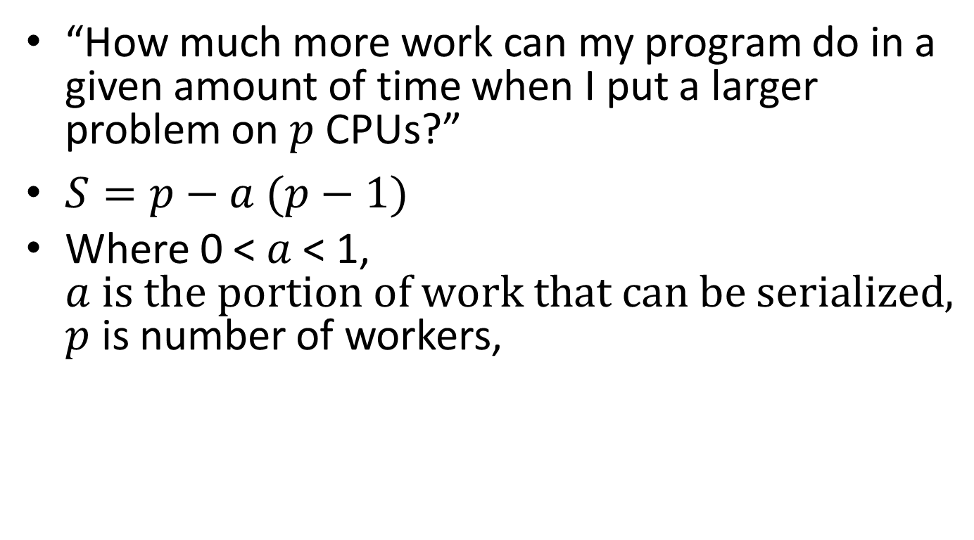
Gustafson’s Law
“How much more work can my program do in a given amount of time when I put a larger problem on $p$CPUs?”
$S=p−a (p−1)$
Where 0 < $a$< 1, $a is the portion of work that can be serialized, p$ is number of workers,

Slide 27

Parallel Efficiency
$E= \frac{Performance on N CPUs}{N x Performance on one CPU} = \frac{Speed Up}{N}$

Slide 28
Multi-core Processors
Cores on a die can have separate caches or shared caches at certain levels
Sharing cache will reduce latency and improve bandwidth for communication between core
But it may lead to cache bandwidth bottlenecks
Recent multicore designs have integrated memory controller which is connected directly to memory modules without chipset
This reduce main memory latency and allows addition of Hyper Transport or Quick Path inter-socket networks
Efficient cache coherence communication

Slide 29
Dual core Processor
Separate L1, L2, and L3 Cahes
Intel Monticeto
P
P
L1D
L1D
L2
L2
L3
L3

Slide 30
Quad Core Processor
Two Dual core processors with Shared L1, Separate L2 (Intel Harpertown)
P
P
P
P
L1D
L1D
L1D
L1D
L2
L2

Slide 31
Hexa core processor
Shared L2, separate L3
L2 groups are dual cores and L3 group is whole chip
Intel Dunnigton
P
P
P
P
P
P
L1D
L1D
L1D
L1D
L1D
L1D
L2
L2
L2
L3

Slide 32
Quad Core Processor
Separate L1 and L2 caches
Shared L3 cache
L3 group is whole chip
Built-in memory interface allows to attach memory and other sockets without chipset
AMD Shangai and Intel Nehalem
P
P
P
P
L1D
L1D
L1D
L1D
L2
L2
L2
L2
L3
HT/QPI
Memory Interface

Slide 33
Shared-memory
A system where the number of CPUs work on the physical address space
Two varieties:
Uniform Memory Access (UMA)
Cache Coherent Non-Uniform Memory Access (ccNUMA)

Slide 34
UMA
Known as Symmetric Multi Processing (SMP)
Latency and Bandwidth are the same for all the processors
Simplest implementation is Dual-core

Slide 35
UMA System with two Single-core chips
P
P
Common Front Side Bus (FSB)
Socket
L1D
L1D
L2
L2
Chipset
Memory

Slide 36
UMA System with two Dual-core chips
P
P
P
P
Socket
L1D
L1D
L1D
L1D
L2
L2
Chipset
Memory

Slide 37
Cache Coherence
Cache coherence mechanism is required
Because of same copy of cache line is resided in in several caches
If one of those caches get modified, other cache content needs to be reflected

Slide 38
MESI Protocol
M: modified
E: exclusive
S: shared
I: invalid
P1
P2
C1
C2
3
7
A1 A2
A1 A2
A1
A2
Memory

Slide 39
1. C1 requests exclusive CL ownership
2. set CL in C2 to state I
3. CL has state E in C1 → modify A1 in C1 and set to state M
4. C2 requests exclusive CL ownership
5. evict CL from C1 and set to state I
6. load CL to C2 and set to state E
7. modify A2 in C2 and set to state M in C2
P1
P2
C1
C2
3
7
A1 A2
A1 A2
A1
A2
Memory
Courtesy: Hager, G. (2017). Introduction To high performance computing for scientists and engineers: CRC press

Slide 40
NUMA System
P
P
P
P
P
P
P
P
L1D
L1D
L1D
L1D
L1D
L1D
L1D
L1D
L2
L2
L2
L2
L2
L2
L2
L2
L3
L3
Memory Interface
Coherent
Link
Memory Interface
Memory
Memory

Slide 41
Distributed Memory
P
P
P
P
P-Processor
C-Cache
NI-Network Interface
M-Memory
C
C
C
C
M
M
M
M
NI
NI
NI
NI
Communication Network

Slide 42
Reference
Hager, G. (2017). Introduction To high performance computing for scientists and engineers: CRC press.
Patterson and Hennesy. Computer architecture: a quantitative approach, 5th edition

