Slide 1
Principles of Parallel Algorithm Design

Slide 2
Nontrivial parallel algorithm
Identifying portions of the work that can be performed concurrently.
Mapping the concurrent pieces of work onto multiple processes running in parallel.
Distributing input, output and intermediate data.
Managing accesses to data shared by multiple processors.
Synchronizing the processors at various stages of the parallel program execution.

Slide 3
Preliminaries
Dividing a computation into smaller tasks for parallel execution is called as decomposition
The sub division of main computation by means of decomposition as decided by the programmer is represented as tasks
Concurrent execution of multiple tasks is the preferred solution for reducing the overall execution time
A task could be of any arbitrary size
The decomposed problem into multiple task need not to be of the same size. It could vary as per programmer’s decision.

Slide 4
Task Dependency Graph
It is the abstraction used for indicating task dependencies and the relative execution order.
It is a directed acyclic graph where the nodes representing tasks and edges representing dependencies between them.
The task representing a node could be executed only if all the tasks connected by incoming edges have completed.
The task dependency graphs could also be disconnected and the edge set of it could be empty in the case of matrix multiplication where each task corresponds to entries subset of the final product vector matrix.

Slide 5
Decomposition Terminologies
Granularity: The number and size of tasks based on which a problem is decomposed
Fine-Grained: Decomposition of a problem into huge number of small tasks . Eg: In matrix multiplication of nXn, where n = 100, with Number of tasks = 100.
Coarse- Grained: Decomposition of a problem into small number of huge tasks. Eg: In matrix multiplication of nXn, where n = 100, with Number of tasks = 4.

Slide 6
Decomposition Techniques
Recursive decomposition
Data decomposition
Exploratory decomposition
Speculative decomposition

Slide 7
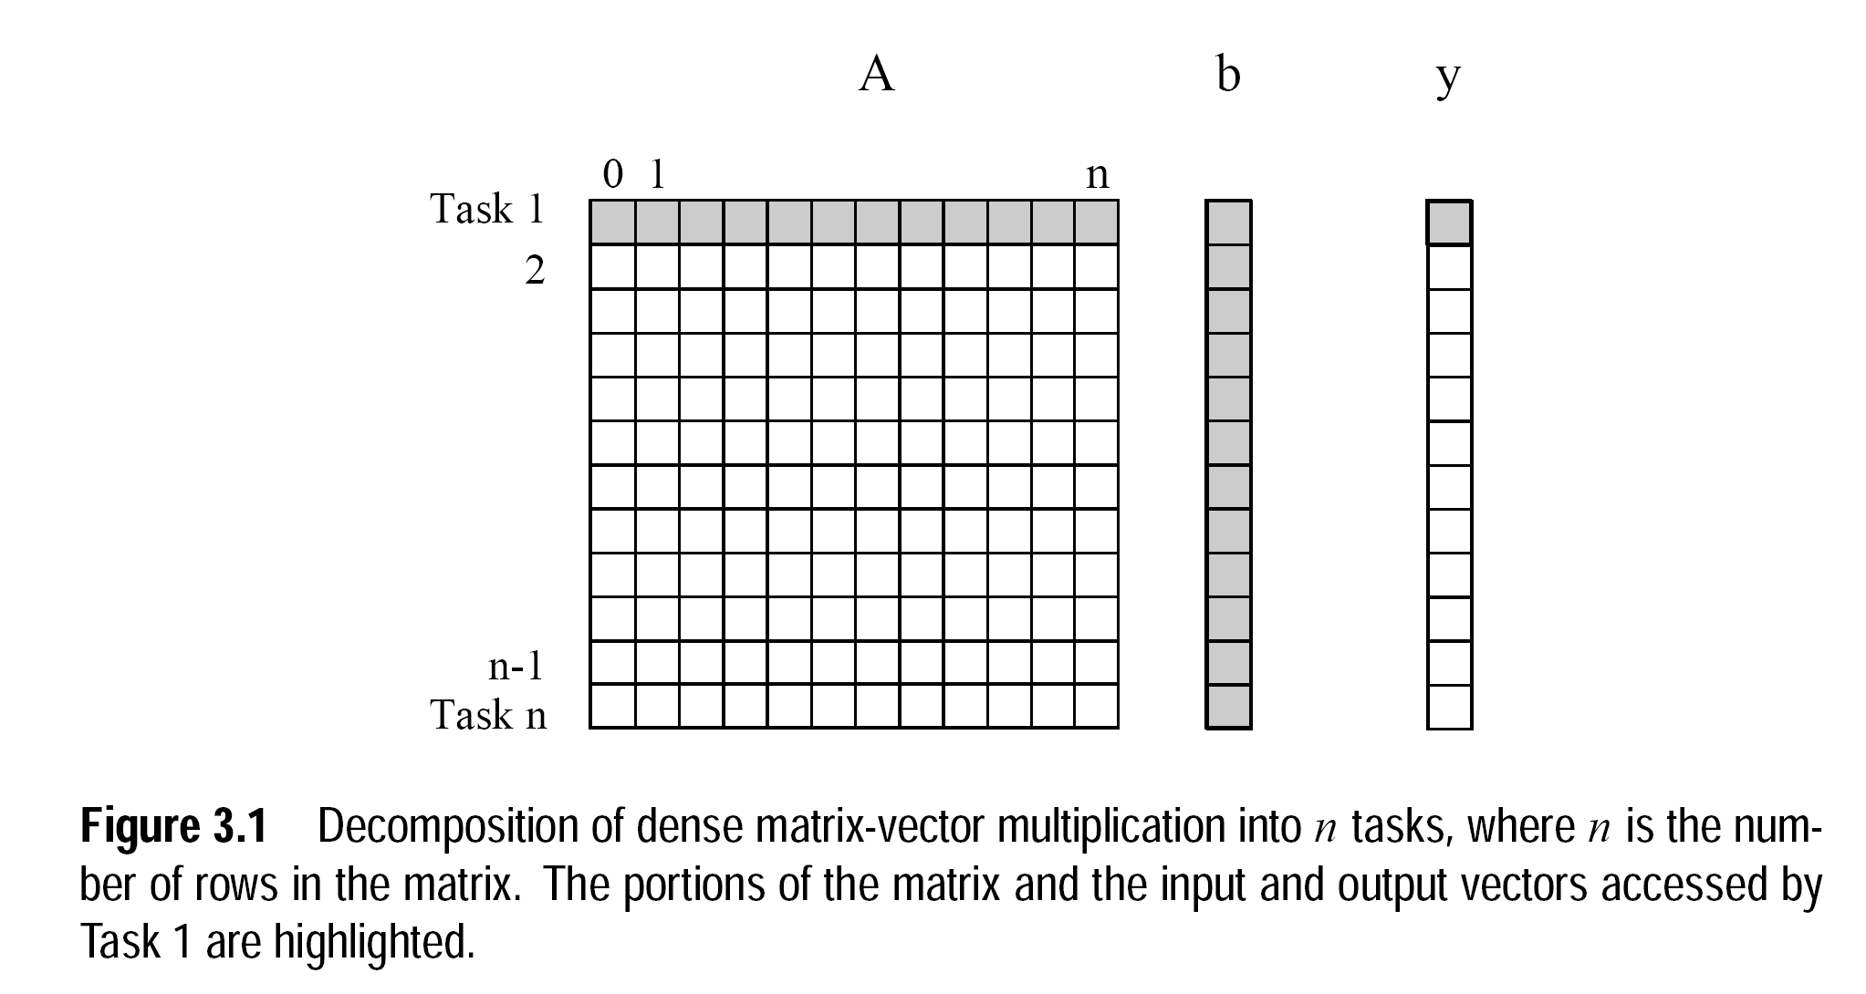

Slide 8
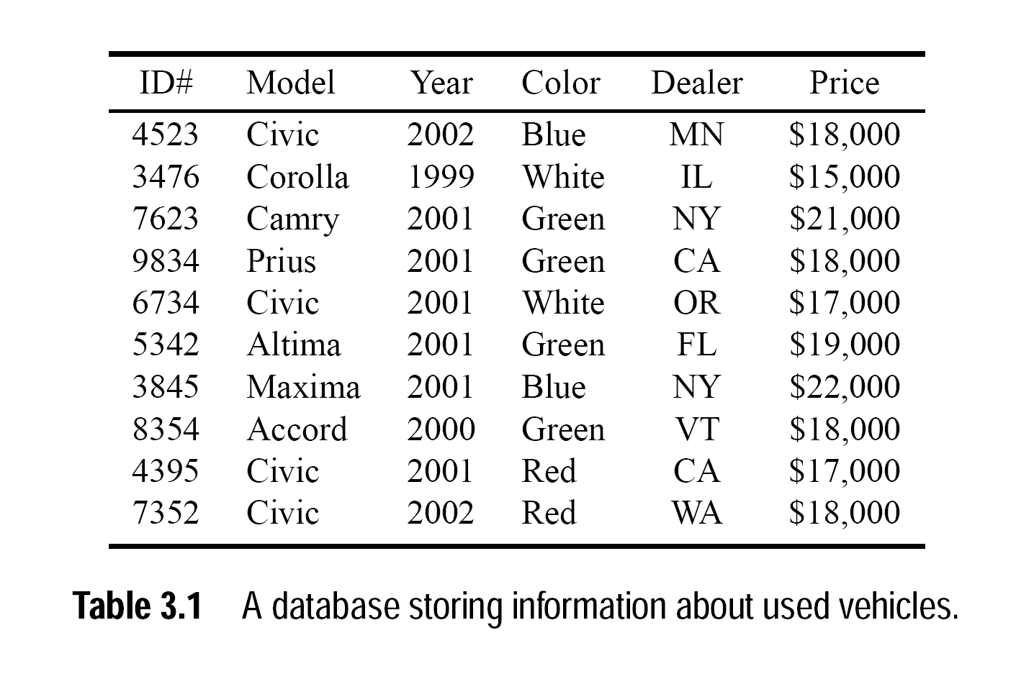

Slide 9
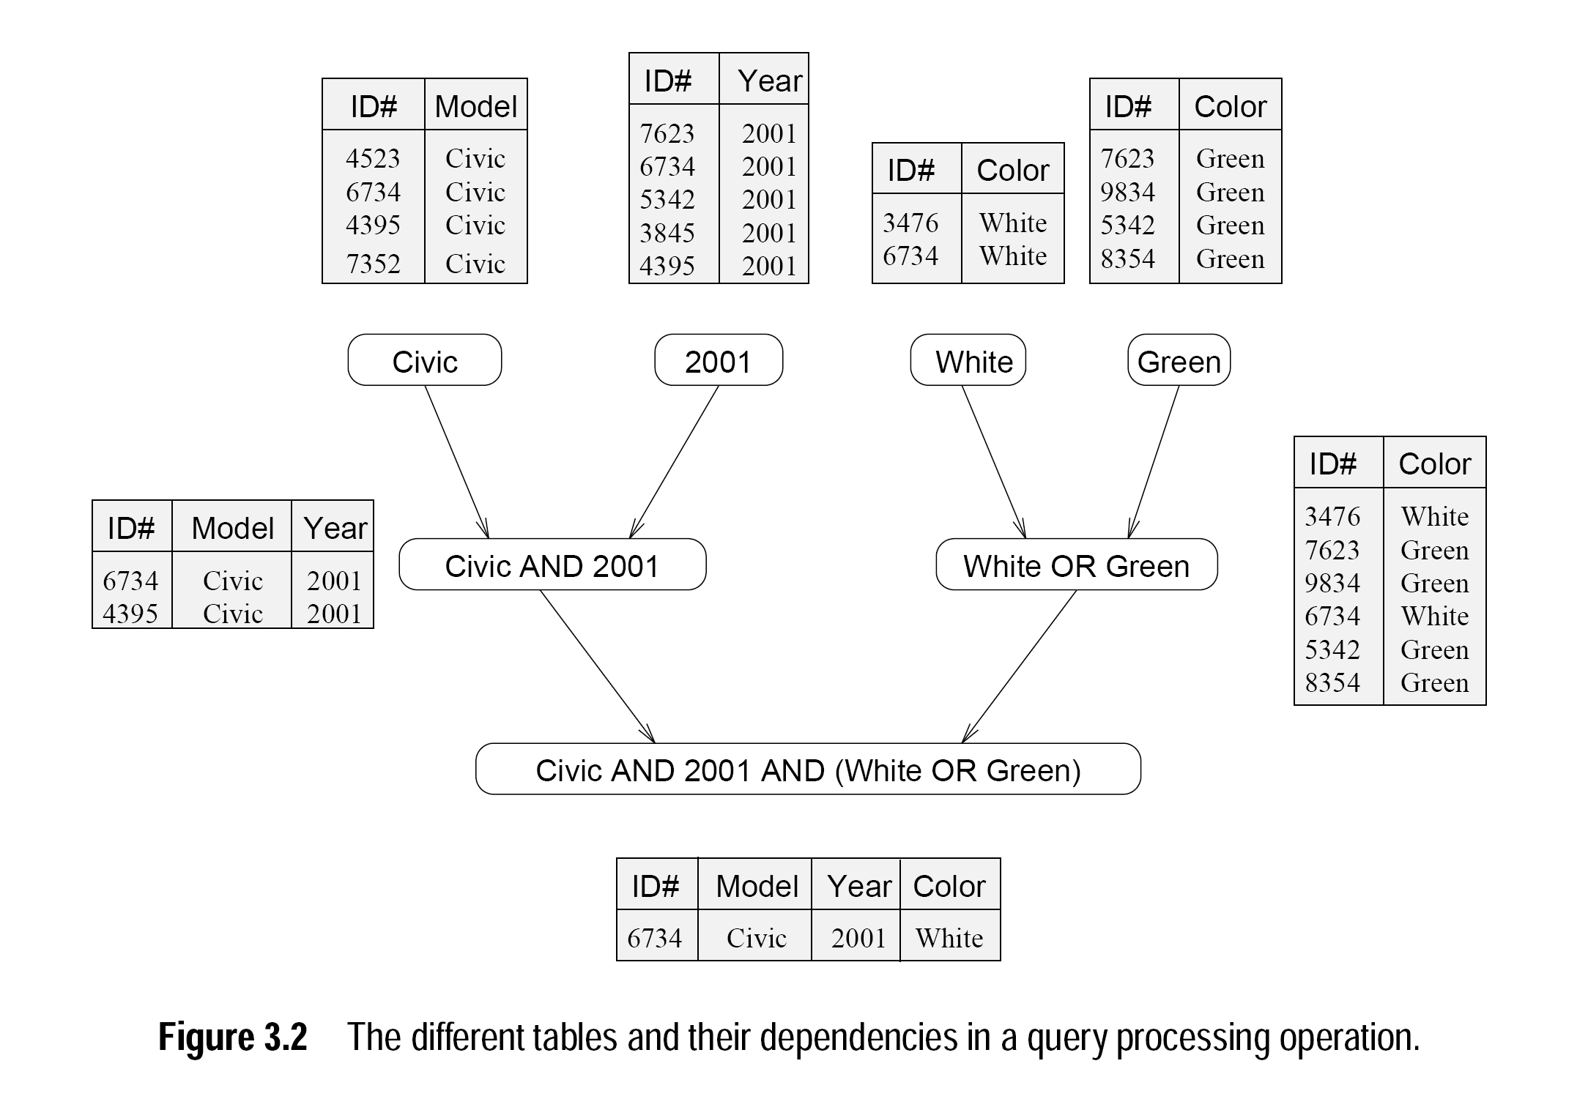

Slide 10
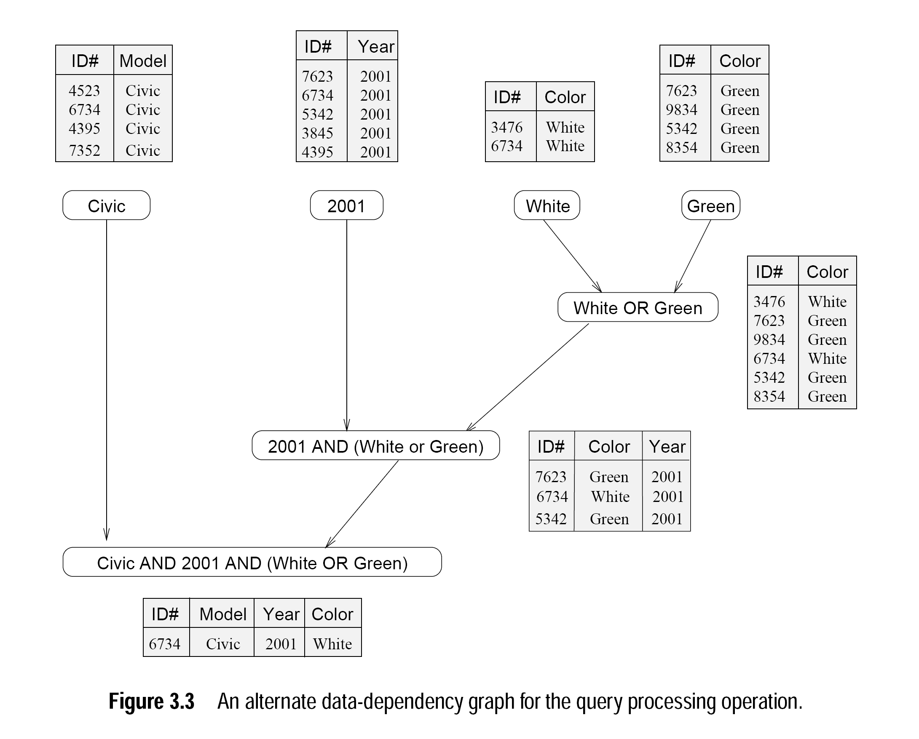

Slide 11
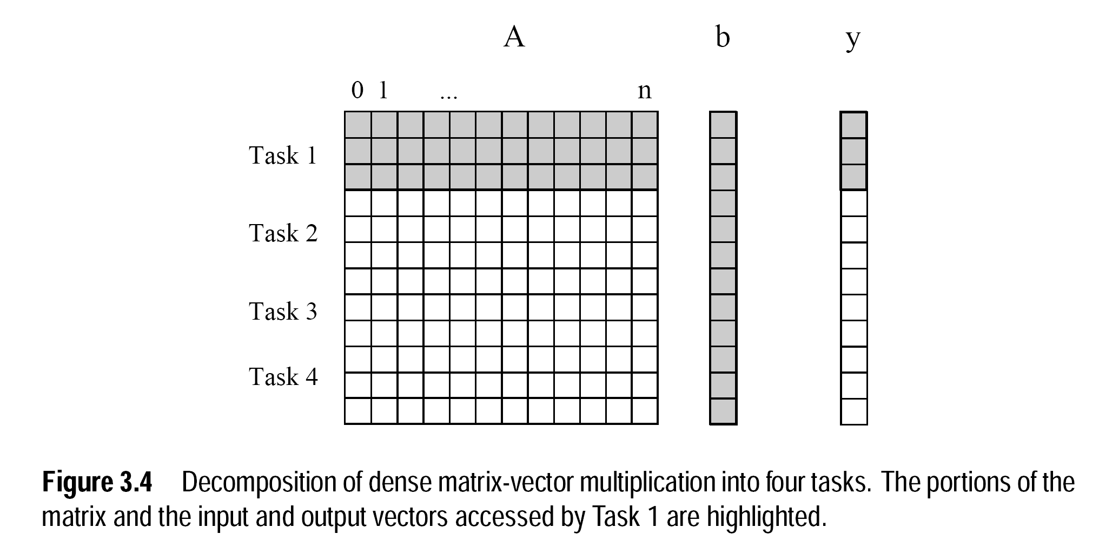

Slide 12
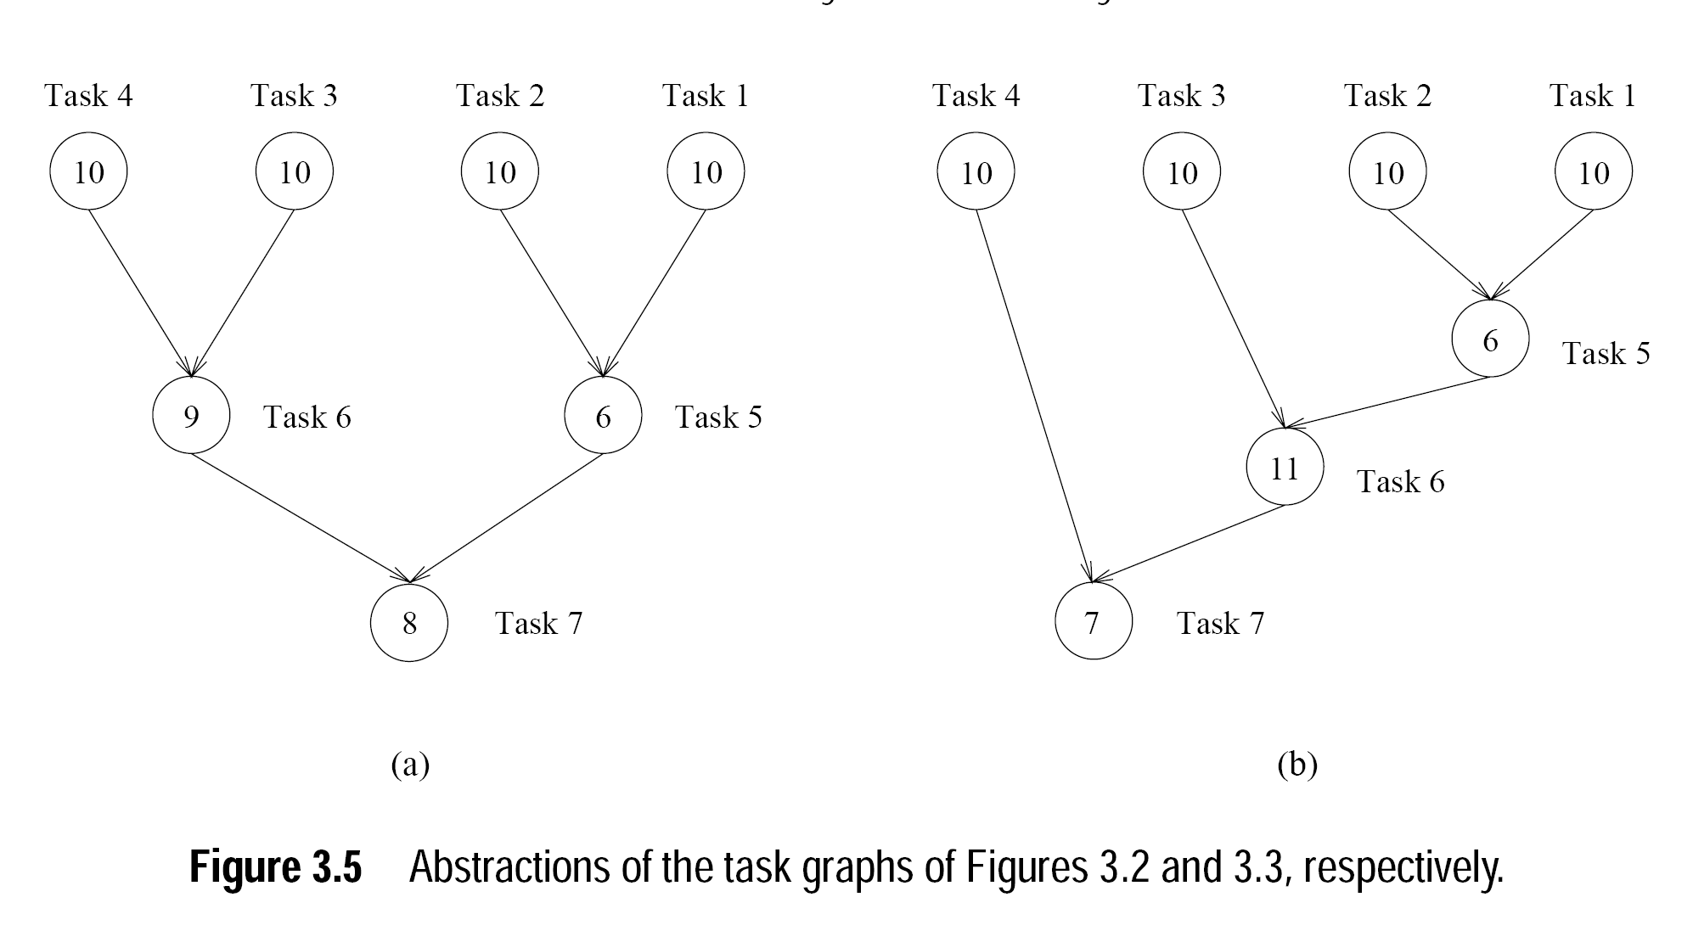

Slide 13
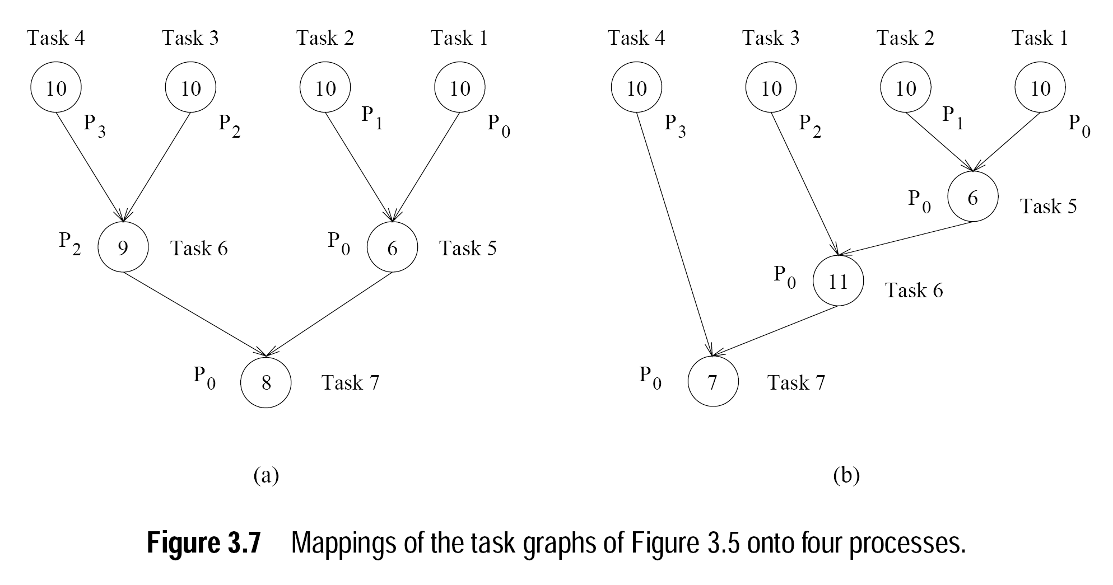

Slide 14
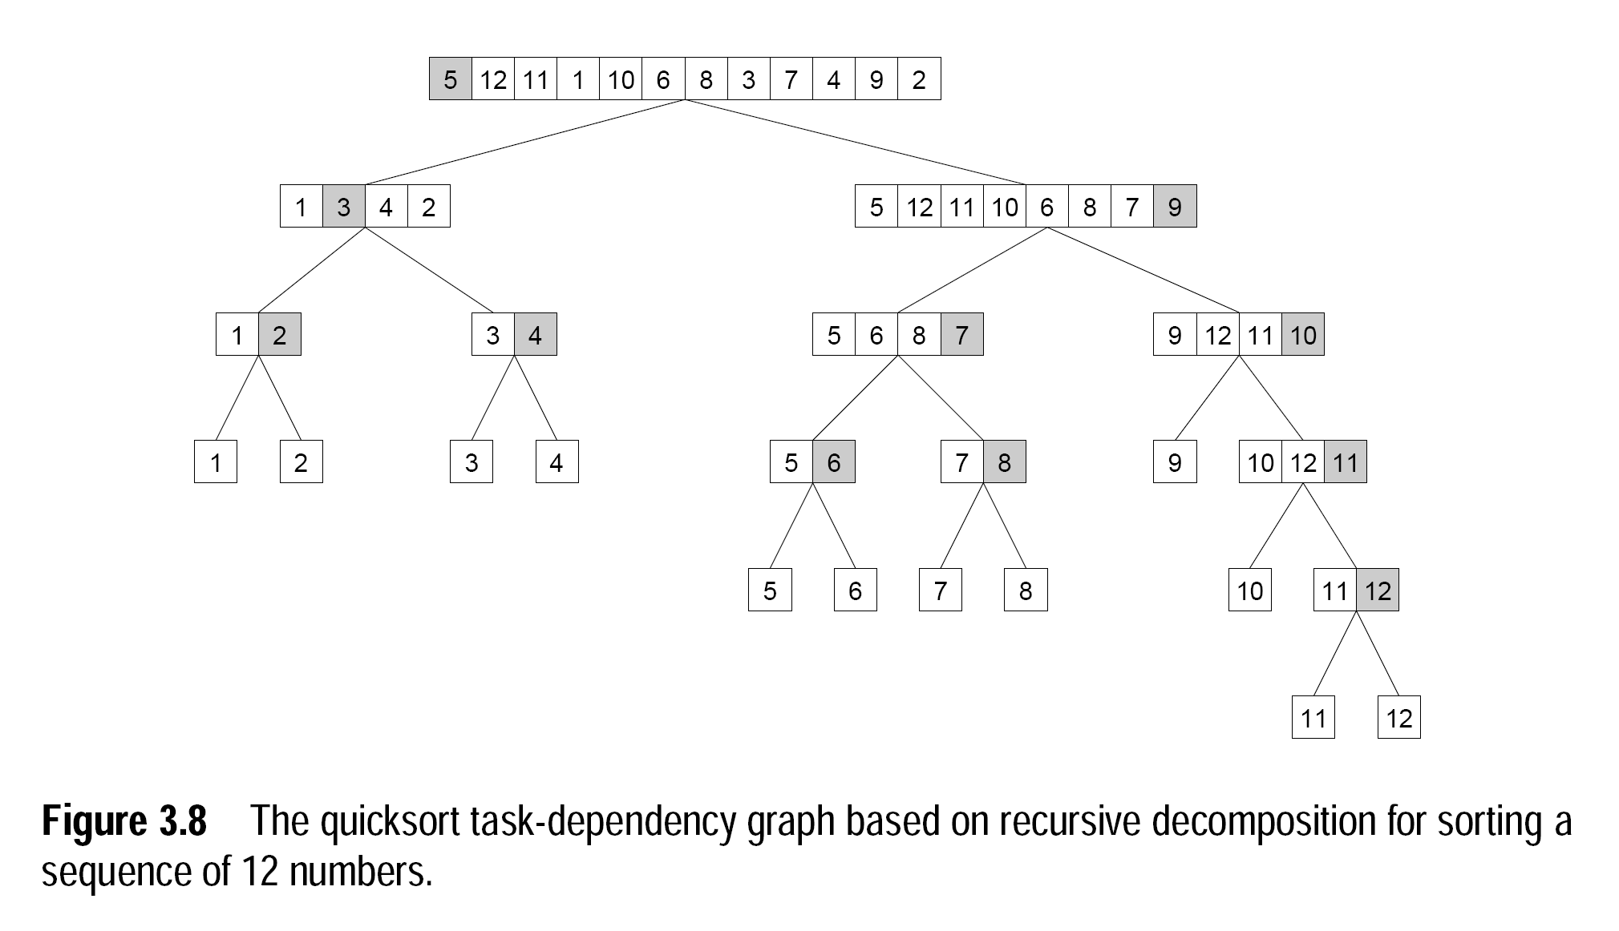

Slide 15
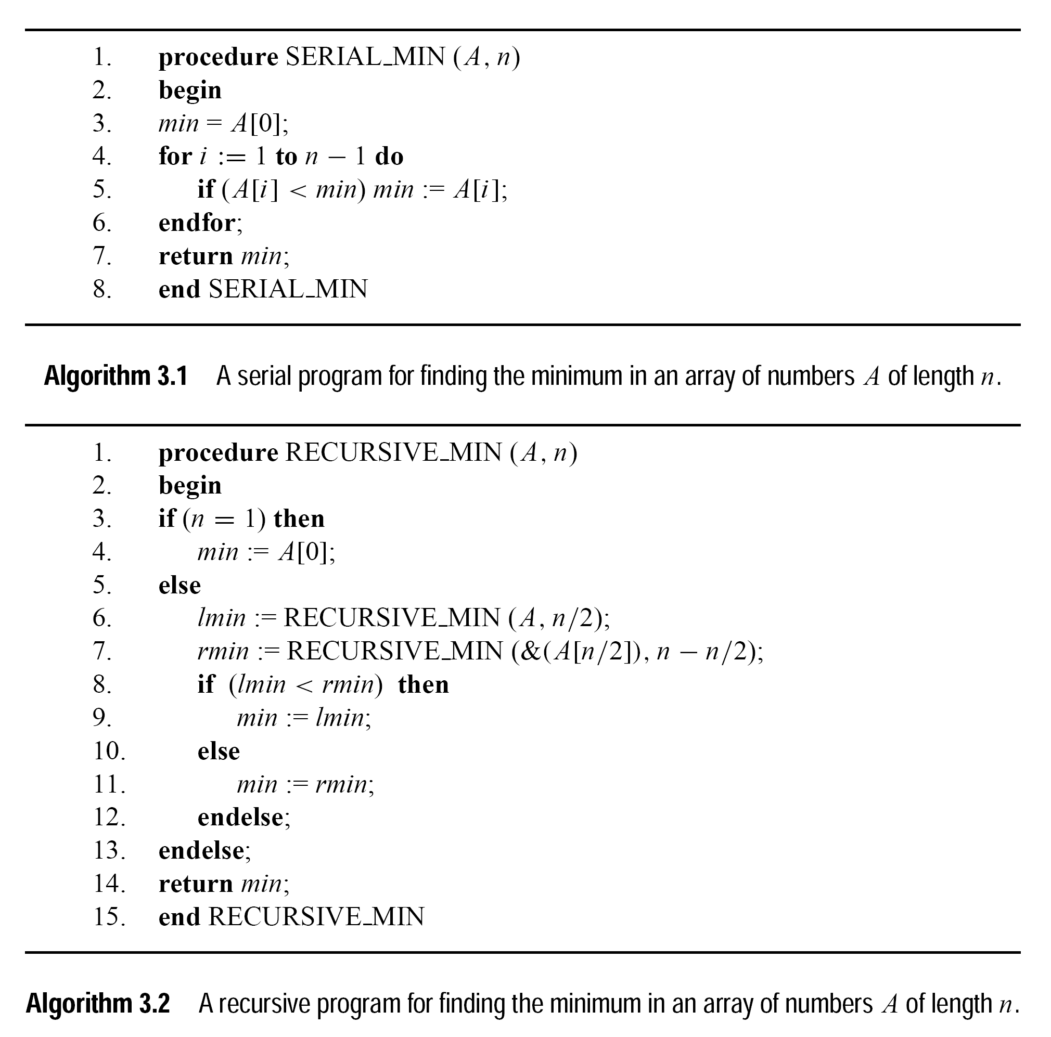

Slide 16
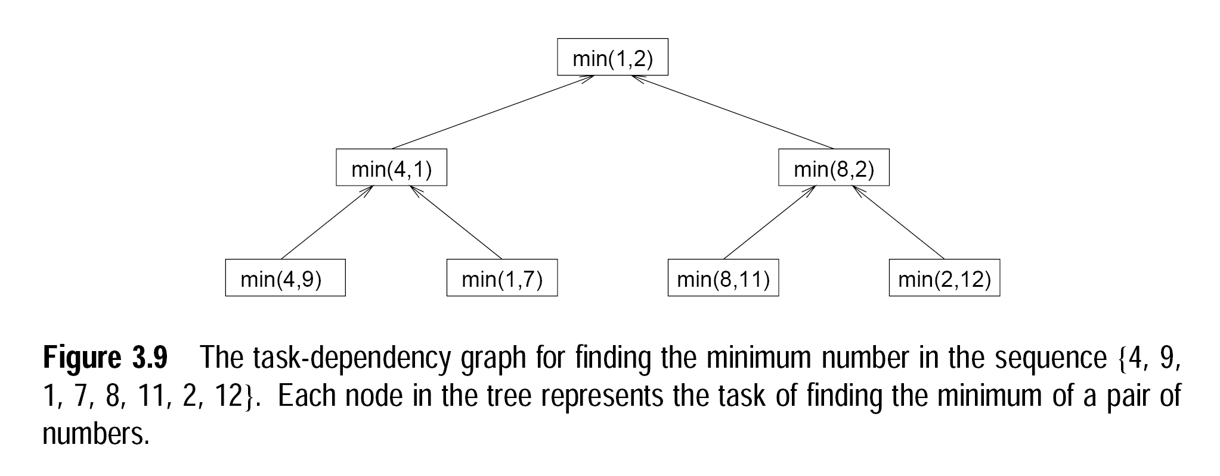

Slide 17
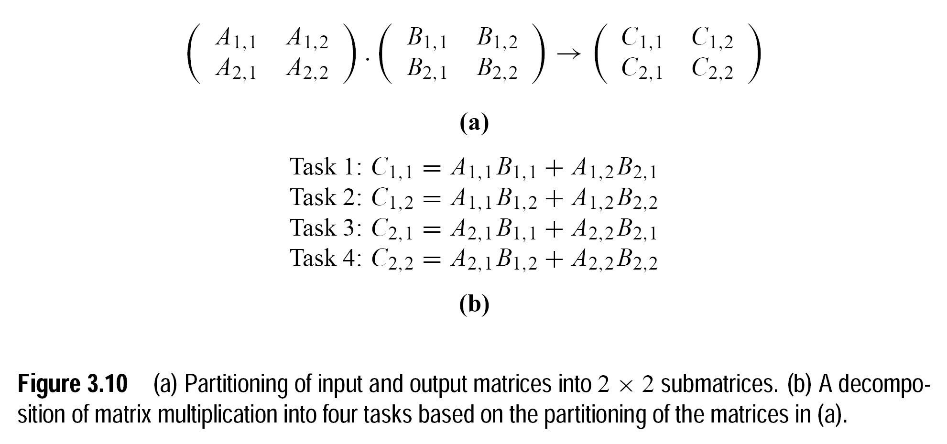

Slide 18
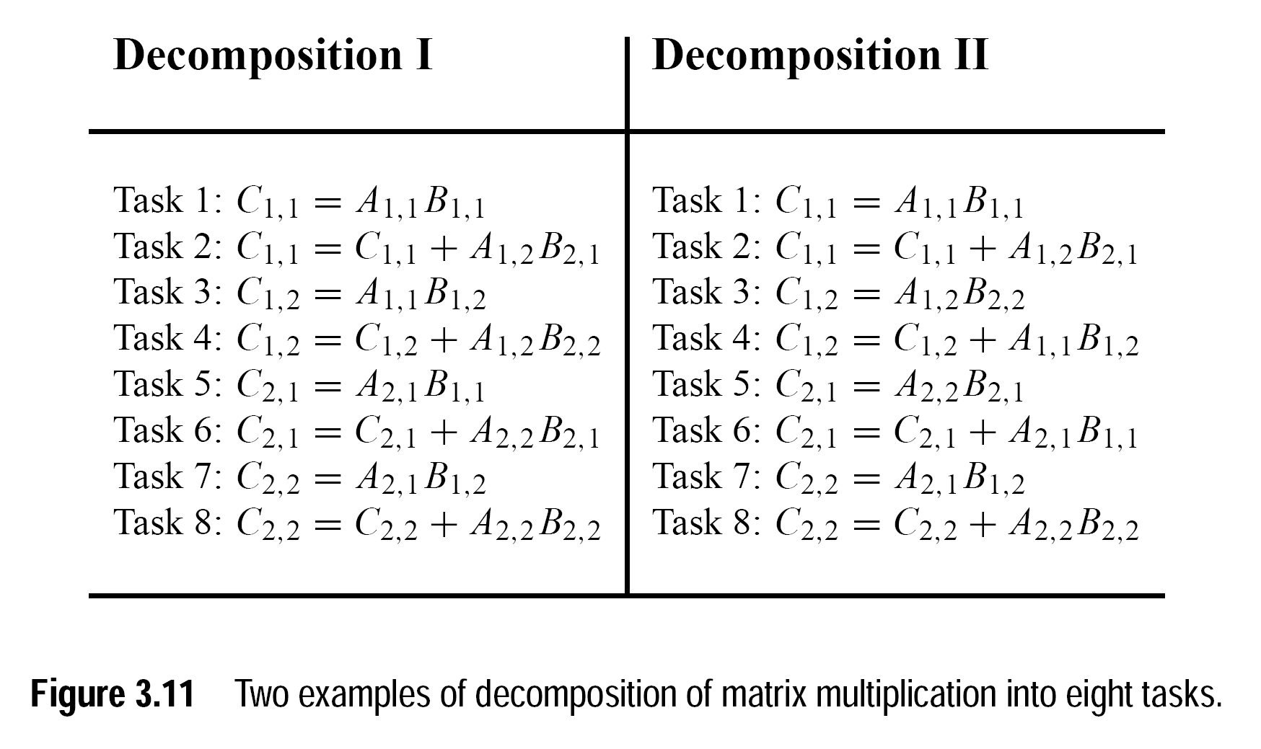

Slide 19
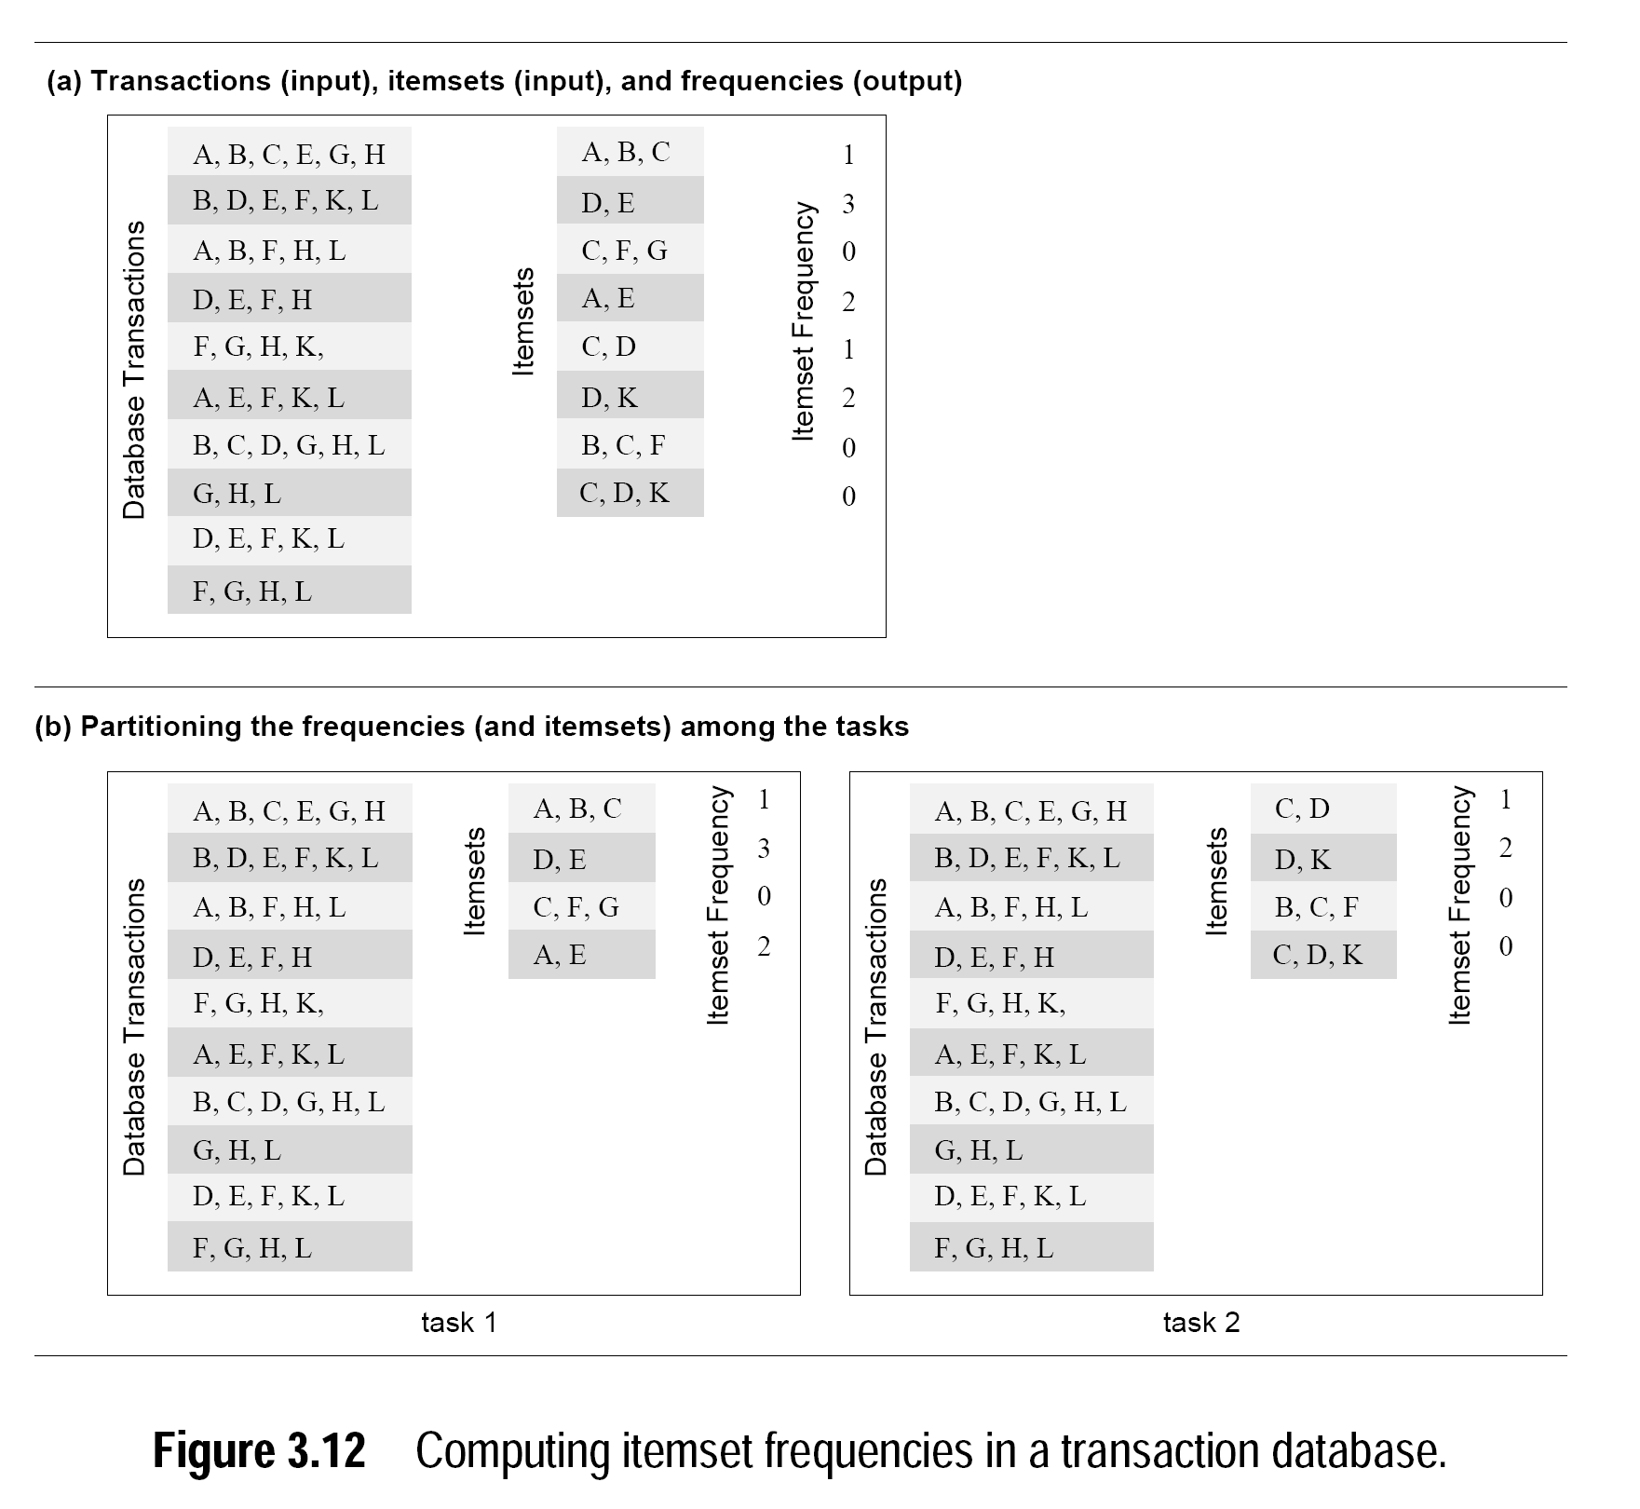

Slide 20
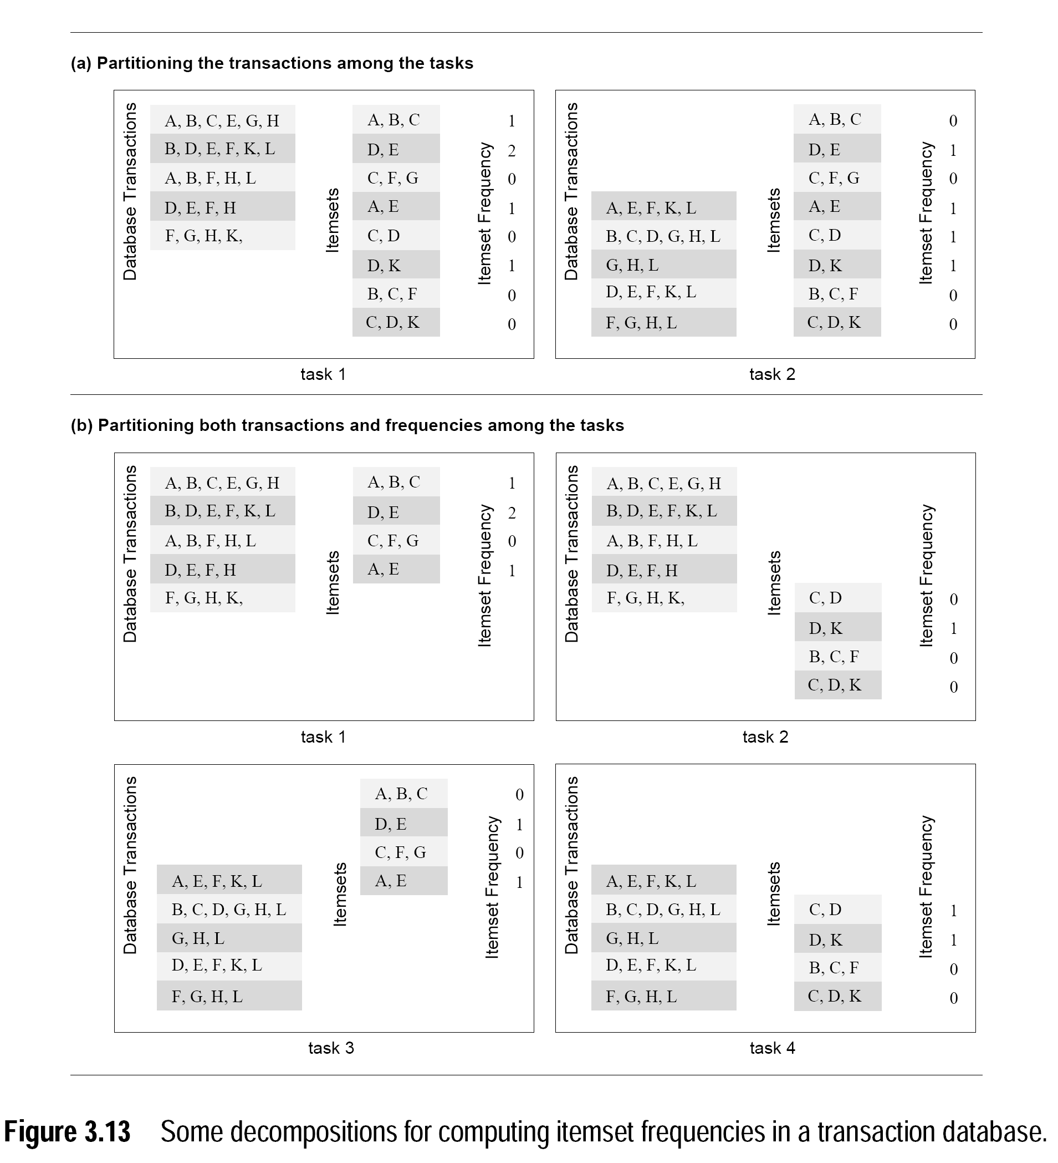

Slide 21
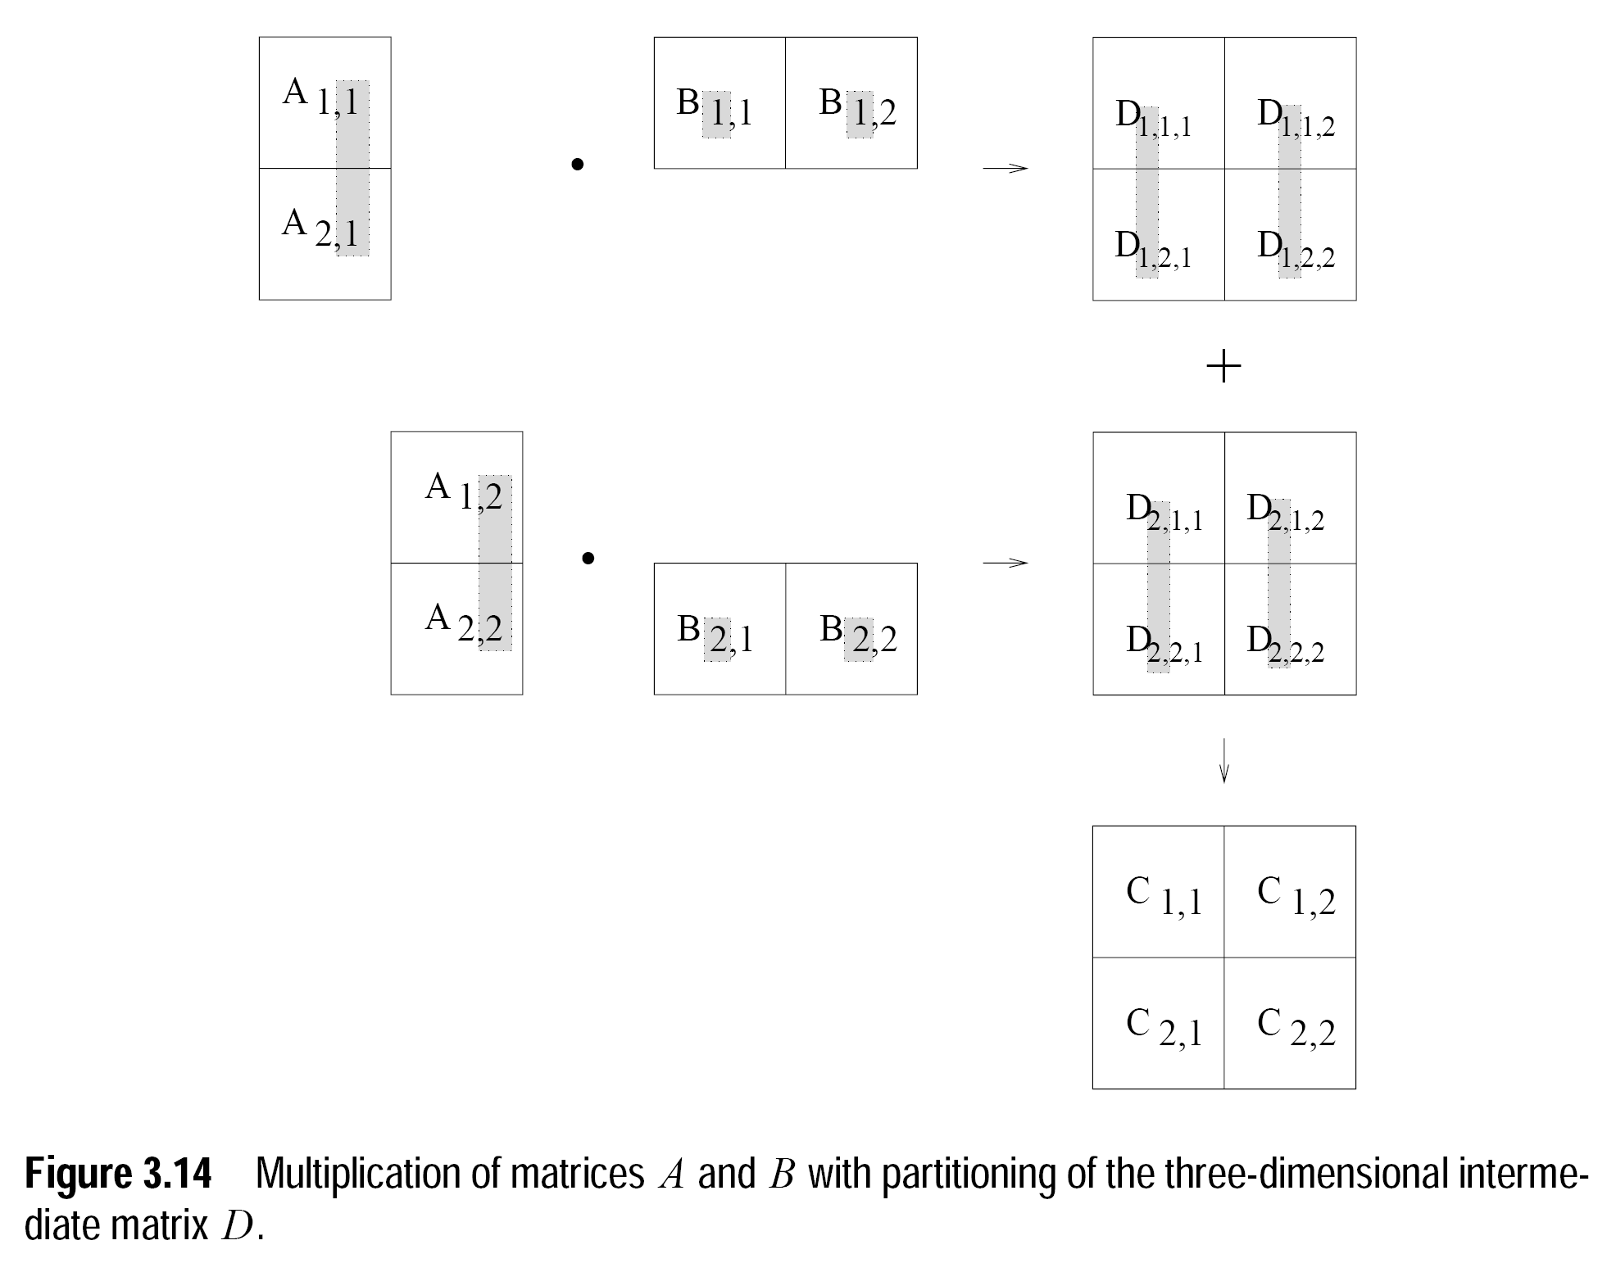

Slide 22
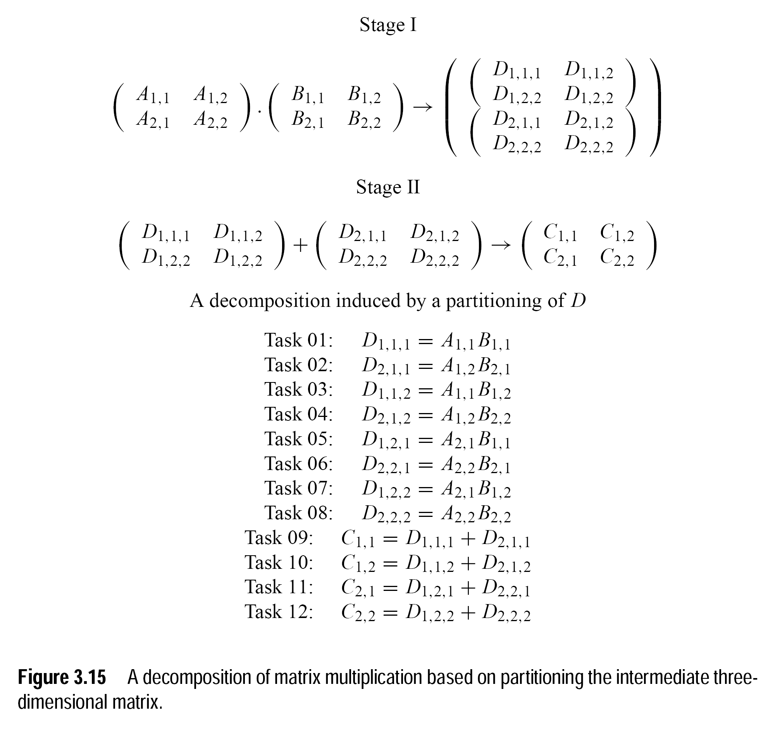

Slide 23
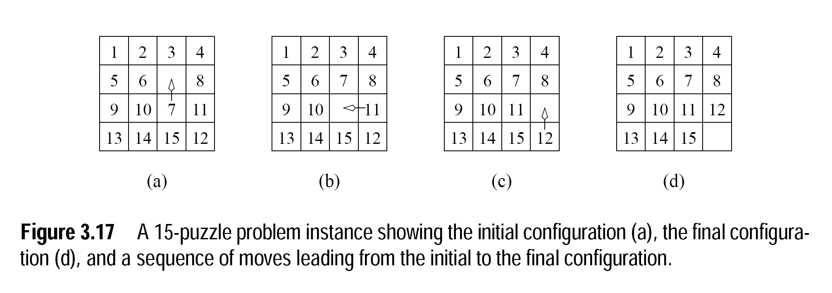

Slide 24
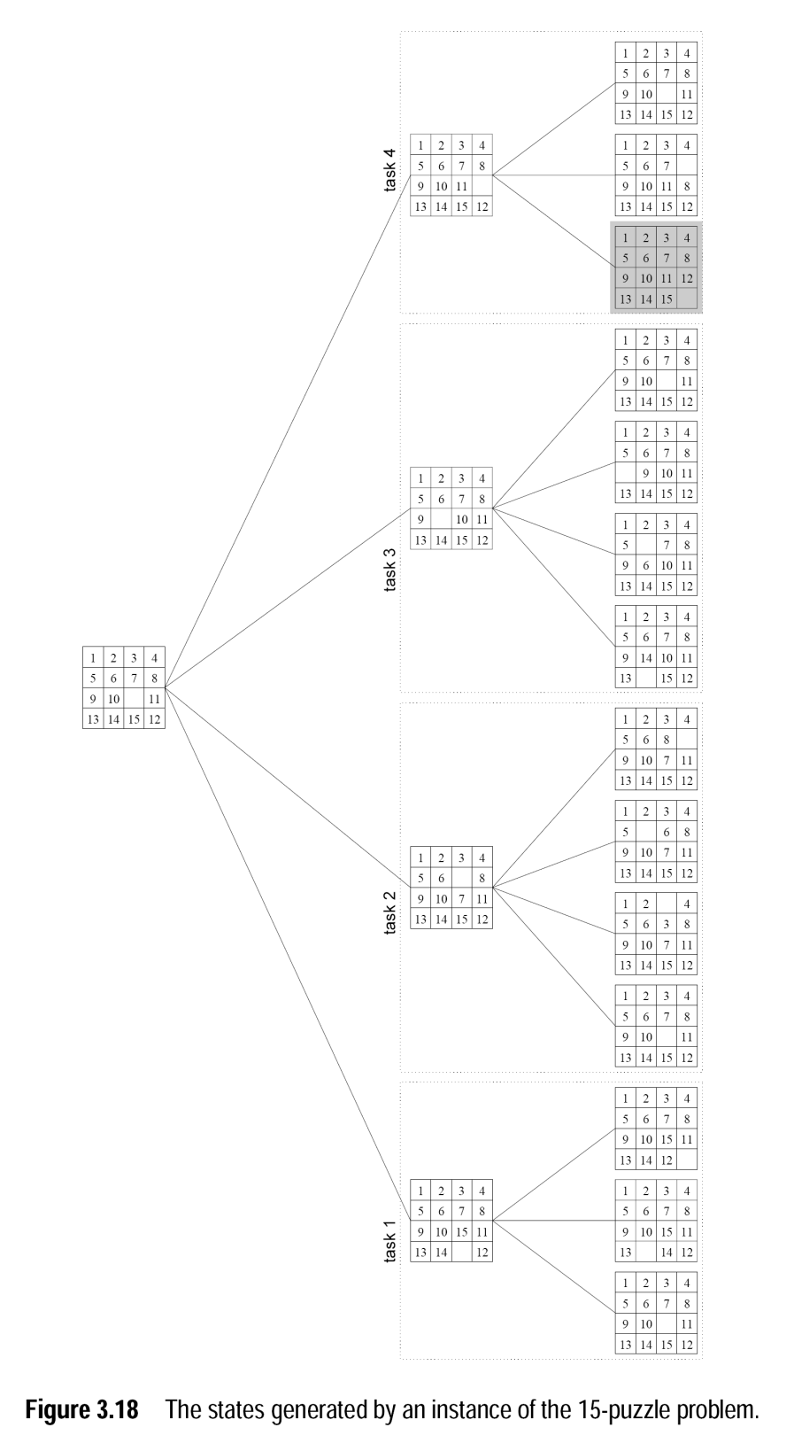

Slide 25
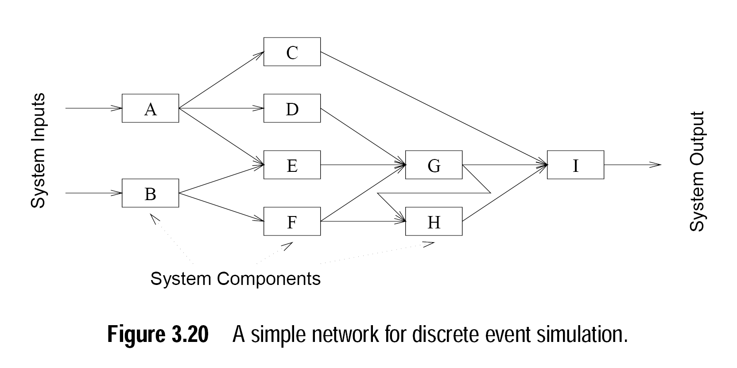

Slide 26
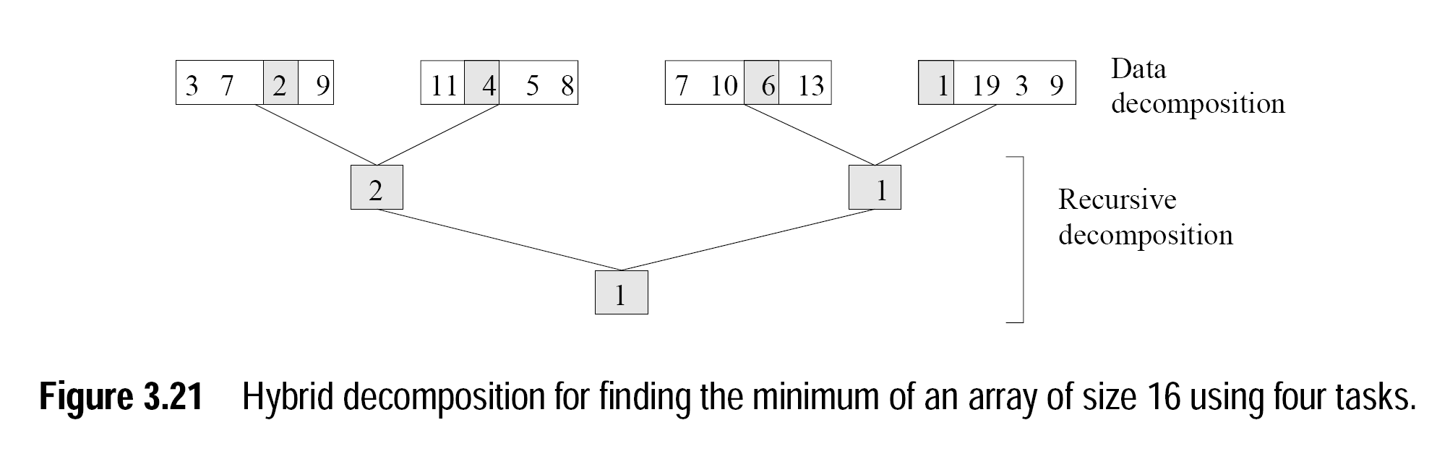

Slide 27
Characteristics of Tasks and Interactions
Task Generation
Task Sizes
Knowledge of Task Sizes
Size of Data Associated with Tasks

Slide 28
Characteristics of Tasks and Interactions
The tasks which constitutes parallel algorithms could be generated either statically or dynamically.
Static task generation represents all tasks are known before execution. Example: Matrix multiplication
Dynamic task generation indicates the actual tasks and dependencies are not known priori. Example: Quick sort
Exploratory decomposition could formulate tasks either statically or dynamically
Task size is the relative time required for completing a task

Slide 29
Continued…
The tasks are said to be uniform if all requires roughly the same time to complete Example: Matrix multiplication
The tasks are said to be non-uniform if the task time varies significantly. Example: Quick sort
Knowledge of task sizes indicates the choice of mapping scheme based on knowledge of task size. If the tasks size is known, it could be utilized for mapping tasks to processes.
Size of data associated with tasks is an important criteria for mapping the associated data with task. The size and location of the data decides data-movement overheads

Slide 30
Characteristics of Inter-task interactions
Static Vs Dynamic:
Classification based on interaction pattern
Programming could be done using message passing paradigm
Dynamic interactions are harder to program
Regular Vs Irregular
Classification based on spatial structure
A pattern is regular if it needs some structure to be exploited for efficient implementation
A pattern is irregular if no regular pattern exists

Slide 31
Continued…
Read-only Vs Read-write:
In read-only interactions, the tasks require read –access for the data to be shared among various concurrent tasks
Example: In matrix multiplication, the tasks need to read the shared input matrices A and B.
In read-write interactions, multiple tasks will be waiting to read and write on the same shared input data.
One Way Vs Two way:
The two way interactions involves the producer and consumer tasks and the communication is two way.
If only a pair of communicating tasks both initiates and completes the interaction without disturbing other one, then it is called as one way.

Slide 32
Parallel algorithm models
The data parallel model
Task graph model
The work pool model
Pipelining or producer-consumer model

Slide 33
Data-parallel model
The tasks are mapped either statically or semi-statically into processes and each task performs similar operations on different data
The result of identical operations applied on concurrently various data items is represented as data parallelism
The data operates on various phases will be different
It could be implemented in either in shared model or message passing model
Interaction overheads in this model could be reduced by choosing a locality preserving decomposition through overlapping of computation and interaction

Slide 34
Task graph model
The inter dependencies and relationships between various tasks are utilized for promoting locality or for reducing the interaction costs
This model would be appropriate if the amount of data associated with tasks is large when compared with the amount of related computation.
In general, the task mapping is done statically for optimizing cost of data movement
In few scenarios, decentralized dynamic mapping is adopted
This type of parallelism expressed by independent tasks in a task dependency graph is represented as task level parallelism

Slide 35
The work pool model
This model is characterized by the dynamic mapping of tasks into processes to carry out load balancing
There is no desired pre-mapping
The mapping could follow either centralized or de-centralized fashion
The task pointers are stored in list, priority queue, hash table ,tree or any physically distributed data structure.
The processes may generate work and add it to the global work pool
Eg: Parallelization of loops through chunk scheduling

Slide 36
Master-Slave Model
One or more process generate work and allocate it to worker processes.
If the size of tasks could be estimated priori, tasks could be allocated or a random mapping could be done for load balancing.
At different times, the workers will be assigned with smaller pieces of work.
Synchronization between workers is done through the manager
This could be viewed as hierarchical or multi-level manager worker model in which the top level is responsible for providing input chunks to the second level where it is further sub divided.

Slide 37
Pipelining or producer-consumer model
A stream of data is passed through various processors with tasks assigned to each of it.
The concurrent execution of different programs on a data stream is called stream parallelism
Load balancing is a function of task granularity
If the granularity is large, the time taken is more to fill the pipeline
If the granularity is small, the interaction overheads increases as the tasks need to interact even for small pieces of computation.

