Slide 1
System Models
Notes:
Dr. Almetwally Mostafa

Slide 2
Overview
Distributed System Models
Distributed System Software Layers
Distributed System Architectures.
Client-Server Model Variations.
Distributed Processes Interfaces and Objects.
Distributed Architectures Design Requirements.
Fundamental Models:
  Interaction Model.
  Failure Model.
  Security Model.

Slide 3
Distributed System Models
Architectural models:
  Define the way in which the components of systems are:
    Interact with one another, and
    Mapped onto an underlying network of computers.
  Describe the layered structure of distributed system software.
Fundamental models:
  Concerned with properties that are common in all of the architectural models.
  Addressed by three models:
    The interaction model: deals with the difficulty of setting time limits.
    The failure model: attempts to give a specification of the exhibited faults by processes and communication channels.
    The security model: discusses possible threats to processes and communication channels.

Slide 4
Software Layers
In the layered view of a system each layer offers its services to the level above and builds its own service on the services of the layer below.
Software architecture is the structuring of software in terms of layers (modules) or services that can be requested locally or remotely.
Applications
Middleware
Operating system
Platform
Computer and network hardware

Slide 5
Software Layers
Platform:
  Lowest-level layers that provide services to other higher layers.
  bring a system’s programming interface for communication and coordination between processes .
  Examples:
    Pentium processor / Linux
    SPARC processor / Solaris
Middleware:
  Layer of software to mask heterogeneity and provide a unified distributed programming interface to application programmers.
  Provide services, infrastructure services, for use by application programs.
  Examples:
    Object Management Group’s Common Object Request Broker Architecture (CORBA).
    Java Remote Object Invocation (RMI).
    Microsoft’s Distributed Common Object Model (DCOM).
Notes:
Dr. Almetwally Mostafa

Slide 6
System Architectures
The architecture include:
  The division of responsibilities between system components.
  The placement of the components on computers in the network.
Client-server model:
  Most important and most widely distributed system architecture.
  Client and server roles are assigned and changeable.
    Servers may in turn be clients of other servers.
  Services may be implemented as several interacting processes in different host computers to provide a service to client processes:
    Servers partition the set of objects on which the service is based and distribute them among themselves (e.g. Web data and web servers)
    Servers maintain replicated copies of the service objects on several hosts for reliability and performance (e.g. AltaVista)

Slide 7
System Architectures
Client
invocation
invocation
Server
result
result
Server
Client
Key:
Process:
Computer:
Clients invoke individual servers

Slide 8
System Architectures
Service
Server
Client
Server
Client
Server
A service provided by multiple servers

Slide 9
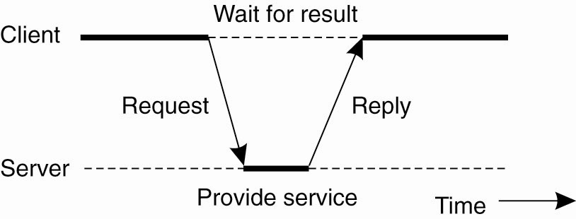
Centralized Architectures
General interaction between a client and a server.
Notes:
Dr. Almetwally Mostafa

Slide 10
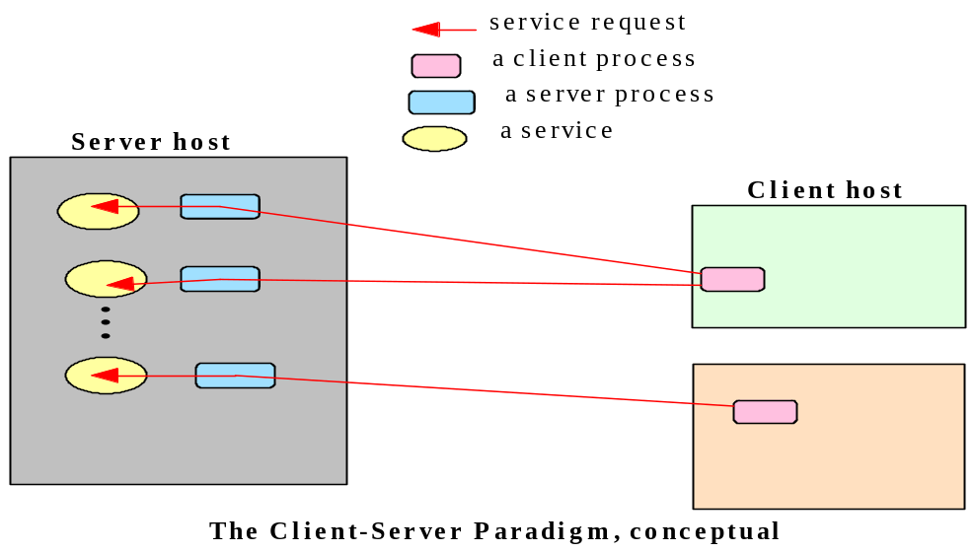
The Client-Server Paradigm
Perhaps the best known paradigm for network applications, the client-server model assigns asymmetric roles to two collaborating processes.
One process, the server, plays the role of a service provider which waits passively for the arrival of requests. The other, the client, issues specific requests to the server and awaits its response.

Slide 11
The Client-Server Paradigm - 2
Simple in concept, the client-server model provides an efficient abstraction for the delivery of network services.
Operations required include those for a server process to listen and to accept requests, and for a client process to issue requests and accept responses.
By assigning asymmetric roles to the two sides, event synchronization is simplified: the server process waits for requests, and the client in turn waits for responses.
Many Internet services are client-server applications. These services are often known by the protocol that the application implements. Well known Internet services include HTTP, FTP, DNS, finger, etc.

Slide 12
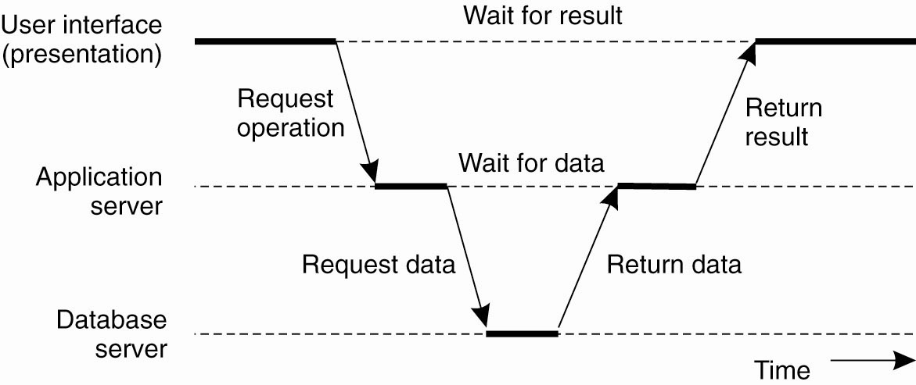
Multi-tiered Architectures
Notes:
Dr. Almetwally Mostafa

Slide 13
System Architectures
Caches and proxy servers:
  Cache:
    A store of recently used data objects that is closer to the client process than those remote objects.
    When an object is needed by a client process the caching service checks the cache and supplies the object from there in case of an up-to-date copy is available.
  Proxy server:
    Provides a shared cache of web resources for client machines at a site or across several sites.
    Increase availability and performance of a service by reducing load on the WAN and web servers.
    May be used to access remote web servers through a firewall.

Slide 14
System Architectures
Client
Web
server
Proxy
server
Client
Web
server
Web proxy server

Slide 15
System Architectures
Peer processes:
  All processes play similar roles without destination as a client or a server.
  Interacting cooperatively to perform a distributed activity.
  Communications pattern will depend on application requirements.
Application
Coordination
code
Application
Coordination
code
Application
Coordination
code
A distributed application based on peer processes

Slide 16
Client-server Model Variations
(Mobile Code)
Example: Java applets
  The user running a browser selects a link to an applets whose code is stored on a web server.
  The code is downloaded to the browser and runs there.
Advantage:
  Good interactive response.
  Does not suffer from the delays or variability of bandwidth associated with network communication.
Disadvantage:
  Security threat to the local resources in the destination computer.

Slide 17
Client-server Model Variations
(Mobile Code)
a) client request results in the downloading of applet code
Client
Web
Applet code
server
b) client interacts with the applet
Web
Client
Applet
server
Web applets

Slide 18
Client-server Model Variations
(Mobile Agents)
A running program (including both code and data) that travels from one computer to another in a network carrying out a task on someone’s behalf.
Can make many invocations to local resources at each visited site.
Visited sites must decide which local resources are allowed to use based on the identity of the user owning the agent.
Advantage: Reduce communication cost and time by replacing remote invocation with local ones.
Disadvantages:
  Limited applicability.
  Security threat of the visited sites resources.

Slide 19
Client-server Model Variations
(Network Computers)
Downloads its operating system and any applications needed by the user from a remote file server.
Applications run locally but files are managed by a remote file server.
Users can migrate from one network computer to another.
Its processor and memory capacities can be restricted to reduce its cost.
Its disk (if included) holds only a minimum of software and use the reminder space as cache storage to hold copies of the most recently software and data files loaded from servers.

Slide 20
Client-server Model Variations
(Thin Clients)
Software layer that supports a window-based user interface on a local computer while executing application programs on a remote computer.
Same as the network computer scheme but instead of downloading the applications code into the user’s computer, it runs them on a server machine, compute server.
Compute server is a powerful computer that has the capacity to run large numbers of applications simultaneously.
Disadvantage: Increasing of the delays in highly interactive graphical applications

Slide 21
Client-server Model Variations
(Thin Clients)
Compute server
Network computer or PC
Thin
network
Application
Client
Process
Thin clients and compute servers

Slide 22
The Peer-to-Peer System Architecture
In system architecture and networks, peer-to-peer is an architecture where computer resources and services are direct exchanged between computer systems.
These resources and services include the exchange of information, processing cycles, cache storage, and disk storage for files..
In such an architecture, computers that have traditionally been used solely as clients communicate directly among themselves and can act as both clients and servers, assuming whatever role is most efficient for the network.

Slide 23
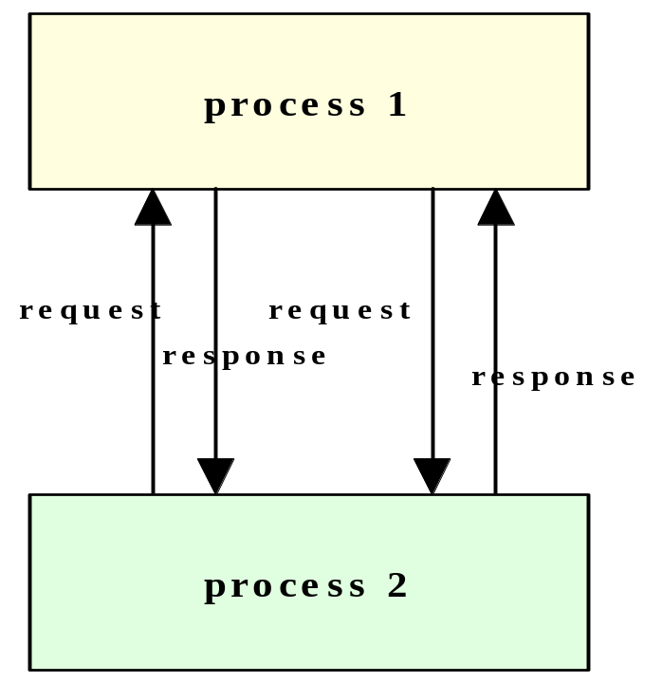
The Peer-to-Peer Distributed Computing Paradigm
In the peer-to-peer paradigm, the participating processes play equal roles, with equivalent capabilities and responsibilities (hence the term “peer”). Each participant may issue a request to another participant and receive a response.

Slide 24
Interfaces and Objects
Interface definitions specify the set of functions available for invocation in a server processes.
In OO paradigm, distributed processes can be constructed as objects whose methods can be accessed by remote invocation (COBRA approach).
Many objects can be encapsulated in server or peer processes.
Number, types, and locations (in some implementation) of objects may change dynamically as system activates require.
Therefore, new services can be instantiated and immediately be made available for invocation.

Slide 25
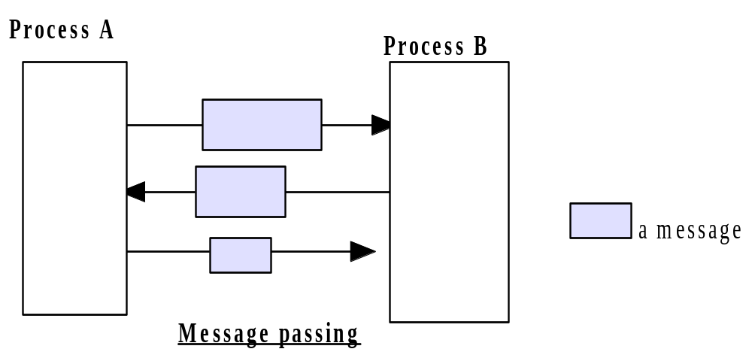
The Message Passing Paradigm
Message passing is the most fundamental paradigm for distributed applications.
A process sends a message representing a request.
The message is delivered to a receiver, which processes the request and sends a message in response.
In turn, the reply may trigger a further request, which leads to a subsequent reply and so forth.

Slide 26
The Message Passing Paradigm
The basic operations required to support the basic message passing paradigm are send and receive.
For connection-oriented communication, the operations connect and disconnect are also required.
With the abstraction provided by this model, the interconnected processes perform input and output to each other, in a manner similar to file I/O. The I/O operations encapsulate the detail of network communication at the operating-system level.
The socket application programming interface is based on this paradigm.
  http://www.sockets.com/

Slide 27
Architectures Design Requirements
Performance Issues:
  Considered under the following factors:
    Responsiveness:
      Fast and consistent response time is important for the users of interactive applications.
      Response speed is determined by the load and performance of the server and the network and the delay in all the involved software components.
      System must be composed of relatively few software layers and small quantities of transferred data to achieve good response times.
    Throughput:
      The rate at which work is done for all users in a distributed system.
    Load balancing:
      Enable applications and service processes to proceed concurrently without competing for the same resources.
      Exploit available processing resources.

Slide 28
Architectures Design Requirements
Quality of Service:
  Main system properties that affect the service quality are:
    Reliability: related to failure fundamental model.
    Performance: ability to meet timeliness guarantees.
    Security: related to security fundamental model.
    Adaptability: ability to meet changing resource availability and system configurations.
Dependability issues:
  A requirement in most application domains.
  Achieved by:
    Fault tolerance: continuing to function in the presence of failures.
    Security: locate sensitive data only in secure computers.

Slide 29
Fundamental Models
(Interaction Model)
Distributed systems consists of multiple interacting processes with private set of data that can access.
Distributed processes behavior is described by distributed algorithms.
Distributed algorithms define the steps to be taken by each process in the system including the transmission of messages between them.
Transmitted messages transfer information between these processes and coordinate their ordering and synchronization activities.

Slide 30
Fundamental Models
(Interaction Model)
Interacting processes in a distributed system are affected by two significant factors:
  Performance of communication channels: is characterized by:
    Latency: delay between sending and receipt of a message including
      Network access time.
      Time for first bit transmitted through a network to reach its destination.
      Processing time within the sending and receiving processes.
    Throughput: number of units (e.g., packets) delivered per time unit.
    Bandwidth: total amount of information transmitted per time unit.
    Jitter: variation in the time taken to deliver multiple messages of the same type (relevant to multimedia data).

Slide 31
Fundamental Models
(Interaction Model)
  Computer clocks:
    Each computer in a distributed system has its own internal clock to supply the value of the current time to local processes.
    Therefore, two processes running on different computers read their clocks at the same time may take different time values.
    Clock drift rate refers to the relative amount a computer clock differs from a perfect reference clock.
    Several approaches to correcting the times on computer clocks are proposed.
    Clock corrections can be made by sending messages, from a computer has an accurate time to other computers, which will still be affected by network delays.

Slide 32
Fundamental Models
(Interaction Model)
Setting time limits for process execution, as message delivery, in a distributed system is hard.
Two opposing extreme positions provide a pair of simple interaction models:
  Synchronous distributed systems:
    A system in which the following bounds are defined:
      Time to execute each step of a process has known lower and upper bounds.
      Each message transmitted over a channel is received within a known bounded time.
      Each process has a local clock whose drift rate from perfect time has a known bound.
    Easier to handle, but determining realistic bounds can be hard.

Slide 33
Fundamental Models
(Interaction Model)
  Asynchronous distributed systems:
    A system in which there are no bounds on:
      process execution times.
      message delivery times.
      clock drift rate.
    Allows no assumptions about the time intervals involved in any execution.
    Exactly models the Internet.
      Browsers are designed to allow users to do other things while they are waiting.

Slide 34
Fundamental Models
(Interaction Model)
Event ordering: when need to know if an event at one process (sending or receiving a message) occurred before, after, or concurrently with another event at another process.
It is impossible for any process in a distributed system to have a view on the current global state of the system.
The execution of a system can be described in terms of events and their ordering despite the lack of accurate clocks.
Logical clocks define some event order based on causality.
Logical time can be used to provide ordering among events in different computers in a distributed system (since real clocks cannot be synchronized).

Slide 35
Fundamental Models
(Failure Model)
Defines the ways in which failure may occur in order to provide an understanding of its effects.
A taxonomy of failures which distinguish between the failures of processes and communication channels is provided:
  Omission failures
    Process or channel failed to do something.
  Arbitrary failures
    Any type of error can occur in processes or channels (worst).
  Timing failures
    Applicable only to synchronous distributed systems where time limits may not be met.

Slide 36
Fundamental Models
(Failure Model)
Process p
Process q
send
m
receive
Communication channel
Outgoing message buffer
Incoming message buffer
Processes and channels

Slide 37
Fundamental Models
(Failure Model)
Omission and arbitrary failures
Class of failure
Affects
Description
Fail-stop
Process
Process halts and remains halted. Other processes may
detect this state.
Crash
Process
Process halts and remains halted. Other processes may
not be able to detect this state.
Omission
Channel
A message inserted in an outgoing message buffer never
arrives at the other end’s incoming message buffer.
Send-omission
Process
A process completes a
send,
but the message is not put
in its outgoing message buffer.
Receive-omission
Process
A message is put in a process’s incoming message
buffer, but that process does not receive it.
Arbitrary
Process or
Process/channel exhibits arbitrary behaviour: it may
(Byzantine)
channel
send/transmit arbitrary messages at arbitrary times,
commit omissions; a process may stop or take an
incorrect step.

Slide 38
Fundamental Models
(Failure Model)
Timing failures
Class of Failure
Affects
Description
Clock
Process
Process’s local clock exceeds the bounds on its
rate of drift from real time.
Performance
Process
Process exceeds the bounds on the interval
between two steps.
Performance
Channel
A message’s transmission takes longer than the
stated bound.

Slide 39
Fundamental Models
(Security Model)
Secure processes and channels and protect objects encapsulated against unauthorized access.
Protecting access to objects
  Access rights
  In client server systems: involves authentication of clients.
Protecting processes and interactions
  Threats to processes: problem of unauthenticated requests / replies.
    e.g., "man in the middle"
  Threats to communication channels: enemy may copy, alter or inject messages as they travel across network.
    Use of “secure” channels, based on cryptographic methods.

Slide 40
Fundamental Models
(Security Model)
Access rights
Object
invocation
Client
result
Server
Principal (user)
Network
Principal (server)
Objects and principals

Slide 41
Fundamental Models
(Security Model)
Copy of
m
The enemy
m’
Process
p
m
Process
q
Communication channel
The enemy

Slide 42
Fundamental Models
(Security Model)
Principal
B
Principal
A
Process
p
Secure channel
Process
q
Secure channels

Slide 43
Fundamental Models
(Security Model)
Denial of service
  e.g., “pings” to selected web sites
  Generating debilitating network or server load so that network services become de facto unavailable
Mobile code:
  Requires executability privileges on target machine
  Code may be malicious (e.g., mail worms)

