Slide 1

Module 4: Communication

Slide 2
Contents
Introduction to Distributed Systems
Characterization of Distributed Systems
Distributed Shared Memory Approaches
Message Passing
Programming Using the Message-Passing Paradigm
Group Communication
Case Study (RPC and Java RMI)

Slide 3
Introduction to Distributed Systems

Slide 4
Can you name some examples of distributed systems?
NFS
The internet
DNS
Amazon AWS
Google Cloud Platform

Slide 5
What is Distributed System?
Collection of entities (along with some memory) to work towards a common goal
Distribution is Transparent to the users and appears as one local machine

Slide 6
Generic Components of Distributed System
Computing system
Mostly heterogeneous
Multicore, general purpose / embedded processing, SIMD or MIMD
Communication
LAN, Internet

Slide 7
How is distributed system different from Networked system?
In networked systems, user is aware of individual node, their location and functionality
Distributed system appears as a single machine to the users

Slide 8
Centralized System

Slide 9
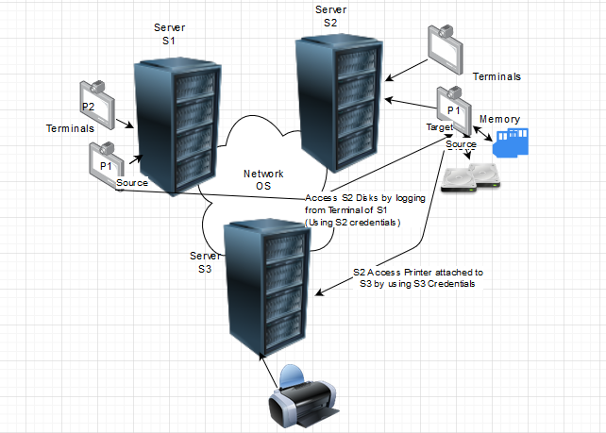
Networked System

Slide 10
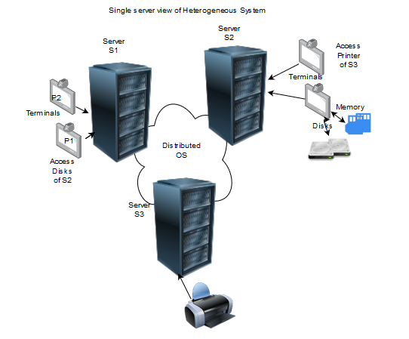
Distributed System

Slide 11
Characterization of Distributed Systems

Slide 12
Three Significant Characteristics
Concurrency
Lack of Global Clock
Independent Failure of Components

Slide 13
Typical Distributed System Design Goals
Heterogeneity
Availability
Scalability
Transparency
Concurrency
Efficiency
Robustness

Slide 14
Other Ideal Characteristics
Efficient Resource Management: Middle ware should manage efficiently heterogeneous systems
Effective Synchronization: Issues in the absence of global clock should be effectively managed
Security
Complexity
Highly variable bandwidth and latency
Openness – Distributed system should be extensible
Transparency
Quality of Service

Slide 15
Trends in Distributed System
Emergence of pervasive technologies – almost always connected
Increased Multimedia support and use
Distributed systems as utility → Cluster, Cloud, Grid

Slide 16
Distributed Shared Memory (DSM) Approaches

Slide 17
How to share data between distributed processor nodes?
Distributed Shared Memory
It’s the abstraction to share data between distributed computers
It enables access across multiple distributed physical memory to be accessed as single shared memory

Slide 18
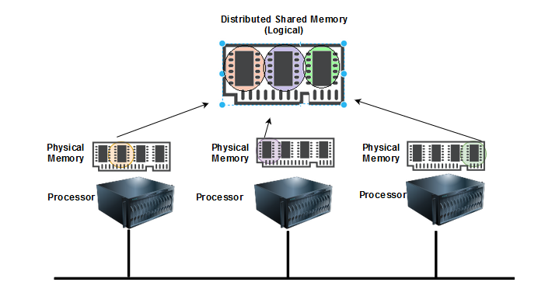
DSM Abstraction

Slide 19
Working of DSM
DSM enables easy access of individual computer shared data items
DSM run time support sends updates as messages between computers
Each computer has a local copy of recently accessed data items stored in DSM

Slide 20
…Continued…
Shared memory request for a non-local piece of data is raised
Single copy of data fetched and given to the requested system
If multiple machines access the data at the same time, synchronization primitive like semaphore is used to handle the situation

Slide 21
…Continued
Read(shared variable)
Write (data, shared variable)

Slide 22
Issues related to DSM Semantics
Structure and granularity – data shared at the bit, word or page level
Consistency – If multiple requests for a single data and each machine tries to update it, consistency should be maintained. This involves cache coherence like solution
Heterogeneity – Accommodating different data representations of different machines, languages and OS
Scalability – Bus latency, Increased broadcast messages

Slide 23
DSM Versus Message Passing
No marshaling of messages in DSM where as messages are marshalled and unmarshalled in message passing
Synchronization in DSM is by constructs like semaphore/locks where as in message passing it is by message passing primitives
DSM→ processes can communicate with non-overlapping lifetimes where as in message passing processes communicate at the same time
Efficiency in DSM heavily depends on the pattern of Data access by multiple machines where as the same is not true for message passing

Slide 24
DSM features
Space- uncoupled
Time – uncoupled
State based service
Used for parallel and distributed computation
Limited scalability
Not associative
Spark Ignite – DSM in memory

Slide 25
Methods of Implementing DSM
Hardware – Cache coherence circuits, network interfaces
Software

Slide 26
Software DSM implementation
There are three ways of implementing a software distributed shared memory:
page based approach using the system’s virtual memory
shared variable approach using some routines to access shared variables
object based approach ideally accessing shared data through object-oriented discipline

Slide 27
Memory Coherence and DSM
Memory coherence is necessary
To track and maintain the state of data blocks in nodes across the memories comprising the system
Directory based coherence

Slide 28
Directory memory coherence
Track at least 3 states
Uncached (U)
Exclusive Owned or Modified Owned (EM)
Shared (S)
Two methods to track the block status
Home-centric request and response
Requester-centric request and response

Slide 29
Home-centric request and response
DSM will avoid having to handle request-response races between nodes by allowing only one transaction to occur at a time until the home node has decided that the transaction is finished

Slide 30
Requester-centric request and response
DSM will allow nodes to talk at will to each other through the home
For example: when one node is processing a block, if it receives a request for that block from another node it will send a NAck (Negative Acknowledgement) to tell the initiator that the processing node can't fulfill that request right away.

Slide 31
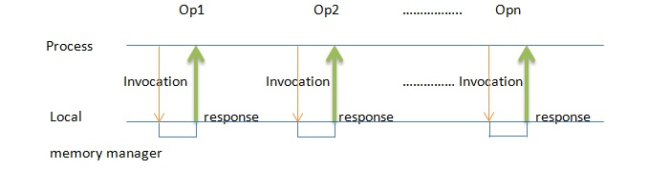
Consistency Models…
DSM must follow certain rules to maintain consistency over how read and write order is viewed among nodes, called the system's consistency model.

Slide 32
…Consistency Models
Memory coherence model defines which interleavings are allowed
Strict Coherence
Read returns value written by the most recent write
All operations are atomically executed
All processors see same order of events equivalent to global timing
Other such protocols also exist. But whatever the case, if si is the number of operations Pi (processor i), then the maximum possible interleavings will be (s1+s2+…Sn)!/s1!s2!...sn!

Slide 33
Replication in DSM
Two types of Algorithms
Read replication
Multiple nodes can read at the same time but only one node can write
Write replication
Multiple nodes can read and write at the same time
Write requests are handled by a sequencer
Replication reduces network traffic, improve parallelism

Slide 34
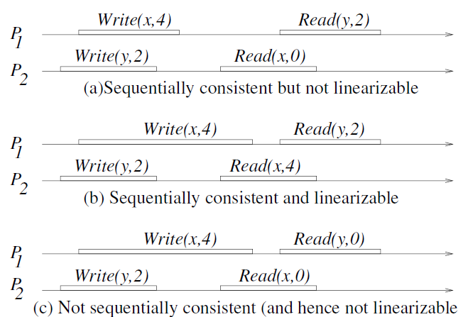
Example

Slide 35
Message Passing & Programming Using the Message-Passing Paradigm

Slide 36
Message Passing Interface (MPI)
Standard API for message passing operations
Includes synchronous and Asynchronous variants
To communicate, one process sends a message (a sequence of bytes) to a destination and another process at the destination receives the message.

Slide 37
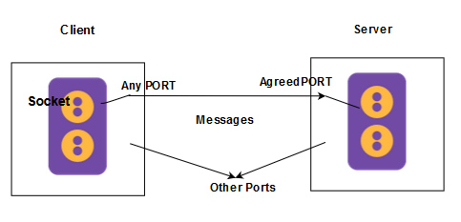
Overview

Slide 38
Synchronous and Asynchronous Message Passing
Queue is associated with each message destination
Sending process adds message to remote queue
Receiving process reads from local queue
Synchronous → Send and receive are blocking
Asynchronous → Send is non-blocking ; Receive can be blocking or non-blocking

Slide 39
External Data Representation
Information stored in processes as data structures
Data structures can be multi dimensional but has to be flattened before communication
Similarly upon receiving has to be rebuilt

Slide 40
Two ways to agree upon the format
Both the machines will follow the same format
Values are transmitted in sender’s format. Along with the values, data format is also sent to the reciever

Slide 41
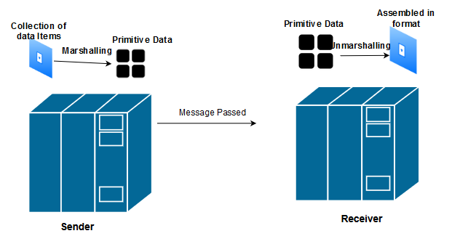
Marshalling
Process of taking collection of data items and assembling them in order to transmit
Unmarshalling is the reverse of marshalling

Slide 42
Simple MPI Program
#include <mpi.h>
#include <stdio.h>
int main(int argc, char** argv) {
// Initialize the MPI environment
MPI_Init(NULL, NULL);
// Get the number of processes
int world_size;
MPI_Comm_size(MPI_COMM_WORLD, &world_size);
// Get the rank of the process
int world_rank;
MPI_Comm_rank(MPI_COMM_WORLD, &world_rank);

Slide 43
…Continued
// Get the name of the processor
char processor_name[MPI_MAX_PROCESSOR_NAME];
int name_len;
MPI_Get_processor_name(processor_name, &name_len);
// Print off a hello world message
printf("Hello world from processor %s, rank %d out of %d processors\n",
processor_name, world_rank, world_size);
// Finalize the MPI environment.
MPI_Finalize();
}

Slide 44
Types of Communication in MPI
Point to Point
Group (or) Collective

Slide 45
Point to Point Communication
MPI_Send()
MPI_Recv()
MPI_Isend()
MPI_Irecv()
MPI_Probe()
MPI_Wait()

Slide 46
Broadcasting with MPI Send and Receive Sample
void my_bcast(void* data, int count, MPI_Datatype datatype, int root, MPI_Comm communicator) {
int world_rank;
MPI_Comm_rank(communicator, &world_rank);
int world_size;
MPI_Comm_size(communicator, &world_size);
if (world_rank == root) {
// If we are the root process, send our data to everyone
int i;
for (i = 0; i < world_size; i++) {
if (i != world_rank) {
MPI_Send(data, count, datatype, i, 0, communicator);
}
}
} else {
// If we are a receiver process, receive the data from the root
MPI_Recv(data, count, datatype, root, 0, communicator,
MPI_STATUS_IGNORE);
}
}

Slide 47
Compare MPI_Bcast and MPI send, receive (Complete the code)
for (i = 0; i < num_trials; i++) {
// Time my_bcast
// Synchronize before starting timing
MPI_Barrier(MPI_COMM_WORLD);
total_my_bcast_time -= MPI_Wtime();
my_bcast(data, num_elements, MPI_INT, 0, MPI_COMM_WORLD);
// Synchronize again before obtaining final time
MPI_Barrier(MPI_COMM_WORLD);
total_my_bcast_time += MPI_Wtime();
// Time MPI_Bcast
MPI_Barrier(MPI_COMM_WORLD);
total_mpi_bcast_time -= MPI_Wtime();
MPI_Bcast(data, num_elements, MPI_INT, 0, MPI_COMM_WORLD);
MPI_Barrier(MPI_COMM_WORLD);
total_mpi_bcast_time += MPI_Wtime();
}

Slide 48
MPI Non Blocked Point to Point Communication
MPI_Isend and MPI_Irecv will not wait for the buffer data to be copied
It will attach a pointer to the message transfer and immediately return
Use MPI_Wait to ensure proper communication between send and receive

Slide 49
Sample
#include "mpi.h"
#include <stdio.h>
int main(int argc, char *argv[])
{
int myid, numprocs, left, right;
int buffer[10], buffer2[10];
MPI_Request request, request2;
MPI_Status status;
MPI_Init(&argc,&argv);
MPI_Comm_size(MPI_COMM_WORLD, &numprocs);
MPI_Comm_rank(MPI_COMM_WORLD, &myid);
right = (myid + 1) % numprocs;
left = myid - 1;
if (left < 0)
left = numprocs - 1;
MPI_Irecv(buffer, 10, MPI_INT, left, 123, MPI_COMM_WORLD, &request);
MPI_Isend(buffer2, 10, MPI_INT, right, 123, MPI_COMM_WORLD, &request2);
MPI_Wait(&request, &status);
MPI_Wait(&request2, &status);
MPI_Finalize();
return 0;
}

Slide 50
MPI Collective Communications
MPI_BCAST
MPI_BARRIER
MPI_SCATTER
MPI_GATHER

Slide 51
MPI_BCAST
Main()
{
….
data =1;
MPI_Bcast(data, num_elements, MPI_INT, 0, MPI_COMM_WORLD);
//print the value of data inside a if condition that checks the rank (other than the root)
}

Slide 52
MPI_Scatter
Designated root process sending data to all processes in a communicator
MPI_Bcast → Same data
MPI_Scatter → chunk of data from different processes

Slide 53
Syntax
MPI_Scatter( void* send_data, int send_count, MPI_Datatype send_datatype, void* recv_data, int recv_count, MPI_Datatype recv_datatype, int root, MPI_Comm communicator);

Slide 54
Example: Root process generates random numbers and scatters it among multiple slaves
float create_rand_nums(int n)
{
float *rnd=(float *) malloc(sizeof(float)*n);
for i= 0 to n
{
rnd[i]=rand();
}
return rnd;
}

Slide 55
…Continued
Main()
{
….
int id;
int p;
MPI_Comm_rank(MPI_COMM_WORLD, &id);
MPI_Comm_size(MPI_COMM_WORLD, &p);
float *rand_nums = NULL;
if (id== 0) {
rand_nums = create_rand_nums(int *p);
}
float *sub_rand_nums = (float *)malloc(sizeof(float) * p);
MPI_Scatter(rand_nums, num_elements_per_proc, MPI_FLOAT, sub_rand_nums, 1, MPI_FLOAT, 0, MPI_COMM_WORLD);
…..
}

Slide 56
MPI_Gather
MPI_Gather( void* send_data, int send_count, MPI_Datatype send_datatype, void* recv_data, int recv_count, MPI_Datatype recv_datatype, int root, MPI_Comm communicator);

Slide 57
MPI_AllGather
It is MPI_Gather followed by MPI_Bcast

Slide 58
Case Study (RPC and Java RMI)

Slide 59
RMI
The RMI (Remote Method Invocation) is an API that provides a mechanism to create distributed application in java.
The RMI allows an object to invoke methods on an object running in another JVM.
The RMI provides remote communication between the applications using two objects stub and skeleton.

Slide 60
…Continued…
A remote object is an object whose method can be invoked from another JVM.
stub
The stub is an object, acts as a gateway for the client side.
All the outgoing requests are routed through it.
It resides at the client side and represents the remote object.

Slide 61
What happens when the caller invokes method on the stub object?
It initiates a connection with remote Virtual Machine (JVM),
It writes and transmits (marshals) the parameters to the remote Virtual Machine (JVM),
It waits for the result
It reads (unmarshals) the return value or exception, and
It finally, returns the value to the caller.

Slide 62
skeleton
The skeleton is an object, acts as a gateway for the server side object.
All the incoming requests are routed through it.

Slide 63
Upon receiving the incoming request
It reads the parameter for the remote method
It invokes the method on the actual remote object, and
It writes and transmits (marshals) the result to the caller.

Slide 64
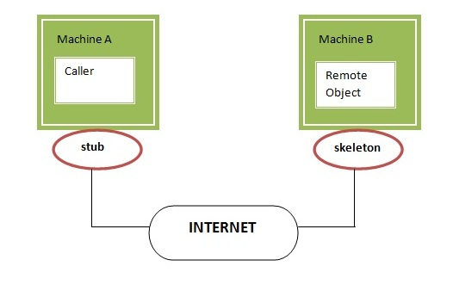
…Continued…

Slide 65
Distributed applications Requirements
If any application performs these tasks, it can be distributed application.
The application need to locate the remote method
It need to provide the communication with the remote objects, and
The application need to load the class definitions for the objects.
The RMI application have all these features, so it is called the distributed application.

Slide 66
Java RMI Example
6 steps to write the RMI program
Create the remote interface
Provide the implementation of the remote interface
Compile the implementation class and create the stub and skeleton objects using the rmic tool
Start the registry service by rmiregistry tool
Create and start the remote application
Create and start the client application

Slide 67
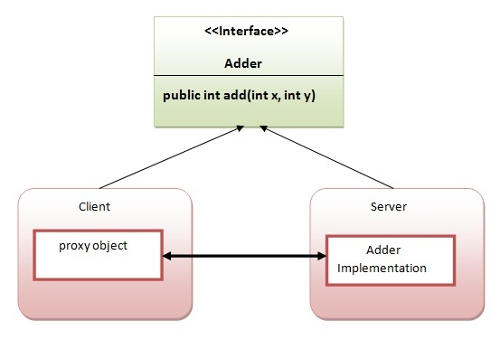
The client application need only two files, remote interface and client application. In the rmi application, both client and server interacts with the remote interface. The client application invokes methods on the proxy object, RMI sends the request to the remote JVM. The return value is sent back to the proxy object and then to the client application.

Slide 68
1) create the remote interface
import java.rmi.*;
public interface Adder extends Remote
{
public int add(int x,int y)throws RemoteException;
}

Slide 69
2) Provide the implementation of the remote interface
import java.rmi.*;
import java.rmi.server.*;
public class AdderRemote extends UnicastRemoteObject implements Adder{
AdderRemote()throws RemoteException{
super();
}
public int add(int x,int y){return x+y;}
}

Slide 70
3) create the stub and skeleton objects using the rmic tool.
The rmic tool invokes the RMI compiler and creates stub and skeleton objects.
rmic AdderRemote

Slide 71
4) Start the registry service by the rmiregistry tool
start the registry service by using the rmiregistry tool.
rmiregistry 5000
5000 – port number

Slide 72
5) Create and run the server application
import java.rmi.*;
import java.rmi.registry.*;
public class MyServer{
public static void main(String args[]){
try{
Adder stub=new AdderRemote();
Naming.rebind("rmi://localhost:5000/sonoo",stub);
}catch(Exception e){System.out.println(e);}
}
}

Slide 73
6) Create and run the client application
import java.rmi.*;
public class MyClient{
public static void main(String args[]){
try{
Adder stub=(Adder)Naming.lookup("rmi://localhost:5000/sonoo");
System.out.println(stub.add(34,4));
}catch(Exception e){}
}
}

