Slide 1
Parallel Algorithm Design

Slide 2
Task/ Channel Model
Represents parallel computation as a set of tasks that may interact with each other by sending messages
Task → A program, its local memory and collection of I/O ports

Slide 3
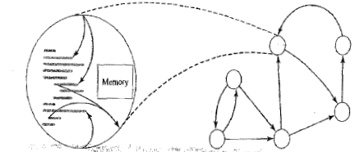
Parallel tasks and memory viewed as Directed Graph

Slide 4
Continued..
Task Channel Model
  Receiving Synchronous
  Sending Asychronous

Slide 5
Foster’s Design Methodology
Partitioning
Communication
Agglomeration
Mapping & Analysis

Slide 6
Partitioning
  Domain Decomposition
    With respect to domain
  Functional Decomposition
    With respect to functionality (computation)

Slide 7
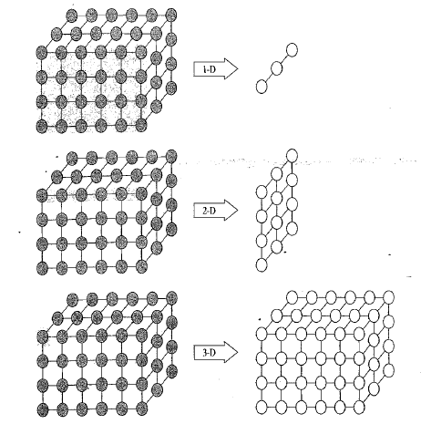
Domain Decomposistion

Slide 8
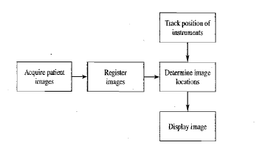
Functional Decomposition

Slide 9
Ideal Partitioning
There are at least an order of magnitude more primitive tasks than processors in the target parallel computer.
Redundant computations and redundant data structure storage are minimized.
Primitive tasks are roughly the same size.
The number of tasks is an increasing function of the problem size.

Slide 10
Communication
Two Patterns
  Local
    When a task needs values from a small number of other tasks in order to perform a computation, we create channels from the tasks supplying the data to the task consuming the data.
  Global
    When a significant number of the primitive tasks must contribute data in order to perform a computation

Slide 11
Continued…
Communication among tasks is part of the overhead of a parallel algorithm, because it is something the sequential algorithm does not need to do.

Slide 12
Ideal Communication
The communication operations are balanced among the tasks.
Each task communicates with only a small number of neighbours.
Tasks can perform their communications concurrently.
Tasks can perform their computations concurrently.

Slide 13
Agglomeration
Agglomeration is the process of grouping tasks into larger tasks in order to improve performance or simplify programming.
  Reduce Communication Overhead
  Maintain Scalability

Slide 14
Ideal Agglomeration
The agglomeration has increased the locality of the parallel algorithm.
Replicated computations take less time than the communications they replace.
The amount of replicated data is small enough to allow the algorithm to scale.
Agglomerated tasks have similar computational and communications costs.

Slide 15
…Continued..
The number of tasks is an increasing function of the problem size.
The number of tasks is as small as possible, yet at least as great as the number of processors in the likely target computers.
The trade-off between the chosen agglomeration and the cost of modifications to existing sequential code is reasonable.

Slide 16
Mapping
Mapping is the process of assigning tasks to processors.
The goals of mapping are to maximize processor utilization and minimize inter processor communication
Processor utilization is the average percentage of time the system's processors are actively executing tasks necessary for the solution of the problem

Slide 17
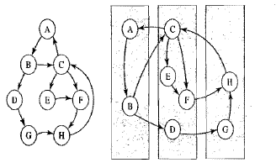
Continue…

Slide 18
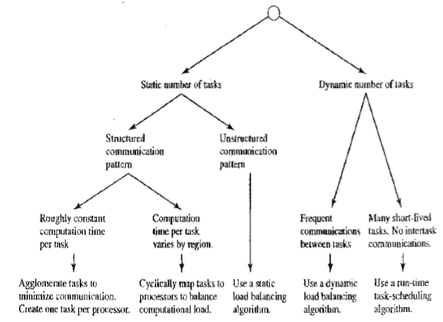
Decision tree to choose mapping strategy

Slide 19
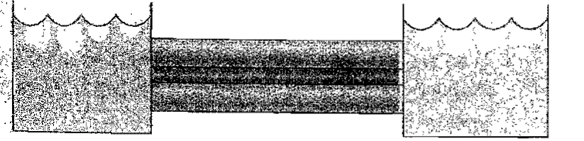
Boundary Value Problem
Finding the temperature of the Rod (thin rod insulated by thermal insulators)

Slide 20
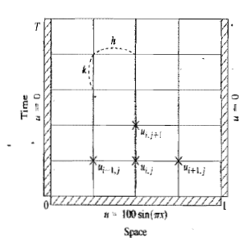
Continued…
Divide rod into parts and measure temperature of each part (n parts) of the rod in ‘m’ iterations

Slide 21
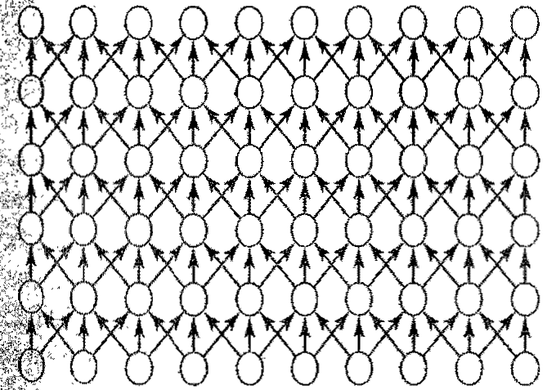
Continued…
Partitioning
  One primitive task with each grid point
Communication

Slide 22
Continued…
Agglomeration and Mapping
  Even if enough processors were available, it would be impossible to compute every task concurrently
  There is no point in maintaining the illusion of multiple tasks when they must be performed sequentially
  Combining tasks row wise may not be meaningful → So agglomerate tasks column wise

Slide 23

Continued….
Agglomerated tasks
Each agglomerated task can be mapped to a node

Slide 24
Analysis
Computing Time
  m(n-1)X → serial algorithm
    X → Computation time
  Parallel Algorithm
    m[(n-1)/p]X + λ

Slide 25
FINDING THE MAXIMUM
Partitioning
  The list has n values, let's divide it into n pieces
  Our goal is to find the sum of all n values

Slide 26
Continued…
Communication
  In order to compute the sum, we must set up channels between the tasks
  A channel from task A to task B allows task B to compute the sum of the values held by the two tasks.

Slide 27

Continued…
At the end of the computation we want one task to have the grand total → Let’s say it is done by root task
If it takes λ time for a task to communicate a value to another task and X time to perform an addition, then this first parallel algorithm requires time
  (n - 1)(λ +X)

Slide 28
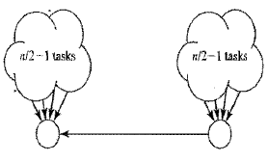
Continued…
What if two tasks cooperated to perform the reduction?
Let's-have two semi-root tasks, each responsible for n/2 of the elements

Slide 29
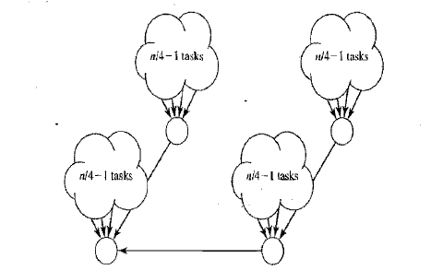
Continued…

Slide 30
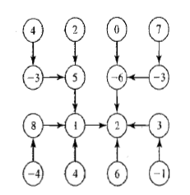
Continued…
Binomial Tree
  Tree with n=2^{k} nodes

Slide 31
Continued…
What if the number of tasks is not a power of 2?

Slide 32
Continued…
Agglomeration and Mapping
(n/p – 1)X + log p(λ +X)

Slide 33
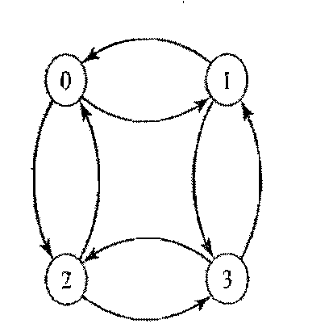
N-Body Problem

Slide 34
Continued…
Communication Steps → Log p
Length of messages →
  n/p
  2n/p …

Slide 35
Analysis
Since messages of different sizes, cannot expect the same time for transmitting them
Let λ → Time needed to initiate the message
β → number of data items that can be sent down a channel in one unit of time
So sending a message containing ‘n’ data items require,
λ + n / β

Slide 36
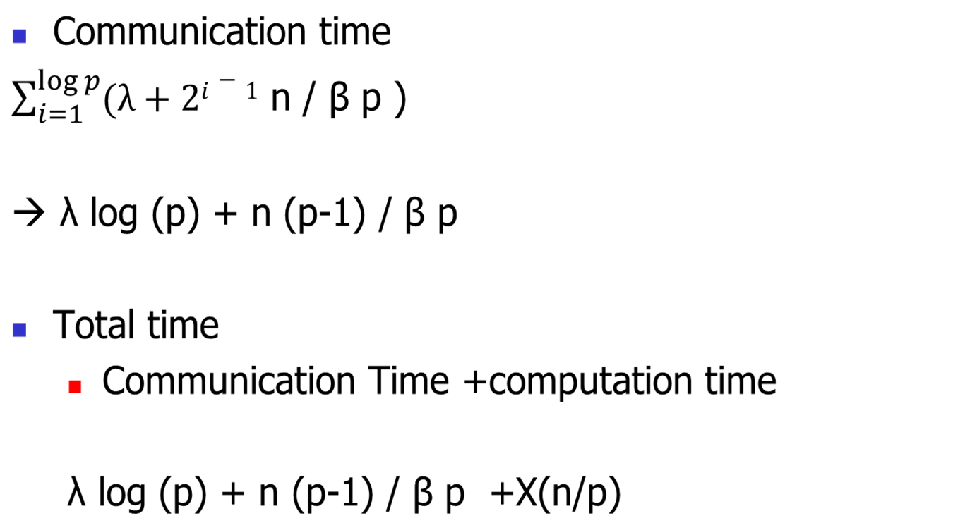
Continued…

Slide 37
Adding Data Input and Output
To augment the time taken for I/O communication

Slide 38
Sample MPI programming
Eg : Circuit Satisfiability
Identify Parallel tasks
  2¹⁶ = 65536

Slide 39
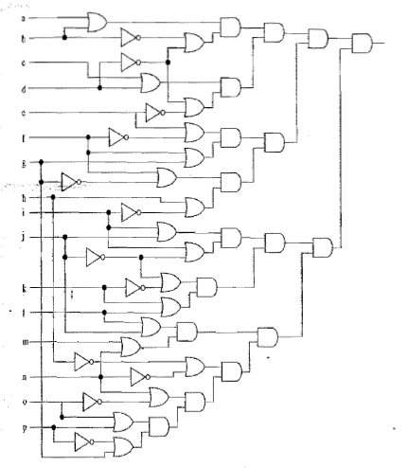

Slide 40
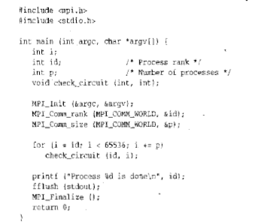

Slide 41
Compiling MPI Programs
mpicc –o output_filename filename.c
Example
mpicc –o hello hello.c

Slide 42
Executing MPI Programs
mpirun –np no.of.processes filename
Example
mpirun –np 4 hello

Slide 43
Collective Communication
What if the total number of satisfiable solutions to be counted?
  Collective Communication :
  A communication operation in which a group of processes works together to distribute or gather together a set of one or more values.
  Reduction is an example of an operation that requires collective communication in a message-passing environment

Slide 44
Continued…
Include an integer variable “solutions”
  Local to each process
Initialize solutions =0
In the for loop include the following
for (i=0 to 65536)
solutions = solutions + checkcircuit(id, i)

Slide 45
Continued…
Now solutions will have number of solutions by each process
To get collective results of all process include a global variable
  Int global_solutions;

Slide 46
Continued…
Use MPI_Reduce to perform the reduction operation on results from different processes

Slide 47
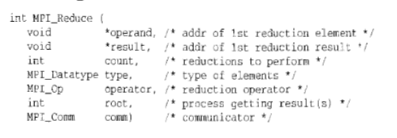
MPI_Reduce

Slide 48
Continued…
MPI_Reduce(&solutions, &global_solutions, 1, MPI_INT, MPI_SUM, 0, COMM_WORLD);

Slide 49
MPI_Wtime and MPI_Wtick
Helps measure elapsed time
Eg:
Double elapsed_time;
….
elapsed_time = -MPI_Wtime();
//Code to measure performance
Elapsed_time += MPI_Wtime();

Slide 50
MPI Collective Communications
Collective communications refer to set of MPI functions that transmit data among all processes specified by a given communicator.
Three general classes
  Barrier
  Global communication (broadcast, gather, scatter)
  Global reduction

Slide 51
Continued….
Collective functions are less flexible than point-to-point in the following ways:
  Amount of data sent must exactly match amount of data specified by receiver
  No tag argument
  Blocking versions only
  Only one mode (analogous to standard)

Slide 52
MPI_Gather
MPI_Gather (void *sendbuf, int sendcount, MPI_Datatype sendtype, void *recvbuf, int recvcount, MPI_Datatype recvtype, int root, MPI_Comm comm)
  IN sendbuf (starting address of send buffer)
  IN sendcount (number of elements in send buffer)
  IN sendtype (type)
  OUT recvbuf (address of receive bufer)
  IN recvcount (n-elements for any single receive)
  IN recvtype (data type of recv buffer elements)
  IN root (rank of receiving process)
  IN comm (communicator)

Slide 53
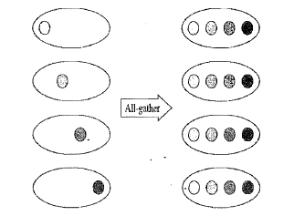

Slide 54
MPI_Scatter
MPI_Scatter (void *sendbuf, int sendcount, MPI_Datatype sendtype, void *recvbuf, int recvcount, MPI_Datatype recvtype, int root, MPI_Comm comm)
  IN sendbuf (starting address of send buffer)
  IN sendcount (number of elements sent to each process)
  IN sendtype (type)
  OUT recvbuf (address of receive bufer)
  IN recvcount (n-elements in receive buffer)
  IN recvtype (data type of receive elements)
  IN root (rank of sending process)
  IN comm (communicator)

Slide 55
MPI_Allgather
MPI_Allgather (void *sendbuf, int sendcount, MPI_Datatype sendtype, void *recvbuf, int recvcount, MPI_Datatype recvtype, MPI_Comm comm)
  IN sendbuf (starting address of send buffer)
  IN sendcount (number of elements in send buffer)
  IN sendtype (type)
  OUT recvbuf (address of receive bufer)
  IN recvcount (n-elements received from any proc)
  IN recvtype (data type of receive elements)
  IN comm (communicator)

Slide 56
MPI_Alltoall
MPI_Alltoall (void *sendbuf, int sendcount, MPI_Datatype sendtype, void *recvbuf, int recvcount, MPI_Datatype recvtype, MPI_Comm comm)
  IN sendbuf (starting address of send buffer)
  IN sendcount (number of elements sent to each proc)
  IN sendtype (type)
  OUT recvbuf (address of receive bufer)
  IN recvcount (n-elements in receive buffer)
  IN recvtype (data type of receive elements)
  IN comm (communicator)

Slide 57
Example: Scatter and Gather

Slide 58
…..
if (world_rank == 0) {
rand_nums = create_rand_nums(elements_per_proc * world_size);
}
float *sub_rand_nums = malloc(sizeof(float) * elements_per_proc);
MPI_Scatter(rand_nums, elements_per_proc, MPI_FLOAT, sub_rand_nums, elements_per_proc, MPI_FLOAT, 0, MPI_COMM_WORLD);
float sub_avg = compute_avg(sub_rand_nums, elements_per_proc);
float *sub_avgs = NULL;
if (world_rank == 0)
{ sub_avgs = malloc(sizeof(float) * world_size); }
MPI_Gather(&sub_avg, 1, MPI_FLOAT, sub_avgs, 1, MPI_FLOAT, 0,
MPI_COMM_WORLD);
if (world_rank == 0) {
float avg = compute_avg(sub_avgs, world_size);
}
….

Slide 59
float *create_rand_nums(int num_elements) {
float *rand_nums = (float *)malloc(sizeof(float) * num_elements);
assert(rand_nums != NULL);
int i;
for (i = 0; i < num_elements; i++) {
rand_nums[i] = (rand() / (float)RAND_MAX);
}
return rand_nums;
}

Slide 60
float compute_avg(float *array, int num_elements) {
float sum = 0.f;
int i;
for (i = 0; i < num_elements; i++) {
sum += array[i];
}
return sum / num_elements;
}

