Slide 1

Module 6: Distributed Transactions

Slide 2
Outline (6hours)
Transaction And Concurrency Control- Nested Transactions- Locks - Optimistic Concurrency Control- Timestamp Ordering.
Distributed Transactions- Flat and Nested, Atomic, Two phase Commit protocol, Concurrency Control

Slide 3
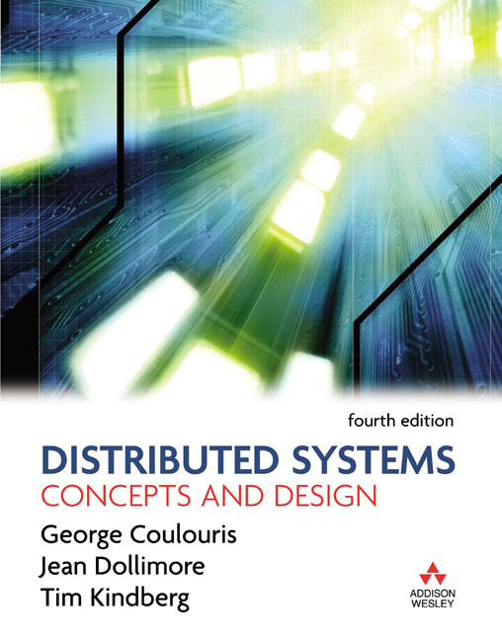
Text Book
Coulouris, G. (2012). Distributed systems. Boston: Addison-Wesley

Slide 4
Transactions and Concurrency Control
A Transaction defines a sequence of server operations that is guaranteed to be atomic in the presence of multiple clients and server crash.
All concurrency control protocols are based on serial equivalence and are derived from rules of conflicting operations.
Locks used to order transactions that access the same object according to request order.
Optimistic concurrency control allows transactions to proceed until they are ready to commit, whereupon a check is made to see any conflicting operation on objects.
Timestamp ordering uses timestamps to order transactions that access the same object according to their starting time.

Slide 5
Banking Example
Each account is represented by a remote object whose interface Account provides operations
for making deposits and withdrawals and
for enquiring about and setting the balance.
Each branch of the bank is represented by a remote object whose interface Branch provides operations
for creating a new account,
for looking up an account by name and
for enquiring about the total funds at that branch.

Slide 6
Banking Example
Main issue: unless a server is carefully designed, its operations performed on behalf of different clients may sometimes interfere with one another.
Such interference may result in incorrect values in the object.

Slide 7
Operations of the Account interface
deposit(amount)
deposit amount in the account
withdraw(amount)
withdraw amount from the account
getBalance() -> amount
return the balance of the account
setBalance(amount)
set the balance of the account to amount
Operations of the Branch interface
create(name) -> account
create a new account with a given name
lookUp(name) -> account
return a reference to the account with the given name
branchTotal() -> amount
return the total of all the balances at the branch

Slide 8
Simple Synchronization without Transactions
The use of multiple threads is beneficial to the performance.
Multiple threads may access the same objects.
For example, deposit and withdraw methods:
the actions of two concurrent executions of the methods could be interleaved arbitrarily and
have strange effects on the instance variables of the account object.

Slide 9
Simple Synchronization without Transactions
Synchronized keyword can be applied to method in Java, so only one thread at a time can access an object.
If one thread invokes a synchronized method on an object, then that object is locked, another thread that invokes one of the synchronized method will be blocked.

Slide 10
Enhancing Client Cooperation by Signaling
We have seen how clients may use a server as a means of sharing some resources.
E.g. some clients update the server’s objects and other clients access them.
However, in some applications, threads need to communicate and coordinate their actions.
Producer and Consumer problem.
Wait and Notify actions.

Slide 11
Transactions
Transaction originally from database management systems.
Clients require a sequence of separate requests to a server to be atomic in the sense that:
They are free from interference by operations being performed on behalf of other concurrent clients; and
Either all of the operations must be completed successfully or they must have no effect at all in the presence of server crashes.

Slide 12
Atomicity
All or nothing: a transaction either completes successfully, and effects of all of its operations are recorded in the object, or it has no effect at all.
Failure atomicity: effects are atomic even when server crashes
Durability: after a transaction has completed successfully, all its effects are saved in permanent storage for recover later.

Slide 13
Atomicity
Isolation: each transaction must be performed without interference from other transactions.
The intermediate effects of a transaction must not be visible to other transactions.

Slide 14
A client’s banking transaction
Transaction T:
a.withdraw(100);
b.deposit(100);

Slide 15
Operations in Coordinator interface
openTransaction() -> trans;
starts a new transaction and delivers a unique TID trans. This identifier will be used in the other operations in the transaction.
closeTransaction(trans) -> (commit, abort);
ends a transaction: a commit return value indicates that the transaction has committed; an abort return value indicates that it has aborted.
abortTransaction(trans);
aborts the transaction.

Slide 16
Transaction life histories
Successful
Aborted by client
Aborted by server
openTransaction
openTransaction
openTransaction
operation
operation
operation
operation
operation
operation
server aborts
transaction
operation
operation
operation ERROR
reported to client
closeTransaction
abortTransaction
If a transaction aborts for any reason (self abort or server abort), it must be guaranteed that future transaction will not see its effect either in the object or in their copies in permanent storage.

Slide 17
Concurrency Control: the lost update problem
Transaction
T
:
Transaction
U
:
balance = b.getBalance();
balance = b.getBalance();
b.setBalance(balance*1.1);
b.setBalance(balance*1.1);
a.withdraw(balance/10)
c.withdraw(balance/10)
balance = b.getBalance();
$200
balance = b.getBalance();
$200
b.setBalance(balance*1.1);
$220
b.setBalance(balance*1.1);
$220
a.withdraw(balance/10)
$80
c.withdraw(balance/10)
$280
a, b and c initially have bank account balance are: 100, 200, and 300. T transfers an amount from a to b. U transfers an amount from c to b.

Slide 18
The lost update problem
The lost update problem is illustrated by the following pair of transactions on bank accounts A, B and C, whose initial balances are $100, $200 and $300, respectively.
Transaction T transfers an amount from account A to account B.
Transaction U transfers an amount from account C to account B.
In both cases, the amount transferred is calculated to increase the balance of B by 10%.
The net effects on account B of executing the transactions T and U should be to increase the balance of account B by 10% twice, so its final value is $242.

Slide 19
The lost update problem
Now consider the effects of allowing the transactions T and U to run concurrently, as in Figure.
Both transactions get the balance of B as $200 and then deposit $20.
The result is incorrect, increasing the balance of account B by $20 instead of $42.
This is an illustration of the ‘lost update’ problem.
U’s update is lost because T overwrites it without seeing it.
Both transactions have read the old value before either writes the new value.

Slide 20
Concurrency Control: The inconsistent retrievals problem
Transaction
V
:
Transaction
W
:
a.withdraw(100)
aBranch.branchTotal()
b.deposit(100)
a.withdraw(100);
$100
total = a.getBalance()
$100
total = total+b.getBalance()
$300
total = total+c.getBalance()
b.deposit(100)
$300
a, b accounts start with 200 both.

Slide 21
The inconsistent retrievals problem
The balances of the two bank accounts, A and B, are both initially $200.
The result of branchTotal includes the sum of A and B as $300, which is wrong.
This is an illustration of the ‘inconsistent retrievals’ problem.
W’s retrievals are inconsistent because V has performed only the withdrawal part of a transfer at the time the sum is calculated.

Slide 22
Serial equivalence
If these transactions are done one at a time in some order, then the final result will be correct.
If we do not want to sacrifice the concurrency,
an interleaving of the operations of transactions may lead to the same effect as if the transactions had been performed one at a time in some order.

Slide 23
Serial equivalence
We say it is a serially equivalent interleaving
The use of serial equivalence is a criterion for correct concurrent execution to prevent lost updates and inconsistent retrievals.

Slide 24
A serially equivalent interleaving of T and U
Transaction
T
:
Transaction
U
:
balance = b.getBalance()
balance = b.getBalance()
b.setBalance(balance*1.1)
b.setBalance(balance*1.1)
a.withdraw(balance/10)
c.withdraw(balance/10)
balance = b.getBalance()
$200
b.setBalance(balance*1.1)
$220
balance = b.getBalance()
$220
b.setBalance(balance*1.1)
$242
a.withdraw(balance/10)
$80
c.withdraw(balance/10)
$278

Slide 25
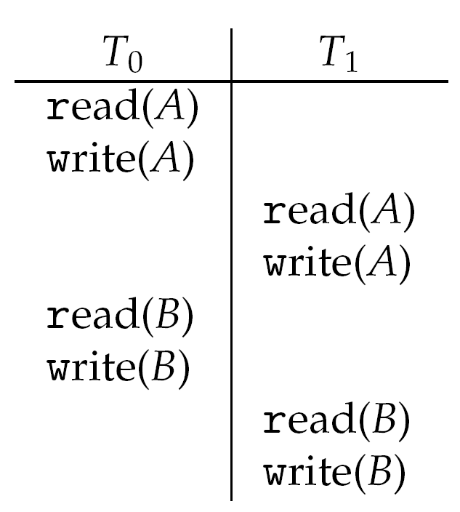
Conflicting Operations
When we say a pair of operations conflicts we mean that their combined effect depends on the order in which they are executed. E.g. read and write
Three ways to ensure serializability:
Locking
Timestamp ordering
Optimistic concurrency control

Slide 26
Read and write operation conflict rules
Operations of different
Conflict
Reason
transactions
read
read
No
Because the effect of a pair of
read
operations
does not depend on the order in which they are
executed
read
write
Yes
Because the effect of a
read
and a
write
operation
depends on the order of their execution
write
write
Yes
Because the effect of a pair of
write
operations
depends on the order of their execution

Slide 27
Nested transactions
T : top-level transaction
T
1
= openSubTransaction
T
2
= openSubTransaction
commit
T
1
:
T
2
:
openSubTransaction
openSubTransaction
openSubTransaction
prov. commit
abort
T
11
:
T
12
:
T
21
:
openSubTransaction
prov. commit
prov. commit
prov. commit
T
211
:
prov.commit

Slide 28
Locks
A simple example of a serializing mechanism is the use of exclusive locks.
Server can lock any object that is about to be used by a client.
If another client wants to access the same object, it has to wait until the object is unlocked in the end.

Slide 29
Transactions T and U with exclusive locks
Transaction
T
:
Transaction
U
:
balance = b.getBalance()
balance = b.getBalance()
b.setBalance(bal*1.1)
b.setBalance(bal*1.1)
a.withdraw(bal/10)
c.withdraw(bal/10)
Operations
Locks
Operations
Locks
openTransaction
bal = b.getBalance()
lock
B
b.setBalance(bal*1.1)
openTransaction
a.withdraw(bal/10)
Lock A
bal = b.getBalance()
waits for
T
’s
lock on
B
closeTransaction
unlock
A
,
B
lock
B
b.setBalance(bal*1.1)
c.withdraw(bal/10)
lock
C
closeTransaction
unlock
B
,
C

Slide 30
Lock compatibility
For one object
Lock requested
read
write
Lock already set
none
OK
OK
read
OK
wait
write
wait
wait
An object can be read and write. From the compatibility table, we know pairs of read operations from different transactions do not conflict. So a simple exclusive lock used for both read and write reduces concurrency more than necessary. (Many readers/Single writer)
Rules;
If T has already performed a read operation, then a concurrent transaction U must not write until T commits or aborts.
If T already performed a write operation, then concurrent U must not read or write until T commits or aborts.

Slide 31
Shared Lock and Exclusive lock
Locks must be obtained before read/write can begin
If a transaction want to read and write the same object, it can either
Obtain an X-lock before reading and unlock it immediately afterwards
Obtain an S-lock before reading, then obtain an X-lock before writing. And unlock it immediately afterwards

Slide 32
Shared Lock and Exclusive lock
Consider the following examples
A1 <- Read(X)
A1 <- A1 – k
Write(X, A1)
A2 <- Read(Y)
A2 <- A2 + k
Write(Y, A2)
A1 <- Read(X)
A1 <- A1* 1.01
Write(X, A1)
A2 <- Read(Y)
A2 <- A2 * 1.01
Write(Y, A2)
T1 (Transfer)
T2 (Dividend)

Slide 33
Lock-based protocol – example: Example of schedule with locks
S-lock(X)
A1 <- Read(X)
Unlock(X)
A1 <- A1 – k
X-lock(X)
X-lock(X)
Write(X, A1)
Unlock(X)
….
S-lock(X)
A1 <- Read(X)
Unlock(X)
A1 <- A1* 1.01
X-lock(X)
X-lock(X)
No wait: S-locks
T1 waits
T2 waits
T1
T2
T2 can go ahead

Slide 34
Lock based protocol – need for a protocol
S-lock (X)
A1 <- Read(X)
A1 <- A1 – k
Write(X, A1)
4. A2 <- Read(Y)
5. A2 <- A2 + k
6. Write(Y, A2)
Unlock(X)
X-lock (X)
S-lock (X)
Unlock(X)
A1 <- Read(X)
A1 <- A1* 1.01
Write(X, A1)
A2 <- Read(Y)
A2 <- A2 * 1.01
Write(Y, A2)
Unlock(X)
X-lock(X)
Unlock(X),
S-lock(Y)
Unlock(Y)
X-lock(Y)
Unlock(Y),
S-lock (Y)
Unlock(Y)
X-lock (Y)
Not conflict serializable.
Unlock(Y)
X : 100 -> 50 -> 50.5; Y : 200 -> 202 -> 252; X+Y = 302.5

Slide 35
Two-phase locking -- motivation
What is the problem?
When a transaction release a lock on an object , that means other transactions can obtain a lock on it.
X-lock(X)
Write(X, 100)
Unlock(X)
S-lock(X)
Read(X)
……
T1
T2

Slide 36
Two-phase locking -- motivation
In this case, there is contention from T1 to T2
To ensure serializability, we must ensure there is no conflict from T2 back to T1
Ensure that T1 does not read/write anything that T2 read/write.
Unrealistic to check in real life

Slide 37
Two-phase locking -- motivation
What is a sufficient condition then?
Ensure T1 does not read/write anything after releasing the lock!
⇒ (basic) Two-phase locking

Slide 38
Two phase locking – definition
The basic two-phase locking (2PL) protocol
A transaction T must hold a lock on an item x in the appropriate mode before T accesses x
If a conflicting lock on x is being held by another transaction, T waits.
Once T releases a lock, it cannot obtain any other lock subsequently.

Slide 39
Two phase locking – definition
Note: a transaction is divided into two phases:
A growing phase (obtaining locks)
A shrinking phase (releasing locks)
Claim : 2PL ensures conflict serializability

Slide 40
Two phase locking – Serializability
Lock-point: the point where the transaction obtains all the locks
With 2PL, a schedule is conflict equivalent to a a serial schedule ordered by the lock-point of the transactions

Slide 41
Recoverability from aborts
Servers must record the effect of all committed transactions and none of the effects of the aborted transactions.
A transaction may abort by preventing it affecting other concurrent transactions if it does so.
Two problems associated with aborting transactions that may occur in the presence of serially equivalent execution of transactions:
Dirty reads
Premature writes

Slide 42
A dirty read when transaction T aborts
Transaction
T
:
Transaction
U
:
a.getBalance()
a.getBalance()
a.setBalance(balance + 10)
a.setBalance(balance + 20)
balance = a.getBalance()
$100
a.setBalance(balance + 10)
$110
balance = a.getBalance()
$110
a.setBalance(balance + 20)
$130
commit transaction
abort transaction
Dirty reads caused by a read in one transaction U and an earlier unsuccessful write in another transaction T on the same object.
T will be rolled back and restore the original a value, thus U will have seen a value that never existed. U is committed, so cannot be undone. U performs a dirty read.

Slide 43
Dirty Read
T1 reads a value that T2 wrote, then commits and later, T2 aborts
The value is “dirty”, since the update to it should not have happened
T1 has committed, so it cannot be undone

Slide 44
Handling dirty reads
New rule: let T1 wait until T2 commits or aborts!
But if T2 aborts, we must abort T1
...and so on: others may depend on T1
…cascading aborts
Better rule: Transactions are only allowed to read objects that committed transactions have written

Slide 45
Premature Write: Overwriting uncommitted values
Transaction
T
:
Transaction
U
:
a.setBalance(105)
a.setBalance(110)
$100
a.setBalance(105)
$105
a.setBalance(110)
$110
Premature write: related to the interaction between write operations on the same object belonging to different transactions.
a. If U aborts and then T commit, we got a to be correct 105.
Some systems restore value to “Before images” value for abort action, namely the value before all the writes of a transaction. a is 100, which is the before image of T’s write. 105 is the before image of U’s write.
b. Consider if U commits and then T aborts, we got wrong value of 100.
c. Similarly if T aborts then U aborts, we got 105, which is wrong and should be 100.
So to ensure correctness, write operations must be delayed until earlier transactions that updated the same object have either committed or aborted.

Slide 46
Premature writes
“Before images” to recover from bad writes
Let x = 50 initially
T1: write(x, 10); T2: write(x, 20)
Let T1 execute before T2
What happens if either one aborts?
Order of commit/abort matters!

Slide 47
Handling premature writes
If before images are used, delay the writes to objects until other, earlier, transactions that write to the same object have committed/aborted
Systems that avoid both dirty reads and premature writes are “strict”
Highly desirable!
Tentative versions (local to each transaction)

Slide 48
Recover problem with 2PL
X-lock(X)
A1 <- Read(X)
A1 <- A1 * 10
Write(X, A1)
Unlock(X)
Abort!
Dirty Read problem!
There is a gap between releasing locks and the decision to commit/abort
Other transactions can still access data written by a uncomitted transaction
X-lock(X)
A2 <- Read(X)
A2 <- A2 + 1
Write(X, A2)
Unlock(X)
Commit

Slide 49
Strict two-phase Locking Protocol
Because transaction may abort, strict execution are needed to prevent dirty reads and premature writes,
which are caused by read or write to same object accessed by another earlier unsuccessful transaction that already performed an write operation.

Slide 50
Strict two-phase Locking Protocol
So to prevent this problem, a transaction that needs to read or write an object must be delayed until other transactions that wrote the same object have committed or aborted.
Rule:
Any locks applied during the progress of a transaction are held until the transaction commits or aborts.

Slide 51
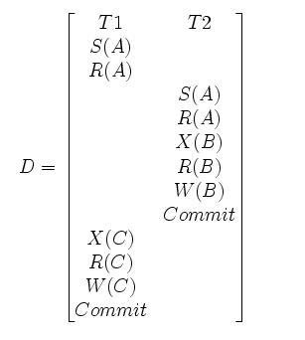
Strict two-phase Locking Protocol

Slide 52
Use of locks in strict two-phase locking
1. When an operation accesses an object within a transaction:
(a) If the object is not already locked, it is locked and the operation proceeds.
(b) If the object has a conflicting lock set by another transaction, the transaction must wait until it is unlocked.
(c) If the object has a non-conflicting lock set by another transaction, the lock is shared and the operation proceeds.
(d) If the object has already been locked in the same transaction, the lock will be promoted if necessary and the operation proceeds. (Where promotion is prevented by a conflicting lock, rule (b) is used.)
2. When a transaction is committed or aborted, the server unlocks all objects it locked for the transaction.
A transaction with a read lock that is shared by other transactions cannot promote its read lock to a write lock, because write lock will conflict with other read locks.

Slide 53
Lock class
public class Lock {
private Object object; // the object being protected by the lock
private Vector holders; // the TIDs of current holders
private LockType lockType; // the current type
public synchronized void acquire(TransID trans, LockType aLockType ){
while(/*another transaction holds the lock in conflicing mode*/) {
try {
wait();
}catch ( InterruptedException e){/*...*/ }
}
if(holders.isEmpty()) { // no TIDs hold lock
holders.addElement(trans);
lockType = aLockType;
} else if(/*another transaction holds the lock, share it*/ ) ){
if(/* this transaction not a holder*/) holders.addElement(trans);
} else if (/* this transaction is a holder but needs a more exclusive lock*/)
lockType.promote();
}
}

Slide 54
public synchronized void release(TransID trans ){
holders.removeElement(trans); // remove this holder
// set locktype to none
notifyAll();
}
}

Slide 55
Deadlock with write locks
Transaction
T
Transaction
U
Operations
Locks
Operations
Locks
a.deposit(100);
write lock
A
b.deposit(200)
write lock
B
b.withdraw(100)
waits for
U
’s
a.withdraw(200);
waits for
T
’s
lock on
B
lock on
A

Slide 56
The wait-for graph
Held by
Waits for
A
T
U
T
U
Waits for
B
Held by

Slide 57
A cycle in a wait-for graph
U
T
V

Slide 58
Another wait-for graph
V
Held by
T
W
T
Held by
Held by
C
U
Held by
B
U
W
V
Waits for
T and W then request write locks on object C and a deadlock arises. V is involved in two cycles.

Slide 59
Deadlock Prevention
Order the objects in certain order. Acquiring the locks need to follow this certain order.
Judge if system can remain in a Safe state by satisfying a certain resource request. Banker’s algorithm.

Slide 60
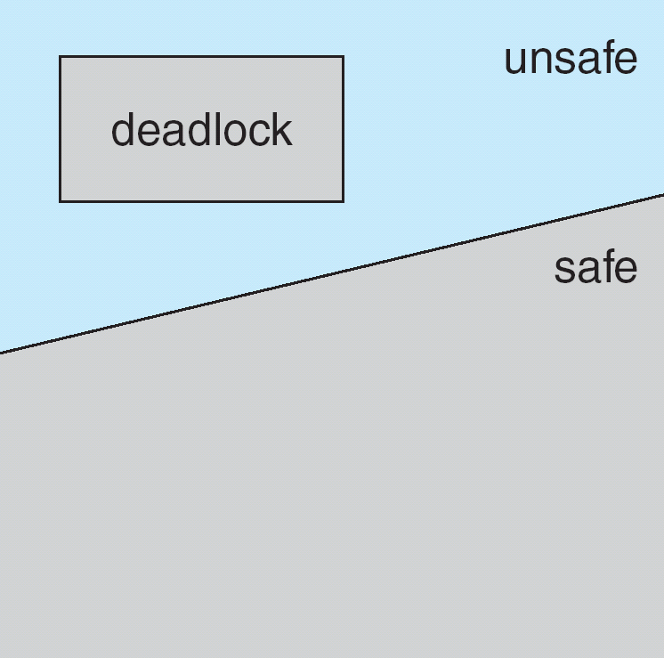
Safe State
System is in safe state if there exists a sequence <P₁, P₂, …, P_{n}> of ALL the processes is the systems such that for each P_{i}, the resources that P_{i} can still request can be satisfied by currently available resources + resources held by all the P_{j}, with j < i.
If a system is in safe state ⇒ no deadlocks.
If a system is in unsafe state ⇒ possibility of deadlock.
Avoidance ⇒ ensure that a system will never enter an unsafe state.

Slide 61
Banker’s Algorithm
1. Let Available and Finish be vectors of length m (resource types) and n (processes number), respectively. Initialize:
Finish [i] = false for i = 0, 1, …, n- 1.
2. Find and i such that both:
(a) Finish [i] = false
(b) Need_{i} ≤ Available
If no such i exists, go to step 4.
3. Available = Available + Allocation_{i} Finish[i] = true go to step 2.
4. If Finish [i] == true for all i, then the system is in a safe state

Slide 62
Available :
It is a 1-d array of size ‘m’ indicating the number of available resources of each type.
Available[ j ] = k means there are ‘k’ instances of resource type R_{j}

Slide 63
Max :
It is a 2-d array of size ‘n*m’ that defines the maximum demand of each process in a system.
Max[ i, j ] = k means process P_{i} may request at most ‘k’ instances of resource type R_{j.}

Slide 64
Allocation :
It is a 2-d array of size ‘n*m’ that defines the number of resources of each type currently allocated to each process.
Allocation[ i, j ] = k means process P_{i} is currently allocated ‘k’ instances of resource type R_{j}

Slide 65
Need :
It is a 2-d array of size ‘n*m’ that indicates the remaining resource need of each process.
Need [ i, j ] = k means process P_{i} currently need ‘k’ instances of resource type R_{j} for its execution.
Need [ i, j ] = Max [ i, j ] – Allocation [ i, j ]

Slide 66
Safety Algorithm
1) Let Work and Finish be vectors of length ‘m’ and ‘n’ respectively. Initialize: Work = Available Finish[i] = false; for i=1, 2, 3, 4….n
2) Find an i such that both a) Finish[i] = false b) Need_{i} <= Work if no such i exists goto step (4)
3) Work = Work + Allocation[i] Finish[i] = true goto step (2)
4) if Finish [i] = true for all i then the system is in a safe state

Slide 67
Resource Request Algorithm
1) If Request_{i} <= Need_{i} Goto step (2) ; otherwise, raise an error condition, since the process has exceeded its maximum claim.
2) If Request_{i} <= Available Goto step (3); otherwise, P_{i} must wait, since the resources are not available.
3) Have the system pretend to have allocated the requested resources to process Pi by modifying the state as follows: Available = Available – Requesti Allocation_{i} = Allocation_{i} + Request_{i} Need_{i} = Need_{i}– Request_{i}

Slide 68
Example
5 processes P₀ through P₄;
3 resource types:
A (10 instances), B (5instances), and C (7 instances).
Snapshot at time T₀:
Allocation Max Available
A B C A B C A B C
P₀ 0 1 0 7 5 3 3 3 2
P₁ 2 0 0 3 2 2
P₂ 3 0 2 9 0 2
P₃ 2 1 1 2 2 2
P₄ 0 0 2 4 3 3

Slide 69
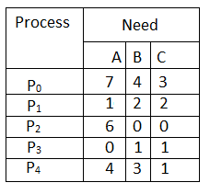
the content of Need Matrix is:
Max-Allocation

Slide 70
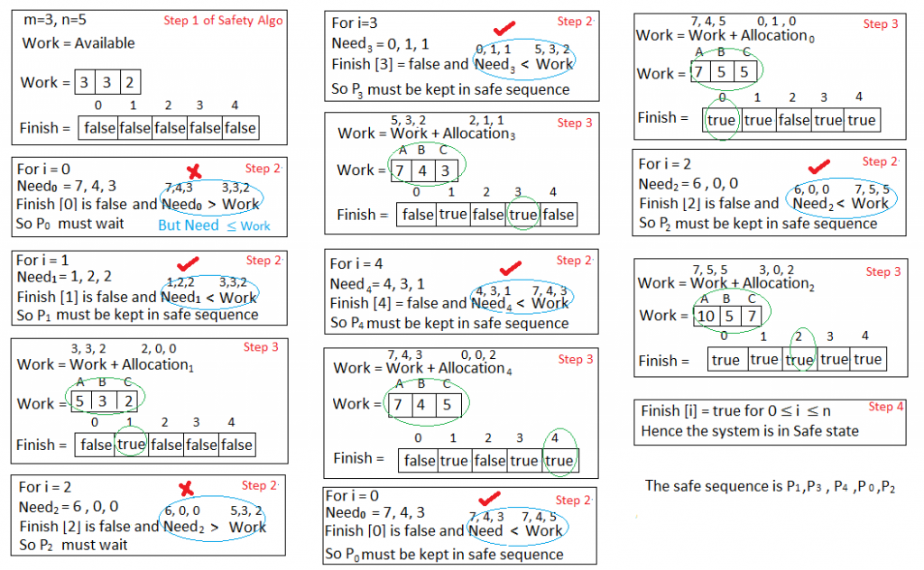

Slide 71
Optimistic Concurrency Control
Disadvantages of lock-based
Lock maintenance represents an overhead that is not present in systems that do not support concurrent access to shared data. Locking sometimes are only needed for some cases with low probabilities.
The use of lock can result in deadlock. Deadlock prevention reduces concurrency severely. The use of timeout and deadlock detection is not ideal for interactive programs
To avoid cascading aborts, locks cannot be released until the end of the transaction. This may reduce the potential for concurrency.

Slide 72
It is based on observation that, in most applications, the likelihood of two clients’ transactions accessing the same object is low.
Transactions are allowed to proceed as though there were no possibility of conflict with other transactions until the client completes its task and issues a closeTransaction request.
When conflict arises, some transaction is generally aborted and will need to be restarted by the client

Slide 73
Optimistic Concurrency Control
Each transaction has the following phases
Working phase
Validation phase
Update phase

Slide 74
Validation of Transactions
Validation uses the read-write conflict rules to ensure that the scheduling of a particular transaction is serially equivalent with respect to all other overlapping transactions- that is, any transactions that had not yet committed at the time this transaction started.
Each transaction is assigned a number when it enters the validation phase (when the client issues a closeTransaction).
Such number defines its position in time.
A transaction always finishes its working phase after all transactions with lower numbers.
That is, a transaction with the number Ti always precedes a transaction with number Tj if i < j.

Slide 75
Serializability of transaction T with respect to transaction T_{i}
T_{v}
T_{i}
Rule
write
read
1.
T_{i}
must not read objects written by
T_{v}
read
write
2.
T_{v}
must not read objects written by
T_{i}
write
write
3.
T_{i}
must not write objects written by
T_{v}
and
T_{v}
must
not write objects written by
T_{i}
The validation test on transaction Tv is based on conflicts between operations in pairs of transaction Ti and Tv, for a transaction Tv to be serializable with respect to an overlapping transaction Ti, their operations must conform to the above rules.

Slide 76
Validation of transactions
Working
Validation
Update
T
1
Earlier committed
transactions
T
2
T
3
Transaction
being validated
T
v
active
1
Later active
active
transactions
2

Slide 77
Validation
Backward Validation: checks the transaction undergoing validation with other preceding overlapping transactions- those that entered the validation phase before it.
Forward Validation: checks the transaction undergoing validation with other later transactions, which are still active

Slide 78
Timestamp based concurrency control
Each transaction is assigned a unique timestamp value when it starts, which defines its position in the time sequence of transactions.

Slide 79
The basic timestamp ordering rule is based on operation conflicts and is very simple:
A transaction’s request to write an object is valid only if that object was last read and written by earlier transactions.
A transaction’s request to read an object is valid only if that object was last written by an earlier transaction.
This rule assume that there is only one version of each object and restrict access to one transaction at a time.

Slide 80
Timestamps may be assigned from the server’s clock or a counter that is incremented whenever a timestamp value is issued.
Each object has a write timestamp and a set of tentative versions, each of which has a write timestamp associated with it; and a set of read timestamps.
The write timestamps of the committed object is earlier than that of any of its tentative versions, and the set of read timestamps can be represented by its maximum member.

Slide 81
Whenever a transaction’s write operation on an object is accepted, the server creates a new tentative version of the object with write timestamp set to the transaction timestamp.
Whenever a read operation is accepted, the timestamp of the transaction is added to its set of read timestamps.
When a transaction is committed, the values of the tentative version become the values of the object, and the timestamps of the tentative version become the write timestamp of the corresponding object.

Slide 82
Operation conflicts for timestamp ordering
Rule
T_{c}
T_{i}
1.
write
read
T_{c}
must not
write
an object that has been
read
by any
T_{i}
where
T_{i}
>
T_{c}
this requires that
T_{c}
≥ the maximum read timestamp of the object.
2.
write
write
T_{c}
must not
write
an object that has been
written
by any
T_{i}
where
T_{i}
>
T_{c}
this requires that
T_{c}
> write timestamp of the committed
object.
3.
read
write
T_{c}
must not
read
an object that has been
written
by any
T_{i}
where
T_{i}
>
T_{c}
this requires that
T_{c}
> write timestamp of the committed object.
Each request from a transaction is checked to see whether it conforms to the operation conflict rules. Conflict may occur when previous done operation from other transaction Ti is later than current transaction Tc.
It means the request is submitted too late.

Slide 83
Write operations and timestamps
(a)
T₃
write
(b)
T₃
write
Before
T
2
Before
T
1
T
2
Key:
T
i
T
T
Committed
After
2
3
After
T
1
T
2
T
3
T
i
Time
Time
Tentative
object produced
by transaction T_{i}
(c)
T₃
write
(d)
T₃
write
Transaction
Before
T
1
T
4
T
4
aborts
T₁<T₂<T₃<T₄
Before
After
T
1
T
3
T
4
After
T
4
Time
Time

Slide 84
Timestamp ordering write rule
if (T_{c} ≥ maximum read timestamp on D &&
T_{c} > write timestamp on committed version of D)
perform write operation on tentative version of D with write timestamp T_{c}
else /* write is too late */
Abort transaction T_{c}

Slide 85
Timestamp ordering read rule
if ( T_{c} > write timestamp on committed version of D) {
let D_{selected} be the version of D with the maximum write timestamp ≤ T_{c}
if (D_{selected} is committed)
perform read operation on the version D_{selected}
else
Wait until the transaction that made version D_{selected} commits or aborts
then reapply the read rule
} else
Abort transaction T_{c}

Slide 86
Read operations and timestamps
(a) T₃ read
(b) T₃ read
Key:
read
read
T
2
proceeds
T
2
T
4
proceeds
T
i
Selected
Selected
Committed
Time
Time
(d) T₃ read
T
i
(c) T₃ read
Tentative
read waits
Transaction
T
T
T
4
aborts
1
2
Selected
Time
Time

