Slide 1


Slide 2

Looping
Topic/Course
Sub-Topic (Example: name of college)

Slide 3
Looping
A loop statement allows us to execute a statement or group of statements multiple times.

Slide 4
Looping/Iteration statements
for
while
do while
Enhanced for

Slide 5
for
It is used to iterate a part of the program several times.
If the number of iteration is fixed, it is recommended to use for loop.

Slide 6
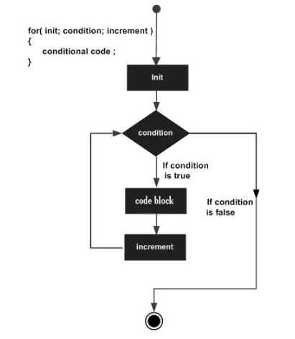
Syntax:
for (initialization condition; testing condition; increment/decrement)
{
statement(s) ;
}

Slide 7

class forLoopDemo
{
public static void main(String args[])
{
for (int x = 2; x <= 4; x++)
System.out.println("Value of x:" + x);
}
}
output
1
2
3
4
5
6
7
8
Value of x:2
Value of x:3
Value of x:4

Slide 8
while
It is used to iterate a part of the program several times.
If the number of iteration is not fixed, it is recommended to use while loop.

Slide 9
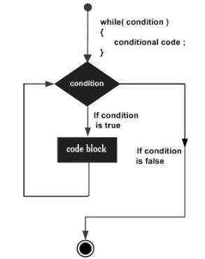
Syntax:
while(condition)
{
statement(s) ;
}

Slide 10
class whileLoopDemo
{
public static void main(String args[])
{
int x = 1;
while (x <= 4)
{
System.out.println("Value of x:" + x);
x++;
}
}
}
output
1
2
3
4
5
6
7
8
9
10
11
12
Value of x:1
Value of x:2
Value of x:3
Value of x:4

Slide 11
do while
It is used to iterate a part of the program several times.
Use do while if the number of iteration is not fixed and you must have to execute the loop at least once.

Slide 12
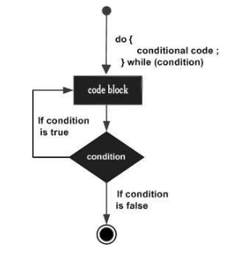
Syntax:
do
{
statement(s) ;
} while(condition);

Slide 13
class dowhileloopDemo
{
public static void main(String args[])
{
int x = 21;
do
{
System.out.println("Value of x:" + x);
x++;
}while (x < 20);
}
}
output
1
2
3
4
5
6
7
8
9
10
11
12
Value of x: 21

Slide 14
What is the difference between
while and do while ?

Slide 15
Enhanced for
Enhanced for loop provides a simpler way to iterate through the elements of a collection or array.

Slide 16
Syntax:
for (T element:Collection obj/array)
{
statement(s) ;
}

Slide 17
public class enhancedforloop
{
public static void main(String args[])
{
String array[] = {"Ron", "Harry","Hermoine"};
for (String x:array)
{
System.out.println(x);
}
}
}
output
1
2
3
4
5
6
7
8
9
10
11
12
13
Ron
Harry
Hermoine

Slide 18
When to use Enhanced for loop ?
Notes:
Java also includes another version of for loop introduced in Java 5. Enhanced for loop provides a simpler way to iterate through the elements of a collection or array. It is inflexible and should be used only when there is a need to iterate through the elements in sequential manner without knowing the index of currently processed element. Also note that the object/variable is immutable when enhanced for loop is used i.e it ensures that the values in the array can not be modified, so it can be said as read only loop where you can’t update the values as opposite to other loops where values can be modified. We recommend using this form of the for statement instead of the general form whenever possible.(as per JAVA doc.)

Slide 19
Infinite loop
One of the most common mistakes while implementing any sort of looping is that it may not ever exit, that is the loop runs for infinite time.

Slide 20
public class LooppitfallsDemo
{
public static void main(String[] args)
{
int x = 5;
while (x == 5)
{
System.out.println("In the loop");
}
}
}
output
1
2
3
4
5
6
7
8
9
10
11
In the loop
In the loop
In the loop
In the loop
In the loop
In the loop
In the loop
In the loop
In the loop
In the loop
In the loop
..
..
..

Slide 21
Jump statements
break
continue
return

Slide 22
break
Used to break loop or switch statement.
When a break statement is encountered inside a loop, the loop is immediately terminated and the program control resumes at the next statement following the loop.

Slide 23
public class BreakExample {
public static void main(String[] args) {
for(int i=1;i<=10;i++){
if(i==5){
break;
}
System.out.println(i);
}
}
}
output
1
2
3
4
5
6
7
8
9
10
1
2
3
4

Slide 24
continue
Used to continue the loop, it continues the current flow of the program and skips the remaining code at the specified condition.
The continue statement is used in loop control structure when you need to jump to the next iteration of the loop immediately.
It can be used with for loop or while loop.

Slide 25
public class ContinueExample {
public static void main(String[] args) {
for(int i=1;i<=10;i++){
if(i==5){
continue;
}
System.out.println(i);
}
}
}
output
1
2
3
4
5
6
7
8
9
10
1
2
3
4
6
7
8
9
10

Slide 26
return
Return is used to exit from a method, with or without a value.

Slide 27

// Predict the output
class Test {
public static void main(String[] args)
{
int j = 0;
do
for (int i = 0; i++ < 1 ; )
System.out.println(i);
while (j++ < 2);
}
}
1
2
3
4
5
6
7
8
9
10
11

Slide 28
OUTPUT
1. 111 2. 222 3. 333 4. error
Notes:
Output: 111
As we all know that curly braces are optional in do and for loop. But the only criteria is if we declare a statement without curly statement, then the statement should not be declarative.

Slide 29
// Predict the output
class Test {
static String s = "";
public static void main(String[] args)
{
P:
for (int i = 2; i < 7; i++) {
if (i == 3)
continue;
if (i == 5)
break P;
s = s + i;
}
System.out.println(s);
}
}
1
2
3
4
5
6
7
8
9
10
11
12
13
14
15
16

Slide 30
OUTPUT
1. 32 2. 23 3. 24 4. 42
Notes:
Output: 24
In the above example, when the first for loop is executed then it holds the value of i as 2. As long as the i value is 2, the loop will not execute the if condition and will be directly as s=s+i. Here s stores the value in a string format. Next time when s=s+i is executed, the i value becomes 4. Both these values are stored in the s in the form of a string.

Slide 31
// Predict the output
class Test {
public static void main(String[] args)
{
for (int i = 0; i < 10; i++)
int x = 10;
}
}
1
2
3
4
5
6
7
8
9

Slide 32
OUTPUT
1. No Output 2. Compile time error 3. Runtime error 4. Runtime Exception
Notes:
Output: No Output
;(semicolon) is a valid java statement which is also known as empty statement. Therefore we can apply it in if statement also.

Slide 33
// Predict the output
class Test {
public static void main(String[] args)
{
int i = 0;
for (System.out.println("HI"); i < 1; i++)
System.out.println("HELLO");
}
}
1
2
3
4
5
6
7
8
9

Slide 34
OUTPUT
1. HI HELLO 2. No Output 3. Compile time error 4. HELLO
Notes:
Output: HI HELLO
Explanation:I n the initialization section we can take any valid java statement including System.out.println(). In the for loop initialization section is executed only once that’s why here it will print first HI and after that HELLO

Slide 35
// Predict the output
class Test {
public static void main(String[] args)
{
for (int i = 0;; i++)
System.out.println("HELLO");
}
}
1
2
3
4
5
6
7
8

Slide 36
OUTPUT
1. Compile time error 2. HELLO 3. HELLO(Infinitely) 4. Run-time Exception
Notes:
Output: HELLO(Infinitely)
Explanation: In the conditional check we can take any valid java statement but should be of type Boolean. If we did not give any statement then it always returns true.

Slide 37

THANK YOU
Notes:
Thank you slide

