Slide 1


Slide 2


Operators
Topic/Course
Sub-Topic (Example: name of college)

Slide 3
Operators are used to perform operations on variables and values.
Topic/Course
operators
Sub-Topic (Example: name of college)
Unary operators
Binary operators
Ternary operators
X = Y – 1
operands

Slide 4
Operators in Java
Unary operators
Arithmetic operators
Relational operators
Bitwise operators
Logical operators
Ternary operators
Assignment operators
instanceof operator

Slide 5
Unary operators
Unary operator performs operation on only one operand.
They are used to increment, decrement or negate a value.

Slide 6
Unary operators
Operator | Description | Example
++ | Increases the value of a variable by 1 | ++x(prefix) x++(postfix)
-- | Decreases the value of a variable by 1 | --x(prefix) x--(postfix)
+ | Used for giving positive values | + x
- | Used for negating the values | - x
~ | Negating an expression | ~ x
! | Inverting the value of a boolean | ! x

Slide 7
What is the difference between ++x and x++ ?

Slide 8

class OperatorExample{
public static void main(String args[]){
int x=10;
System.out.println(x++);
System.out.println(++x);
System.out.println(x--);
System.out.println(--x);
}
}
output
1
2
3
4
5
6
7
10
11
12
10
12
12
10

Slide 9
class OperatorExample{
public static void main(String args[]){
int a=10;
int b=-10;
boolean c=true;
boolean d=false;
System.out.println(~a);
System.out.println(~b);
System.out.println(!c);
System.out.println(!d);
}
}
output
1
2
3
4
5
6
7
10
11
12
13
14
-11
9
False
true

Slide 10
Arithmetic operators
Arithmetic operators are used to perform common mathematical operations like addition, subtraction etc..

Slide 11
Arithmetic operators
Operator | Description | Example
+ | Adds two values | x + y
- | Subtracts one value from another | x - y
* | Multiplies two values | x * y
/ | Returns the division quotient | x / y
% | Returns the division remainder | x % y

Slide 12
What is the difference between / and % ?

Slide 13
class OperatorExample{
public static void main(String args[]){
int a=10;
int b=5;
System.out.println(a+b);
System.out.println(a-b);
System.out.println(a*b);
System.out.println(a/b);
System.out.println(a%b);
}
}
1
2
3
4
5
6
7
10
11
12
13
output
15
5
50
2
0

Slide 14
Relational operators
Relational/Comparison operators are used to compare two values.
They return boolean result after the comparison.

Slide 15
Relational operators
Operator | Description | Example
== | Returns true if left hand side is equal to right hand side | x == y
!= | Returns true if left hand side is not equal to right hand side | x != y
< | Returns true if left hand side is less than right hand side | x < y
<= | Returns true if left hand side is less than or equal to right hand side | x < =y
> | Returns true if left hand side is greater than right hand side | x >=y
>= | Returns true if left hand side is greater than or equal to right hand side | x >= y

Slide 16
public class Test {
public static void main(String args[]){
int a = 10;
int b = 20;
System.out.println(a>b);
System.out.println(a<b);
System.out.println(a>=b);
System.out.println(a<=b);
System.out.println(a==b);
System.out.println(a!=b);
}
}
output
1
2
3
4
5
6
7
10
11
12
13
14
false
true
false
true
false
true

Slide 17
Bitwise operators
Bitwise operator works on bits and performs bit-by-bit operation.
Can be applied to the integer types, long, int, short, char, and byte.

Slide 18
Bitwise operators
Operator | Description | Example
& | Returns bit by bit AND of input values | x & y
| | Returns bit by bit OR of input values | x | y
^ | Returns bit by bit XOR of input values | x ^ y
~ | Returns the one’s compliment representation of the input value | ~ x
<< | shifts the bits of the number to the left and fills 0 on voids left as a result | x << 2
>> | shifts the bits of the number to the right | x >> 2
>>> | shifts the bits of the number to the right and fills 0 on voids left as a result | x >>>2

Slide 19
public class Main {
public static void main(String args[]){
int a = 10;
int b = 20;
System.out.println(a&b);
System.out.println(a|b);
System.out.println(~a);
System.out.println(a<<2);
System.out.println(a>>2);
System.out.println(a>>>2);
}
}
output
1
2
3
4
5
6
7
10
11
12
13
14
0
30
-11
40
2
2

Slide 20
Logical operators
The logical operators || (conditional-OR) and && (conditional-AND) operates on boolean expressions.
The second condition is not evaluated if the first one is false, i.e. it has a short-circuiting effect.

Slide 21
Logical operators
Operator | Description | Example
&& | Returns true if both statements are true | x < 5 && x < 10
|| | Returns true if one of the statements is true | x < 5 || x < 4
! | Reverse the result, returns false if the result is true | !(x < 5 && x < 10)

Slide 22
public class Test {
public static void main(String args[]){
boolean a = true;
boolean b = false;
System.out.println(a&&b);
System.out.println(a||b);
System.out.println(!(a && b));
}
}
output
1
2
3
4
5
6
7
10
11
false
true
true

Slide 23
Ternary operator
Ternary/Conditional operator consists of three operands and is used to evaluate Boolean expressions.
Ternary operator is a shorthand version of if-else statement.
It has three operands and hence the name ternary.

Slide 24
class OperatorExample{
public static void main(String args[]){
int a=2;
int b=5;
int min=(a<b)?a:b;
System.out.println(min);
}
}
output
1
2
3
4
5
6
7
10
2

Slide 25
Assignment operators
Assignment operator is used to assign a value to any variable.
In many cases assignment operator can be combined with other operators to build a shorter version of statement called Compound Statement.

Slide 26
Assignment operators
Operator | Description | Example
= | Assigns values from right side operands to left side operand. | C = A + B
+= | Adds right operand to the left operand and assign the result to left operand. | C += A
-= | Subtracts right operand from the left operand and assign the result to left operand. | C -= A
*= | Multiplies right operand with the left operand and assign the result to left operand. | C *= A
/= | Divides left operand with the right operand and assign the result to left operand. | C /= A
%= | Takes modulus using two operands and assign the result to left operand. | C %= A

Slide 27
Assignment operators
Operator | Description | Example
<<= | Left shift AND assignment operator | C <<= 2
>>= | Right shift AND assignment operator | C >>= 2
&= | Bitwise AND assignment operator | C &= 2
^= | Bitwise exclusive OR and assignment operator | C ^= 2
|= | Bitwise inclusive OR and assignment operator | C |= 2

Slide 28
What is the difference between = and == ?
Notes:
= is assignment operator a=5 assigns value 5 to a.
== is comparison operator a==5 checks whether value of a is equal to 5.

Slide 29
class OperatorExample{
public static void main(String[] args){
int a=10;
a+=3;
System.out.println(a);
a-=4;
System.out.println(a);
a*=2;
System.out.println(a);
a/=2;
System.out.println(a);
}
}
output
1
2
3
4
5
6
7
10
11
12
13
14
15
13
9
18
9

Slide 30
instanceof operators
instanceof operator is used only for object reference variables.
The operator checks whether the object is of a particular type (class type or interface type).

Slide 31
public class Test {
public static void main(String args[]) {
String name = "James";
boolean result = name instanceof String;
System.out.println( result );
}
}
output
1
2
3
4
5
6
7
10
11
true
Notes:
Program will return true since name is type of String

Slide 32
Precedence and associativity
Operator precedence determines which operator is evaluated first when an expression has more than one operators.
Associativity is used when there are two or more operators of same precedence is present in an expression.

Slide 33
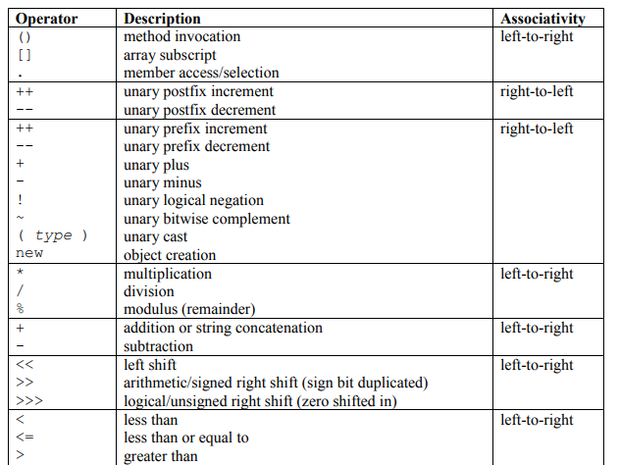

Slide 34
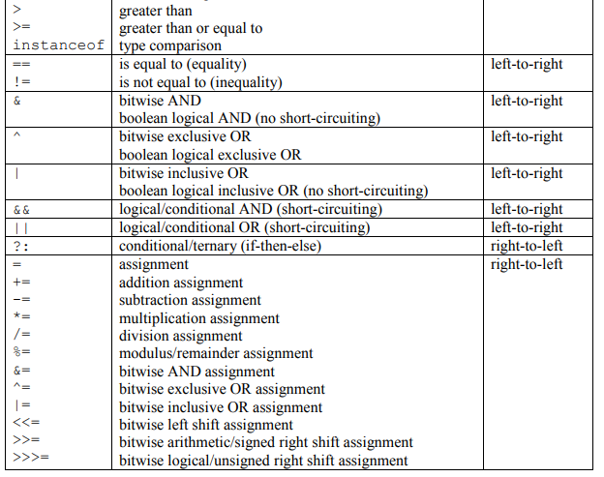

Slide 35

// Predict the output
public class A {
public static void main(String[] args)
{
int $_ = 5;
}
}
1
2
3
4
5
6
7

Slide 36
OUTPUT
1. Nothing
2. Error
Notes:
Output: Nothing

Slide 37
// Predict the output
class Test {
public static void main(String args[]) {
System.out.println(10 + 20 + “Face");
System.out.println(“Face" + 10 + 20);
}
}
1
2
3
4
5
6
7

Slide 38
OUTPUT
30Face Face30
1020Face Face1020
30Face Face1020
1020Face Face30
Notes:
Output: 30Face Face1020
Explanation: In the given expressions 10 + 20 + “Face” and “Face” + 10 + 20 , there are two + operators, so associativity comes to the picture. The + operator is left to right. So the first expression is evaluated as (10 + 20) + “Face” and second expression is evaluated as (“Face” + 10) + 20 .

Slide 39
// Predict the output
class Test
{
public static void main(String args[])
{
String s1 = “FACE";
String s2 = “FACE";
//System.out.println(s1==s2);
System.out.println("s1 == s2 is:" + s1 == s2);
}
}
1
2
3
4
5
6
7
8
9
10

Slide 40
OUTPUT
true
false
compiler error
throws an exception
Notes:
Output: false
Explanation: The output is “false” because in java + operator precedence is more than == operator. So the given expression will be evaluated to “s1 == s2 is:geeksquiz” == “geeksquiz” i.e false.

Slide 41

THANK YOU
Notes:
Thank you slide

