Slide 1
TIME AND GLOBAL STATES

Slide 2
Overview
Clocks
Synchronizing physical clocks
Logical time and logical clocks
Global states

Slide 3
Clocks, Events, States
Interaction model
Distributed systems consist of collection of N processes p₁, p₂, …, p_{N}
  Each process executes on a single processor
  Each process has a state s_{i} which it transforms
  Processes communicate by sending messages
  Each process executes a series of actions: action is
    Message Send operation
    Message Receive operation
    Operation that transforms p_{i}’s state
  Event is occurrence of a single action that process carries out as executes
    Sequence of events
      e → e’ if event e occurs before e’ in p_{i}
  History of process p_{i}:
    History(p_{i}) = h_{i} = <e⁰_{i}, e¹_{i}, e²_{i}, …>

Slide 4
Clocks
How to timestamp events
Each computer owns physical clock
  Counts oscillations occurring in a crystal at a definite frequency
Software clock C_{i}(t) = αH_{i}(t) + β
  Approximate measure for real, physical time t for process p_{i}:
  H_{i}(t) is hardware clock value
  α is scale value
  β is offset
  I.e. could be 64-bit value of the number of nanoseconds that have elapsed at time t since a convenient reference time
  Note that successive events will correspond to different timestamps only if clock resolution is smaller than the time interval between successive events

Slide 5
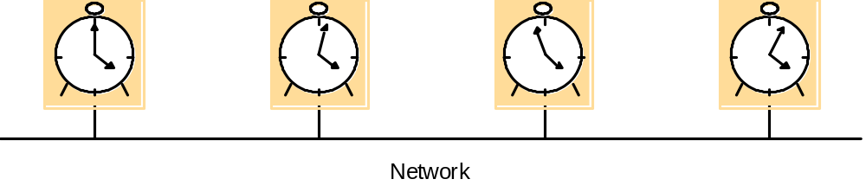
Clocks
Skew between clocks
  Instantaneous difference between the readings of any two clocks
Clock drift
  Crystal-based clocks count time at different rates and diverge
  Physical variations, temperature may affect
Clock’s drift rate
  Change in the offset between clock and nominal perfect reference clock
  For ordinary clocks about 10⁻⁶ sec/sec, giving a difference of 1 second every 1 000 000 second
  For ”high precision” clocks 10⁻⁷ to 10⁻⁸

Slide 6
Clocks
Coordinated Universal Time (UTC)‏
  Most accurate physical clocks use atomic oscillator
    Drift rate about one part in 10¹³
    Output is used as standard for elapsed time, International Atomic Time
  International standard for timekeeping
    Based on atomic time but leap second is inserted
    Signals are synchronized and broadcast regularly from radio stations or satellites

Slide 7
Synchronizing Physical Clocks
External synchronization
  Processes’ clocks C_{i} are synchronized with authoritative, external source of time
  For a synchronization bound D > 0 and for source S of UTC time
    |S(t) - C_{i}(t) | < D for i= 1,2,…,N and for all t
    Clocks C_{i} are accurate within the bound D
Internal synchronization
  Clocks are synchronized with each other to a known degree of accuracy
  For a synchronization bound D > 0
    |C_{i}(t) - C_{j}(t)| < D for i, j = 1, 2, …, N and for all t
    Clocks C_{i} are agreed within the bound D
Clocks that are internally synchronized are not necessarily externally synchronized
If system is externally synchronized within bound D then the same system is internally synchronized with bound of 2D

Slide 8
Synchronizing Physical Clocks
Correctness for clocks
  Hardware clock H is correct if its drift rate falls within a known bound ρ > 0
  Error in measuring the interval between real times t and t’ (t’ > t) is bounded
    (1- ρ)(t’-t) ≤ H(t’) - H(t) ≤ (1+ ρ)(t’-t)‏
    Forbids jumps in the value of hardware clocks
  Monotonicity
    t’>t => C(t’) > C(t)‏
  Hybrid correctness condition
    Clock obeys monotonicity condition
    Drift rate is bounded between synchronization points
    Allow clock value to jump ahead at synchronization points

Slide 9
Synchronization in Synchronous System
Internal synchonization between two processes
Bounds are known for
  Drift rate of clocks
  Maximum message transmission delay
  Time to execute each step of process
One process sends time t on its local clock to other in a message
  Receiver process sets its clock to time t + T_{trans}
  T_{trans} is time taken to transmit m
    Is subject to variation and is unknown
    Minimum transmission time min can be measured or conservatively estimated: no other processes are executed or no other network traffic exist
    Let uncertainty in message transmission time be u = max – min
    If receiver sets its clock to t + (max + min)/2, then the skew is at most u/2
    Optimum bound that can be achieved on clock skew when synchronizing N clocks is u(1 - 1/N)‏
Most distributed systems in practice are asynchronous

Slide 10
Cristian’s Method
T_{round} should be in order of 1-10 milliseconds on LAN
  Clock with drift rate of 10⁻⁶ sec/sec varies by at most 10⁻⁵ sec
Simple estimate of the time to which p should set its clock is t + T_{round} /2
  Normally reasonable accurate assumption unless two messages are transmitted over different networks
If min is known or can be conservatively estimated, accuracy can be determined
  Earliest point at which S could have placed the time in m_{t} was min after p dispached m_{r}
  Latest point was min before m_{t} arrived at p
  Time by S’s clock when reply message arrives is in range [ t + min, t + T_{round} – min]
  Width of range is T_{round} - 2min
  Accuracy is +/- (T_{round} /2 - min)‏

Slide 11
Cristian’s Method
Discussion
  Problem associated with all services implemented by single server
    A group of synchronized time servers
    Client could multicast its request
  Faulty time server replies with spurious time values
  Imposter time server that replies with deliberately incorrect time
  Really only suitable for deterministic LAN environment or Intranet

Slide 12
Berkeley Algorithm
For internal synchronization
Coordinator computer acts as master
  Polls the other computers, called slaves, whose clocks are to be synchronized
  Slaves send back their clock values
  Master estimates their local clocks by observing round-trip times and averages the values
    Average cancels out individual clock’s tendencies to run fast or slow
  Master sends to slaves amount by which each individual slave’s clock requires adjustment
Eliminates readings from faulty clocks
  Master takes a fault-tolerant average
Experiment involving 15 computers
  Whose clocks were synchronized to within about 20-25 msec
  Local clock’s drift rate less than 2x10⁻⁵
  Maximum round-trip time 10 msec
If master fails, another can be elected to take over and function

Slide 13
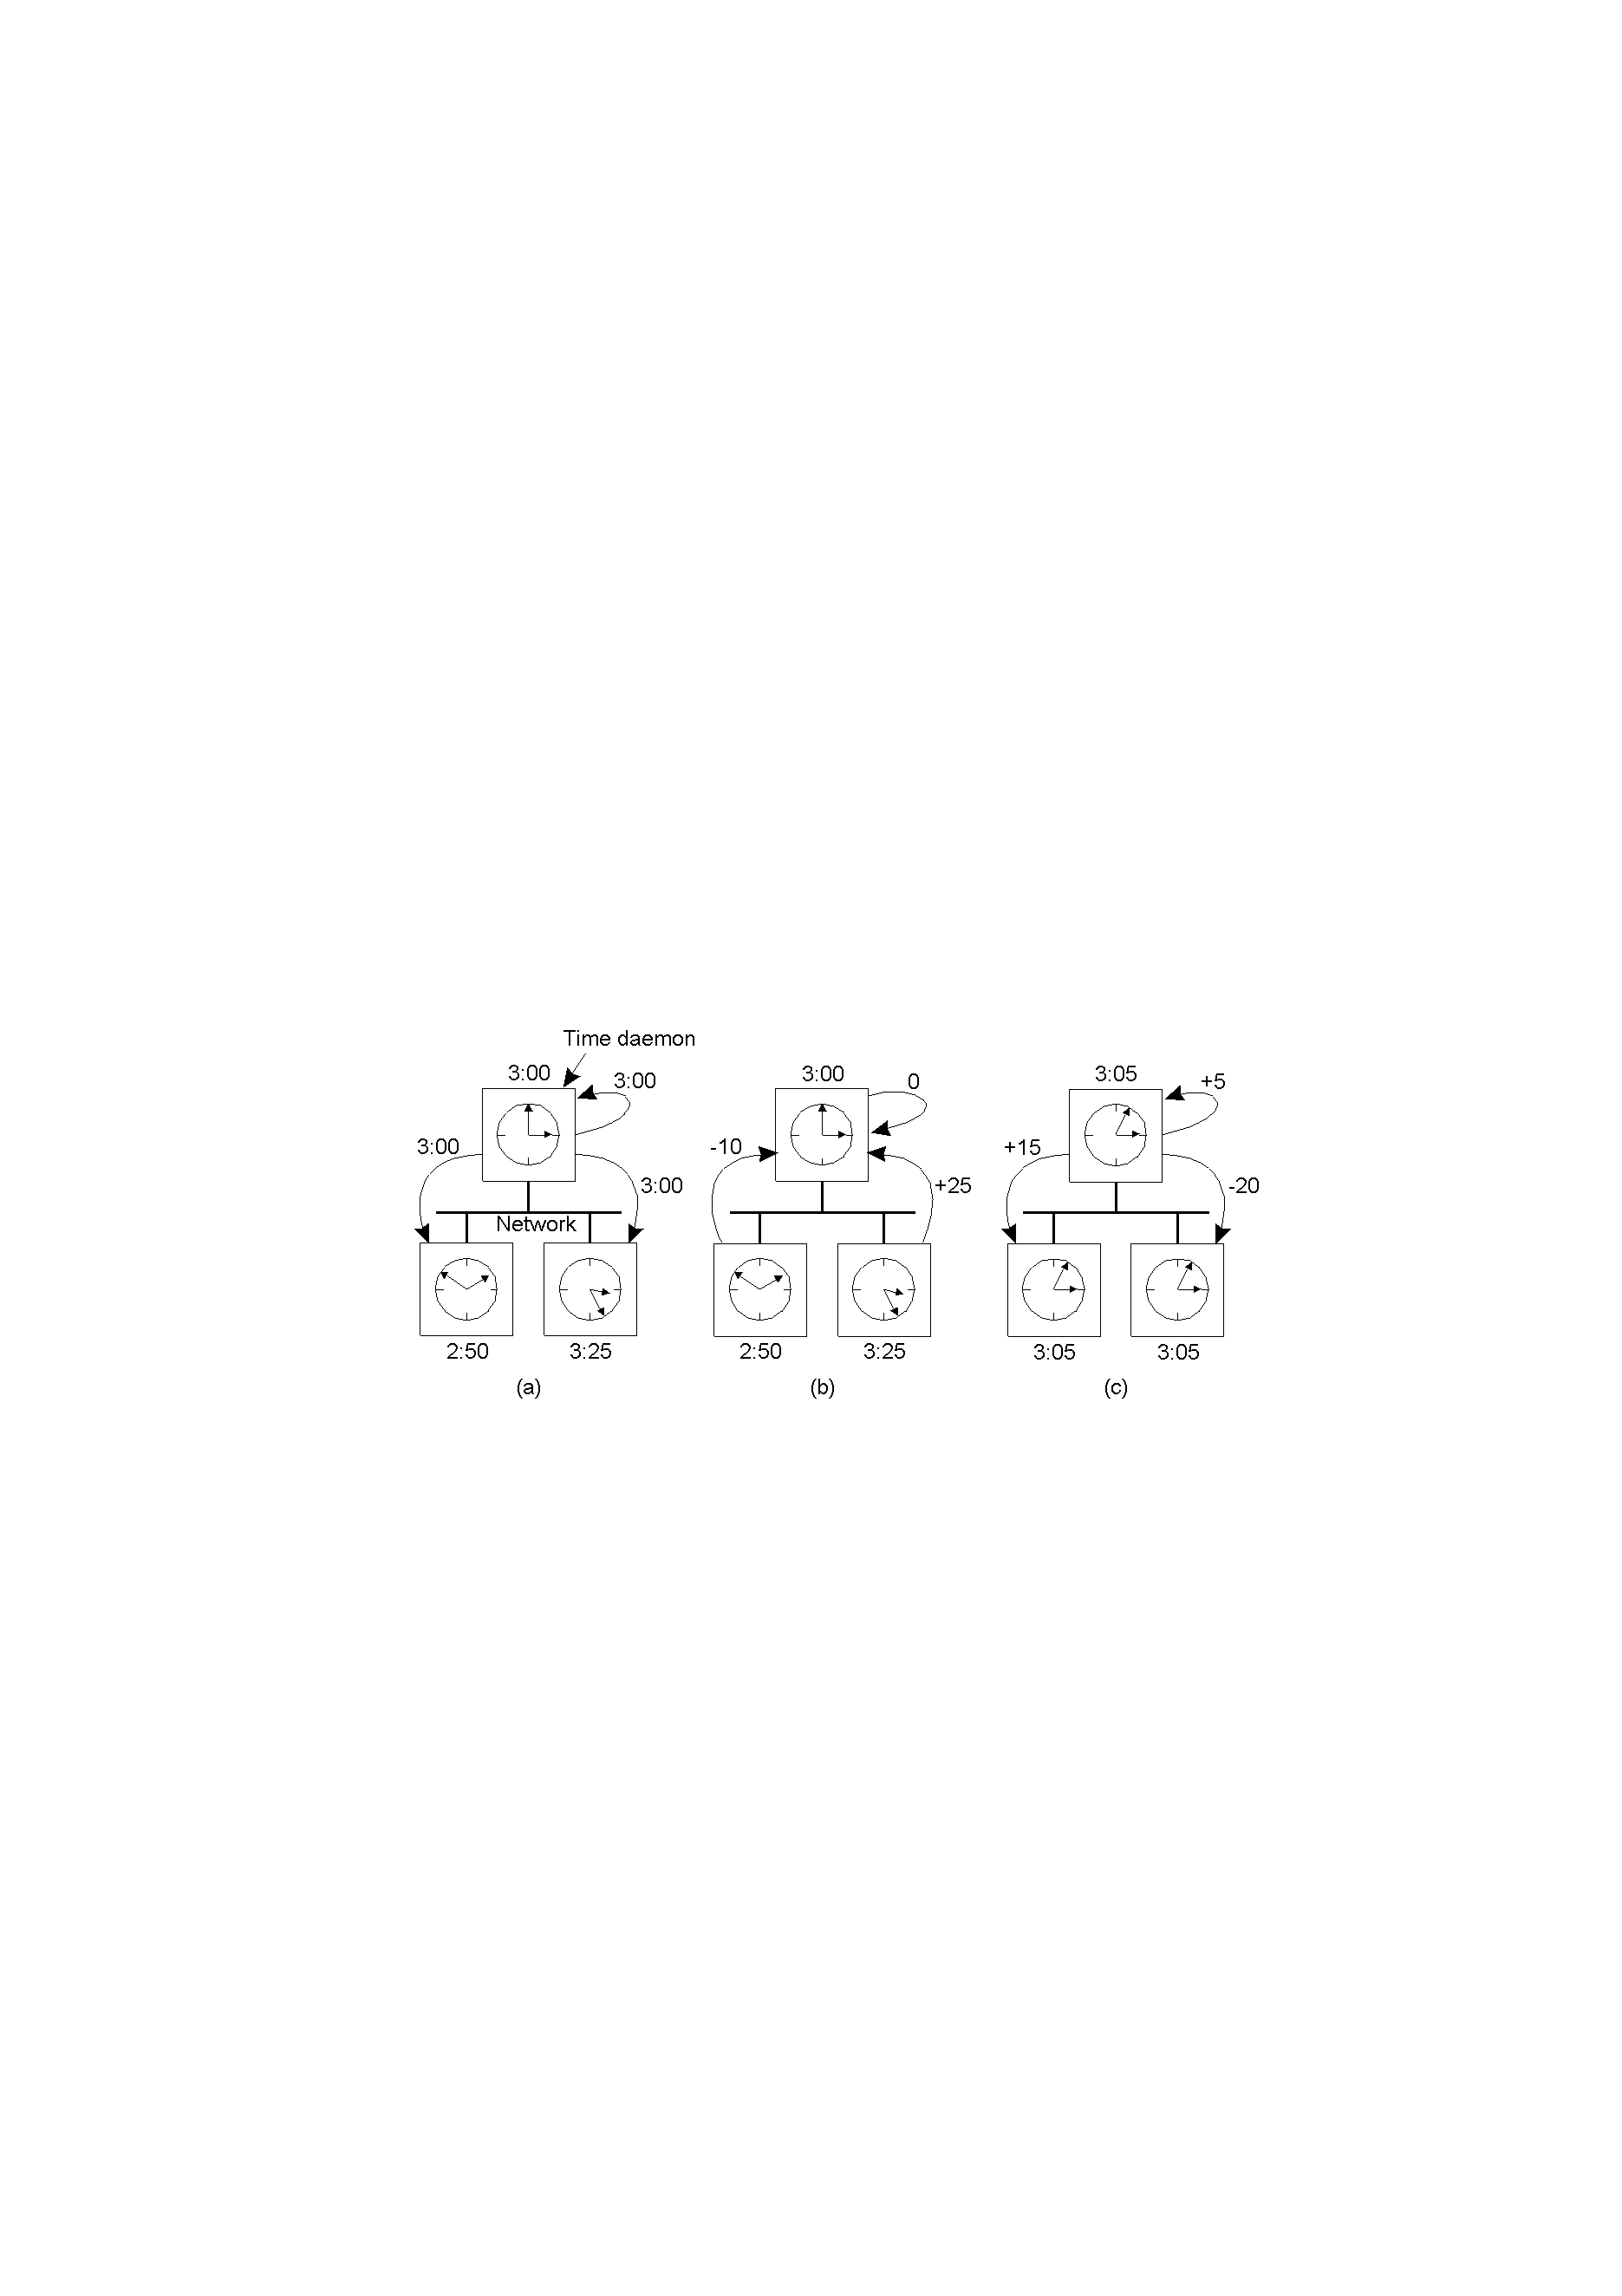
Berkeley Algorithm

Slide 14
Network Time Protocol
An architecture for a time service
Protocol to distribute time information over the Internet
Provides a service enabling clients across Internet to be synchronized accurately to UTC
Provides a reliable service that can survive lengthy losses of connectivity
Enables clients to resynchronize sufficiently frequently to offset the rates of drift found in most computers
Provides protection against interference with time service, whether malicious or accidental
Service is provided by a network of servers across the Internet
  Primary servers and secondary servers
  Forms hierarchy called synchronization subnet; levels are strata
  Lowest-level servers execute in users’ workstations
  If a strata 1 server fails, it may become a stratum 2 secondary server

Slide 15
Network Time Protocol (NTP)
A time service for the Internet - synchronizes clients to UTC
Reliability from redundant paths, scalable, authenticates time sources
Primary servers are connected to UTC sources
Secondary servers are synchronized to primary servers
Synchronization subnet - lowest level servers in users’ computers
1
2
2
3
3
3
Notes:
animates the points relaibility, primary and secondary servers

Slide 16
Network Time Protocol
Servers synchronize with one other in one of three modes:
  Multicast
    For use on a high-speed LAN
    Server periodically multicast the time to other servers
    They set their clocks assuming a small delay
  Procedure-call
    Similar to operation of Christian’s algorithm
    Server accepts requests from other computers and replies with timestamp
    Suitable where higher accuracies are required or where multicast is not supported in hardware
  Symmetric
    For servers that supply time information in LANs and by higher levels of synchronization subnet
    Where highest accuracies are needed
    A pair of servers operating in symmetric mode exchange messages bearing timing information
Messages are delivered using UDP protocol

Slide 17
Network Time Protocol
For each pair of messages sent between two servers the NTP calculates
  Offset o_{i}: an estimate for the actual offset between two clocks
  Delay d_{i}: the total transmission time for two messages
  If the true offset of the clock at B relative to that at A is o and actual transmission times for m and m’ are t and t’ respectively
    Delay:
      T_{i-2} = T_{i-3} + t + o and T_{i} = T_{i-1} + t’ – o leads to
      d_{i} = t + t’ = T_{i-2} - T_{i-3} + T_{i} - T_{i-1}
    Offset
      o = o_{i} + (t’ - t)/2, where o_{i} = (T_{i-2} - T_{i-3} + T_{i-1} - T_{i})/2
    Using t, t’ ≥ 0 it can be shown that o_{i} - d_{i}/2 ≤ o ≤ o_{i} + d_{i}/2
      o_{i} is an estimate for o, and d_{i} is a measure of the accuracy of estimate

Slide 18
Network Time Protocol
Servers apply a data filtering algorithm to successive pairs <o_{i}, d_{i}>
  8 most recent pairs are retained
  The value of o_{i} that corresponds to the minimum value d_{i} is chosen to estimate o
NTP server engages in message exchanges with several peers and applies a peer-selection algorithm
  Peer with unreliable values may be changed
  Peers with lower stratum are more favoured than those in higher strata
NTP employs a phase lock loop model
  Modifies the local clock’s update frequency in accordance with observations of its drift rate
Synchronization accuracies in order of tens of msecs over Internet and 1 msec on LAN

Slide 19
Logical time and clocks
Can't synchronize physical clocks perfectly
Absolute time might not be necessary, just need ordering of events
Logical clocks: Lamport, 1978
Happened-before relationship among events
Potential causal ordering

Slide 20
What are Logical Clocks ?
A logical clock is a mechanism for capturing chronological sequence and causal relationships of events in a distributed system.
Clock Implementation
  Data structure
  Clock Update Protocol
Logical clock algorithms of note are:
  Scalar clocks
  Vector clocks
  Matrix clocks

Slide 21
Happen-before relation
e -> e'
  two events occur in the same process
  a message is sent between two processes
Happened-before relation:
  HB1: if e -> e' in process i, then e -> e'
  HB2: for any message m, send(m) -> receive(m)
  HB3: if e -> e' and e' -> e'', then e -> e''

Slide 22
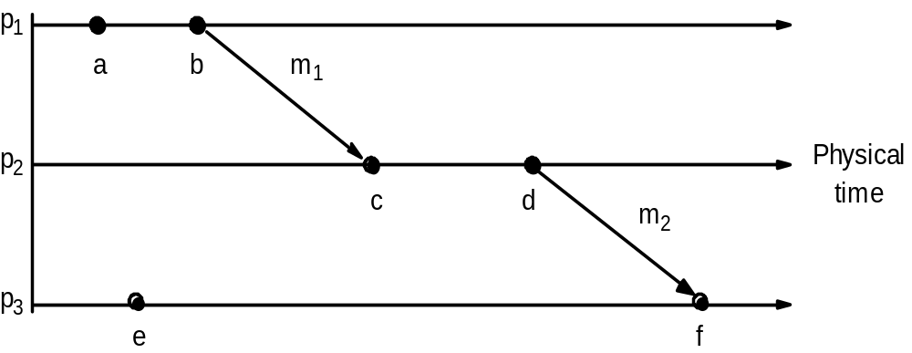
Events occurring at three processes

Slide 23
Happen-before vs. causality
e || e' if the two events aren't in a particular order (concurrent)‏
potential causality: e -> e’ doesn't mean that e causes e'
naturally, if e causes e’, e -> e’

Slide 24
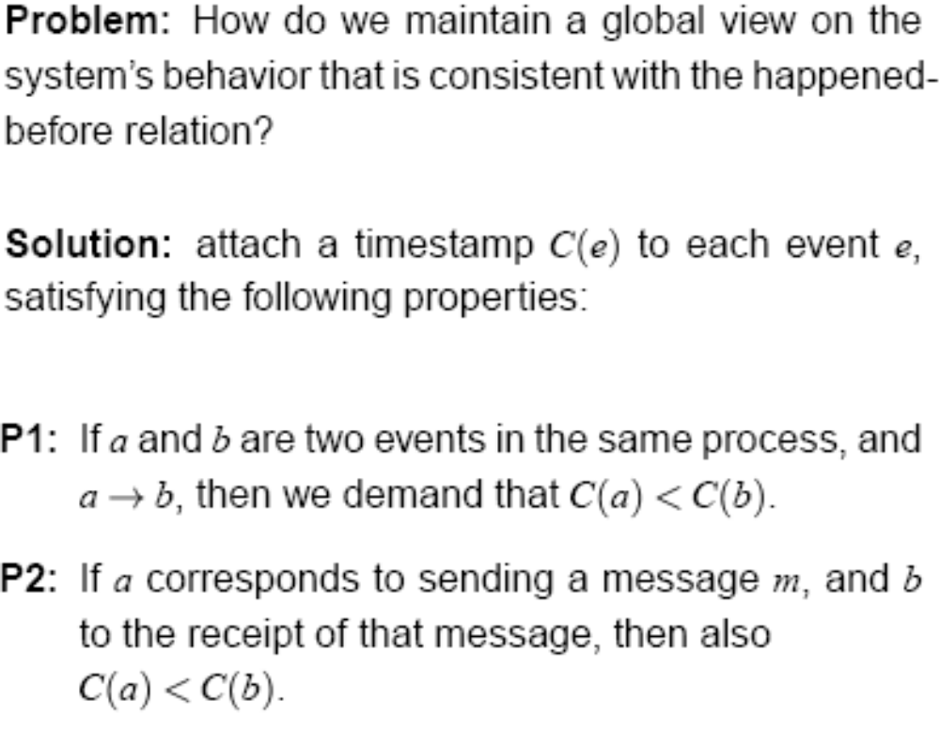
Logical Clocks (1/2)‏

Slide 25
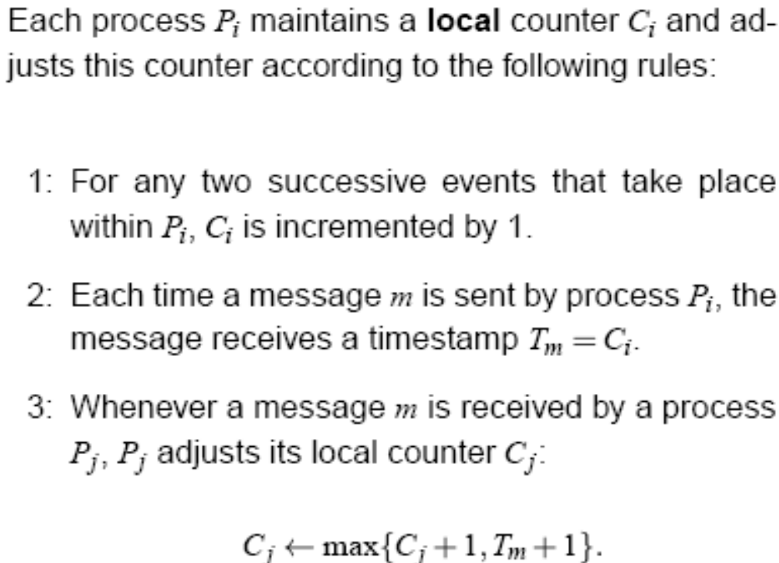
Logical Clocks (2/2)‏

Slide 26
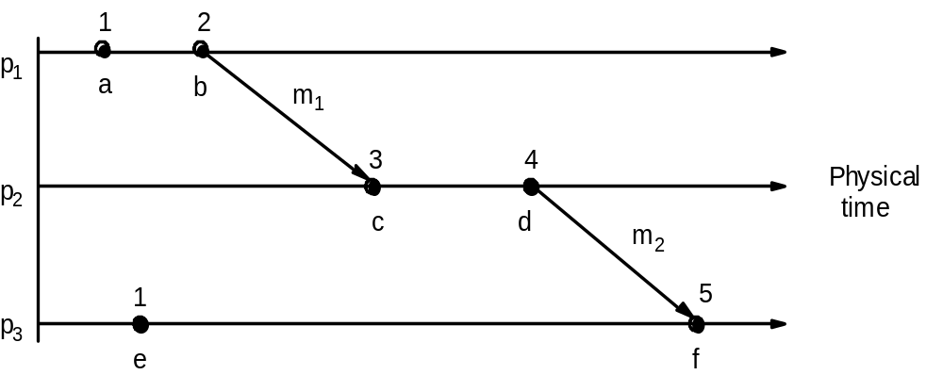
Lamport timestamps

Slide 27
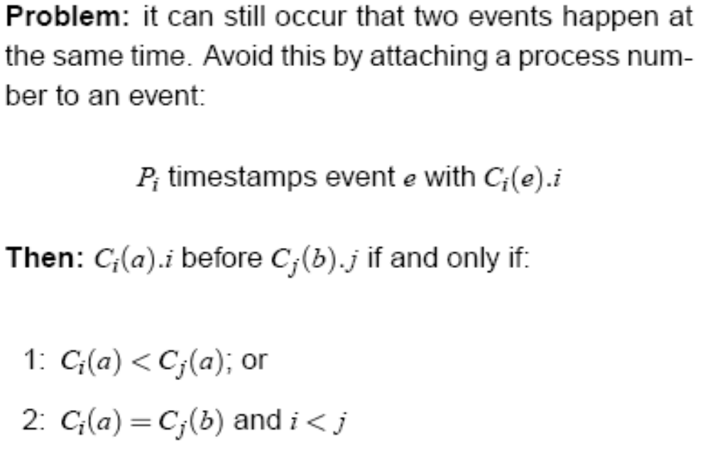
Total Ordering with Logical Clocks

Slide 28
Vector clocks
Lamport clocks: C(e) < C(e') doesn't imply e -> e'
each process keeps its own vector clock V_{i}
piggyback timestamps on messages

Slide 29
Vector clocks
updating vector clocks:
  VC1: Initially, V_{i}[ j ] := 0 for p_{i}, j=1.. N (N processes)‏
  VC2: before p_{i} timestamps an event, V_{i}[ i ] := V_{i}[ i ]+1
  VC3: p_{i} piggybacks t = V_{i} on every message it sends
  VC4: when p_{j} receives a timestamp t, it sets V_{j}[ k ] := max(V_{j}[ k ] , t[ k ]) for k=1..N (merge operation)‏

Slide 30
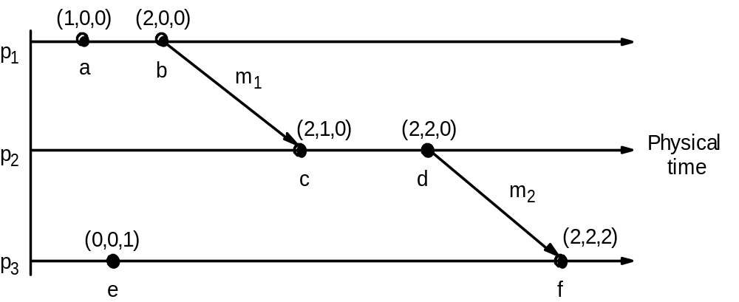
Vector timestamps

Slide 31
Vector clocks
At p_{i}
  V_{i}[i] is the number of events p_{i} timestamped locally
  V_{i}[j] is the number of events that have occurred at p_{j} (that has potentially affected p_{i} )‏

Slide 32
Comparing vector timestamps
V = V’ iff
  V[j] = V’[j], j = 1 .. N
V <= V’ iff
  V[j] <= V’[j], j = 1 .. N
V < V' iff
  V <= V' and V != V‘
    Different from < in all elements

Slide 33
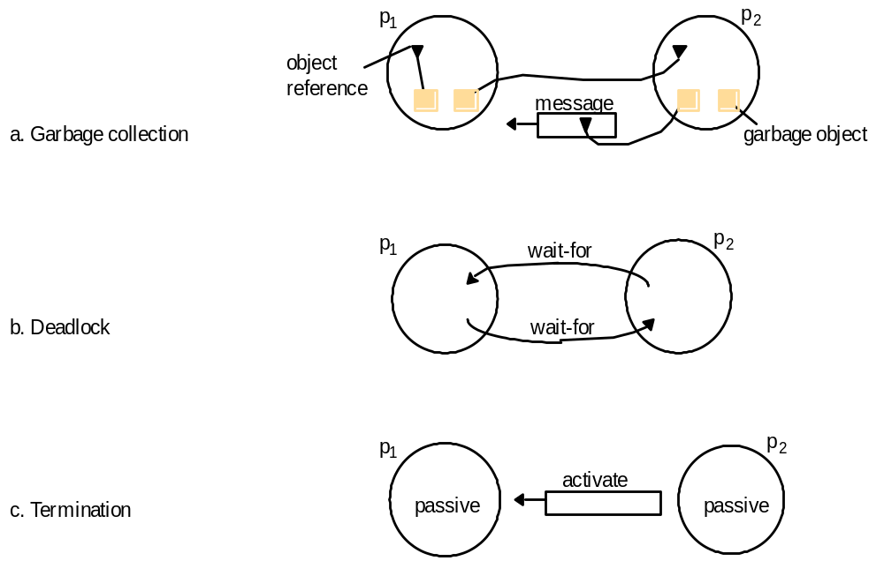
Global States
Detecting global properties

Slide 34

Global States
Essential problem is the absence of global time
  Perfect clock synchronization cannot be achieved -> global states cannot be observed from recorded state at agreed time
History of process p_{i}: h_{i} = < e_{i}⁰, e_{i}¹, e_{i}²,...>
  each event e_{i}^{k} is either an internal action of process or sending or receiving a message over communication channels
S_{i}^{k} is the state of process p_{i} immediately before the kth event occurs
Processes record sending and receiving of all messages as part of their state
Global history: H = h₀ h₁ … h_{N-1}
Cut of the system’s execution is a subset of its global history that is union of prefixes of process history:
  C = h₁^{c1} h₂^{c2} ... h_{N}^{cN}

Slide 35
Global States
Consistent global state
  State that corresponds to a consistent cut
  Global system state S = (s₁, s₂, .., s_{N})‏
Global state sequences
  Execution of system as series of transitions between global states of the system
    S₀ → S₁ → S₂ → ...
    In each transition precisely one event occurs at some single process in the system
    Linearization is an ordering of events in a global history that is consistent with happened-before relation on H
    S’ is reachable from a state S if there is a linearization that passes through S and then S’

Slide 36
Global state predicates
Detecting a condition such as deadlock or termination amounts to evaluating a global state predicate.
A global state predicate is a function that maps from the set of global states of processes in the system P to {True, False}.
One of the useful characteristics of the predicates associated with the state of an object being garbage, of the system being deadlocked or the system being terminated is that they are all stable
Once the system enters a state in which the predicate is True, it remains True in all future states reachable from that state.

Slide 37
Chandy-Lamport Algorithm
A snapshot algorithm for determining global states of distributed systems
Goal is to record a set of process and channel states for a set of processes p_{i} such that even though the combination of recorded states may never have occurred at the same time, the recorded global state is consistent
Algorithm records state locally at processes
Assumes that
  Neither channels nor processes fail: communication is reliable and message is eventually received exactly once
  Channels are unidirectional and provide FIFO-order
  Graph of processes and channels is strongly connected (there is a path between any two processes)‏
  Any process may initiate a snapshot at any time
  The process continues execution while snapshots take place

Slide 38
Chandy-Lamport Algorithm
Idea
  Each process records its state and also for each incoming channel a set of messages sent to it
  Process records for each channel any messages that arrived after it recorded its state and before the sender recorded its state
  Use of marker messages
    Prompt for receiver to save its own state
    Means of determining which messages to include in the channel state
  Two rules
    Marker sending rule
      Obligates processes to send a marker after they have recorded their state
      Before they send any other messages
    Marker receiving rule
      If process has not recorded its state (this is the first received marker)‏
        Obligates process to record its state
      If process has already saved its state
        Records state of that channel as the set of messages it received on since it saved its state

Slide 39
Chandy-Lamport Algorithm
Marker receiving rule for process p_{i}
  On p_{i}’s receipt of a marker message over channel c:
  if (p_{i} has not yet recorded its state) it
    records its process state now;
    records the state of c as the empty set;
    turns on recording of messages arriving over other incoming channels;
  else
    p_{i} records the state of c as the set of messages it has received over c
    since it saved its state.
  end if
Marker sending rule for process p_{i}
  After p_{i} has recorded its state, for each outgoing channel c:
  p_{i} sends one marker message over c
  (before it sends any other message over c).

Slide 40
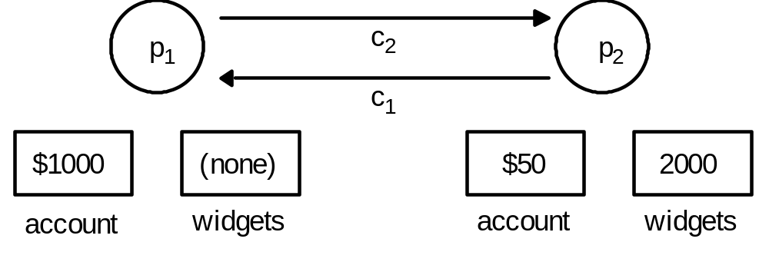
Chandy-Lamport Algorithm
Example

Slide 41
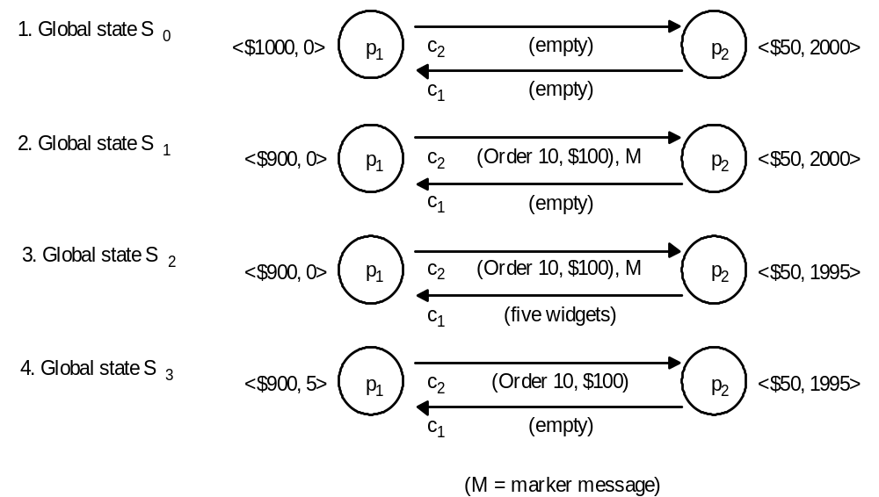
Chandy-Lamport Algorithm
Example

Slide 42
Chandy-Lamport Algorithm
Termination:
  Assumed that a process that has received a marker message records its state within a finite time and sends marker messages over each outgoing channel within finite time
  If there is a path of communication channels and processes from p_{i} to p_{j}, then p_{j} will record its state a finite time after p_{i} recorded its state
  Since the communication graph is strongly connected, all processes will have recorded their state and the states of incoming channels a finite time after some process initially records its state

Slide 43
Chandy-Lamport Algorithm
Cut and recorded state is consistent
  Let e_{i} and e_{j} be events occuring at p_{i} and p_{j}, and let e_{i} → e_{j}
  If e_{j} is in the cut, then e_{i} is in the cut.
  That is, if e_{j} occurred before p_{j} recorded its state, then e_{i} must have occurred before p_{i} recorded its state
    j=i: obvious.
    j≠i:
      Assume p_{i} recorded its state before e_{j} occurred
      Consider the sequence of H messages m₁, m₂, .., m_{H} giving rise to relation e_{i} → e_{j}
      Marker message would have received p_{j} ahead of each of m₁, ..., m_{H} and p_{j} would have recorded its state before event e_{j} -> contradicts assumption

Slide 44
Summary
Clocks
  Hardware clock value is scaled, and offset is added to it
  Clock skew is difference in time values
  Clock drift: clocks count time at different rates
  UTC is international standard for timekeeping
Synchronizing physical clocks
  Christian’s method uses time server
  Berkeley algorithm: master computer polls the other computers and collects slaves’ clock values
  Network Time Protocol: architecture over Internet
    Different levels of servers
Lamport’s clocks
  Happened-before relation is captured in logical clocks
Vector clocks are an improvement on Lamport clocks
  Each process has own vector clock to timestamp local events
  Timestamps are piggybacked in message
  We can tell whether two events are ordered by happened-before or are concurrent by comparing their vector timestamps
Global states
  Snapshot algorithm

