Slide 1



Didactic Solutions
Towards Growth
-- Zikra Shaikh
-- BE-Computer Eng
--Aiktc
Date: 10th September 2022
11am - 1pm (Saturday)

Slide 2



Agenda
11:10 AM
11:20 AM
11:40 AM
12:25 PM
12:35 PM
12:50 PM
Problem/opportunity
Value Proposition
Roles and Functions
Market
Image source — https://www.subpng.com/png-4ek66c/

Slide 3

Problem/opportunity
The IT industry is leading the todays worlds market.
There’s vacancies in every domain of IT.
IT Domain is Lagging the Skilled Professional
Every day there are 100s of startups in IT
Need of skilled professionals
Demand of e-leaning platforms with practical content
Image source — https://rhinosecuritylabs.com/assessment-services/red-team-engagement/

Slide 4
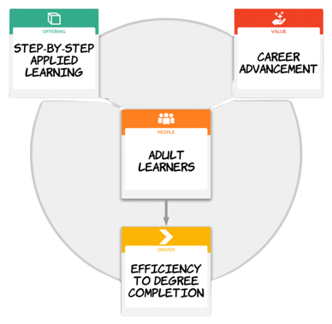
Value Proposition
Subject matter expert.
The highest quality learning courses.
On-demand learning solutions.
Globally available

Slide 5
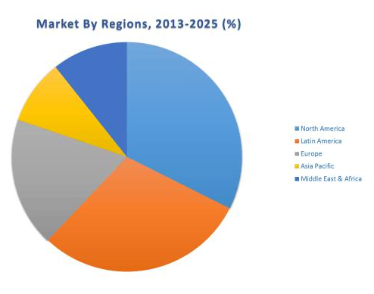

Market

Slide 6
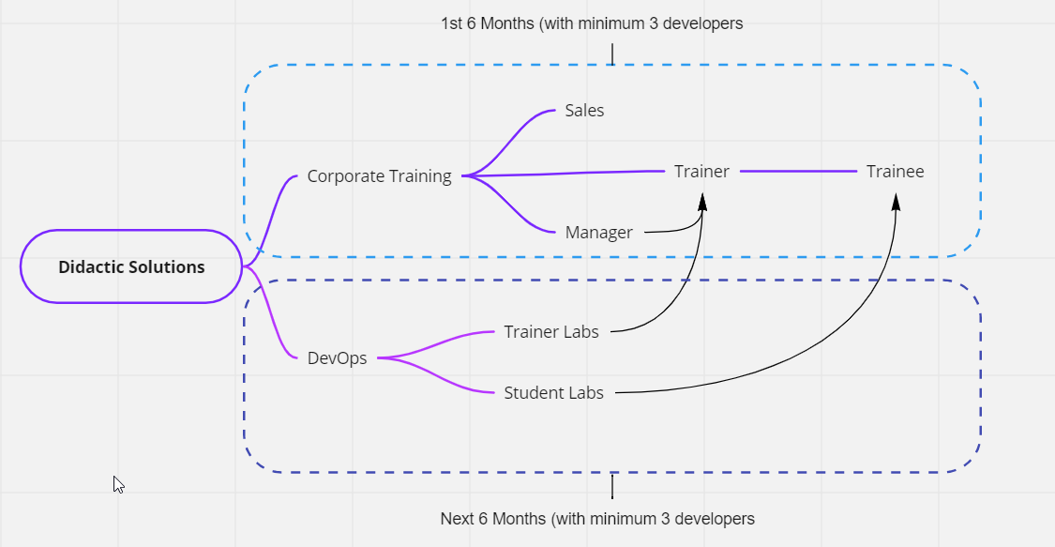
Roles and Functions
Workflow

Slide 7
Competitive Analysis
Workflow

Slide 8
Financial Projection
Workflow

Slide 9

Underlying magic
Every red team engagement will start by defining clear goals
Red team engagements also improve on regular penetration tests by considering several attack surfaces -
Technical Infrastructure
Social Engineering
Physical Intrusion
Depending on the resources available, the red team exercise can be run in several ways -
Full Engagement
Assumed Breach
Table-top Exercise
Image source — https://courseplay.co/wp-content/uploads/2018/08/3.png

Slide 10



Thank you :)
Questions/Suggestions…
Https://www.linkedin.com/in/7absec/
Aftab@maplecloudtechnologies.com

