Slide 1


October 21, 2022
Didactic
Solutions
Group no. 06
-- Khan Aftab(19CO23)
–Khan Muskan(19CO02)
--Shaikh Zikra(19CO08)
–Khan Sana(19CO03)

Slide 2

1
Objective
Today's
Agenda
2
Target Users
3
System Architecture
4
Literature Review
5
Technology Stack
6
Future Scope

Slide 3


Objective
The IT industry is leading the todays worlds market.
There’s vacancies in every domain of IT.
IT Domain is Lagging the Skilled Professional
Need of Skilled Professionals
Demand of E-learning Platforms with practical content.

Slide 4

Target Users
Students
Corporate Employees

Slide 5
Technology Stack
Frontend: Html5, CSS3,ReactJS
Backend: Python, Django REST Framework
Database: MySql

Slide 6
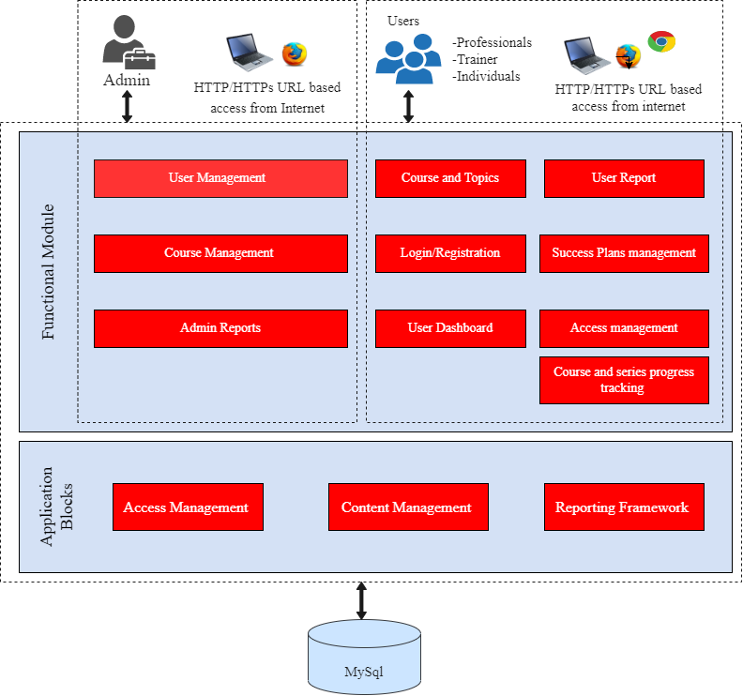
System Architecture:-

Slide 7
Literature Review:-
Koenig Solution
Description:- Online IT Courses - Koenig Solution is one of the World’s leading certification training provider, Offers short-term online training courses.
Features:-
Popular Technology list
Popular courses list
Chat bot
FAQ
Trending Technology
Query Form
Advantage:- Easy to use anyone can use it.
Disadvantage:-
User Interface not upto the mark.
Courses that it provide is costly.

Slide 8
Development and evaluation of a mobile educational application to support teaching of management of process in Operating Systems
Description:- It proposed the development of an educational mobile application called AlgOS, which aims to support the teaching and learning of process management in Operating Systems.The application is equipped not only with simulations of the main process scheduling algorithms, but also with theoretical studies and fixation exercises
Advantage:-
It is a Mobile Application which is easy to use.
For student satisfaction, a questionnaire was developed after using the application.
Notes was given available for all topic.
Disadvantage:-
The content of this application is only limited to one subject.
Live Teaching is not available in this particular Application.
Recorded videos are also not available in this Application.

Slide 9
The Blended Learning Study On Corporate training
Description:- Program planners involved the process of designing and implementing using blended learning from Sinopec training programs on Sinopec Learning Management System.It is build for Sinopec Group, one of the biggest global petro chemistry corporations.
Advantage:-
Blended learning environment supported students active participation to the course activities.
The result indicates that following the content of the courses,homework and program online was interesting and useful.
The creation of content that complement the learning process and the training’s final aims is made possible by the programme designers’ use of explicit objectives.
Disadvantage:-
Recorded videos are not available in this Application.
SLMS can provide with the issues of information access in corporate education institute

Slide 10

Future Scope
Certificates will be provided to students on completion of particular course.
Chat bot will be available for students.
Attractive UI.

Slide 11
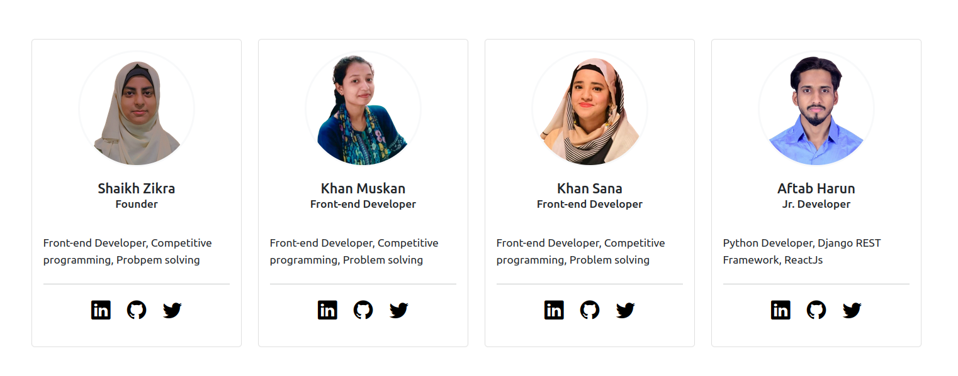
Our Team

Slide 12
We're done!
Thank you. Have a great day ahead.

