Slide 1

BCCE 2026
What chemistry faculty believe
about doctoral education
A phenomenographic and thematic characterization
Zoe Rahimi Pirkoohi
Jordan Harshman · University of Iowa
Supported by NSF CAREER #2142873 & #2602955 · Jordan Harshman, PI

Slide 2
Doctoral education trains the chemists who staff
the discipline — and the enterprise is straining.
~2,900
chemistry PhDs each year
~196
U.S. doctoral programs
unchanged
the same structure for decades
Faculty name four strains: balancing competing responsibilities, no standard assessment of outcomes, uneven implementation, and inconsistent, largely untrained mentorship.
Donkor & Harshman, 2023 · Collini et al., 2025
2

Slide 3
Reform changes the structures of the PhD, not what happens
inside — because beliefs absorb it without yielding.
A reform arrives
Structures change
Practice unchanged
Beliefs are self-perpetuating — they can absorb a reform
without yielding to it. So change must start with them.
Teacher-Centered Systemic Reform · Woodbury & Gess-Newsome, 2002
3

Slide 4
We know what faculty believe about teaching a class.
No one has characterized what they believe about advising a PhD.
TEACHING A CLASS
Beliefs well characterized —
and they predict practice
ADVISING A PhD
A different practice —
never characterized
The closest prior study set beliefs aside — a proper look “warranted its own study.” This is that study.
Kagan, 1992 · Donkor et al., 2024
4

Slide 5
RESEARCH QUESTION
What do chemistry faculty believe
about doctoral education?
what it’s for · how they learn · who develops which skill · the structure they work in
5

Slide 6
First, what counts as a belief? A proposition a person holds
true and acts on — not a fact, and not easily changed.
Propositional
held to be true
Evaluative
guides decisions
Personal
not group consensus
Resistant
survives counter-evidence
= a belief
We inferred beliefs from what faculty said and why — a knowledge claim answers to evidence; a belief is held on conviction.
Rokeach, 1968 · Green, 1971 · Nespor, 1987 · Pajares, 1992
6

Slide 7
We built those beliefs from twenty faculty’s
own words, coded to saturation.
Twenty faculty
U.S. doctoral programs, still advising
Interviews + card sort
~60 min, in their own words
Phenomenography +
thematic analysis
990 sub-codes
15 codes
4 themes
No new codes appeared after interview 7 — the result held from 10 participants to all 20.
Braun & Clarke, 2006 · Åkerlind, 2005
7

Slide 8
Here is the finding: faculty agree on the propositions —
and divide on exactly where each boundary falls.
AGREE
on four shared propositions
DIVIDE
on where the boundaries fall
“What differs is not which beliefs faculty hold, but where they draw the lines those beliefs require.”
8

Slide 9
BELIEF 1 · WHAT THE DOCTORATE IS FOR
The PhD builds a self-directed scientist —
in service of the student’s own goals.
“It’s not my career.
It’s not my goals.”
— P2, on whose goals lead
“When they start bringing ideas forward without necessarily being prompted.”
P2 — on what independence looks like
WHERE THEY DIVIDE
answering existing questions
asking new questions
The realistic goal of the degree, versus the higher bar. Independence is the shared claim; its reach is the split.
9

Slide 10
BELIEF 2 · HOW STUDENTS LEARN
Students learn by doing scaffolded research — but the
same lonely start taught two faculty opposite lessons.
“Finding the answers on my own was not the most efficient — but it made me a much better scientist.”
“Moving toward independence is really done in stages. Not something I tried to model at all.”
P13 — credited the struggle
P7 — drew the opposite lesson
Both were left alone as students. The shared belief is learning-by-doing; the divide is how much unsupported struggle helps.
P5: “I do. We do. You do.” · P12: “Can you teach someone else to do it?”
10

Slide 11
BELIEF 3 · WHO DEVELOPS WHICH SKILL — THE LARGEST THEME
Development is a shared, two-way job — yet the same skill
is one advisor’s to teach and another’s for the student to build.
“Creativity is the faculty’s to teach.”
— P5 · P17
“Creativity is the student’s to build.”
— P9 · P11
Every advisor draws a line between what they must teach and what the student must build — and they draw it in different places.
P6: “I go from the leader to the follower…” · P13: “I cannot teach you to be excited about the science.”
11

Slide 12
BELIEF 4 · THE STRUCTURAL CONDITIONS
Structure shapes advising — and the gaps it leaves
are the program’s to fix, not the student’s.
Fourteen of twenty
already name the gaps —
and can fix them.
“Those professional skills often get kind of forgotten.”
P2 — on the program’s gap
WHERE THEY DIVIDE
the evolved system works
curricula & funding need change
On structure, many faculty are already critics rather than obstacles — they disagree on which gaps are real.
12

Slide 13
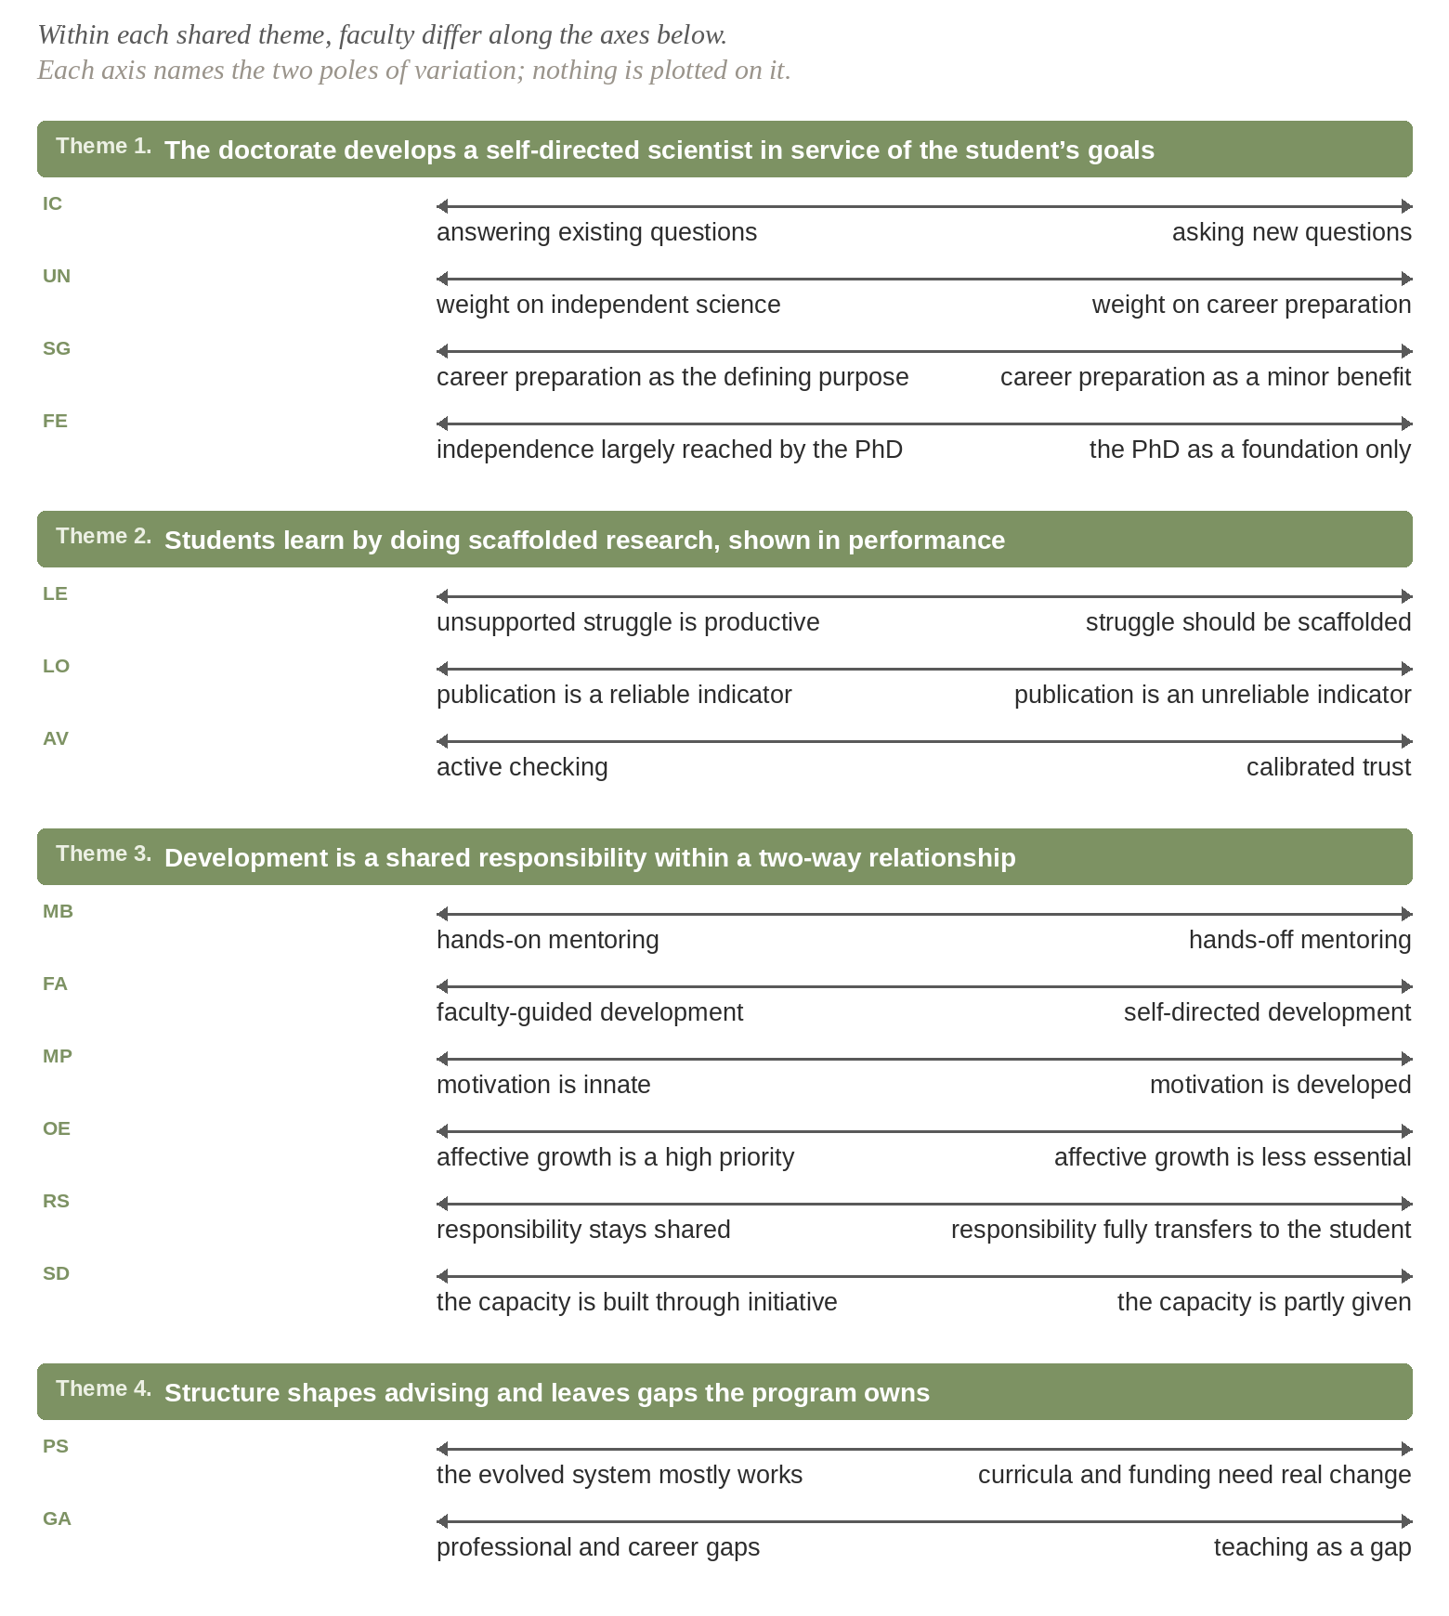
Agreement on every theme.
A fault line under every one.
Fifteen codes. Fifteen axes of division. Every faculty member lands somewhere on each — the agreement is real, and so is the disagreement one level down.
13

Slide 14
This gives reform its real map: shared ground to
build on, and where “aligned” colleagues diverge.
SHARED PROPOSITIONS
Common ground — argue from where
faculty already stand.
BOUNDARY DISAGREEMENTS
The real work — surface them, don’t
assume they’re settled.
And convictions stay stable while practice is refined —
so support the implementation, not just the belief.
13 of 20: stable convictions, refined implementation · Popova et al., 2021
14

Slide 15
IN ONE LINE
Four shared convictions about the PhD —
and the lines faculty quietly draw differently.
Thank you.
Zoe Rahimi Pirkoohi · Jordan Harshman · University of Iowa
Supported by NSF CAREER #2142873 & #2602955 · Jordan Harshman, PI

