Slide 1
Project Presentation of CO-OP Project at Industry (Module-2) (22CS421)
On
GAN for Synthetic Data
Generation
Lakshya Yadav(2210991846) , Gaurav Singh(2210991572), Eklavya Gehlawat(2210991553), Sudhanshi Garg(2210992413)
Supervised By Simar Vikk
Department of Computer Science and Engineering, Chitkara University, Punjab

Slide 2
Objective
Review GAN Architectures
Survey and categorize 23+ GAN architectures introduced between 2014–2024 into a structured three-tier taxonomy.
Analyze Training & Loss Functions
Examine how different training strategies and loss functions (e.g., Wasserstein loss, gradient penalty) impact GAN stability and performance.
Highlight Open Challenges
Discuss unresolved issues including evaluation standardization, scalability, privacy concerns, and dual-use governance risks.
Compare Performance Metrics
Evaluate and compare GAN models across image (FID, IS), tabular (TSTR), and time-series (discriminative & predictive scores) domains.

Slide 3
Introduction
Data collection & labelling is costly and scarce — annotated medical images, rare driving scenarios, etc.
Synthetic data is a solution if generated samples
are statistically indistinguishable from real data.
Pre-GAN models (VAEs, Normalising Flows) produced blurry, low-quality outputs
GANs (Goodfellow et al., 2014) revolutionized this — using a Generator vs Discriminator adversarial game to produce highly realistic synthetic data
This survey reviews 23+ GAN architectures across image, tabular, and time-series domains

Slide 4
HOW GANs WORK
GAN trains two neural networks simultaneously in a competitive game
Generator (G)
Takes random noise (z) as input
Outputs synthetic/fake data
Discriminator (D)
Takes both real and fake data as input
Tries to correctly label which is real and which is fake
The Goal:
G tries to fool D → produce realistic data
D tries to catch G → correctly identify fakes
At Global Optimum:
G perfectly replicates real data distribution
D can no longer distinguish → outputs 0.5 (50/50) for every sample

Slide 5
Key Architectures & Milestones
Decade-long progression in image synthesis quality:
Vanilla GAN (2014) → FID ~120, severe mode collapse
DCGAN (2016) → FID 37.11, convolutional + batch norm
WGAN-GP (2017) → FID 29.3, gradient penalty
BigGAN (2018) → FID 7.4, large-scale conditional
StyleGAN2 (2020) → FID 2.84, near photorealistic

Slide 6
GAN TAXONOMY
Foundational Frameworks — basic training protocols | Vanilla GAN, DCGAN
Stability-Oriented Models — convergence & gradient health | WGAN, WGAN-GP, SN-GAN
Domain-Specific Applications — optimised for data type | StyleGAN2, CTGAN, TimeGAN

Slide 7
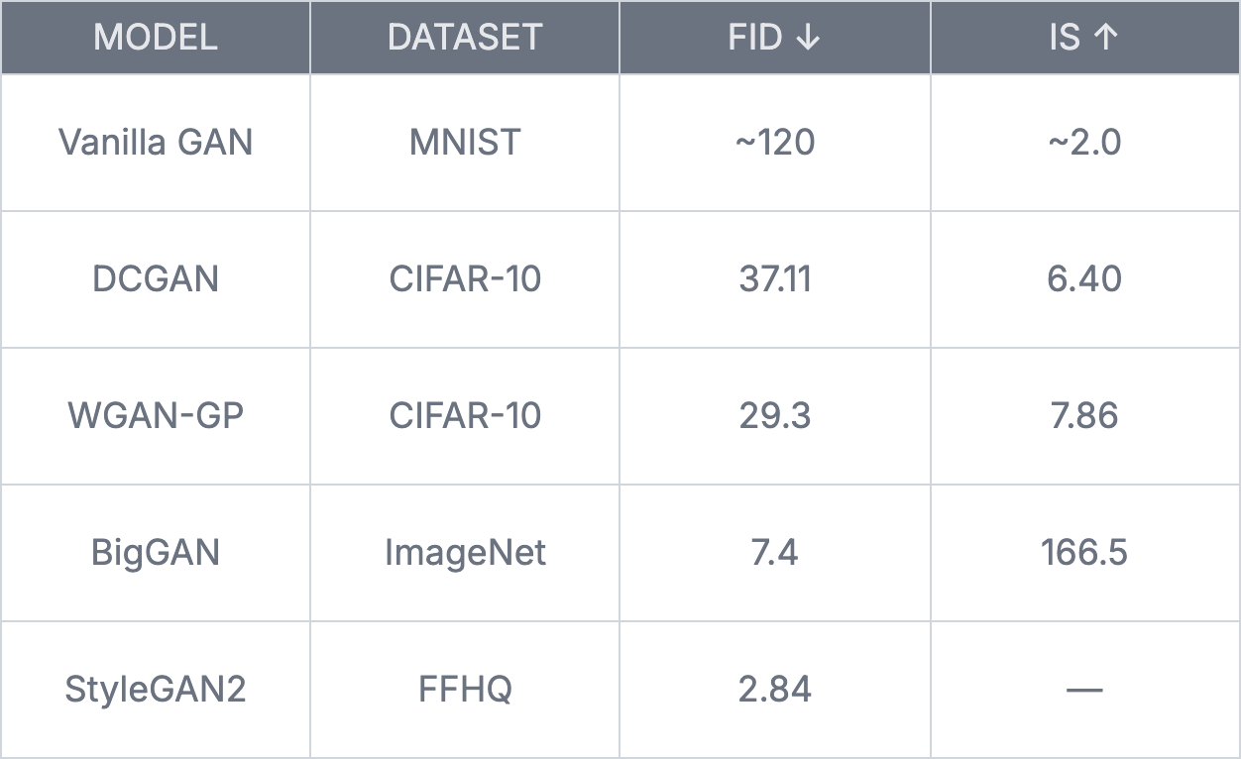
Results & Performa-nce Comparison

Slide 8
Future Scope
Standardised Benchmarks : No canonical benchmarks exist for tabular & time-series GAN evaluation.
Need datasets like CIFAR-10/ImageNet equivalent for non-image domains
Lightweight GAN Architectures : Current SOTA models (StyleGAN2, BigGAN) require datacenter-scale compute.
Future work → GANs deployable on low-resource/edge devices
Privacy-by-Design Pipelines : Formal (ε, δ)-differential privacy guarantees essential for Medical & financial synthetic data applications.
Builds on PATE-GAN framework.
Collaborative Governance : GAN misuse (deepfakes, disinformation) needs coordinated policy responses.
Technical fixes alone (watermarking, detectors) are not sufficient

Slide 9
Thank You

