Slide 1
Protein Family
Classifier
What We Built
k-mer (k=3) + RF
Mohamed Karim
37.5% Acc.
k-mer (k=4) + RF
Mohamed Karim
CAI4704: AI in Bioinformatics — Project 1
35.0% Acc.
Mohamed Karim
Reg: 221010054
Yousef Abdallah Khamis
Reg: 221002152
BLAST Baseline
Yousef Khamis
93.4% Acc.
Dataset: UniProt Swiss-Prot — Homo sapiens — 4 Classes — 80/20 Split

Slide 2
Dataset & Problem Setup
DATASET
Kinase
Protease
Receptor
Transporter
44
test samples
52
test samples
49
test samples
55
test samples
Phosphate transfer
Signaling enzymes
Peptide hydrolysis
Digestion & apoptosis
Signal transduction
Membrane proteins
Molecular transport
Membrane channels
Source
Organism
Seq Length
Split
Total Test
UniProt Swiss-Prot
(Reviewed only)
Homo sapiens
50–1,000 AA
80% Train
20% Test
200 samples
CAI4704 — AI in Bioinformatics | Project 1: Protein Family Classifier

Slide 3
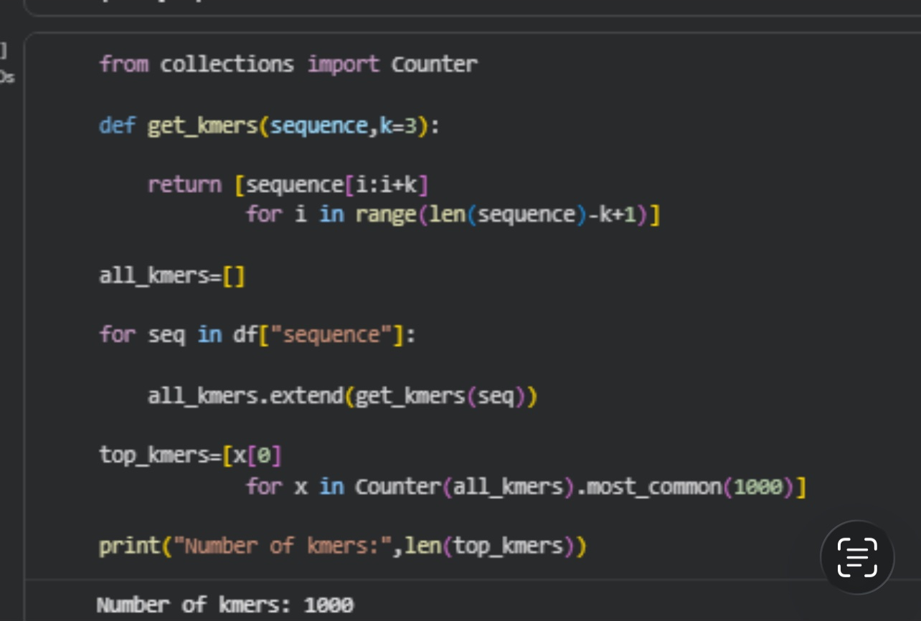
k-mer + Random Forest — Methodology
STUDENT B
Mohamed Karim | Reg: 221010054
How It Works
k=3 Extraction Code
1
Extract k-mers
Sliding window of size k=3 or k=4 over each amino acid sequence
2
Build Vocabulary
Count all k-mers across training set → select top 1,000 most frequent
3
Vectorize
Each sequence → frequency vector of shape (N, 1000)
4
Train RF
Random Forest: 100 trees, majority vote classification
CAI4704 — AI in Bioinformatics | Project 1: Protein Family Classifier

Slide 4
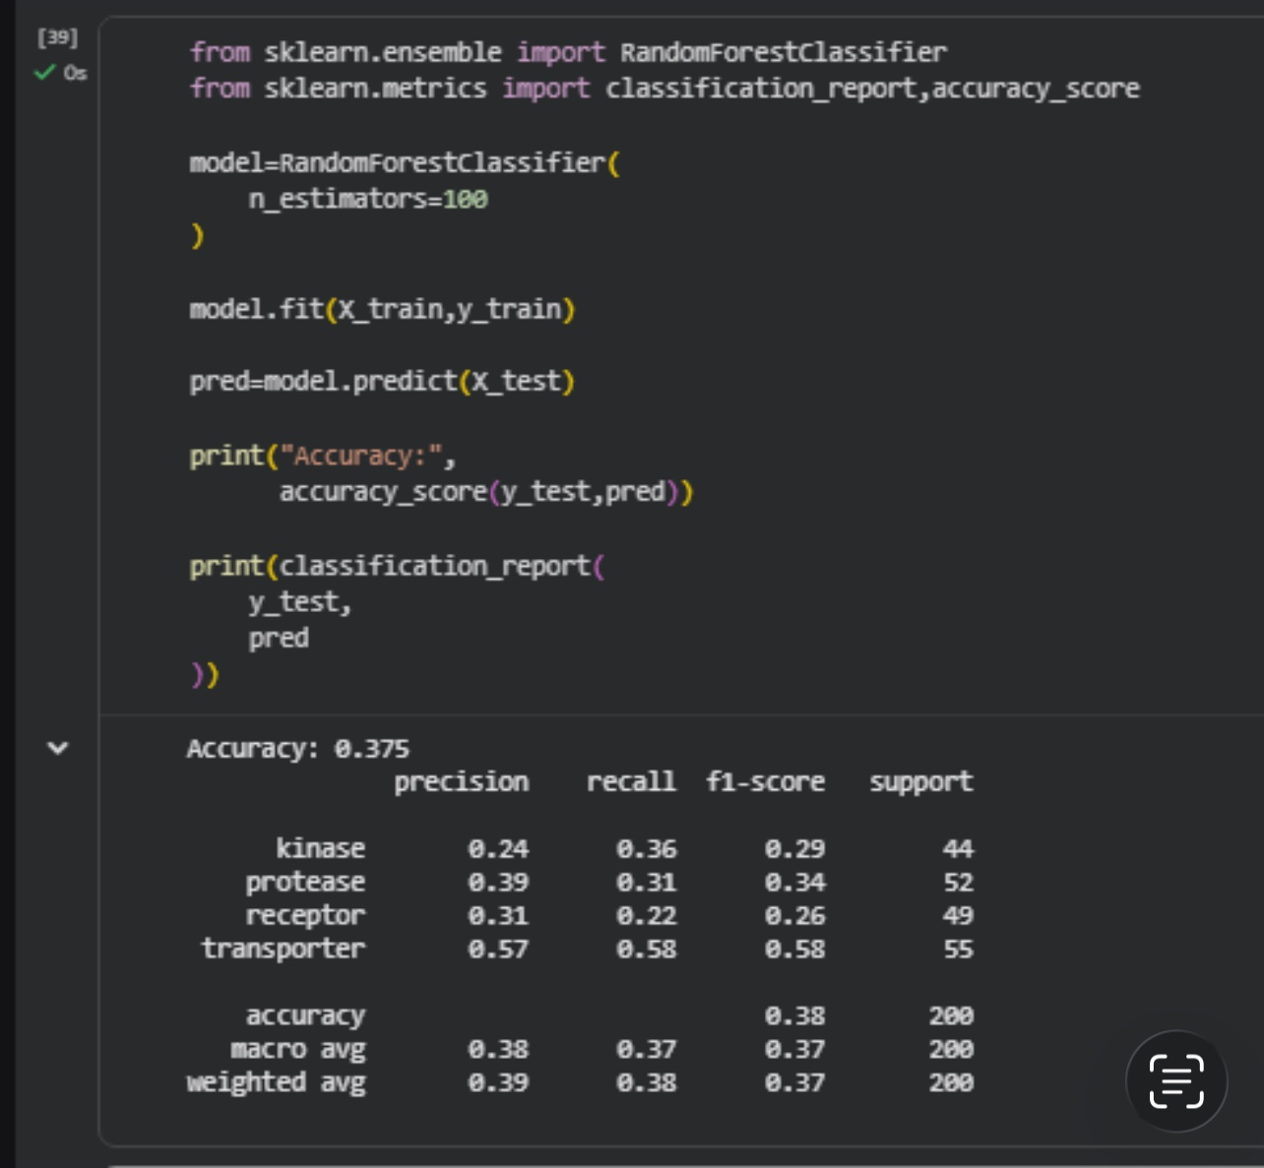
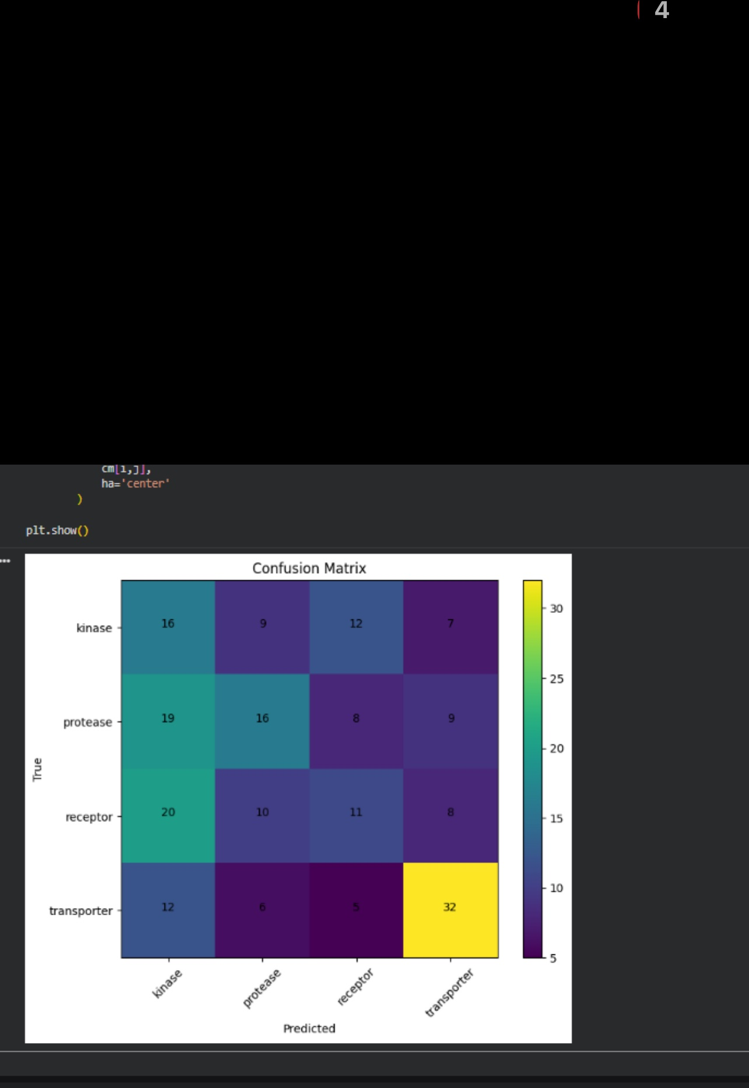
k-mer (k=3) + Random Forest — Results
STUDENT B
Mohamed Karim | Reg: 221010054
37.5%
0.37
Transporter
Kinase
Accuracy
Macro F1
Best Class
Hardest Class
Classification Report
Confusion Matrix
CAI4704 — AI in Bioinformatics | Project 1: Protein Family Classifier

Slide 5
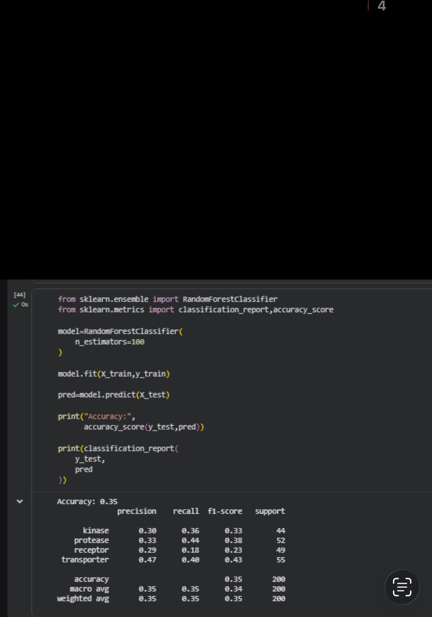
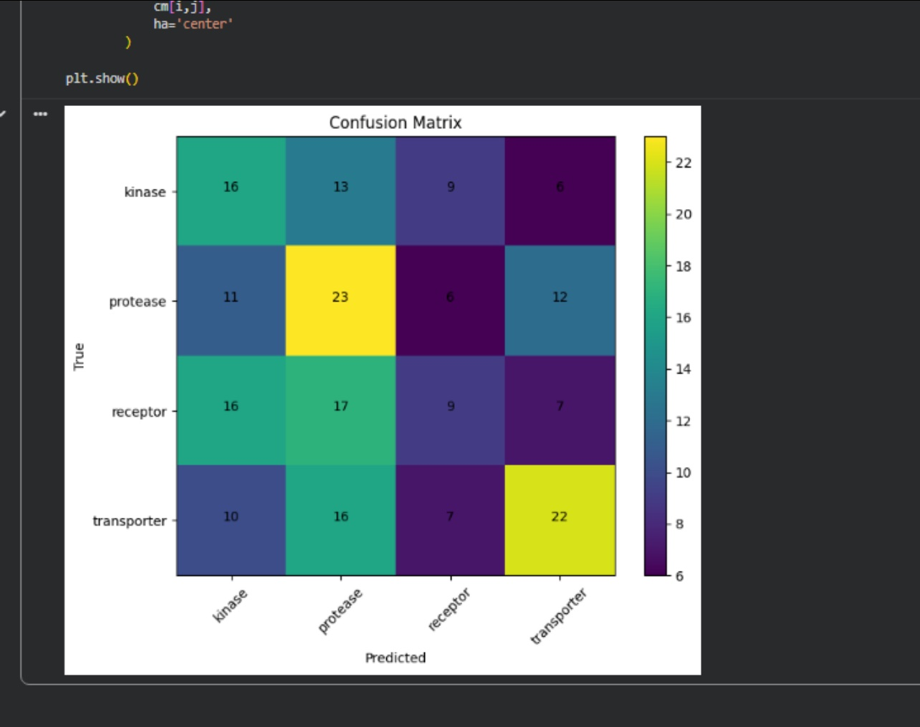
k-mer (k=4) + Random Forest — Results
STUDENT B
Mohamed Karim | Reg: 221010054
35.0%
0.34
Transporter
Receptor
Accuracy
Macro F1
Best Class
Hardest Class
Classification Report
Confusion Matrix
CAI4704 — AI in Bioinformatics | Project 1: Protein Family Classifier

Slide 6
k=3 vs k=4 Comparison
STUDENT B
Mohamed Karim | Reg: 221010054
Key Findings
▸ k=3 outperforms k=4 (37.5% vs 35.0%)
▸ Larger tetra-mer vocabulary (160K possible) means top 1,000 cover less of the feature space
▸ Tetra-mers are sparser per sequence → less training signal
▸ Transporter is easiest class in both models (distinctive hydrophobic TM helices)
▸ Kinase ↔ Receptor confusion in both — biologically expected (receptor tyrosine kinases)
CAI4704 — AI in Bioinformatics | Project 1: Protein Family Classifier

Slide 7
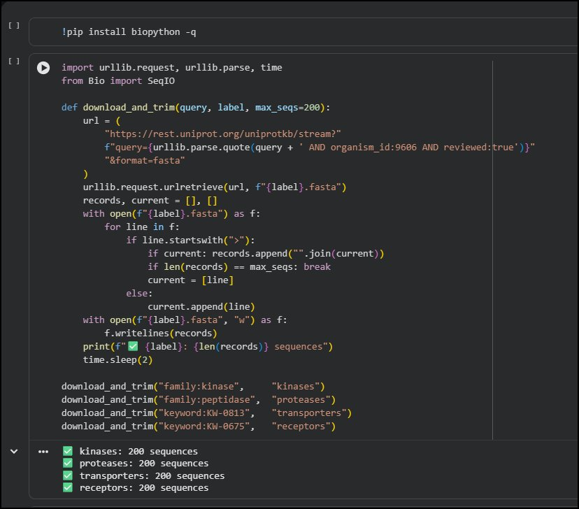
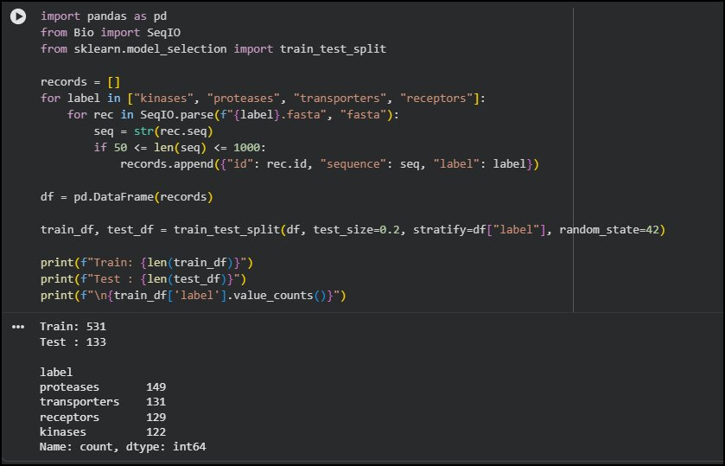
BLAST Baseline — Methodology
STUDENT A
Yousef Abdallah Khamis | Reg: 221002152
Data Acquisition
Data Acquisition
1
Download sequences per family from UniProt (200/family, Homo sapiens, reviewed)
2
Preprocessing
Filter by length (50–1,000 AA), 80/20 stratified split → 531 train / 133 test
3
FASTA Export
Export training sequences with label-embedded headers (>accession|family)
4
Build DB
NCBI BLAST+: makeblastdb -dbtype prot — creates searchable protein database
Preprocessing & Split
5
Run blastp
-outfmt 6, -max_target_seqs 1, -evalue 0.001 → 1-nearest-neighbor classification
6
Evaluate
Match rate check → accuracy on matched sequences only
CAI4704 — AI in Bioinformatics | Project 1: Protein Family Classifier

Slide 8
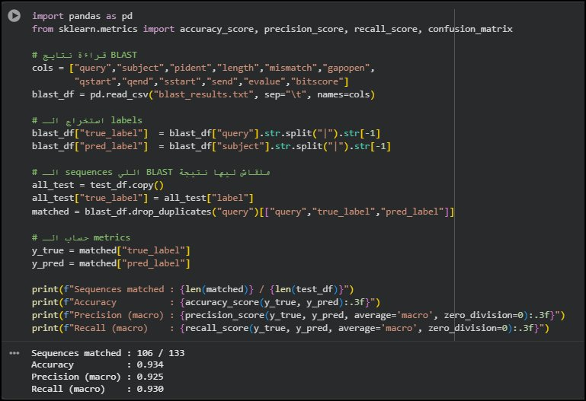
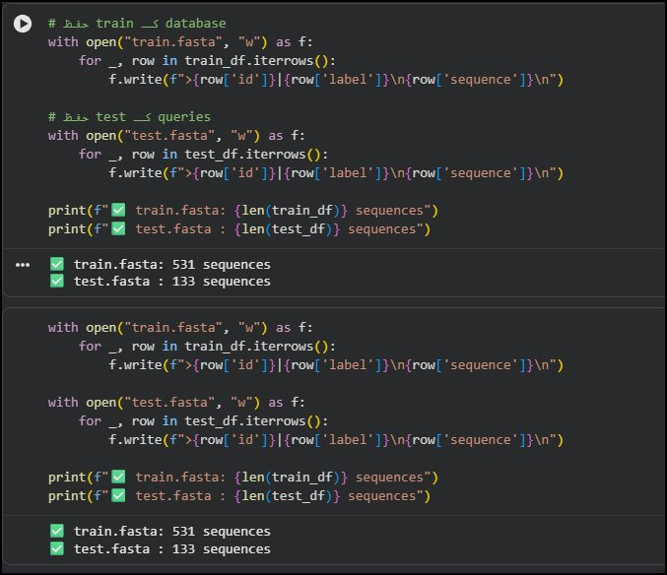
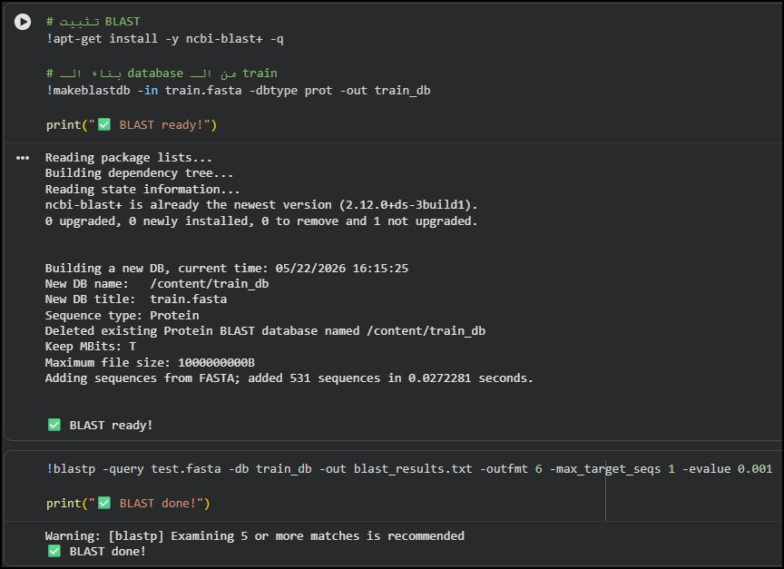
BLAST Baseline — Results
STUDENT A
Yousef Abdallah Khamis | Reg: 221002152
93.4%
79.7%
0.925
BLAST Evaluation Output
Accuracy
Match Rate
Macro Precision
FASTA Export
BLAST Search & Evaluation
CAI4704 — AI in Bioinformatics | Project 1: Protein Family Classifier

Slide 9
Model Comparison & Discussion
GROUP
Model | Accuracy | Macro F1 | Best Class | Coverage
k-mer (k=3) + RF | 37.5% | 0.37 | Transporter | 100%
k-mer (k=4) + RF | 35.0% | 0.34 | Transporter | 100%
BLAST Baseline | 93.4% | 0.93 | All classes | 79.7%
Discussion
▸ BLAST dominates (93.4%) — conserved motifs (P-loop, active-site triad, TM helices) are reliably detected by homology
▸ BLAST limitation: 20.3% unmatched — novel sequences with no database hit remain unclassified → k-mer as fallback
▸ k-mer above random baseline (25%) → useful signal; k=3 > k=4 due to vocabulary sparsity of tetra-mers
▸ Hybrid approach: BLAST for high-confidence + k-mer for unmatched sequences — best of both worlds
CAI4704 — AI in Bioinformatics | Project 1: Protein Family Classifier

Slide 10
Conclusion
🏆 BLAST wins: 93.4% accuracy on matched sequences — conserved motifs make homology search highly effective
📊 k-mer (k=3) best ML: 37.5% accuracy — above 25% random baseline, 100% sequence coverage
🔬 k=3 > k=4: tri-mer vocabulary better matches top-1000 feature selection constraints
⚠️ BLAST gap: 20.3% sequences unmatched — k-mer model can classify these novel proteins
🚀 Future: Hybrid BLAST + k-mer fallback, or protein language models (ESM-2) for better generalization
Mohamed Karim — 221010054 | Yousef Abdallah Khamis — 221002152 | CAI4704 Group 2

