Slide 1
Finding Concurrency Bugs with Jinx
Andrew Whitaker

Slide 2
Background
I was employee #4 at Corensic (2008 - 2012)
Core + Forensics
Mission: helping developers exploit the power of multi-core CPUs
This talk: helping developers find bugs in multithreaded programs with Jinx
The tool is no longer available
But, the ideas live on…

Slide 3
Multi-threaded Example
void transfer(Account *from, Account *to, int amount){
to->value += amount;
from->value -= amount;
}
addition, subtraction operations are not atomic

Slide 4
Multi-threaded Example (2)
void transfer(Account *from, Account *to, int amount){
atomic_increment(&to->value, amount);
atomic_decrement(&from->value, amount);
}
money can appear “out of thin air”

Slide 5
Existing Solutions
Stress Testing
Doesn’t catch all bugs
Race Detectors
Requires manual intervention to weed out benign races
Limited applicability (no custom synchronization, no kernel code).
Subject to false negatives

Slide 6
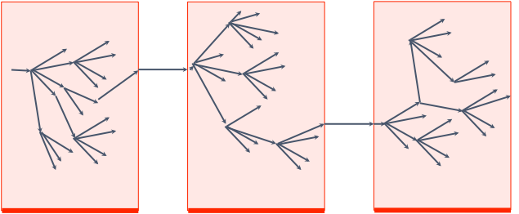
How Jinx Works
Jinx simply “makes bugs happen”
Zero burden placed on developers and testers
Jinx systematically simulates different thread schedules:
Background execution
Background execution
Background execution
simulation
round #1
simulation
round #2
simulation
round #3
Notes:
Notes: forward progress is stopped during a simulation round; each round creates a checkpoint of system state; explorations occur in a sandbox so that the results are not leaked to the user

Slide 7
The Jinx Hypervisor
Jinx runs underneath the OS
Implications: can find bugs in the OS; platform neutrality
MySQL
Firefox
Linux
Jinx
x86

Slide 8
Outline
Introduction
Thin hypervisors
Simulation mechanics
SmartStop
Simulation policies
Conclusions

Slide 9
Where to Implement Jinx?
Increasing
applicability
Runtime / Compiler
Operating System
Hypervisor
Increasing
semantic
knowledge
Hardware
Other considerations: ease of implementation, end user experience

Slide 10
Para-Virtualization
Jinx regains semantic knowledge by passing hints into the hypervisor:
Jinx Assert: indicates application crash
Jinx Magnet: indicates unusual event (e.g. thrown exception)
Registration: indicates process of interest
Application
OS
Hypervisor
Hardware

Slide 11
Thin Hypervisors
Traditional hypervisors load before the guest OS
A thin hypervisor loads after booting the OS
MySQL
Apache
MySQL
Apache
Linux
Linux
Jinx
x86
x86
Before activating Jinx
After activating Jinx

Slide 12
Thin Hypervisor Details
Jinx uses hardware virtualization (HVM) extensions to isolate the hypervisor from the OS
Virtualization pseudocode:
foreach processor:
disable_interrupts();
get_register_snapshot(&buffer); // like setjmp
hvm_enable(); // enable virtualization
initialize_hypervisor_state();
hvm_enter_guest(&buffer); // like longjmp

Slide 13
Thin Hypervisor Implications
Pros:
Transparent to the end user
Easier to implement for a rag-tag startup
Cons:
Not compatible with VMWare
Limited I/O virtualization
Limited length of simulation rounds
Outside simulation, all devices accesses are passed through to the hardware
Inside simulation, Jinx virtualizes a few frequently accessed devices (timers, APIC)
Other device accesses end simulation

Slide 14
Outline
Introduction
Thin hypervisors
Simulation mechanics
Simulation policies
Conclusions

Slide 15
Two Key Insights
Communicating memory accesses are the only instructions that change program output
Communication is rare in most applications
write(A)
thread 1
thread 2
read(A)

Slide 16
Jinx Simulation Phases
Survey: Identify the communicating pairs of accesses in an execution sample
CPU 1
CPU 2
Exploration: Re-run the sample with the two accesses reversed
(paused)
Retirement: Choose the best exploration to present

Slide 17
Survey Phase
Goal: compute a table of communicating memory accesses
Problem: hypervisor only “knows about” pages
Approach: arrange to page fault on all shared pages; single step or emulate each memory access
ID | CPU 1 | CPU 2
1 | read(A)
2 | write(A)
3 | write(B)
4 | write(A)
5 |  | read(A)
6 |  | write(A)
7 |  | read(B)
8 |  | write(A)
time

Slide 18
Exploration Phase
Goal: interleave communicating pairs of accesses
Explorations must be sandboxed
Memory accesses use copy-on-write snapshots
I/O events are skipped (for writes), emulated, or end simulation
Explorations must be replayable
Must find and eliminate non-determinism

Slide 19
Sources of Non-determinism
I/O events
Handled by logging/replay of input events
Multiprocessors
Handled via deterministic multiprocessing (DMP) (Oskin, Ceze ASPLOS 2009)

Slide 20
Deterministic Multiprocessing
Track ownership using a simplified MESI protocol
Shared
Exclusive
Invalid
Ensure determinism by forcing ownership transitions to occur in lockstep
read(x)
write(z)
read(x)
thread 1
quantum boundary
quantum boundary
thread 2
write(x)
timeout

Slide 21
Retirement Phase
Goal: replay the best exploration onto “reality”
Similar to exploration, except:
Don’t use COW memory
Pass I/O operations down to the raw hardware
SmartStop CPUs at an interesting location

Slide 22
Outline
Introduction
Thin hypervisors
Simulation mechanics
SmartStop
Simulation policies
Conclusions

Slide 23
Debugger Overshoot
Problem: the thread responsible for a crash appears nowhere near the bug
Break into
debugger
x=NULL;
thread 1
overshoot
thread 2
*x=17;
CRASH

Slide 24
SmartStop Overview
Goal: Stop each CPU at the earliest point
But, must preserve the final program state
too early
too late
x=NULL;
thread 1
causality
frontier
thread 2
*x=17;
CRASH

Slide 25
Happens-Before Relation
(Lamport, 1978)
A partial order of events that obeys causality
Events on a single processor happen before later events
Message sends happen before message receives
Transitivity: A < B, B < C ⇒ A < C
thread 1
write(x)
thread 2
read(x)
CRASH

Slide 26
Vector Clocks
Vector clock is a compact representation of causal influence.
Entry i represents the last instruction of processor i that influenced the current instruction.
Associate a vector clock with each CPU and shared memory address.

Slide 27
Vector Clock Example
time
ID | CPU 1 | CPU 2 | Clock 1 | Clock 2 | Clock A | Clock B
0
1 | read(A)
2 | write(A)
3 | write(B)
4 | read(A)
5 |  | read(B)
6 |  | read(A)
7 |  | write(A)
8 |  | CRASH
9 | write(A)
(0, 0)
(0, 0)
(0, 0)
(0, 0)
(1, 0)
(2, 0)
(2, 0)
(3, 0)
(3, 0)
(4, 0)
(3, 1)
(3, 2)
(3, 3)
(3, 3)
(3, 4)

Slide 28
SmartStop, Details
0 def add(self, pid, address, is_write):
1 """Record a memory access."""
2 vc = self.processor_clocks[pid]
3 vc = vc.increment(pid) # increment local entry
4
5 if address:
6 if is_write:
7 self.word_clocks[address] = vc
8 else:
9 vc = vc.pairwise_max(self.word_clocks[address])
a
b self.processor_clocks[pid] = vc
c return vc
See: https://github.com/7andrew7/smartstop/blob/master/smartstop.py

Slide 29
Fooling SmartStop
SmartStop can be fooled by irrelevant sharing
Ideal
stop point
void thread1() {
x = NULL;
lots_of_code();
y++;
}
void thread2() {
y++;
*x = 17;// segfault
}
Likely
stop point
Possible solution: iterative deepening
Keep trying successively more aggressive schedules

Slide 30
Outline
Introduction
Thin hypervisors
Simulation mechanics
SmartStop
Simulation policies
Conclusions

Slide 31
Simulation Policies
When do simulation rounds begin and end?
Which simulations do we explore within a round?
Which exploration do we retire at the end of a round?

Slide 32
Exploration Policy
ID | CPU 1 | CPU 2
1 | read(A)
2 | write(A)
3 | write(B)
4 | write(A)
5 |  | read(A)
6 |  | write(A)
7 |  | read(B)
8 |  | write(A)
Communicating pairs: (1, 6), (1, 8), (2, 5), (2, 6), (2, 8), (3, 7), (4, 5), (4, 6), (4, 8)

Slide 33
Exploration Policy #1: Random
Pros:
Simple to implement, understand
Works reasonably well
Cons:
May choose impossible reorderings

Slide 34
An Impossible Reordering
void thread1() {
lock(A);
B = 5;
unlock(A)
}
void thread2() {
lock(A);
C = B + 3;
unlock(A)
}
Attempting to reorder accesses to B will fail:
void thread1() {
lock(A);
DELAY
}
void thread2() {
lock(A);
}
lock never
granted

Slide 35
Exploration Policy #2: Freely Reorderable Pairs
Goal: only consider reorderings that are guaranteed to succeed
delay
thread 1
write(A)
thread 2
read(A)
These two accesses are freely reorderable

Slide 36
A More Complex Example
write(A)
write(B)
thread 1
thread 2
read(B)
read(A)
Accesses to B are freely reorderable
Accesses to A are not freely reorderable

Slide 37
Yet Another Example
write(A)
write(B)
thread 1
thread 2
read(B)
read(A)
All communications are freely re-orderable

Slide 38
FRP Implementation
Use the happens-before relation:
Two events are concurrent if neither happens-before the other
Concurrent events == freely reorderable
Note: read after write require special handling

Slide 39
FRP Details: Read After Write
write(A)
thread 1
pre-read
thread 2
read(A)
Problem: read after write is never concurrent
Because, the write happens-before the read
Solution: use the vector clock before the read takes place

Slide 40
Retirement Policy
Certain events increase the score of a simulation:
Assertions, magnets
Null pointer dereferences
Page faults
Other exceptions (div0, GPF, etc.)
Highest scoring simulation is retired
Experimental: signature-based retirement

Slide 41
Outline
Introduction
Thin hypervisors
Simulation mechanics
Simulation policies
Conclusions

Slide 42
Future Work?
Testing transactional memory (e.g., Intel TSX)
Testing relaxed memory models
Detecting performance bottlenecks (e.g., false sharing)
Avoiding concurrency errors (the anti-Jinx)

Slide 43
Conclusions
Jinx advantages:
Easy to integrate into existing workflow
Largely platform, language agnostic
No false positives
Tunable performance overhead
Jinx poses numerous meaty technical challenges

Slide 44
Hypervisor Benefits
Language agnostic
Can debug the OS itself
Doesn’t require changing the OS scheduler
Provides full control of machine state
Required for copy-on-write snapshots, communication tracking, etc.

Slide 45
Hypervisor Drawbacks
Poor understanding of application-layer abstractions (threads, locks, etc.)
No control over thread schedules
Can be stymied by optimizations
Implementation challenges
We’re basically writing our own OS
Limited length of simulation rounds

Slide 46
Case #1: Write after Read
ID | CPU 1 | CPU 2 | Clock 1 | Clock 2
0 | (0, 0) | (0, 0) | (0, 0) | (0, 0)
1 | read(A) |  | (1, 0)
2 |  | write(A) |  | (0, 2)
These events are concurrent (and freely reorderable)

Slide 47
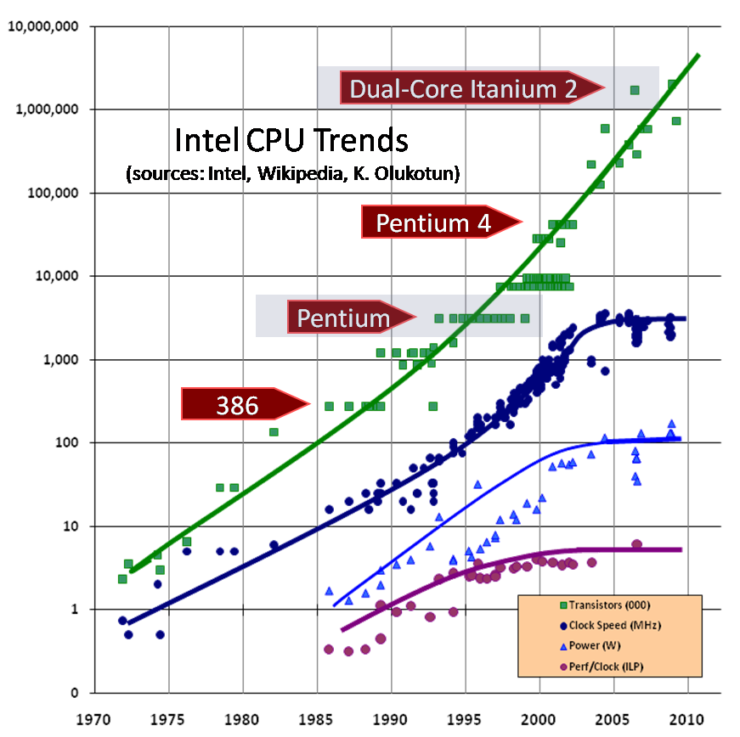
The Rise of Multicore Processors
Source: Herb Sutter
The Free Lunch is Over
http://www.gotw.ca/publications/concurrency-ddj.htm
Implication: Application writers must write concurrent programs to extract performance gains

Slide 48
Multi-threaded Example #2
Q: Is this program correct?
A: It depends!
JVM: No
Alpha: No
C on x86: maybe
int a = 0;
int b = 0;
void thread1(void) {
a = 1;
b = 1;
}
void thread2(void) {
while (b == 0) continue;
assert(a == 1);
}

