Slide 1

Ghrab
VOC — VULNERABILITY OPERATIONS CENTER
An operations center that thinks in attack paths, not findings.
An autonomous, agent-driven platform that reads raw scan results and our own infrastructure, then discovers the multi-step routes an attacker could take from the internet to our crown-jewel systems — every claim verified against reality first.
6/6
7
100%
3
documented attack paths rediscovered autonomously
specialized AI agents working as one team
of AI claims verified before display
AI providers with automatic failover
Notes:
Ghrab means raven in Arabic. This is a Vulnerability Operations Center — it thinks in attack paths, not findings. Lead with the four proof numbers.

Slide 2
01 · THE PROBLEM
Attackers chain findings. Dashboards show rows.
A scanner produces thousands of isolated findings, and humans triage them one by one, by severity. But a real attacker chains several “medium” findings across machines — and a pile of mediocre issues can hide one catastrophic route.
TRADITIONAL TOOLS SEE
GHRAB SEES
Rows in a table
Paths across machines
Rank by CVSS (the 0–10 severity score) , patch the reds, ignore the yellows. Each finding is judged alone; the relationships between them stay invisible.
It connects findings into the actual routes an adversary walks — internet foothold to crown jewel (our most business-critical system) — ranked by the damage each route enables.
Notes:
Scanners produce thousands of isolated findings; humans triage by CVSS. But attackers chain mediums across machines. A table of rows cannot see a route.

Slide 3
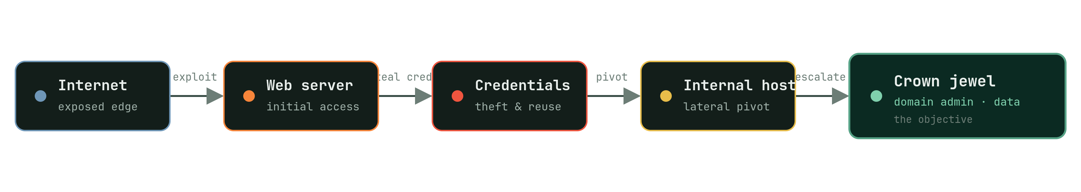
01 · THE PROBLEM, MADE CONCRETE
One attack path, in five hops
Each hop on its own might be a “medium.” Together they form a direct line to the target — exactly the kind of route Ghrab is built to surface.
Notes:
Each hop alone might be a medium. Together they form a direct line to the target. This is what Ghrab is built to surface.

Slide 4
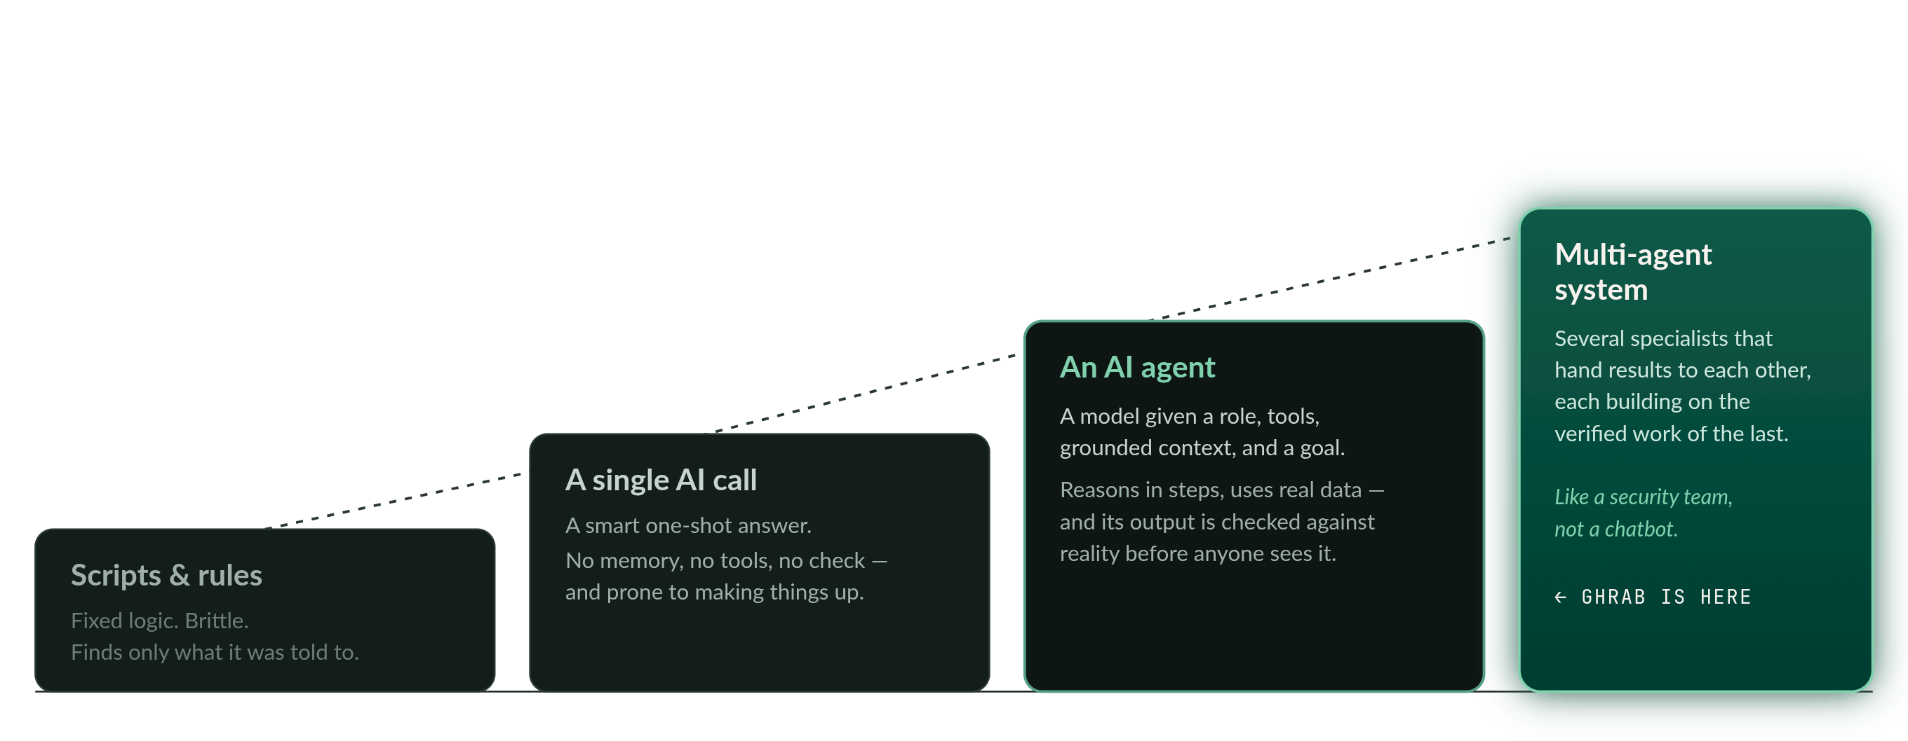
02 · WHAT AN AI AGENT ACTUALLY IS
From a script to a security team
Each rung adds one capability the rung below it lacks. Ghrab sits on the top rung.
Notes:
The ladder: script, single AI call, agent, multi-agent system. Each rung adds one capability the one below lacks. Ghrab sits on the top rung.

Slide 5
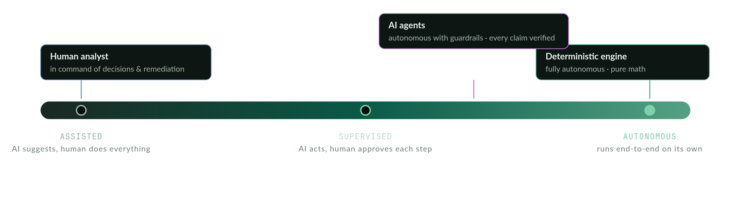
03 · DEGREES OF AUTONOMY
Autonomy where it’s safe, judgment where it matters
Ghrab places each part of the system deliberately on the spectrum — and keeps the analyst in command of the decisions that carry consequences.
Notes:
Autonomy where it's safe, human judgment where it matters. Deterministic engine fully autonomous; agents autonomous with guardrails; the analyst stays in command.

Slide 6
04 · THE AGENT TEAM
Seven specialists, one investigation
Analyst Detection Agent
FLAGSHIP
Given only the infrastructure grounding and a classification of what each finding enables — no hints, no pre-solved answers — it independently reasons out attack paths hop by hop. Every hop is verified against real hosts and real finding IDs.
Discovery Agent
Correlation Agent
Compliance Agent
Validates, ranks and narrates the graph engine’s candidate chains — and hunts “toxic combinations” dangerous only together.
Cross-references the full asset inventory against every finding to surface non-obvious risk and re-prioritize beyond raw severity.
Maps findings and attack paths onto compliance and regulatory impact — a technical route becomes an audit-relevant statement.
groundeddeterministic chains
groundedinventory + findings
groundedfindings + paths
verifiedfinding IDs
verifiedhost references
verifiedcontrol mapping
Triage Agent
Remediation Agent
Grounded AI Analyst
chat
Reads every prior agent’s conclusions and writes one consistent executive synthesis — the narrative on the Command Center.
Turns paths into concrete, ordered fix plans — surfacing the single fix that severs the most attack paths at once.
A streaming conversational analyst answering questions by citing real discovered paths and finding IDs — never generic advice.
groundedall agent outputs
groundedthe attack graph
groundeddiscovered paths
verifiedconsistency check
verifiedpath coverage
verifiedcited IDs
Notes:
Seven specialists, one investigation. The Analyst Detection Agent is the flagship — it reasons out paths from scratch. The rest run in sequence, each grounded in verified work.

Slide 7
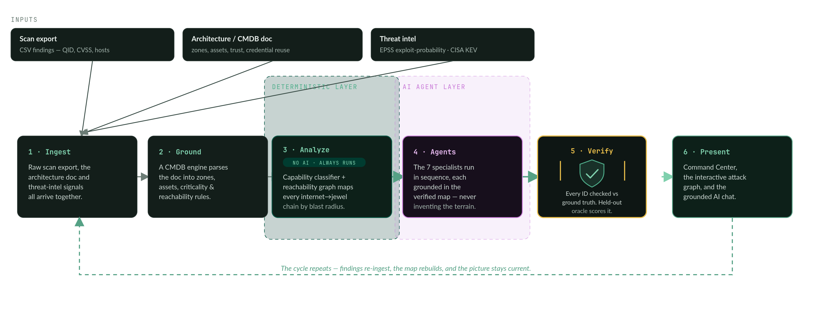
05 · THE PIPELINE CYCLE
Math first, AI second, verified before you see it
QID = scanner’s finding ID · CMDB = inventory of our systems · EPSS = probability a vuln is exploited · KEV = catalog of known-exploited vulns
Notes:
The centerpiece. Math builds a verified map first, agents reason over it, and a verification gate stands between the AI and the screen. The deterministic and AI layers are drawn distinct.

Slide 8
06 · WHY YOU CAN TRUST IT
The AI can’t make things up and reach the screen
01
02
03
04
Deterministic first
Answer key locked away
Post-generation checks
The score is public
The AI never invents the map. It reasons over a map the math already built and proved.
Documented paths sit outside the pipeline — an exam key in a drawer. Agents can’t cheat; they’re scored against it after.
Every cited path, finding and host is re-checked. Anything unverifiable is filtered before the UI.
A Verification page shows how the AI scores against the held-out oracle — honestly, in the open.
6 / 6
6
0
documented attack paths the engine rediscovers — on both test environments.
grounded paths the Analyst Agent found independently, all hitting real crown jewels.
unverifiable references allowed to reach the screen.
Notes:
Four design choices make confident invention structurally hard. And we measure the result publicly — 6/6 rediscovered, 6 found independently, 0 unverifiable references reach the screen.

Slide 9
07 · ENGINEERING RESILIENCE
No single AI vendor can take us down
The platform runs across three independent AI providers with automatic failover, paced to each provider’s limits and retried with backoff. If one has an outage, analysis continues.
Mistral · Groq · Gemini
Rate-limit pacing
Retry with backoff
Three providers behind one interface. If a request fails, it fails over to the next automatically.
Calls are paced per provider so we stay within limits instead of hammering into errors.
Transient failures are retried with increasing waits — a hiccup never becomes a stall.
Notes:
Three independent AI providers behind one interface, with automatic failover, per-provider pacing, and retry with backoff. No single vendor outage stops analysis.

Slide 10
08 · BUSINESS VALUE
Machine speed against a machine adversary
Attackers already automate the chaining of findings. A defense that reviews findings one at a time is structurally outmatched. Ghrab thinks in chains, continuously, and explains itself in plain language.
From noise to routes
The one fix that matters
Audit-ready mapping
An analyst on call
Thousands of findings become a ranked short list of real attack paths.
See the single remediation that severs the most attack paths, first.
Findings and paths tied to compliance impact, ready for review.
A grounded chat answers questions instantly, citing real evidence.
IN THE LIVE PLATFORM TODAY
Command Center
Findings explorer
Attack Paths graph
Teams
Correlation
Compliance
Grounded AI Analyst chat
Verification page
Notes:
Attackers automate chaining; a one-by-one defense is outmatched. Ghrab thinks in chains, continuously, and explains itself. Name the live views.

Slide 11
09 · WHAT I’M ASKING FROM YOU
Back the production rollout
Ghrab VOC works today and proves itself against a held-out answer key. To run it as core infrastructure, I’m asking for support to harden it for production and connect it to more of our data.
Production hardening
Continuous re-scans
More data connectors
Postgres, Redis, background job workers, single sign-on (OIDC) and a centralized LLM gateway — the plumbing that makes it enterprise-grade.
Scheduled, automatic re-analysis so the attack-path picture stays current between manual reviews.
Direct feeds from more scanners and inventory sources, so coverage grows without manual exports.
Notes:
Ghrab works today and proves itself against a held-out key. Ask for support to harden it for production and connect it to more data.

Slide 12

Ghrab
VOC — VULNERABILITY OPERATIONS CENTER
An operations center that thinks in attack paths, not findings.
غراب · the raven
Notes:
Close on the thesis and the mark. Ghrab — the raven — thinks in attack paths, not findings.

