Slide 1

Modern Development Tools

Slide 2
Welcome to django
What is Django ?
Django is python web development framework
Allows us to build websites and web projects using python.
Of course, we will still use html , CSS and JavaScript for the front end but for the server side we will use Django with python
Notes:
Explain what is a framework

Slide 3
Course prerequisites
Basic python knowledge
Basic web dev knowledge
Notes:
Explain the basic web dev knowledge like requests and what is front end and back end

Slide 4
How to start
Install the latest version of python from
https://www.python.org/downloads/
To make sure python is installed
Open the cmd
Enter the command :
Python or python3 or py depending on your device and the python version

Slide 5
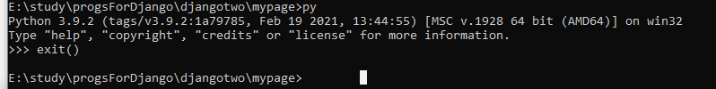
How to start
To exit from the python shell enter the command : ctrl z or exit()
Notes:
Explain what is a framework

Slide 6
How to start cont.
Install django
on the cmd enter the command :
py -m pip install Django
To make sure Django is installed
Enter the command in the cmd
django-admin
Notes:
Explain what is a framework

Slide 7
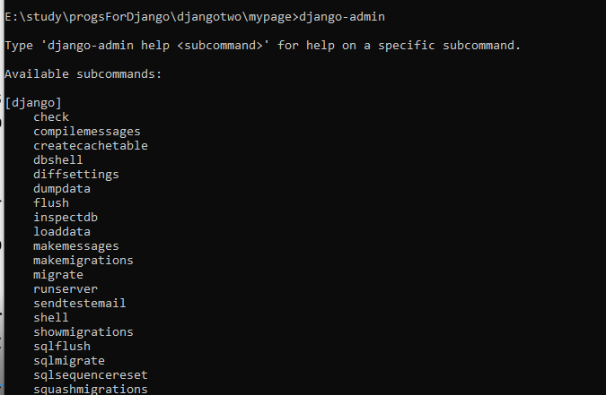
How to start cont.
Notes:
Explain what is a framework

Slide 8


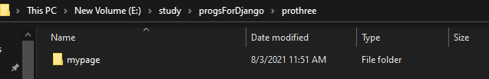
Create a new Django project
navigate to the project location using the cd command
Create new project using the command :
django-admin startproject ProjectName
The project folder is created
Notes:
Explain what is a framework

Slide 9
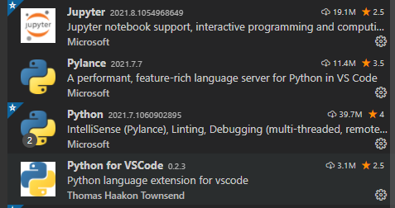
Development environment setup
Install IDE / editor recommended : vs code
In the vs code install the extensions
Notes:
Explain how to install the extensions

Slide 10
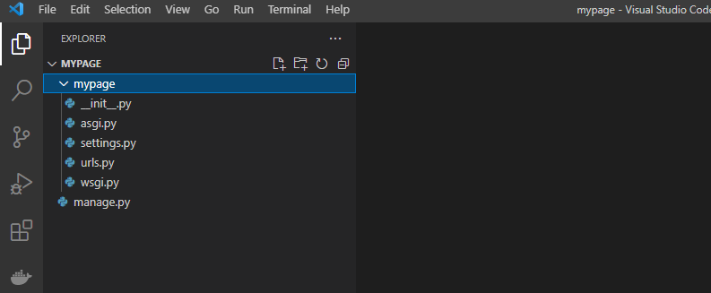
Development environment setup
To open the project folder using the vs code in the cmd enter the command :
code .
The vs code open
Notes:
Explain how to install the extensions

Slide 11
Django python files
Manage.py we use to start the development server or setting a database because it will give access to some build in Django command so we should not edit this file
Asgi.py and the wsgi.py they will become important later when we deploy our project on the web .
Setting.py holds the configuration and the global setting of the project .
Urls.py is important when we start adding more pages to our web application .
Notes:
Explain how to install the extensions

Slide 12
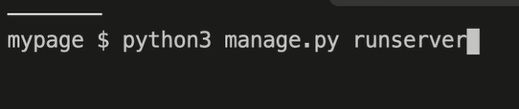
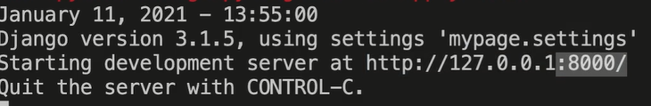
Start a development server
We need to launch a local development server to preview and test the website
Run the command : py manage.py runserver
This command Supported by manage.py and Django
And then go the address shown in the terminal .
Notes:
Explain how to install the extensions

Slide 13
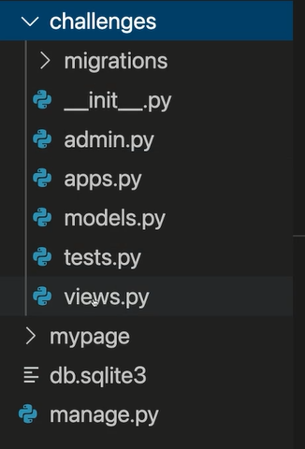
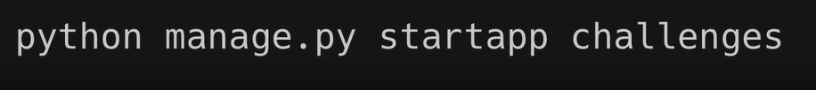
the apps concept
Django projects are a modular structure
Those modules in Django are called apps
To create an app in Django run the command :
Notes:
Explain how to install the extensions

Slide 14
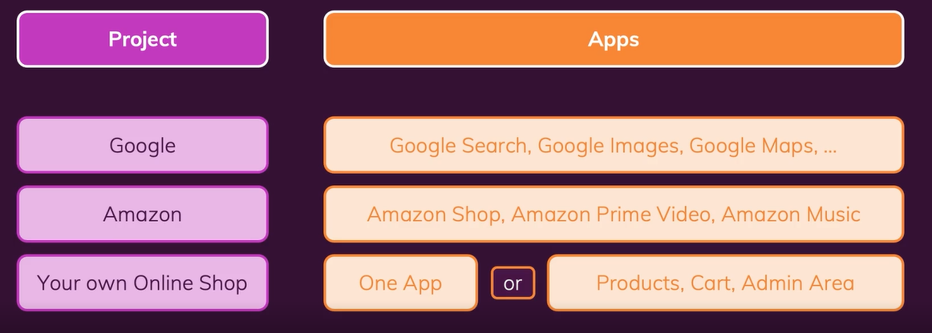
Django apps
The mypage folder contain the project wide configuration for the entire project
Then we got individual apps which we add to the project and each app is a different feature to this project .
Notes:
Explain how to install the extensions

Slide 15
The app challenge structure
Models.py will become important once we start working with the database and add data models to our project.
Tests.py will help with automated testing unit.
Views.py that is where we determine what we want to show to the user .
Notes:
Explain how to install the extensions

Slide 16
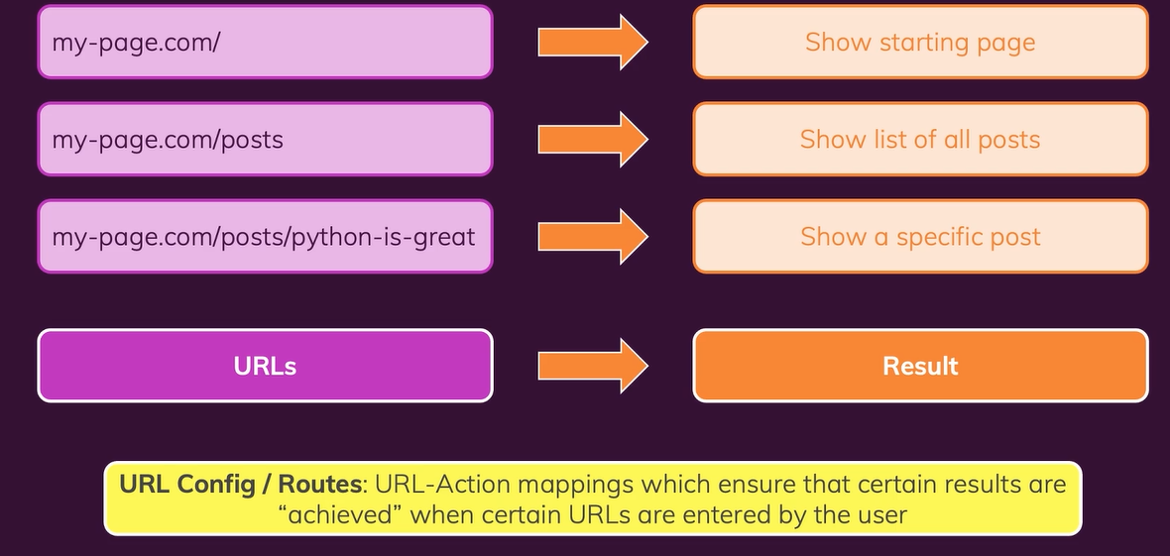
URLs or routes
Urls are responsible for displaying the website .
The user uses the url to make requests to the server which return a different response and result depending on the url or the request.
Notes:
Explain how to install the extensions

Slide 17
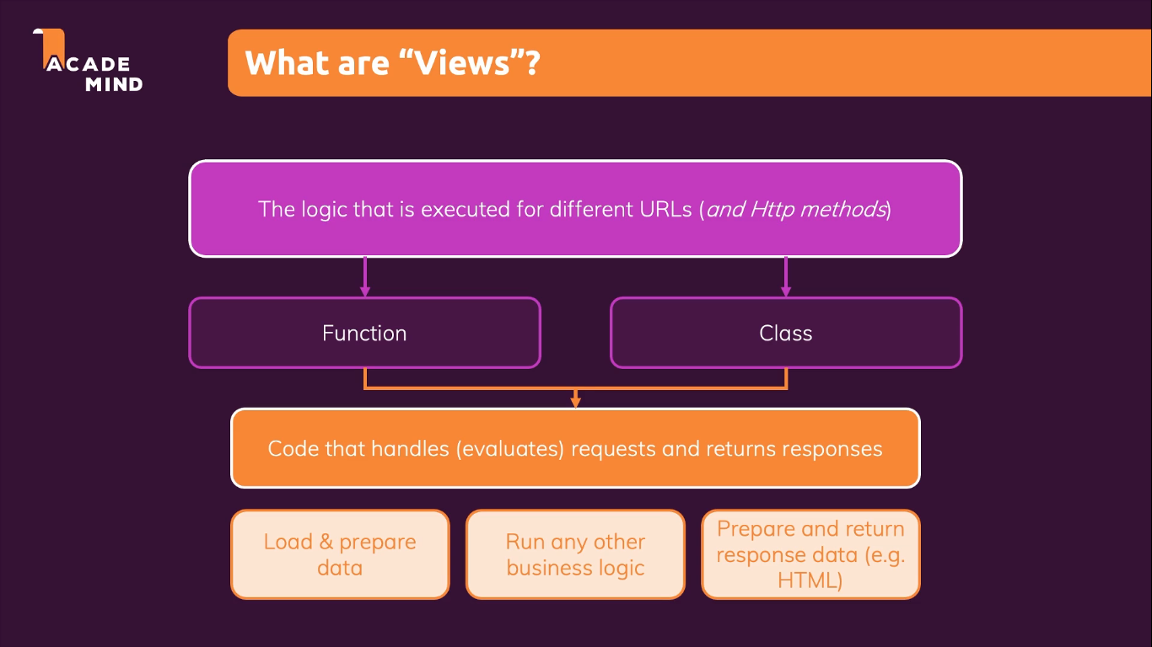
views
Views are the logic or action that is executed for different URLs
Views are functions or a class in python in a Django project which executed automatically when a specific request is made and returns responses.
Notes:
Explain how to install the extensions

Slide 18
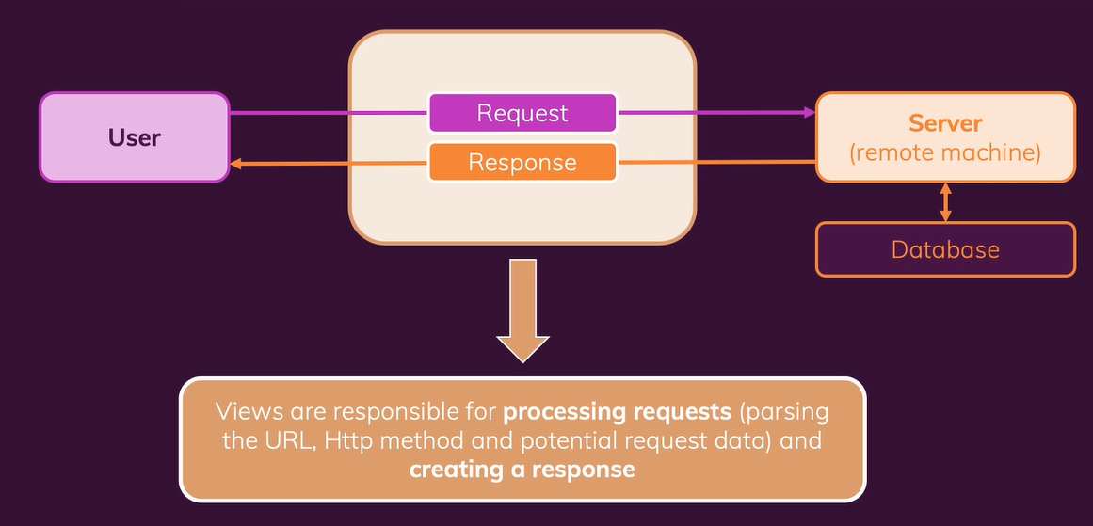
Writing Our first views and url
Go to the views.py in the app folder
Django will automatically execute the function when the request hits the server and forwarded to this function.
Notes:
Explain how to install the extensions

Slide 19
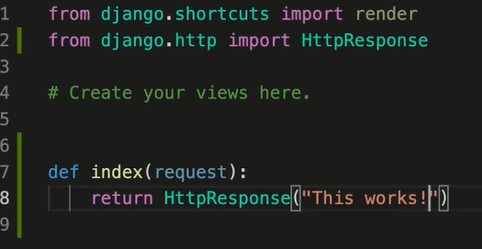
Writing Our first views and url cont.
Notes:
Explain how to install the extensions

Slide 20
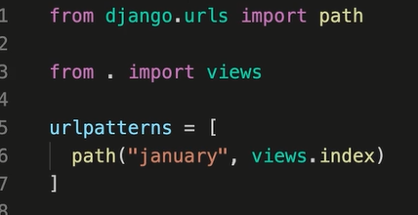
Writing Our first views and url cont.
To add the url for our function add another file in the app folder that we are working on called urls.py
And in that file add a list for all the url you want to support using the path function
Notes:
Explain how to install the extensions

Slide 21
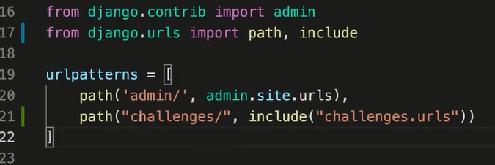
Writing Our first views and url cont.
Now we need to connect this app to the entire project
We need to make the entire project url config aware of the app url config that we are working on.
In the urls.py in the project folder .
Then test the server and the request.
Notes:
Explain how to install the extensions

Slide 22
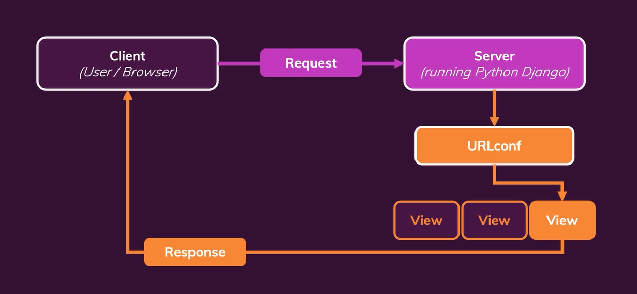
Request and response flow
Notes:
Explain how to install the extensions

Slide 23
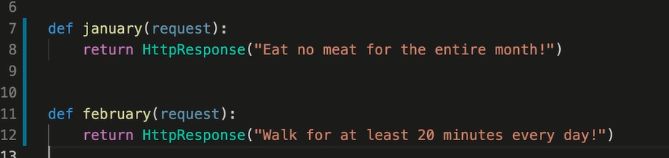
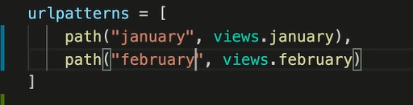
Add another view
Notes:
Explain how to install the extensions

Slide 24
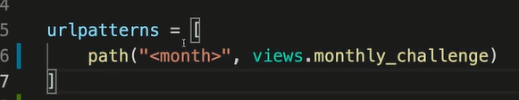
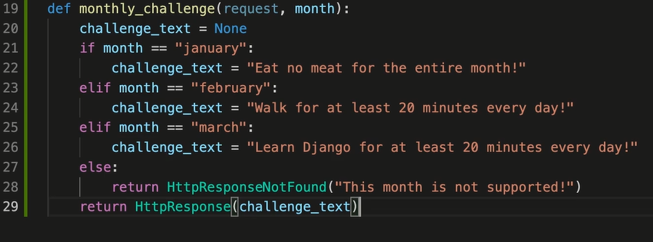
Set dynamic url and view
Set one url pattern for all the months instead of making twelve urls for each month using a place holder.
Set one view function which is triggered by this dynamic url and return a different response based on the value of the month
Notes:
Explain how to install the extensions

Slide 25
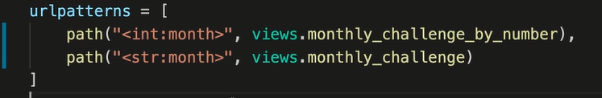
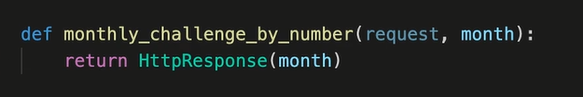
Changing the data type of the place holder
Notes:
Explain how to install the extensions

Slide 26
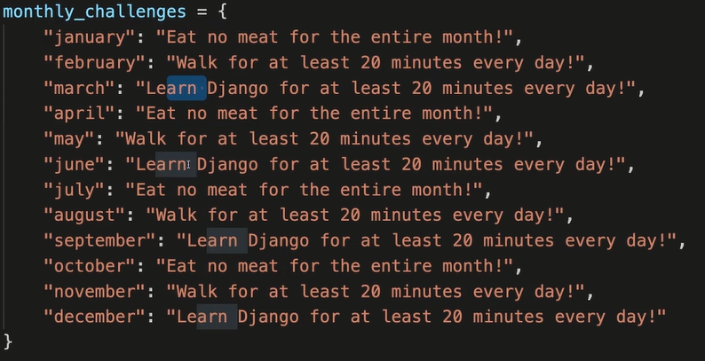
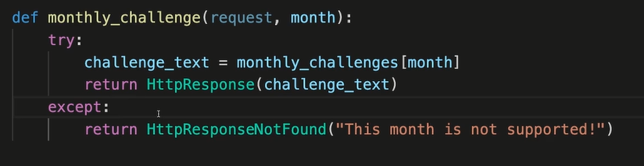
Continue optimizing the view
Notes:
Explain how to install the extensions

Slide 27
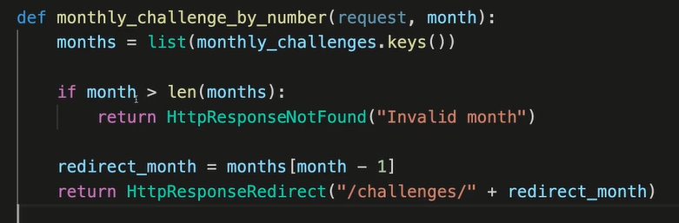
Continue optimizing the view
Notes:
Explain how to install the extensions

Slide 28
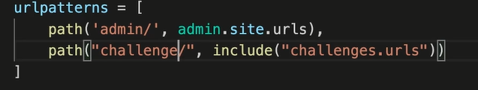
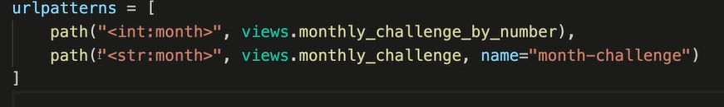
Continue optimizing the view
What happens if we change the url pattern
So we should add a more dynamic way by adding the url a name
Notes:
Explain how to install the extensions

Slide 29

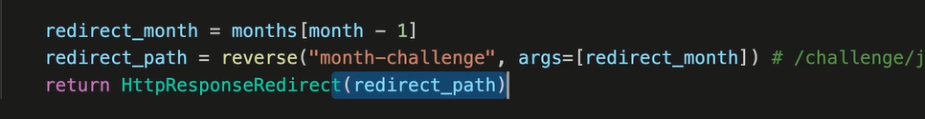
Continue optimizing the view
In the view we add
Notes:
Explain how to install the extensions

Slide 30
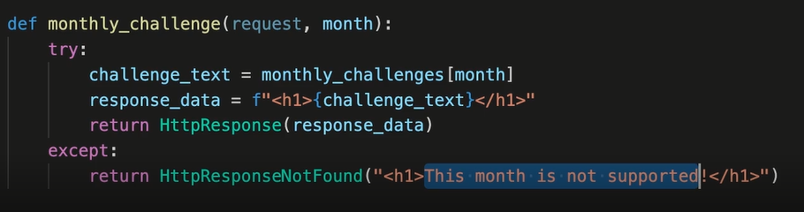
Returning html
html stand for hyper text markup language and it holds a code that the browser understand which holds the content of the pages.
It is also combined with css which stands for cascade style sheet and we use for styling
To use html
Notes:
Explain how to install the extensions

Slide 31
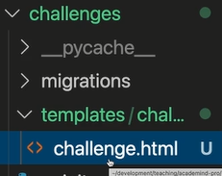
Returning html
create new folder called templates
Create another folder called the name of the app in the template folder
Create a new html file in the inner folder in the template
Notes:
Explain how to install the extensions

Slide 32
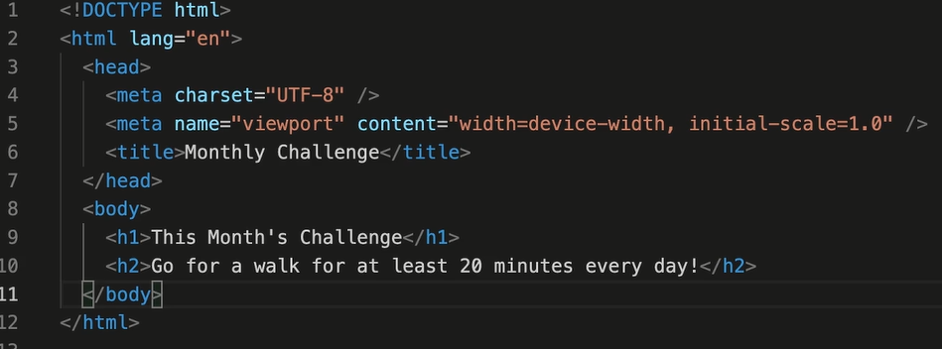
Returning html
in the html file
Notes:
Explain how to install the extensions

Slide 33
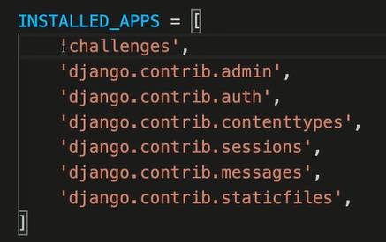
Returning html
Add in the setting page
Notes:
Explain how to install the extensions

Slide 34
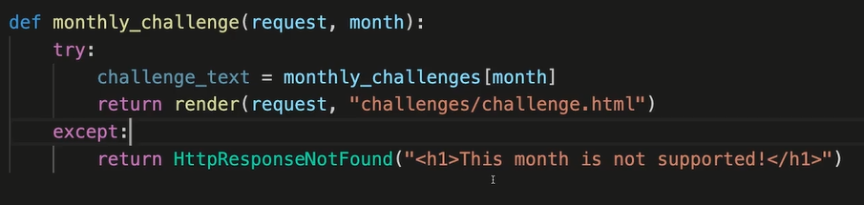
Optimizing using html
Notes:
Explain how to install the extensions

