Slide 1

Modern Development Tools

Slide 2
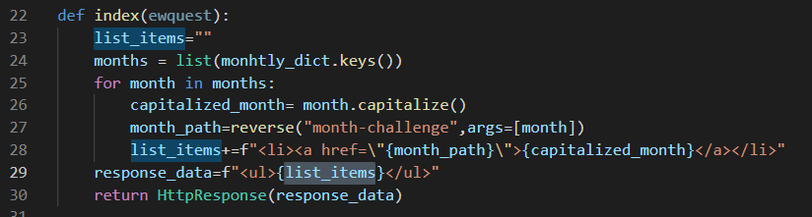
Making a page with a list of links of each month
First add a new url in thye url.py file
path("",views.index),
That way the link will be challenges
Than we make a new view for that url called index

Slide 3
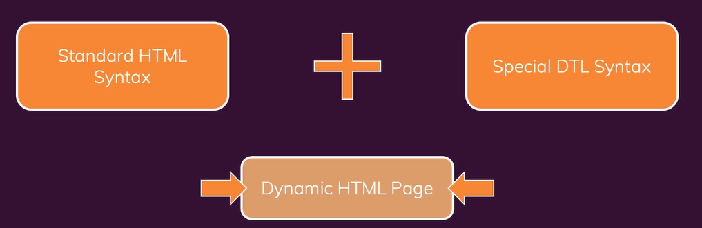
The Django Template language(dtl)
Enhanced html files to create dynamic page

Slide 4
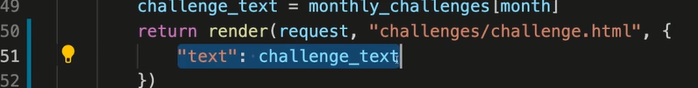
The Django Template language(dtl)
In order to send the text of each month to our html page dynamically
We need a third arg in our render function

Slide 5

The Django Template language(dtl)
To inject a dynamic content in this html page use a special syntax that will be picked up by Django

Slide 6
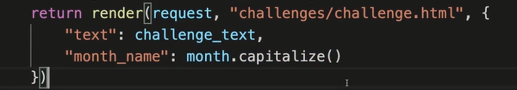
The Django Template language(dtl)
In order to use the months names

Slide 7
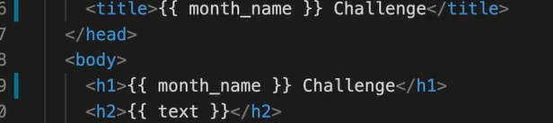
The Django Template language(dtl)
In order to use the months names

Slide 8

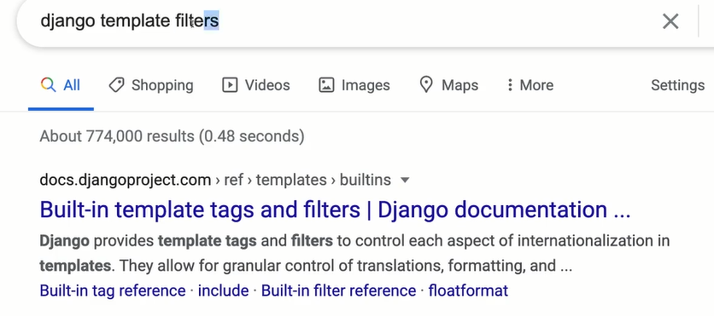
The Django Template language(dtl) tags and filters
For any formatting logic for the anything is displayed its better to do it in the templates instead of the views
So we will use the tags and filter feature

Slide 9
The Django Template language(dtl) tags and filters
Using the title filter

Slide 10

The Django Template language(dtl)
For making the DTL easier it is better to install the extension

Slide 11
The Django Template language(dtl) the for tag
The for tag allow us to loop through content
So we will implement the loop that we used in the index view in an html page using the DTL
So we will create an index html

Slide 12
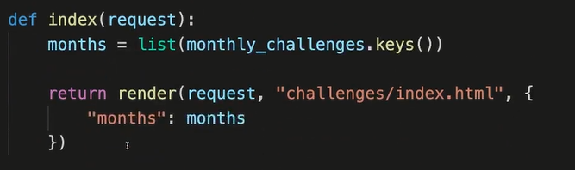
The Django Template language(dtl) the for tag
Notes:
Explain what is a framework

Slide 13
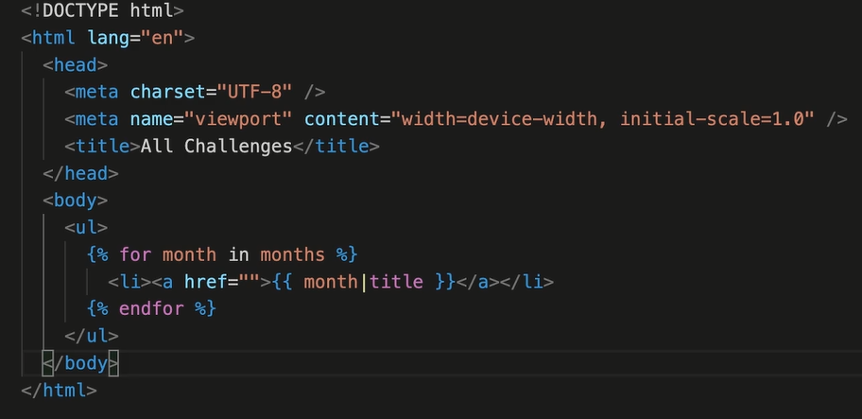
The Django Template language(dtl) the for tag
In the index html

Slide 14
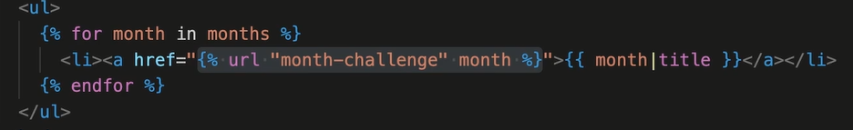
The Django Template language(dtl) the for tag
In the index html
The user doesn’t see the DTL he only sees the final generated html

Slide 15
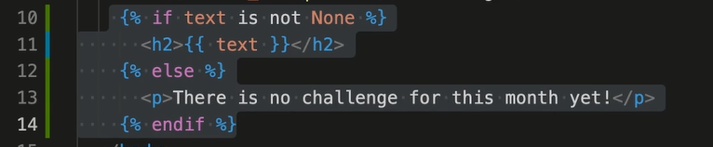
The Django Template language(dtl) the if tag
In the challenge html

Slide 16
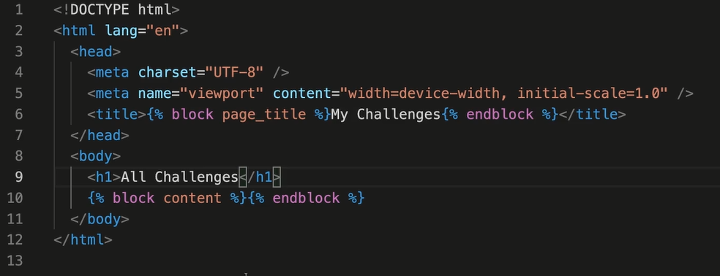
Template inhertance
To inherit a template create a folder called template in the monthely challenges folder
And then create the base htm
The base html

Slide 17
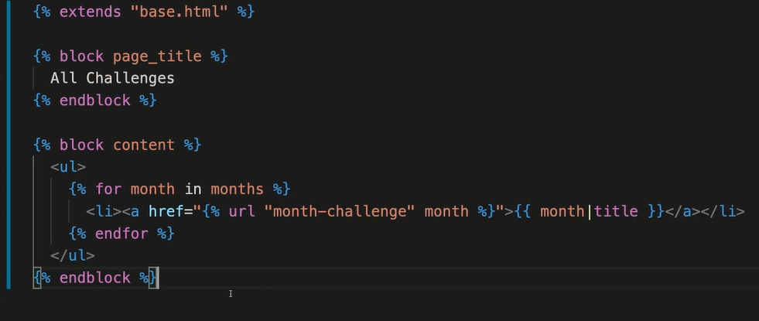
The Django Template language(dtl) the if tag
In the other html files inside the app

Slide 18
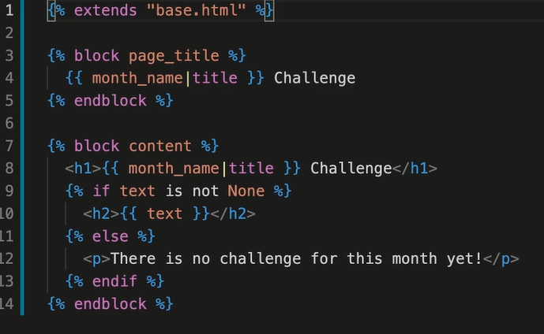
The Django Template language(dtl) the if tag
In the challenge html

Slide 19

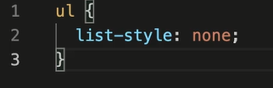
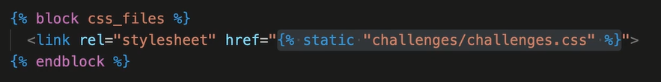
The static files
In order to add javascript and css and pic files we need to create a static folder
Add styling in the css files
To use the css in the index html file

Slide 20
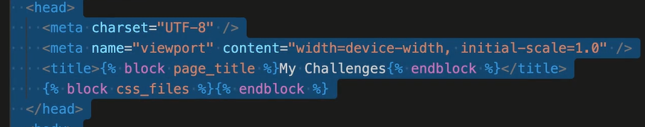
The static files
In the base html

