Slide 1
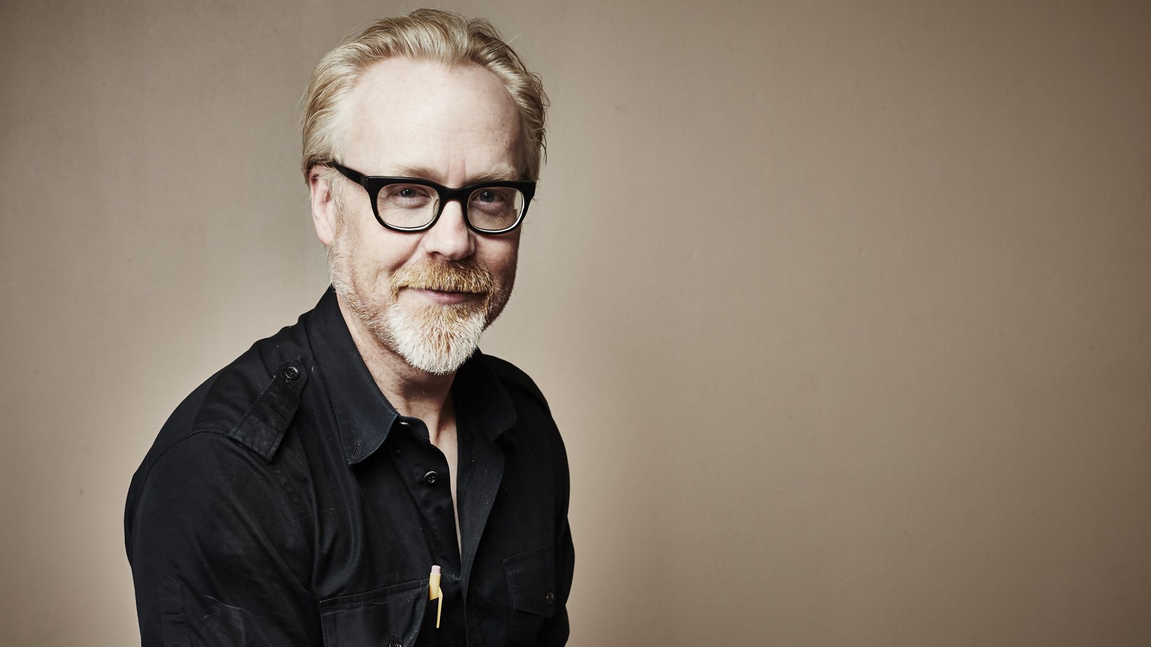
Adam Savage
I reject the reality and substitute my own.
NT111 – Dubravka Vlahovic
Nikola Tasic 3698

Slide 2
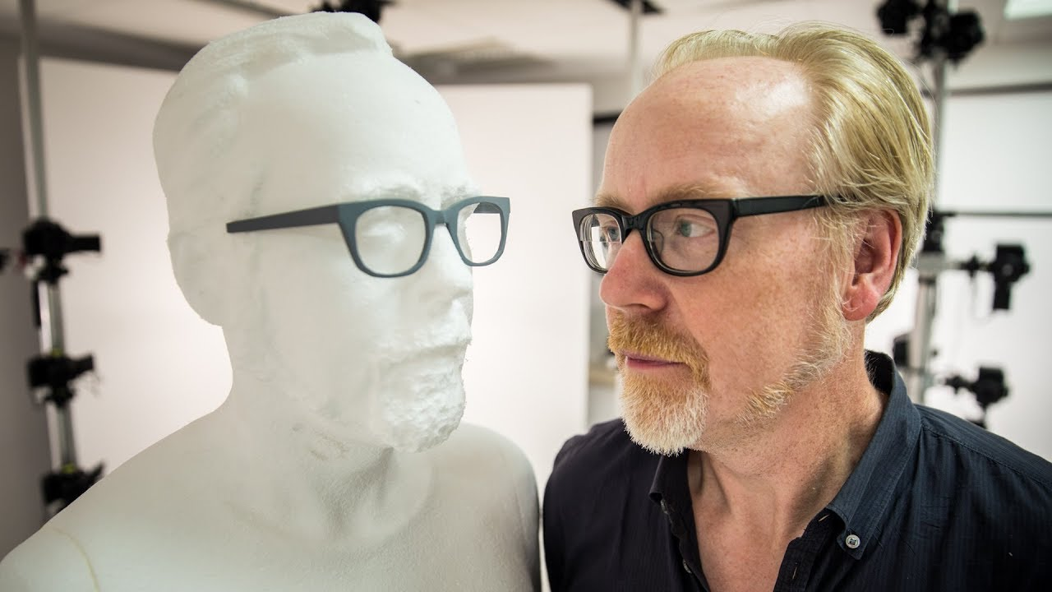
Things I will try not to forget to mention
Life
Career
Fun facts
Thanking the audience

Slide 3
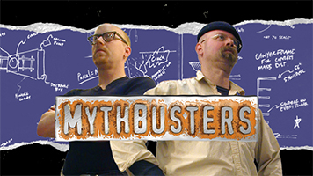
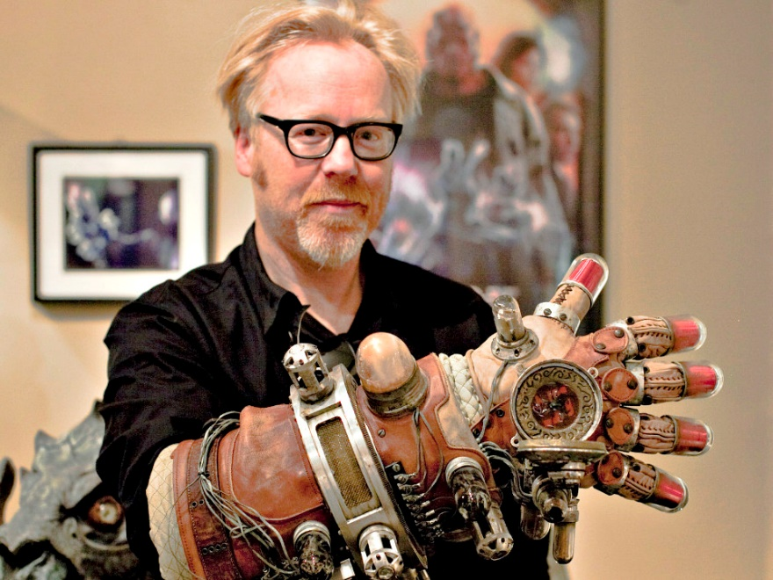
Work, career and stuff
Special effect and model-making for movies Star Wars and Matrix
Taught model making at “Academy of Art University”
“Mythbusters”, obviously
Has a YouTube channel “Tested”
Brain Candy Live with Michael from “Vsauce”
Cameo appearances
TED speaker

Slide 4
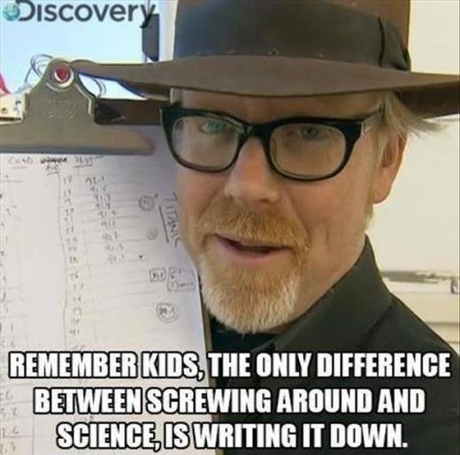
Thank you for your attention!

