Slide 1
UNIX and Free Software
Nikola Tasic

Slide 2
Topics
UNIX
Linux
GNU Project

Slide 3
Unix
Multics (Second System Syndrome) (MIT, GE, Honeywell)
Bell Labs (1969, 1970)
Simpler times
C Language (1973)
The UNIX Epoch

Slide 4
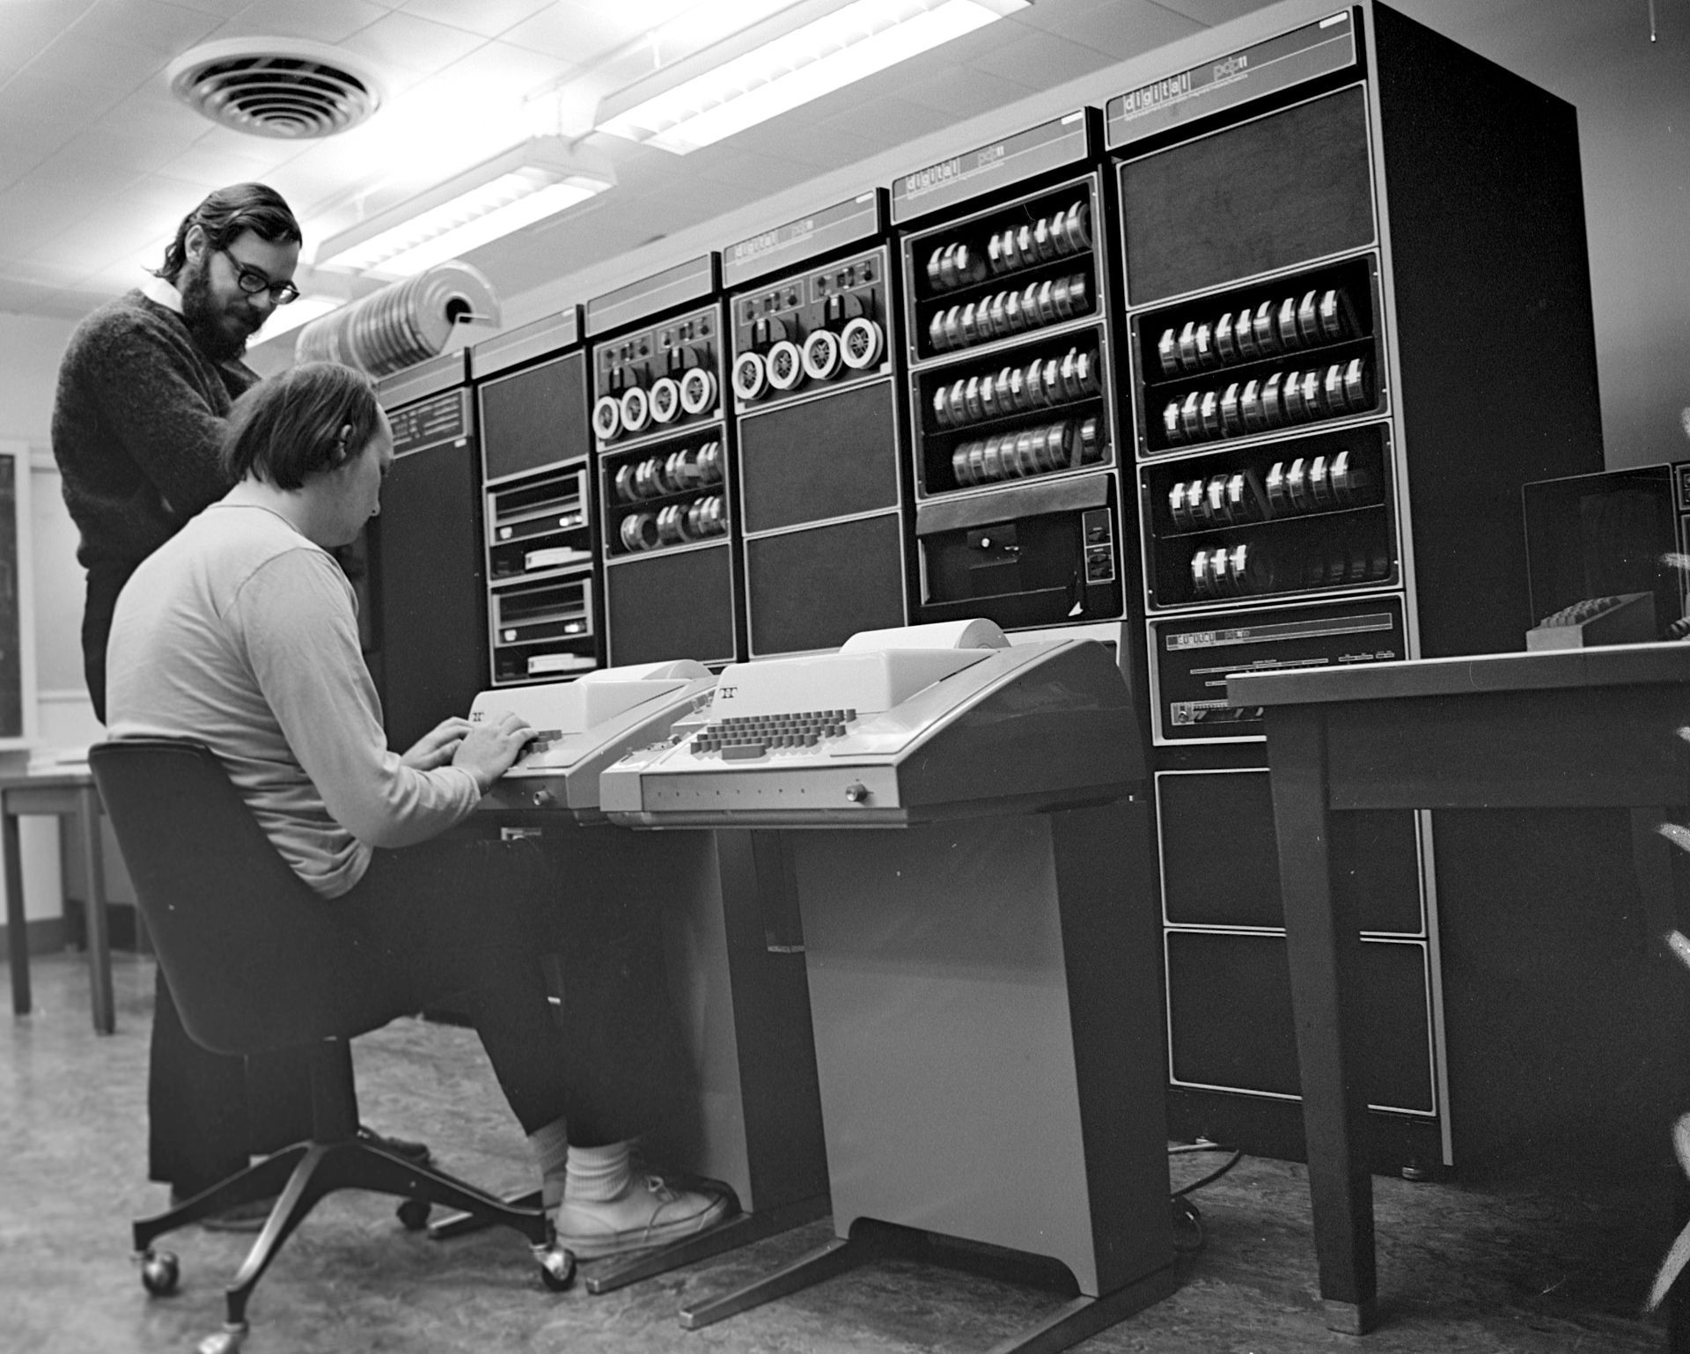
Ken and Dennis
Ken Thompson (sitting) and Dennis Ritchie next to PDP-11

Slide 5
Unix philosophy
Write programs that do one thing and do it well.
Write programs to work together.
Write programs to handle text streams, because that is a universal interface.

Slide 6
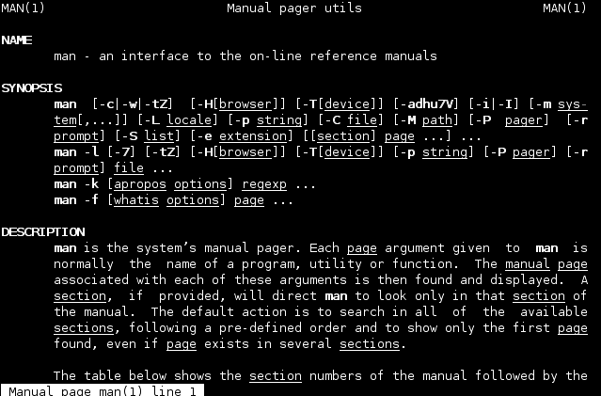
Interface
UNIX Manual

Slide 7
Commands
Terminals!
But very very slow!
Pipes
man, ls, cd, cat, cc, dd, dc, wc, rm, cp, ed, sed, grep
cp thesis.txt ~/Documents/
makewords thesis.txt | lowercase | sort | uniq | missmatch

Slide 8
Licencing
Free until “Version 4” due to monopoly
“Version 5” educational institutions, “Version 6” for companies
System III, System V
Berkley Software Distribution, Microsoft Xenix, Sun Microsystems SunOS

Slide 9
UNIX Wars
Commercial “System V”, breakup of Bell System (1983)
Richard Stallman founds GNU Project
X/Open (1984)
System V Interface Definition SIVD (1985)
POSIX (Portable OS Interface) (1988)
POSIX triumphs (1995)

Slide 10
GNU Project
GNU is Not Unix
Free not as inexpensive but as freedom
GNU Manifesto
Use, Share, Study, Modify

Slide 11
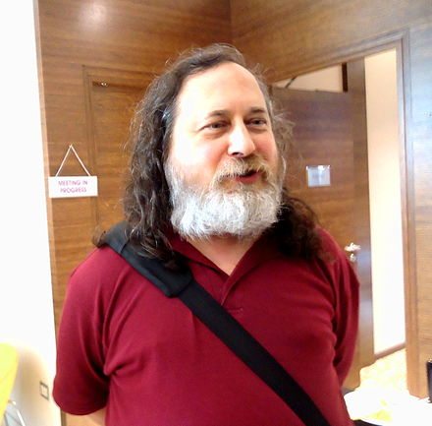
Richard Stallman
Richard Stallman

Slide 12
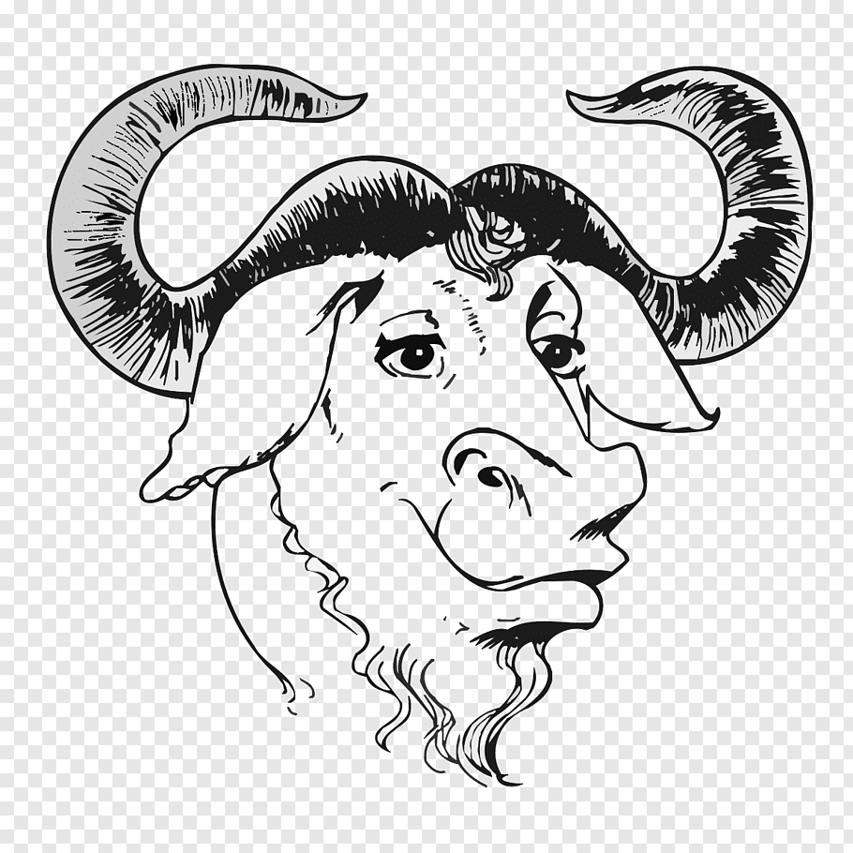
GNU Project
GNU Project Logo

Slide 13
UNIX Descendants
BSD
Linux (OSX)
Darwin
Android
OpenSolaris

Slide 14

Linux
Tux - The Linux mascot

Slide 15
Inception
Developed by Linus Torvalds
Kernel based on Minix (1991)
Wanted his own UNIX
First release - 176.250 SLOC (1992)
GNU/Linux
Linux today is basically everywhere

Slide 16
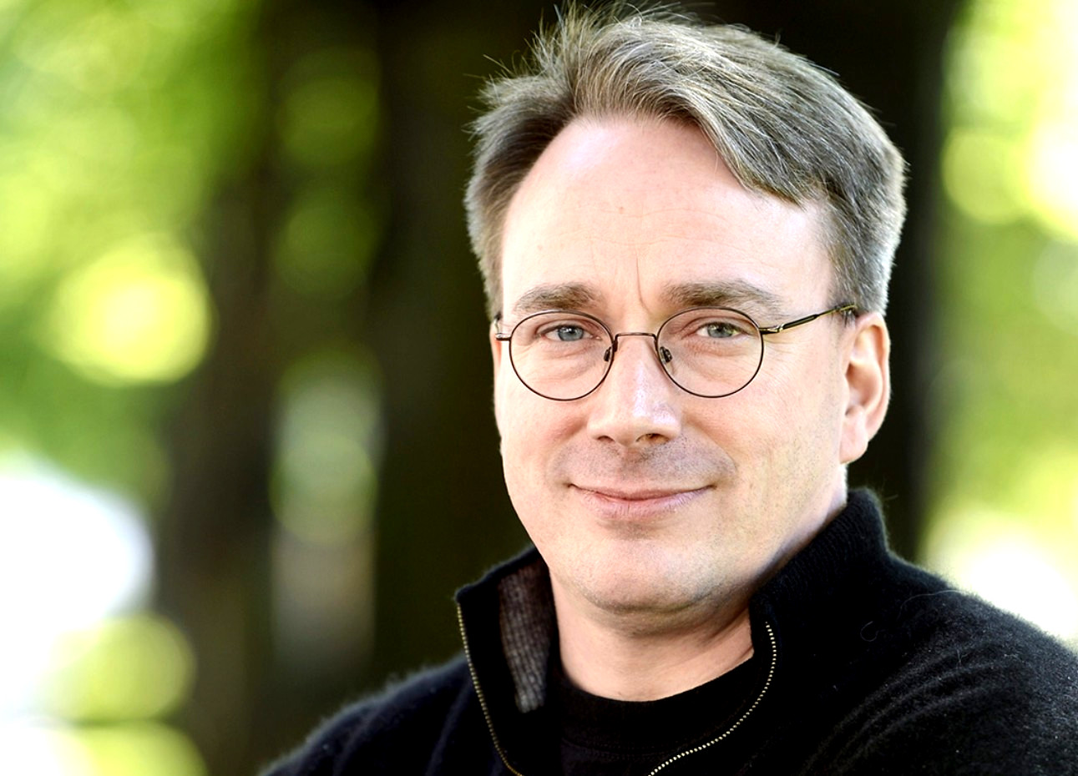
Linus Torvalds
Linus Torvalds

Slide 17
Thank You
Thank you for your attention!
… and use free software!

