Slide 1
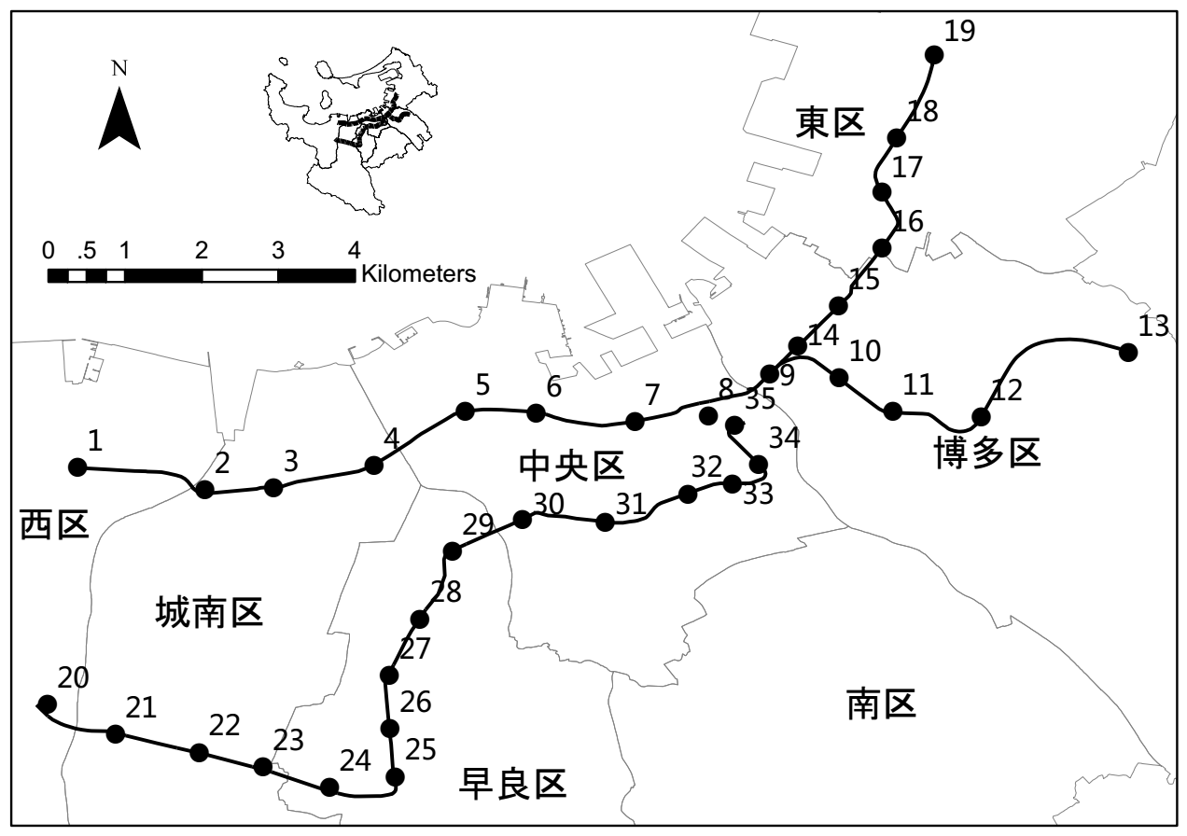
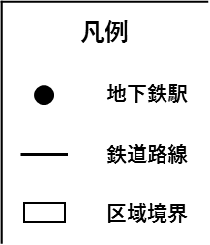
凡例
 | 地下鉄駅
 | 鉄道路線
 | 区域境界
凡例
 | Subway Station
 | Subway Line
 | District Line

Slide 2
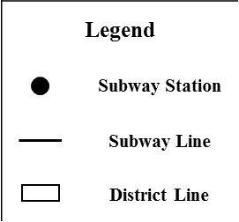
Higashi District
凡例
 | 地下鉄駅
 | 鉄道路線
 | 区域境界
Chuo District
Hakata District
Nishi District
Jyonan District
Sawara District
Minami District
Legend
 | Subway Station
 | Subway Line
 | District Line

Slide 3
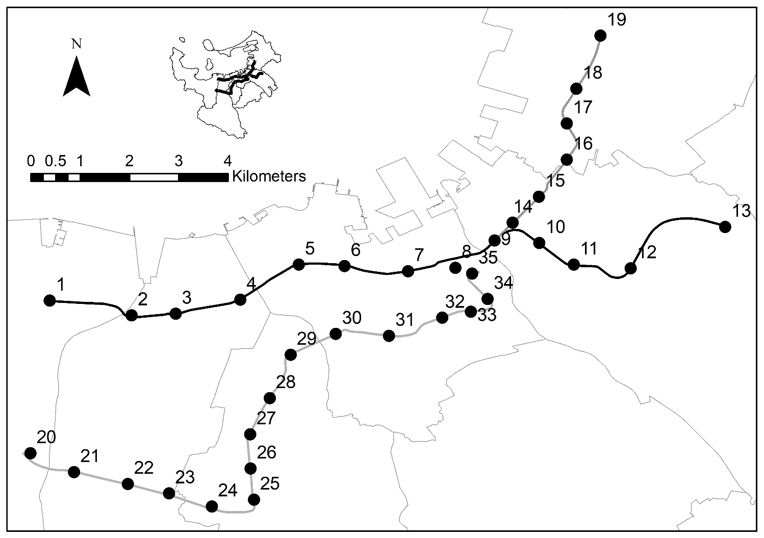
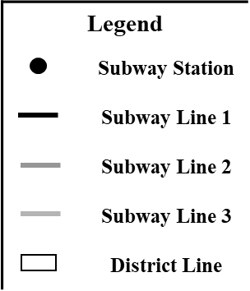
Legend
 | Subway Station
 | Subway Line 1
 | Subway Line 2
 | Subway Line 3
 | District Line

Slide 4
24.64%
Business area
Residence area
100%
24.65%
15.38%
14.86%
Population
Commerce area
14.86%
Notes:
共线性诊断，各变量同时出现共线性的概率

Slide 5
5.7km

Slide 6
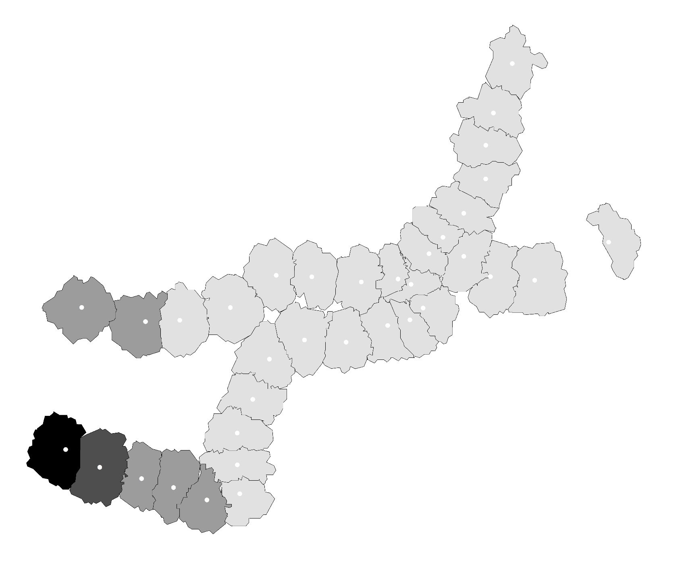



Transportation Facility Area
Confidence Level
Not Significance
$$α≥99\%$$
$99\%>α≥9$5%
$95\%>α≥9$0%

Slide 7
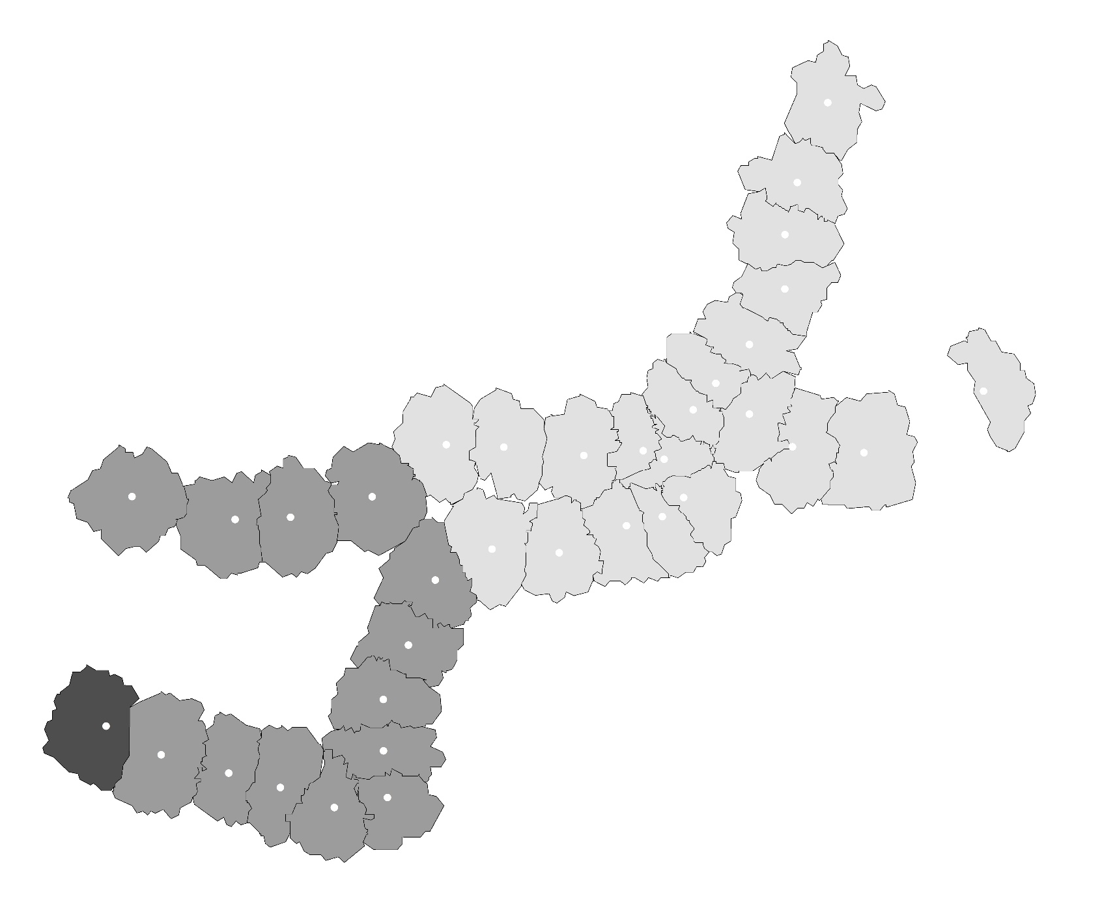



Bus Capacity
Confidence Level
Not Significance
$$α≥99\%$$
$99\%>α≥9$5%
$95\%>α≥9$0%

Slide 8
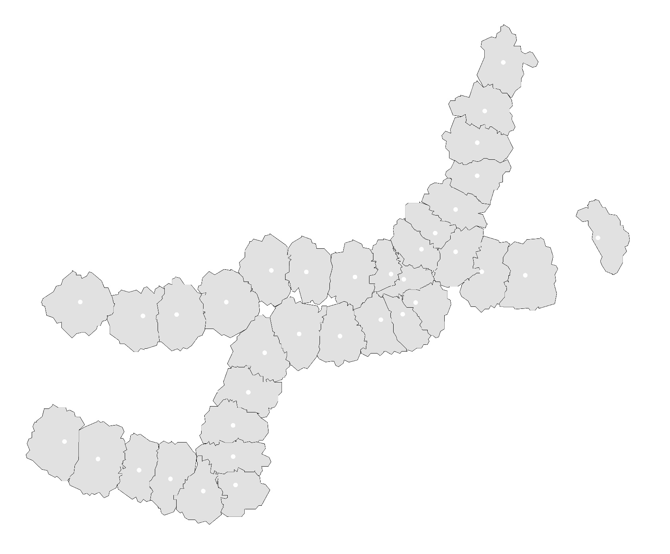
Bus Accessibility
Confidence Level
Not Significance
$$α≥99\%$$
$99\%>α≥9$5%
$95\%>α≥9$0%

Slide 9
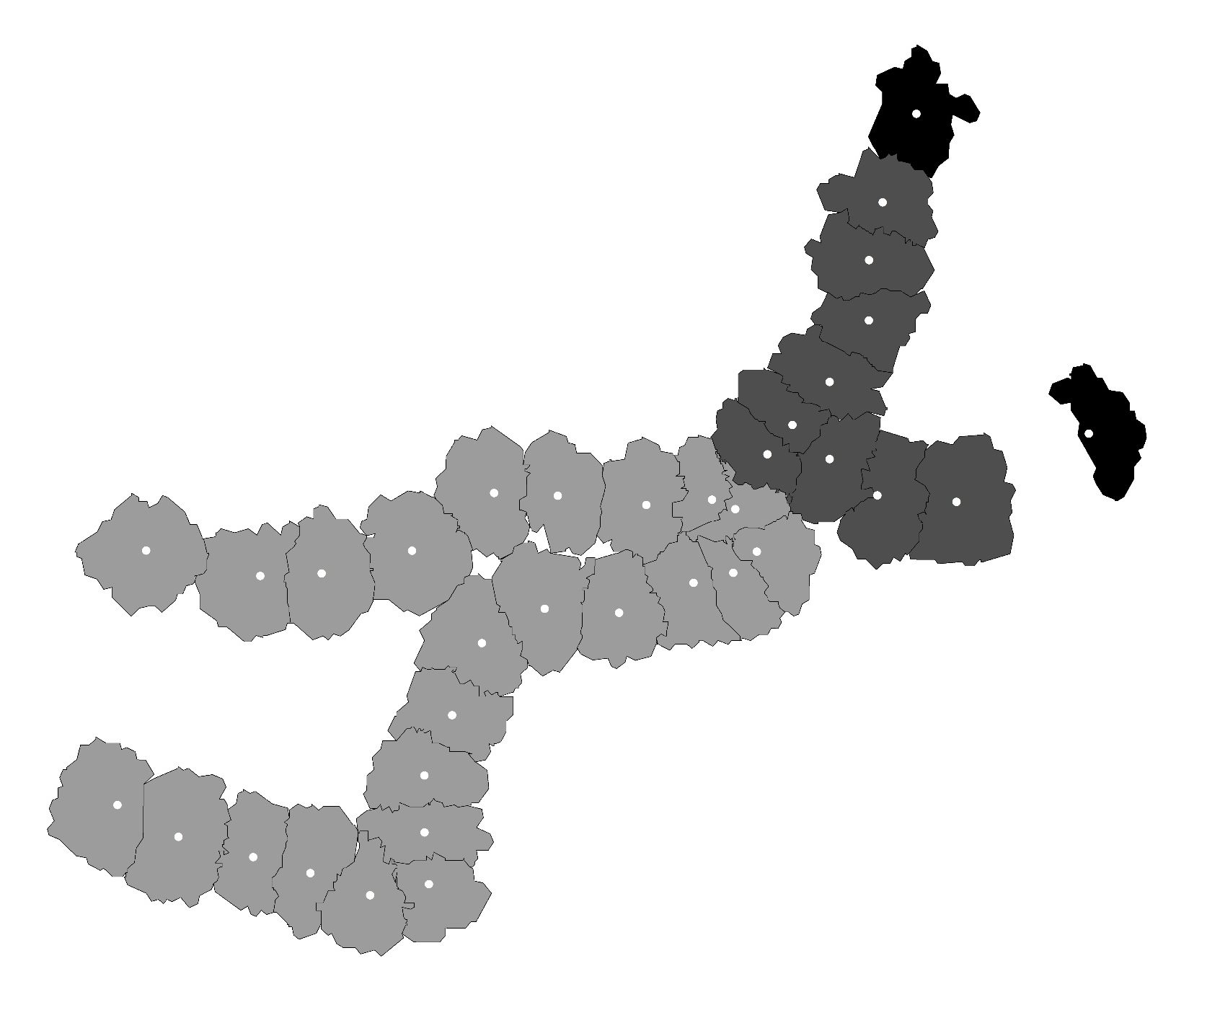
Population Job Balance
Confidence Level
Not Significance
$$α≥99\%$$
$99\%>α≥9$5%
$95\%>α≥9$0%

Slide 10
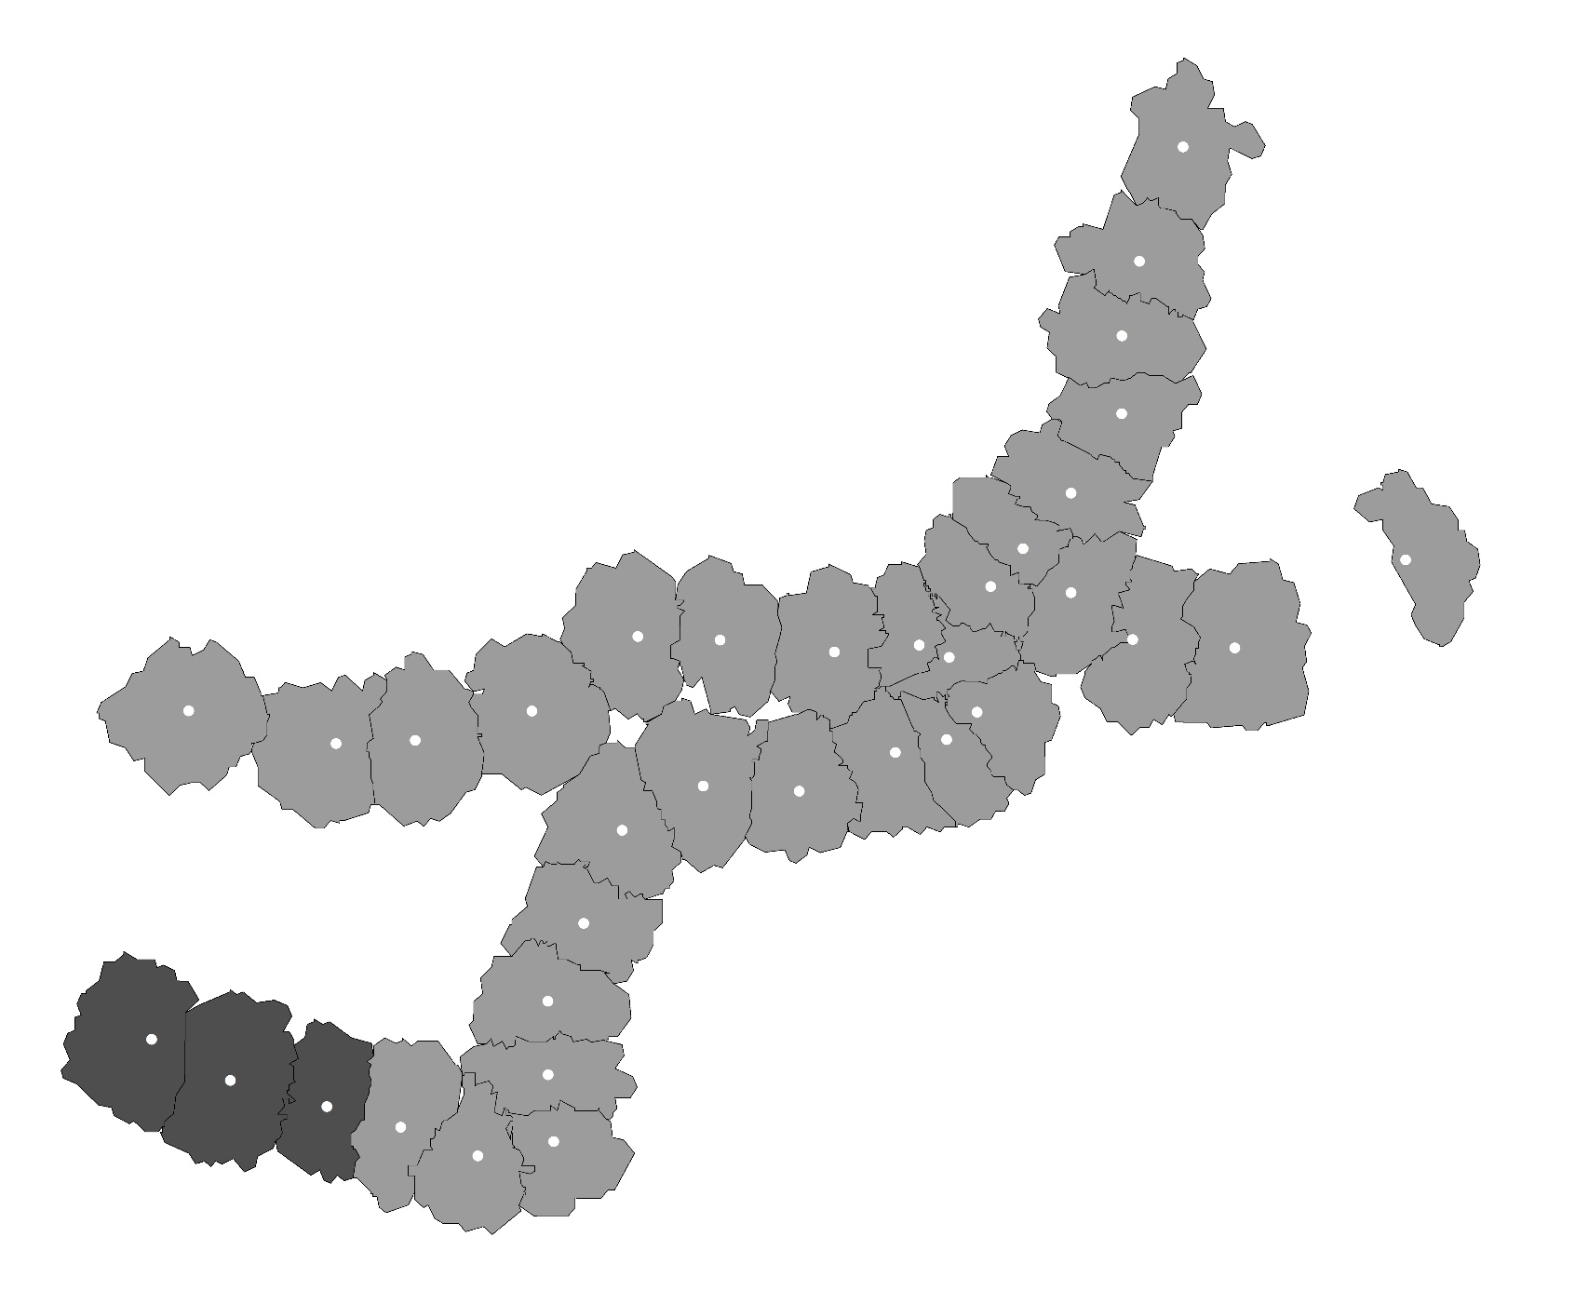
Tenant Proportion
Confidence Level
Not Significance
$$α≥99\%$$
$99\%>α≥9$5%
$95\%>α≥9$0%

Slide 11
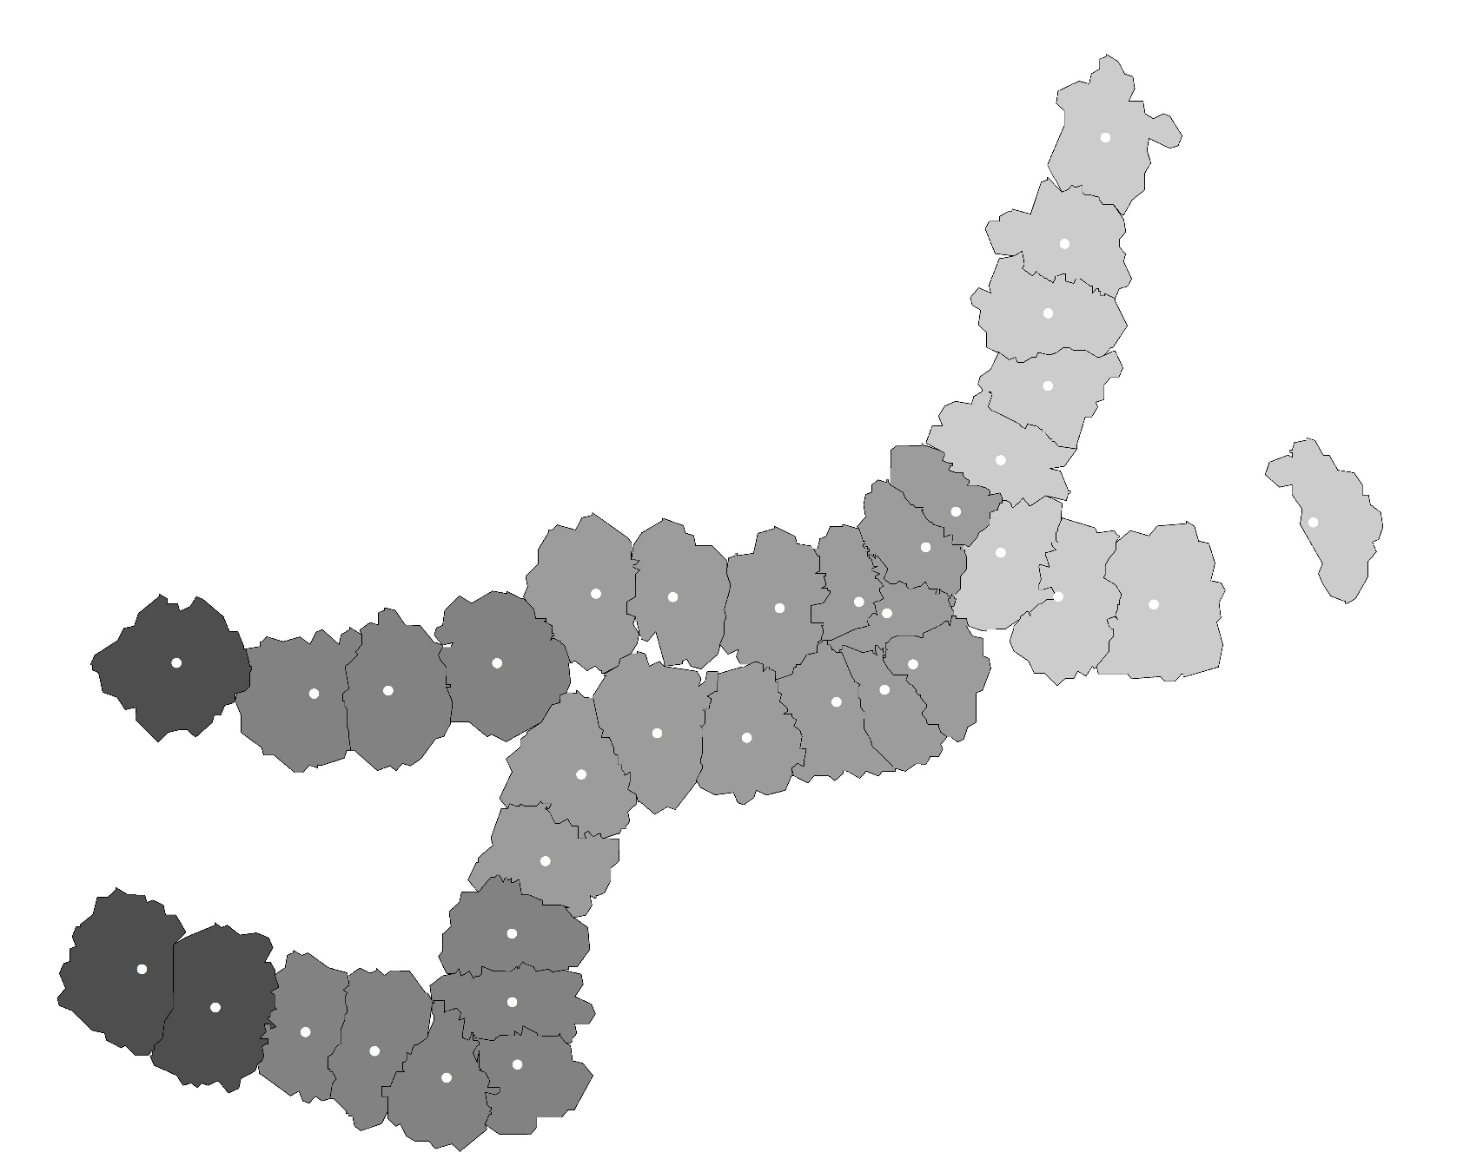
Distribution of Local R²
Local R²
0.960 - 0.965
0.965 – 0.970
0.970 – 0.975
0.975 – 0.980

Slide 12
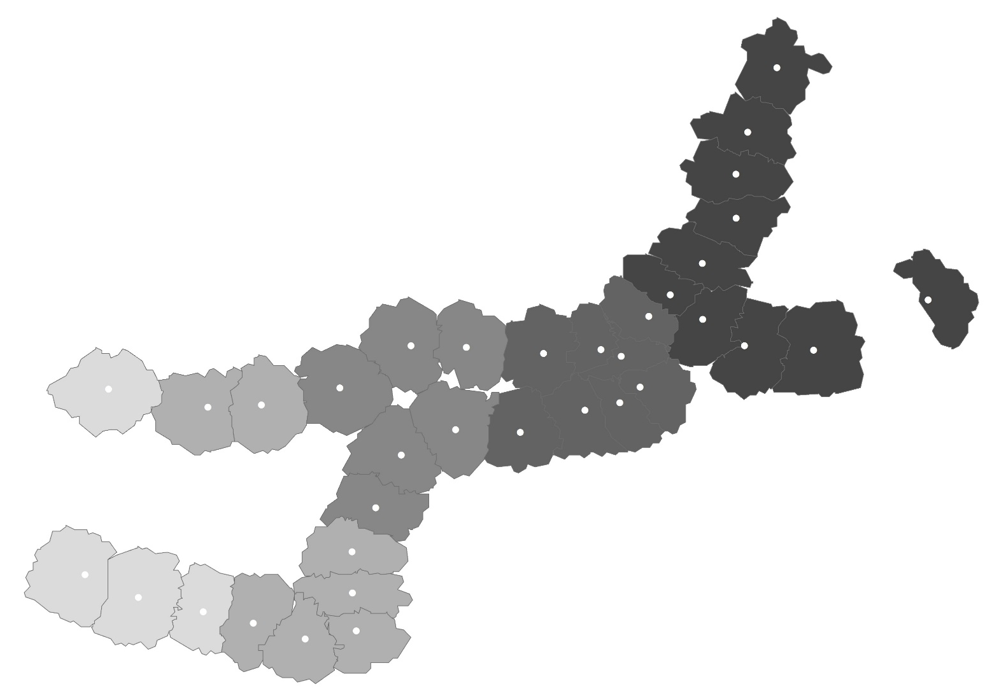
Coefficient Map
Transportation
Transportation Coefficient
0.057 ~ 0.074
0.057 ~ 0.074
0.095 ~ 0.110
0.095 ~ 0.110
0.121 ~ 0.130

Slide 13
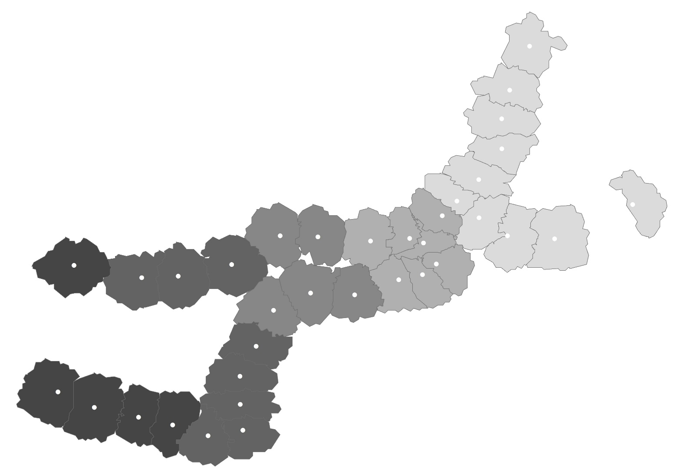
Coefficient Map
Bus Capacity
Bus Capacity Coefficient
-65 ~ -62
-62 ~ -60
-60 ~ -55
-55 ~ -55
-55 ~ -44

Slide 14
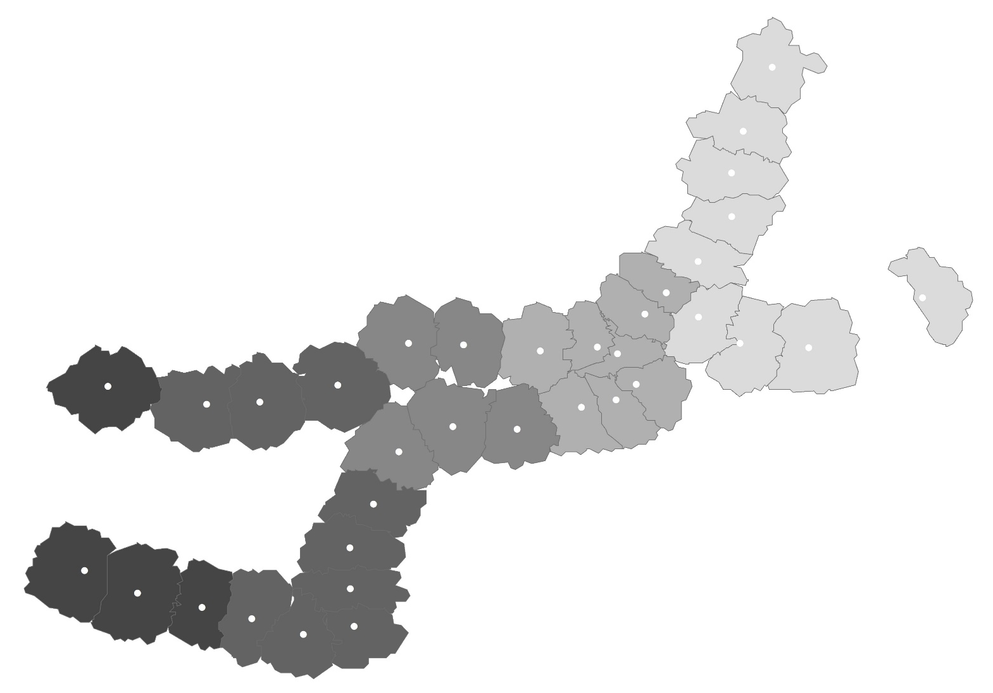
Coefficient Map
Bus Accessibility
Bus Accessibility Coefficient
47 ~ 48
48 ~ 49
49 ~ 51
51 ~ 52
52 ~ 54

Slide 15
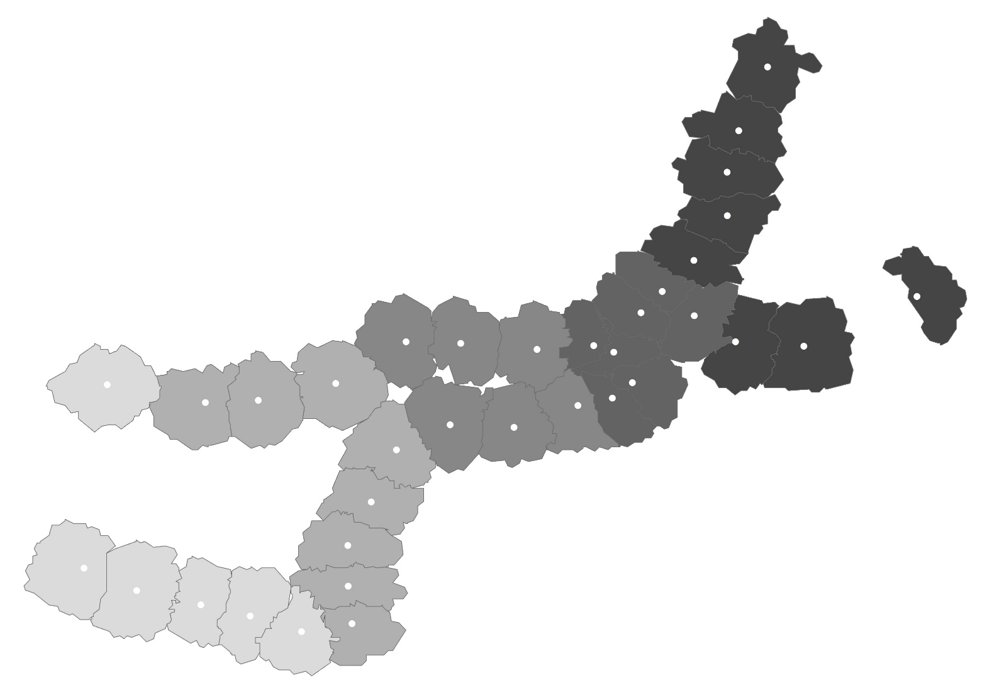
Coefficient Map
Population/Job
Population/Job Coefficient
-3092 ~ -2920
-2920 ~ -2644
-2644 ~ -2356
-2356 ~ -2124
-2124 ~ -1873

Slide 16
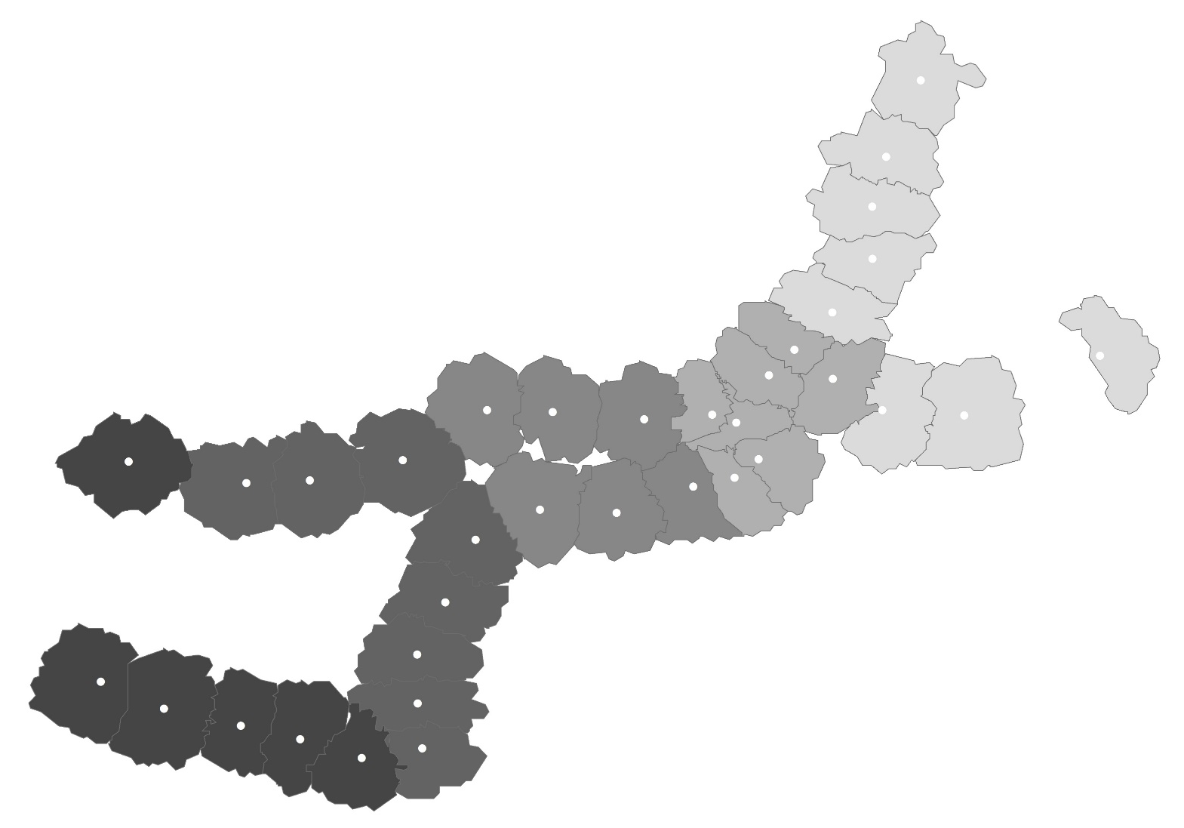
Coefficient Map
Rental House
Rental House Coefficient
-11807 ~ -11357
-11357 ~ -10948
-10948 ~ -10487
-10487 ~ -9850
-9850 ~ -9393

