Slide 1
Research on Factors Influencing the Use of Rail Transit
CHEN Qi
Graduate School of Human-Environment Studies,
Kyushu University, Japan
May 22, 2018

Slide 2
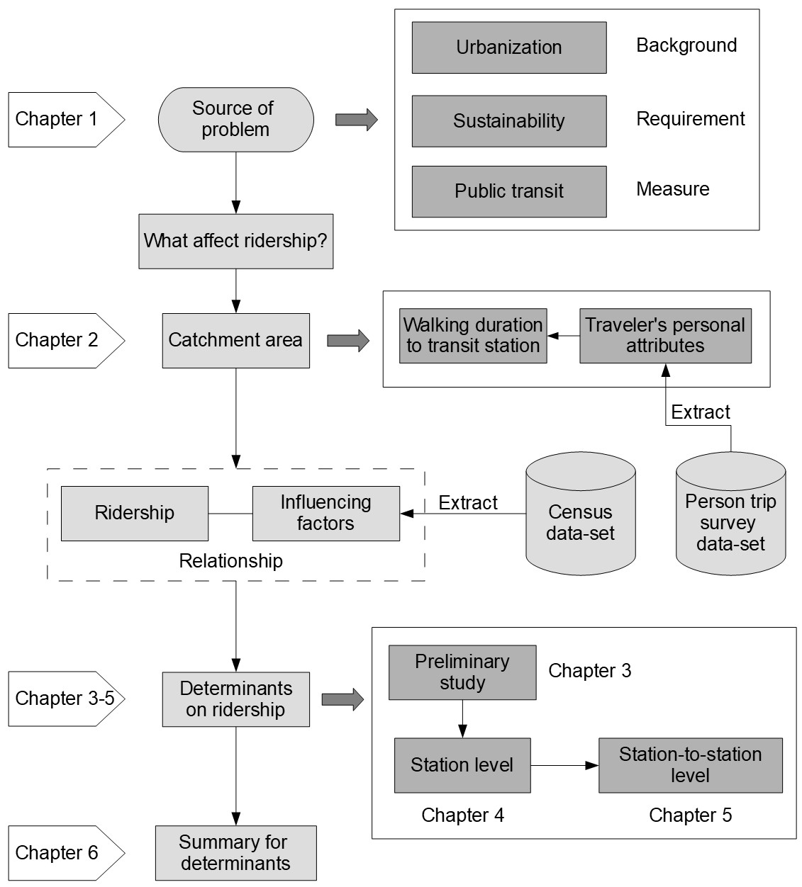
0.0
General flowchart of the dissertation

Slide 3
Chapter 1
Introduction
Background
Research purpose
Literature review
Primary research questions
Dissertation organization

Slide 4
1.1
Background
How is the research topic proposed?
Developing countries
Developed countries
Current situation
Rapid urbanization, severe congestion, pollution.
lack of resources
Aged society, low birthrate, high public financial expenditure
fiscal burden
Requirement according to the situation
Increase supply
Improve financial situation
sustainability
Measures for the requirement
Increase public transportation utilization
Topic
explore the determinants of rail transit ridership
Chapter 1 - Introduction

Slide 5
1.2
Purpose
What we want to do?
How to encourage people to take rail transit?
What explains rail transit ridership?
How to increase the rail transit ridership?
Main purpose
explore the determinants of rail transit ridership
Subject topics to discussion
1. What determines catchment area?
2. What factors explain transit ridership at station level?
3. What factors influence transit ridership among stations?
Chapter 1 - Introduction

Slide 6
1.3
Review
Year |  | 2004 | 2004 | 2009 | 2010 | 2011 | 2012 | 2013 | 2013 | 2015
Author |  | Chu | Kuby et al. | Taylor et al. | Sohn and Shim | Gutiérrez et al. | Cardozo et al. | Chakraborty et al. | Zhao et al. | Jun et al.
Catchment (walking distance) |  | 400m walking distance | 800m walking distance | N/A | N/A | Distance-decay 800m buffer | 800m walking distance | N/A | 800m radius | 300m,600m,900m radius
Method |  | Poisson Regression | WLS | 2SLS | OLS/SEM | OLS | OLS/GWR | OLS/SEM | OLS | OLS/MGWR
Sample Size |  | 2568 | 268 | 265 | 251 | 158 | 190 | 900 | 55 | 442
Number of Valid Indicator |  | 15 | 11 | 8 | 7 | 9 | 4 | 9 | 11 | 11
Coefficient of determination (Adjusted R²) |  | 0.54 | 0.71 | 0.91 | 0.60 | 0.73 | 0.56 | 0.69 | 0.95 | 0.77
Building environment | Built environment |  |  |  | ● | ● |  | ● | ● | ●
 | Hospital |  |  |  |  |  |  |  | ●
 | School/University |  |  |  | ● |  |  |  | ●
 | CBD |  | ● |  |  |  |  |  | ●
 | Land use mix |  |  |  | ● | ● | ● |  |  | ●
 | Other infrastructures |  | ● |  |  |  |  |  | ● | ●
Transportation Accessibility | Accessibility of pedestrian | ● |  |  |  |  |  | ●
 | Accessibility of transfer |  | ● |  | ● | ● | ● | ● | ● | ●
 | Road coverage |  |  | ● | ● |  |  |  | ●
 | Parking |  | ● |  |  |  |  |  | ●
 | Service level of public transit | ● | ● | ● |  | ● | ● |  | ● | ●
 | Locational factor |  | ● |  | ● |  |  |  | ●
Demographic and Socioeconomic Environment | Population |  | ● | ● | ● |  | ● | ● | ● | ●
 | Employment | ● | ● | ● | ● | ● | ● | ● | ● | ●
 | Age | ● |  | ● |  |  |  |  |  | ●
 | Tenant proportion |  | ● |  |  |  |  |  |  | ●
 | Race | ● | ● | ● |  | ●
 | Income | ● |  |  |  |  |  | ●
 | Vehicles holdings | ● |  |  |  |  | ● | ●
 | Fare |  |  | ●
Chapter 1 - Introduction

Slide 7
1.4
Questions
Specific research questions based on the research purpose and paper review
Exploring the relationship between walking distance and walking preference, and trying to explain the catchment area.
Analyzing the characteristics in the variation of transit ridership.
Exploring the approach for screening effective influencing factors.
Shifting the research perspective, trying to describing the relationship between stations and stations.
Chapter 1 - Introduction

Slide 8
1.5
Organization
Chapter 1
Introduction
Chapter 2
Analyzing the Willingness of Walking Duration to Transit Stations Using Socio-Demographic Characteristics
Chapter 3
Analysis on the characteristics of transit ridership and land use
Chapter 4
Influencing Factors on Transit Ridership at Station Level
Chapter 5
Influencing Factors on Transit Ridership at Station-to-Station Level
Chapter 6
Conclusion
Chapter 1 - Introduction

Slide 9
Chapter 2
Analyzing Willingness of Walking Duration to Transit Stations Using Socio-Demographic Characteristics
Introduction
Methods
Data description
Selection for Valid Features
Estimation of Features
Result and Discussion
Conclusion

Slide 10
2.1
Introduction
Research position
objective
Influencing factor
Built-environment
Facilities
Behaviors
Catchment area
Acceptable walking distance/duration
Personal Socio-Demographic Characteristics
(abbreviated as PSDC)
Walking duration to transit stations
Research Point
(This Study)
Relationship
Chapter 2 - Analyzing Willingness of Walking Duration to Transit Stations Using Socio-Demographic Characteristics

Slide 11


2.1
Introduction
Problem description
As an example, for one person who has the attributes:
$\left(Male, 25 years old, student, peak hour, go to school\right)$
Realistic issue
I can accept a walking duration less than 8 minutes
OK
8 min
4 min
0 min
Reflected in questionnaire
This time I walked 6 minutes to the station
6 min
0 min
Chapter 2 - Analyzing Willingness of Walking Duration to Transit Stations Using Socio-Demographic Characteristics

Slide 12

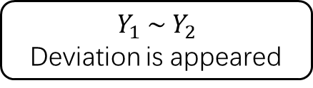
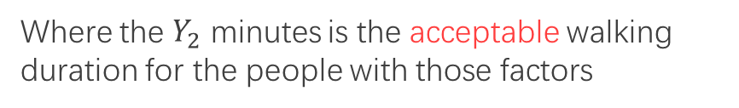
2.1
Introduction
In a general way
The general expression can be:
$$Walking duration=F\left({factor}_{1}, {factor}_{2},{factor}_{3}, ……\right)$$
Walking duration obtained from questionnaire
$$Y_{1} min=F\left({factor}_{1}, {factor}_{2},{factor}_{3}, ……\right)$$
Where the $Y_{1}$ minutes is the reflection of the duration between departures and stations
$$Y_{1} \sim Y_{2}$$
Deviation is appeared
Acceptable walking duration
$$Y_{2} min=F\left({factor}_{1}, {factor}_{2},{factor}_{3}, ……\right)$$
Where the $Y_{2}$ minutes is the acceptable walking duration for the people with those factors
Chapter 2 - Analyzing Willingness of Walking Duration to Transit Stations Using Socio-Demographic Characteristics

Slide 13


2.1
Introduction
The work of this study
Research purpose
Explorer how the PSDC can affect the acceptable walking duration to transit stations.
Entry point
Try to explain the acceptable walking duration using probability.
Research object
Examine the probability at the given threshold of walking duration
Continuous value of Walking duration
Threshold of walking duration
$$t_{1}\sim t_{2}$$
$$t_{1}, t_{2}, t_{3}……$$
Chapter 2 - Analyzing Willingness of Walking Duration to Transit Stations Using Socio-Demographic Characteristics

Slide 14
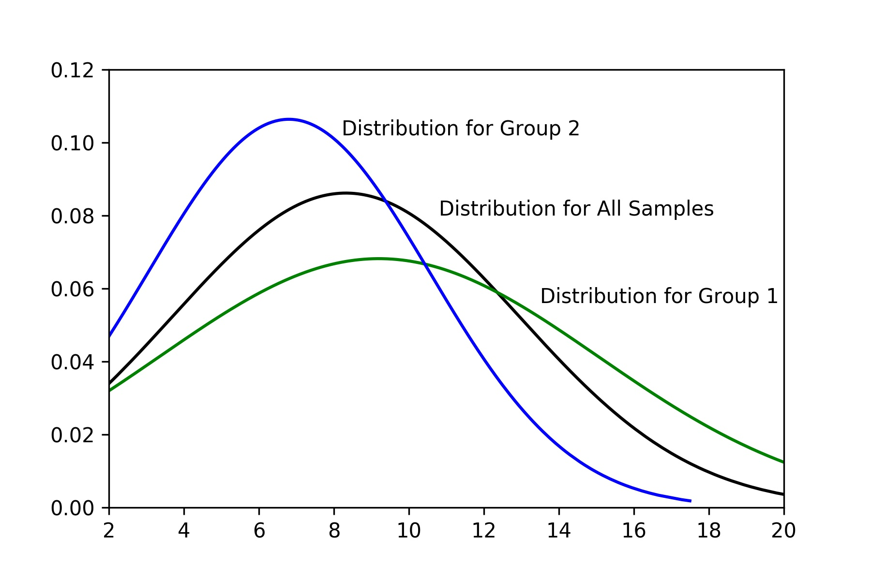
2.2
Methods
Important assumption
Group 1
Group 2
Probability
All Samples
6 min
If considering the threshold of 6 minutes
minute
Assuming the walking duration distribution of the passengers with the same attributions subject to the normal distribution.
If the survey result obtained from the questionnaire showed one group of passengers with a specific PSDC tend to walk longer, it means this group of passengers can accept a longer walking duration.
In this graph it can be considered that Group 1 can accept a longer walking duration than Group 2
Chapter 2 - Analyzing Willingness of Walking Duration to Transit Stations Using Socio-Demographic Characteristics

Slide 15
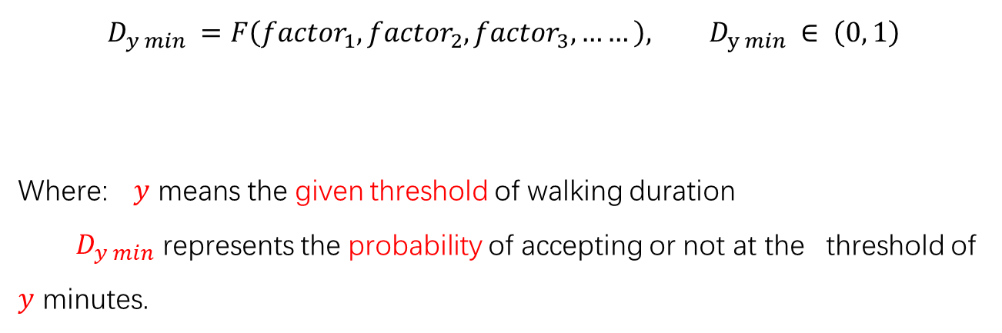
2.2
Methods
Model construction
Abstract form of the model
PSCD
$$D_{y min} =F\left({factor}_{1}, {factor}_{2},{factor}_{3}, ……\right), D_{y min} ∈ \left(0, 1\right)$$
Where: $y$ means the given threshold of walking duration
$D_{y min}$ represents the probability of accepting or not at the threshold of $y$ minutes.
Chapter 2 - Analyzing Willingness of Walking Duration to Transit Stations Using Socio-Demographic Characteristics

Slide 16
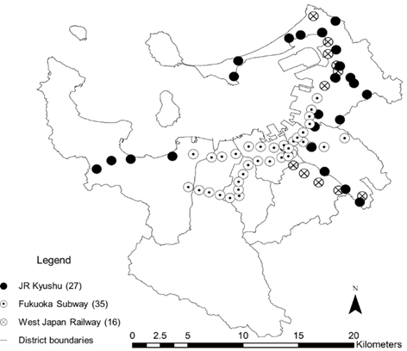
2.3
Data description
Study case: Fukuoka
Distribution of the transit stations
data in this study
Chapter 2 - Analyzing Willingness of Walking Duration to Transit Stations Using Socio-Demographic Characteristics

Slide 17
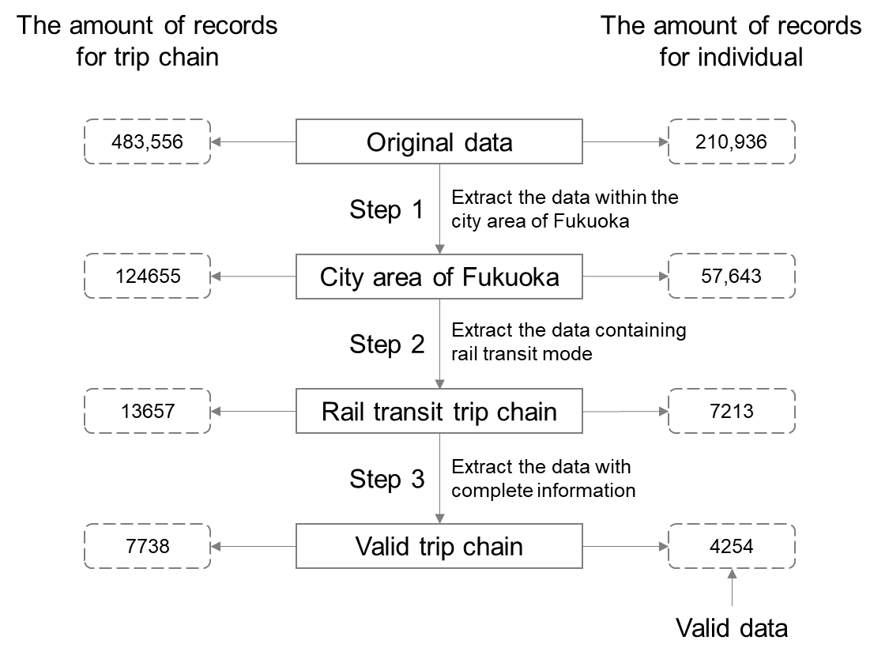
2.3
Data description
Data disposal
Source: Person Trip Survey
Chapter 2 - Analyzing Willingness of Walking Duration to Transit Stations Using Socio-Demographic Characteristics

Slide 18
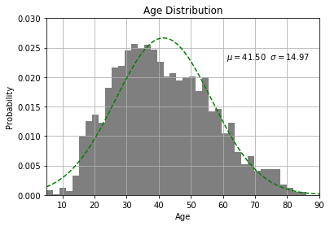
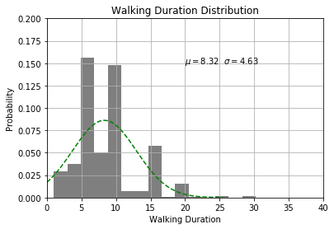
2.3
Data description
Distribution verification
There are peak values at 5, 10, 15 min
The age distribution of passengers
Distribution of walking duration
People are inclined to reply a looser answer when they are being asked some questions about details.
Subject to normal distribution, the samples can be viewed valid.
Chapter 2 - Analyzing Willingness of Walking Duration to Transit Stations Using Socio-Demographic Characteristics

Slide 19
2.4
Selection for Valid Features
Selection of thresholds
According to the existing studies, the acceptable walking duration mainly range from 5 – 13 minutes.
In this study, the average walking duration is about 8 minutes.
The thresholds selected in this study is 5, 8, 13 minutes.
Analysis of variance
L : tend to spend Less than the threshold
M: tend to spend more than the threshold
Valid Features at each threshold
Chapter 2 - Analyzing Willingness of Walking Duration to Transit Stations Using Socio-Demographic Characteristics

Slide 20
2.4
Selection for Valid Features
Analysis of variance
L : tend to spend Less than the threshold
M: tend to spend more than the threshold
Valid Features at each threshold
Chapter 2 - Analyzing Willingness of Walking Duration to Transit Stations Using Socio-Demographic Characteristics

Slide 21
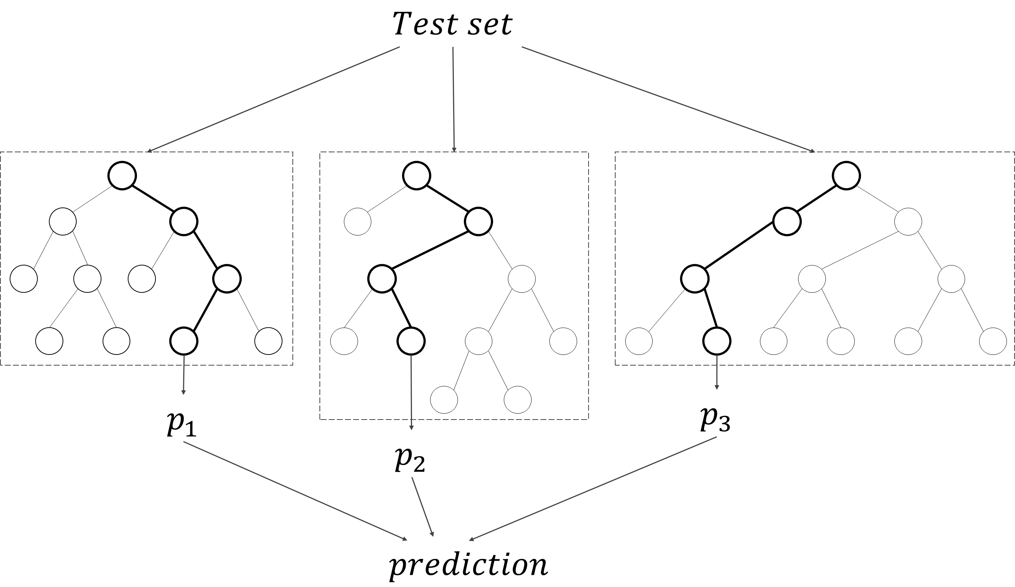
2.5
Estimation of Features
The rationality of model selection
Logistic regression
Decision tree
Good generalization for different forms of data
Binary choice issue
Bayesian model
Support vector machine
Artificial neural networks
…
Decision tree and forest random models
Forest random model is constructed by random selection of features and samples based on decision tree model.
The result is obtained by the average value of multiple decision trees.
Chapter 2 - Analyzing Willingness of Walking Duration to Transit Stations Using Socio-Demographic Characteristics

Slide 22
2.5
Estimation of Features
Prediction
Individual Value |  | Group Trend
Actual | Predicted | Actual | Predicted
1 | 1.000 | 0.654 | 0.637
1 | 0.897 | 0.653 | 0.636
1 | 0.897 | 0.651 | 0.635
… | … | … | …
0 | 0.621 | 0.581 | 0.580
1 | 0.621 | 0.581 | 0.579
1 | 0.621 | 0.580 | 0.579
… | … | … | …
0 | 0.498 | 0.435 | 0.411
1 | 0.496 | 0.437 | 0.411
1 | 0.496 | 0.434 | 0.410
… | … | … | …
The predicted result is probabilities of accepting the giving threshold of walking duration.
The accuracy of results are evaluated by using the method of simple moving average.
Simple moving average
Chapter 2 - Analyzing Willingness of Walking Duration to Transit Stations Using Socio-Demographic Characteristics

Slide 23
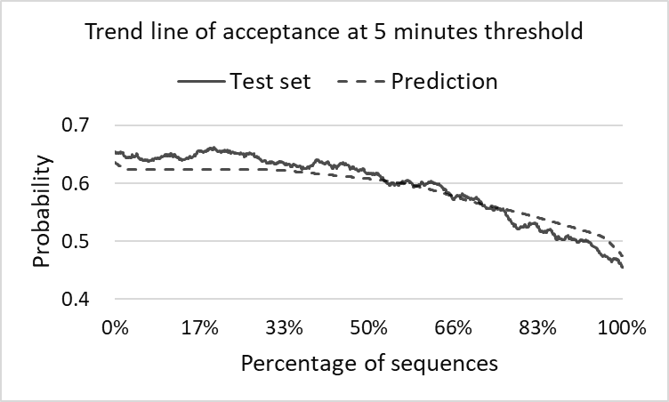
2.6
Result and Discussion
Evaluation of prediction
Evaluation of 5 minutes threshold
High precision
Possible explanation: The threshold of 5 minute is a commonly acceptable walking duration, some one who cannot accept this threshold can be considered to have some specific characteristics. The features are significant at this threshold.
Chapter 2 - Analyzing Willingness of Walking Duration to Transit Stations Using Socio-Demographic Characteristics

Slide 24
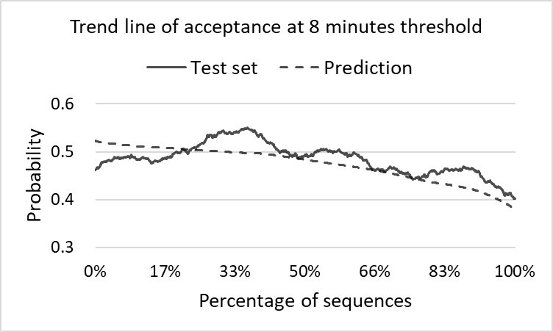
2.6
Result and Discussion
Evaluation of prediction
Evaluation of 8 minutes threshold
Low precision
Possible explanation: There may be some randomness in making the decision of whether walking to transit stations at the 8 minutes threshold. People may have some ambiguity in choosing whether to accept or not. The features are not significant at this threshold.
Chapter 2 - Analyzing Willingness of Walking Duration to Transit Stations Using Socio-Demographic Characteristics

Slide 25
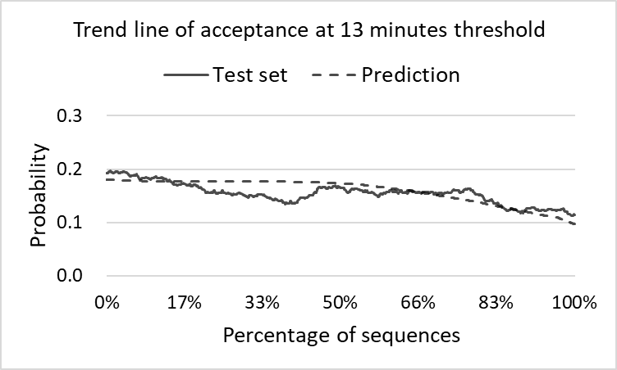
2.6
Result and Discussion
Evaluation of prediction
Evaluation of 13 minutes threshold
Slightly high precision
Possible explanation: The threshold of 13 minute is not a commonly acceptable walking duration, some one who can accept this threshold can be considered to have some specific characteristics. The features are significant at this threshold.
Chapter 2 - Analyzing Willingness of Walking Duration to Transit Stations Using Socio-Demographic Characteristics

Slide 26
2.7
Conclusion
Superior Topic
Exploring the use tendencies of urban rail transit
Application of this achievement
PSDC data in the blocks (e.g. A/B/C)
input
A
5 min
8 min
B
Model
13 min
Station
The trend (probability) of using this station in the blocks can be grasped.
Block
C
output
Achievement in this study
Probability of accepting the given threshold of walking duration
Chapter 2 - Analyzing Willingness of Walking Duration to Transit Stations Using Socio-Demographic Characteristics

Slide 27
Chapter 3
Analysis on the characteristics of transit ridership and land use
Introduction
Data
Characteristics of transit ridership and land use
Influencing factors of transit ridership
Conclusion

Slide 28
3.1
Introduction
Background
Problem
Aging population
Reduction in share rate of public transit
Traffic congestion
Demand
Promoting the use of rail transit
Alleviating the pressure on government finances
Making a better living environment for residents
Chapter 3 - Analysis on the characteristics of transit ridership and land use

Slide 29
3.1
Introduction
Research position
Preliminary study
Master the characteristics
Transit ridership
Influencing factor
Explore the influence
Relationship
Provide foundation for estimating the influence
Station level
Station-to-station level
Chapter 4
Chapter 5
Chapter 3 - Analysis on the characteristics of transit ridership and land use

Slide 30
3.1
Introduction
Purpose
To describe the characteristics of transit stations in terms of both transit ridership and land use
To explore the relationship between transit ridership and land use on the base of intensive description on the characteristics of transit stations.
Chapter 3 - Analysis on the characteristics of transit ridership and land use

Slide 31
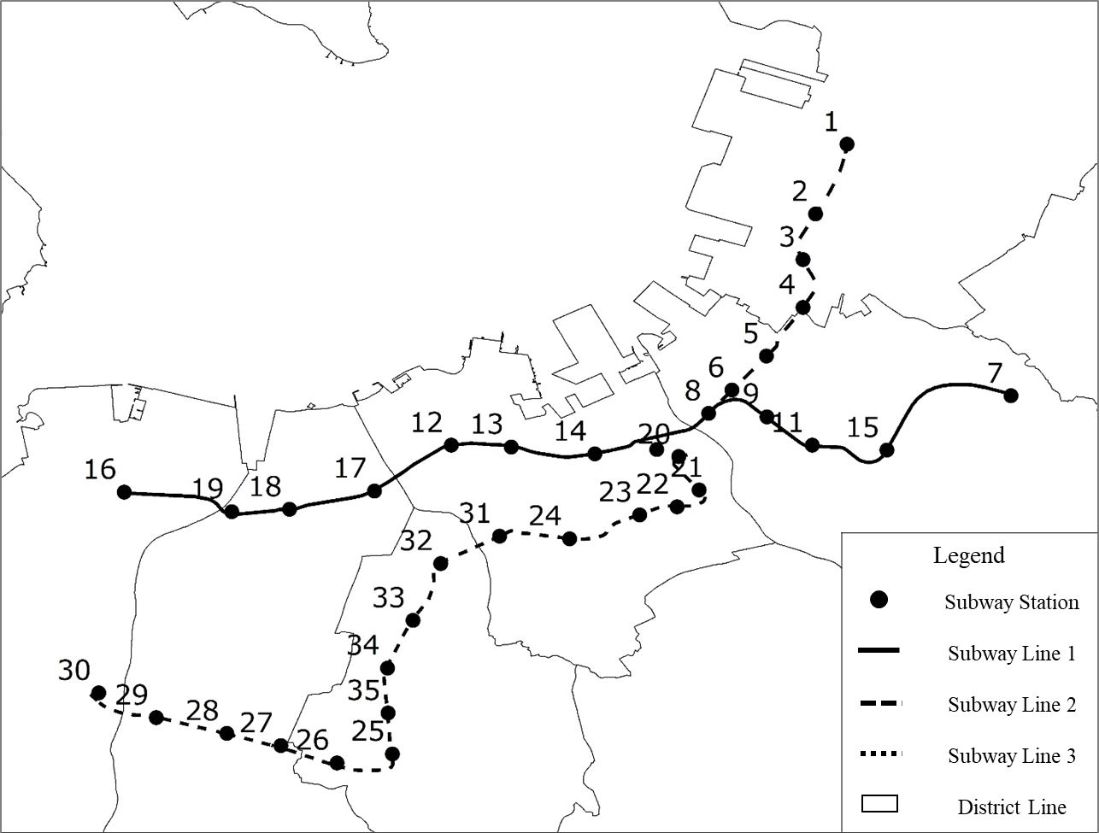
3.2
Data
Study case
Fukuoka subway
3 Lines
35 Stations
30km operating distance
600, 000 passengers per day
20% of total motorized travel
Chapter 3 - Analysis on the characteristics of transit ridership and land use

Slide 32
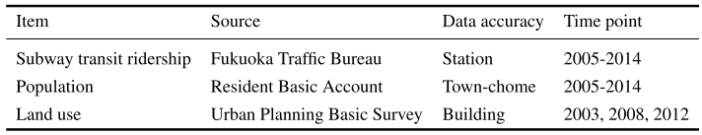
3.2
Data
Data collection
Chapter 3 - Analysis on the characteristics of transit ridership and land use

Slide 33
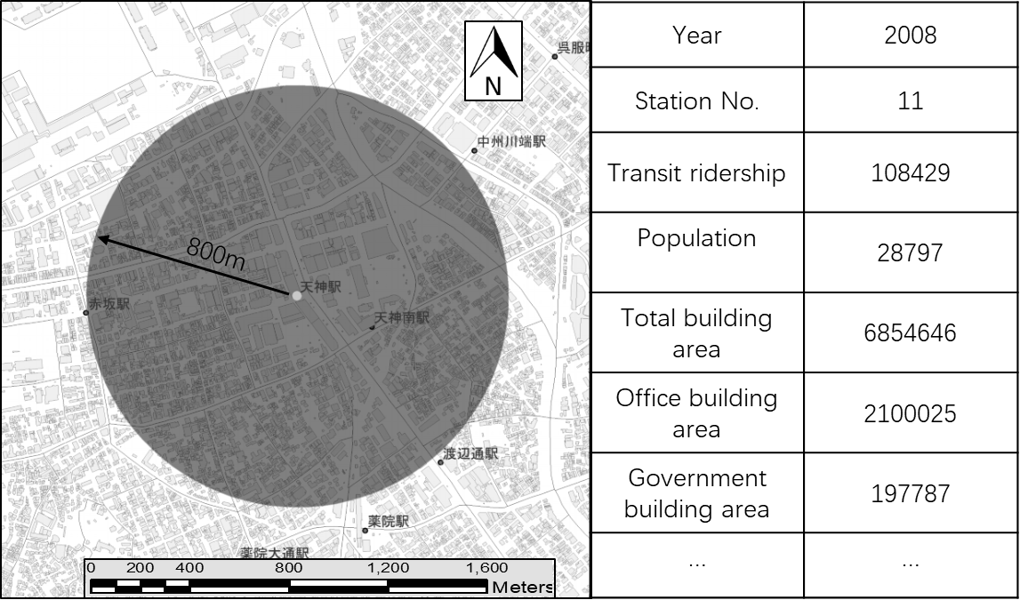
3.2
Data
Data collection
1. Matching the region of data.
2. Matching the time points of data.
3. Extracting the data within the catchment area.
Chapter 3 - Analysis on the characteristics of transit ridership and land use

Slide 34
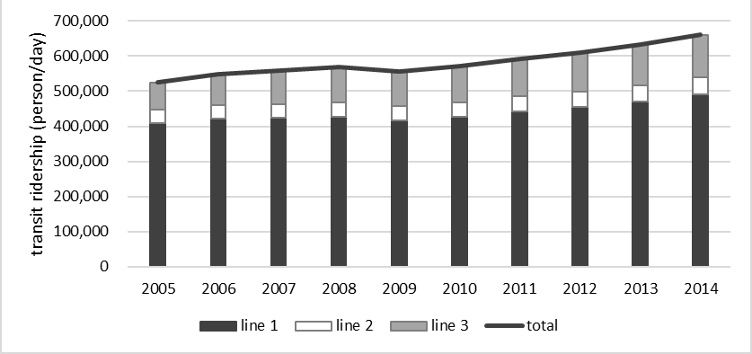
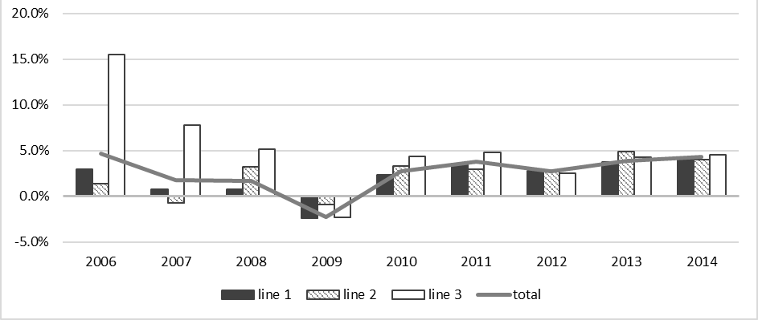
3.3
Characteristics of transit ridership and land use
Transit ridership characteristics
Three line carries more than 0.5 million passengers per day
Line 1 accounts for the most reaching about 0.5 million
Line 3 had a much higher growth rate at the first few years of the opening
The growth rate of three lines tend to be stable after the year of 2009
Chapter 3 - Analysis on the characteristics of transit ridership and land use

Slide 35
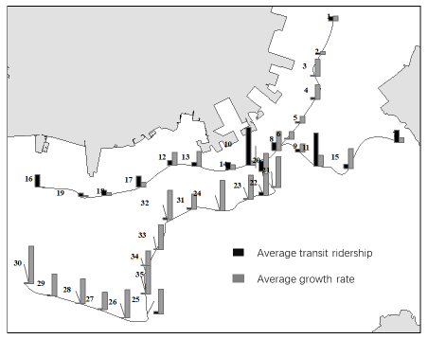
3.3
Characteristics of transit ridership and land use
Transit ridership characteristics
Transit ridership | Total | Line 1 | Line 2 | Line 3
Hub | 2 | 2 | 0 | 0
Large | 4 | 3 | 0 | 1
Medium | 11 | 8 | 1 | 2
Small | 18 | 0 | 4 | 4
Growth rate | Total | Line 1 | Line 2 | Line 3
0-2.5 | 12 | 8 | 4 | 0
2.5-4.5 | 11 | 5 | 2 | 4
4.5-6.0 | 6 | 0 | 0 | 6
6.0- | 6 | 0 | 0 | 6
Chapter 3 - Analysis on the characteristics of transit ridership and land use

Slide 36
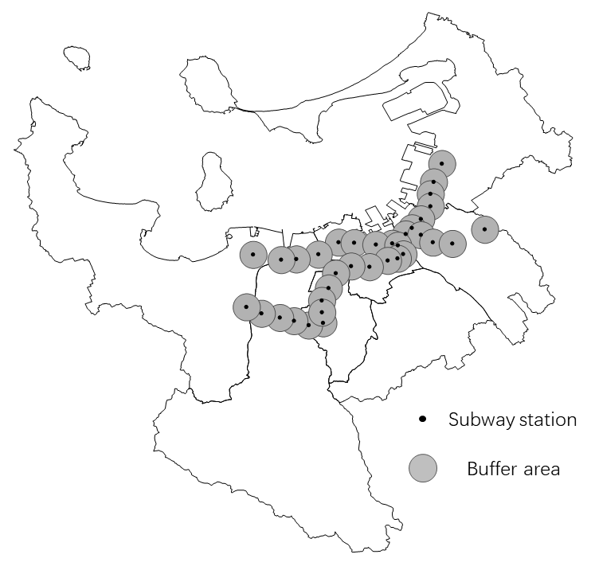
3.3
Characteristics of transit ridership and land use
Land use characteristics
Chapter 3 - Analysis on the characteristics of transit ridership and land use

Slide 37
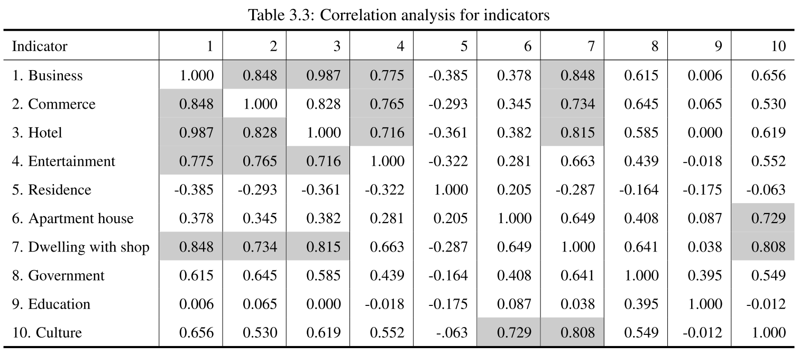
3.3
Characteristics of transit ridership and land use
Land use characteristics
Chapter 3 - Analysis on the characteristics of transit ridership and land use

Slide 38
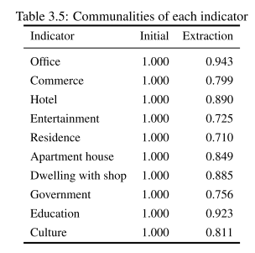
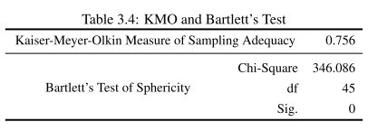
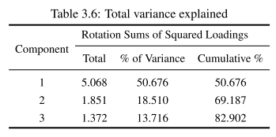
3.3
Characteristics of transit ridership and land use
Land use characteristics
Factor 2: Mixed residence
The indicators of apartment, residence, and culture mainly attribute to this factor, which can reﬂect the attribute of residence with supporting facilities.
Factor 1: Ofﬁce & commerce
This factor represents the land use mainly including ofﬁce area, large commercial area, and some commercial supporting facilities.
Factor 3: Education
Except for the indicator of education, the indicator of government also at tributes a large part of this factor. It means that the land use of education and government have a relatively strong correlation.
Chapter 3 - Analysis on the characteristics of transit ridership and land use

Slide 39
3.3
Characteristics of transit ridership and land use
Land use - classification
Type | Station | Population-density | Business | Commerce | Residence | Government | Education
Low-density residence | 30 | 33 | 1.70% | 41.50% | 44.95% | 0.01% | 0.18%
 | 26 | 54 | 2.81% | 1.23% | 58.26% | 0.00% | 2.85%
 | 29 | 78 | 3.02% | 5.40% | 75.86% | 0.00% | 6.94%
 | 27 | 79 | 4.30% | 4.24% | 75.87% | 0.07% | 0.77%
 | 28 | 81 | 3.55% | 3.42% | 73.46% | 0.03% | 6.24%
 | 3 | 91 | 4.01% | 8.58% | 59.97% | 3.04% | 6.25%
 | 33 | 101 | 1.74% | 2.10% | 81.71% | 0.00% | 7.84%
 | 24 | 103 | 2.14% | 2.17% | 66.82% | 0.10% | 8.30%
 | 34 | 109 | 2.38% | 3.28% | 86.12% | 0.01% | 0.86%
 | Average | 81 | 2.85% | 7.99% | 69.23% | 0.36% | 4.47%
This factor represents the land use mainly including ofﬁce area, large commercial area, and some commercial supporting facilities.
Chapter 3 - Analysis on the characteristics of transit ridership and land use

Slide 40
3.3
Characteristics of transit ridership and land use
Land use - classification
Type | Station | Population-density | Business | Commerce | Residence | Government | Education
High-density residence | 19 | 121 | 2.17% | 3.15% | 76.63% | 2.77% | 0.12%
 | 13 | 125 | 11.11% | 6.48% | 46.08% | 1.29% | 4.51%
 | 16 | 142 | 4.59% | 5.03% | 72.75% | 1.43% | 2.68%
 | 18 | 142 | 2.27% | 1.96% | 64.58% | 4.81% | 6.80%
 | 31 | 143 | 4.14% | 2.26% | 54.17% | 0.51% | 18.28%
 | 17 | 144 | 6.02% | 7.28% | 55.45% | 0.74% | 10.60%
 | 12 | 145 | 4.16% | 1.77% | 66.22% | 0.19% | 4.39%
 | 32 | 170 | 1.17% | 1.28% | 73.54% | 0.73% | 9.93%
 | 23 | 193 | 10.00% | 6.18% | 44.52% | 0.04% | 2.56%
 | Average | 151 | 5.43% | 4.03% | 59.66% | 1.22% | 7.47%
The indicators of apartment, residence, and culture mainly attribute to this factor, which can reﬂect the attribute of residence with supporting facilities.
Chapter 3 - Analysis on the characteristics of transit ridership and land use

Slide 41
3.3
Characteristics of transit ridership and land use
Land use - classification
Type | Station | Population-density | Business | Commerce | Residence | Government | Education
Education | 25 | 35 | 1.38% | 2.31% | 30.04% | 0.00% | 39.83%
 | 1 | 56 | 8.70% | 1.91% | 48.01% | 0.53% | 17.89%
 | 35 | 58 | 5.63% | 3.78% | 55.18% | 0.07% | 21.37%
 | 4 | 67 | 4.93% | 3.49% | 33.52% | 13.55% | 14.63%
 | 2 | 77 | 4.03% | 11.75% | 44.03% | 0.81% | 23.24%
 | 5 | 89 | 11.53% | 7.26% | 30.51% | 8.90% | 7.30%
 | Average | 64 | 6.03% | 5.08% | 40.22% | 3.98% | 20.71%
Except for the indicator of education, the indicator of government also attributes a large part of this factor. It means that the land use of education and government have a relatively strong correlation.
Chapter 3 - Analysis on the characteristics of transit ridership and land use

Slide 42
3.3
Characteristics of transit ridership and land use
Land use - classification
Type | Station | Population-density | Business | Commerce | Residence | Government | Education
Downtown commerce | 9 | 64 | 44.97% | 20.55% | 10.62% | 2.17% | 0.70%
 | 20 | 67 | 34.60% | 36.74% | 11.34% | 3.01% | 1.26%
 | 8 | 67 | 42.97% | 27.86% | 12.23% | 0.16% | 0.59%
 | 11 | 79 | 37.12% | 17.38% | 18.47% | 2.50% | 1.89%
 | 10 | 92 | 30.76% | 26.26% | 15.72% | 2.55% | 1.74%
 | Average | 74 | 38.08% | 25.76% | 13.68% | 2.08% | 1.24%
The type of downtown commerce includes 5 stations, which constituted the CBD area of Fukuoka. These stations have the highest proportion of ofﬁce and commerce, while proportion of residence is the lowest and population
density is relatively lower.
Chapter 3 - Analysis on the characteristics of transit ridership and land use

Slide 43
3.3
Characteristics of transit ridership and land use
Land use - classification
Type | Station | Population-density | Business | Commerce | Residence | Government | Education
Business | 15 | 64 | 31.63% | 7.80% | 25.80% | 4.39% | 5.73%
 | 6 | 96 | 34.56% | 17.29% | 21.61% | 0.10% | 1.75%
 | 14 | 105 | 26.97% | 17.27% | 17.61% | 3.74% | 2.80%
 | 21 | 136 | 22.86% | 16.12% | 33.66% | 0.16% | 2.70%
 | 22 | 167 | 21.38% | 12.53% | 36.79% | 0.04% | 2.50%
 | Average | 114 | 27.48% | 14.20% | 27.09% | 1.69% | 3.10%
Airport | 7 | 19 | 3.55% | 1.45% | 33.45% | 0.03% | 1.25%
This type includes 5 stations, of which the main land use is ofﬁce. These stations mainly distribute around the CBD area, mixed land use is one of the main characteristics.
Chapter 3 - Analysis on the characteristics of transit ridership and land use

Slide 44
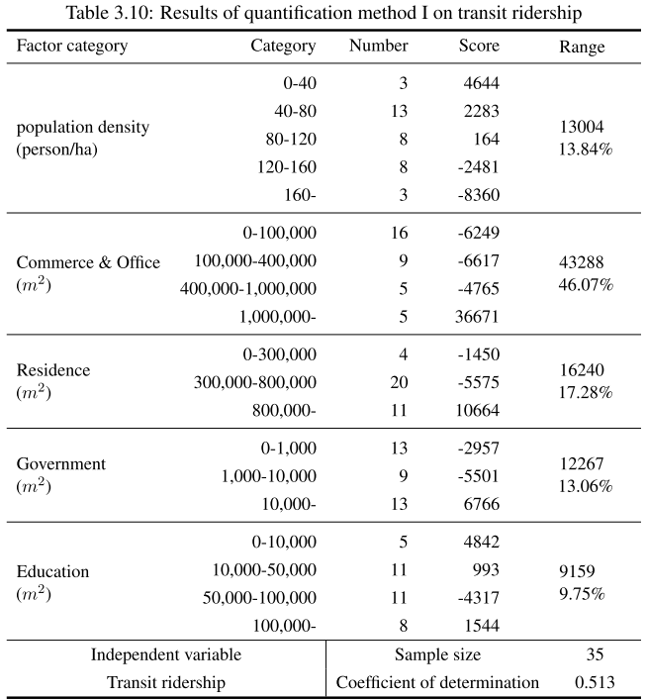
3.4
Influencing factors of transit ridership
Chapter 3 - Analysis on the characteristics of transit ridership and land use

Slide 45
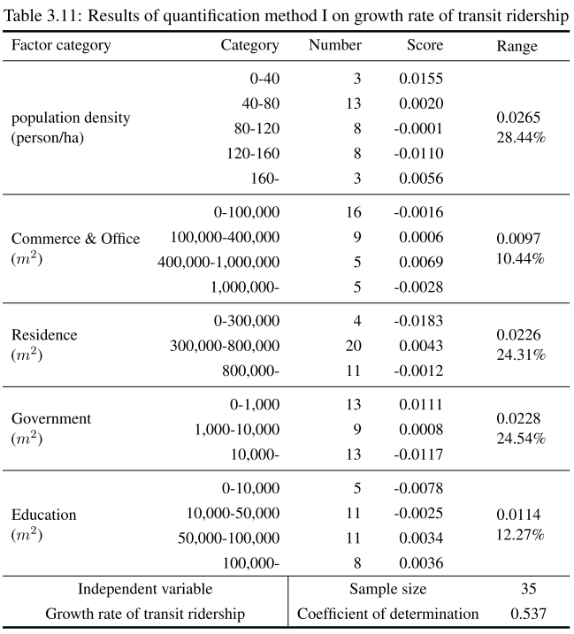
3.4
Influencing factors of transit ridership
Chapter 3 - Analysis on the characteristics of transit ridership and land use

Slide 46
3.4
Conclusion
provided references for selecting more valid indicator to make a prediction in the future research.
Implications for next stage
The determination of catchment area needs more investigation. Since the 800-meter circle catchment does not consider the differences in the form of the road network, the same 800 meters catchment area may represent different walking distance reﬂecting on the real road network.
The selection of indicators explaining the transit ridership needs more exploration. The other categories of indicators about such as facilities, socio-economic, and urban design should also have inﬂuence on the transit ridership.
The selection and usage of estimation model need more investigation. The issue of transit ridership is not only a simple regression problem, but it also relates to the location of stations. A model which is suitable for spatial analysis may be better than an ordinary regression model.
The approach of dealing with small sample case should be considered. Statistical analysis needs a certain sample size, otherwise, it cannot say the estimation result is credible. The problem led by small sample also reﬂects on the procedure of selecting the valid explanatory variables.
Chapter 3 - Analysis on the characteristics of transit ridership and land use

Slide 47
Chapter 4
Influencing Factors on Transit Ridership at Station Level
Introduction
Influencing factors
Identification of valid factors
Model estimation
Residual analysis
Conclusion

Slide 48
4.1
Introduction
Present Situation
Weakness in population growth
Tendency of using private transport
The financial pressure of public transport operator
Research Purpose
Explore and explain the factors influencing subway ridership
Explore the handling of small samples in this kind of issue
Research Content
Build the index framework based on prior study;
Identify the valid variables that do affect subway ridership
Estimate the Mix Geographically Weighted Regression model.
Chapter 4 - Influencing Factors on Transit Ridership at Station Level

Slide 49
4.1
Introduction
Catchment Area of Stations
Range for general
Catchment area: walking distance accessing the subway station.
(Pedestrian Catchment Area, PCA)
Thresholds range: 400m ~ 1000m
Most adopted: 800m
Rang in Fukuoka
Walking speed: about 4.8km/h
Average walking distance is about 600m
It can be inferred that most trips can be included in the range of 800 meters in Fukuoka
 | Walking |  | Bicycle
 | Proportion | Ave time | Proportion | Ave time
Average | 78% | 7.2 | 9% | 9.0
median | 85% | 7.0 | 8% | 9.5
Max | 22% | 4.8 | 0% | 0.0
Mix | 100% | 9.2 | 33% | 20.0
Chapter 4 - Influencing Factors on Transit Ridership at Station Level

Slide 50
4.2
Influencing factors
Variable Summary
Category | Variable | Expected sign | Min Value | Max Value | Average | Unit
Built environment | Commerce | + | 2,921 | 811,281 | 114,353 | m²
 | Office | + | 2,614 | 839,956 | 167,088 | m²
 | Residence | + | 110,748 | 1,067,523 | 528,533 | m²
 | Education | + | 294 | 305,559 | 59,691 | m²
 | Government | + | - | 128,471 | 20,878 | m²
 | Transportation Facility Area | + | 197 | 132,777 | 21,204 | m²
 | Land use Aggregation | + | 0.09 | 0.75 | 0.31 | -
Transportation Accessibility | Transfer Dummy | + | 1 | 4 | 1.34 | -
 | Bicycle Parking | Unknown | 64 | 4,375 | 778 | -
 | Bus Capacity | Unknown | 3 | 260 | 58.48 | -
 | Bus Accessibility | Unknown | 4 | 455 | 89.71 | -
 | Road Density | - | 191 | 479 | 299 | m/ha²
Demographic and Socioeconomic Environment | Population | + | 1,908 | 19,393 | 9,813 | -
 | House Member | - | 1.86 | 2.79 | 2.18 | -
 | Job-Resident Balance | Unknown | 1.27 | 2.61 | 1.80 | -
 | Tenant Proportion | - | 0.15 | 0.65 | 0.43 | %
Dependent variable: average daily subway ridership
Chapter 4 - Influencing Factors on Transit Ridership at Station Level

Slide 51
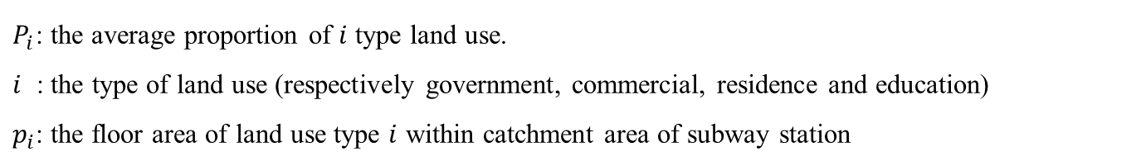


4.2
Influencing factors
Variable Interpretation
Land-use Aggregation
The indicator of land-use mix is re-defined into the aggregation of land-use.
Range of PCA | Residence | Office | Commerce | Education | Total
600 | 51.8% | 19.3% | 13.8% | 5.5% | 90.5%
800 | 55.3% | 17.5% | 12.0% | 6.2% | 90.9%
1000 | 57.6% | 16.5% | 10.8% | 6.0% | 90.9%
1200 | 59.2% | 15.5% | 10.2% | 5.9% | 90.8%
Ave | 62.8% | 10.1% | 7.5% | 5.3% | 85.7%
Average $P_{i}$
$G=\sqrt{\sum{{\left(p_{i}−P_{i}\right)}^{2}}}$
$P_{i}$: the average proportion of $i$ type land use.
$i$ : the type of land use (respectively government, commercial, residence and education)
$p_{i}$: the floor area of land use type $i$ within catchment area of subway station
Chapter 4 - Influencing Factors on Transit Ridership at Station Level

Slide 52
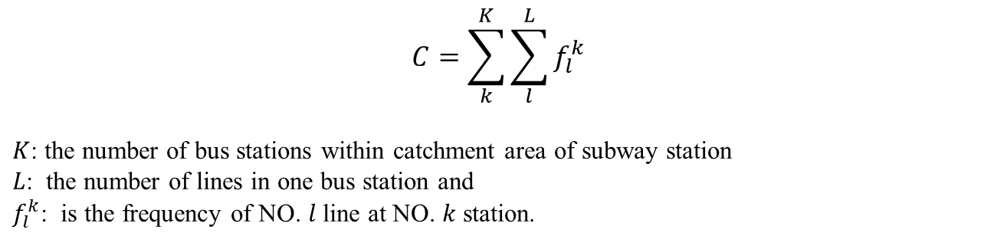
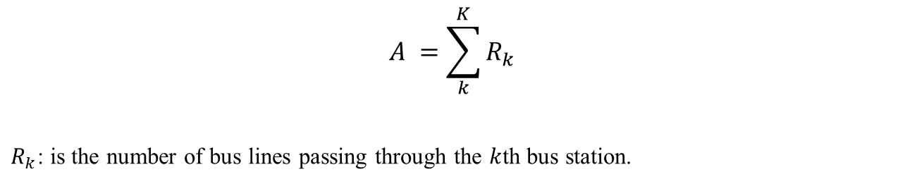
4.2
Influencing factors
Variable Interpretation
Bus capacity
$$C=\sum_{k}^{K}{\sum_{l}^{L}{f_{l}^{k}}}$$
$K$: the number of bus stations within catchment area of subway station
$L$: the number of lines in one bus station and
$f_{l}^{k}$: is the frequency of NO. $l$ line at NO. $k$ station.
Bus Accessibility
$$A =\sum_{k}^{K}{R_{k}}$$
$R_{k}$: is the number of bus lines passing through the $k$th bus station.
Chapter 4 - Influencing Factors on Transit Ridership at Station Level

Slide 53
4.3
Identification of Valid Factors
Exploratory Regression – Stage 1
Category | Variable | Statistical Information
 |  | VIF | Validity | stability | times | + | -
 | Total |  |  |  | 367 | 253 | 114
Built environment | Commerce Area | 8.8 | 32.1% | 100.0% | 25 | 25 | 0
 | Office Area | 10.4 | 9.0% | 71.4% | 7 | 5 | 2
 | Residence Area | 27.5 | 12.8% | 70.0% | 10 | 7 | 3
 | Education Area | 1.8 | 7.7% | 100.0% | 6 | 6 | 0
 | Government Area | 1.8 | 42.3% | 100.0% | 33 | 33 | 0
 | Transportation Facility | 3.0 | 67.9% | 100.0% | 53 | 53 | 0
 | Land use Aggregation | 2.5 | 50.0% | 100.0% | 39 | 39 | 0
Transportation Accessibility | Transfer Dummy | 3.0 | 34.6% | 100.0% | 27 | 27 | 0
 | Bicycle Parking | 4.5 | 44.9% | 100.0% | 35 | 35 | 0
 | Bus Capacity | 6.6 | 37.2% | 96.6% | 29 | 1 | 28
 | Bus Accessibility | 6.8 | 19.2% | 100.0% | 15 | 15 | 0
 | Road Density | 2.3 | 1.3% | 100.0% | 1 | 1 | 0
Demographic Socioeconomic Environment | Population | 23.9 | 12.8% | 60.0% | 10 | 6 | 4
 | Household Members | 3.0 | 39.7% | 100.0% | 31 | 0 | 31
 | Job-Resident Balance | 3.0 | 37.2% | 100.0% | 29 | 0 | 29
 | Tenant Proportion | 2.2 | 21.8% | 100.0% | 17 | 0 | 17
The cell marked with dark color means that it doesn’t meet the judgment.
Chapter 4 - Influencing Factors on Transit Ridership at Station Level

Slide 54
4.3
Identification of Valid Factors
Exploratory Regression – Stage 2
Independent variables | Test model
 | Beta | Sig | VIF
Government Area | 0.10 | 0.02 | 1.36
Transportation Facility Area | 0.20 | 0.00 | 2.31
Land use Aggregation | 0.10 | 0.03 | 1.42
Bicycle Parking | 0.46 | 0.00 | 2.60
Bus Capacity | -0.20 | 0.01 | 3.56
Bus Accessibility | 0.26 | 0.00 | 4.71
Transfer Dummy | 0.26 | 0.00 | 2.79
Job-Resident Balance | -0.10 | 0.05 | 1.94
Tenant Proportion | -0.09 | 0.03 | 1.32
Household Members | - | - | -
Residual sum of squares | 337744990
Adjusted R² | 0.96
AICc | 694.39
Jarque-Bera test (Sig) | 0.61 *
Koenker (BP) test (Sig) | 0.85 **
SA test (Sig) | 0.27 ***
* No biased standard errors due to heteroscedasticity
** Not deviating from a normal theoretical distribution
*** Not spatial autocorrelated
Chapter 4 - Influencing Factors on Transit Ridership at Station Level

Slide 55
4.4
Model estimation
Identification for Global/Local Variable
Variable | Moran's Index | Z-score | P-value* | Pattern | DIFF of Criterion** | Type
Government Area | 0.04 | 0.66 | 0.51 | Random | - | Global
Transportation Facility | 0.29 | 3.33 | 0.00 | Clustered | -1.95 | Local
Land use Aggregation | -0.01 | 0.20 | 0.84 | Random | - | Global
Transfer Dummy | 0.13 | 1.58 | 0.12 | Random | - | Global
Bicycle Parking | -0.12 | -0.92 | 0.36 | Random | - | Global
Bus Capacity | 0.70 | 7.57 | 0.00 | Clustered | 0.18 | Local
Bus Accessibility | 0.45 | 5.04 | 0.00 | Clustered | 0.04 | Local
Job-Resident Balance | 0.77 | 7.61 | 0.00 | Clustered | -0.17 | Local
Tenant Proportion | 0.24 | 2.54 | 0.01 | Clustered | 1.02 | Local
* Statistical significance means autocorrelation
** More than or equal to the value of 2, means the local term is better to be assumed as global
Chapter 4 - Influencing Factors on Transit Ridership at Station Level

Slide 56
4.4
Model estimation
MGRW Parameter Setting
Kernel Type
Fixed Gaussian kernel function
Bandwidth selection method
Golden-section search
5.7km
Chapter 4 - Influencing Factors on Transit Ridership at Station Level

Slide 57
4.4
Model estimation
Coefficient
Variable | Type | OLS model |  |  |  | MGWR model
 |  | B | SE | t |  | B | SE | t
Government Area | Global | 0.05 | 0.02 | 2.41 |  | 0.05 | 0.02 | 2.59
Land use | Global | 11,832.53 | 5323.15 | 2.22 |  | 13,384.34 | 5,408.81 | 2.48
Transfer Dummy | Global | 6,578.09 | 1216.82 | 5.41 |  | 5,968.65 | 1,198.72 | 4.98
Bicycle Parking | Global | 7.51 | 0.93 | 8.11 |  | 7.72 | 0.90 | 8.59
Transport Area | Local | 0.11 | 0.03 | 3.58 |  | 0.10 | 0.02 | -
Bus Capacity | Local | -59.21 | 20.71 | -2.86 |  | -55.14 | 5.94 | -
Bus Accessibility | Local | 50.71 | 14.64 | 3.46 |  | 48.61 | 2.43 | -
Job-Resident Balance | Local | -2,762.24 | 1,079.33 | -2.56 |  | -2,411.17 | 364.44 | -
Tenant Proportion | Local | -9,987.81 | 4,380.30 | -2.28 |  | -10,304.66 | 756.09 | -
Best bandwidth |  |  |  |  |  | 5.7km
AICc |  | 694.39 |  |  |  | 690.60
Residual sum of squares |  | 337,744,989 |  |  |  | 296311499
Chapter 4 - Influencing Factors on Transit Ridership at Station Level

Slide 58
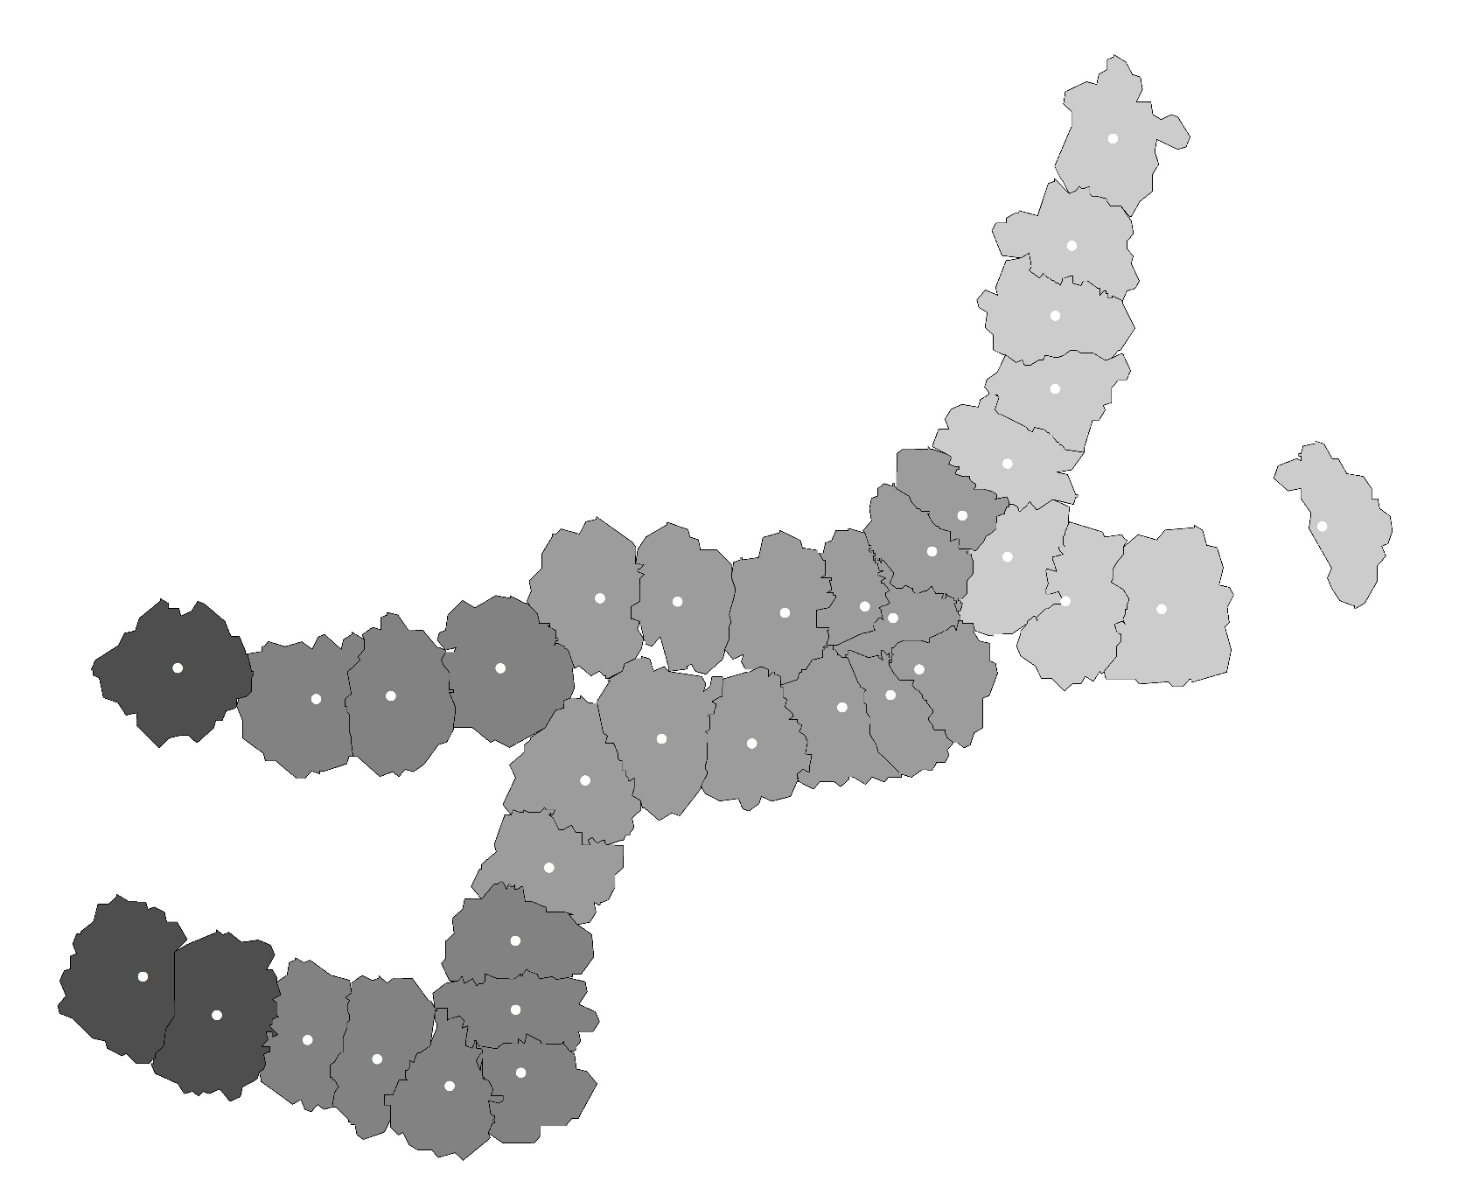
4.5
Residual Analysis
Distribution of Local R²
Local R²
0.960 - 0.965
0.965 – 0.970
0.970 – 0.975
0.975 – 0.980
Distribution of Residuals
Indicator | OLS | MGWR
Moran’s index | 0.08 | 0.03
Expected index | -0.03 | -0.03
Variance | 0.01 | 0.01
z-score | 1.09 | 0.61
p-value | 0.27 | 0.54
Moran’s index in MGWR is more closer to the expected index than that in OLS
Z-score in MGWR is less than that in OLS
Chapter 4 - Influencing Factors on Transit Ridership at Station Level

Slide 59
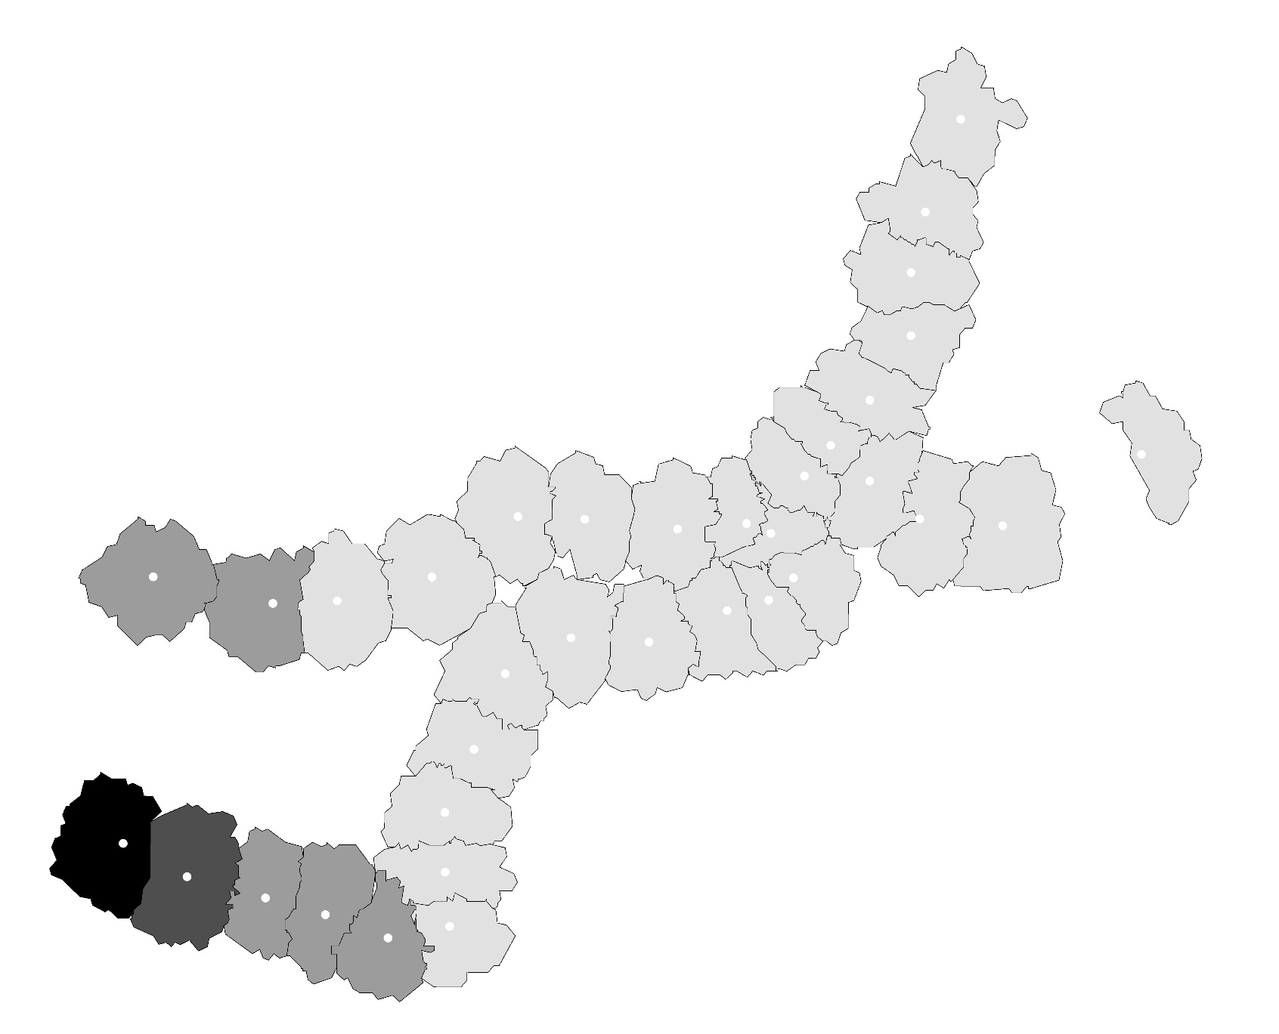
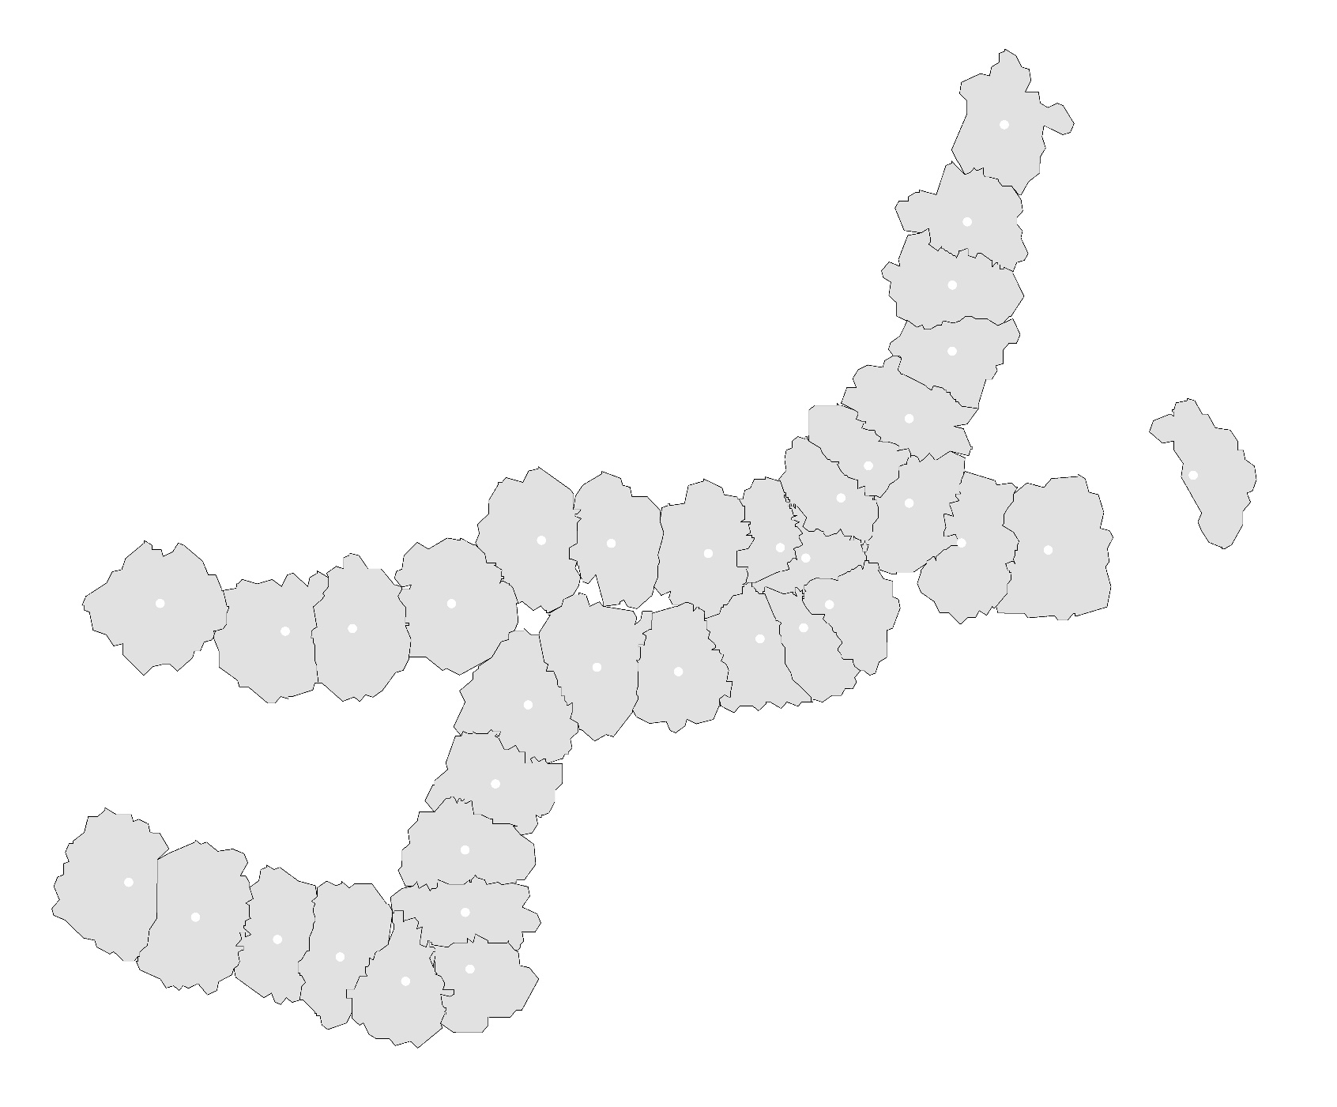
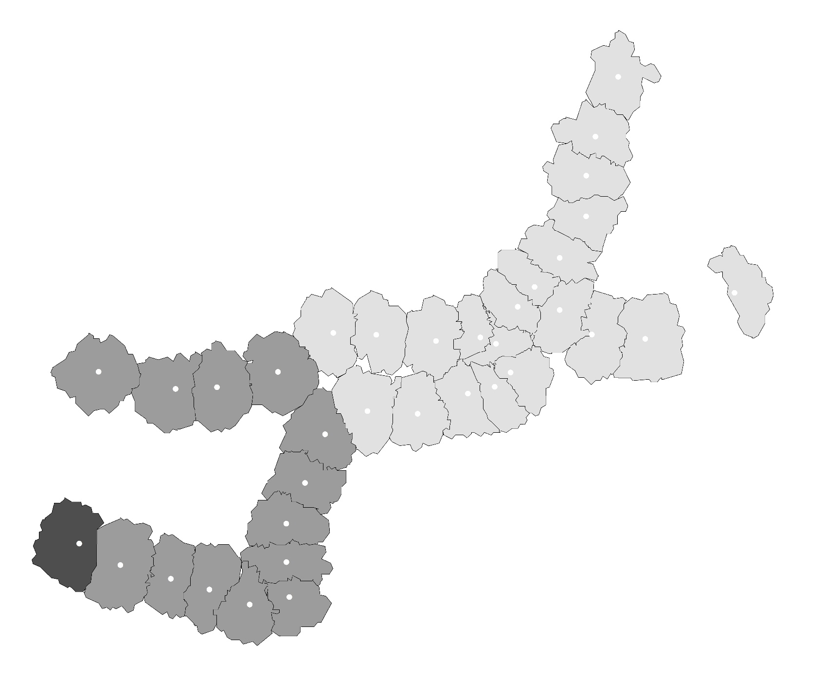
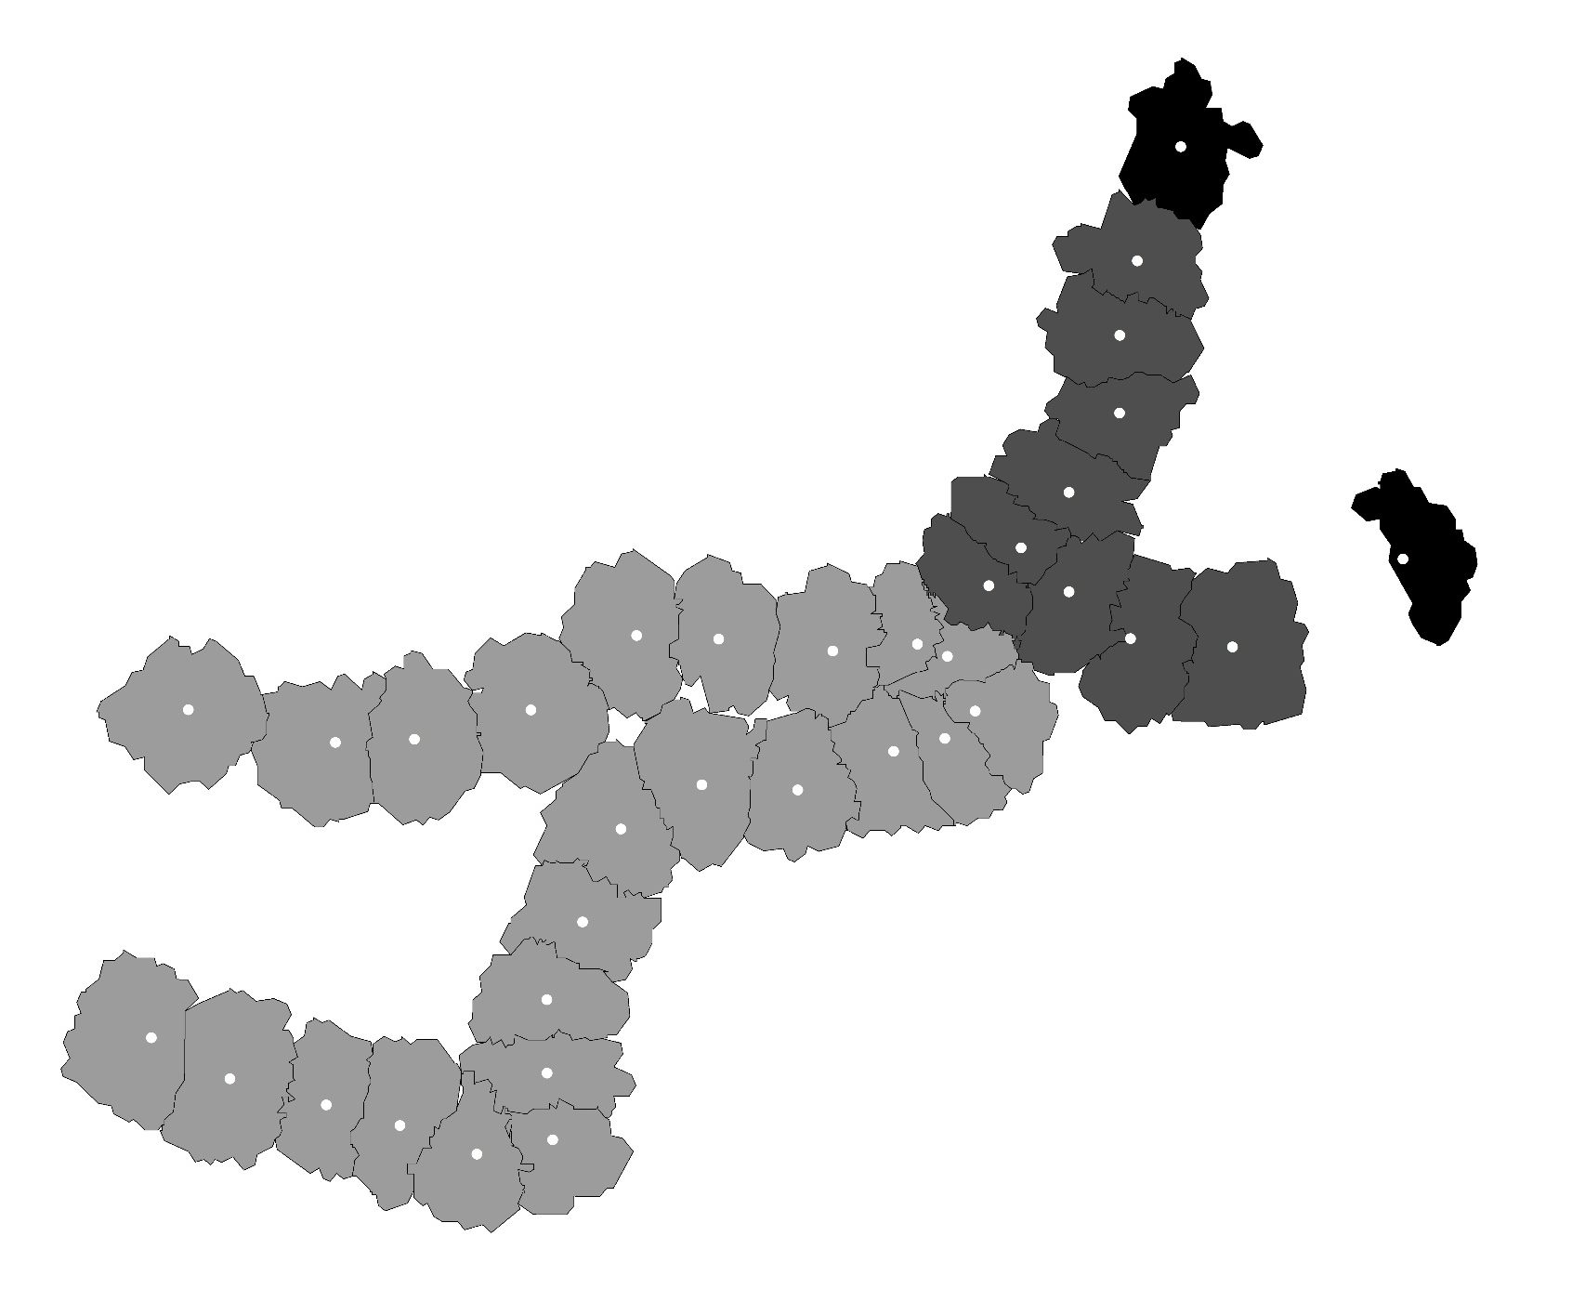
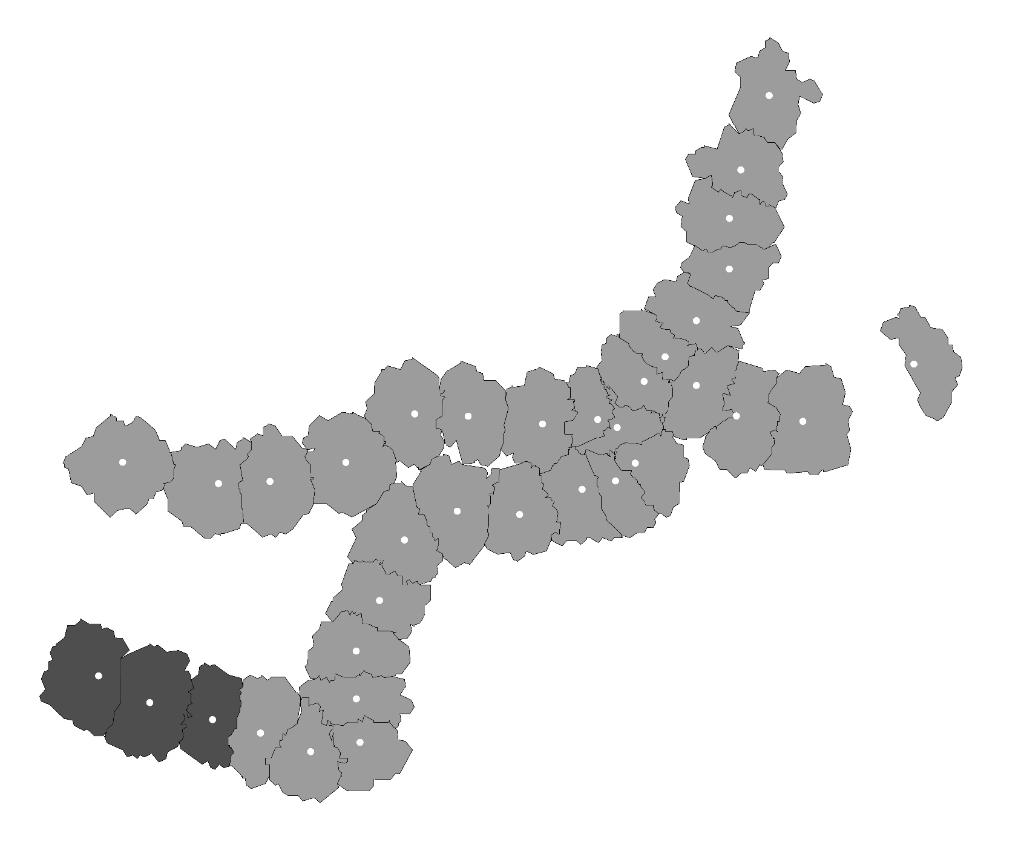
4.5
Residual Analysis
Significance Map
Transportation Facility Area
Bus Accessibility
Bus Capacity
Significance Map
Not Significance
P = 0.01
P = 0.05
P = 0.1
Population Job Balance
Tenant Proportion
Chapter 4 - Influencing Factors on Transit Ridership at Station Level

Slide 60
4.6
Conclusion
Main Work
Reclassified and reorganized the indicator framework.
Proposed the approach of selecting variables from candidates using the tool of exploratory regression in ArcGIS.
Provided a method for judging whether a variable is global or local used in estimating the MGWR model.
Chapter 4 - Influencing Factors on Transit Ridership at Station Level

Slide 61
Chapter 5
Influencing Factors on Transit Ridership at Station-to-Station Level
Introduction
Research object
Method
Methods
Results Discussion

Slide 62
5.1
Introduction
Development of urban rail transit
The urban rail transit has become one of the most important travel modes in modern cities.
Public transit goes first
The policy of giving priority to the development of public transport has widely been adopted around the world.
Coordination between urban planning and urban rail transit
How to master the relationship between land-use and passenger volume has become an important issue.
Chapter 5 - Influencing Factors on Transit Ridership at Station-to-Station Level

Slide 63
5.1
Introduction
 | Scale | Objective
Station-Level | single station | Passenger volume of station
Station-to-Station-Level | station network | OD passenger volume
Research Questions
To describe the connectivity between different stations using OD ridership.
To explain how the connectivity is determined by land-use factors.
Some References
[1] Taylor, B.D. et al., (2003). Analyzing the determinants of transit ridership using a two-stage least squares regression on a national sample of urbanized areas. University of California Transportation Center.
[2] Choi, J. et al., (2012). An analysis of Metro ridership at the station-to-station level in Seoul. Transportation, 39(3), 705–722.
[3] Gutiérrez, J., Cardozo, O.D. & García-Palomares, J.C., (2011). Transit ridership forecasting at station level: An approach based on distance-decay weighted regression. Journal of Transport Geography, 19(6), 1081–1092.
Chapter 5 - Influencing Factors on Transit Ridership at Station-to-Station Level

Slide 64
5.1
Introduction
Dependent variable
Index framework
Independent variable
Conversion of realistic issue
Probability of getting off at a specific destination station
Discrete choice issue
Model estimation
Logistic regression
Result and Discussion
Chapter 5 - Influencing Factors on Transit Ridership at Station-to-Station Level

Slide 65

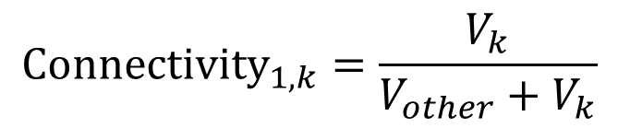

5.2
Research object
Description for Connectivity —— dependent variable
Other
Stations
2
3
Passenger Volume
4
5
$$V_{other}$$
Station
1
……
Station k
Passenger Volume
k
$$V_{k}$$
Boarding
Alighting
$${Connectivity}_{1,k}=\frac{V_{k}}{V_{other}+V_{k}}$$
Chapter 5 - Influencing Factors on Transit Ridership at Station-to-Station Level

Slide 66
5.2
Research object
Determinants for transit ridership —— independent variables
Land-use
Residence proportion
Office proportion
Commerce proportion
Education proportion
Land-use aggregation
Impedance
Bus capacity
Operation distance of subway
Bus accessibility
Chapter 5 - Influencing Factors on Transit Ridership at Station-to-Station Level

Slide 67
5.3
Method
Realistic issues
Boarding
Alighting
Station 1
Other
Stations
Station 2
……
……
Station k
Impedance between boarding and alighting station
Independent variable
Affect
Dependent variable
Choice of whether to get off at station k
land-use feature of boarding station
Chapter 5 - Influencing Factors on Transit Ridership at Station-to-Station Level

Slide 68
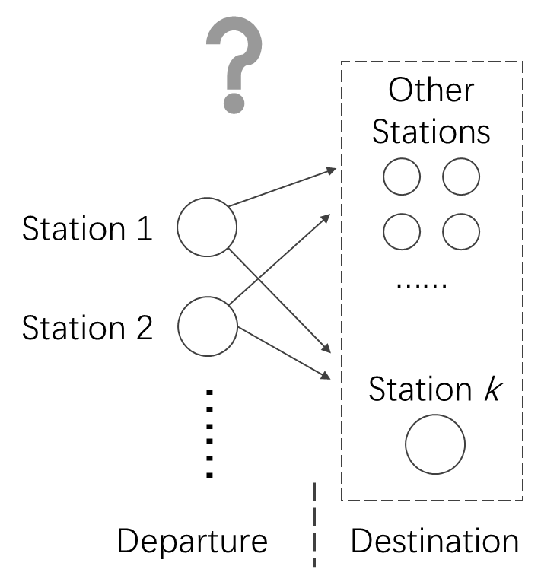
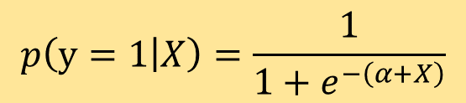

5.3
Method
Mathematical problems
Logistic regression model
$$p\left(y=1 | X\right)=\frac{1}{1+e^{−\left(α+X\right)}}$$
$p$: probability of getting off
$y$ : result of choice
$X$ : vector of explanatory variable
$α$ : residual item.
Discrete choice issue
Chapter 5 - Influencing Factors on Transit Ridership at Station-to-Station Level

Slide 69
5.3
Method
Select sample station
Station type | Station name | Population density | Commerce proportion | Office proportion | Residence proportion | Education proportion
Medium-density residence | Kamo | 98 Person/Ha | 4% | 3% | 83% | 4%
High-density residence | Fujisaki | 173 Person/Ha | 5% | 7% | 76% | 6%
Education | Hakozakikyudai | 83 Person/Ha | 5% | 6% | 51% | 22%
Office | Gofukumachi | 135 Person/Ha | 8% | 31% | 49% | 3%
Commerce | Tenjin | 69 Person/Ha | 34% | 32% | 24% | 1%
Airport | Fukuoka Airport | 36 Person/Ha | 1% | 3% | 45% | 2%
Note:
The highlighted cells refer to the representative values that having much higher percentage than other land-use types.
Chapter 5 - Influencing Factors on Transit Ridership at Station-to-Station Level

Slide 70
5.5
Results and discussion
Result of estimation
Destination Station |  | Variables in Departure Station
Type | Destination Station | Land-use |  |  |  |  |  | Impedance
 |  | C | O | R | E | L-A |  | D | B-C | B-A
Medium-density residence | Kamo | 0.95 | 0.94 | 0.94 | 0.93 | 0.97 |  | 1.07 | 1.01 | 1.00
High-density residence | Fujisaki | 1.01 |  | 0.99 | 1.01 | 0.98 |  | 0.95 | 1.00 | 1.00
Education | Hakozakikyudai | 1.02 |  | 1.02 | 1.03 | 0.99 |  | -0.13 | 0.00 | 0.00
Office | Gofukumachi | 1.02 | 0.98 | 1.02 | 1.06 | 0.99 |  |  | 1.00 | 1.00
Commerce | Tenjin | 1.00 | 0.99 | 1.01 | 1.03 | 1.02 |  | 1.06 |  | 1.00
Airport | Airport | 0.97 | 1.03 | 0.99 | 0.99 | 1.03 |  | 0.92 | 1.00 | 1.00
Note: full name of the abbreviation
C: Commerce, O: Office, R: Residence, E: Education, L-A: Land-use Aggregation, D: Distance, B-C: Bus Capacity, B-A: Bus Accessibility.
Chapter 5 - Influencing Factors on Transit Ridership at Station-to-Station Level

Slide 71
5.5
Results and discussion
Discussion for results
Destination Station |  | Variables in Departure Station
Type | Destination Station | Land-use |  |  |  |  |  | Impedance
 |  | C | O | R | E | L-A |  | D | B-C | B-A
Medium-density residence | Kamo | 0.95 | 0.94 | 0.94 | 0.93 | 0.97 |  | 1.07 | 1.01 | 1.00
High-density residence | Fujisaki | 1.01 |  | 0.99 | 1.01 | 0.98 |  | 0.95 | 1.00 | 1.00
Education | Hakozakikyudai | 1.02 |  | 1.02 | 1.03 | 0.99 |  | -0.13 | 0.00 | 0.00
Office | Gofukumachi | 1.02 | 0.98 | 1.02 | 1.06 | 0.99 |  |  | 1.00 | 1.00
Commerce | Tenjin | 1.00 | 0.99 | 1.01 | 1.03 | 1.02 |  | 1.06 |  | 1.00
Airport | Airport | 0.97 | 1.03 | 0.99 | 0.99 | 1.03 |  | 0.92 | 1.00 | 1.00
Result: Medium-density residence have weak connectivity with all other types.
Discussion: The private traffic ratio is higher.
Chapter 5 - Influencing Factors on Transit Ridership at Station-to-Station Level

Slide 72
5.5
Results and discussion
Discussion for results
Destination Station |  | Variables in Departure Station
Type | Destination Station | Land-use |  |  |  |  |  | Impedance
 |  | C | O | R | E | L-A |  | D | B-C | B-A
Medium-density residence | Kamo | 0.95 | 0.94 | 0.94 | 0.93 | 0.97 |  | 1.07 | 1.01 | 1.00
High-density residence | Fujisaki | 1.01 |  | 0.99 | 1.01 | 0.98 |  | 0.95 | 1.00 | 1.00
Education | Hakozakikyudai | 1.02 |  | 1.02 | 1.03 | 0.99 |  | -0.13 | 0.00 | 0.00
Office | Gofukumachi | 1.02 | 0.98 | 1.02 | 1.06 | 0.99 |  |  | 1.00 | 1.00
Commerce | Tenjin | 1.00 | 0.99 | 1.01 | 1.03 | 1.02 |  | 1.06 |  | 1.00
Airport | Airport | 0.97 | 1.03 | 0.99 | 0.99 | 1.03 |  | 0.92 | 1.00 | 1.00
Result: Education type have strong connectivity with most of other types.
Discussion: Students are more inclined to use subway.
Chapter 5 - Influencing Factors on Transit Ridership at Station-to-Station Level

Slide 73
5.5
Results and discussion
Discussion for results
Destination Station |  | Variables in Departure Station
Type | Destination Station | Land-use |  |  |  |  |  | Impedance
 |  | C | O | R | E | L-A |  | D | B-C | B-A
Medium-density residence | Kamo | 0.95 | 0.94 | 0.94 | 0.93 | 0.97 |  | 1.07 | 1.01 | 1.00
High-density residence | Fujisaki | 1.01 |  | 0.99 | 1.01 | 0.98 |  | 0.95 | 1.00 | 1.00
Education | Hakozakikyudai | 1.02 |  | 1.02 | 1.03 | 0.99 |  | -0.13 | 0.00 | 0.00
Office | Gofukumachi | 1.02 | 0.98 | 1.02 | 1.06 | 0.99 |  |  | 1.00 | 1.00
Commerce | Tenjin | 1.00 | 0.99 | 1.01 | 1.03 | 1.02 |  | 1.06 |  | 1.00
Airport | Airport | 0.97 | 1.03 | 0.99 | 0.99 | 1.03 |  | 0.92 | 1.00 | 1.00
Result: Similar types have weak connectivity
Discussion: Traffic demand is generated by different trip purpose
Chapter 5 - Influencing Factors on Transit Ridership at Station-to-Station Level

Slide 74
Chapter 6
Conclusion
Summary
Contributions
Recommendations

Slide 75
6.1
Summary
Taking explaining the rail transit ridership as the overall goal analyzed the inﬂuence of various factors on ridership from station level and station-to-station level respectively.
Provided new explanations for the catchment area of rail transit stations.
Provided an approach for selecting the valid indicators;
Proposed a ridership forecasting method with the consideration of interaction among stations and stations
showed a way to accurately estimate the catchment area.
Chapter 6 - Conclusion

Slide 76
6.2
Contributions
Chapter 2
Reinterpreted the implication of surveyed walking distance/duration to transit stations, that it has no linear relation with people willingness but just the reﬂection of the distance between departures and stations.
Described the correlation between surveyed walking duration and people’s individual characteristics from the view of probability, which can be further applied to the estimation of catchment area of rail transit stations.
Chapter 6 - Conclusion

Slide 77
6.2
Contributions
Chapter 3
Analyzed the trend of variations in transit ridership, and classiﬁed the sub-way stations of Fukuoka into 5 types in terms of land use. Conﬁrmed the correlations between transit ridership and land use.
Chapter 6 - Conclusion

Slide 78
6.2
Contributions
Chapter 4
Considered the inﬂuence of bus on rail transit ridership from both the sides of bus capacity and bus accessibility, and veriﬁed that the effect of bus capacity is positive to rail transit ridership, while the effect of bus accessibility is negative.
Proposed the approach of screening valid indicators by introducing the exploratory regression, and conﬁrmed its effectiveness in a small sample case.
Distinguished the local and global variables in MGWR model by examining the spatial distribution of each variable, and the effectiveness was conﬁrmed in the estimation of MGWR model
Chapter 6 - Conclusion

Slide 79
6.2
Contributions
Chapter 5
By examining the probability of selecting the destination station from all the stations, established a logistic regression model for describing the correlation between stations and stations.
Quantitatively validated the impact of land use types on the selection of destination stations.
Chapter 6 - Conclusion

Slide 80
6.3
Recommendations
recommendations for helping increase the
use of rail transit
People’s walking preferences have signiﬁcant inﬂuence on the use of rail transit. It is suggested that the design for pedestrian accessibility should also consider the individual characteristics of resident, thus helping increase the use of rail transit.
With the development of rail transit, if viewing from the whole transit system, the positioning of bus system is gradually inclining to be the connection between departures and rail transit. Rather than planning higher capacity for bus transport, it is suggested to plan more accessible bus routes which can help people use rail transit more convenient.
According to the ﬁndings, the more aggregation in land use functions the more demand in rail transit. Thus suggesting to connect more functional regions as possible when making rail transit planning.
Chapter 6 - Conclusion

Slide 81
6.3
Recommendations
recommendations for helping increase the
use of rail transit
Surveys of income and occupation, exploring the effect on travel behavior.
Integer of the whole process of estimating the catchment area of rail transit stations based on the achievements of this dissertation.
Joint of the estimation of catchment area and ridership forecasting, improving the accuracy.
Analysis of the inﬂuence on land use affected by the use of rail transit, exploring the interaction between land use and transit.
Analysis of balance condition among various elements in the catchment area of transit stations, including human, resource, land use, transportation etc. achieving the goal of sustainable development.
Chapter 6 - Conclusion

