Slide 1

Research on Determinants of Rail Transit Ridership
CHEN Qi
Graduate School of Human-Environment Studies,
Kyushu University, Japan
November 27, 2018
Notes:
Hello everyone, I’m Chen Qi, the doctor candidate from Zhao laboratory.
The title of my dissertation is Research on Determinants of Rail Transit Ridership.
Now I will give my presentation.

Slide 2
Chapter 1
Introduction
Background
Research purpose
Research contents
Primary research questions
Notes:
The chapter 1 is a brief introduction for the whole dissertation

Slide 3
1.1
Background
Problems
1
2
Reduction in share rate of public transit
Traffic congestion
Chapter 1 - Introduction
Notes:
This research uses the Fukuoka public rail transit as the study case to examine the influencing factors on ridership.
Now Fukuoka is facing a problem of reduction in public transit share.
The private car share rate keeps on increasing, while the rail transit share has begun to decline.

Slide 4
1.1
Background
Problems
1
2
Reduction in share rate of public transit
Traffic congestion
Chapter 1 - Introduction
Notes:
Another problem the traffic congestion, which we are experiencing every day.
At present, the average travel speed during crowed time has almost fallen under 20 kilometers per hour, and it keeps on getting worse now.

Slide 5
1.1
Background
Problems
1
2
Reduction in share rate of public transit
Traffic congestion
Demand
Promoting the use of public rail transit
Theme
Exploring the determinants of utilization transit ridership
Chapter 1 - Introduction
Notes:
With these transportation problems, it’s clear that we have the demand to promote the use of public transit.
And that is what I want to talk about in this dissertation.
The theme is to explore the influencing factors of rail transit ridership.

Slide 6

1.2
Research purpose
Primary questions
1
What influence the walking duration to transit stations?
Walking duration
1
Station
Station
Ridership
Ridership
2
3
2
What factors explain transit ridership at station level?
3
What factors influence the transit ridership between station and station?
Chapter 1 - Introduction
Notes:
0. Around this topic, there are 3 primary questions to answer.
1. The first one is what influence the walking duration to transit stations? Since most travel accessing the transit station is walking, the walking duration should be one of the most important factors influencing the ridership.
2. The second is what factors explain transit ridership at station level? As we know, the environment around a station of cause can affect the ridership of this station, so our aim is to find and estimate the influencing factors.
3. Based on the second question, because stations are in the network, the ridership in one of the stations varied, the ridership in other stations must vary as well. Here the third question is proposed, that is what factors influence the transit ridership between station and station.
00. These are the primary questions in this dissertation

Slide 7
1.3
Literature review
Year |  | 2004 | 2004 | 2009 | 2010 | 2011 | 2012 | 2013 | 2013 | 2015
Author |  | Chu | Kuby et al. | Taylor et al. | Sohn and Shim | Gutiérrez et al. | Cardozo et al. | Chakraborty et al. | Zhao et al. | Jun et al.
Catchment (walking distance) |  | 400m walking distance | 800m walking distance | N/A | N/A | Distance-decay 800m buffer | 800m walking distance | N/A | 800m radius | 300m,600m,900m radius
Method |  | Poisson Regression | WLS | 2SLS | OLS/SEM | OLS | OLS/GWR | OLS/SEM | OLS | OLS/MGWR
Sample Size |  | 2568 | 268 | 265 | 251 | 158 | 190 | 900 | 55 | 442
Number of Valid Indicator |  | 15 | 11 | 8 | 7 | 9 | 4 | 9 | 11 | 11
Coefficient of determination (Adjusted R²) |  | 0.54 | 0.71 | 0.91 | 0.60 | 0.73 | 0.56 | 0.69 | 0.95 | 0.77
Building environment | Built environment |  |  |  | ● | ● |  | ● | ● | ●
 | Hospital |  |  |  |  |  |  |  | ●
 | School/University |  |  |  | ● |  |  |  | ●
 | CBD |  | ● |  |  |  |  |  | ●
 | Land use mix |  |  |  | ● | ● | ● |  |  | ●
 | Other infrastructures |  | ● |  |  |  |  |  | ● | ●
Transportation Accessibility | Accessibility of pedestrian | ● |  |  |  |  |  | ●
 | Accessibility of transfer |  | ● |  | ● | ● | ● | ● | ● | ●
 | Road coverage |  |  | ● | ● |  |  |  | ●
 | Parking |  | ● |  |  |  |  |  | ●
 | Service level of public transit | ● | ● | ● |  | ● | ● |  | ● | ●
 | Locational factor |  | ● |  | ● |  |  |  | ●
Demographic and Socioeconomic Environment | Population |  | ● | ● | ● |  | ● | ● | ● | ●
 | Employment | ● | ● | ● | ● | ● | ● | ● | ● | ●
 | Age | ● |  | ● |  |  |  |  |  | ●
 | Tenant proportion |  | ● |  |  |  |  |  |  | ●
 | Race | ● | ● | ● |  | ●
 | Income | ● |  |  |  |  |  | ●
 | Vehicles holdings | ● |  |  |  |  | ● | ●
 | Fare |  |  | ●
Points discussed in previous studies
Catchment area
Model
Indicator system
Lack of consideration
Small sample case
The ridership between station and station
Chapter 1 - Introduction
Notes:
With the primary questions, I will give an overview of the previous studies.
Most studies paid the concentration on catchment area, model construction and estimation, and the indicator system.
But very few studies focus on the small sample case and the ridership transfer between station and station.

Slide 8
1.4
Research contents
Specific research topic
1
Exploring the willingness of walking duration to transit stations regarding passengers’ personal attributes.
Chapter 2
2
Analyzing the characteristics in the variation of transit ridership.
Chapter 3
3
Exploring the approach of screening effective influencing factors in small sample case
Chapter 4
4
Shifting the research perspective, trying to describing the variation of ridership between stations and stations.
Chapter 5
Chapter 1 - Introduction
Notes:
Based on the research purpose and previous studies, 4 specific research topics are proposed, corresponding to the chapters from 2 to 5.
Chapter 2 is Exploring the willingness of walking duration to transit stations regarding passengers’ personal attributes.
Chapter 3 is Analyzing the characteristics in the variation of transit ridership.
Chapter 4 is Exploring the approach of screening effective influencing factors in small sample case
Chapter 5 is Shifting the research perspective, trying to describing the variation of ridership between stations and stations.
This is the introduction of my dissertation.

Slide 9
Chapter 2
Analyzing Willingness of Walking Duration to Transit Stations Using Socio-Demographic Characteristics
Introduction
Methods
Data description
Selection for Valid Features
Estimation of Features
Result and Discussion
Conclusion
Notes:
The chapter 2, Analyzing Willingness of Walking Duration to Transit Stations Using passenger’s personal attributes

Slide 10
2.1
Introduction
The question to answer
1
What influence the walking duration to transit stations?
Walking duration
1
Station
Station
Ridership
Ridership
2
3
2
What factors explain transit ridership at station level?
3
What factors influence transit ridership between station and station?
Chapter 2 - Analyzing Willingness of Walking Duration to Transit Stations Using Socio-Demographic Characteristics
Notes:
This study aims to answer the first primary question that I proposed at the very beginning.
That is, what influence the walking duration to transit stations.

Slide 11
2.1
Introduction
distance to destinations is widely thought to be an important predictor of active travel
Background
Walking is the most important travel modes in accessing transit stations.
Walking duration to transit station is widely thought to be an important determinants on the use of public transit.
Research purpose
Identify the correlation between walking duration to stations and the probability of accepting this walking duration.
Walking duration
Correlation
Probability of accepting it or not
Chapter 2 - Analyzing Willingness of Walking Duration to Transit Stations Using Socio-Demographic Characteristics
Notes:
Because Walking is the most important travel modes in accessing transit stations. The Walking duration to transit station is also widely thought to be an important determinants on the use of public transit.
This research mainly focuses on Identifying the correlation between walking duration to stations and the probability of accepting this walking duration.

Slide 12


2.1
Introduction
Problem description
Give an example, for one person who has the attributes:
$\left(Male, 25 years old, student, peak hour, go to school\right)$
Realistic issue
I can accept a walking duration less than 8 minutes
OK
8 min
4 min
0 min
Reflected in person trip survey
I walked 6 minutes to the station
6 min
0 min
Chapter 2 - Analyzing Willingness of Walking Duration to Transit Stations Using Socio-Demographic Characteristics
Notes:
There has been a lot of studies on the relationship between walking duration and personal attributes, however, the problem of walking duration is not well solved.
So, at first, I’m going to give an example to explain what I want to do in this research.
Think about a people who has the attributes like this, we suppose he can accept a walking duration less than 8 minutes for accessing transit stations.
But if it is reflected in a person trip survey, it will be like “I walked 6 minutes to the station”. Obviously, it cannot represent how long he are willing to walk to stations.

Slide 13
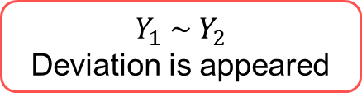
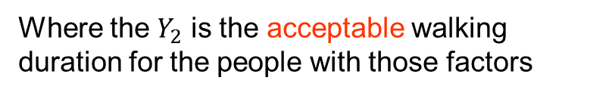
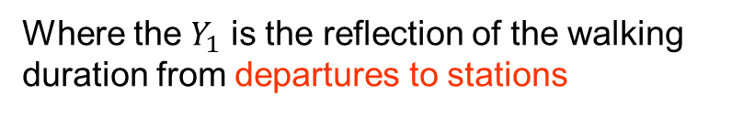
2.1
Introduction
Mathematical description
The general expression can be:
$$Walking duration=F\left({factor}_{1}, {factor}_{2},{factor}_{3}, ……\right)$$
Real Walking duration obtained from person trip survey
$$Y_{1} min=F\left({factor}_{1}, {factor}_{2},{factor}_{3}, ……\right)$$
Where the $Y_{1}$ is the reflection of the walking duration from departures to stations
Real ≠ Acceptable
$$Y_{1} \sim Y_{2}$$
Deviation is appeared
$$Y_{2} min=F\left({factor}_{1}, {factor}_{2},{factor}_{3}, ……\right)$$
Acceptable walking duration
Where the $Y_{2}$ is the acceptable walking duration for the people with those factors
Chapter 2 - Analyzing Willingness of Walking Duration to Transit Stations Using Socio-Demographic Characteristics
Notes:
I will change the description to a mathematical way.
According to the previous research, walking duration to transit station should have a relationship with personal attributes.
The general expression should be like this. The walking duration is a function of personal attributes.
However, the walking duration obtained from questionnaire is just a reflection of walking duration from the departure to the station. It should not have relationship with personal attributes.
But, as we know, the personal attributes should have influence on the travel behaviors including the walking duration to stations. In fact, what the personal attributes can influence is the acceptable walking duration.

Slide 14
2.1
Introduction
Research object
Dependent variable
Probability
accepting the given threshold of walking duration
Explanatory variables
Behavior
Personal socio-demographic characteristics
Other personal attributes
Trip chain info
Chapter 2 - Analyzing Willingness of Walking Duration to Transit Stations Using Socio-Demographic Characteristics
Notes:
On the base of interpreting the problems in this research topic, the research object in this study is carried out.
The dependent variable is the probability of accepting the given threshold of walking duration
The explanatory variables are passengers’ behaviors including Personal socio-demographic characteristics, some other personal attributes, and also the trip chain information.

Slide 15
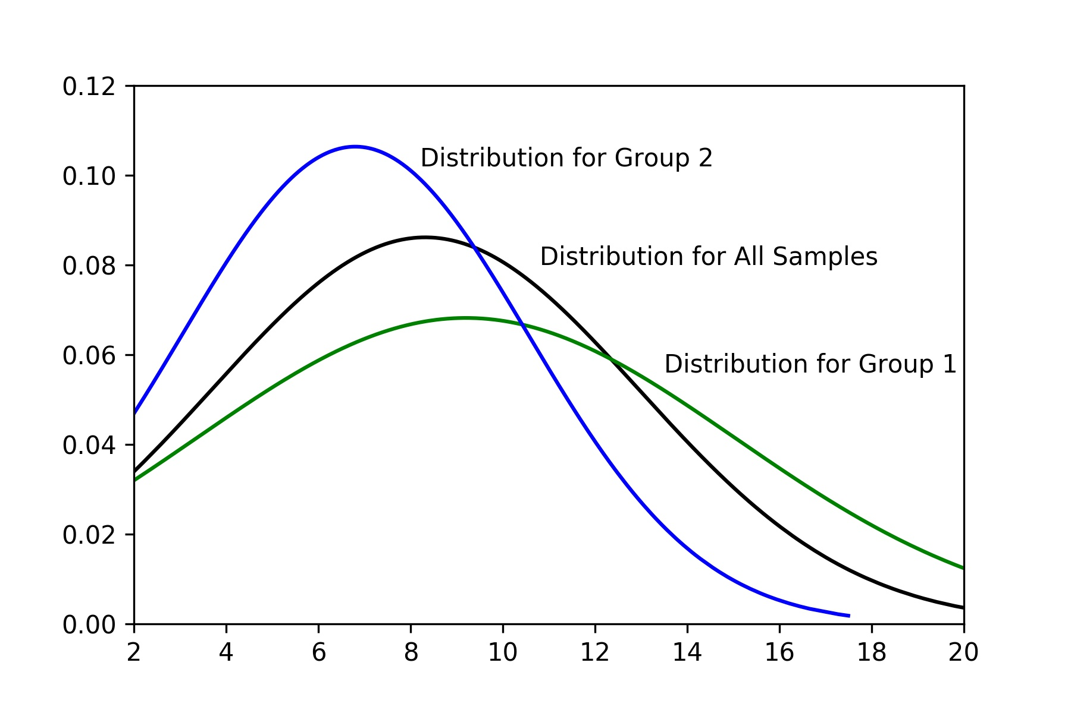
2.2
Methods
Important assumption
Group 1
Group 2
Probability
All Samples
6 min
If considering the threshold of 6 minutes
minute
Assuming the distribution of walking duration of the passengers with the same attributions subject to the normal distribution.
If the survey result obtained from the questionnaire showed one group of passengers with specific attributes tend to walk longer, it means this group of passengers can accept a longer walking duration.
In this graph it can be considered that Group 1 can accept a longer walking duration than Group 2.
Chapter 2 - Analyzing Willingness of Walking Duration to Transit Stations Using Socio-Demographic Characteristics
Notes:
Then I’m going to explain the methods.
Firstly, An important assumption is necessary in this research.
Think about an example, as shown in this figure, we assume two groups of passengers, the passengers in each group have the same characteristics in personal characteristics, but group 1 is different from group 2.
The passengers in the two groups may have different preference of walking duration.
Now we give the assumption that the distribution of walking duration with the same personal attributes should subject to the normal distribution.
If the survey result obtained from the questionnaire showed group 1 tend to walk longer, it means this group of passengers can accept a longer walking duration.
As expressed in this figure, if investigating the threshold of 6 minutes, Group 1 can accept a longer walking duration than Group 2.

Slide 16


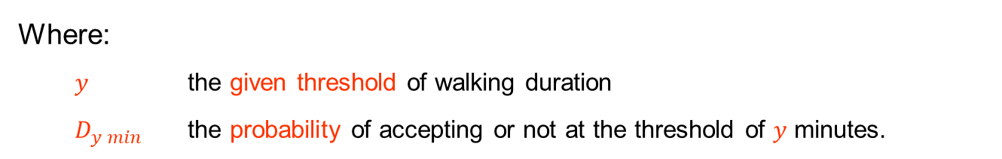
2.2
Methods
Model construction
Abstract form of the model
$$Walking duration=F\left({factor}_{1}, {factor}_{2},{factor}_{3}, ……\right)$$
Continuous value of Walking duration $t_{1}\sim t_{2}$
Threshold of walking duration $t_{1}, t_{2}, t_{3}……$
Attributes
$$D_{y min} =F\left({factor}_{1}, {factor}_{2},{factor}_{3}, ……\right), D_{y min} ∈ \left(0, 1\right)$$
Where:
$y$ the given threshold of walking duration
$D_{y min}$ the probability of accepting or not at the threshold of $y$ minutes.
Chapter 2 - Analyzing Willingness of Walking Duration to Transit Stations Using Socio-Demographic Characteristics
Notes:
Then I will give the abstract model for this problem.
Different from that in previous studies, the dependent variable is the probability of accepting or not at the threshold of y minutes.
Note it, the investigated walking duration is not a continuous value but some specific thresholds.

Slide 17
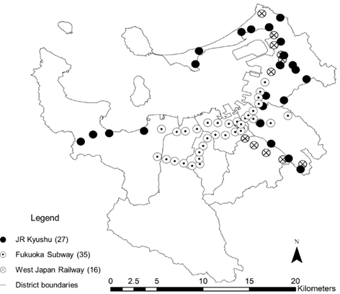
2.3
Data description
Study case: Fukuoka
Distribution of the transit stations
Data in this study
Chapter 2 - Analyzing Willingness of Walking Duration to Transit Stations Using Socio-Demographic Characteristics
Notes:
After introducing the methods, I’m going to give an overview of the study case and dataset in this study.
The study case is the rail transit stations in Fukuoka, there are 78 stations in total, including JR Kyushu, Fukuoka subway, and West Japan Railway.
The main data source used in this study is from the 4th nationwide person trip survey, mainly including the information about trip chaining behavior and some socio-demographic attributes.

Slide 18
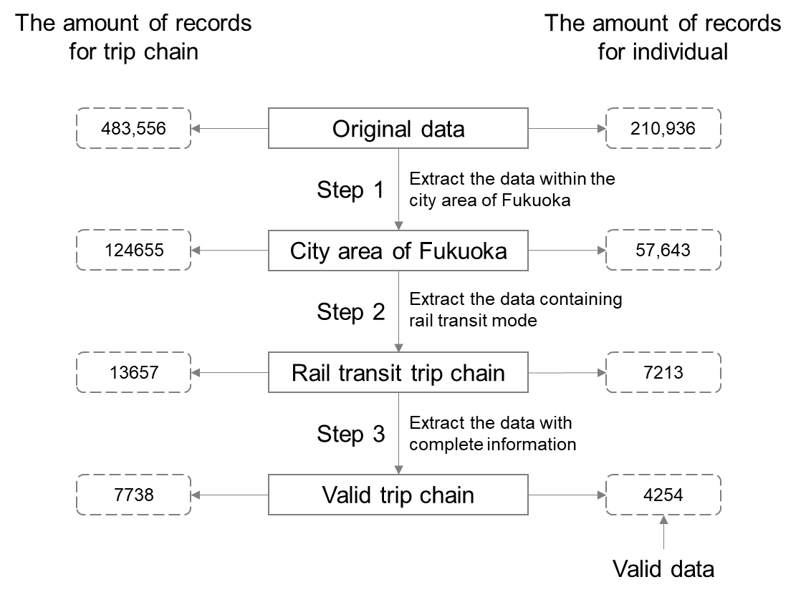
2.3
Data description
Data disposal
Source: Person Trip Survey
Chapter 2 - Analyzing Willingness of Walking Duration to Transit Stations Using Socio-Demographic Characteristics
Notes:
The original data covers all the main cities in Kitakyushu.
I set the filter with city area of Fukuoka, rail transit trip chain, without null record, the remaining valid dataset has 4000 records.

Slide 19
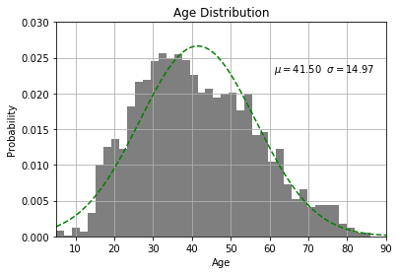
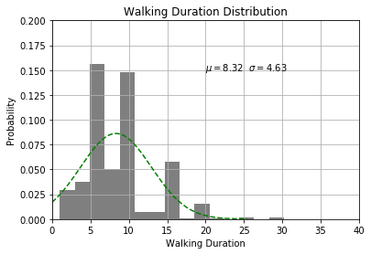
2.3
Data description
Distribution verification
Peak values at 5, 10, 15 min
The age distribution of passengers
Distribution of walking duration
The passengers aged between 25-55 who are still at production age account for the majority
People tend to reply a looser answer when they are being asked some questions about details.
Chapter 2 - Analyzing Willingness of Walking Duration to Transit Stations Using Socio-Demographic Characteristics
Notes:
This is the data description. The left part is the age distribution of passengers.
As we can see in this figure, the passengers aged between 25-55 who are still at production age account for the majority.
The right part is the distribution of walking duration, we can clearly see 3 peak values in this figure, they are 5, 10, 15 minutes, respectively.
Here are some reasons for this result. That is if people were asked some questions about details like how much did you spend, how long did you take, for such kinds of questions, people tend to reply a looser answer, some general number like 5, 10, or something.
This is also considered as one of the reasons that using the continuous value of walking duration cannot get a good result.
In this study, since this research investigate the threshold of walking duration, even the obtained loose answer can be viewed that the passenger has accepted.
We can thing that the peak values will not cause anomaly in this study.

Slide 20
2.4
Selection for Valid Features
Selection of thresholds
According to the existing studies, the acceptable walking duration mainly range from 5 – 13 minutes.
In this study, the average walking duration is about 8 minutes.
The thresholds selected in this study is 5, 8, 13 minutes.
Analysis of variance
L : tend to spend Less than the threshold
M: tend to spend more than the threshold
Valid Features at each threshold
Chapter 2 - Analyzing Willingness of Walking Duration to Transit Stations Using Socio-Demographic Characteristics
Notes:
It has been said in the former slides, the research objects are some specific threshold of walking durations.
According to the previous research and the investigation of Fukuoka, the acceptable walking duration mainly range from 5-13 minutes, and the average duration is about 8 minutes in Fukuoka.
Therefore, the threshold of walking duration to be investigated are set to 5, 8. 13 minutes.
Regarding the three thresholds, I picked the valid factors at each threshold, by using the analysis of variance.
For this table, in the column of effect, the cell marked with L means people with this attributes tend to accept a longer time than this threshold, M is the opposite.
For example, at the 5 minutes threshold, we can see that passengers who has the attributes of peak hour, and purpose of commuting to work tend to walk a less time than the given threshold of 5 minutes.

Slide 21
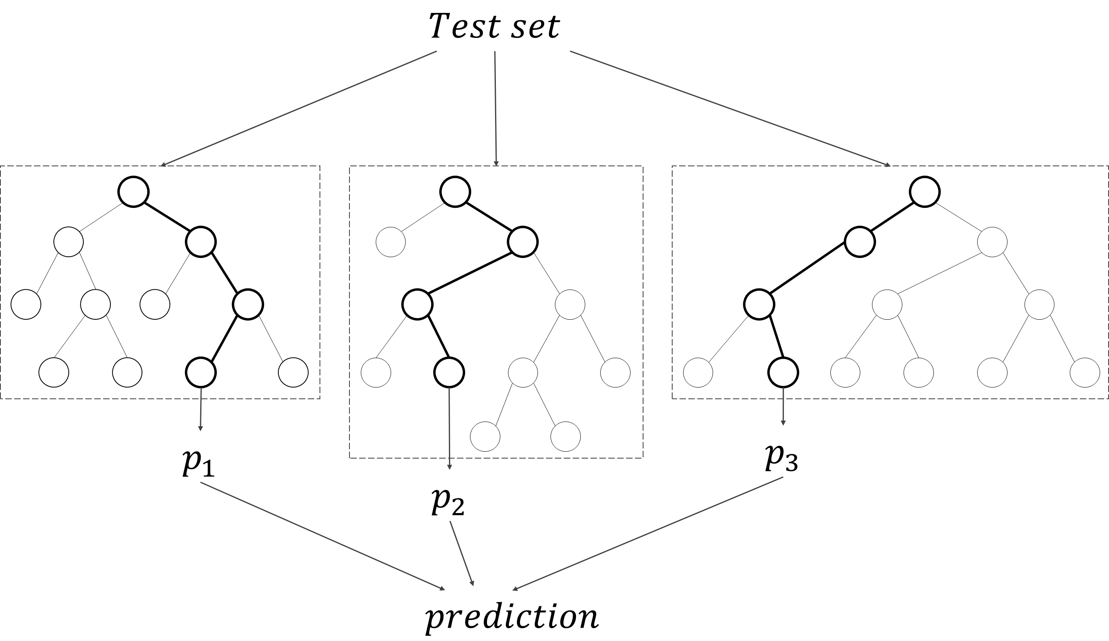
2.5
Estimation of Features
Decision tree and forest random
Forest random model is constructed by random selection of features and samples based on decision tree model.
The result is obtained by the average value of multiple decision trees.
Chapter 2 - Analyzing Willingness of Walking Duration to Transit Stations Using Socio-Demographic Characteristics
Notes:
Now we have got the valid features, the next step is to estimate the model to obtain the influence of the features on the acceptable walking duration.
I used the forest random decision tree model in this study.
Forest random model is constructed by random selection of features and samples based on decision tree model.
The result is obtained by the average value of multiple decision trees.

Slide 22
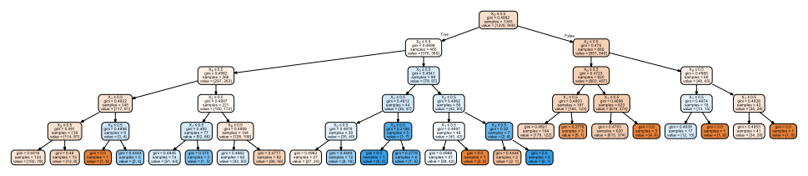
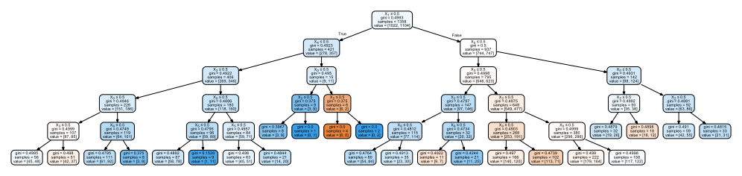
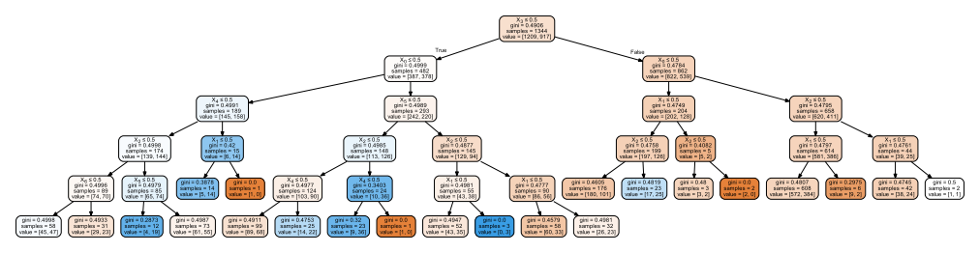
2.5
Estimation of Features
Prediction
Individual Value |  | Group Trend
Actual | Prediction | Actual | Prediction
1 | 1.000 | 0.654 | 0.637
1 | 0.897 | 0.653 | 0.636
1 | 0.897 | 0.651 | 0.635
… | … | … | …
0 | 0.621 | 0.581 | 0.580
1 | 0.621 | 0.581 | 0.579
1 | 0.621 | 0.580 | 0.579
… | … | … | …
0 | 0.498 | 0.435 | 0.411
1 | 0.496 | 0.437 | 0.411
1 | 0.496 | 0.434 | 0.410
… | … | … | …
200 records
Average
The predicted result is probabilities of accepting the giving threshold of walking duration.
The accuracy of results are evaluated by using the method of simple moving average.
Simple moving average
Chapter 2 - Analyzing Willingness of Walking Duration to Transit Stations Using Socio-Demographic Characteristics
Notes:
The result of decision tree is as shown in the figure. Here I just give a summary of the result to show.
As shown in the table on the right part, column of actual is the actual choice of individual, the prediction column is the value obtained from the estimation of decision tree.
The results are evaluated by using the method of simple moving average.
Sort the result by probability in descending order, the group trend is expressed by the average value of 200 samples.
So the trends between practice and prediction can be compared.

Slide 23
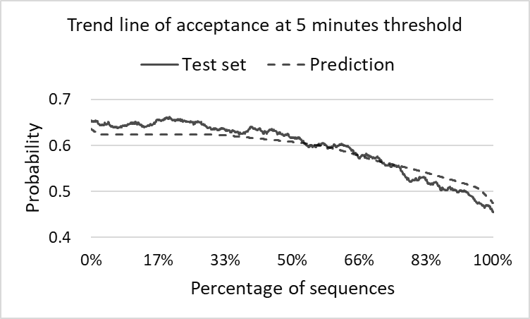
2.6
Result and Discussion
Evaluation of prediction
Evaluation of 5 minutes threshold
Good fitness
The features are significant at 5 minutes threshold.
The threshold of 5 minute is a commonly acceptable walking duration.
Chapter 2 - Analyzing Willingness of Walking Duration to Transit Stations Using Socio-Demographic Characteristics
Notes:
Continuously, I will show the trend line of prediction at each threshold of walking duration.
First is the 5 minutes threshold.
As we can see, the prediction trend line fit the actual trend line quite well, the features are significant at this threshold.
The threshold of 5 minute is a commonly acceptable walking duration

Slide 24
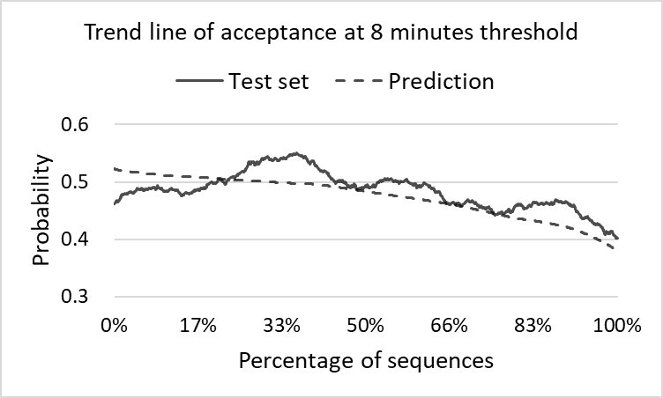
2.6
Result and Discussion
Evaluation of prediction
Evaluation of 8 minutes threshold
Low fitness
The features are not significant at 8 minutes threshold.
There is randomness in choosing whether accepting the 8 minutes walking duration or not.
Chapter 2 - Analyzing Willingness of Walking Duration to Transit Stations Using Socio-Demographic Characteristics
Notes:
Next is the 8 minutes threshold.
The fitness at 8 minutes is not well, the features are not significant at this threshold.
There is randomness in choosing whether accepting the 8 minutes walking duration or not.

Slide 25
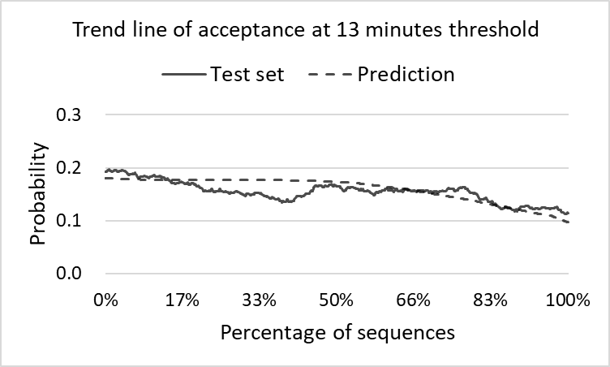
2.6
Result and Discussion
Evaluation of prediction
Evaluation of 13 minutes threshold
Good fitness
The features are significant at 13 minutes threshold.
The threshold of 13 minute is not a commonly acceptable walking duration
Chapter 2 - Analyzing Willingness of Walking Duration to Transit Stations Using Socio-Demographic Characteristics
Notes:
The fitness at 13 minutes is not bad.
From the probability we can know the 13 minutes is not a commonly accepted walking duration.

Slide 26
2.7
Conclusion
Findings
5 minutes is a widely accepted walking duration to rail transit.
Whether accepting the 8 minutes walking duration is ambiguous in passenger’s practical behaviors.
Passengers with the private travel purpose tend to accept the longest walking duration.
Passengers with the commuting travel purpose and during the peak hour tend to arrive at transit station as soon as possible.
Chapter 2 - Analyzing Willingness of Walking Duration to Transit Stations Using Socio-Demographic Characteristics
Notes:
Now we get the conclusion of chapter 2.
The main findings of this study can be summarized into 4.
1. 5 minutes is a widely accepted walking duration to rail transit.
2. Whether accepting the 8 minutes walking duration is ambiguous in passenger’s practical behaviors.
3. Passengers with the private travel purpose tend to accept the longest walking duration.
4. Passengers with the commuting travel purpose and during the peak hour tend to arrive at transit station as soon as possible.
This is the chapter 2.

Slide 27
Chapter 3
Analysis on the characteristics of transit ridership and land use
Introduction
Data
Characteristics of transit ridership and land use
Exploration the influence on transit ridership
Conclusion
Notes:
Next, Chapter 3, Analysis on the characteristics of transit ridership and land use.

Slide 28
3.1
Introduction
Research position
Purpose
Preliminary study
Characteristics
Land use
Ridership
To grasp the characteristics of transit stations in terms of both transit ridership and land use
Relationship
Chapter 3
Ridership Estimation
Station level
Chapter 4
Station-to-station
Chapter 5
Chapter 3 - Analysis on the characteristics of transit ridership and land use
Notes:
This chapter is a preliminary study for estimating the influence on transit ridership, mainly focus on the characteristics of transit ridership and land use, also give a simple exploration on the relationship between them.
The purposes of chapter 3 is to grasp the characteristics of transit stations in terms of both transit ridership and land use.

Slide 29
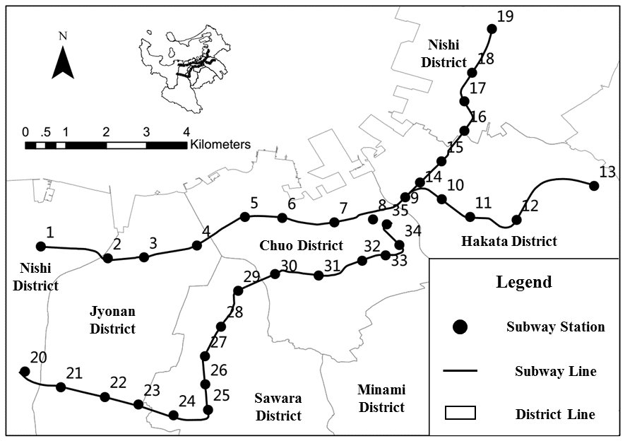
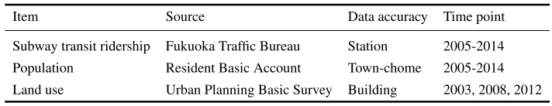
3.2
Data
Study case
Fukuoka subway
35 subway stations
3 operating subway lines
29.8 km operating mileage
20% share of motorized travel
Data source
Chapter 3 - Analysis on the characteristics of transit ridership and land use
Notes:
This is the overview of study case and data source.
This study uses the Fukuoka subway stations as the study case.
The main data source in this study is the subway transit ridership, statistic of population, and land use.

Slide 30
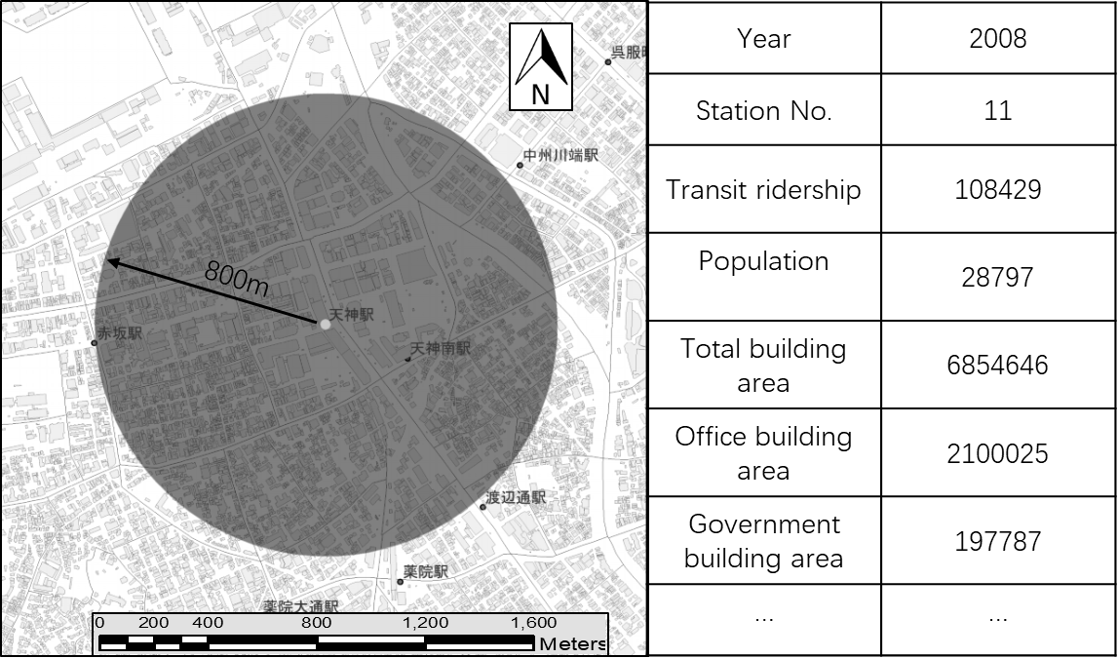
3.2
Data
Data extraction
1. Matching the region of data.
2. Matching the time points of data.
3. Extracting the data within the catchment area.
Chapter 3 - Analysis on the characteristics of transit ridership and land use
Notes:
This is the procedure of data extraction.

Slide 31
3.3
Characteristics of transit ridership and land use
Transit ridership characteristics
Trends of variation in transit ridership
Growth trend.
More than 600,000 passengers per day.
Significant difference in ridership among the three lines.
Chapter 3 - Analysis on the characteristics of transit ridership and land use
Notes:
Next is the transit ridership characteristics.
This is the trends of variation in transit ridership.
The ridership keeps a growth trend
Also we can see that there are significant differences in ridership among the three lines.

Slide 32
3.3
Characteristics of transit ridership and land use
Transit ridership characteristics
Annual growth rate of transit ridership
Line 3 had a much higher growth rate at the first few years of the opening
The growth rate of three lines tend to be stable after the year of 2009
Chapter 3 - Analysis on the characteristics of transit ridership and land use
Notes:
This is the annual growth rate of transit ridership.
Line 3 had a much higher growth rate at the first few years of the opening.
The growth rate of three lines tend to be stable after the year of 2009.

Slide 33
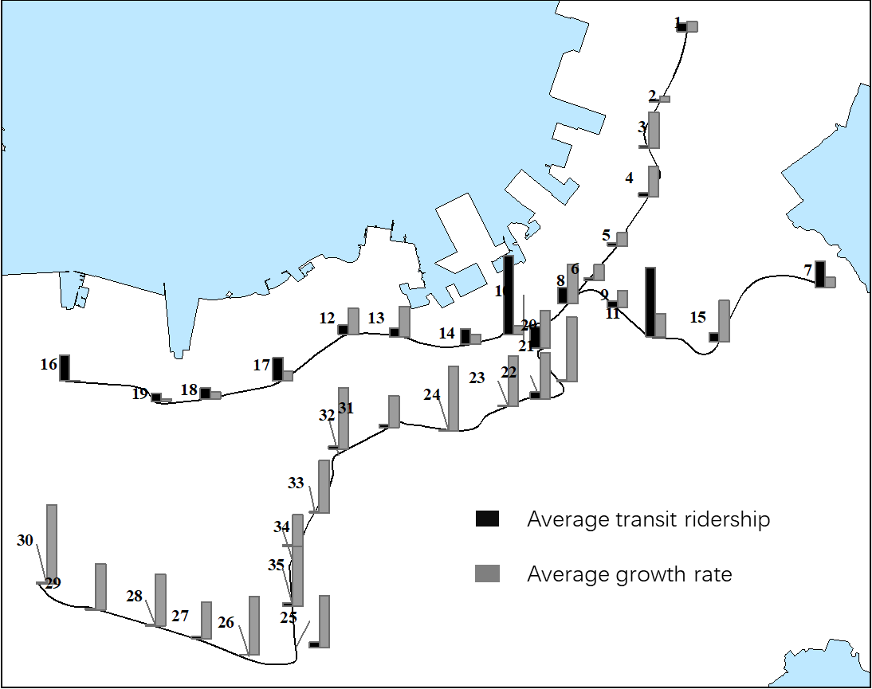
3.3
Characteristics of transit ridership and land use
Transit ridership characteristics
Spatial distribution of transit ridership
Terminal
Airport
Hub
Hub
Terminal
Newly opened
Chapter 3 - Analysis on the characteristics of transit ridership and land use
Notes:
This is the characteristics of spatial distribution.
Fukuoka subway has two terminal stations, two hub stations, and one station serving for the airport.
We can see that, most stations located in the central area have higher ridership.

Slide 34
3.3
Characteristics of transit ridership and land use
Transit ridership characteristics
Classification based on transit ridership
Transit ridership | Total | Line 1 | Line 2 | Line 3
Hub | 2 | 2 | 0 | 0
Large | 4 | 3 | 0 | 1
Medium | 11 | 8 | 1 | 2
Small | 18 | 0 | 4 | 4
Line 1
Large scale
Low growth rate
Line 2
Small scale
Low growth rate
Growth rate | Total | Line 1 | Line 2 | Line 3
0-2.5 | 12 | 8 | 4 | 0
2.5-4.5 | 11 | 5 | 2 | 4
4.5-6.0 | 6 | 0 | 0 | 6
6.0- | 6 | 0 | 0 | 6
Line 3
Small scale
High growth rate
Chapter 3 - Analysis on the characteristics of transit ridership and land use
Notes:
Regarding the transit ridership and their growth rate, the two cross tables are given to help understand the characteristics.
From the two tables, the three lines represent significant differences.

Slide 35
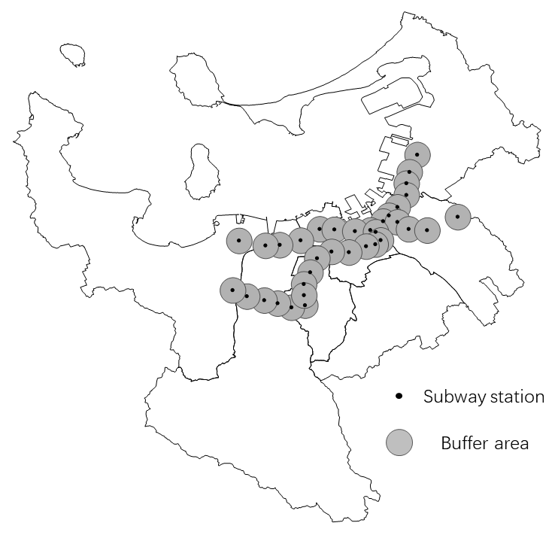
3.3
Characteristics of transit ridership and land use
Land use characteristics
Data extraction
ArcGIS
800m-radius region
Extracting data
Main land use
Business
Commerce
Hotel
Entertainment
Residence
Apartment house
Dwelling with shop
Government
Education
Culture
Chapter 3 - Analysis on the characteristics of transit ridership and land use
Notes:
Next is the analysis on the land use characteristics.
The information of land use is extracted using an 800 meters radius region around the stations.

Slide 36
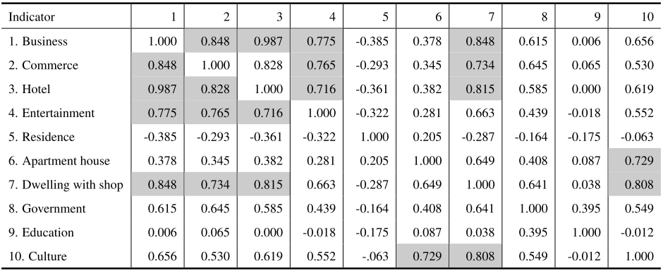
3.3
Characteristics of transit ridership and land use
Land use characteristics
Correlation analysis for indicators
High correlation ( >0.7)
Chapter 3 - Analysis on the characteristics of transit ridership and land use
Notes:
Then is the land use characteristics.
A correlation analysis is conducted to master the relationship among all the indicators.
The cells marked with grey color represent a strong linear correlation between the two indicator.

Slide 37
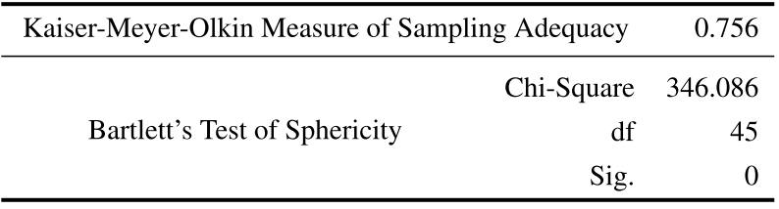
3.3
Characteristics of transit ridership and land use
Land use characteristics
Factor analysis
Purpose
To deal with the strong collinearity among indicators
Further explore the internal relationship
Test for factor analysis
Suggested value
> 0.7
KMO and Bartlett’s Test
Suggested value
< 0.05
PASSED the test
Chapter 3 - Analysis on the characteristics of transit ridership and land use
Notes:
To deal with this linear correlation, the factor analysis is conducted to make a further exploration on the internal relationship.
According to the test for factor analysis, this dataset is thought to be suitable to do factor analysis.

Slide 38
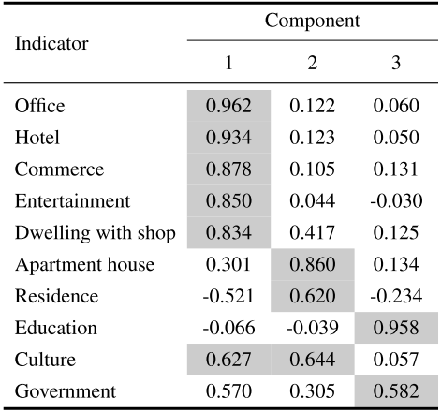
3.3
Characteristics of transit ridership and land use
Land use characteristics
Factor extraction
Factor 1: Ofﬁce & commerce
Component Matrix
Office
Hotel
Commerce
Entertainment
Dwelling with shop
Culture
Factor 2: Residence
Apartment house
Residence
Culture
Factor 3: Education
Education
Government
Chapter 3 - Analysis on the characteristics of transit ridership and land use
Notes:
As a result, three factors are extracted by the factor analysis, they are office & commerce, Residence, and education.

Slide 39
3.4
Exploration the influence on transit ridership
Land use characteristics
Station classification based on land use
Chapter 3 - Analysis on the characteristics of transit ridership and land use
Notes:
This is the summary for each type of stations.

Slide 40
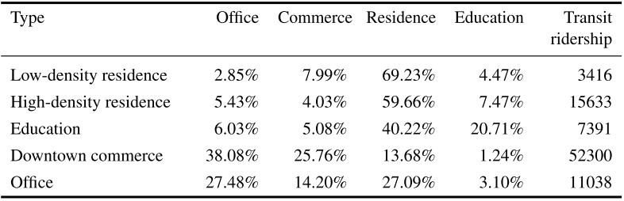

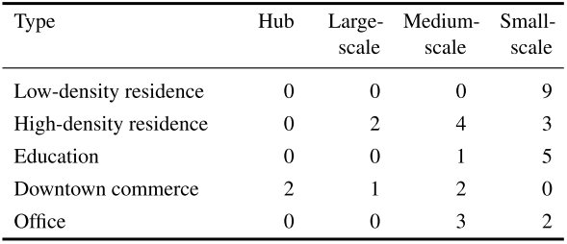
3.4
Exploration the influence on transit ridership
General relationship
Summary for each type of station
Cross table of land use and transit ridership
Large differences in different types
Low density = Low ridership
Commercial center = High ridership
Chapter 3 - Analysis on the characteristics of transit ridership and land use
Notes:
Combining with the cross table of land use and transit ridership, we can get some information.
They are, different land use characteristics have different scales in transit ridership.
The density of both population and land use have significant influence on transit ridership.
Commercial land use produces more ridership.

Slide 41
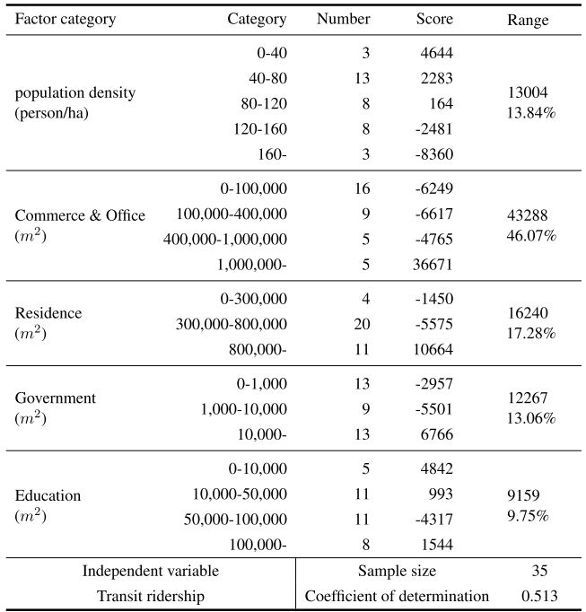
3.4
Exploration the influence on transit ridership
Statistical relationship - quantiﬁcation method I
Part 1
Dependent variable
Transit ridership per day
Explanatory variables
Population density
Commerce & office
Residence
Education
Coefficient of determination
0.513
Key factors
Commerce area
Office area
Chapter 3 - Analysis on the characteristics of transit ridership and land use
Notes:
After the general understanding of the relationship between ridership and land use, the quantification method one is used to make a further exploration.
In the first part of quantification method one, the dependent variable is transit ridership per day.
The result showed two key factors of commerce area and office area. But it did not show a good fitness.

Slide 42
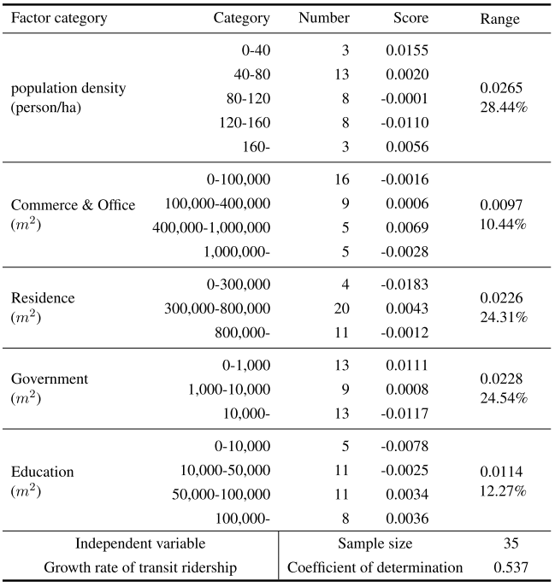
3.4
Exploration the influence on transit ridership
Statistical relationship - quantiﬁcation method I
Part 2
Dependent variable
Growth rate of transit ridership
Explanatory variables
Population density
Commerce & office
Residence
Government
Education
Coefficient of determination
0.537
Key factors
Population density
Chapter 3 - Analysis on the characteristics of transit ridership and land use
Notes:
In the part 2, the same indicator set is used for estimating growth rate of transit ridership.
The same with part 1, the result did not show a good fitness as well.

Slide 43
3.5
Conclusion
Implications for next stage
Summary
Provided foundation and references for the further exploration on the determinants on transit ridership
Implications
Pedestrian area should be considered.
Explanatory variables should be enriched.
Model should be improved.
The approach of dealing with small sample case should be considered.
Chapter 3 - Analysis on the characteristics of transit ridership and land use
Notes:
This is the content of this chapter, here gives a summary.
This study provided foundation and references for the further exploration on the determinants on transit ridership
Also the experiences obtained from this study gave some implications for the next.
Pedestrian area should be considered.
Explanatory variables should be enriched.
Model should be improved.
The approach of dealing with small sample case should be considered.

Slide 44
Chapter 4
Influencing Factors on Transit Ridership at Station Level
Introduction
Indicators
Identification of valid factors
Model estimation
Residual analysis
Conclusion
Notes:
Next, chapter 4, Influencing Factors on Transit Ridership at Station Level.

Slide 45
4.1
Introduction
The question to answer
1
What influence the walking duration to transit stations?
Walking duration
1
Station
Station
Ridership
Ridership
2
3
2
What factors explain transit ridership at station level?
3
What factors influence transit ridership between station and station?
Chapter 4 - Influencing Factors on Transit Ridership at Station Level
Notes:
Chapter 4 aims to answer the second question that I proposed at the very beginning
it is What factors explain transit ridership at station level?

Slide 46
4.1
Introduction
Purpose
Explore and explain the factors influencing subway ridership at station level using a small sample case
Research questions
1
Improve index system
Propose and reconstruct indicators to improve the index system
2
Identify valid indicators
Propose effective index screening method for small samples
3
Improve accuracy in estimation
Consider the different spatial distribution of indicators in the spatial regression model
Chapter 4 - Influencing Factors on Transit Ridership at Station Level
Notes:
The main purpose of chapter 4 is to explore and explain the factors influencing subway ridership at station level using a small sample case.
Around this purpose, this study focuses on three specific topics.
The first one is to propose and reconstruct indicators to improve the index system
Second is to find an approach of identifying the valid indicators for small sample case.
The third one is to consider the different spatial distribution of indicators in the spatial regression model to improve accuracy in estimation.

Slide 47

4.1
Introduction
Catchment area of stations
In general
Catchment area: walking distance accessing the subway station. (Pedestrian Catchment Area, PCA)
Pedestrian area range: 400m ~ 1000m
Most adopted: 800m
In the case of Fukuoka
Walking speed: about 4.8km/h
Average walking distance: about 600m
1. Walking is the main method of accessing transit station.
2. Most walking distances are within 800m
 | Walking |  | Bicycle
 | Proportion | Ave time | Proportion | Ave time
AVG | 78% | 7.2 | 9% | 9.0
Mid | 85% | 7.0 | 8% | 9.5
Max | 22% | 4.8 | 0% | 0.0
Min | 100% | 9.2 | 33% | 20.0
Chapter 4 - Influencing Factors on Transit Ridership at Station Level
Notes:
As to the catchment area, this study uses the 800 meters pedestrian area.
Summarized from the previous studies, the catchment area ranges from 400 meters to 1 kilometer in general, and the most accepted pedestrian area is 800 meters.
Back to our study case Fukuoka, according to the subway survey report, the average walking distance in Fukuoka will be about 600 meters.
We can think that 800 meters covers most of the passengers in Fukuoka.
Based on the above, it can be viewed that 800 meters pedestrian area is reasonable in this study.

Slide 48
4.2
Indicators
Variable summary
Category | Variable | Expected sign | Min Value | Max Value | Average | Unit
Built environment | Commerce | + | 2,921 | 811,281 | 114,353 | m²
 | Office | + | 2,614 | 839,956 | 167,088 | m²
 | Residence | + | 110,748 | 1,067,523 | 528,533 | m²
 | Education | + | 294 | 305,559 | 59,691 | m²
 | Government | + | - | 128,471 | 20,878 | m²
 | Transportation Facility Area | + | 197 | 132,777 | 21,204 | m²
 | Land use Aggregation | + | 0.09 | 0.75 | 0.31 | -
Transportation Accessibility | Transfer Dummy | + | 1 | 4 | 1.34 | -
 | Bicycle Parking | Unknown | 64 | 4,375 | 778 | -
 | Bus Capacity | Unknown | 3 | 260 | 58.48 | -
 | Bus Accessibility | Unknown | 4 | 455 | 89.71 | -
 | Road Density | - | 191 | 479 | 299 | m/ha²
Demographic and Socioeconomic Environment | Population | + | 1,908 | 19,393 | 9,813 | -
 | House Member | - | 1.86 | 2.79 | 2.18 | -
 | Population/Job Balance | Unknown | 1.27 | 2.61 | 1.80 | -
 | Tenant Proportion | - | 0.15 | 0.65 | 0.43 | %
Dependent variable: average daily subway ridership
Chapter 4 - Influencing Factors on Transit Ridership at Station Level
Notes:
This is the data description.
In this study, the dependent variable is average daily ridership.
The candidate independent variables are summarized into 3 categories: 1. built environment; 2. transportation accessibility; 3. demographic and socioeconomic environment.
In the column of expected sign, plus sign means the increase in this indicator is expected to cause an increase in transit ridership, while the minus sign is expected to have an opposite effect.

Slide 49



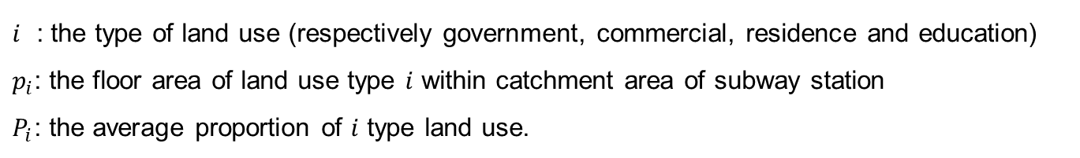
4.2
Indicators
Variable interpretation
Land-use Aggregation
Describing the variety of land use
$A=\sqrt{\sum{{\left(p_{i}−P_{i}\right)}^{2}}}$
Range
0
Variety
1
More
Less
$i$ : the type of land use (respectively government, commercial, residence and education)
$p_{i}$: the floor area of land use type $i$ within catchment area of subway station
$P_{i}$: the average proportion of $i$ type land use.
Range of PCA | Residence | Office | Commerce | Education | Total
800 | 55.3% | 17.5% | 12.0% | 6.2% | 90.9%
Average $P_{i}$
Chapter 4 - Influencing Factors on Transit Ridership at Station Level
Notes:
Then I will give some interpretation for some of the indicators in details.
First one is the indicator of land-use aggregation.
This indicator is used to describe the variety of land use.
The indicator A ranges from 0 to 1, the higher the indicator A is, the land use variety is lower. On the contrary, the land use variety is higher.

Slide 50






4.2
Indicators
Variable interpretation
Indicators of bus system
Bring passengers to rail transit
Departure
Destination
Departure
Share passengers from rail transit
Bus capacity
Share passengers from rail transit. Negative effect on rail transit ridership
Bus Accessibility
Bring passengers to rail transit. Positive effect on rail transit ridership
Chapter 4 - Influencing Factors on Transit Ridership at Station Level
Notes:
In this study, the indicator of bus system is considered from two aspects.
Like shown in the figure, bus should have two effect on the rail transit, one is bringing passengers to rail transit, and another one is share passengers from rail transit.
The indicator of bus capacity is expected to share passengers from rail transit, having negative effect on rail transit.
The indicator of bus accessibility is expected to bring passengers to rail transit, having positive effect on rail transit.

Slide 51
4.3
Identification of valid factors
Flowchart of screening valid factors with small sample
Number of
indicators
Flow
16
Candidate indicators
Judgement
Multicollinearity
Validity
Stability
Exploratory
regression
10
Valid indicators
Linear
regression
9
Optimal combination
Chapter 4 - Influencing Factors on Transit Ridership at Station Level
Notes:
This part is for identifying the valid factors with small sample.
This is the flowchart of screening valid factors with small sample.
This identification is conducted by two procedures, using the exploratory regression and linear regression, respectively.
At beginning, there were 16 candidate indicators, after running the exploratory regression, 10 valid indicators are left. At last, the optimal combination contains 9 valid indicators.
As to the procedure of screening valid factors, simply speaking, three judgments are used to identify the valid variables, they are multicollinearity, validity, and stability.

Slide 52
4.3
Identification of valid factors
Exploratory regression
Stage 1
Suggested value
VIF< 7.5; Validity > 10%; Stability >90%
Category | Variable | Statistical Information
 |  | VIF | Validity | stability | times | + | -
 | Total |  |  |  | 367 | 253 | 114
Built environment | Commerce Area | 8.8 | 32.1% | 100.0% | 25 | 25 | 0
 | Office Area | 10.4 | 9.0% | 71.4% | 7 | 5 | 2
 | Residence Area | 27.5 | 12.8% | 70.0% | 10 | 7 | 3
 | Education Area | 1.8 | 7.7% | 100.0% | 6 | 6 | 0
 | Government Area | 1.8 | 42.3% | 100.0% | 33 | 33 | 0
 | Transportation Facility | 3.0 | 67.9% | 100.0% | 53 | 53 | 0
 | Land use Aggregation | 2.5 | 50.0% | 100.0% | 39 | 39 | 0
Transportation Accessibility | Transfer Dummy | 3.0 | 34.6% | 100.0% | 27 | 27 | 0
 | Bicycle Parking | 4.5 | 44.9% | 100.0% | 35 | 35 | 0
 | Bus Capacity | 6.6 | 37.2% | 96.6% | 29 | 1 | 28
 | Bus Accessibility | 6.8 | 19.2% | 100.0% | 15 | 15 | 0
 | Road Density | 2.3 | 1.3% | 100.0% | 1 | 1 | 0
Demographic Socioeconomic Environment | Population | 23.9 | 12.8% | 60.0% | 10 | 6 | 4
 | Household Members | 3.0 | 39.7% | 100.0% | 31 | 0 | 31
 | Population/Job Balance | 3.0 | 37.2% | 100.0% | 29 | 0 | 29
 | Tenant Proportion | 2.2 | 21.8% | 100.0% | 17 | 0 | 17
Valid Variable
The cell marked with dark color means that it doesn’t meet the judgment.
Chapter 4 - Influencing Factors on Transit Ridership at Station Level
Notes:
The procedure of the first step is as shown in this table.
The indicators with the VIF less than 7.5, the validity more than 10%, and the stability more than 90% is viewed as valid.

Slide 53
4.3
Identification of valid factors
Exploratory regression
Stage 2
Independent variables | Test model
 | Beta | Sig | VIF
Government Area | 0.10 | 0.02 | 1.36
Transportation Facility Area | 0.20 | 0.00 | 2.31
Land use Aggregation | 0.10 | 0.03 | 1.42
Bicycle Parking | 0.46 | 0.00 | 2.60
Bus Capacity | -0.20 | 0.01 | 3.56
Bus Accessibility | 0.26 | 0.00 | 4.71
Transfer Dummy | 0.26 | 0.00 | 2.79
Population/Job Balance | -0.10 | 0.05 | 1.94
Tenant Proportion | -0.09 | 0.03 | 1.32
Household Members | - | - | -
Residual sum of squares | 337744990
Adjusted R² | 0.96
AICc | 694.39
Jarque-Bera test (Sig) | 0.61
Koenker (BP) test (Sig) | 0.85
SA test (Sig) | 0.27
No biased standard errors due to heteroscedasticity
Not deviating from a normal theoretical distribution
Not spatial autocorrelated
Chapter 4 - Influencing Factors on Transit Ridership at Station Level
Notes:
In the second step, the linear regression is conducted again to select an optimal combination of valid explanatory variables.
The judgement is the statistical test for regression.
As shown in this table, there are 9 valid variables entering the model at last.

Slide 54
4.4
Model estimation
Identification for global/local variable
Variable | Moran's Index | Z-score | P-value* | Pattern | DIFF of Criterion** | Type
Government Area | 0.04 | 0.66 | 0.51 | Random | - | Global
Transportation Facility | 0.29 | 3.33 | 0.00 | Clustered | -1.95 | Local
Land use Aggregation | -0.01 | 0.20 | 0.84 | Random | - | Global
Transfer Dummy | 0.13 | 1.58 | 0.12 | Random | - | Global
Bicycle Parking | -0.12 | -0.92 | 0.36 | Random | - | Global
Bus Capacity | 0.70 | 7.57 | 0.00 | Clustered | 0.18 | Local
Bus Accessibility | 0.45 | 5.04 | 0.00 | Clustered | 0.04 | Local
Population/Job Balance | 0.77 | 7.61 | 0.00 | Clustered | -0.17 | Local
Tenant Proportion | 0.24 | 2.54 | 0.01 | Clustered | 1.02 | Local
* Statistical significance means autocorrelation
** More than or equal to 2.00, means the local term is better to be assumed as global
Chapter 4 - Influencing Factors on Transit Ridership at Station Level
Notes:
Before estimating the model, we should determine whether the indicator is a local or global indicator.
This procedure is conducted by using Moran’s index to examine if the variable is spatial autocorrelation or not.
The indicators with clustered pattern are selected as the local variable.

Slide 55
4.4
Model estimation
Estimation of Mix Geographically Weighted Regression
Variable | Type | OLS model |  |  |  | MGWR model
 |  | B | SE | t |  | B | SE | t
Government Area | Global | 0.05 | 0.02 | 2.41 |  | 0.05 | 0.02 | 2.59
Land use | Global | 11,832.53 | 5323.15 | 2.22 |  | 13,384.34 | 5,408.81 | 2.48
Transfer Dummy | Global | 6,578.09 | 1216.82 | 5.41 |  | 5,968.65 | 1,198.72 | 4.98
Bicycle Parking | Global | 7.51 | 0.93 | 8.11 |  | 7.72 | 0.90 | 8.59
Transport Area | Local | 0.11 | 0.03 | 3.58 |  | 0.10 | 0.02 | -
Bus Capacity | Local | -59.21 | 20.71 | -2.86 |  | -55.14 | 5.94 | -
Bus Accessibility | Local | 50.71 | 14.64 | 3.46 |  | 48.61 | 2.43 | -
Population/Job Balance | Local | -2,762.24 | 1,079.33 | -2.56 |  | -2,411.17 | 364.44 | -
Tenant Proportion | Local | -9,987.81 | 4,380.30 | -2.28 |  | -10,304.66 | 756.09 | -
Best bandwidth |  |  |  |  |  | 5.7km
AICc |  | 694.39 |  |  |  | 690.60
Residual sum of squares |  | 337,744,989 |  |  |  | 296,311,499
Chapter 4 - Influencing Factors on Transit Ridership at Station Level
Notes:
This is the result of estimation.
As a result, the indicators of building area have a positive effect on the subway ridership.
The indicator of land-use aggregation shows land use variety can lead to decrease in ridership.
As the expectation, the indicator of bus capacity has a negative effect on the subway ridership, and the bus accessibility has a positive effect.
The factor of resident/job balance and tenant proportion tells that working people and tenants are more willing to use subway.

Slide 56
4.5
Residual Analysis
Distribution of residuals
Indicator | OLS | MGWR
Moran’s index | 0.08 | 0.03
Expected index | -0.03 | -0.03
Variance | 0.01 | 0.01
z-score | 1.09 | 0.61
p-value | 0.27 | 0.54
Better
Moran’s index in MGWR is closer to the expected index than that in OLS
Z-score in MGWR is lower than that in OLS
Chapter 4 - Influencing Factors on Transit Ridership at Station Level
Notes:
This part is the residual analysis.
From the residual distribution, Moran’s index in MGWR is closer to the expected index than that in OLS, Z-score is also lower than that in OLS.
We can say the result of MGWR is better than that of OLS.
The lower part is the distribution of residuals of both linear regression and geographically weighted regression, to have a look if the accuracy increased. The Moran’s index in MGWR is closer to the expected index than that in OLS, and the Z-score in MGWR is less than that in OLS, the accuracy did increase.

Slide 57
4.6
Conclusion
Findings
Approach of screening valid indicator in small sample case is confirmed to be effective.
High diversity of land use leads to decrease in transit ridership.
The bus system has both positive and negative effects on rail transit ridership.
The tenants are more willing to use rail transit in the case of Fukuoka.
Chapter 4 - Influencing Factors on Transit Ridership at Station Level
Notes:
For a conclusion, this study reorganized the indicator framework, and proposed a method of selecting valid variables for small sample.
The main findings of this study are
High diversity of land use leads to decrease in transit ridership.
The bus system has both positive and negative effects on rail transit ridership.
The tenants are more willing to use rail transit in the case of Fukuoka.

Slide 58
Chapter 5
Influencing Factors on Transit Ridership at Station-to-Station Level
Introduction
Research object
Method
Results and Discussion
Conclusion
Notes:
Chapter 5, Influencing Factors on Transit Ridership at Station-to-Station Level

Slide 59
5.1
Introduction
The question to answer
1
What influence the walking duration to transit stations?
Walking duration
1
Station
Station
Ridership
Ridership
2
3
2
What factors explain transit ridership at station level?
3
What factors influence transit ridership between station and station?
Chapter 5 - Influencing Factors on Transit Ridership at Station-to-Station Level
Notes:
This chapter aims to answer the third question that I proposed at the very beginning, that is What factors influence transit ridership between station and station?

Slide 60
5.1
Introduction
Background
Catchment B
Station A
Station B
If the elements varied in catchment B
Ridership will vary in both the stations
The variation of land use in the catchment B can affect the probability that passengers boarding from station A choose station B as the destination
Research purpose
Explore the influence of land-use on the choice of destination station
Chapter 5 - Influencing Factors on Transit Ridership at Station-to-Station Level
Notes:
At the beginning, I want to repeat it once again that why I focus on the ridership between station and station.
There is a station A, if the ridership of station A varied because of the variation in the elements within the catchment area of station A, it is obvious, the transit ridership of station B will also vary, because station A is connecting with station B, the variation of transit ridership in Station A must bring new variation in Station B.
With this issues, the purpose of this study is proposed, Exploring how the factors of land-use influence the choice of destination station for passengers from the perspective of TOD

Slide 61
5.1
Introduction
Flowchart
Index framework
Dependent variable
Independent variable
Conversion of realistic issue
Probability of getting off at a specific destination station
Discrete choice issue
Logistic regression
Model estimation
Result and Discussion
Chapter 5 - Influencing Factors on Transit Ridership at Station-to-Station Level
Notes:
This is the research flow of this study.
First, I will construct the index framework, and then convert this realistic issue into a mathematical problem.
Finally, estimate the logistic regression model, and give discussion for the result.

Slide 62
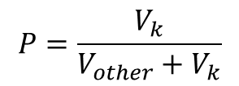
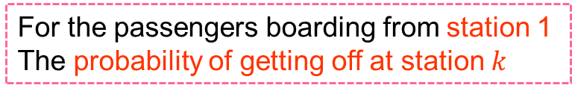


5.2
Research object
Dependent variable
Probability of choosing the destination
Other
Stations
Passenger Volume
2
3
$$V_{other}$$
4
5
Station
1
……
Station k
Passenger Volume
k
$$V_{k}$$
Boarding
Alighting
For the passengers boarding from station 1
The probability of getting off at station $k$
$$P=\frac{V_{k}}{V_{other}+V_{k}}$$
Chapter 5 - Influencing Factors on Transit Ridership at Station-to-Station Level
Notes:
I will give an interpretation for the research object.
With this figure, the dependent variable in this study is the probability of getting off at station k for the passengers boarding from station 1.
As is shown in this formula

Slide 63
5.2
Research object
Independent variables
Land use
Residence proportion
Office proportion
Commerce proportion
Education proportion
Land-use aggregation
Impedance
Bus capacity
Operation distance of subway
Bus accessibility
Chapter 5 - Influencing Factors on Transit Ridership at Station-to-Station Level
Notes:
Here are the independent variables in this study.
The factors are selected from two aspects, land-use and impedance.
There are 8 indicators in total.

Slide 64
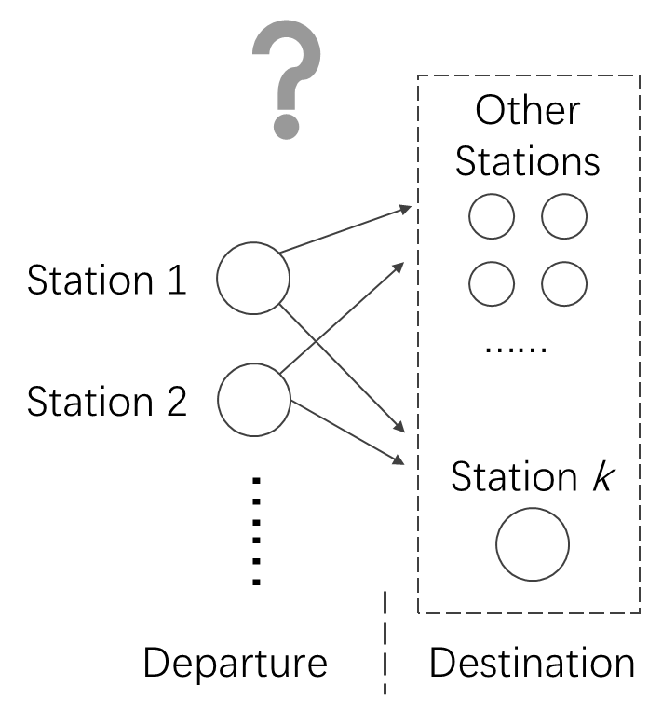
5.3
Method
Mathematical problems
Conversion
Binary discrete model
$$P_{k}=F\left(x_{1}, x_{2},x_{3}, ……\right)$$
Probability of getting off at the investigated station
Explanatory variable for making the choice of whether getting off
Logistic regression model
Chapter 5 - Influencing Factors on Transit Ridership at Station-to-Station Level
Notes:
Now the research objects have been given, we have to convert this issue into a mathematical problems.
As the interpretation before, this issue is converted into a binary discrete problem.
I choose the logistic regression to estimate this binary discrete problem.

Slide 65
5.3
Method
Selecting sample station
Station type | Station name | Population density | Commerce proportion | Office proportion | Residence proportion | Education proportion
Low-density residence | 賀茂 | 98 Person/Ha | 4% | 3% | 83% | 4%
High-density residence | 藤崎 | 173 Person/Ha | 5% | 7% | 76% | 6%
Education | 箱崎九大前 | 83 Person/Ha | 5% | 6% | 51% | 22%
Office | 呉服町 | 135 Person/Ha | 8% | 31% | 49% | 3%
Commerce | 天神 | 69 Person/Ha | 34% | 32% | 24% | 1%
Note:
The highlighted cells refer to the representative values that having much higher proportion than other land-use types.
Chapter 5 - Influencing Factors on Transit Ridership at Station-to-Station Level
Notes:
In this problem, what we want to know is how the independent variables determine the choice of where to get off.
To master the significant features of choosing destination regarding different type of land-use, I will select some typical stations as research objective.
I chose one station from each of the land use type.
The six stations are Kamo station of medium-density residence
Fujisaki station of high-density residence
Hakozakikyudai station of education
Gofukumachi station of office
Tenjin station of commerce
and airport station.

Slide 66
5.4
Results and discussion
Result of estimation
Destination Station |  | Variables in Departure Station
Station Type | Station Name | Land-use |  |  |  |  |  | Impedance
 |  | C | O | R | E | L-A |  | D | B-C | B-A
Low-density residence | 賀茂 | 0.95 | 0.94 | 0.94 | 0.93 | 0.97 |  | 1.07 | 1.01 | 1.00
High-density residence | 藤崎 | 1.01 |  | 0.99 | 1.01 | 0.98 |  | 0.95 | 1.00 | 1.00
Education | 箱崎九大前 | 1.02 |  | 1.02 | 1.03 | 0.99 |  | -0.13 | 0.00 | 0.00
Office | 呉服町 | 1.02 | 0.98 | 1.02 | 1.06 | 0.99 |  |  | 1.00 | 1.00
Commerce | 天神 | 1.00 | 0.99 | 1.01 | 1.03 | 1.02 |  | 1.06 |  | 1.00
Airport | 空港 | 0.97 | 1.03 | 0.99 | 0.99 | 1.03 |  | 0.92 | 1.00 | 1.00
Increase in this type of land use will lead to a decrease in the probability of choosing this station as the destination
Increase in this type of land use will lead to an increase in the probability of choosing this station as the destination
Meaning of the coefficients
1% increase in the proportion of land use will lead to a corresponding variation in the probability of getting off at the destination
Note
Full name of the abbreviation
C: Commerce
O: Office
R: Residence
E: Education
L-A: Land-use Aggregation
D: Distance
B-C: Bus Capacity
B-A: Bus Accessibility
Chapter 5 - Influencing Factors on Transit Ridership at Station-to-Station Level
Notes:
This is the result of estimation.
In this table, the values less than 1 means Increase in this type of land use will lead to a decrease in the probability of choosing this station as the destination
The values larger than 1 means Increase in this type of land use will lead to an increase in the probability of choosing this station as the destination
For the meaning of the coefficients, 1% increase in the proportion of land use will lead to a corresponding variation in the probability of getting off at the destination
. The blank means this value does not pass the statistical significance test.

Slide 67
5.4
Results and discussion
Discussion for results
Destination Station |  | Variables in Departure Station
Station Type | Station Name | Land-use |  |  |  |  |  | Impedance
 |  | C | O | R | E | L-A |  | D | B-C | B-A
Low-density residence | 賀茂 | 0.95 | 0.94 | 0.94 | 0.93 | 0.97 |  | 1.07 | 1.01 | 1.00
High-density residence | 藤崎 | 1.01 |  | 0.99 | 1.01 | 0.98 |  | 0.95 | 1.00 | 1.00
Education | 箱崎九大前 | 1.02 |  | 1.02 | 1.03 | 0.99 |  | -0.13 | 0.00 | 0.00
Office | 呉服町 | 1.02 | 0.98 | 1.02 | 1.06 | 0.99 |  |  | 1.00 | 1.00
Commerce | 天神 | 1.00 | 0.99 | 1.01 | 1.03 | 1.02 |  | 1.06 |  | 1.00
Airport | 空港 | 0.97 | 1.03 | 0.99 | 0.99 | 1.03 |  | 0.92 | 1.00 | 1.00
Result
Land use increased in departure station: All types
Probability of choosing the destination station belong to low-density residence type: decrease
Chapter 5 - Influencing Factors on Transit Ridership at Station-to-Station Level
Notes:
Then I will give some details for the results.
Look at the values marked with frame.
It means the any type of Land use increased in departure station
The Probability of choosing the destination station belong to low-density residence type will decrease

Slide 68
5.4
Results and discussion
Discussion for results
Destination Station |  | Variables in Departure Station
Station Type | Station Name | Land-use |  |  |  |  |  | Impedance
 |  | C | O | R | E | L-A |  | D | B-C | B-A
Low-density residence | 賀茂 | 0.95 | 0.94 | 0.94 | 0.93 | 0.97 |  | 1.07 | 1.01 | 1.00
High-density residence | 藤崎 | 1.01 |  | 0.99 | 1.01 | 0.98 |  | 0.95 | 1.00 | 1.00
Education | 箱崎九大前 | 1.02 |  | 1.02 | 1.03 | 0.99 |  | -0.13 | 0.00 | 0.00
Office | 呉服町 | 1.02 | 0.98 | 1.02 | 1.06 | 0.99 |  |  | 1.00 | 1.00
Commerce | 天神 | 1.00 | 0.99 | 1.01 | 1.03 | 1.02 |  | 1.06 |  | 1.00
Airport | 空港 | 0.97 | 1.03 | 0.99 | 0.99 | 1.03 |  | 0.92 | 1.00 | 1.00
Result
Land use increased in departure station: increase in education
Probability of choosing the destination station: increase
Chapter 5 - Influencing Factors on Transit Ridership at Station-to-Station Level
Notes:
Look at the column of education
It means the Increase in the education land use tends to lead increase in the ridership between station and station.

Slide 69
5.4
Results and discussion
Discussion for results
Destination Station |  | Variables in Departure Station
Station Type | Station Name | Land-use |  |  |  |  |  | Impedance
 |  | C | O | R | E | L-A |  | D | B-C | B-A
Low-density residence | 賀茂 | 0.95 | 0.94 | 0.94 | 0.93 | 0.97 |  | 1.07 | 1.01 | 1.00
High-density residence | 藤崎 | 1.01 |  | 0.99 | 1.01 | 0.98 |  | 0.95 | 1.00 | 1.00
Education | 箱崎九大前 | 1.02 |  | 1.02 | 1.03 | 0.99 |  | -0.13 | 0.00 | 0.00
Office | 呉服町 | 1.02 | 0.98 | 1.02 | 1.06 | 0.99 |  |  | 1.00 | 1.00
Commerce | 天神 | 1.00 | 0.99 | 1.01 | 1.03 | 1.02 |  | 1.06 |  | 1.00
Airport | 空港 | 0.97 | 1.03 | 0.99 | 0.99 | 1.03 |  | 0.92 | 1.00 | 1.00
Result
Land use increased in departure station: The same type with the that of the destination station
Probability of choosing the destination station: decrease
Chapter 5 - Influencing Factors on Transit Ridership at Station-to-Station Level
Notes:
Look at the values with frames.
This represent, the probability of choosing a destination has a trend of decreasing between the same type of land use.

Slide 70
5.5
Conclusion
Findings
Confirmed the influence of land use on the choice of destination.
The probability of choosing a destination has a trend of decreasing between the same type of land use.
The probability of choosing a destination belong to low-density residence type never increase regarding to the variation of land use in the departure station.
Increase in the education land use tends to lead increase in the ridership between station and station.
Chapter 5 - Influencing Factors on Transit Ridership at Station-to-Station Level
Notes:
This is the chapter 5, the main findings of this chapter is as belowpp, Defined the “connectivity” between station and station. The influence of land use on the connectivity was estimated.
Also we got some implications for the future, Further enrich the indicator system. The share of different transportation modes should be considered. The indicators belong to impedance should be improved. The influence of bus system also should be considered at the station-to-station level

Slide 71
Chapter 6
Conclusion
Findings
Recommendations

Slide 72
6.1
Findings
Walking duration
5 minutes is a widely accepted walking duration to rail transit.
Whether accepting the 8 minutes walking duration is ambiguous in passenger’s practical behaviors.
Passengers with the private travel purpose tend to accept the longest walking duration.
Passengers with the commuting travel purpose and during the peak hour tend to arrive at transit station as soon as possible.
Chapter 6 - Conclusion

Slide 73
6.1
Findings
Valid factors selection in small sample case
Approach of screening valid indicator in small sample case is confirmed to be effective.
High diversity of land use leads to decrease in transit ridership.
The bus system has both positive and negative effects on rail transit ridership.
The tenants are more willing to use rail transit in the case of Fukuoka.
Chapter 6 - Conclusion

Slide 74
6.1
Findings
Choice of destination regarding land use
Confirmed the influence of land use on the choice of destination.
The probability of choosing a destination has a trend of decreasing between the same type of land use.
The probability of choosing a destination belong to low-density residence type never increase regarding to the variation of land use in the departure station.
Increase in the education land use tends to lead increase in the ridership between station and station.
Chapter 6 - Conclusion

Slide 75
6.2
Recommendations
Application of the achievements
Achievement from Chapter 2
PSDC data in the blocks (e.g. A/B/C)
A
5 min
input
7 min
B
Model
11 min
Station
The trend (probability) of using this station in the blocks can be mastered.
Block
C
Estimating the catchment area
output
Combination with the achievements
Using the estimated catchment area to make prediction of transit ridership
Using the results of ridership transfer between station and station to correct the prediction of ridership at single station
Chapter 2 - Analyzing Willingness of Walking Duration to Transit Stations Using Socio-Demographic Characteristics
Notes:
Now we get the conclusion of this study.
In summary, this study estimated the probability of accepting the given threshold of waling duration to rail transit stations.
Well, what can we do with this achievement?
As this figure, for example we have a station in the center, and three blocks around this station, the distances to this station are not the same for the 3 stations. Now if we have the data of personal attributes in each block, we can input this dataset into the model discussed in this study, and then get the trend of using this station in each block.
With this output, obviously, the catchment area of the station can be estimated.
This is the contents of chapter 2.

Slide 76
0.0
Organization
Chapter 1
Introduction
Analyzing Willingness of Walking Duration to Transit Stations Using Socio-Demographic Characteristics
Chapter 2
Analysis on the characteristics of transit ridership and land use
Chapter 3
Influencing Factors on Transit Ridership at Station Level
Chapter 4
Influencing Factors on Transit Ridership at Station-to-Station Level
Chapter 5
Chapter 6
Conclusion
Notes:
At the first, I want to give an overview for the organization.
This dissertation is organized by 6 chapters.
Chapter 1 is introduction….

Slide 77
1.1
Background
Problems
1
2
3
Reduction in share rate of public transit
Aging population
Traffic congestion
Chapter 1 - Introduction
Notes:
This research uses the Fukuoka public rail transit as the study case to examine the influencing factors on ridership.
At the very beginning, I’d like to give an introduction of the background in Fukuoka.
Nowadays, even though Fukuoka is still in a rapid growth, there are also many social problems that Fukuoka is facing now.
One of that is the aging population, this figure gives the prediction of Fukuoka’s population in tens years. As we can see, The population of that in production age has reached the peak recently, and the total population will reach the peak in ten years. The population structure is not optimistic in Fukuoka.

Slide 78


1.1
Background
How is the research topic proposed ?
Developing Countries
Developed Countries
Urbanization
Congestion, pollution
Lack of resources
Aged society
Low birthrate
Fiscal burden
Status quo
Increasing supply
Improving financial situation
Demand
sustainability
Measure
Increase public transportation utilization
Topic
Exploring the determinants of rail transit ridership
Chapter 1 - Introduction
Notes:
As we know, nowadays, most of the cities either in developing countries or developed countries, are facing somewhat social problems. I can give a familiar and obvious instance, my country, China, now is still at the period of rapid urbanization, many problems like traffic congestion, air pollution, are not solved yet, while Japan, where now I’m living in, has totally different social problems, like serious aged society, low birthrate, heavy fiscal burden. Therefore, the developing countries like China have more demands on resource and environment protection, while developed countries like Japan need to improve financial situation. However, the demands of both developing and developed country can be viewed as sustainability. For this common demand, promoting public transportation is widely accepted as one of the most important measures.
With the goal of increasing public transportation utilization, the topic was proposed, that is exploring the determinants of rail transit ridership.

Slide 79
1.2
Research purpose
Main purpose
Explore the determinants of rail transit ridership
Giving reference for increasing the rail transit ridership
Subject topics
What determines catchment area?
What factors explain transit ridership at station level?
What factors influence transit ridership among stations?
Chapter 1 - Introduction
Notes:
With this topic, I will interpreter the research purpose in details. The main purpose of this research can be briefed to exploring the determinants of rail transit ridership, thus giving reference for increasing the rail transit ridership.
In details, the subject topics discussed in this research mainly have 3 parts. They are, what determines catchment area, what factors explain transit ridership at station level, what factors influence transit ridership among stations.

Slide 80
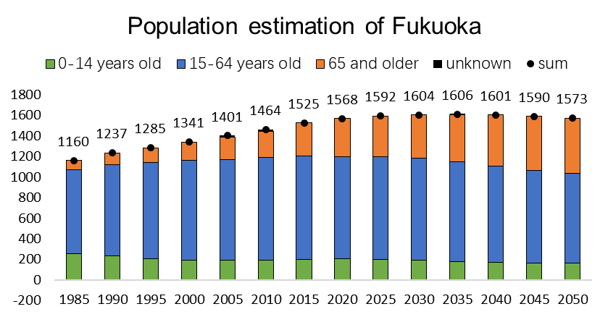
3.1
Introduction
Background
Problems
1
2
3
Reduction in share rate of public transit
Aging population
Traffic congestion
Chapter 3 - Analysis on the characteristics of transit ridership and land use

Slide 81
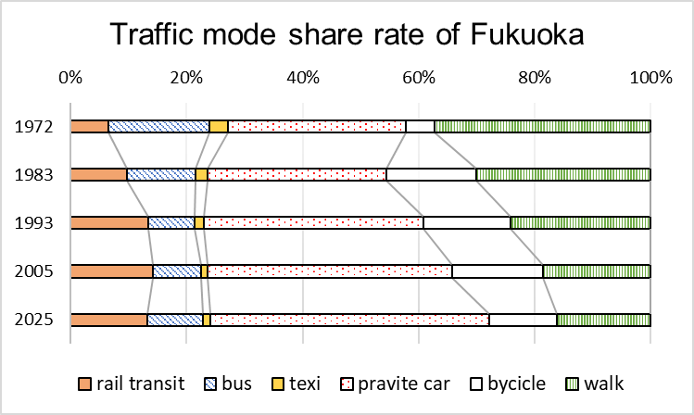
3.1
Introduction
Background
Problems
1
2
3
Reduction in share rate of public transit
Aging population
Traffic congestion
Chapter 3 - Analysis on the characteristics of transit ridership and land use

Slide 82
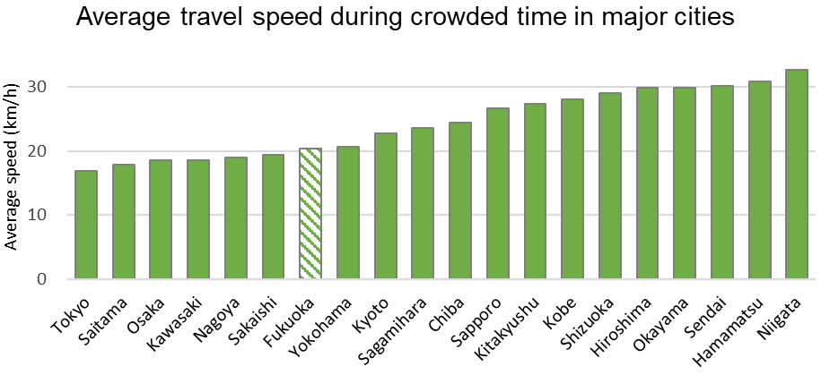
3.1
Introduction
Background
Problems
1
2
3
Reduction in share rate of public transit
Aging population
Traffic congestion
Chapter 3 - Analysis on the characteristics of transit ridership and land use

Slide 83
3.1
Introduction
Background
Problems
1
2
3
Reduction in share rate of public transit
Aging population
Traffic congestion
Demands
Promoting the use of rail transit
Alleviating the pressure on government finances
Chapter 3 - Analysis on the characteristics of transit ridership and land use

Slide 84


2.1
Introduction
Research position
Catchment area
Influencing factor
The area passengers can accept to walk to the station
Environment
Behaviors
Personal Socio-Demographic Characteristics
(abbreviated as PSDC)
Walking duration to transit stations
Relationship
Research Point
(This Study)
Chapter 2 - Analyzing Willingness of Walking Duration to Transit Stations Using Socio-Demographic Characteristics
Notes:
Before I introduce this research, I want to give a brief position for it. As we know, obviously, the catchment area is a basic determinants for the use of transit station. According to the previous research, catchment area should be determined by various factors, like built-environment, facilities, also people’s behaviors. In this research, we chose the perspective of people’s behaviors to investigate how the catchment area is determined. The walking duration and personal socio-demographic characteristics are used to represent the catchment area and people’s behaviors, respectively.

Slide 85
2.1
Introduction
Research position
Acceptable walking duration to rail transit stations
Behaviors
Catchment area
Determine
Walk to the station
Personal attributes
Socio-demographic characteristics
(abbreviated as PSDC)
Walking duration to transit stations
Research purpose
How the socio-demographic characteristics influence the acceptable walking duration
Chapter 2 - Analyzing Willingness of Walking Duration to Transit Stations Using Socio-Demographic Characteristics
Notes:
Since pedestrian accounts most rail transit users, the walking distance and duration can determine the catchment area to a large extent. And the walking duration is thought to be affected by the behavior preference, which should be affected by personal attributes like socio-demographic characteristics.
Now we can carry out the main research purpose, How the socio-demographic characteristics influence the acceptable walking duration?

Slide 86


2.1
Introduction
The work of this study
Research purpose
Explore how the PSDC can affect the acceptable walking duration to transit stations using the data of person trip survey.
Research object
Examine the probability of accepting the given threshold of walking duration
Continuous value of Walking duration
Threshold of walking duration
$$t_{1}\sim t_{2}$$
$$t_{1}, t_{2}, t_{3}……$$
Entry point
Try to explain the acceptable walking duration using probability.
Chapter 2 - Analyzing Willingness of Walking Duration to Transit Stations Using Socio-Demographic Characteristics
Notes:
With the interpretation of the existing problems in previous studies, here the research purpose is proposed, that is to explore how the personal socio-demographic characteristics can affect the acceptable walking duration to transit stations using the data of person trip survey.
And different from the existing studies, I investigate the walking duration by some specific threshold value rather than the continuous value. Moreover, the estimation of relationship is not from the perspective of regression but the probability.
That is to say, I will check the probability of choosing walking to transit stations at some specific threshold.

Slide 87
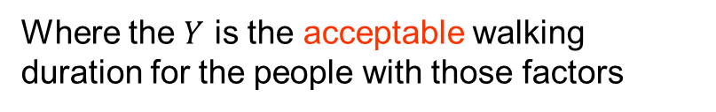
2.1
Introduction
Research object
$$Y=F\left({factor}_{1}, {factor}_{2},{factor}_{3}, ……\right)$$
Acceptable walking duration
Where the $Y$ is the acceptable walking duration for the people with those factors
Examine the probability of accepting the given threshold of walking duration
Continuous value of Walking duration
Threshold of walking duration
$$t_{1}\sim t_{2}$$
$$t_{1}, t_{2}, t_{3}……$$
Entry point
Try to explain the acceptable walking duration using probability.
Chapter 2 - Analyzing Willingness of Walking Duration to Transit Stations Using Socio-Demographic Characteristics
Notes:
With the interpretation of the existing problems in previous studies, here the research purpose is proposed, that is to explore how the personal socio-demographic characteristics can affect the acceptable walking duration to transit stations using the data of person trip survey.
And different from the existing studies, I investigate the walking duration by some specific threshold value rather than the continuous value. Moreover, the estimation of relationship is not from the perspective of regression but the probability.
That is to say, I will check the probability of choosing walking to transit stations at some specific threshold.

Slide 88
2.6
Result and Discussion
Evaluation of prediction
Evaluation of 13 minutes threshold
Slightly high precision
The threshold of 13 minute is not a commonly acceptable walking duration
Some one who can accept this threshold can be considered to have some specific characteristics.
The features are significant at this threshold.
Chapter 2 - Analyzing Willingness of Walking Duration to Transit Stations Using Socio-Demographic Characteristics
Notes:
Next is the evaluation at 13minutes threshold.
We can see the precision is neither good not bad.
A little like the result at 5 minutes threshold, because the threshold of 13 minute is not a commonly acceptable walking duration. Some one who can accept this threshold can be considered to have some specific characteristics. This significant difference from the other passengers explains this fitness at 13 minutes threshold.

Slide 89
3.3
Characteristics of transit ridership and land use
Land use characteristics
Station classification based on land use
Type | Station No. | Population-density | Office | Commerce | Residence | Education
Low-density residence | 30 | 33 | 1.70% | 41.50% | 44.95% | 0.18%
 | 26 | 54 | 2.81% | 1.23% | 58.26% | 2.85%
 | 29 | 78 | 3.02% | 5.40% | 75.86% | 6.94%
 | 27 | 79 | 4.30% | 4.24% | 75.87% | 0.77%
 | 28 | 81 | 3.55% | 3.42% | 73.46% | 6.24%
 | 3 | 91 | 4.01% | 8.58% | 59.97% | 6.25%
 | 33 | 101 | 1.74% | 2.10% | 81.71% | 7.84%
 | 24 | 103 | 2.14% | 2.17% | 66.82% | 8.30%
 | 34 | 109 | 2.38% | 3.28% | 86.12% | 0.86%
Low-density residence
Low population-density
High proportion of residence
Chapter 3 - Analysis on the characteristics of transit ridership and land use
Notes:
According to the analysis of land use indicators, all the 35 stations are classified into several types.
The first is low-density residence, with Low population-density, and High proportion of residence

Slide 90
3.3
Characteristics of transit ridership and land use
Land use characteristics
Station classification based on land use
Type | Station No. | Population-density | Business | Commerce | Residence | Education
High-density residence | 19 | 121 | 2.17% | 3.15% | 76.63% | 0.12%
 | 13 | 125 | 11.11% | 6.48% | 46.08% | 4.51%
 | 16 | 142 | 4.59% | 5.03% | 72.75% | 2.68%
 | 18 | 142 | 2.27% | 1.96% | 64.58% | 6.80%
 | 31 | 143 | 4.14% | 2.26% | 54.17% | 18.28%
 | 17 | 144 | 6.02% | 7.28% | 55.45% | 10.60%
 | 12 | 145 | 4.16% | 1.77% | 66.22% | 4.39%
 | 32 | 170 | 1.17% | 1.28% | 73.54% | 9.93%
 | 23 | 193 | 10.00% | 6.18% | 44.52% | 2.56%
High-density residence
High population density
High proportion of residence
Chapter 3 - Analysis on the characteristics of transit ridership and land use
Notes:
The second is high-density residence, with high population-density, and High proportion of residence

Slide 91
3.3
Characteristics of transit ridership and land use
Land use characteristics
Station classification based on land use
Type | Station | Population-density | Business | Commerce | Residence | Education
Education | 25 | 35 | 1.38% | 2.31% | 30.04% | 39.83%
 | 1 | 56 | 8.70% | 1.91% | 48.01% | 17.89%
 | 35 | 58 | 5.63% | 3.78% | 55.18% | 21.37%
 | 4 | 67 | 4.93% | 3.49% | 33.52% | 14.63%
 | 2 | 77 | 4.03% | 11.75% | 44.03% | 23.24%
 | 5 | 89 | 11.53% | 7.26% | 30.51% | 7.30%
Education
High proportion of education
Chapter 3 - Analysis on the characteristics of transit ridership and land use
Notes:
The third is education, with high proportion education

Slide 92
3.3
Characteristics of transit ridership and land use
Land use characteristics
Station classification based on land use
Type | Station | Population-density | Business | Commerce | Residence | Education
Downtown commerce | 9 | 64 | 44.97% | 20.55% | 10.62% | 0.70%
 | 20 | 67 | 34.60% | 36.74% | 11.34% | 1.26%
 | 8 | 67 | 42.97% | 27.86% | 12.23% | 0.59%
 | 11 | 79 | 37.12% | 17.38% | 18.47% | 1.89%
 | 10 | 92 | 30.76% | 26.26% | 15.72% | 1.74%
Downtown commerce
High proportion of business
High proportion of commerce
Chapter 3 - Analysis on the characteristics of transit ridership and land use
Notes:
Then is downtown commerce, with high proportion in both business and commerce.

Slide 93
3.3
Characteristics of transit ridership and land use
Land use characteristics
Station classification based on land use
Type | Station | Population-density | Business | Commerce | Residence | Education
Office | 15 | 64 | 31.63% | 7.80% | 25.80% | 5.73%
 | 6 | 96 | 34.56% | 17.29% | 21.61% | 1.75%
 | 14 | 105 | 26.97% | 17.27% | 17.61% | 2.80%
 | 21 | 136 | 22.86% | 16.12% | 33.66% | 2.70%
 | 22 | 167 | 21.38% | 12.53% | 36.79% | 2.50%
Office
High proportion of business
Chapter 3 - Analysis on the characteristics of transit ridership and land use
Notes:
Next is the office type, with high proportion in business.

Slide 94

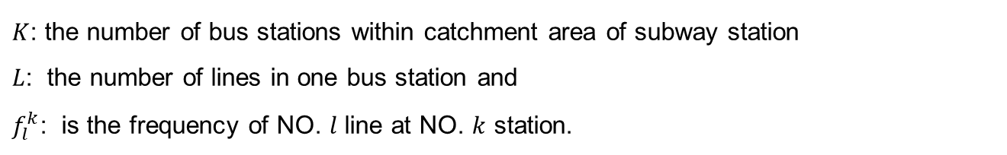

4.2
Indicators
Variable interpretation
Bus capacity
$$BC=\sum_{k}^{K}{\sum_{l}^{L}{f_{l}^{k}}}$$
$K$: the number of bus stations within catchment area of subway station
$L$: the number of lines in one bus station and
$f_{l}^{k}$: is the frequency of NO. $l$ line at NO. $k$ station.
Bus Accessibility
$$BA =\sum_{k}^{K}{R_{k}}$$
$R_{k}$: is the number of bus lines passing through the $k$th bus station.
Chapter 4 - Influencing Factors on Transit Ridership at Station Level
Notes:
There are the two indicators about bus system. In this study, I considered the effect of bus system from two opposite parts, one is the bus capacity, and the other one is bus accessibility.
The indicator of bus capacity represents the ability of how many passengers the bus system can transfer, it relates to the number of bus stops, bus lines and the frequency of bus within the catchment area. It is expected to have negative effect on rail transit ridership, since the large bus capacity may share parts of the passengers from rail transit.
The indicator of bus accessibility represents the areas connecting to the bus system within the catchment area. It only relates to the number of bus lines. This indicator is expected to have positive effect on rail transit ridership, since a better accessibility of bus may take more rail transit passengers.

Slide 95
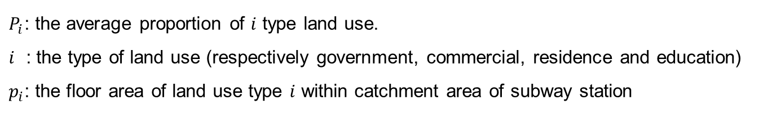
4.2
Indicators
Variable interpretation
Land-use Aggregation
The indicator of land-use mix is re-defined into the aggregation of land-use.
$A=\sqrt{\sum{{\left(p_{i}−P_{i}\right)}^{2}}}$
$P_{i}$: the average proportion of $i$ type land use.
$i$ : the type of land use (respectively government, commercial, residence and education)
$p_{i}$: the floor area of land use type $i$ within catchment area of subway station
Range of PCA | Residence | Office | Commerce | Education | Total
600 | 51.8% | 19.3% | 13.8% | 5.5% | 90.5%
800 | 55.3% | 17.5% | 12.0% | 6.2% | 90.9%
1000 | 57.6% | 16.5% | 10.8% | 6.0% | 90.9%
1200 | 59.2% | 15.5% | 10.2% | 5.9% | 90.8%
Ave | 62.8% | 10.1% | 7.5% | 5.3% | 85.7%
Average $P_{i}$
Chapter 4 - Influencing Factors on Transit Ridership at Station Level
Notes:
Let me go on to interpret some of the indicators. Firstly, the variable of land-use aggregation. This indicator is used to describe the variety of land use. Maybe we usually hear about the word of land-use mix, but not aggregation. Here I redefined it. Look at this formula, it represents the spatial distance between the uppercase P and lowercase p, where the uppercase P means the average proportion of each kind of land use, and the lowercase p represents the proportion in the observing station. The higher the indicator A is, the function of land use is more aggregative, which means the land use variety is lower. The reference value of uppercase P is calculated from the average of all the stations in Fukuoka, using the catchment area of 800 meters walking distance.

Slide 96


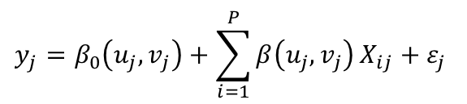
4.4
Model estimation
Ordinary regression
MGRW parameter
Kernel Type
$$y_{j}=\sum_{i=1}^{P}{X_{ij}}+ε_{j}$$
Fixed Gaussian kernel function
Bandwidth selection method
Golden-section search
MGRW model
$$y_{j}=β_{0}\left(u_{j},v_{j}\right)+\sum_{i=1}^{P}{β\left(u_{j},v_{j}\right)}X_{ij}+ε_{j}$$
5.7km
$β$ means the weight at the coordinate of $\left(u,v\right)$
Chapter 4 - Influencing Factors on Transit Ridership at Station Level
Notes:
With these screened indicators, I’m going to estimate the influence on transit ridership quantitively. The transit ridership is not like the common sampling data, it also depends on spatial distribution. Therefore the mix geographically weighted regression is used to deal with the spatial relationship. As we can see the difference between the two formula, beta means the weight at the coordinate of (u, v). The two important parameters in MGRW is set as shown. The bandwidth is set to 5.7 kilometers, which is selected by golden-section search.

Slide 97
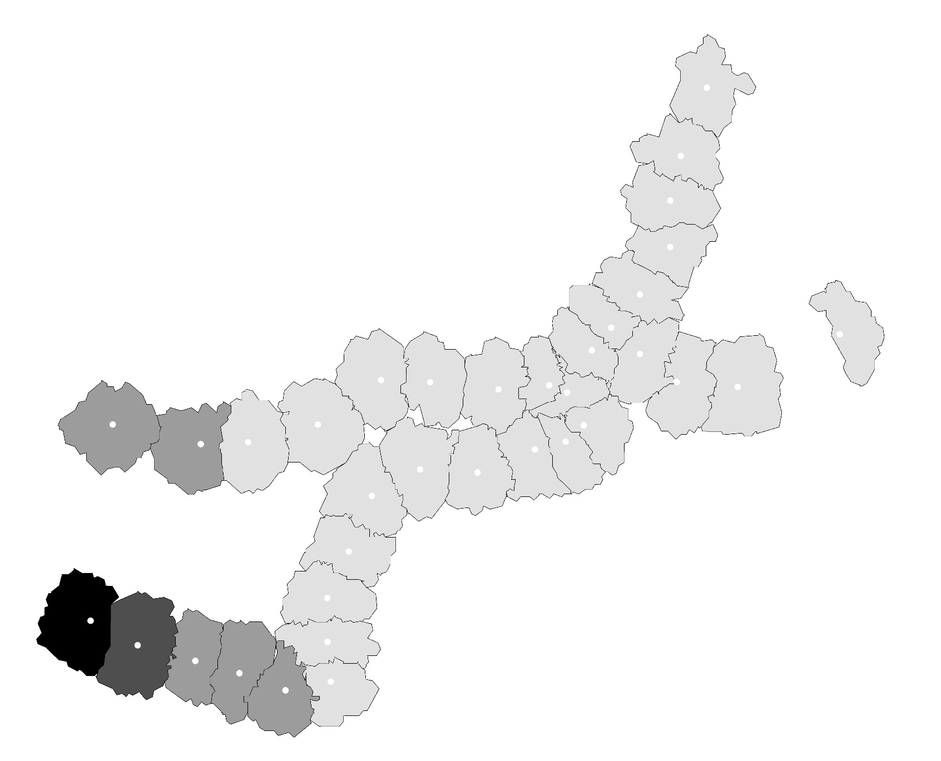
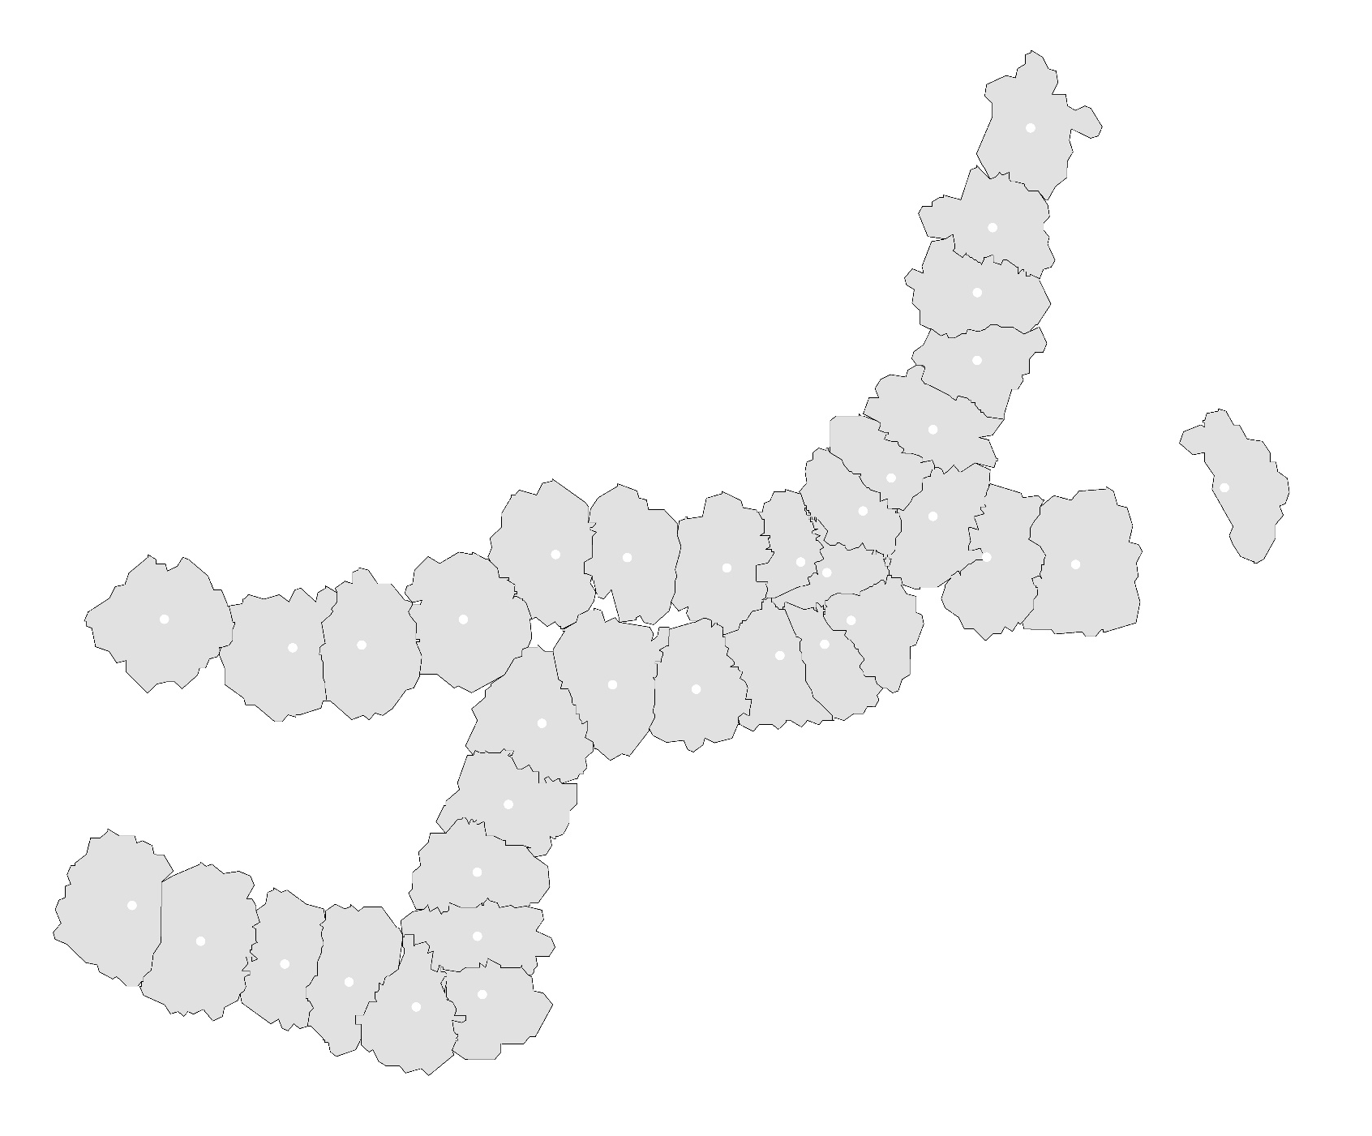
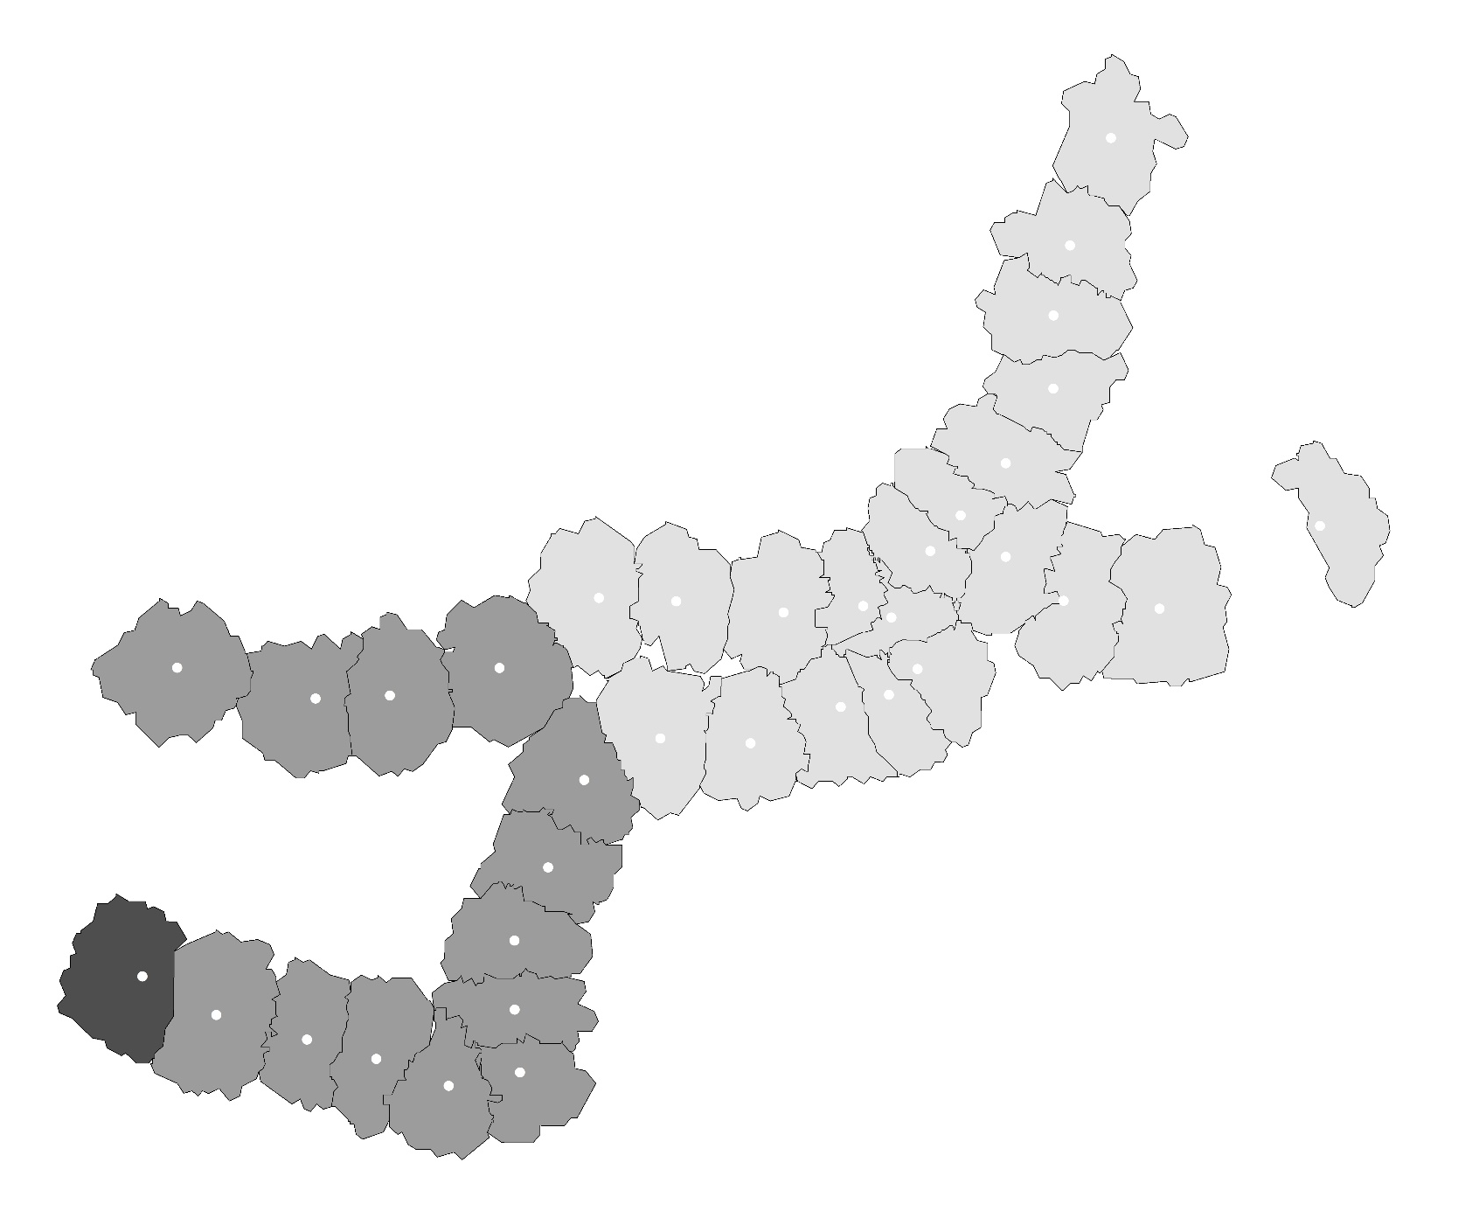
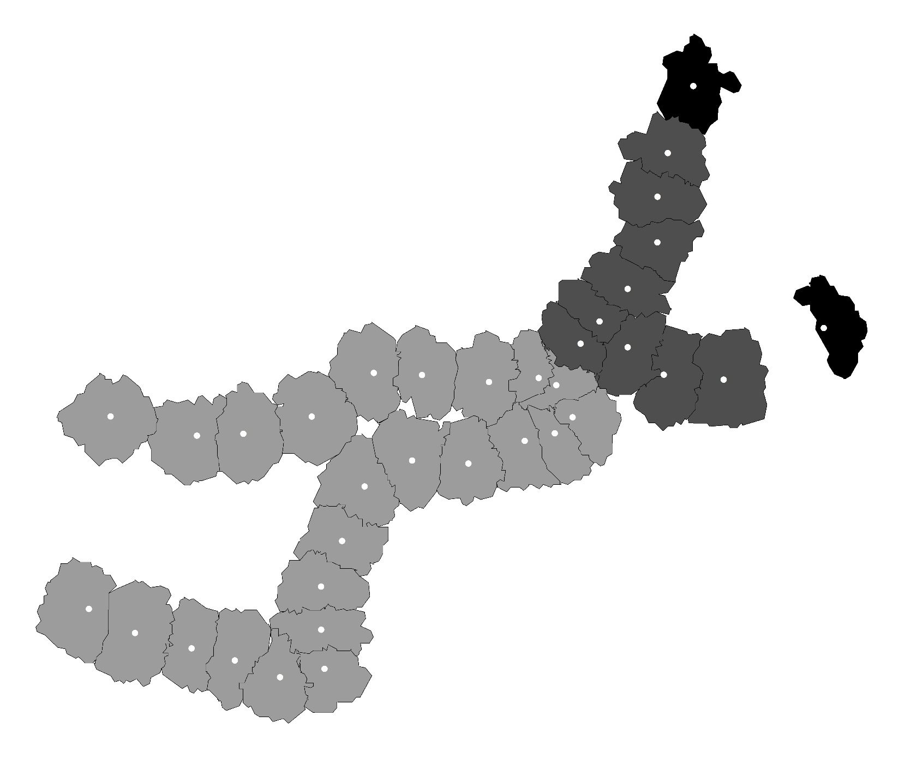
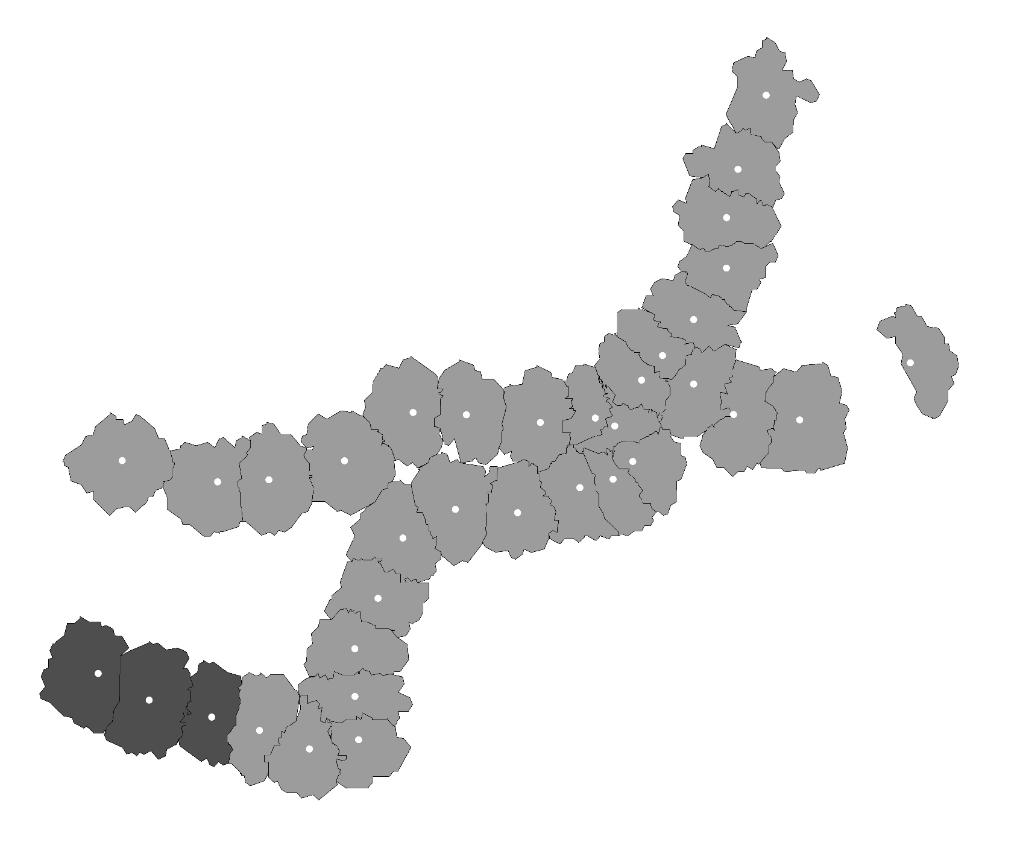
4.5
Residual Analysis
Significance Map
Transportation Facility Area
Bus Accessibility
Bus Capacity
Significance Map
Not Significance
P = 0.01
P = 0.05
P = 0.10
Population Job Balance
Tenant Proportion
Chapter 4 - Influencing Factors on Transit Ridership at Station Level
Notes:
The spatial distribution of significance for each local variable are mapped in Figure 4.4. For the variables of building area of transportation, bus capacity, bus accessibility, job-resident balance and tenant proportion, there are 33, 34, 35, 24 and 32 data points having statistical significance at confidence level 95% respectively. As in the figures, the two indicators for bus that proposed in this study have good performance in terms of significance and stability, while the variable of ‘tenant proportion’ has a little worse stability.

Slide 98
4.6
Conclusion
Main works
Reclassified and reorganized the indicator framework.
Proposed the approach of selecting variables from candidates using the tool of exploratory regression in ArcGIS.
Provided a method for judging whether a variable is global or local used in estimating the MGWR model.
Main findings
The higher diversity of land use leads to decrease in transit ridership.
The bus system has both positive and negative effects on rail transit ridership.
The tenants are more willing to use rail transit in the case of Fukuoka.
Chapter 4 - Influencing Factors on Transit Ridership at Station Level
Notes:
For a conclusion, this study reorganized the indicator framework, and proposed a method for selecting valid variables. Also, provided a way for judging whether a variable is global or local in the mix geographically weighted regression model.
Also there are some interesting finding from this study.
The higher diversity of land use leads to decrease in transit ridership.
The bus system has both positive and negative effects on rail transit ridership.
The tenants are more willing to use rail transit in the case of Fukuoka.

Slide 99
5.1
Introduction
Description for the research
Differences with station-level
 | Scale | Objective
Station-Level | single station | Passenger volume of station
Station-to-Station-Level | station network | OD passenger volume
Research contents
To describe the connectivity between different stations using OD ridership.
To explain how the connectivity is determined by land-use factors.
Chapter 5 - Influencing Factors on Transit Ridership at Station-to-Station Level
Notes:
This study is at the station-to-station level, but not station-level. Different from station-level, the research scale shift to station network but not a sing station, the research objective is changed to OD passenger volume but not the passenger volume of single station. The emphasis of station-to-station level is not only the prediction of ridership, but also the connectivity between the station and station.
The research contents mainly have two parts, to describe the connectivity between different stations using OD ridership, and to explain how the connectivity is determined by land-use factors.

Slide 100
5.3
Method
Description for the research question
Boarding
Alighting
Station 1
Other
Stations
……
Station 2
Station k
……
Dependent variable
Independent variable
land-use feature of boarding station
Impedance between boarding and alighting station
Affect
Choice of whether to get off at station k
Chapter 5 - Influencing Factors on Transit Ridership at Station-to-Station Level
Notes:
Before constructing the mathematical model, I am going to explain how to convert this realistic problem into a mathematical problem. If we examine the case of alighting station k, this probability of getting off at station k is affected by the land-use and impedance of boarding station. Here we can convert this problem into a discrete choice problem. And it can be expressed using logistic regression. In this logistic regression, if we take the alighting station k as an example, the dependent variable is the connectivity between all the boarding stations and alighting station k, it is the probability of getting off at station k. The independent variables are the land-use of departure stations and the impedance between boarding stations and the alighting station k.

Slide 101
5.5
Conclusion
Main works
Defined the “connectivity” between station and station
The influence of land use on the connectivity was estimated
In the future
The indicator system should be further enriched
The share of different transportation modes should be considered
The indicators belong to impedance should be improved
The influence of bus system also should be considered at the station-to-station level
Chapter 5 - Influencing Factors on Transit Ridership at Station-to-Station Level
Notes:
This is the chapter 5, the main work of this study includes two parts, Defined the “connectivity” between station and station. The influence of land use on the connectivity was estimated.
Also we got some implications for the future, Further enrich the indicator system. The share of different transportation modes should be considered. The indicators belong to impedance should be improved. The influence of bus system also should be considered at the station-to-station level

Slide 102
6.2
Contributions
Chapter 2
Reinterpreted the implication of surveyed walking distance/duration to transit stations. The surveyed walking distance/duration has no linear relation with people willingness but just the reﬂection of the distance between departures and stations.
Described the correlation between surveyed walking duration and people’s individual characteristics from the view of probability, which can be further applied to the estimation of catchment area of rail transit stations.
Chapter 6 - Conclusion

Slide 103
6.2
Contributions
Chapter 3
Analyzed the trend of variations in transit ridership, and classiﬁed the sub-way stations of Fukuoka into 5 types in terms of land use. Conﬁrmed the correlations between transit ridership and land use.
Chapter 6 - Conclusion

Slide 104
6.2
Contributions
Chapter 4
Considered the inﬂuence of bus on rail transit ridership from both the sides of bus capacity and bus accessibility, and veriﬁed that the effect of bus capacity is positive to rail transit ridership, while the effect of bus accessibility is negative.
Proposed the approach of screening valid indicators by introducing the exploratory regression, and conﬁrmed its effectiveness in a small sample case.
Distinguished the local and global variables in MGWR model by examining the spatial distribution of each variable, and the effectiveness was conﬁrmed in the estimation of MGWR model
Chapter 6 - Conclusion

Slide 105
6.2
Contributions
Chapter 5
By examining the probability of selecting the destination station from all the stations, established a logistic regression model for describing the correlation between stations and stations.
Quantitatively validated the impact of land use types on the selection of destination stations.
Chapter 6 - Conclusion

Slide 106
6.1
Summary
Main findings
Analyzed the inﬂuence of various factors on rail transit ridership from station level and station-to-station level respectively.
Provided new explanations for the catchment area of rail transit stations.
Provided an approach for selecting the valid indicators
Proposed a ridership forecasting method with the consideration of interaction among stations and stations
Chapter 6 - Conclusion

Slide 107
6.2
Recommendations
How to increase the use of rail transit
People’s walking preferences have signiﬁcant inﬂuence on the use of rail transit. It is suggested that the design for pedestrian accessibility should also consider the individual characteristics of resident, thus helping increase the use of rail transit.
With the development of rail transit, if viewing from the whole transit system, the positioning of bus system is gradually inclining to be the connection between departures and rail transit. Rather than planning higher capacity for bus transport, it is suggested to plan more accessible bus routes which can help people use rail transit more convenient.
According to the ﬁndings, the more aggregation in land use functions the more demand in rail transit. Thus suggesting to connect more functional regions as possible when making rail transit planning.
Chapter 6 - Conclusion

Slide 108
6.2
Recommendations
The further research
Enrich indicator system
Combine the estimation of catchment area and the prediction of transit ridership.
Explore how the rail transit affect land use.
Explore the balance condition among various elements in the catchment area of transit stations, including human, resource, land use, transportation etc., providing reference to create the compact city.
Chapter 6 - Conclusion

