Slide 1
MDA5 (IFIH1) and Nestin (NES) expression in the human brain and in multiple sclerosis
Cell-type-resolved single-nucleus transcriptomic analysis

Slide 2
Two questions
1 Which cell types express IFIH1 in the normal human brain, and does this differ between grey and white matter?
2 How does the cellular distribution of IFIH1 change in MS lesions, and is the change the same in the two regions?
Cohort | Compartment | Donors | Nuclei | Role
CELLxGENE Census | Normal brain | 783 | 18,551,076 | Cell-type expression profile
GSE180759 Absinta 2021 | Subcortical white matter | 3 ctrl + 5 MS | 66,432 | White matter, lesion stages
GSE279180 Lerma-Martin 2024 | Subcortical white matter | 6 ctrl + 7 MS | 103,780 | White matter, primary cohort
Schirmer 2019 | Cortical block | 9 ctrl + 12 MS | 48,919 | Cortex
Macnair 2025 | Cortex + subcortical WM | 26 ctrl + 54 MS | 632,375 | Lesion stages, within one study
Nucleic Acids Res. 2025 Jan 6;53(D1):D886-D900;
Nature. 2021 Sep;597(7878):709-714;
Nat Neurosci. 2024 Dec;27(12):2354-2365;
Nature. 2019 Sep;573(7772):75-82;
Neuron. 2025 Feb 5;113(3):396-410.e9.
1

Slide 3
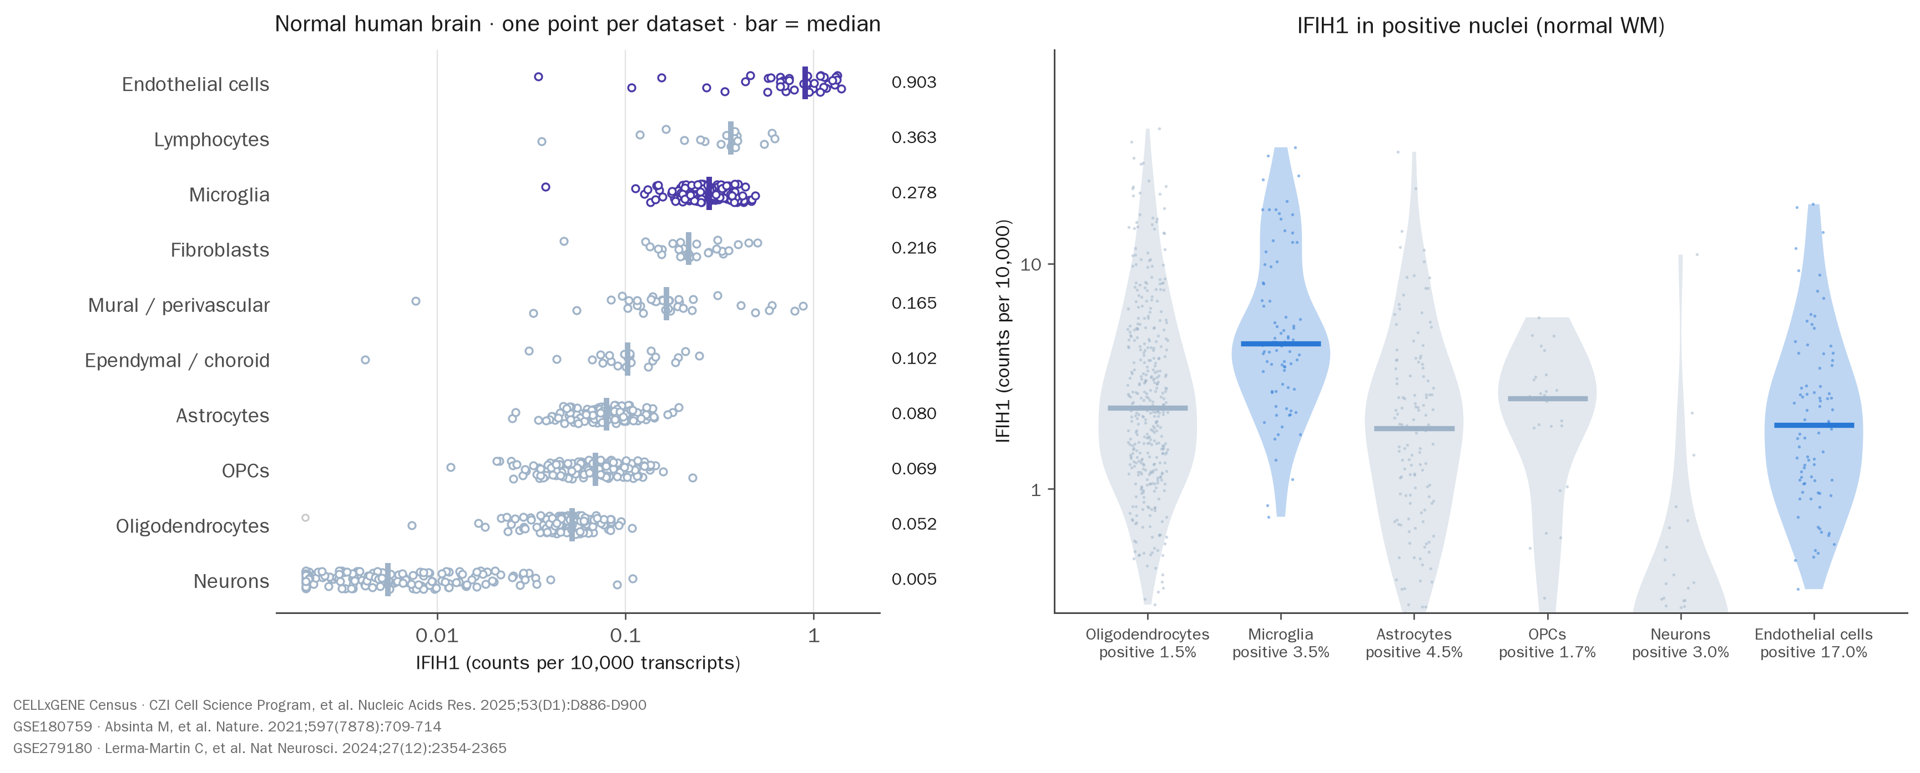
IFIH1 expression across human brain cell types
2

Slide 4
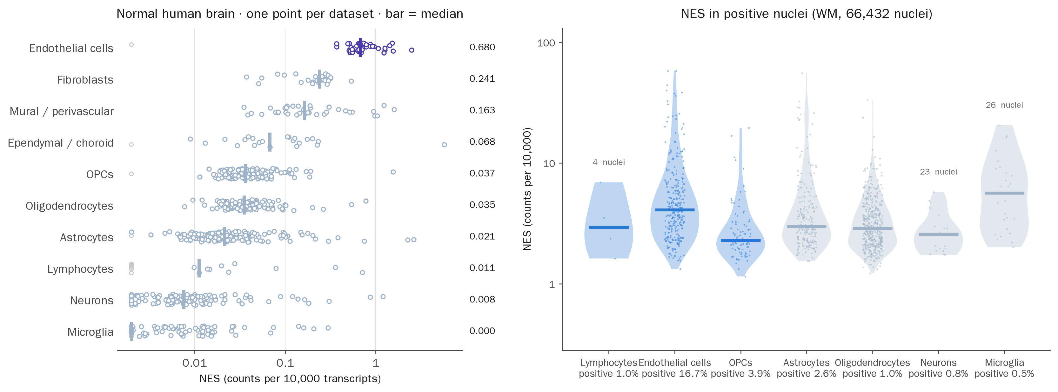
Nestin (NES) expression across CNS cell types
CELLxGENE Census · CZI Cell Science Program, et al. Nucleic Acids Res. 2025;53(D1):D886-D900
GSE180759 · Absinta M, et al. Nature. 2021;597(7878):709-714
3

Slide 5
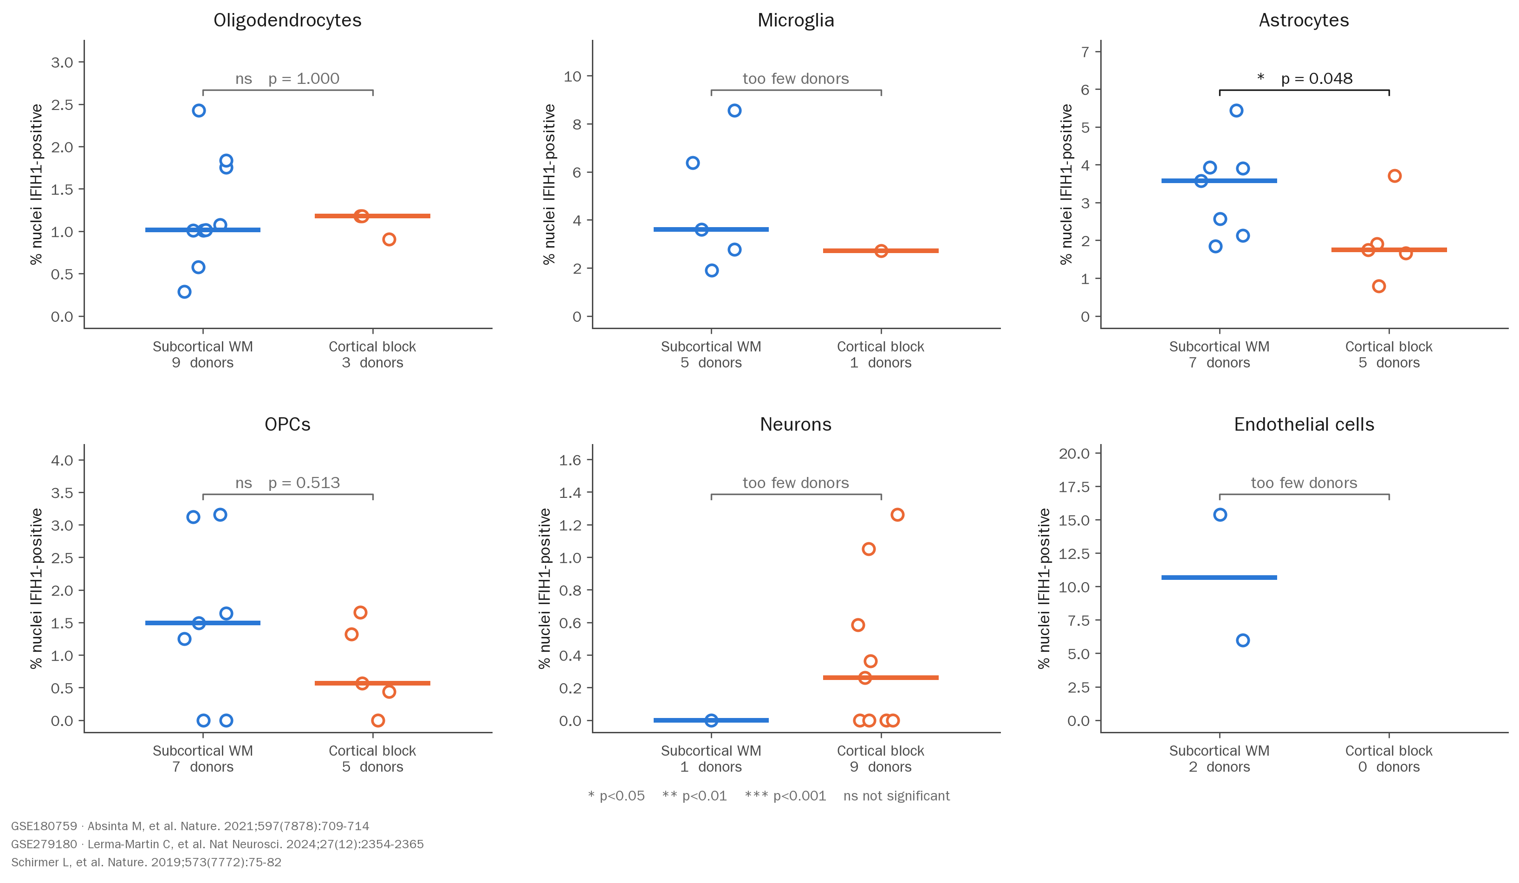
Normal brain: no difference between the two anatomical regions
4

Slide 6
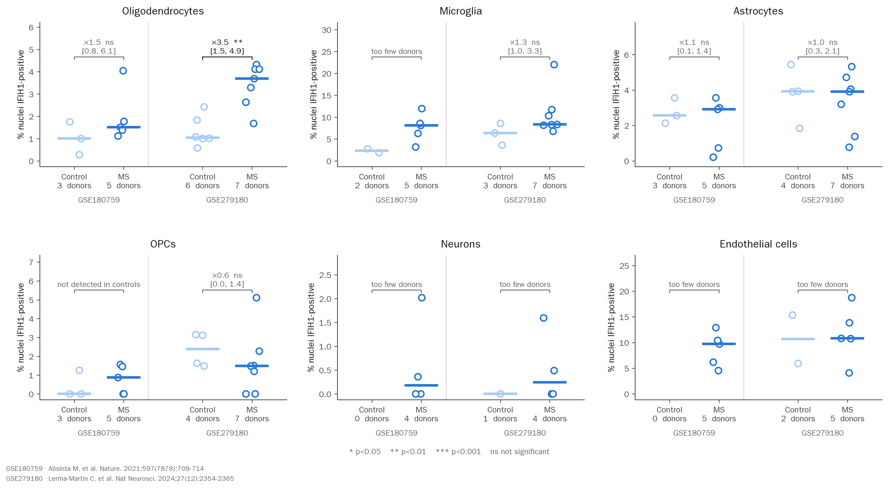
MS white matter: more IFIH1-positive oligodendrocytes
5

Slide 7
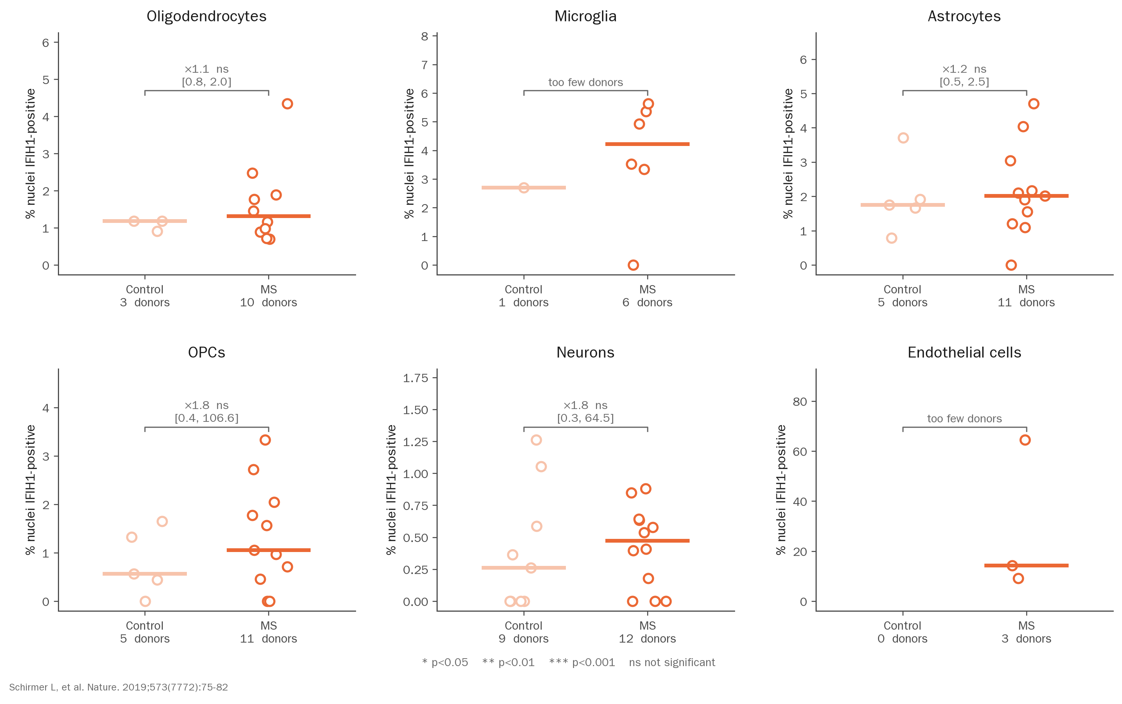
MS cortex: no change of comparable magnitude
6

Slide 8
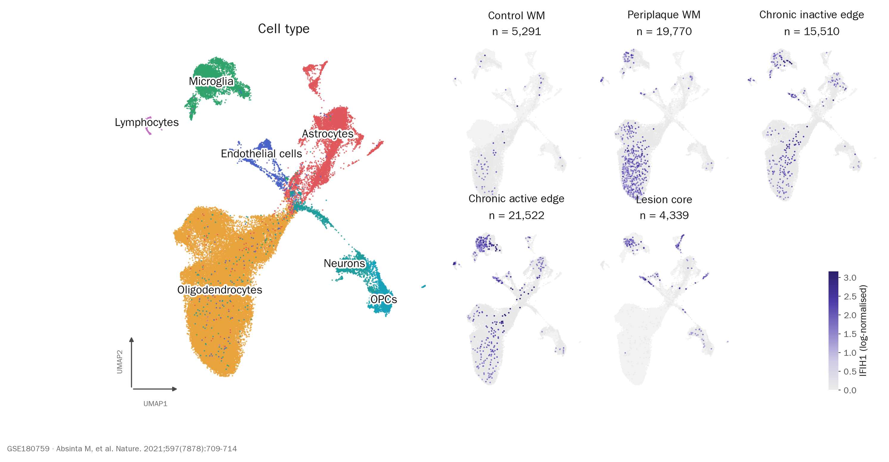
IFIH1 across white-matter nuclei, by lesion stage
7

Slide 9
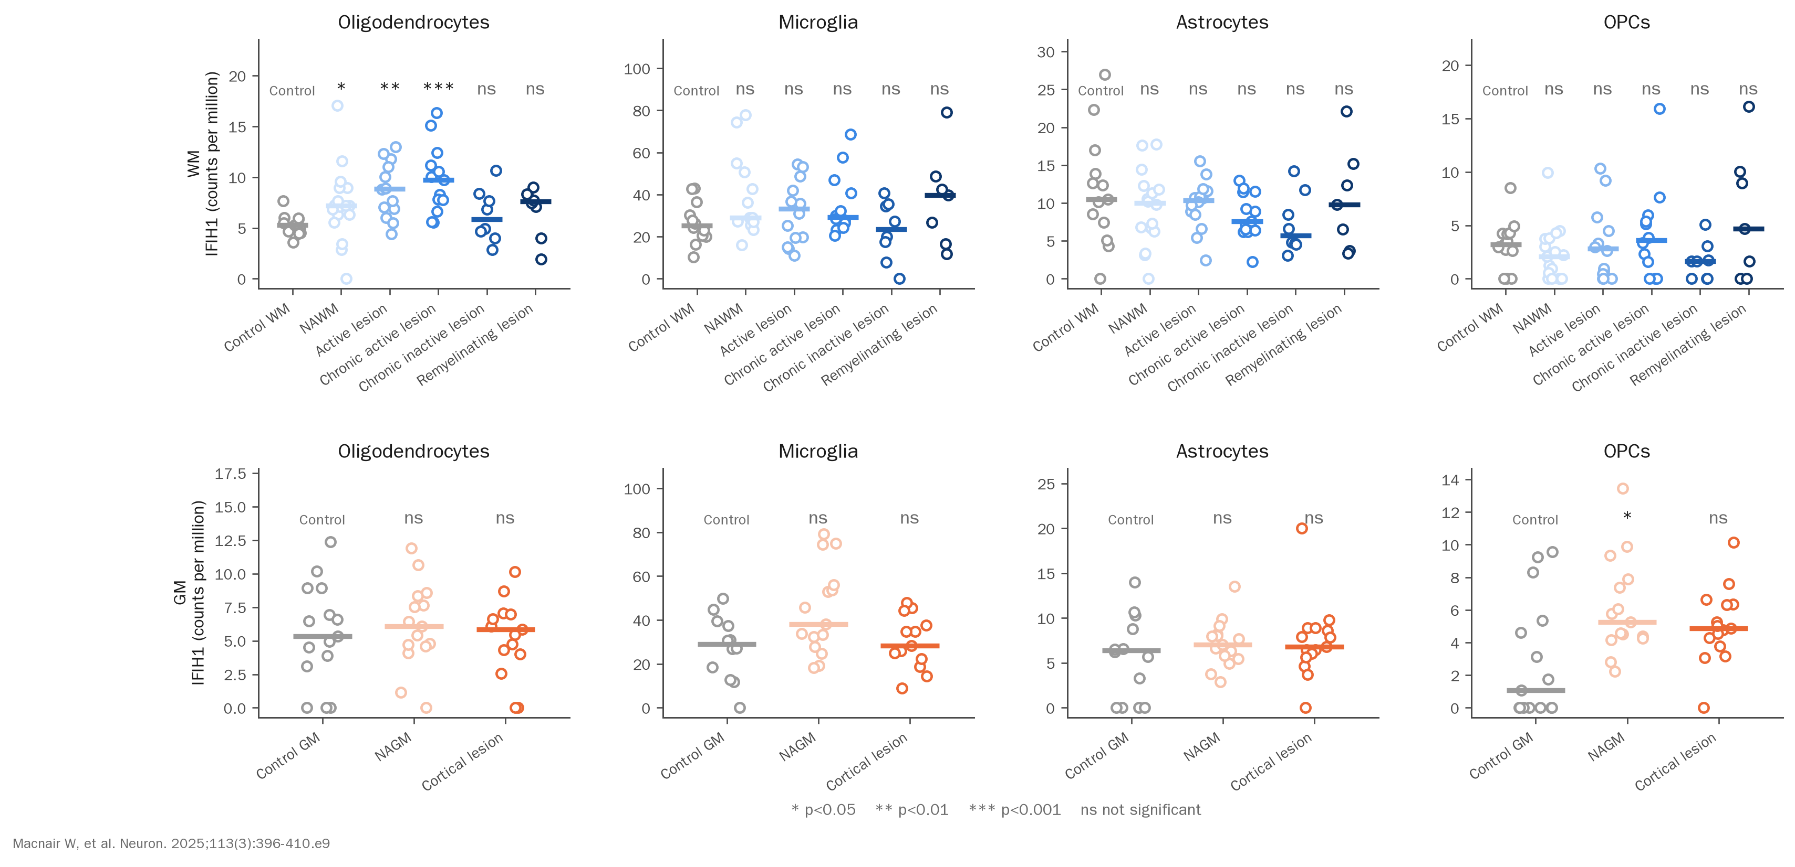
Each demyelinating lesion stage against its own control
8

