Slide 1
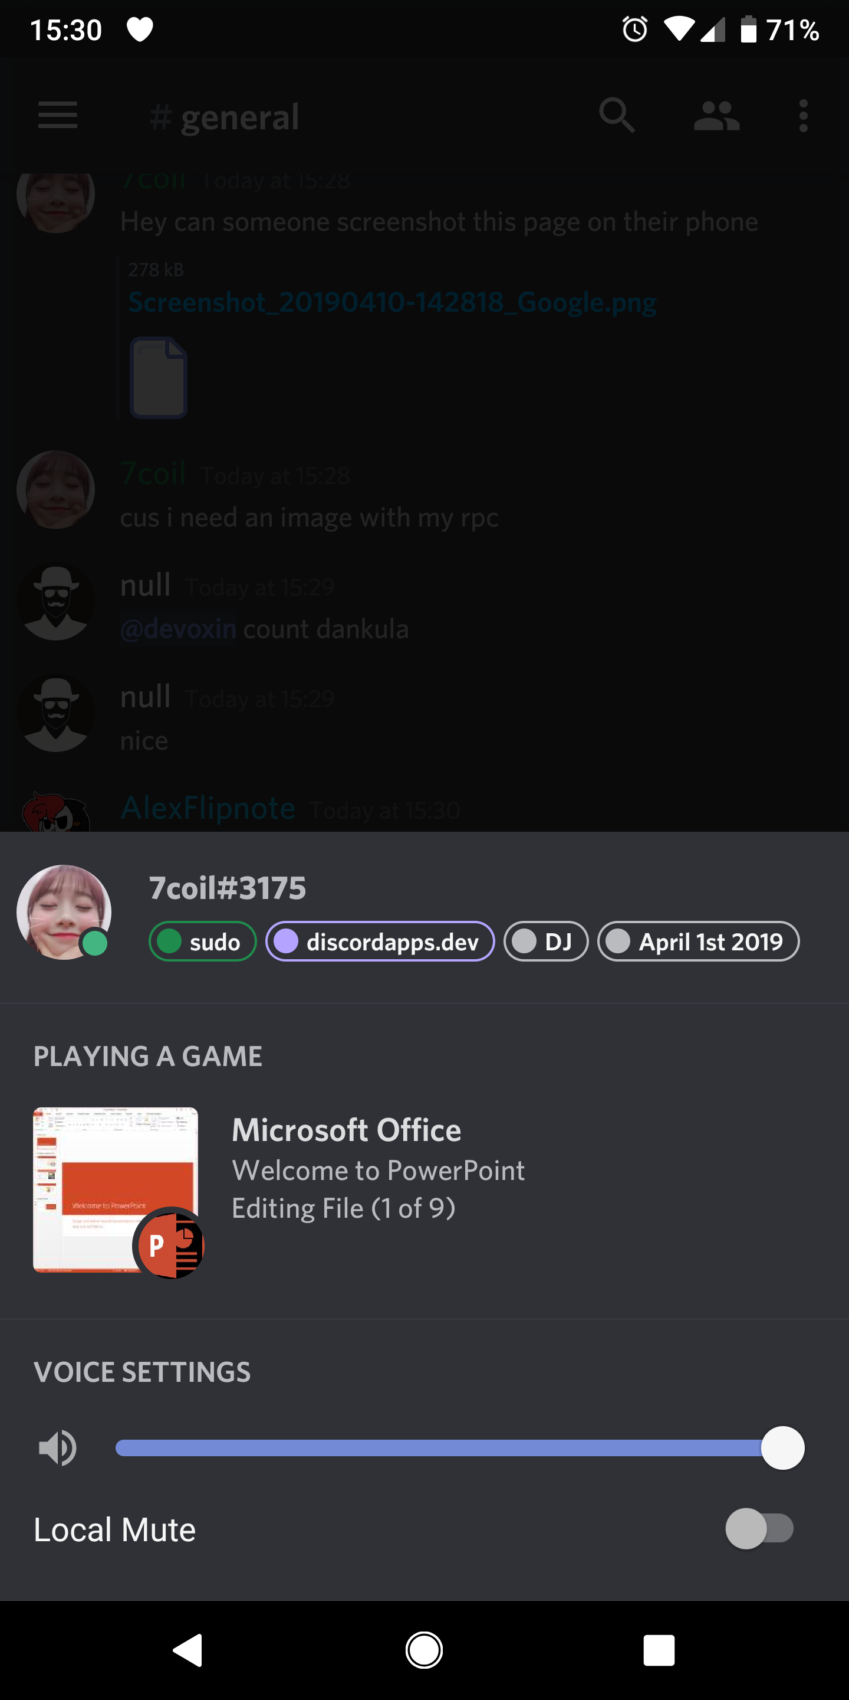
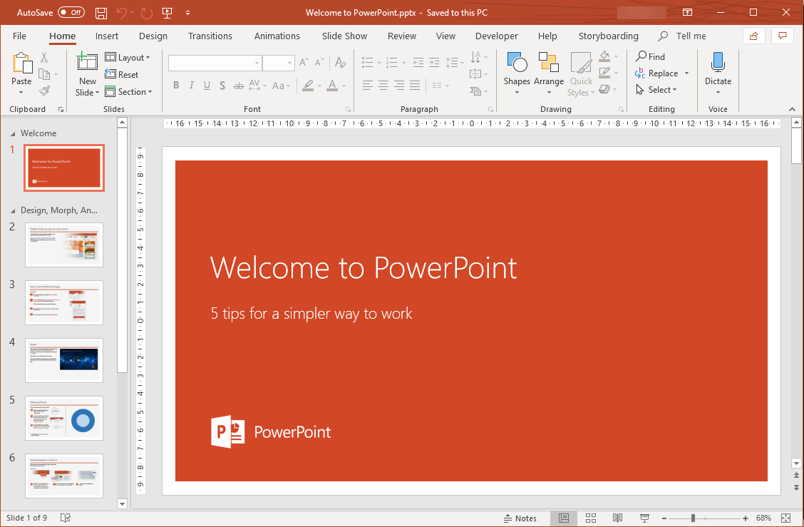
Show off what you’re doing in Office
Compatible with Office 2013, 2016, 2019 and 365
This application is not affiliated with nor endorsed by Microsoft Corporation

