Slide 1
COMS E6998: Microservices and Cloud Applications Lecture 11: Q&A, Final Project, All Project Summary
Dr. Donald F. Ferguson
dff9@columbia.edu

Slide 2
Comments Questions

Slide 3
Projects

Slide 4
Final Project

Slide 5
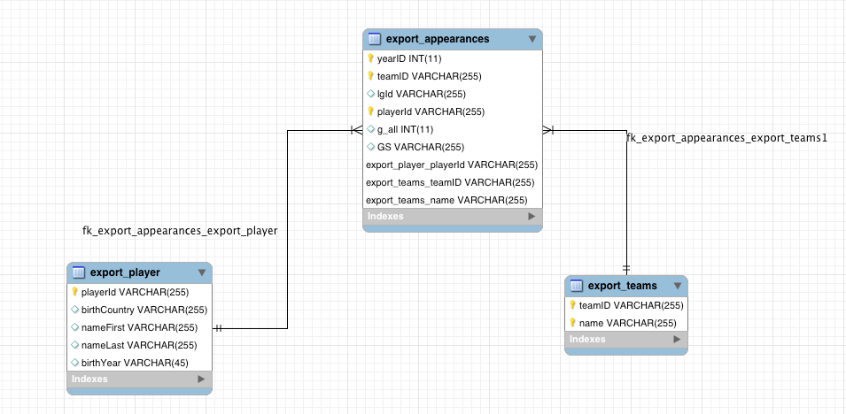
Logical Data Model

Slide 6
Standalone Neo4J Microservice
Import data into Neo4J (local sever or in cloud)
Files are at https://courseworks2.columbia.edu/courses/47421/files/#
appearances.csv
teams.csv
players.csv
Neo4J Import Process
Import from URL via HTTP or
From local directory (On Mac = /Users/donaldferguson/Documents/Neo4j/default.graphdb/import)
Using LOAD CSV commands

Slide 7
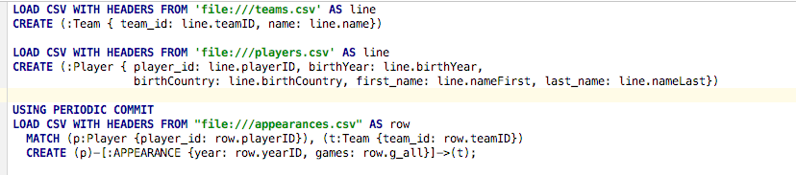
Neo4J LOAD CSV
Statement 1 creates nodes with label :Team for each row in CSV file
Statement 2 creates nodes with label :Player for each row in CSV
Statement 3: For each row in CSV
Find the node (p) :Player that has the row’s playerID
Find the node (t) :Team that has the row’s teamID
Create a relation :APPEARANCE from (p) to (t) with properties year, games to represent the fact that (p) appeared in games games in year year for team (t)

Slide 8
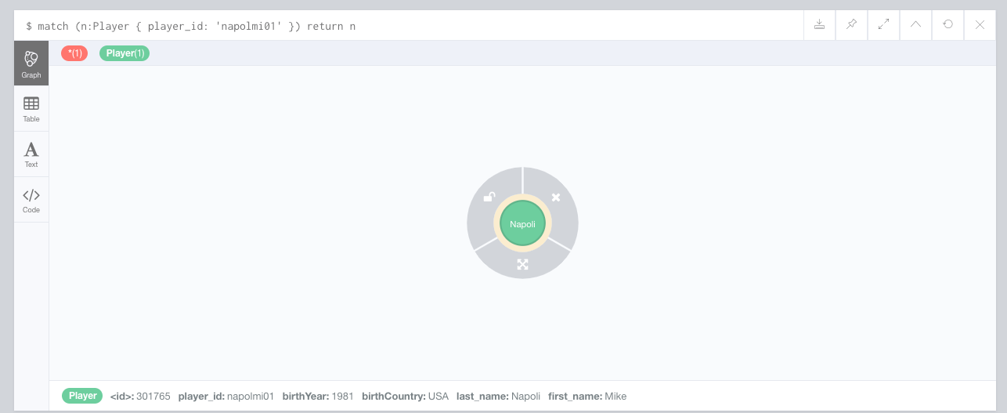
Find Player with player_id ‘napolmi01’

Slide 9
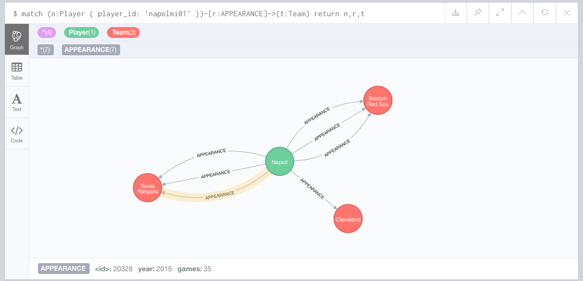
Find the Teams/Years for Which Napoli Appeared

Slide 10
Final (Standalone) Project
Implement a Players microservice
/Players
GET (with query params)
POST
/Players/{playerid}
GET
PUT
DELETE
/Players/{id}/teams (GET only)
/Players/{id}/teammates
GET only.
One optional query parameter ?year=1234
Returns anyone with whom the player was on a team

Slide 11
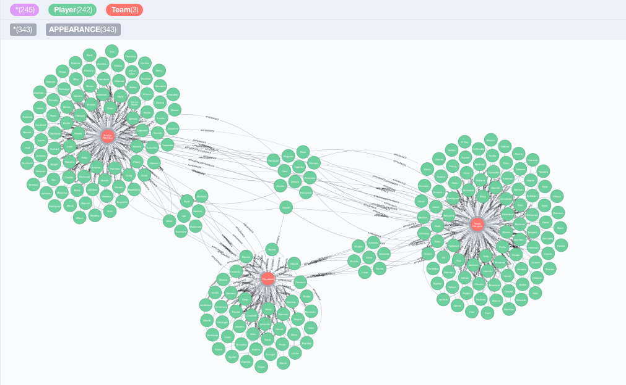
This is Where it Gets Freaky
Players A and B
Were teammates
If
A and B
Both appeared for
Any team T
In the same year.
You will
Write queries to find
All of the teammates of last_name=‘Napoli’
Using Neo4J and SQL

Slide 12
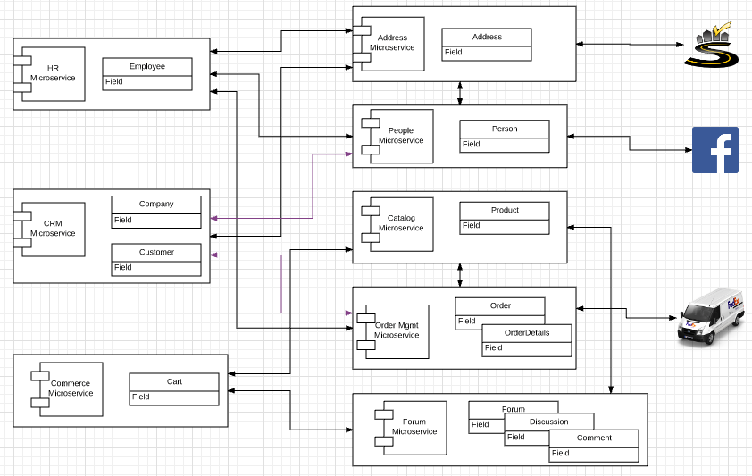
Original Big Picture

Slide 13
Other Projects

Slide 14
0th Project
Teams
Form your teams (approx. 5 people)
Identify contact focal point.
Give your team a “cool” name.
Signup (reuse) and Amazon Web Service Account
Free Tier should be fine.
Provide access to team members.
Create an Elastic Beanstalk instance/application.
Use one of the sample application.
Will have to make more sophisticated starting next week; I will use Node JS with Express for Elastic Beanstalk examples.

Slide 15
1st Project – Part 1
Implement two distinct microservices
Person
Address
Tasks
Use Swagger Editor to define and document REST APIs.
Implement an Elastic Beanstalk application (microservice) for each resource that implements the relevant REST API.
Each microservice should support
GET and POST on resource, e.g. /Person
GET, PUT, DELETE on resource/id, e.g. /Person/dff9
Simple query, e.g. /Person?lastName=Ferguson
Pagination
Relationship paths: /Person/dff9/address and /Addresses/someID/persons
HATEOAS links where appropriate.
Simple HTML/Angular demo UI.
Due: 11:59 PM on 26-Sep-2017

Slide 16
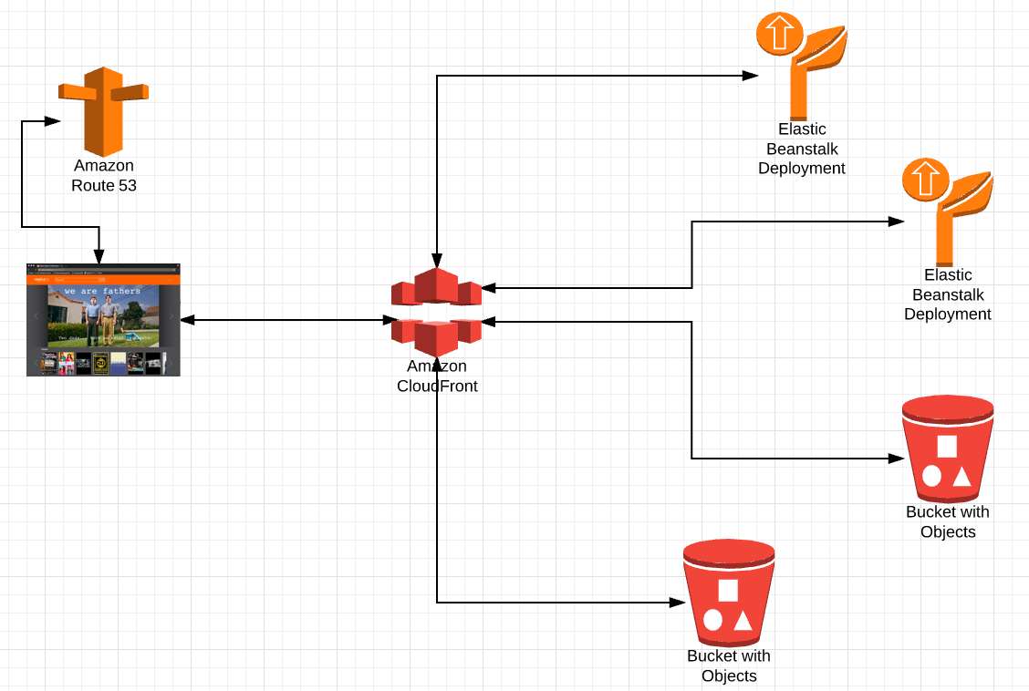
Single Site
DNS
Resolve dff-company.com to
Something.amazon.com
Under the covers
Map
/api/person
/api/address
/app
/js
/views
/app-content
/digital-assets
/images
/videos
To correct IP addresses and sub-paths

Slide 17
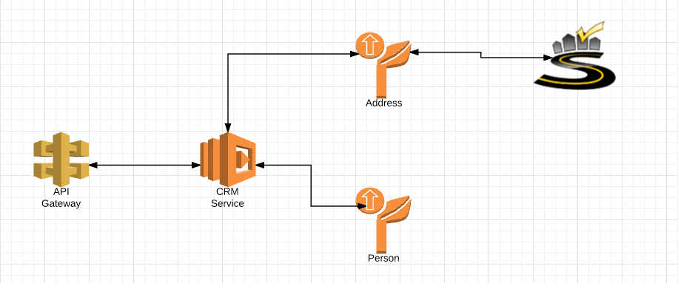
Project 2 – Part 1
Build on 1st to microservices
Implement the CRM Service (and HR Service) using Lambda functions, and orchestration approach from previous lecture.
Integrate with SmartyStreets
Deploy all 3 microservices via API Gateway.
Deliver web content via CloudFront and S3.

Slide 18
Project 2 – Part 2
Implement middleware plugins and microservices implementing
ETag generation and processing.
Idempotent functions.
SNS Event generation on PUT, POST and DELETE.
Plug/deploy the plugin layer in
Each of the Beanstalk Microservices
The CRM Lambda function.
Write an empty, placeholder Lambda function that reacts to the SNS events. We will do some interesting things with this later.

Slide 19
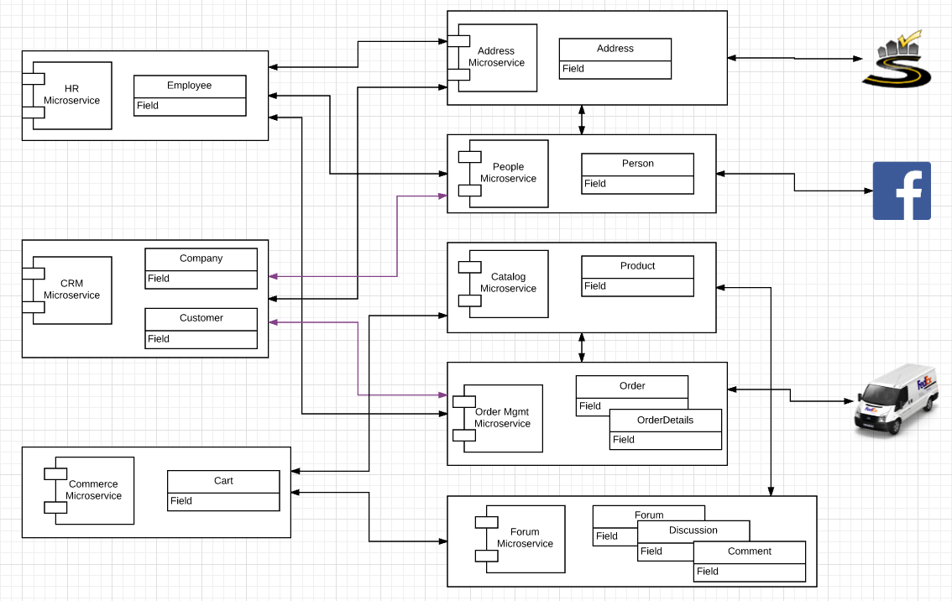
Project 3 4 – Start/Expand Commerce Microservice
Use Lambda function
Customers may
Register with
And subsequently logon with
Facebook or Twitter
Just
Implement register/logon
We will later
Use Step Functions for composing microservices and APIs
Publish commerce actions to FB and Twitter.
Also, write
A placeholder
API Gateway Custom Authorizer
Which we will later use to manager authorization to orders.

Slide 20
Last Week’s Lecture – CAP and New Datamodels
The initial idea was
DynamoDB for the forum
Neo4J to track/query
Who bought what?
Who has bought things similar to whom?
Who commented on what?
etc.
Use Redis to optimize
Idempotency
Etag
But
we do not have enough time to do in context of solution.
Will have to do smaller scenarios and use cases.

Slide 21
My View on Status
Project | Subtask | Element
Project 0 | Set up team Run ELB
Project 1 | Implement 2 microservices | Implement REST API/HATEOAS Query, relationships
 | Swagger | Document, test Integrate with API GW, development tools, …
Project 2 | Cloud APIs | SmartyStreets (UI, backend)
 | Orchestration | In code
 | Single Site Image | S3 for content CloudFront API Gateway
 | Middleware | ETag and idempotency technical microservice SNS event generation
Project 3 | OAuth2 | Logon, Register Custom API GW Authorizer → Authorization
Additional Goals |  | Step functions SNS to integrate registration, commerce views, etc. with Neo4J SNS → Swagger via WebHooks/Lambda Redis: Optimize data sharing for middleware scenarios Rules engines Text search

Slide 22
Timetable
Project 2 and project 3
Complete (initial) reviews by 05-Dec.
Use 27-Nove and 05-Dec lectures if possible, then office hours, then extra OH.
We will hold one final project review with each team
Covering all elements of projects 1, 2 and 3
Including modification/correction based on feedback from prior reviews.
I will provide a list of completion requirements metrics.
Project 4, which has two small subelements
Simple idempotency check microservice → Redis
POST token returns OK if token not previously seen.
POST returns error if token previously recorded.
Simple graph microservice on Neo4J using sample data.
POST a simple query command in JSON.
Returns results from Neo4J.

