Slide 1

Design Conceptual Aircraft
via SUAVE
Student Lecturer: Lin Yi
Date：March 17, 2026
Email：linyi@mail.nwpu.edu.cn
Notes:
Hello every one，I’m Lin Yi. Today we will talk about how to design conceptual aircraft using SUAVE.
Aircraft design and SUAVE are both really complex. I can’t make you a SUAVE expert or an aircraft design expert just with this one class. It’s just not possible. So like I said, today we are just having a discussion. If you have any questions, or if you think I’ve said something wrong during class, just interrupt me any time.

Slide 2
content
Background Introduction
Prepare
Overall Design Process
Design Flowchart
Case Implementation
Main Modules
Vehicle
Mission
Aerodynamic Analysis
Customization & Extension
Notes:
Here is what we’ll do today. We’ll start with a background of SUAVE, then I will help you install the suave, run a test case, and build your first case yourself. After that, I will introduce some main modules of SUAVE so that you can have a deeper insight into this code. If we have extra time, I will show some examples of how to create custom modules.

Slide 3
1、Background Introduction
SUAVE is a conceptual level aircraft design environment built with the ability to analyze and optimize both conventional and unconventional designs. This capability is achieved in part by allowing analysis information for aircraft to be drawn from multiple sources. Many other software tools for aircraft conceptual design rely on fixed empirical correlations and other handbook approximation. SUAVE instead provides a framework that can be used to design aircraft featuring advanced technologies by augmenting relevant correlations with physics-based methods.
Notes:
So let’s start with SUAVE’s background first. SUAVE is a conceptual level aircraft design environment built with the ability to analyze and optimize both conventional and unconventional designs, Blah blah blah. You have probably noticed this is the official intro from its website, so I’m not gonna read it word by word, just focus on this line, “SUAVE provides a framework”. To me, I’d rather call it a code style, a style to make code highly encapsulated and modularized. You can assemble these modules however you want, modify’em, rewrite’em or even create your own with your idea. Alright, sorry I went off track a bit. Anyway it’s a super customizable program. Let’s dive in.

Slide 4
2、Prepare
1、Prepare the Anaconda
2、Create python environment
cmd
conda create –n suave python = 3.60
conda activate suave
Libraries | version
matplotlib | 3.3.4
numpy | 1.16.6
scipy | 1.2.3
scikit-learn | 0.18.2
plotly | 5.18.0
openvsp | 3.29.1
3、Install libraries the suave need
cmd
pip install –r requirement.txt
or
cmd
pip install numpy==1.16.6
...
4、Download suave
suavecode/SUAVE: An Aircraft Design Toolbox
suavecode/Tutorials: This is where the tutorial scripts live
Notes:
So the first thing we should do is to install the python environment for SUAVE. I believe you have downloaded the Anaconda before this class ok? That will make things more easy.

Slide 5
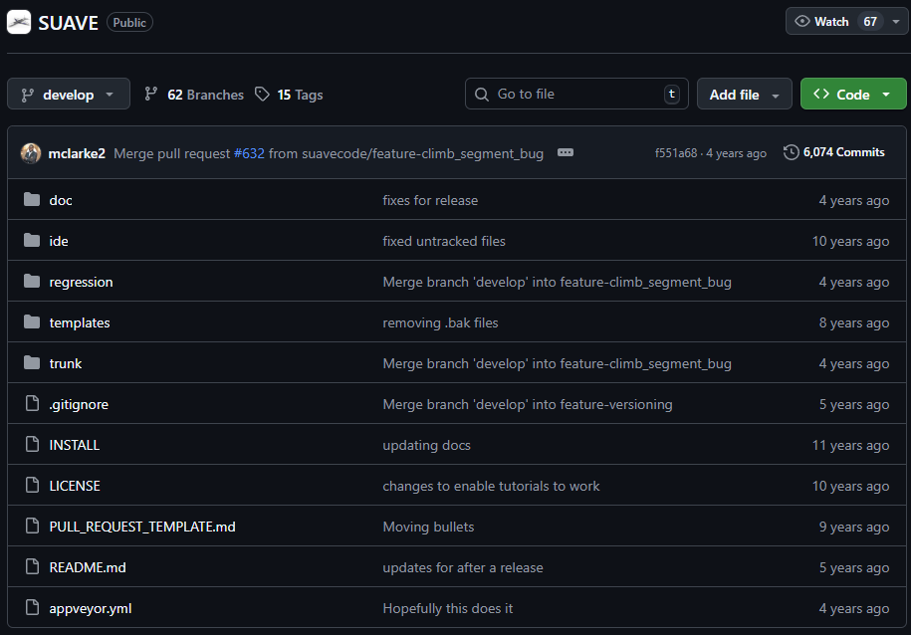
2、Prepare
4、Download suave
suavecode/SUAVE: An Aircraft Design Toolbox
suavecode/Tutorials: This is where the tutorial scripts live
Git bash
git clone https://github.com/suavecode/SUAVE.git
or
Download the zip from release directly
5、Install suave
GitHub repository
cmd
cd D:\SUAVE-2.5.2\trunk ##change the path
python3 setup.py install
Notes:
Once we set up a working environment for SUAVE, we can download the code from the github. Maybe you can not use the git clone, just download the zip file. Then run a command to install it.

Slide 6
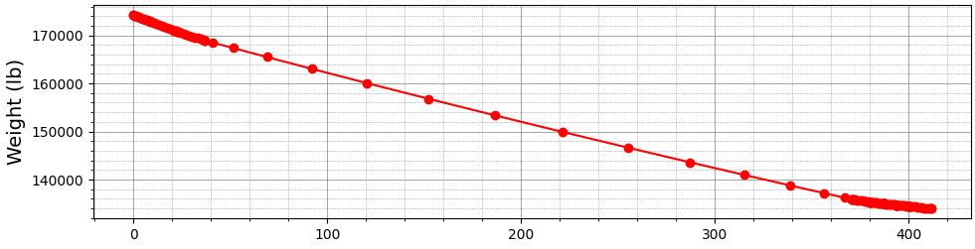
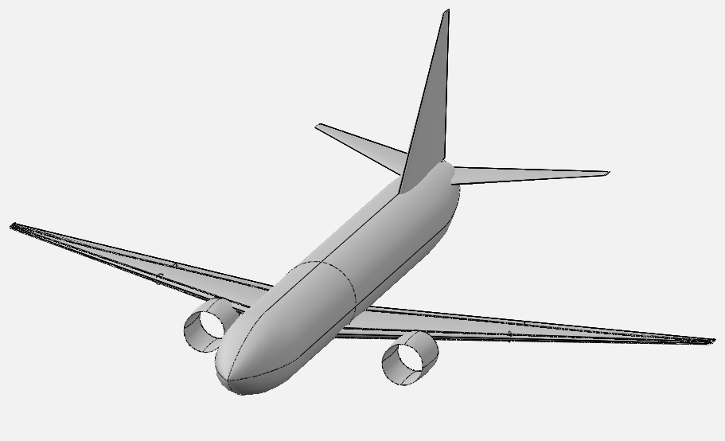
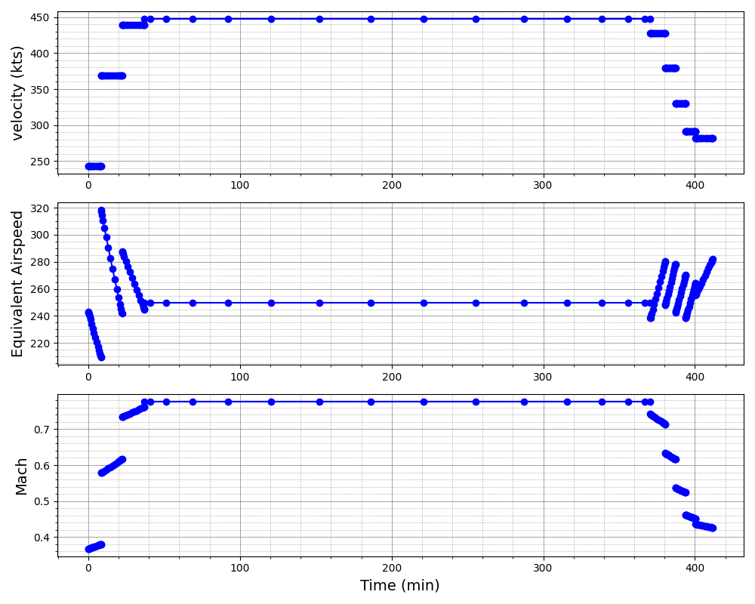
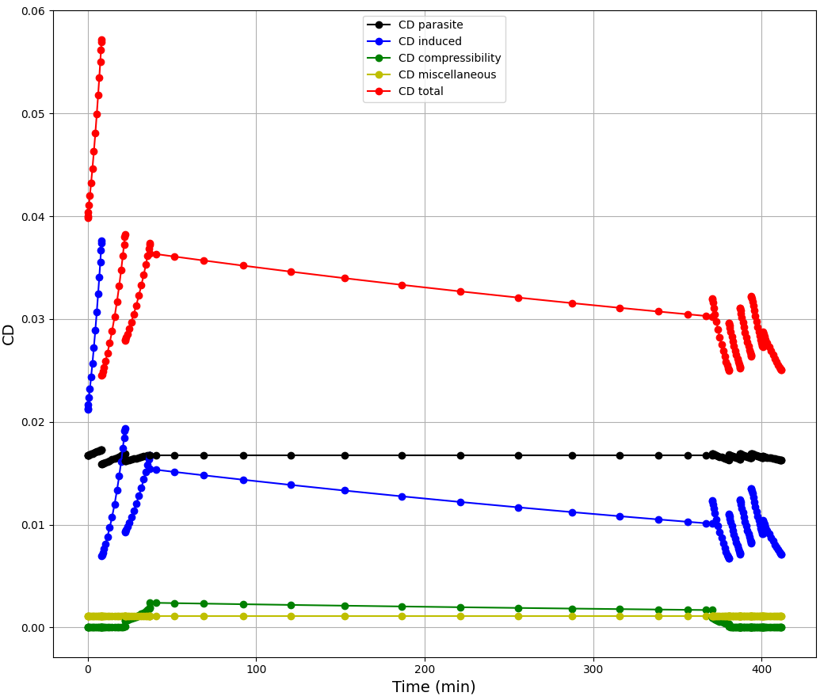
2、Prepare
Test if you setup SUAVE successfully
B737-800 in openvsp
Run the tut_mission_B737.py to see these pictures as shown above
Notes:
Open the Tutorial folder, find the tut_mission_B737.py script, run it
Just wait a minute — I think it’ll take about one minute.
Then you’ll see lots of plots fill your whole screen! Like this
Altitude, weight, lift, drag… all kinds of information will pop up right in front of you.
Don’t worry. We’ll go through these plots together later.
This is just to check / if you’ve installed SUAVE correctly.
If you don’t see those plots, / just let me know.
Alright?
Alright, we’ve got SUAVE installed.
Now it’s time to learn how to use it.

Slide 7
3、Overall Design Process
What do we need to design for an aircraft?
Aerodynamic
Weight
Requirements
Mission
Configuration
Analysis
Thrust
Stability
…
Notes:
Wait, no—before we start coding,
we need to figure out what we actually need to design an aircraft.
First is why we need this aircraft

Slide 8
3、Overall Design Process - Build the main function
Main function: encapsulates aircraft, analysis, mission, and post-processing modules.
def main():
vehicle = vehicle_setup()
configs = configs_setup(vehicle)
configs_analyses = analyses_setup(configs)
analyses = SUAVE.Analyses.Analysis.Container()
analyses.configs = configs_analyses
simple_sizing(configs)
configs.finalize()
analyses.finalize()
mission = analyses.mission
results = mission.evaluate() plot_mission(results)
return
🛠️ Config Setup
Create analysis config
✈️ Simple sizing
Complete basic settings of vehicle
🧮 Mission Calculate
Run the mission and plot the result
Notes:
So we will firstly build the main function. And we can create several component functions to handle specific operation of the aircraft, like aerodynamic, like vehicle,

Slide 9
3、Overall Design Process - Define the Analyses
Base analysis: create analysis component and set aerodynamic solver.
def base_analysis(vehicle):
analyses = SUAVE.Analyses.Vehicle()
weights = SUAVE.Analyses.Weights.Weights_Transport()
weights.vehicle = vehicle
analyses.append(weights)
aerodynamics = SUAVE.Analyses.Aerodynamics.Fidelity_Zero()
aerodynamics.geometry = vehicle
analyses.append(aerodynamics)
energy = SUAVE.Analyses.Energy.Energy()
energy.network = vehicle.networks
analyses.append(energy)
planet = SUAVE.Analyses.Planets.Planet()
analyses.append(planet)
atmosphere = SUAVE.Analyses.Atmospheric.US_Standard_1976()
atmosphere.features.planet = planet.features
analyses.append(atmosphere)
return analyses
🔍Weights module
Calculate weight change by fuel
🔍Aerodynamic solver
This cases uses vortex
🛠️ Basic setting
No need to modify usually
Notes:
Once we have finished the main function, the basic framework for aircraft design, the first module will be developed first is the base_analysis function. To start we need to define the output of this function, we want this function can return a analyses modoule so that we can use it in other steps of aircraft

Slide 10
3、Overall Design Process - Define the Analyses
Analyses_setup and configs_setup:
Set tag for analysis component,
if you have more than one analysis component you can call them by different tags.
def analyses_setup(configs):
analyses = SUAVE.Analyses.Analysis.Container()
for tag,config in configs.items():
analysis = base_analysis(config)
analyses[tag] = analysis
return analyses
def configs_setup(vehicle):
configs = SUAVE.Components.Configs.Config.Container()
base_config = SUAVE.Components.Configs.Config(vehicle)
base_config.tag = 'base'
configs.append(base_config)
return configs
🛠️ Basic setting
Transfer vehicle to analysis component

Slide 11
3、Overall Design Process - Define the mission
Mission_setup:
Define the flight mission, including takeoff, climb, cruise, descent, land
def mission_setup(analyses):
mission = SUAVE.Analyses.Mission.Sequential_Segments()
mission.tag = 'simple_mission'
airport = SUAVE.Attributes.Airports.Airport()
airport.altitude = 0.0 * Units.km
airport.delta_isa = 0.0
airport.atmosphere =
SUAVE.Attributes.Atmospheres.Earth.US_Standard_1976()
mission.airport = airport
🔍Airport setting
Sometime will need to modify, like takeoff from plateau

Slide 12
3、Overall Design Process - Define the mission
Define the takeoff
🛠️Basic segments class
Segments = SUAVE.Analyses.Mission.Segments
base_segment = Segments.Segment()
segment = Segments.Climb.Constant_Speed_Constant_Rate(base_segment)
segment.tag = "climb"
segment.analyses.extend( analyses.base )
segment.altitude_start = 0.0 * Units.km
segment.altitude_end = 10.668 * Units.km
segment.air_speed = 160.0 * Units['m/s']
segment.climb_rate = 6.0 * Units['m/s’]
mission.append_segment(segment)

Slide 13
3、Overall Design Process - Define the mission
Define the cruise
segment = Segments.Cruise.Constant_Speed_Constant_Altitude(base_segment)
segment.tag = "cruise"
segment.analyses.extend( analyses.base )
segment.air_speed = 230.412 * Units['m/s']
segment.distance = 2490. * Units.nautical_miles
mission.append_segment(segment)

Slide 14
3、Overall Design Process - Define the mission
Define the descent
segment = Segments.Descent.Constant_Speed_Constant_Rate(base_segment)
segment.tag = "descent"
segment.analyses.extend( analyses.base )
segment.altitude_end = 0.0 * Units.km
segment.air_speed = 160.0 * Units['m/s']
segment.descent_rate = 6.0 * Units['m/s’]
mission.append_segment(segment)
return mission

Slide 15
3、Overall Design Process - Create the Vehicle
Overall parameter
def vehicle_setup():
vehicle = SUAVE.Vehicle()
vehicle.tag = 'Boeing_737-800'
vehicle.mass_properties.max_takeoff = 79015.8 * Units.kg
vehicle.mass_properties.takeoff = 79015.8 * Units.kg
vehicle.mass_properties.operating_empty = 62746.4 * Units.kg
vehicle.mass_properties.max_zero_fuel = 62732.0 * Units.kg
vehicle.mass_properties.cargo = 10000. * Units.kg
vehicle.envelope.ultimate_load = 3.75
vehicle.envelope.limit_load = 2.5
vehicle.reference_area = 124.862 * Units['meters**2']
vehicle.passengers = 170
vehicle.systems.control = "fully powered"
vehicle.systems.accessories = "medium range"

Slide 16
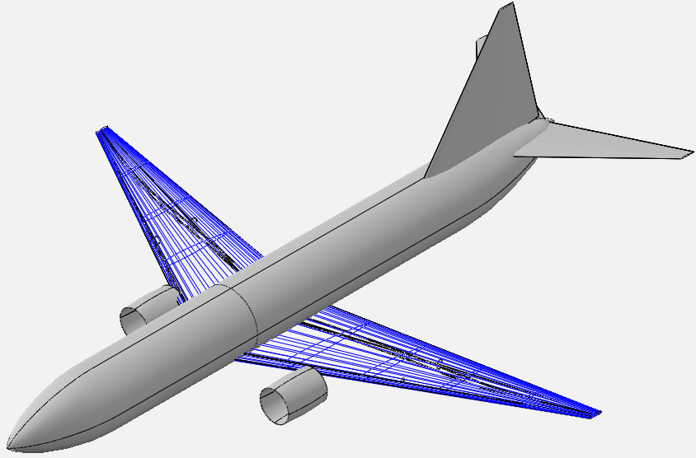
3、Overall Design Process - Create the Vehicle
Main Wing
wing = SUAVE.Components.Wings.Main_Wing()
wing.tag = 'main_wing'
wing.aspect_ratio = 10.18
wing.sweeps.quarter_chord = 25 * Units.deg
wing.thickness_to_chord = 0.1
wing.taper = 0.1
wing.spans.projected = 34.32 * Units.meter
wing.chords.root = 7.760 * Units.meter
wing.chords.tip = 0.782 * Units.meter
wing.chords.mean_aerodynamic = 4.235 * Units.meter
wing.areas.reference = 124.862 * Units['meters**2']
wing.twists.root = 4.0 * Units.degrees
wing.twists.tip = 0.0 * Units.degrees
wing.origin = [[13.61, 0, -1.27]] * Units.meter
wing.vertical = False
wing.symmetric = True
vehicle.append_component(wing)

Slide 17
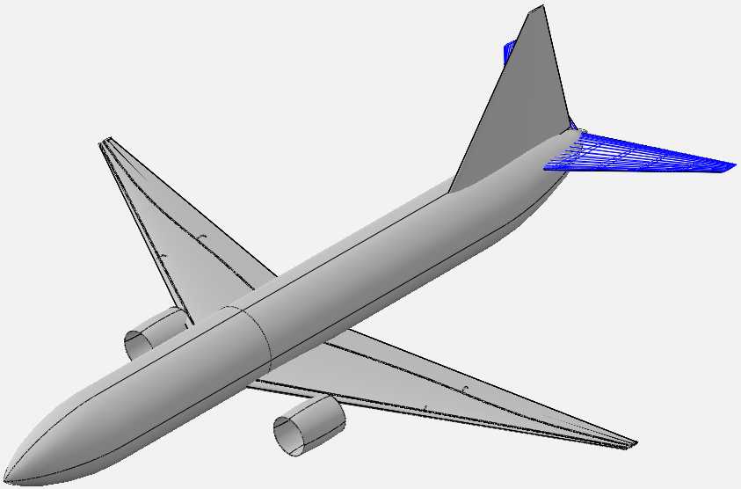
3、Overall Design Process - Create the Vehicle
Horizontal Tail
wing = SUAVE.Components.Wings.Horizontal_Tail()
wing.tag = 'horizontal_stabilizer'
wing.aspect_ratio = 6.16
wing.sweeps.quarter_chord = 40.0 * Units.deg
wing.thickness_to_chord = 0.08
wing.taper = 0.2
wing.spans.projected = 14.2 * Units.meter
wing.chords.root = 4.7 * Units.meter
wing.chords.tip = 0.955 * Units.meter
wing.chords.mean_aerodynamic = 3.0 * Units.meter
wing.areas.reference = 32.488 * Units['meters**2']
wing.twists.root = 3.0 * Units.degrees
wing.twists.tip = 3.0 * Units.degrees
wing.origin = [[32.83 * Units.meter,
0 , 1.14 * Units.meter]]
wing.vertical = False
wing.symmetric = True
vehicle.append_component(wing)

Slide 18
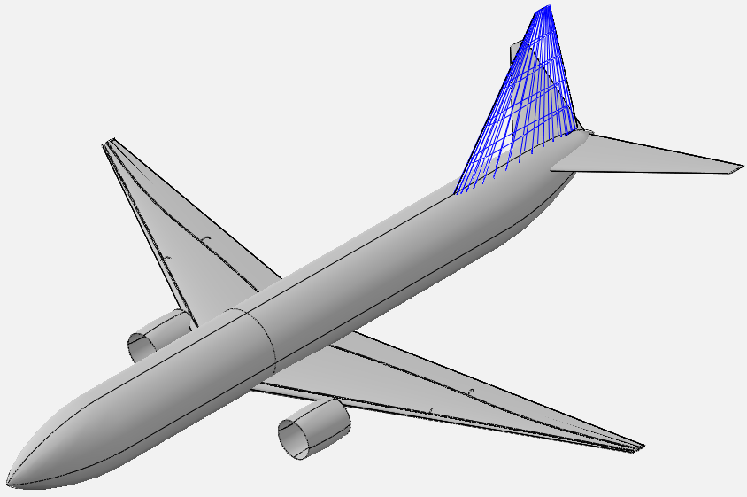
3、Overall Design Process - Create the Vehicle
Vertical Tail
wing = SUAVE.Components.Wings.Vertical_Tail()
wing.tag = 'vertical_stabilizer'
wing.aspect_ratio = 1.91
wing.sweeps.quarter_chord = 25. * Units.deg
wing.thickness_to_chord = 0.08
wing.taper = 0.25
wing.spans.projected = 7.777 * Units.meter
wing.chords.root = 8.19 * Units.meter
wing.chords.tip = 0.95 * Units.meter
wing.chords.mean_aerodynamic = 4.0 * Units.meter
wing.areas.reference = 27.316 * Units['meters**2']
wing.twists.root = 0.0 * Units.degrees
wing.twists.tip = 0.0 * Units.degrees
wing.origin = [[28.79, 0, 1.54]] * Units.meter
wing.vertical = True
wing.symmetric = False
vehicle.append_component(wing)

Slide 19
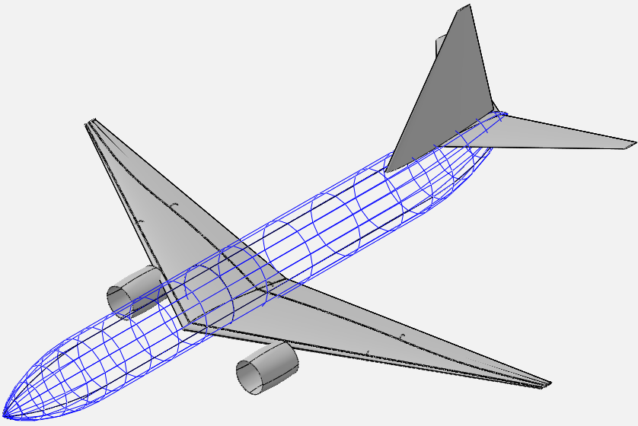
3、Overall Design Process - Create the Vehicle
Fuselage
fuselage = SUAVE.Components.Fuselages.Fuselage()
fuselage.tag = 'fuselage'
fuselage.fineness.nose = 1.6
fuselage.fineness.tail = 2.
fuselage.lengths.nose = 6.4 * Units.meter
fuselage.lengths.tail = 8.0 * Units.meter
fuselage.lengths.total = 38.02 * Units.meter
fuselage.lengths.fore_space = 6. * Units.meter
fuselage.lengths.aft_space = 5. * Units.meter
fuselage.width = 3.74 * Units.meter
fuselage.heights.maximum = 3.74 * Units.meter
fuselage.effective_diameter = 3.74 * Units.meter
fuselage.areas.side_projected = 142.1948 * Units['meters**2']
fuselage.areas.wetted = 446.718 * Units['meters**2']
fuselage.areas.front_projected = 12.57 * Units['meters**2']
fuselage.differential_pressure = 5.0e4 * Units.pascal
vehicle.append_component(fuselage)

Slide 20
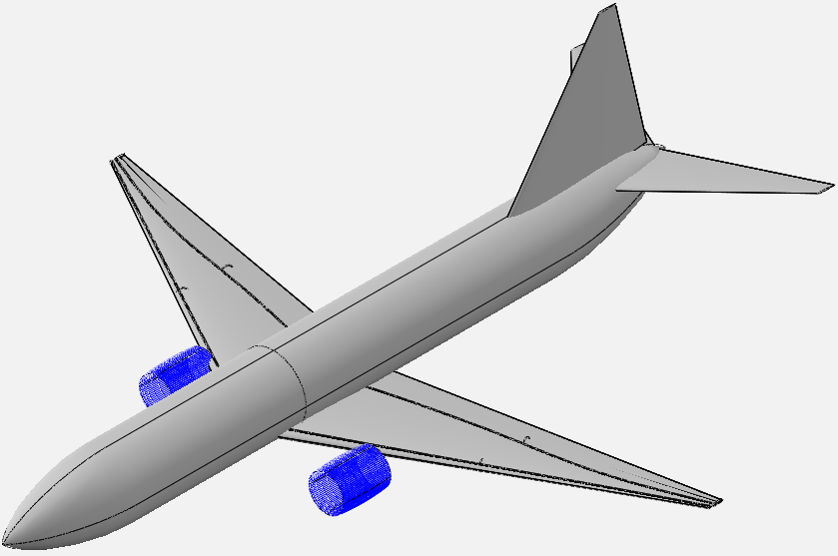
3、Overall Design Process - Create the Vehicle
Nacelle
nacelle = SUAVE.Components.Nacelles.Nacelle()
nacelle.tag = 'nacelle_1'
nacelle.length = 2.71
nacelle.inlet_diameter = 1.90
nacelle.diameter = 2.05
nacelle.areas.wetted = 1.1*np.pi*nacelle.diameter*nacelle.length
nacelle.origin = [[13.72, -4.86,-1.9]]
nacelle.flow_through = True
nacelle_airfoil = SUAVE.Components.Airfoils.Airfoil()
nacelle_airfoil.naca_4_series_airfoil = '2410'
nacelle.append_airfoil(nacelle_airfoil)
nacelle_2 = deepcopy(nacelle)
nacelle_2.tag = 'nacelle_2'
nacelle_2.origin = [[13.72, 4.86,-1.9]]
vehicle.append_component(nacelle)
vehicle.append_component(nacelle_2)

Slide 21
3、Overall Design Process - Create the Vehicle
Turbofan Network
turbofan = SUAVE.Components.Energy.Networks.Turbofan()
turbofan.tag = 'turbofan'
turbofan.number_of_engines = 2
turbofan.bypass_ratio = 5.4
turbofan.origin =
[[13.72, 4.86,-1.9],[13.72, -4.86,-1.9]] * Units.meter
turbofan.working_fluid = SUAVE.Attributes.Gases.Air()
Air ➡️ Ram ➡️ Inlet Nozzle ➡️ Fan ➡️ Low Pressure Compressor ➡️
High Pressure Compressor ➡️ Combustor ➡️ High Pressure Turbine ➡️
Low Pressure Turbine ➡️ Core Nozzle / Fan Nozzle ➡️ Thrust

Slide 22
3、Overall Design Process - Create the Vehicle
Turbofan Network
ram = SUAVE.Components.Energy.Converters.Ram()
ram.tag = 'ram'
turbofan.append(ram)
inlet_nozzle =
SUAVE.Components.Energy.Converters.Compression_Nozzle()
inlet_nozzle.tag = 'inlet_nozzle'
inlet_nozzle.polytropic_efficiency = 0.98
inlet_nozzle.pressure_ratio = 0.98
turbofan.append(inlet_nozzle)
Air ➡️ Ram ➡️ Inlet Nozzle ➡️ Fan ➡️ Low Pressure Compressor ➡️
High Pressure Compressor ➡️ Combustor ➡️ High Pressure Turbine ➡️
Low Pressure Turbine ➡️ Core Nozzle / Fan Nozzle ➡️ Thrust

Slide 23
3、Overall Design Process - Create the Vehicle
Turbofan Network
fan = SUAVE.Components.Energy.Converters.Fan()
fan.tag = 'fan'
fan.polytropic_efficiency = 0.93
fan.pressure_ratio = 1.7
turbofan.append(fan)
compressor =
SUAVE.Components.Energy.Converters.Compressor()
compressor.tag = 'low_pressure_compressor'
compressor.polytropic_efficiency = 0.91
compressor.pressure_ratio = 1.14
turbofan.append(compressor)
Air ➡️ Ram ➡️ Inlet Nozzle ➡️ Fan ➡️ Low Pressure Compressor ➡️
High Pressure Compressor ➡️ Combustor ➡️ High Pressure Turbine ➡️
Low Pressure Turbine ➡️ Core Nozzle / Fan Nozzle ➡️ Thrust

Slide 24
3、Overall Design Process - Create the Vehicle
Turbofan Network
compressor =
SUAVE.Components.Energy.Converters.Compressor()
compressor.tag = 'high_pressure_compressor'
compressor.polytropic_efficiency = 0.91
compressor.pressure_ratio = 13.415
turbofan.append(compressor)
Air ➡️ Ram ➡️ Inlet Nozzle ➡️ Fan ➡️ Low Pressure Compressor ➡️
High Pressure Compressor ➡️ Combustor ➡️ High Pressure Turbine ➡️
Low Pressure Turbine ➡️ Core Nozzle / Fan Nozzle ➡️ Thrust

Slide 25
3、Overall Design Process - Create the Vehicle
Turbofan Network
combustor =
SUAVE.Components.Energy.Converters.Combustor()
combustor.tag = 'combustor'
combustor.efficiency = 0.99
combustor.alphac = 1.0
combustor.turbine_inlet_temperature = 1450 # K
combustor.pressure_ratio = 0.95
combustor.fuel_data =
SUAVE.Attributes.Propellants.Jet_A()
turbofan.append(combustor)
Air ➡️ Ram ➡️ Inlet Nozzle ➡️ Fan ➡️ Low Pressure Compressor ➡️
High Pressure Compressor ➡️ Combustor ➡️ High Pressure Turbine ➡️
Low Pressure Turbine ➡️ Core Nozzle / Fan Nozzle ➡️ Thrust

Slide 26
3、Overall Design Process - Create the Vehicle
Turbofan Network
turbine = SUAVE.Components.Energy.Converters.Turbine()
turbine.tag='high_pressure_turbine'
turbine.mechanical_efficiency = 0.99
turbine.polytropic_efficiency = 0.93
turbofan.append(turbine)
turbine = SUAVE.Components.Energy.Converters.Turbine()
turbine.tag='low_pressure_turbine'
turbine.mechanical_efficiency = 0.99
turbine.polytropic_efficiency = 0.93
turbofan.append(turbine)
Air ➡️ Ram ➡️ Inlet Nozzle ➡️ Fan ➡️ Low Pressure Compressor ➡️
High Pressure Compressor ➡️ Combustor ➡️ High Pressure Turbine ➡️
Low Pressure Turbine ➡️ Core Nozzle / Fan Nozzle ➡️ Thrust

Slide 27
3、Overall Design Process - Create the Vehicle
Turbofan Network
nozzle =
SUAVE.Components.Energy.Converters.Expansion_Nozzle()
nozzle.tag = 'core_nozzle'
nozzle.polytropic_efficiency = 0.95
nozzle.pressure_ratio = 0.99
turbofan.append(nozzle)
===========================================================
nozzle =
SUAVE.Components.Energy.Converters.Expansion_Nozzle()
nozzle.tag = 'fan_nozzle'
nozzle.polytropic_efficiency = 0.95
nozzle.pressure_ratio = 0.99
turbofan.append(nozzle)
Air ➡️ Ram ➡️ Inlet Nozzle ➡️ Fan ➡️ Low Pressure Compressor ➡️
High Pressure Compressor ➡️ Combustor ➡️ High Pressure Turbine ➡️
Low Pressure Turbine ➡️ Core Nozzle / Fan Nozzle ➡️ Thrust

Slide 28
3、Overall Design Process - Create the Vehicle
Turbofan Network
thrust = SUAVE.Components.Energy.Processes.Thrust()
thrust.tag ='compute_thrust'
thrust.total_design = 2*24000. * Units.N
turbofan.thrust = thrust
altitude = 35000.0*Units.ft
mach_number = 0.78
Determine turbofan behavior at the design condition
turbofan_sizing(turbofan,mach_number,altitude)
vehicle.append_component(turbofan)
return vehicle
Air ➡️ Ram ➡️ Inlet Nozzle ➡️ Fan ➡️ Low Pressure Compressor ➡️
High Pressure Compressor ➡️ Combustor ➡️ High Pressure Turbine ➡️
Low Pressure Turbine ➡️ Core Nozzle / Fan Nozzle ➡️ Thrust

Slide 29
3、Overall Design Process - Create the Vehicle
Simple sizing
def simple_sizing(configs):
base = configs.base
base.pull_base()
base.mass_properties.max_zero_fuel =
0.9 * base.mass_properties.max_takeoff
for wing in base.wings:
wing.areas.wetted = 2.0 * wing.areas.reference
wing.areas.exposed = 0.8 * wing.areas.wetted
wing.areas.affected = 0.6 * wing.areas.wetted
base.store_diff()
return
Simple sizing: This function automatically computes unspecified critical parameters for the vehicle using overall design inputs, finalizing the aircraft model for subsequent analysis.

Slide 30
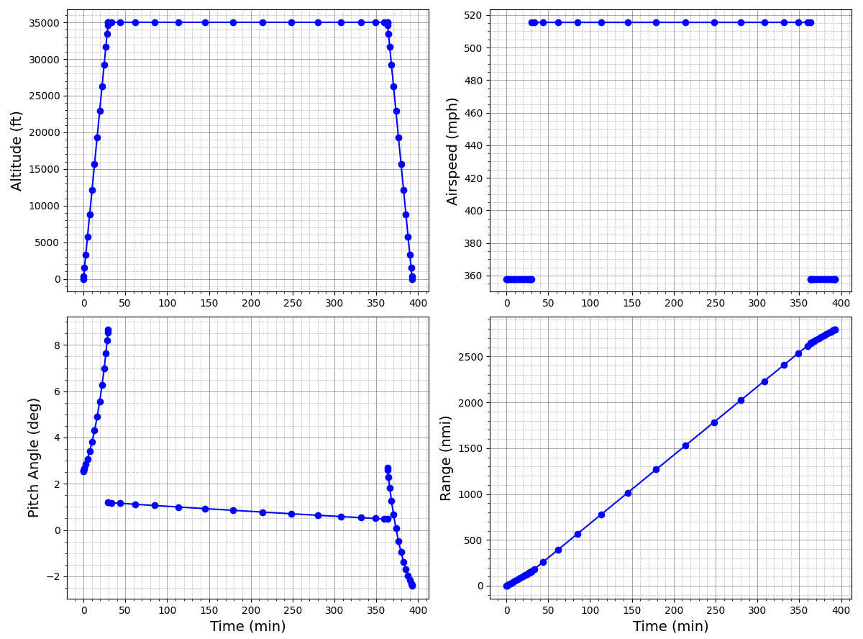
3、Overall Design Process - Plot the result
plot_mission:
Plot mission result by matplotlib
def plot_mission(results,line_style='bo-'):
plot_flight_conditions(results, line_style)
plot_aerodynamic_forces(results, line_style)
plot_aerodynamic_coefficients(results, line_style)
plot_drag_components(results, line_style)
plot_altitude_sfc_weight(results, line_style)
plot_aircraft_velocities(results, line_style)
return

Slide 31
4、Main Modules - Vehicle
1、Download openvsp==3.29.1
cmd
cd D:\OpenVSP-3.29.1-win64\python ##change the path
pip install -r requirements-dev.txt
add
from SUAVE.Input_Output.OpenVSP import write
to the import section
add
write(vehicle, 'base')
after vehicle_setup() in main()
Run your code again, “base.vsp3”will be generated under your code directory

Slide 32
4、Main Modules - Vehicle
How SUAVE create the aircraft geometry
# Create the wing
wing_id = vsp.AddGeom( "WING" )
vsp.SetGeomName(wing_id, wing.tag)
area_tags[wing.tag] = ['wings',wing.tag]
x_secs = []
x_sec_curves = []
for i_segs in range(0,n_segments+2):
x_secs.append('XSec_' + str(i_segs))
x_sec_curves.append('XSecCurve_' + str(i_segs))
vsp.SetParmVal( wing_id,'X_Rel_Location','XForm',wing_x)
vsp.SetParmVal( wing_id,'Y_Rel_Location','XForm',wing_y)
vsp.SetParmVal( wing_id,'Z_Rel_Location','XForm',wing_z)
Partial source code of vsp_write

Slide 33
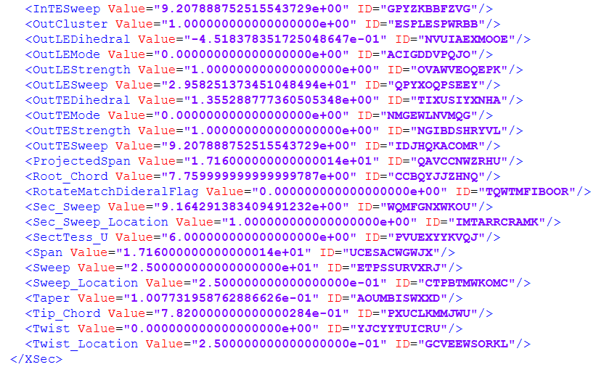
4、Main Modules - Vehicle
How OpenVSP create the aircraft geometry
OpenVSP uses XML format to record geometric parameters of each component with structured tags.
wing.sweeps.quarter_chord=25
wing.thickness_to_chord =0.1
wing.taper =0.1
wing.spans.projected =34.32
wing.chords.root =7.760
wing.chords.tip =0.782
Partial text of vsp file

Slide 34
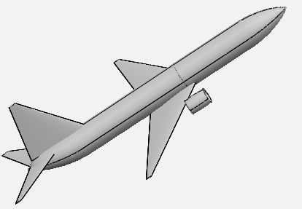
4、Main Modules - Mission
If you want your flight mission to be more realistic, you should adopt a multi-segment climb and descent mode to achieve smoother speed transitions and configure distinct aircraft states for takeoff and landing.
Flight Mission
Takeoff & Climb
Cruise
Descent & landing

Slide 35
4、Main Modules – Aerodynamic Analysis
Fidelity_Zero | Based on VLM method, it is suitable for aerodynamic force calculation of low-speed aircraft.
Supersonic_Zero | Also based on VLM method, but modified with empirical formulas for supersonic conditions.
AERODAS | An airfoil aerodynamic prediction method developed by NASA. Its core function is to calculate the CL and CD of airfoils over the entire angle of attack range through empirical formulas and curve fitting.
SU2_Euler | Generate volume meshes via Gmsh, run CFD simulations in SU2.
Supersonic_OpenVSP_Wave_Drag | Call the wave_drag method in openvsp
Lifting_Line | Lift line theory

Slide 36
5、Customization & Extension
How to optimize your aircraft via SUAVE

Slide 37
Thank You！
Student Lecturer: Lin Yi
Date：March 17, 2026
Email：linyi@mail.nwpu.edu.cn

