Slide 1

Introduction to Programming
Introduction
Giorgi Akhalaia

Slide 2

Overview
Course Overview
Why do we need programming?
Why do we have so many programming languages?
How do computers store data?
Number Systems

Slide 3
Why do we need Programming?

Slide 4
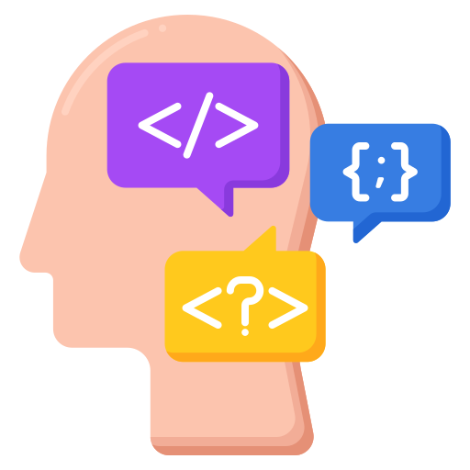
Introduction
We need specific languages to communicate with computers.
Programming languages serve as the medium through which humans communicate instructions to computers.
A programming language is a set of instructions written in a specific syntax to perform defined tasks.
These languages are used to develop applications such as desktop software, operating systems, websites, and mobile applications.
Notes:
Just as humans need a common language to communicate with each other, we also need specific languages to communicate with computers. For example, if two people speak different languages, such as Hindi and Telugu, they can use a common language like English to understand each other. In the same way, programming languages serve as the medium through which humans communicate instructions to computers.
A programming language is a set of instructions written in a specific syntax to perform defined tasks. These languages are used to develop applications such as desktop software, operating systems, websites, and mobile applications.

Slide 5
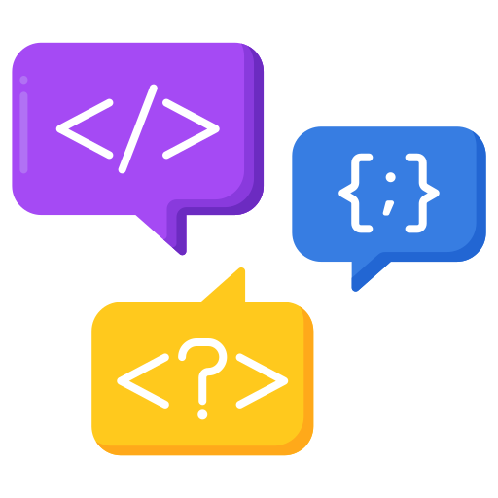
Types of Programming Languages
Programming languages are broadly classified into three categories:
Low-level languages
Low-level languages are machine-dependent and closely related to hardware. They work directly with binary numbers (0s and 1s), making them fast and efficient for execution by processors. Programs written in low-level languages can run without the need for compilers or interpreters.
High-level languages
High-level programming languages (HLL) are designed to be user-friendly and closer to human languages. They require a compiler or interpreter to translate instructions into machine language so that the computer can execute them. Examples include Python, Java, JavaScript, PHP, C#, and C++.
Middle-level languages
Middle-level programming languages lie between low-level and high-level languages. They combine the efficiency of low-level programming with the user-friendliness of high-level programming. These languages allow programmers to write code that interacts with hardware as well as perform complex software development tasks.
Notes:
Types of Programming Languages
Programming languages are broadly classified into three categories:
1. Low-level languages 2. High-level languages 3. Middle-level languages
Low-level Languages
Low-level languages are machine-dependent and closely related to hardware. They work directly with binary numbers (0s and 1s), making them fast and efficient for execution by processors. Programs written in low-level languages can run without the need for compilers or interpreters.
Low-level languages are divided into two categories:
1) Machine Language - Also known as machine code or object code. - Written in binary (or sometimes hexadecimal), which is directly understood by computers. - Very difficult for humans to read and write. - Does not require a translator, since computers can execute it directly.
2) Assembly Language - Designed for specific processors. - Represents instructions in symbolic and more human-readable form. - Requires an assembler to translate assembly code into machine code.
High-level Programming Languages
High-level programming languages (HLL) are designed to be user-friendly and closer to human languages. They require a compiler or interpreter to translate instructions into machine language so that the computer can execute them. Examples include Python, Java, JavaScript, PHP, C#, and C++.
High-level languages can be categorized into three types:
1) Procedural-Oriented Programming Languages (POP) - Derived from structured programming and based on procedure calls. - Programs are divided into small modules called routines or functions. - Examples: C, FORTRAN, BASIC, Pascal.
2) Object-Oriented Programming Languages (OOP) - Based on the concept of objects. - Programs are divided into objects that represent real-world entities. - Supports features like inheritance, polymorphism, and abstraction. - Examples: C++, Java, Python, C#.
3) Natural Language Processing (NLP)-based Languages - These are not traditional programming languages but allow computers to process and understand human languages like English or German. - Used in artificial intelligence and machine learning applications.
Middle-level Programming Languages
Middle-level programming languages lie between low-level and high-level languages. They combine the efficiency of low-level programming with the user-friendliness of high-level programming. These languages allow programmers to write code that interacts with hardware as well as perform complex software development tasks.
Examples: C, C++.

Slide 6
Programming languages are essential tools for communicating with computers.
They enable us to create applications, automate tasks, and solve real-world problems.

Slide 7
Why do we have so
many programming languages?

Slide 8
Every programming language possesses a unique set of attributes, strengths, and limitations.
This makes it crucial to carefully choose the one that aligns best with your project’s specific requirements.
By understanding the different types of programming languages, we can choose the appropriate one based on the task and level of abstraction required.

Slide 9
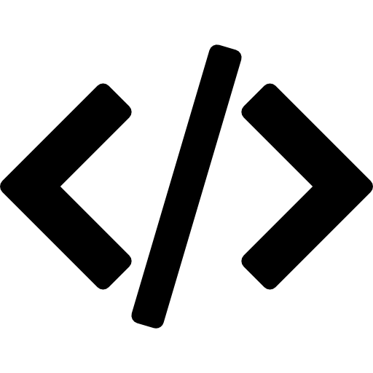
Top Programming Languages and Their Uses
Python
Python is a general-purpose programming language that is known for its simplicity and readability. Strengths: Simple, readable, widely used in data science, AI/ML, web development (backend), and scripting. It is one of the most popular programming languages in the world and is used for a wide variety of projects, including:
- Instagram backend uses Python (Django).
- Spotify uses Python for data analysis and backend services.
JavaScript
JavaScript is used to add interactivity and dynamism to web pages. It is also used to develop server-side applications with Node.js. Some popular JavaScript frameworks include React, Angular, and Vue.js.
- YouTube and Facebook use JavaScript extensively in the user interface.
- Netflix uses Node.js for parts of its backend.
Java
Java is a general-purpose programming language that is known for its reliability and portability. It is widely used in enterprise applications, web development, and mobile development.
- Android app development (Java and Kotlin).
- Large-scale enterprise applications.

Slide 10
Top Programming Languages and Their Uses
C/C++
They are known for their speed and high performance. They are widely used in systems programming, embedded systems, and game development.
- Linux kernel in C.
- Windows OS core in C/C++.
- Game engines (Unreal, etc.) rely on C++.
PHP
A server-side scripting language that is widely used for web development. Popular in legacy and modern web apps (WordPress, parts of Facebook).
GO
Used by Google and Dropbox for scalable backends; strong concurrency support.
Swift
Main language for iOS/macOS apps (e.g., Shazam).

Slide 11
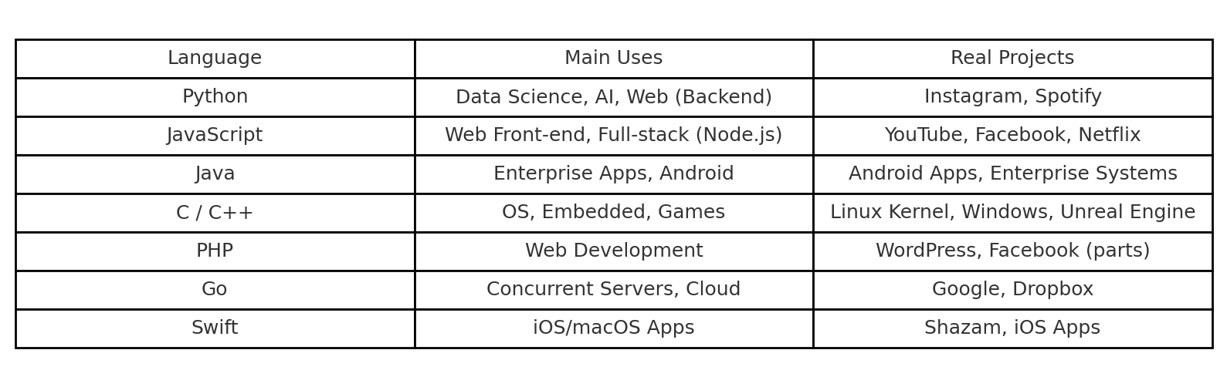

Slide 12
What is data?

Slide 13
Data is a collection of raw facts, numbers, text, observations, or symbols that can be processed and analyzed to extract meaning and gain insights.
It is the fundamental material that can be quantified, qualified, and interpreted, and it serves as the foundation for decision-making, innovation, and understanding in various fields, from computing to business.

Slide 14
How do computers
store data?

Slide 15
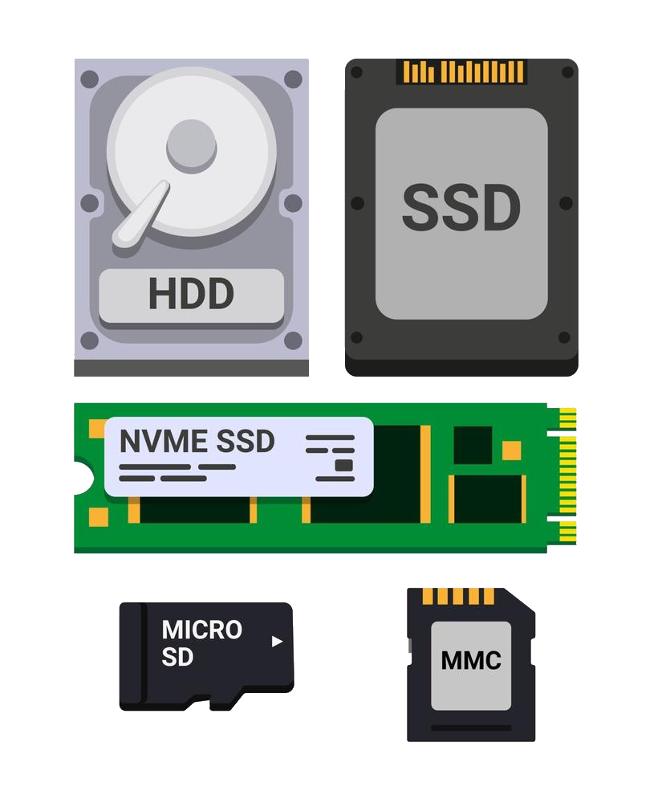
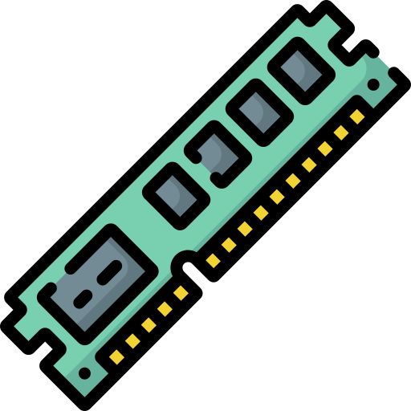
How do computers store data?
In the world of computing, the ability to process and manage data efficiently is at the core of every operation.
Whether it’s handling variables, numbers, strings, or arrays, a computer relies on a vital component known as Random Access Memory (RAM) to store and manipulate this data, enabling programs to run seamlessly.
Apart from RAM, there’s another critical aspect of data storage: persistent storage. This type of storage is used to house files like music, documents, and more. It comes in various forms, such as disk drives, SD cards, flash drives, and solid-state drives.
Unlike RAM, data stored in persistent storage remains intact even when the device is powered off. However, there’s a trade-off, as persistent storage tends to be slower in data retrieval.

Slide 16
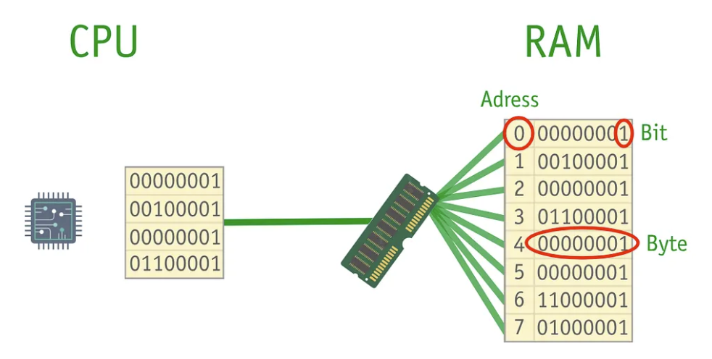
How do computers store data?
At the heart of this data management process is the central processing unit (CPU), often likened to a diligent worker that carries out all the necessary calculations. The CPU plays a pivotal role in accessing both RAM and storage. Notably, it accesses RAM at a much faster rate than persistent storage.
Think of RAM as a large storage area made up of tiny shelves. Each shelf has a unique number called an address and can hold 1 byte (8 bits). A bit is the smallest unit, like a tiny switch that can be on (1) or off (0).
The CPU connects to a memory controller that reads and writes data in RAM. This gives the CPU random access, meaning it can reach any memory location almost instantly. Although it can jump to any address, most programs usually access nearby locations, making data retrieval faster.

Slide 17
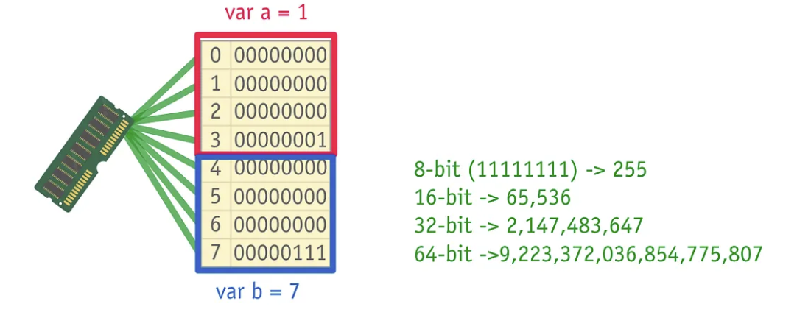
How do computers store data?
Computers use CPU cache, a small, fast memory that stores recently used data, to speed up access. A common method is Least Recently Used (LRU) caching, which keeps frequently accessed data close to the CPU.
Data structures are essential tools for efficiently storing information. For instance, when you store a variable like ‘var a = 1’ on a modern computer, it’s typically represented as a 32-bit integer (though some systems now use 64 bits). This means that the number ‘1’ occupies 32 bits of RAM and can be located at a specific address, such as 0123. Similarly, another variable ‘var b = 7’ would be stored in the next block of RAM.
Different computer systems have varying bit sizes, such as 8-bit, 16-bit, 32-bit, or 64-bit. These sizes determine the amount of information a system can hold. For example, an 8-bit system can represent 255 different values, while larger bit sizes provide greater data storage capacity.

Slide 18
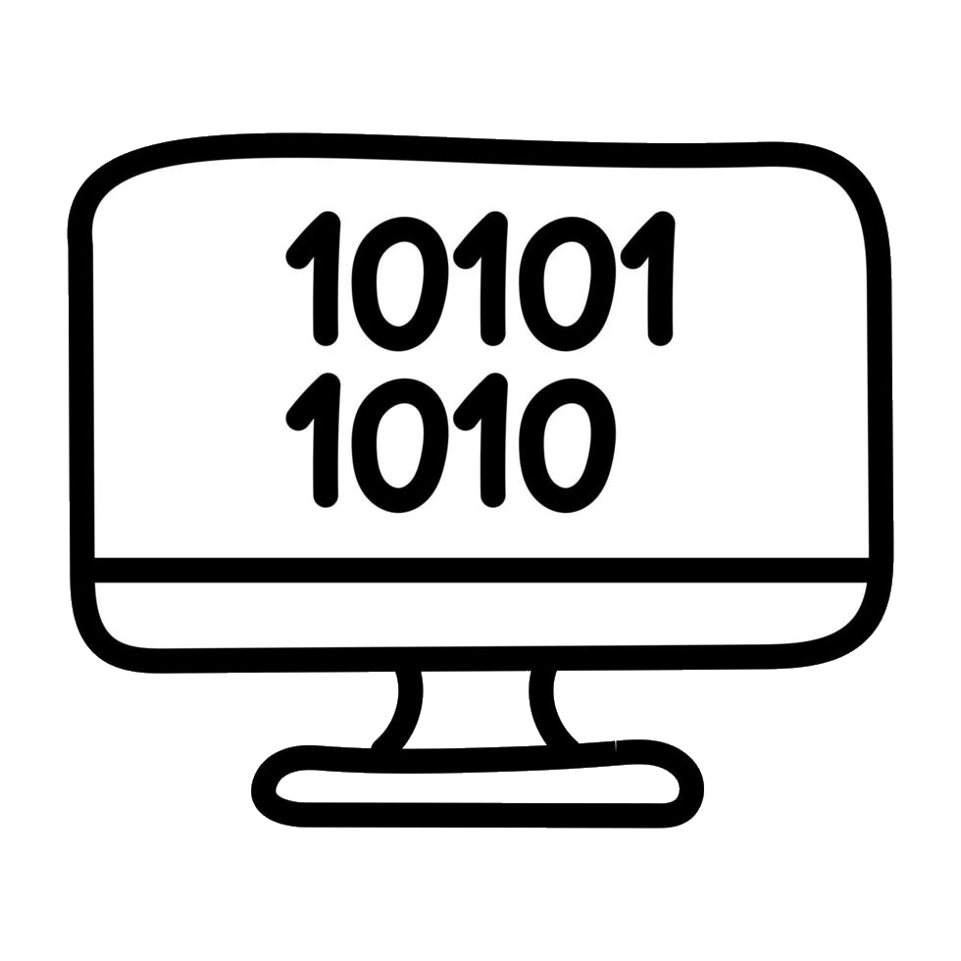
Introduction to Number Systems
Computers store and process everything in numbers. A number system defines how numbers are represented using a set of symbols (digits) and a base (radix). Below are the common number systems:
1. Decimal Number System (Base-10)
• Digits: 0–9 (10 symbols) • Each position represents a power of 10 • Example: 345 = (3 × 10²) + (4 × 10¹) + (5 × 10⁰)
2. Binary Number System (Base-2)
• Digits: 0, 1 (2 symbols) • Each position represents a power of 2 • Example: 1011 = (1 × 2³) + (0 × 2²) + (1 × 2¹) + (1 × 2⁰) = 11 (decimal)

Slide 19
Introduction to Number Systems
Computers store and process everything in numbers. A number system defines how numbers are represented using a set of symbols (digits) and a base (radix). Below are the common number systems:
3. Octal Number System (Base-8)
• Digits: 0–7 (8 symbols) • Each position represents a power of 8 • Example: 127₈ = (1 × 8²) + (2 × 8¹) + (7 × 8⁰) = 87 (decimal)
4. Hexadecimal Number System (Base-16)
• Digits: 0–9, A–F (16 symbols) • A=10, B=11, …, F=15 • Example: 2F₁₆ = (2 × 16¹) + (15 × 16⁰) = 47 (decimal)

Slide 20
Conversion Table
• Binary → The computer’s natural language
• Octal & Hexadecimal → Compact shorthand for binary, easier for humans
• Decimal → Everyday human use
Decimal | Binary | Octal | Hexadecimal
0 | 0 | 0 | 0
1 | 1 | 1 | 1
5 | 101 | 5 | 5
10 | 1010 | 12 | A
15 | 1111 | 17 | F
31 | 11111 | 37 | 1F
255 | 11111111 | 377 | FF

Slide 21
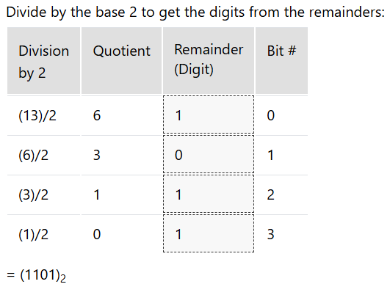
Decimal → Binary
Formula / Method
Divide the decimal number by 2.
Write down the remainder (0 or 1).
Divide the quotient again by 2 and record the remainder.
Continue until the quotient becomes 0.
Read the remainders from bottom to top → that’s the binary number.
Notes:
https://www.rapidtables.com/convert/number/decimal-to-binary.html?x=13

Slide 22
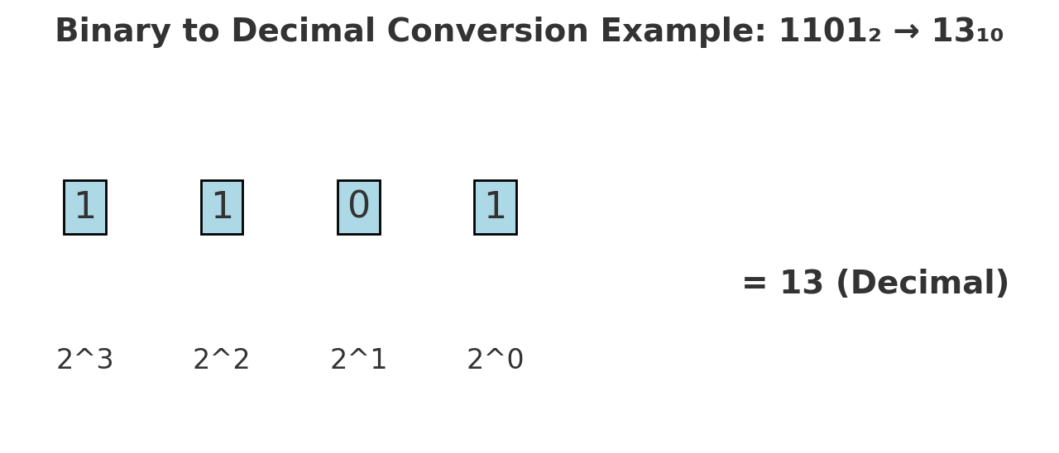
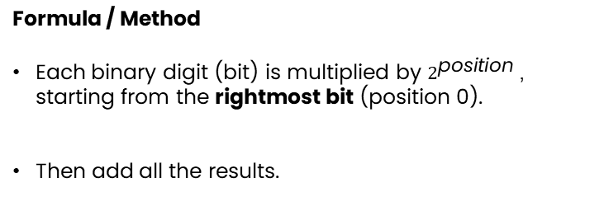
Binary → Decimal
Formula / Method
Each binary digit (bit) is multiplied by $2^{\text{position}}$, starting from the rightmost bit (position 0).
Then add all the results.
(1101)₂ = (1 × 2³) + (1 × 2²) + (0 × 2¹) + (1 × 2⁰) = (13)₁₀
Notes:
https://www.rapidtables.com/convert/number/binary-to-decimal.html?x=1101

Slide 23
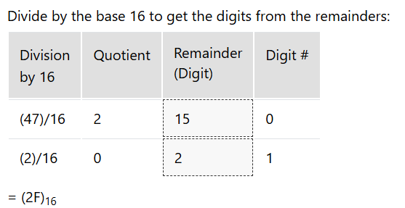
Decimal → Hexadecimal
Formula / Method
Divide the decimal number by 16.
Write down the remainder, where:
0–9 = 0–9
A=10, B=11, C=12, D=13, E=14, F=15
Divide the quotient again by 16 and record the remainder.
Continue until the quotient becomes 0.
Read the remainders from bottom to top → that’s the hex number.
Notes:
Divide by 16, record remainders.
Digits above 9 → A–F.
Read remainders in reverse order.
https://www.rapidtables.com/convert/number/decimal-to-hex.html?x=47

Slide 24
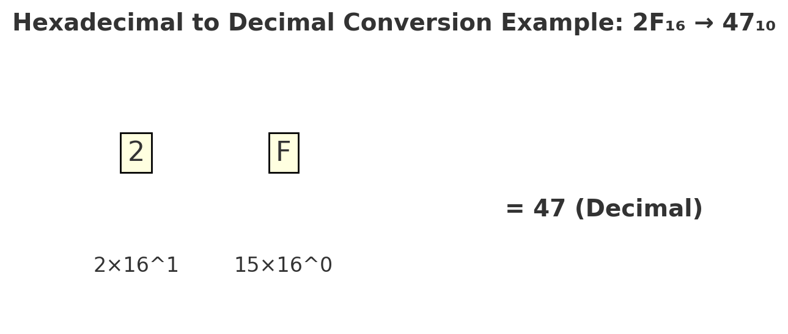
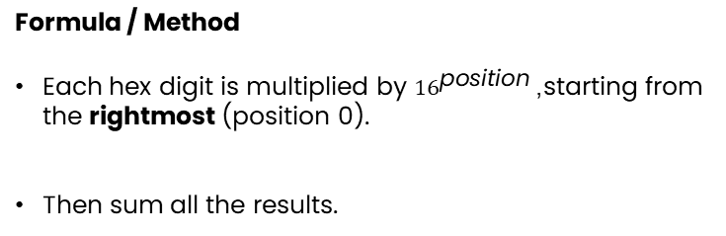
Hexadecimal → Decimal
Formula / Method
Each hex digit is multiplied by ${16}^{\text{position}}$, starting from the rightmost (position 0).
Then sum all the results.
(2F)₁₆ = (2 × 16¹) + (15 × 16⁰) = (47)₁₀
Notes:
https://www.rapidtables.com/convert/number/hex-to-decimal.html?x=2F

Slide 25
What is ASCII?

Slide 26
Thank you for Attention !
Contact
Email: giorgi.akhalaia@iliauni.edu.ge
Mobile: 598 590158

