Slide 1
2024.10.17 Manual
(work from source code)
Han Qiuhan

Slide 2
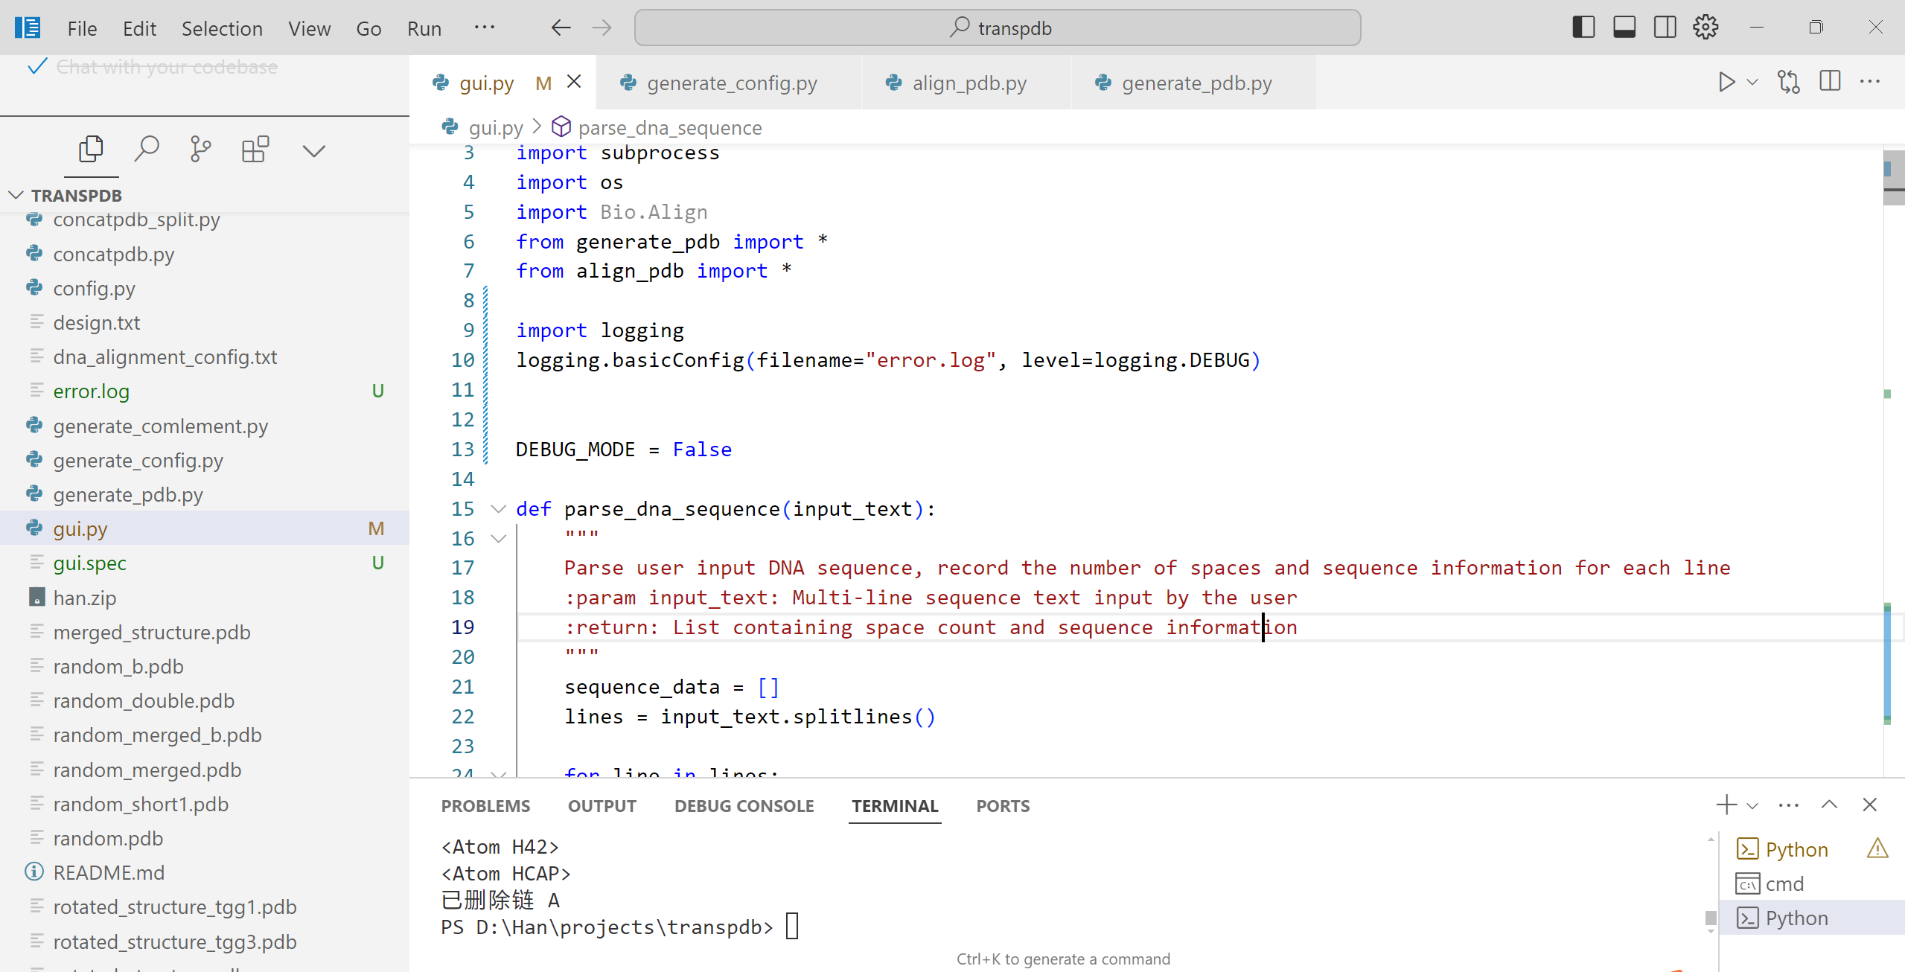
1. unzip the .zip file, open this project use Vscode
2. open the gui.py file
3. click run button
3
2

Slide 3
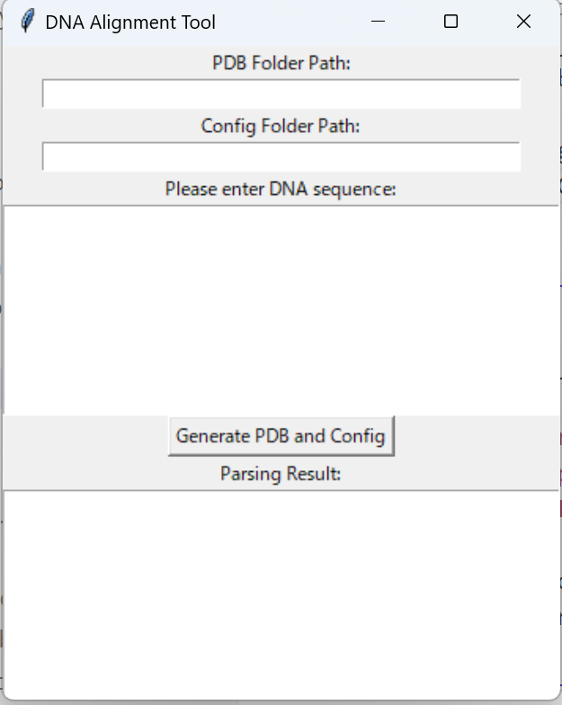
4. input the pdb folder path, where the generated pdb file will be saved
(e.g. D:\Han\projects\transpdb\han\generated_pdb)
5. input the config folder path, where the generated config file will be saved
(e.g. D:\2024.02.22_VRSim-Gutmann\SimulationFolder\PDB_Files\Configuration_Files)
4
5

Slide 4
6. Input the DNA sequences
e.g.
gcta
atcgatcgatcgatcgatcgatcgatcgatcg
tagc
(currently, only the align positions within the longest DNA strand are considered. Make sure shorter DNA strands are behind the longest one)
（現在、最も長いDNA鎖内でのアライメント位置のみが考慮されています。短いDNA鎖が最も長いDNA鎖の後ろに配置されていることを確認してください。）
6

Slide 5
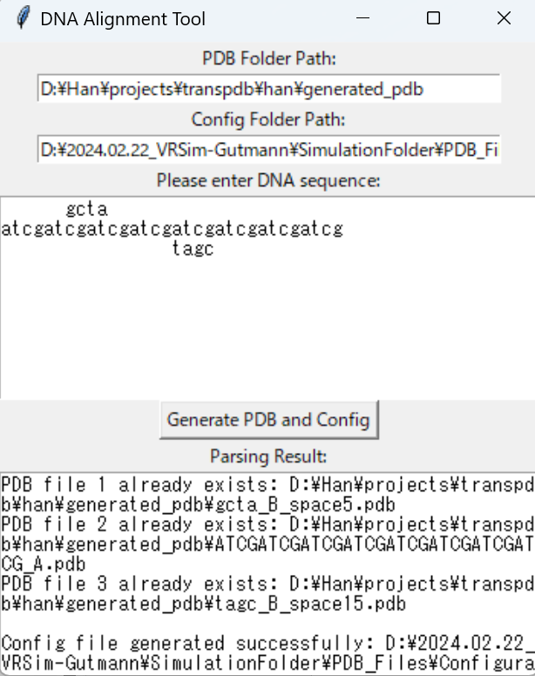
7. click the button
If running successufully, result will show
PDB file n generated successfully or
PDB file n already exists
and
Config file generated successfully
If failed, please report the errors both on this interface and on the console of VS code
8. Open the config file in VR system
7

