Slide 1


South Korea’s Climate Changes during 1970-2020
Seoul National Univ. Mechanical Engineering
Taejin Kim

Slide 2
Compare climate 1970 vs 2020

Slide 3
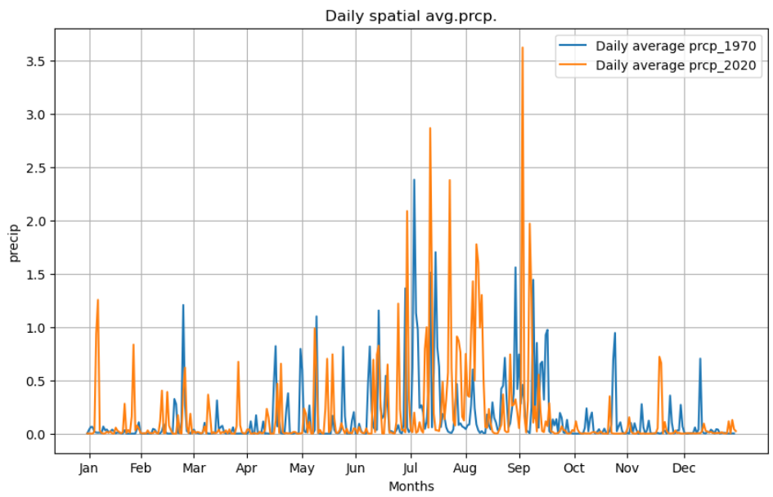
1. precipitation
Increase in Summer
Decrease in Winter
Avg precipitation
2020 > 1970

Slide 4
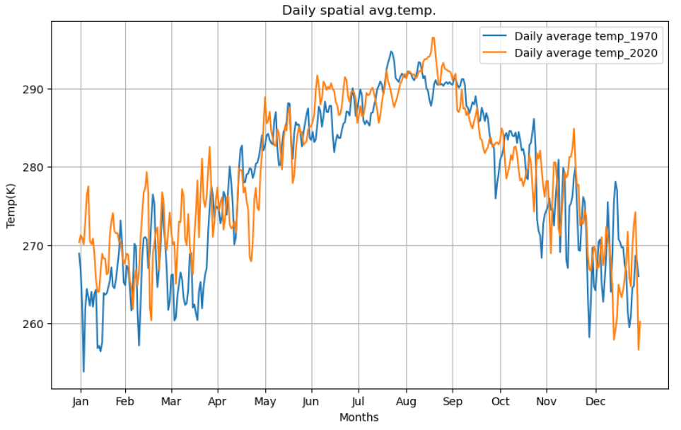
2.Temperature
Increase in Summer
Decrease in Winter
Maximum in Aug to Sep

Slide 5
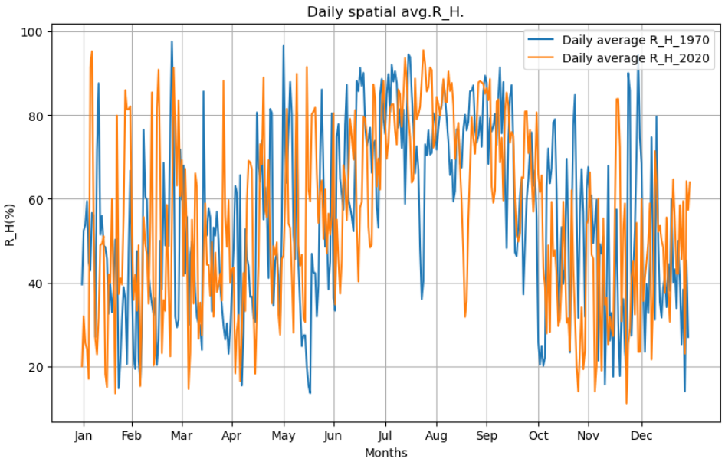
3.R_H
Slightly increase in Summer
A bit of decrease in Winter
Vibrate near total average

Slide 6
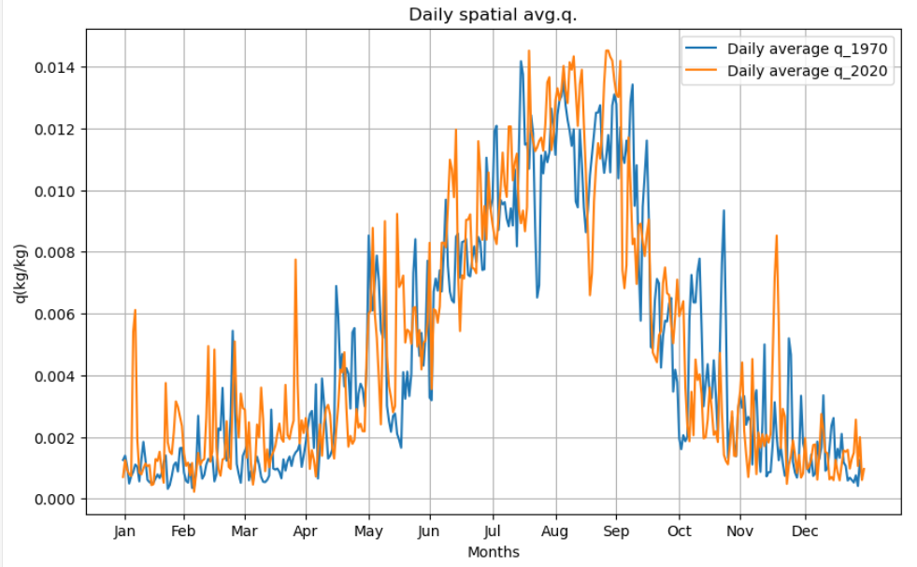
4. q
Increase in Summer
Decrease in Winter
Maximum in Aug to Sep
(Similar with temp)

Slide 7
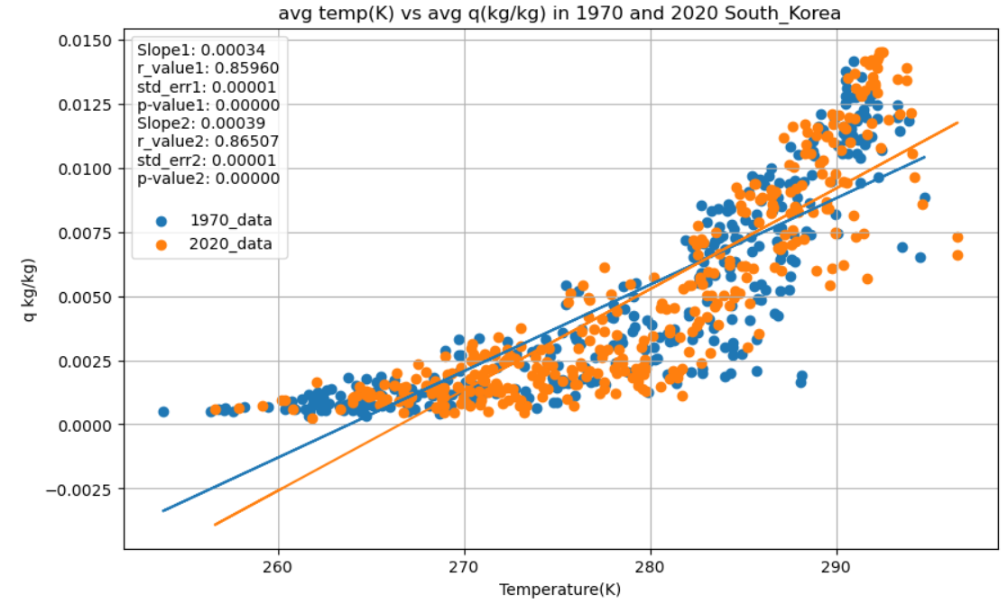
Some correlation between temp & q
Maybe
Linear or exponential

Slide 8
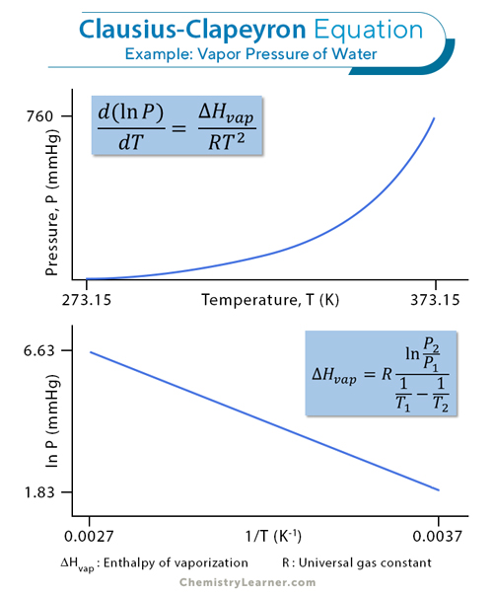
Some correlation between temp & q

Slide 9
Time series 1970 to 2020

Slide 10
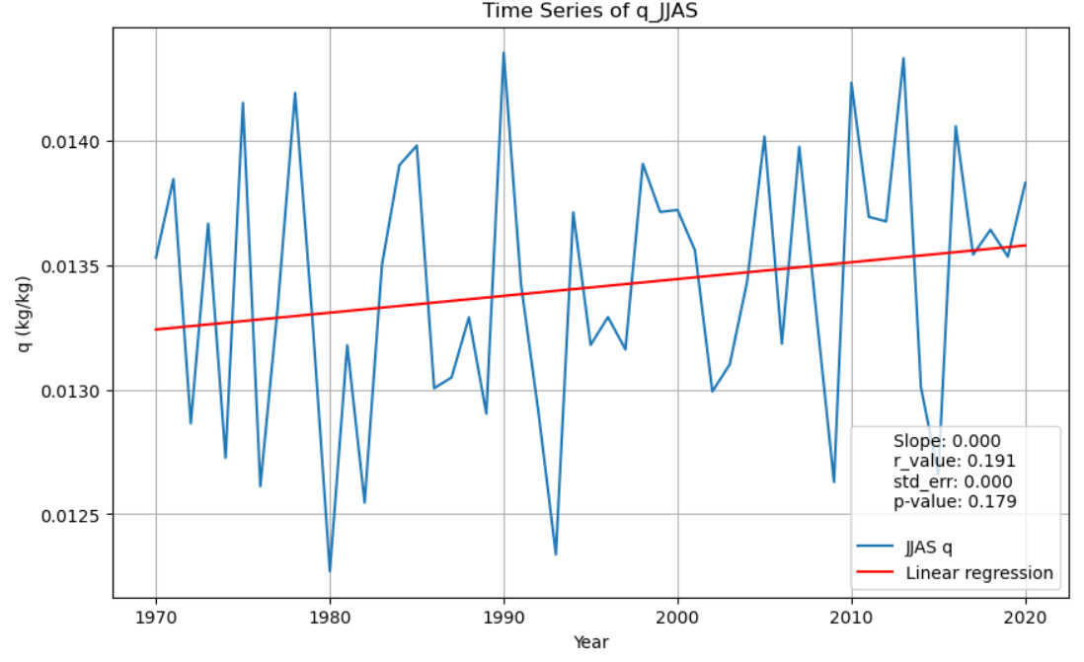
1. Time series for q
Slightly decrease in Specific Humidity

Slide 11
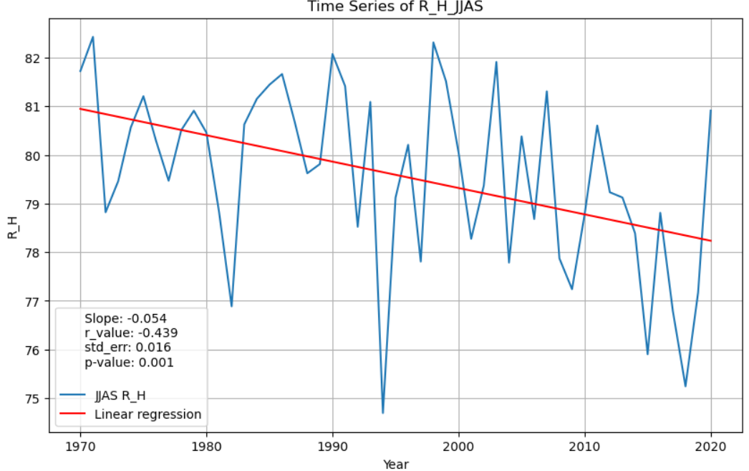
2. Time series for R_H
Slightly decrease in Relative Humidity

Slide 12
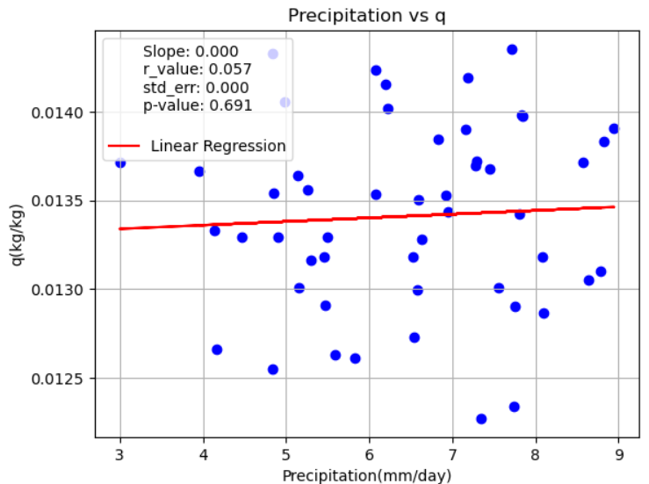
3. Precipitation vs q (scatter)
Little Correlation in q and Precipitation

Slide 13
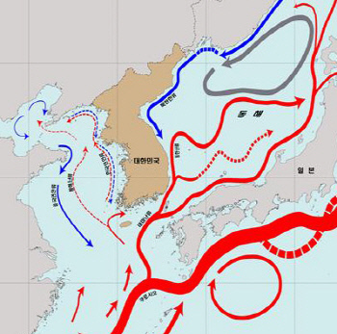
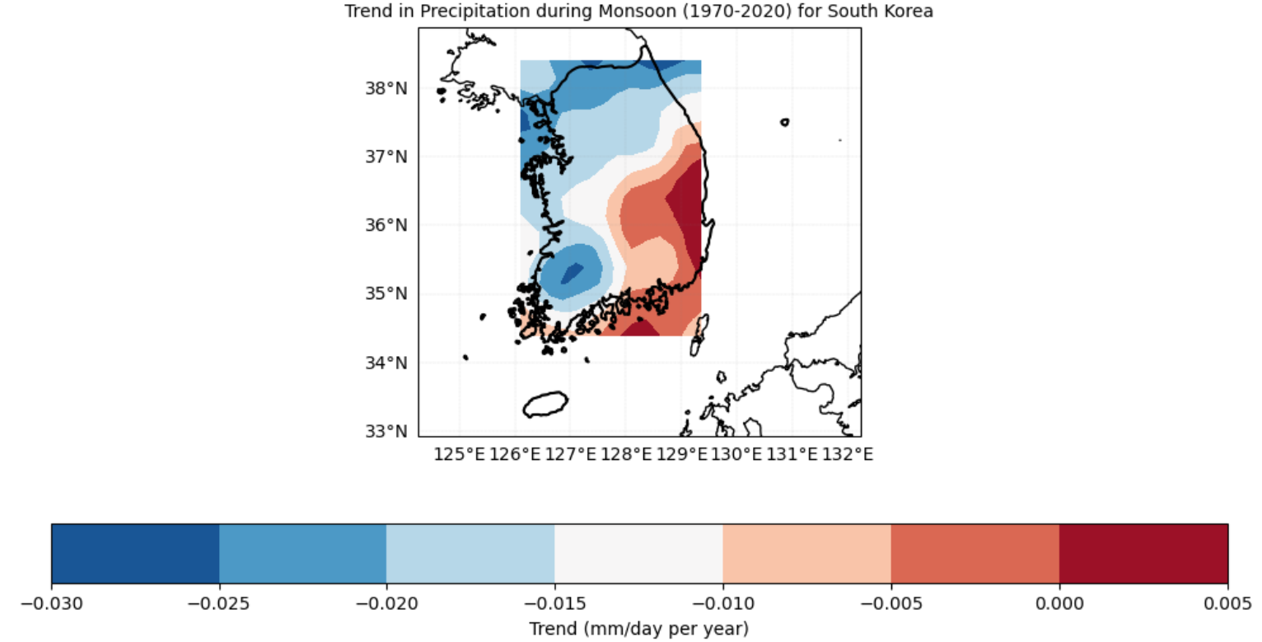
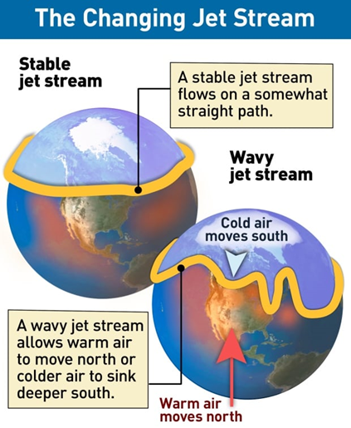
4. Spatial data in precipitation
Ocean current
Wind current

Slide 14
10 years moving avg 1970 to 2020

Slide 15
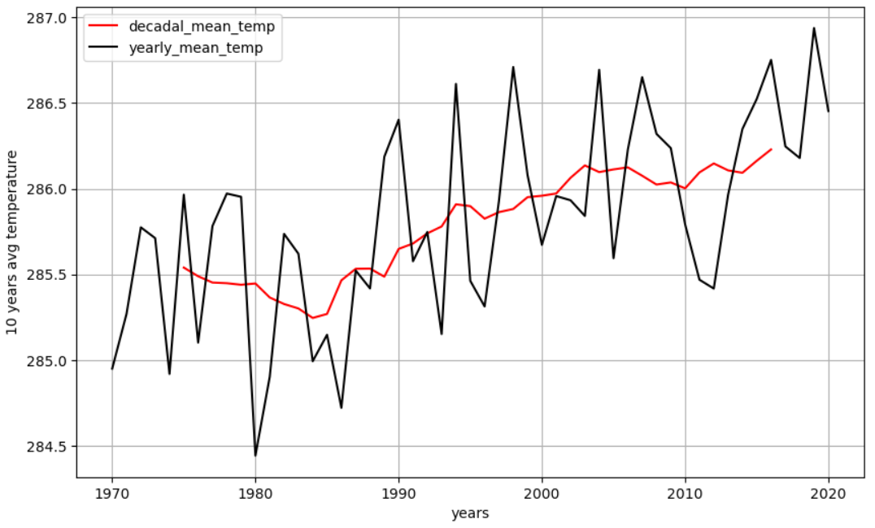
1. Temperature moving avg
Temperature Higher

Slide 16
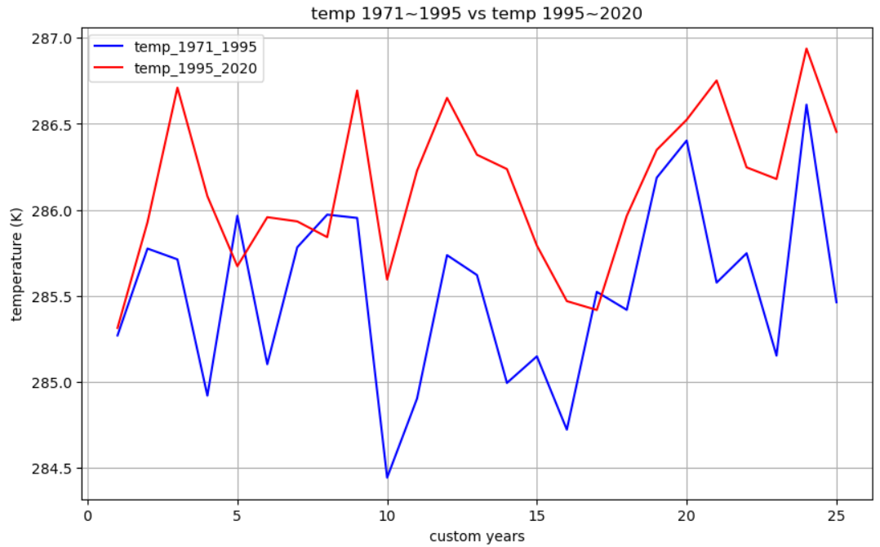
2. Compare 1971-1995 & 1995-2020
Temperature Higher

