Slide 1
Client Side Technology CST
{04}
CST
</
} /> [
/>
Day04

Slide 2
{ Day Objectives
Dealing with Fonts
Colors and Backgrounds
Styling Lists
Display and Visibility
Transform
Flex Box

Slide 3
{ Fonts
font-family: typeface used (e.g., Arial, Times)
font-size: size of text
font-style: normal, italic
font-weight: normal, bold
line-height: spacing between lines
<p style="font-family: Arial; font-size: 16px;">Arial Text</p> <p style="font-weight: bold; font-style: italic;">Bold Italic</p> <p style="line-height: 1.5;">Line Height Example</p>

Slide 4
{ Colors and Backgrounds
color: sets the text color
background-color: sets the background color of an element
background-image: adds an image background
background-repeat: repeat behavior (repeat, no-repeat)
background-position: position of background image
<p style="color: red; background-color: yellow;"> Red text on yellow background </p> <div style="background-image: url('bg.jpg'); background-repeat: no-repeat; background-position: center;"> Background Image Example </div>

Slide 5
{ Styling Lists
Customize list bullets:
list-style-type: disc, circle, square, none
list-style-image: use custom bullet image
list-style-position: inside | outside
Can be applied to <ul>, <ol>
<ul style="list-style-type: square;"> <li>Square Bullet</li> </ul> <ul style="list-style-image: url('bullet.png');"> <li>Custom Bullet</li> </ul>

Slide 6
{ Visibility Property
Controls visibility without affecting layout.
Values:
visible
hidden
visibility: hidden: element is hidden but space remains.
display: none: element is hidden and space is removed.
<div style="visibility: hidden;">Hidden but takes space</div> <div style="display: none;">Not rendered</div>

Slide 7
{ Transformation : translate, rotate , scale, skew and transition
ITI Tanta

Slide 8
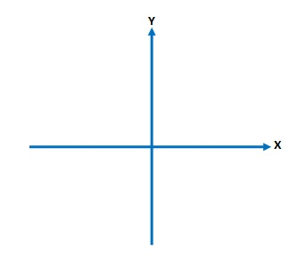
{ Flex Box
Flexbox is a CSS layout model that makes it easier to design flexible responsive layout structures.
It aligns items both horizontally and vertically.

Slide 9
{ Flex Box : Parent Properties
Parent Properties:
display:flex;
justify-content: align items horizontal if flex –direction row otherwise align items vertical
Flex-start | flex-end | center | space-between | space-evenly | space-around
align-items: align items vertical if flex –direction row otherwise align items horizonal
Flex-end | Flex-start | Center | Stretch (default)
flex-wrap : no-wrap | wrap
flex-direction : row | column | row-reverse | column-reversed

Slide 10
{ Flex Box : Child Properties
Child Properties:
align-self
flex-grow:0 | 1
flex-shrink
Flex-basis
Flex: grow shrink basis : short hand

Slide 11
Background Image
ITI Tanta
Login
Footer

Slide 12
Thanks!
{04}
CST
</
} /> [
Do you have any questions?
/>
Day04

