Slide 1

David Shui
Department of Mechanical Engineering
University of Texas at Austin
Aggregate-Induced Emission Monitoring for Control in Vat Polymerization

Slide 2
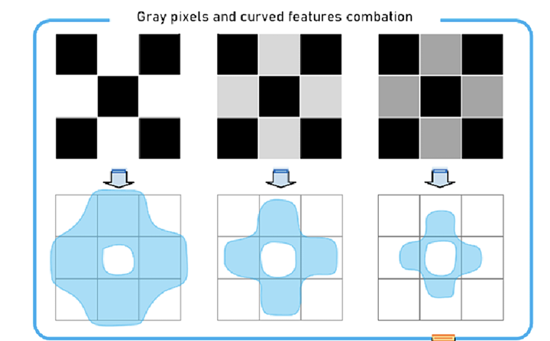
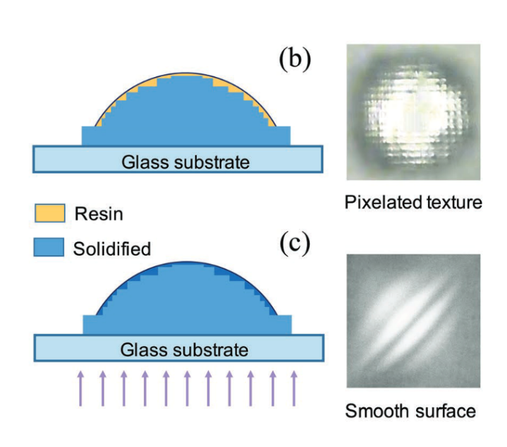
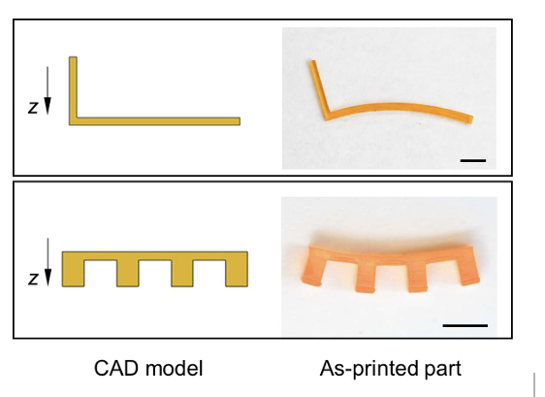
DLP Challenge
Grayscale Mismatch & Resolution Limitation [1]
Surface Roughness [2]
Volume Shrinkage [3]
Pixel-level grayscale control can improve boundary smoothness, but limited projector resolution and light scattering can still cause shape mismatch and overcuring.
Layer-wise curing and pixelated light projection can create rough or stair-stepped surfaces, especially near curved boundaries.
Photopolymerization-induced shrinkage can distort printed geometries and cause deviation from the CAD model.
[1] Ma, Y., Tian, Z., Wang, B., Zhao, Y., Nie, Y., Wildman, R. D., ... & He, Y. (2024). Enhancing the 3D printing fidelity of vat photopolymerization with machine learning-driven boundary prediction. Materials & Design, 241, 112978.
[2] Xu, Y., Huang, P., To, S., Zhu, L. M., & Zhu, Z. (2022). Low‐cost volumetric 3D printing of high‐precision miniature lenses in seconds. Advanced Optical Materials, 10(17), 2200488.
[3] Zhang, Q., Weng, S., Hamel, C. M., Montgomery, S. M., Wu, J., Kuang, X., ... & Qi, H. J. (2021). Design for the reduction of volume shrinkage-induced distortion in digital light processing 3D printing. Extreme Mechanics Letters, 48, 101403.
Notes:
because light intended for a specific location often scatters or diffracts into surrounding locations, creating a halo of unwanted polymerization and enlarges features
Associated with the resin curing process is the material volume shrinkage, which is due to the shortening of intermolecular distances of their molecules and depends on the degree of cure (DoC) of the resin.

Slide 3
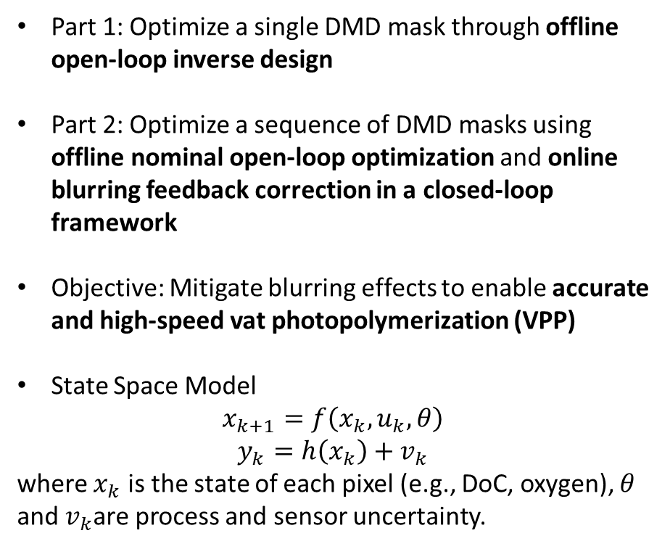
Outline
Part 1: Optimize a single DMD mask through offline open-loop inverse design
Part 2: Optimize a sequence of DMD masks using offline nominal open-loop optimization and online blurring feedback correction in a closed-loop framework
Objective: Mitigate blurring effects to enable accurate and high-speed vat photopolymerization (VPP)
State Space Model
$$x_{k+1}=f\left(x_{k}, u_{k}, θ\right)$$
$$y_{k}=h\left(x_{k}\right)+v_{k}$$
where $x_{k}$ is the state of each pixel (e.g., DoC, oxygen), $θ$ and $v_{k}$are process and sensor uncertainty.
Ref. Yap, T., Singh, K., Chen, X., O’Dea, C., Crawford, N. K., Bae, K., Page, Z. A., & Cullinan, M. (2026, June 14–18). Inversely designed projection image generation for vat photopolymerization in a machine learning framework. In Proceedings of the ASME 2026 21st International Manufacturing Science and Engineering Conference (MSEC2026),

Slide 4
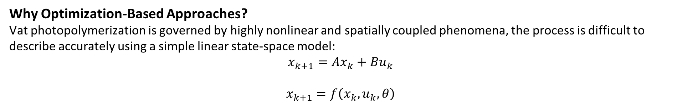
Offline Optimization Overview
Why Optimization-Based Approaches?
Vat photopolymerization is governed by highly nonlinear and spatially coupled phenomena, the process is difficult to describe accurately using a simple linear state-space model:
$$x_{k+1}=Ax_{k}+Bu_{k}$$
$$x_{k+1}=f\left(x_{k}, u_{k}, θ\right)$$
ML-based methods can effectively learn the nonlinear relationship.
Optimization-Based Approaches
Data-driven [1]
Learns boundary correction directly from printed experimental data.
2. Model-based [2] [3] [4]
Uses either more detailed physical models to improve prediction fidelity or reduced-order model by simplifying curing models to reduce computational cost while preserving key process trends.
[1] Ma, Y., Tian, Z., Wang, B., Zhao, Y., Nie, Y., Wildman, R. D., ... & He, Y. (2024). Enhancing the 3D printing fidelity of vat photopolymerization with machine learning-driven boundary prediction. Materials & Design, 241, 112978.
[2] Xu, Y., Huang, P., To, S., Zhu, L. M., & Zhu, Z. (2022). Low‐cost volumetric 3D printing of high‐precision miniature lenses in seconds. Advanced Optical Materials, 10(17), 2200488.
[3]Kumar, H., Ambhorkar, P., Foulds, I., Golovin, K., & Kim, K. (2022). A kinetic model for predicting imperfections in bioink photopolymerization during visible-light stereolithography printing. Additive Manufacturing, 55, 102808.
[4] Zhang, Q., Weng, S., Hamel, C. M., Montgomery, S. M., Wu, J., Kuang, X., ... & Qi, H. J. (2021). Design for the reduction of volume shrinkage-induced distortion in digital light processing 3D printing. Extreme Mechanics Letters, 48, 101403.

Slide 5
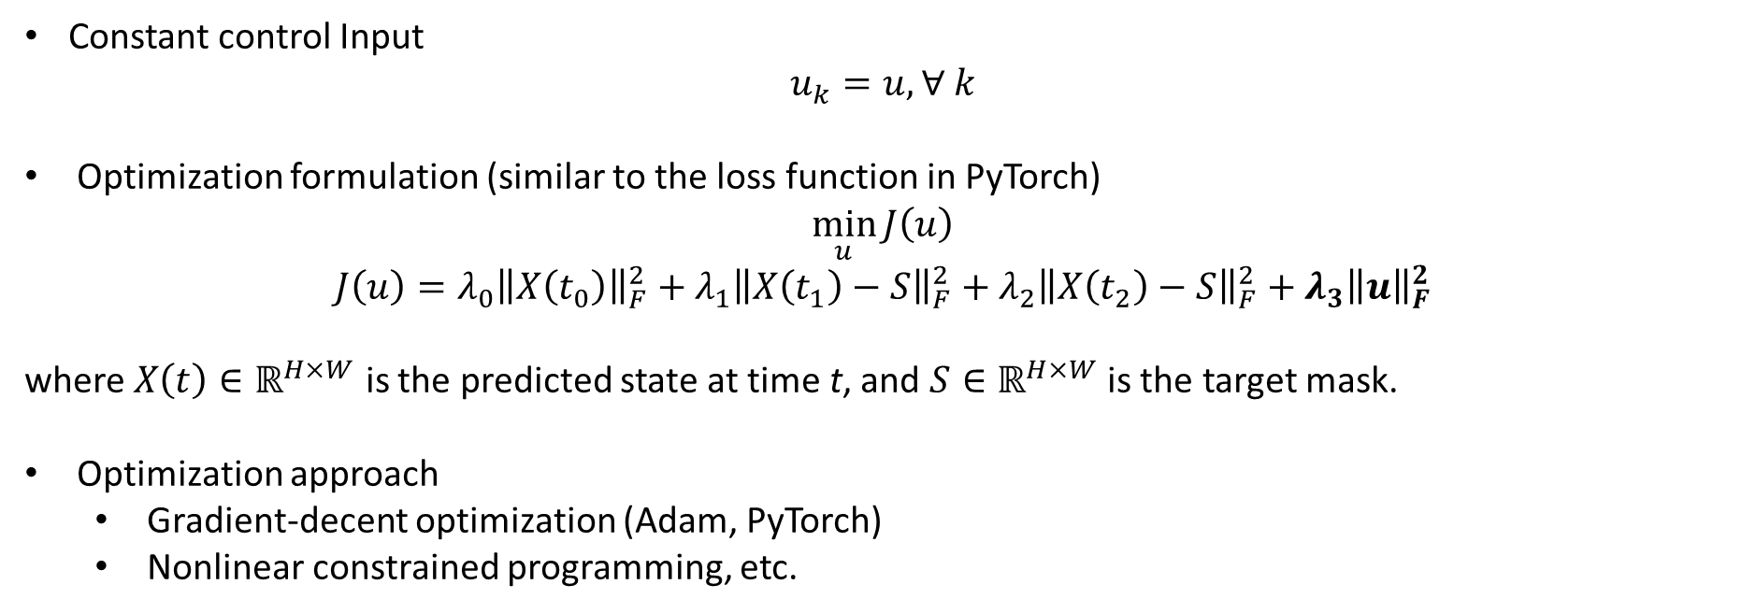
Inverse Design
Constant control Input
$$u_{k}=u, ∀ k$$
Optimization formulation (similar to the loss function in PyTorch)
$$\min_{u}{J\left(u\right)}$$
$$J\left(u\right)=λ_{0}{\left\|X\left(t_{0}\right)\right\|}_{F}^{2}+λ_{1}{\left\|X\left(t_{1}\right)−S\right\|}_{F}^{2}+λ_{2}{\left\|X\left(t_{2}\right)−S\right\|}_{F}^{2}+λ_{3}{\left\|u\right\|}_{F}^{2}$$
where $X\left(t\right)∈ℝ^{H×W}$ is the predicted state at time t, and $S∈ℝ^{H×W}$ is the target mask.
Optimization approach
  Gradient-decent optimization (Adam, PyTorch)
  Nonlinear constrained programming, etc.

Slide 6
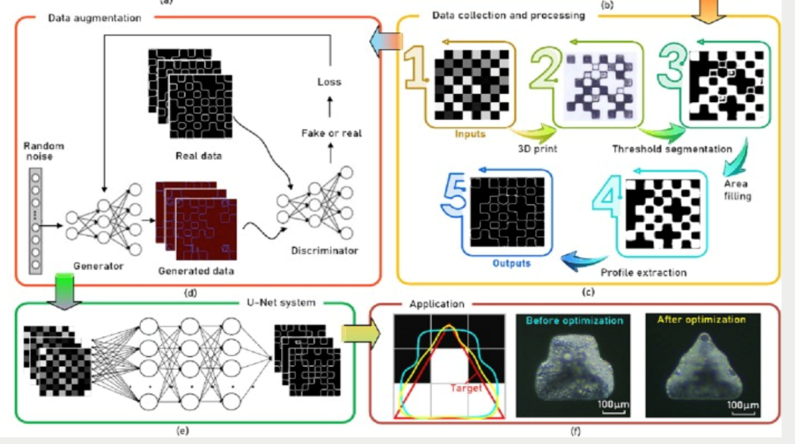
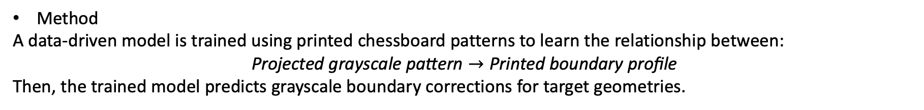
Offline Optimization (Open Loop Control)
1. Data-driven [1]
Motivation: This method uses machine learning to predict optimized grayscale boundary pixels without relying on full physics-based simulation.
Method
A data-driven model is trained using printed chessboard patterns to learn the relationship between:
$$\text{Projected grayscale pattern}→\text{Printed boundary profile}$$
Then, the trained model predicts grayscale boundary corrections for target geometries.
Pros: Fast prediction after training
Cons: Data preparation can be labor-intensive.
[1] Ma, Y., Tian, Z., Wang, B., Zhao, Y., Nie, Y., Wildman, R. D., ... & He, Y. (2024). Enhancing the 3D printing fidelity of vat photopolymerization with machine learning-driven boundary prediction. Materials & Design, 241, 112978.
Notes:
Ignore in-depth curing effect

Slide 7
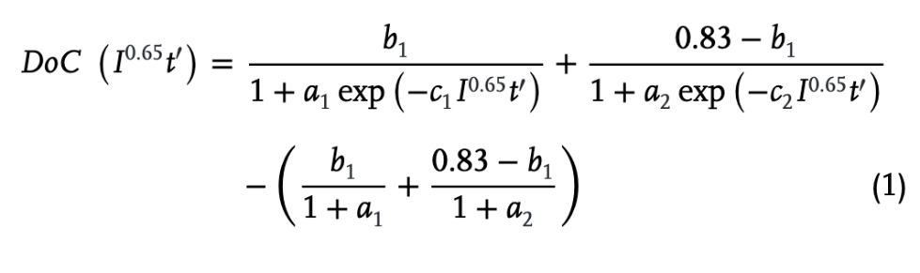
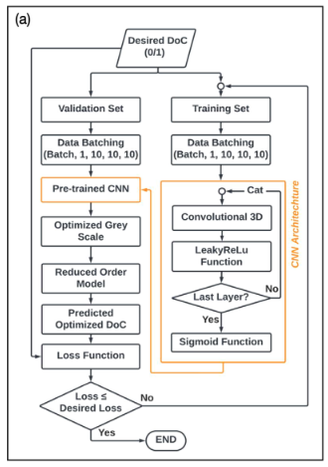
Offline Optimization (Open Loop Control)
2. Model-Based [2] [3] [4]
➡️ Purely curve fitting means fast computation
Pros:
Fast prediction and lower computational cost, which is suitable for large-scale offline mask generation
Cons
Requires resin-specific DoC and light-profile calibration
Less physically detailed than high-fidelity photobleaching models
May require retraining when resin composition changes
Notes:
Each rasin has own curve
Overview slides

Slide 8
Online Optimization and Control Overview
Why online Approaches?
Real-time adjustment can compensate for process uncertainty, model mismatch, and accumulated printing errors
The main objective is to track the desired cure state or geometry while satisfying physical and hardware constraints
For DLP/VPP systems, online strategies can be broadly divided into:
1. Classical Feedback Control [1]
Uses real-time measurements to adjust exposure time or light intensity.
2. Sequential Mask Optimization [2]
Uses a sequence of optimized masks to improve spatial resolution and compensate for light spreading.
[1] Zhao, X., & Rosen, D. W. (2018). An implementation of real-time feedback control of cured part height in exposure controlled projection lithography with in-situ interferometric measurement feedback. Additive Manufacturing, 23, 253-263.
[2] Zhou, C., & Chen, Y. (2012). Additive manufacturing based on optimized mask video projection for improved accuracy and resolution. Journal of manufacturing processes, 14(2), 107-118.

Slide 9
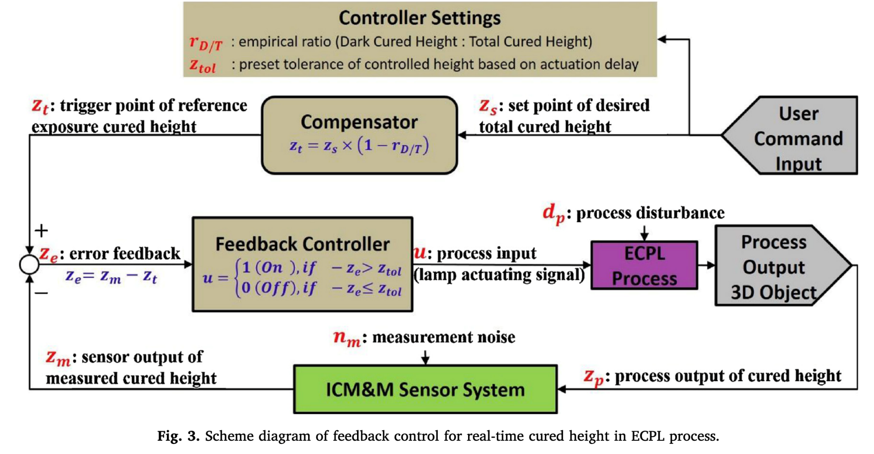
Classical Feedback Control for Cured Height Regulation [1]
The controller compares the measured cured height with a reference trigger height.
A compensator accounts for dark curing after the exposure is turned off.
The exposure is terminated when the measured height reaches the target tolerance.
Classical feedback control can reduce process uncertainty, but its performance strongly depends on measurement speed, sensor accuracy, and actuation delay.

Slide 10
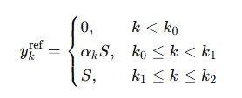
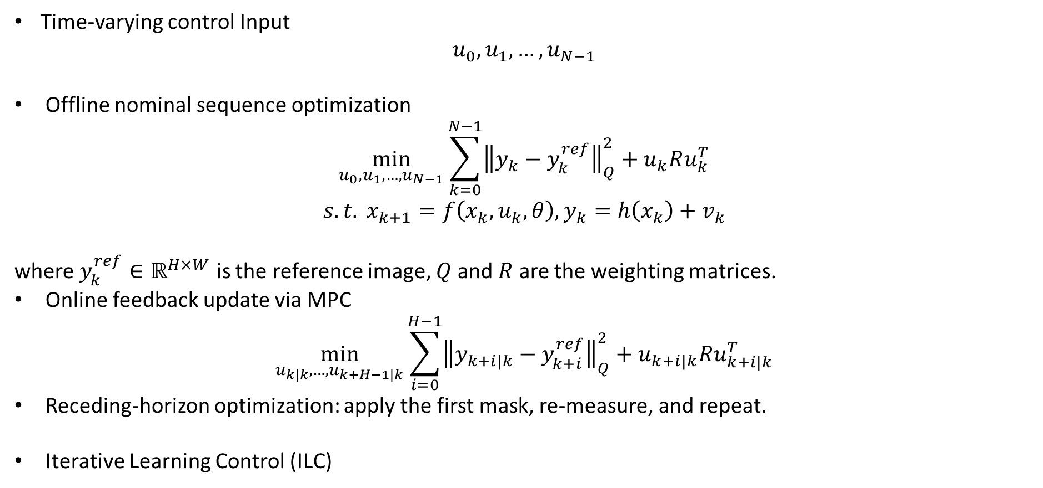
Sequential Mask Optimization
Time-varying control Input
$$u_{0},u_{1},…, u_{N−1}$$
Offline nominal sequence optimization
$$\min_{u_{0},u_{1},…, u_{N−1}}{\sum_{k=0}^{N−1}{{\left\|y_{k}−y_{k}^{ref}\right\|}_{Q}^{2}}+u_{k}Ru_{k}^{T}}$$
$$s.t. x_{k+1}=f\left(x_{k}, u_{k}, θ\right),y_{k}=h\left(x_{k}\right)+v_{k}$$
where $y_{k}^{ref}∈ℝ^{H×W}$ is the reference image, $Q$ and $R$ are the weighting matrices.
Online feedback update via MPC
$$\min_{u_{k|k},…, u_{k+H−1|k}}{\sum_{i=0}^{H−1}{{\left\|y_{k+i|k}−y_{k+i}^{ref}\right\|}_{Q}^{2}}+u_{k+i|k}Ru_{k+i|k}^{T}}$$
Receding-horizon optimization: apply the first mask, re-measure, and repeat.
Iterative Learning Control (ILC)

Slide 11
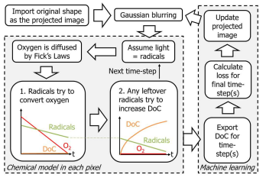
Can Our Cure Model Enable Sequential Optimization?
Can our oxygen–DoC model be used as a forward model for mask optimization?
$$H\left(x , y , t\right)→O_{2}\left(x , y , t\right), DoC\left(x , y , t\right)→F^{′}$$
where $H$ is the projected mask intensity and $F^{′}$ is the predicted solidified pattern.
If this mapping is reliable, then we can formulate the problem as:
$$\text{Find}\text{:}\text{ optimized mask sequence }H_{1},H_{2},...,H_{m}$$
$$\text{Minimize}\text{:}\text{ mismatch between target pattern }F\text{ and predicted cured pattern }F^{′}$$

Slide 12
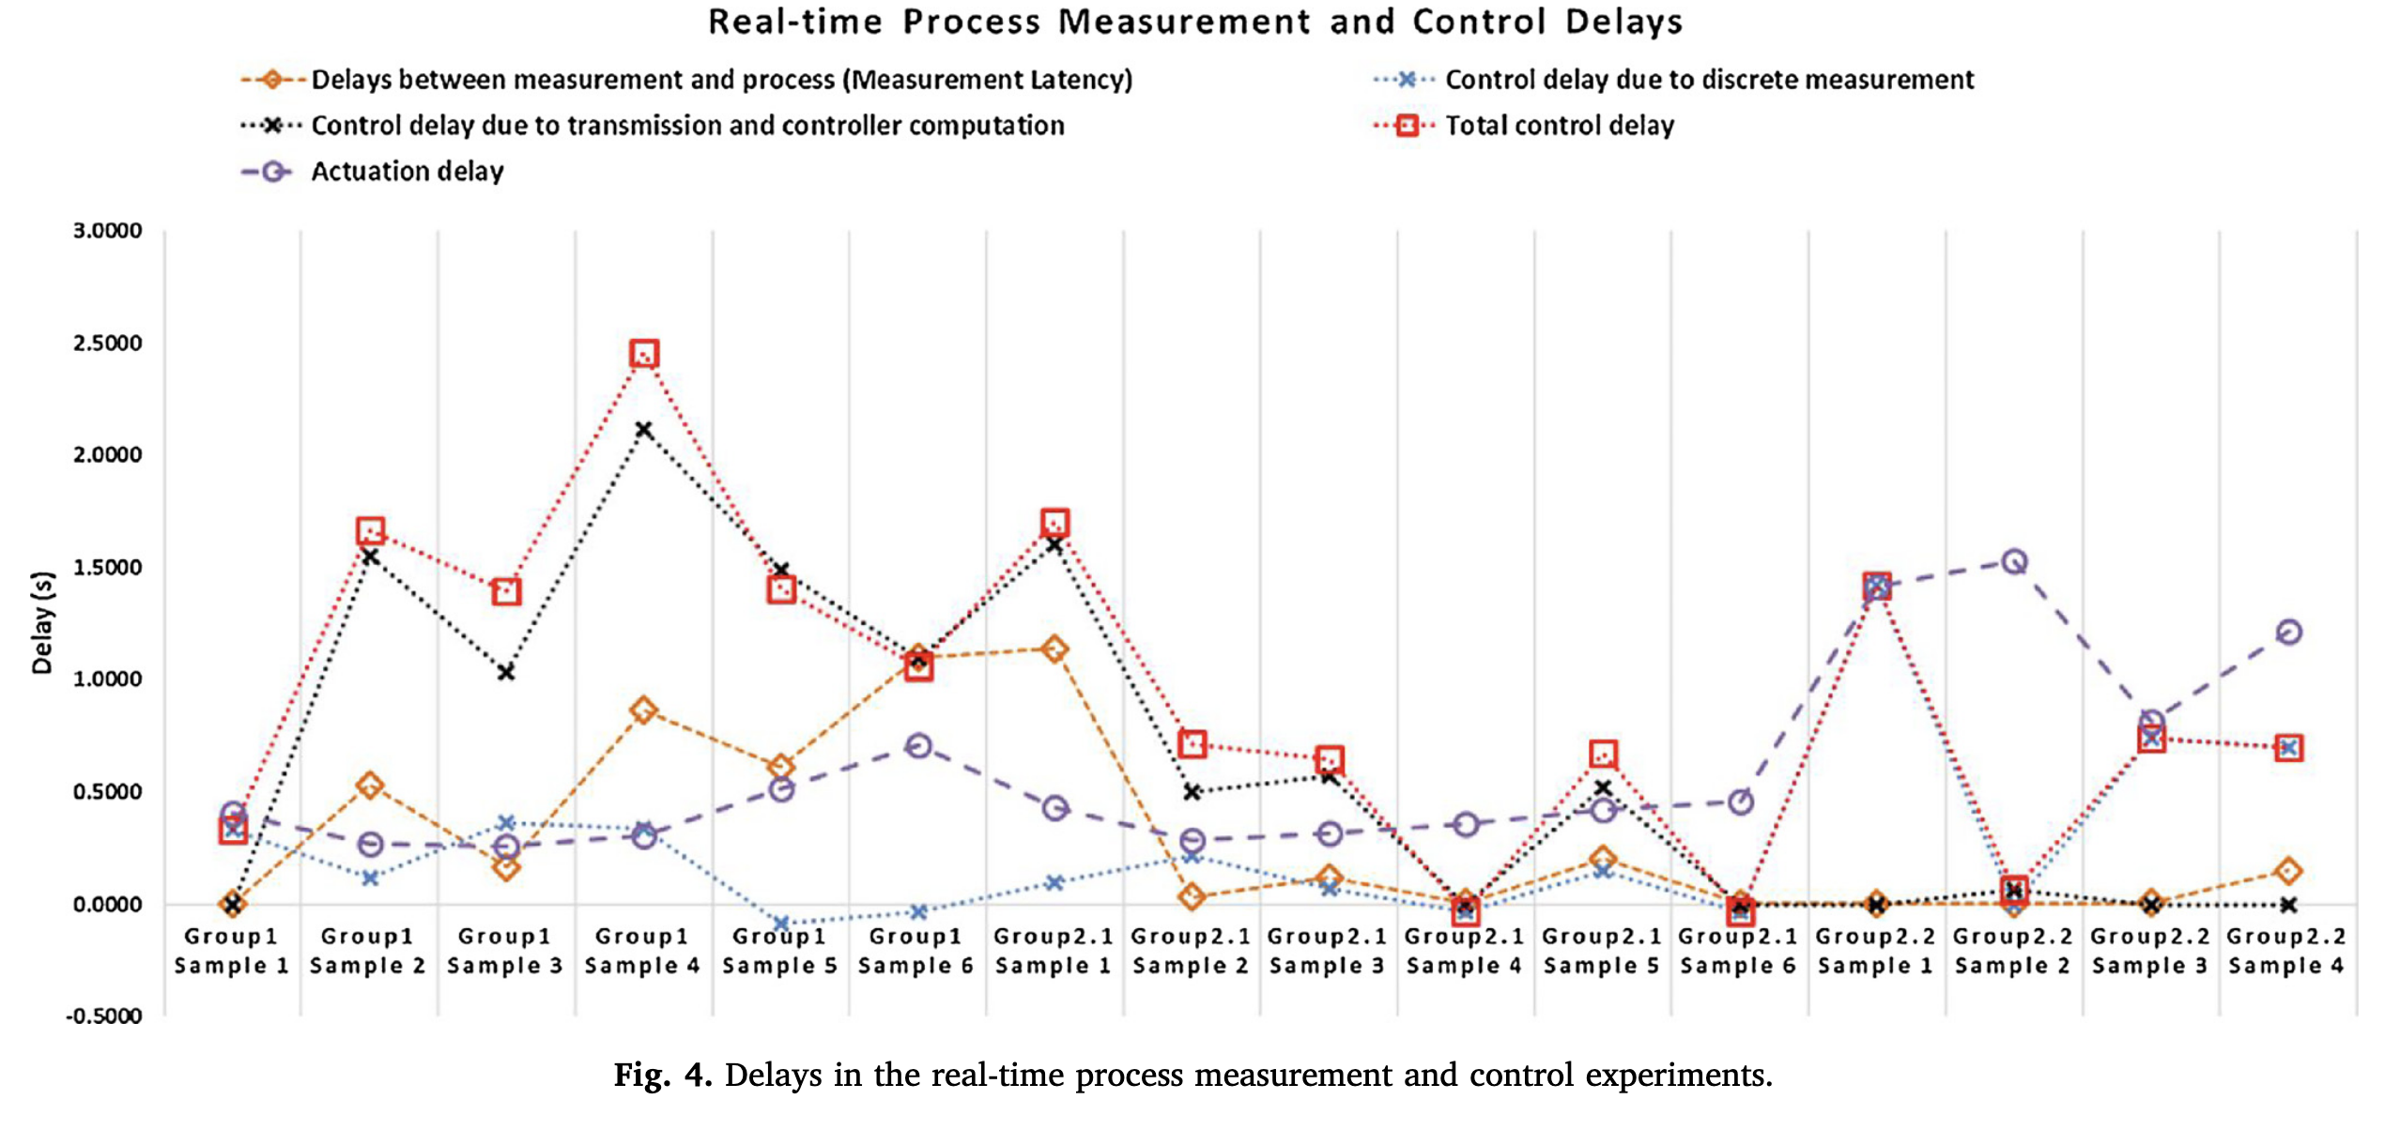
Implementation Challenges for Real-Time Control
Major Sources of Delay
Measurement latency: time required for image acquisition and sensor processing.
Control computation delay: time required to calculate the next control action.
Discrete measurement delay: missed trigger point due to finite sampling interval.
Actuation delay: delay between sending the command and changing the UV exposure.
Group1: normal process
Group2: slow process

Slide 13
08/27/2026
Differentiable Nonlinear MPC for AIE-VPP Mask Control

Slide 14

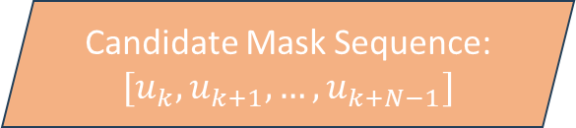



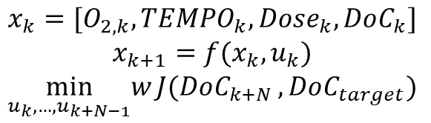
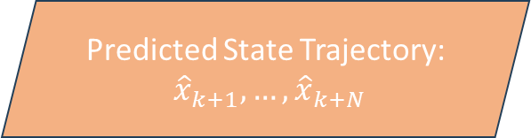

Nonlinear MPC
Target Geometry + Current State $x_{k}$
After optimization converges, apply only $u_{k}^{∗}$ ​and update the state to $x_{k+1}$
Optimizer
$$∇_{U}J$$
Candidate Mask Sequence:
$$[u_{k},u_{k+1}, …,u_{k+N−1}]$$
$$x_{k}=[O_{2,k}, TEMPO_{k}, Dose_{k}, DoC_{k}]$$
$$x_{k+1}=f(x_{k},u_{k})$$
$$\min_{u_{k},…,u_{k+N−1}}w{J(DoC_{k+N}},DoC_{target})$$
$$u_{k}^{∗}$$
AIE model predicts the next curing state from the current state and projected mask
AIE Model
Differentiable AIE Model
$$x_{k+1}$$
Predicted State Trajectory:
${\hat{x}}_{k+1}, …,{\hat{x}}_{k+N}$
Cost Function

Slide 15

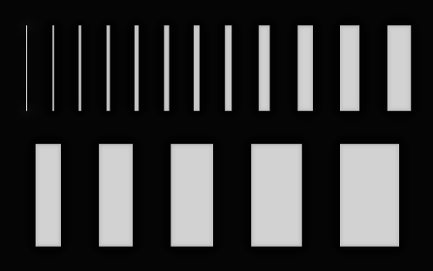
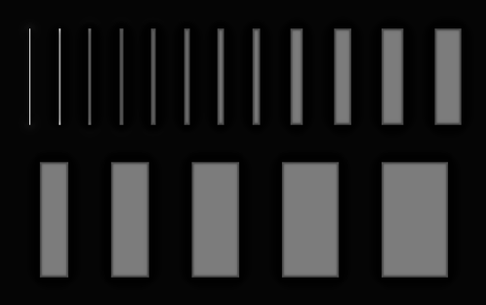
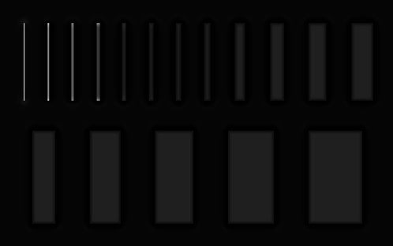
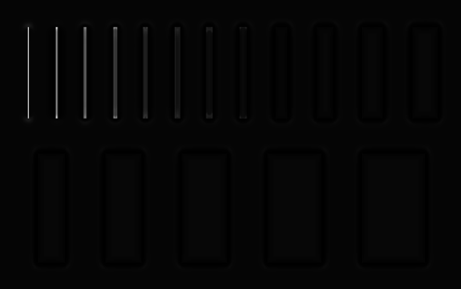
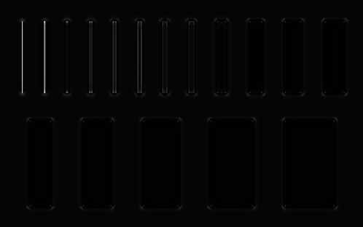
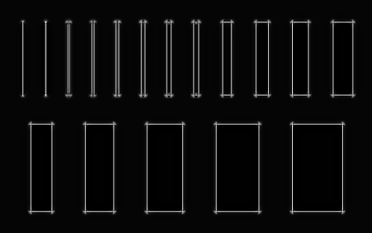
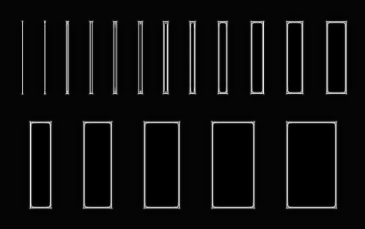


70 mW / 0 mM Tempo for Lines
Goal: 40% DoC @ 3.5 Sec
$$D_{desired}\left(3.5\right)=0.4$$
T = 0.0 s
T = 0.5 s
T = 1.0 s
T = 1.5 s
T = 2.0 s
T = 2.5 s
T = 3.0 s
$$D_{achieved}\left(3.5\right)=0.627$$

Slide 16
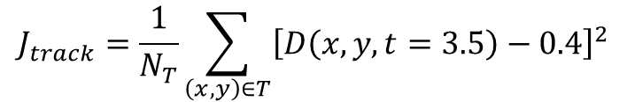

70 mW / 0 mM Tempo for Lines
time | approximate target-region mean* | Mean target DoC
0.0 s | ~0.85 | 0.014
0.5 s | ~0.49 | 0.293
1.0 s | ~0.16 | 0.406
1.5 s | ~0.09 | 0.467
2.0 s | ~0.08 | 0.503
2.5 s | ~0.17 | 0.534
3.0 s | ~0.23 | 0.627
For the first time step,
$$70\left(0.8\right)\left(0.5\right)≈28 mJ/cm^{2}$$
Which is essentially close enough to consume the O2 inhibition 27.7117.
The controller has an overshoot around 0.2, and it’s not reversible.
$$J_{track}=\frac{1}{N_{T}}\sum_{\left(x,y\right)∈T}{{\left[D\left(x,y,t=3.5\right)−0.4\right]}^{2}}$$
Increase the controller resolution
Increase the optimizer iteration to have better convergence
Constraint the initial masks intentionally
Modify the loss weight or even the definition

Slide 17

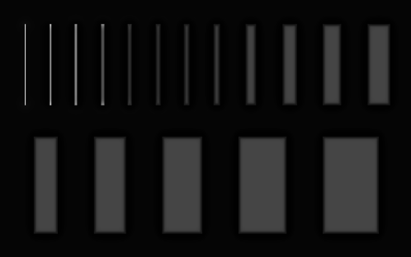
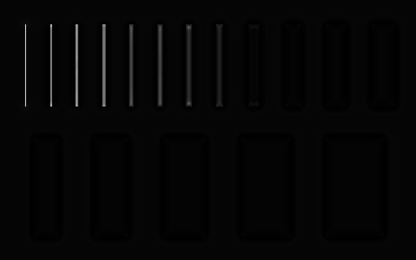
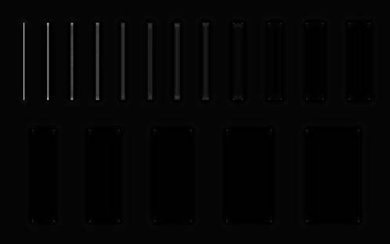
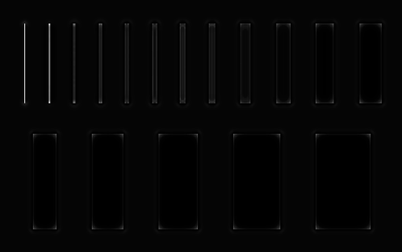
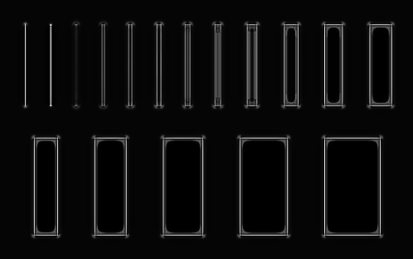
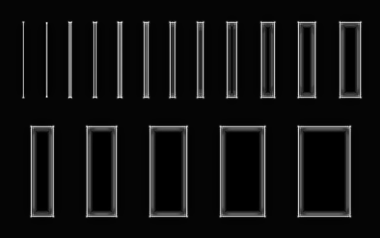

1. Smaller Control Step
Change $dt$ from 0.5 to 0.25
T = 0.0 s
T = 0.5 s
T = 1.0 s
T = 1.5 s
T = 2.0 s
T = 2.5 s
T = 3.0 s

Slide 18
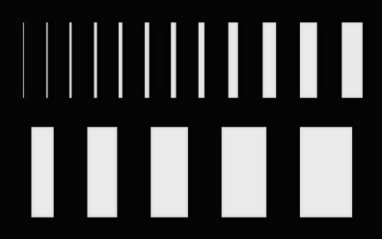
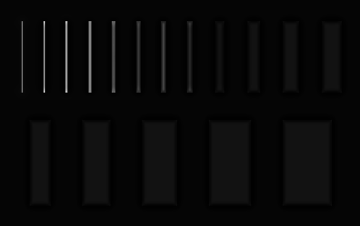
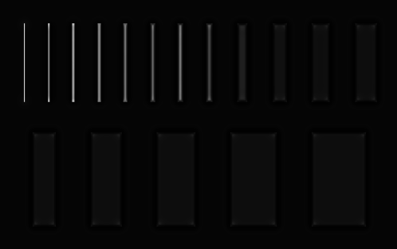
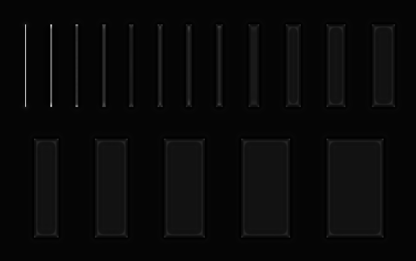
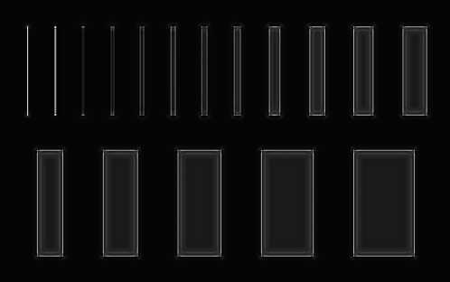
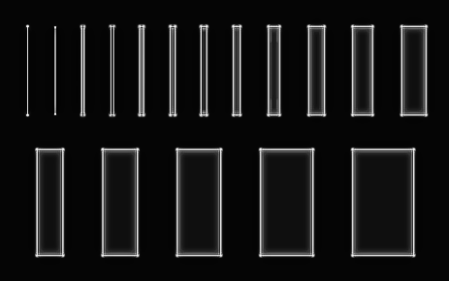
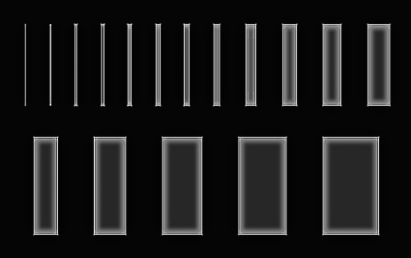

1. Smaller Control Step
Change $dt$ from 0.25 to 0.1
T = 0.0 s
T = 0.5 s
T = 1.0 s
T = 1.5 s
T = 2.0 s
T = 2.5 s
T = 3.0 s

Slide 19
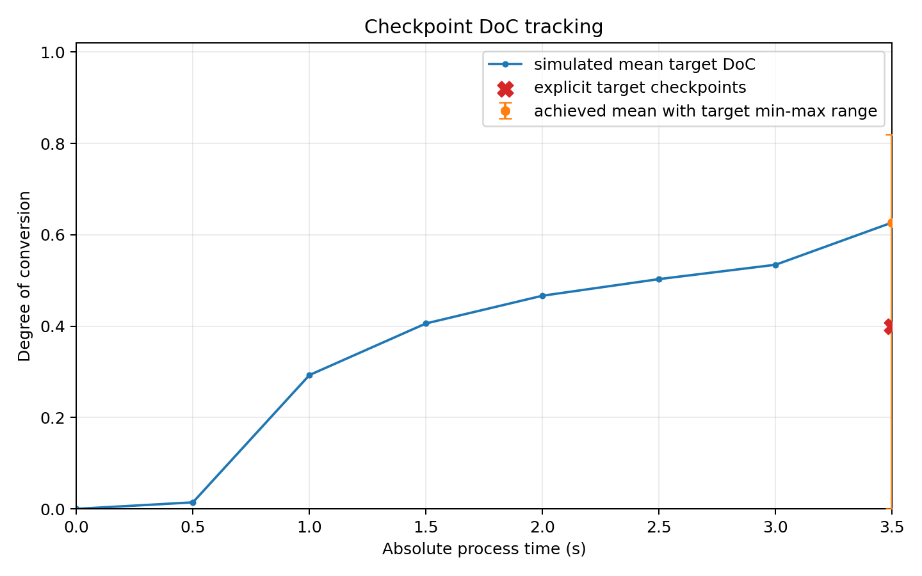
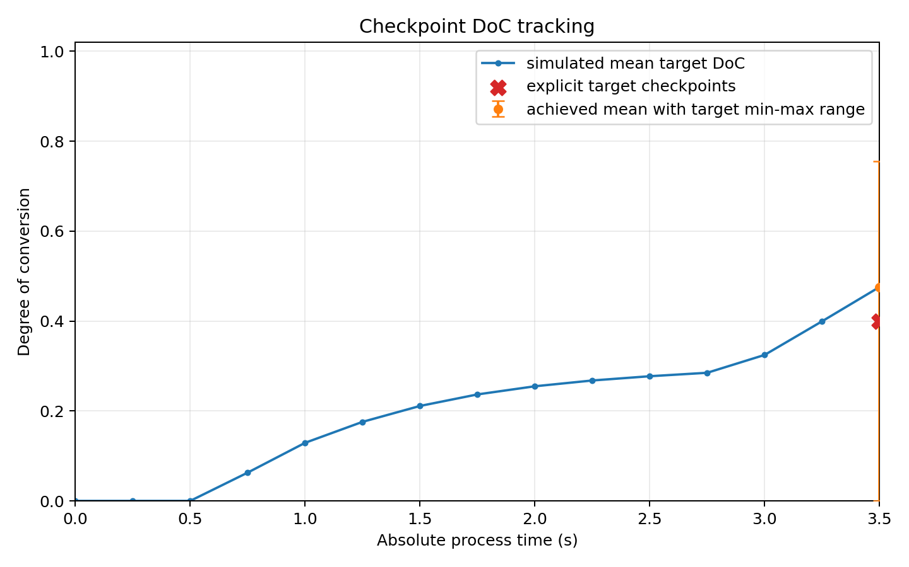
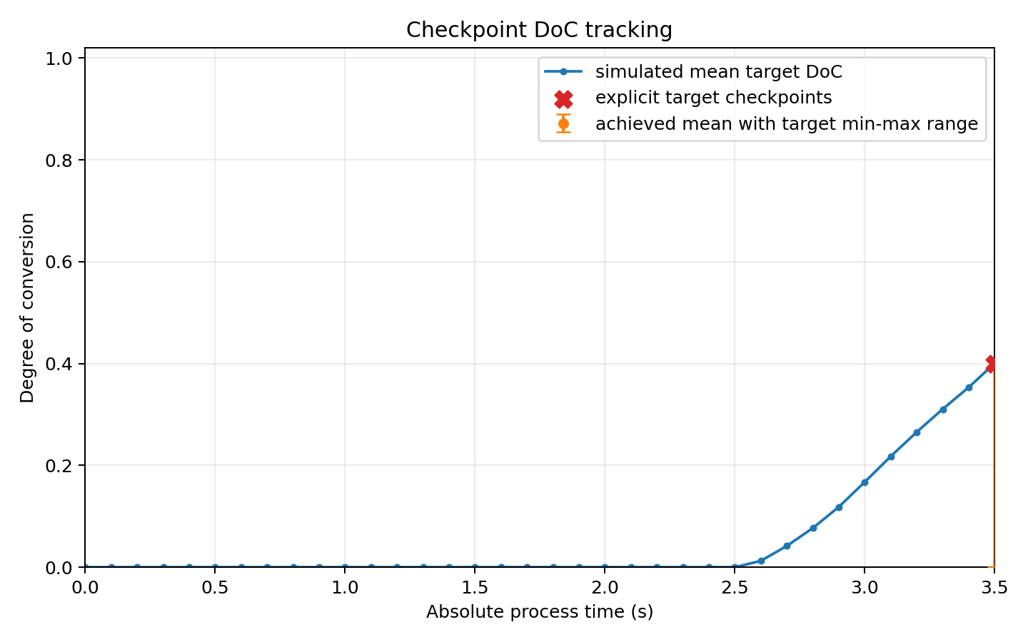
1. Comparison@ t = 3.5 sec

Slide 20
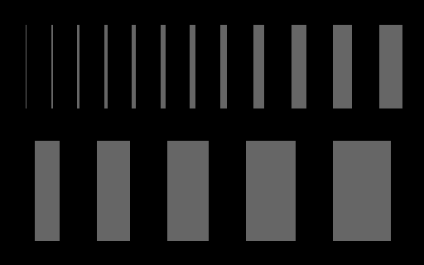
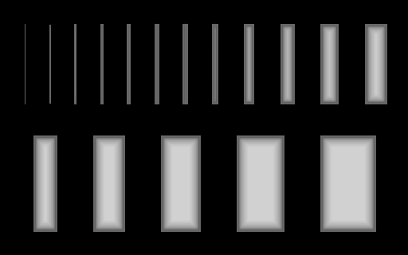


1. Comparison@ t = 3.5 sec

Slide 21
1. Smaller Control Step
Metric at 3.5 s | control_dt = 0.50 s | control_dt = 0.25 s | control_dt = 0.1 s
Requested DoC | 0.4000 | 0.4000 | 0.4000
Mean target DoC | 0.6269 | 0.4758 | 0.4005
Mean error | +0.2269 | +0.0758 | +0.0005
Target min | 0.0000 | 0.0000 | 0.0000
Target max | 0.8201 | 0.7552 | 0.4090
Target std | 0.1679 | 0.1212 | 0.0041
Min component mean | 0.3923 | 0.3922 | 0.3921
Max component mean | 0.7026 | 0.5462 | 0.4006
Component-mean range width | 0.3103 | 0.1540 | 0.0085
Targets include all-white pixels, whereas the component is the pixels within each lines or shapes

Slide 22
Next Step
Redefine the loss function?
Investigate the initial constraint
Check the hardware limitation

Slide 23
09/10/2026
Differentiable Nonlinear MPC for AIE-VPP Mask Control

Slide 24
MPC Initialization & Convergence Issues
From simulations, all different step sizes, e.g., 0.5, 0.25, 0.1, were generating the pretty close bright first masks.
Larger step size wouldn’t have enough chance to compensate overshoots. Also, the DoC irreversibility caused the controller has less room to mistake.
Solution: increase the number of iterations for each time step.

Slide 25
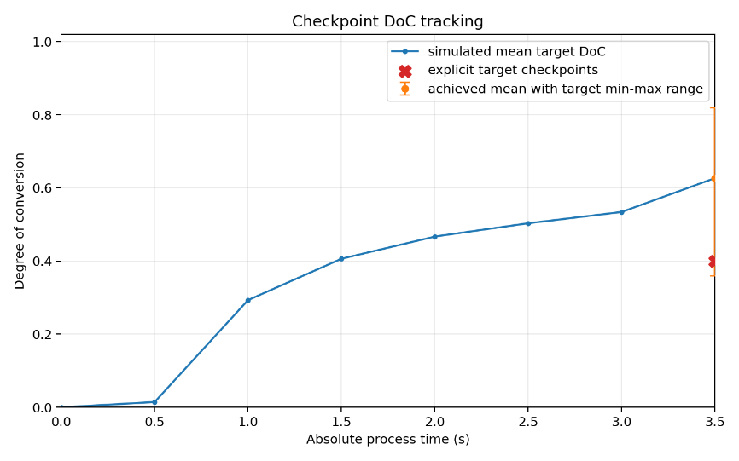
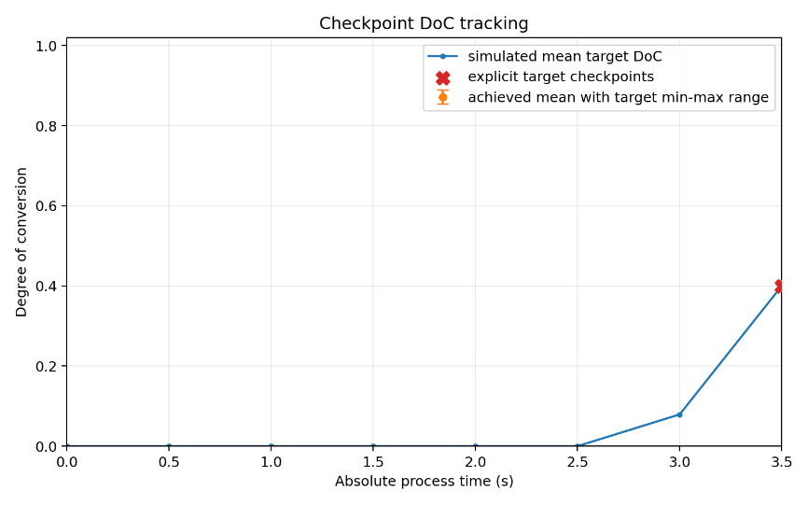
MPC Iterations Analysis
Time (s) | 20 iterations mean DoC | 50 iterations mean DoC | Difference
0.5 | 0.0143 | 0.0000 | -0.0143
1.0 | 0.2932 | 0.0000 | -0.2932
1.5 | 0.4062 | 0.0000 | -0.4062
2.0 | 0.4670 | 0.0000 | -0.4670
2.5 | 0.5034 | 0.0000 | -0.5034
3.0 | 0.5342 | 0.0793 | -0.4549
3.5 | 0.6270 | 0.4003 | -0.2267
Iterations: 20
Iterations: 50

Slide 26
MPC Iterations Analysis
Time (s) | 20 iterations mean DoC | 50 iterations mean DoC | Difference
0.5 | 0.0143 | 0.0000 | -0.0143
1.0 | 0.2932 | 0.0000 | -0.2932
1.5 | 0.4062 | 0.0000 | -0.4062
2.0 | 0.4670 | 0.0000 | -0.4670
2.5 | 0.5034 | 0.0000 | -0.5034
3.0 | 0.5342 | 0.0793 | -0.4549
3.5 | 0.6270 | 0.4003 | -0.2267
Iterations: 20
Iterations: 50

Slide 27
MPC Iterations Analysis
Time (s) | 20 iterations mask mean | 50 iterations mask mean
0.5 | 0.219 | 0.039
1.0 | 0.127 | 0.056
1.5 | 0.042 | 0.054
2.0 | 0.022 | 0.052
2.5 | 0.020 | 0.061
3.0 | 0.045 | 0.100
3.5 | 0.058 | 0.136
Component metric | 20 iterations | 50 iterations
Component mean DoC | 0.5124 | 0.40027
Minimum component mean | 0.3999 | 0.39995
Maximum component mean | 0.7027 | 0.40036
Component range width | 0.3028 | 0.00041

Slide 28
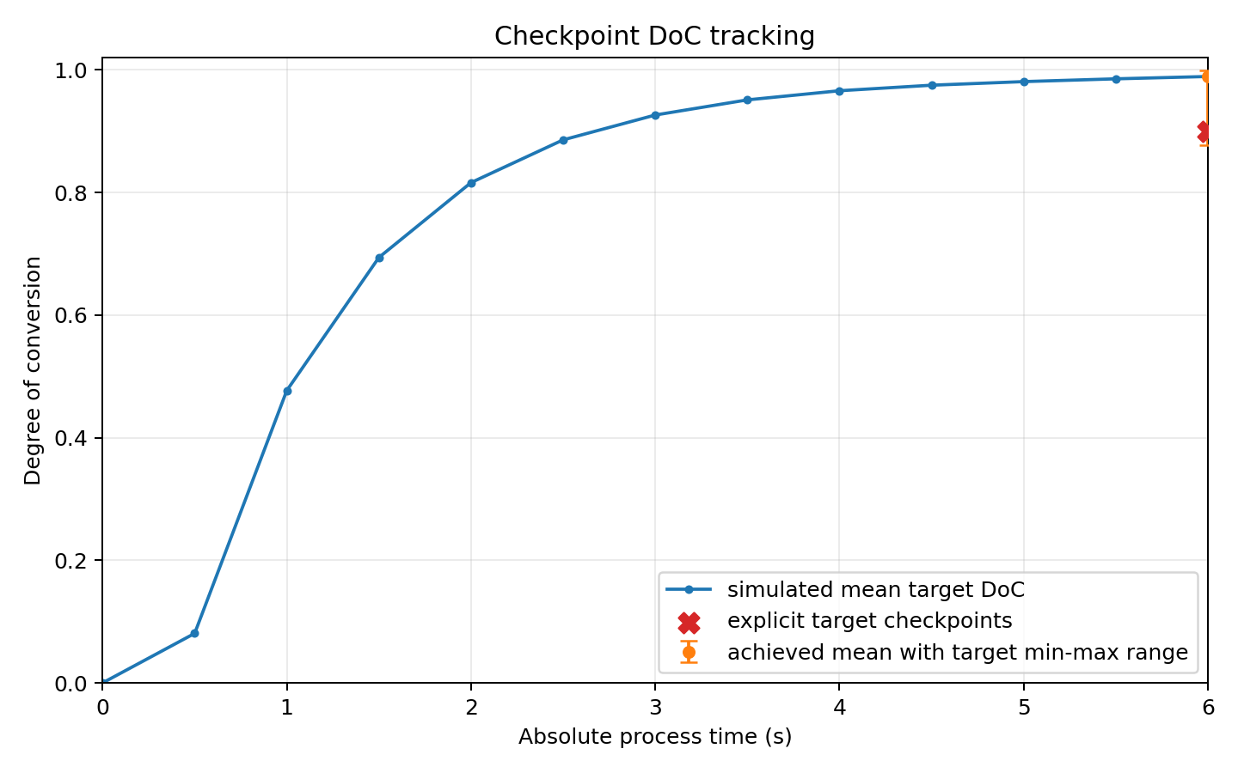
Longer DoC Target
If we try to aim 90% DoC @ 6 sec, it won’t have the same good results as the previous setting.
Initial mask intensity = 0.95 * 70 mW

Slide 29
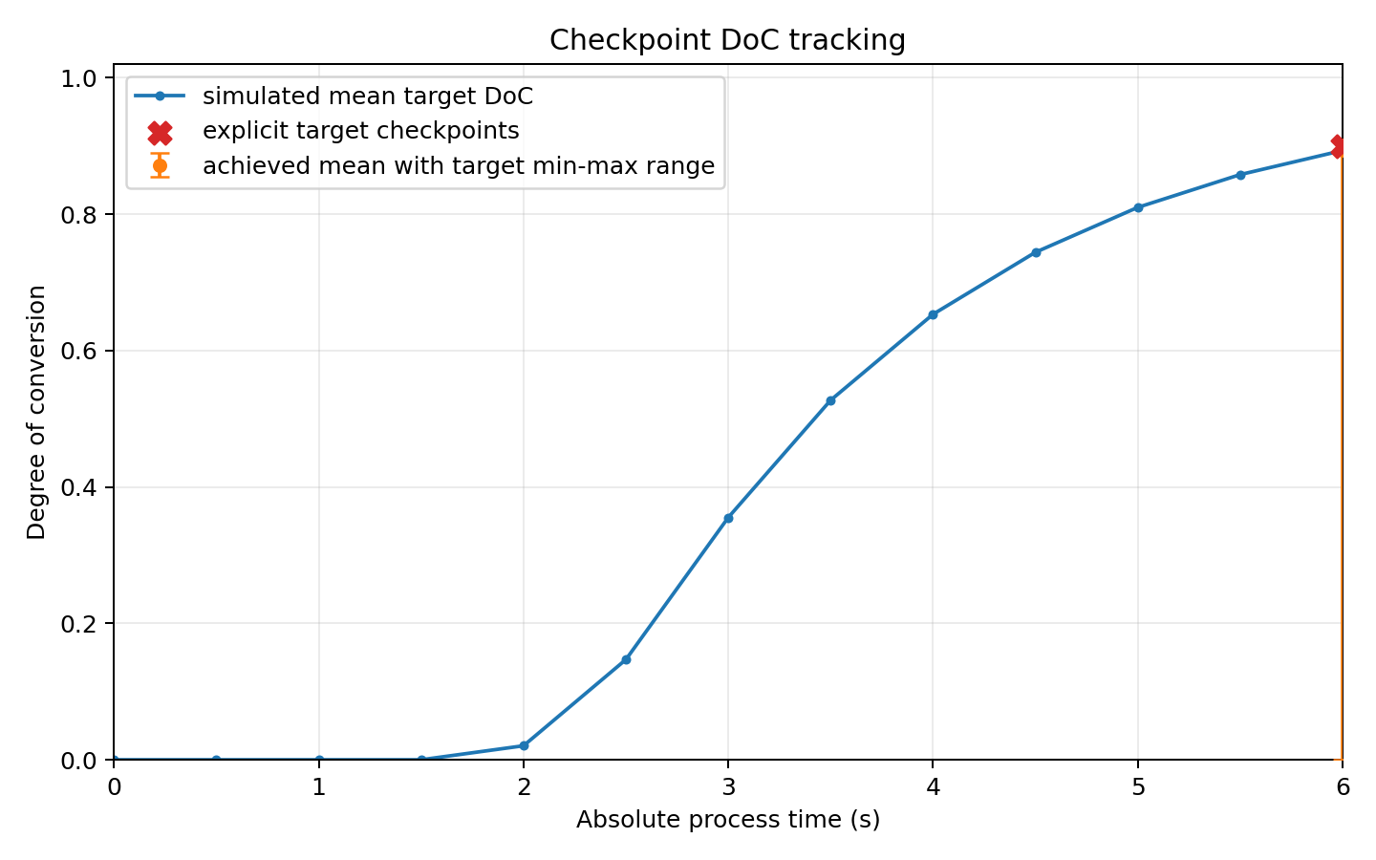
Longer DoC Target
Even if we try to aim 90% DoC @ 6 sec with different initial mask intensity, the smallest feature hadn’t been cured.
Zero gradient due to oxygen incomplete depletion
MPC is too sensitive to the initial condition
  Too high, it will cause overshoot
  Too low, it will cause zero gradient
Initial mask intensity = 0.20 * 70 mW

Slide 30






Optimize Reaction Progress instead of DoC
$$R=−\ln\left(1−D_{p}\right)=\sum_{k}{B(I_{k})}Δt$$
$$D_{p}=1−e^{−R}$$
$$\frac{∂J}{∂u}=\frac{∂J}{∂D}\frac{∂D}{∂R}\frac{∂R}{∂I}\frac{∂I}{∂u}$$
DoC-based Loss
$$J=mean_{p∈Ω_{T}}{\left(D_{p}−D_{p}^{∗}\right)}^{2}+mean_{p∈Ω_{Out}}{\left(D_{p}\right)}^{2}$$ For one pixel, $$\frac{∂J}{∂u}=2(D_{p}−D_{p}^{∗})(1−Dp)\frac{∂R_{p}}{∂u}$$ As $D_{p}→1$, the controller become less sensitive even if error still exists
$$Ω=\left\{\left(x,y\right) \right| x=1, …,W, y=1,…,H\}$$
Reaction-Progress-based Loss
$$J=mean_{p∈Ω_{T}}{\left(R_{p}−R_{p}^{∗}\right)}^{2}+mean_{p∈Ω_{Out}}{\left(R_{p}\right)}^{2}$$ For one pixel, $$\frac{∂J}{∂u}=2(R_{p}−R_{p}^{∗})\frac{∂R_{p}}{∂u}$$ Stronger correction signal is preserved near high conversion
Interpretation:
For highly cured pixel, optimizing $R$ provides a much stronger gradient than optimizing $D$, which would prevent overcured situation more.
Notes:
That means $R$ represents the accumulated amount of polymerization-driving reaction progress required to move the material along the conversion curve.

Slide 31



Snowflake Hollow
Metric | MPC | Static
Checkpoint mean DoC | 0.8997 | 0.7890
Checkpoint abs. error | 0.000263 | 0.111045
Target DoC RMSE | 0.001355 | 0.323922
Target DoC std | 0.00133 | 0.304293
Component mean DoC min | 0.899707 | 0.786087
Mean outside DoC | 0.008671 | 0.001731
IoU | 0.7177 | 0.7844
Dice | 0.8357 | 0.8792
Target
MPC
Static

Slide 32

Comments
Current reaction-progress MPC
$$J=mean_{p∈Ω_{T}}{\left(R_{p}−R_{p}^{∗}\right)}^{2}+0.5∗mean_{p∈Ω_{Out}}{\left(R_{p}\right)}^{2}$$
Target image size: $320∗512=163840 px$ (only $3822 px$ for cured)
MPC created additional 1503 false cured px, which only take account for $≈1503/160018≈0.94\%$.
Strategy
  Rather than adjusting weight of outside pixels, we could add one more region along the boundary.
  We already know that $D_{p}=0$ could give very weak or zero DoC feedback due to trivial gradient.
  Coupled with a Oxygen-based loss function into boundary to protect over-curing.
  $$J_{boundary}=mean_{p∈boundary}{(\frac{O_{2,0}−O_{2} }{O_{2,0}})}^{2}$$
  $\frac{O_{2,0}−O_{2} }{O_{2,0}}$: fraction of the oxygen inhibition reserve that has been depleted.
  The physical meaning of it is to inform MPC that when getting dangerously close to curing resin outside the desired geometry, reduce exposure now.

Slide 33

New Loss Function
$$J=mean_{p∈Ω_{T}}{\left(R_{p,t_{end}}−R_{p}^{∗}\right)}^{2}+\frac{ω_{DoC}}{H}\sum_{t=1}^{H}{mean_{{p∈Ω}_{out}}{\left(D_{p,t}\right)}^{2}}+\frac{ω_{O_{2}}}{H}\sum_{t=1}^{H}{\frac{\sum_{p∈Ω_{out}}{ω_{p}}q_{p,t}^{2}}{\sum_{p∈Ω_{out}}{ω_{p}}}}$$
where
$q_{p,t}^{2}={\left(1−\frac{O_{2,p}(t)}{O_{2,p}(0)}\right)}^{2}$, $ω_{p}=exp⁡(−\frac{d_{p}}{L_{opt}})$
$d_{p}$ is the distance from that outside pixel to the nearest target boundary, i.e.,
$$d_{p}={\min_{q∈Ω_{in}}\left\|p−q\right\|}_{2},p∈Ω_{Out}$$
$L_{opt}$ is derived from the existing optical scattering length in the forward model.
$H$ is the prediction horizon.
We want:
Target area is sensitive to gradients
Outside are is less sensitive to gradients
Outside area is also protected by the weighted mean of oxygen.

Slide 34
Thank you!
Q & A
dshui@utexas.edu

