Slide 1
Information on AIE’s data analysis / simulation / optimization side
Timothy Yap, 04/23/2026

Slide 2
Agenda
Broadly, how does VPP work
Setting up a simulation for VPP (2D at first), and comparing to experimental results
Setting up the optimization
Future work

Slide 3
Broadly, how does VPP work

Slide 4
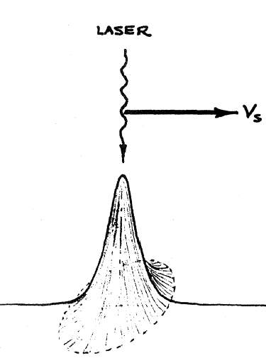
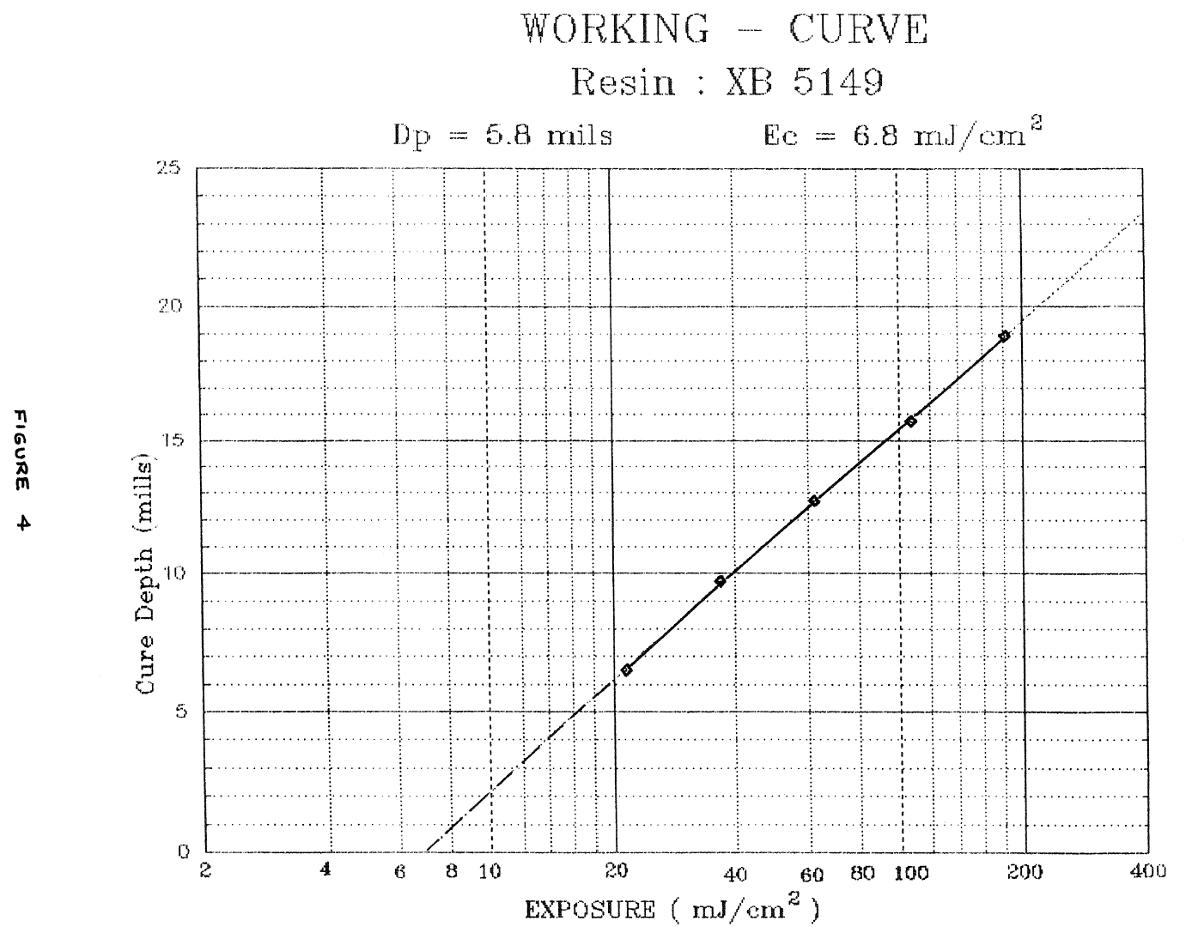
Jacobs (1992), at UT’s 1st SFF Symposium
‘SLA’ is described via the movement of a (Gaussian-distribution) laser on top of resin
The working curve is important:
x-axis = time * intensity (called “exposure”/ “dose”/ “dosage”)
y-axis = Cure Depth
Questions:
Is dosage always reciprocal?
How do you measure ‘degree of cure’ anyway, other than cure depth (which is only analogous)?
Beer-Lambert attenuation into the resin?
What happens below critical dose 6.8 mJ/cm²?

Slide 5
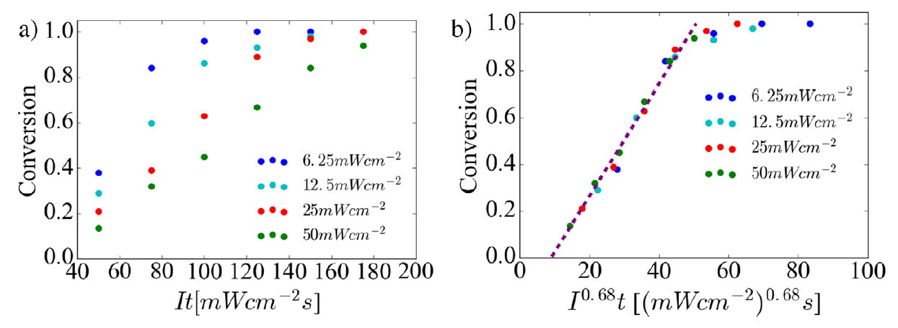
Q1: Reciprocal? or non-linear?
Dosage = I × t
But some people started noticing nonlinearities in the working curve (Wyden 2014, Rudenko 2024), but Uzcategui 2018 put it together and proposed an exponent ‘n’: i.e., Dosage = I^{n} × t
n = 0.68

Slide 6
Where does non-linearity come from?
Multi-step chemistries, so perhaps some later stage creates inhibitors, accelerators [sic]
Uzcategui: “While primary photochemical reactions such as absorbance and initiator cleavage follow the first order scaling of reciprocity, radical polymerizations are known for their sub-linear dependence on light intensity due to subsequent bimolecular radical termination…”
Crucially, pre-knowledge of the multiple steps is not needed
Multiple wavelengths which may act as …
Crucially, pre-knowledge of full spectra response is not needed

Slide 7
Where does non-linearity come from?
Stevens 2023 (Page group) also cite oxygen inhibition, optical self-focusing, optical scattering, heating (exotherms or from external light sources), photobleaching (resin turns from translucent to transparent after curing, allowing deeper conversions)
They investigate multiple wavelengths for conversion (only for LEDs), and their solution is to use a Recker-Jacobs equation which accounts for differential absorption

Slide 8
Let’s be clear on how they measured time
Uzcategui: not stated
Stevens: in a rheometer, starting from when they start the light
I suspect there is human error in starting a stopwatch, but what do I know

Slide 9
Implications
Will the n exponent capture all the secondary / higher-order effects?
Namely, exotherms, optical scattering / self-focusing / photobleaching, oxygen…
Conclusion: I don’t care, let’s just simulate it

Slide 10
Q2: We want to use ‘degree of cure’
Working curve’s ‘cure depth’ is only analogous to ‘degree of cure’ (DoC) / ‘degree of conversion’ / ‘conversion’
Let’s first be clear on how they measured depth
Bennett 2017: stylus profilometry uses a small force, but will not work well on the sides of the part. Confocal is good for that. Calipers are fine for rigid materials.

Slide 11
How they measured DoC: FTIR
FTIR shoots IR onto / into a sample
It comes back / goes through, and has to interfere with itself such that you can see the interference
The Fourier Transform will use the interference to break down the wavenumbers (cm⁻¹) absorbed: requiring chemistry pre-knowledge
Question: do they state which mode?
Transmission mode: goes through the entire thing
Question: if transmission, how thick? 1um? 1km?
Attenuated Total Reflection / Specular Reflection: just the surface
Question: if surface, like, 1um into the surface? 1nm?

Slide 12
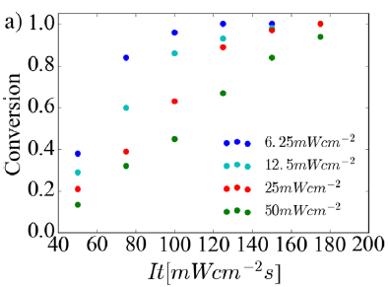
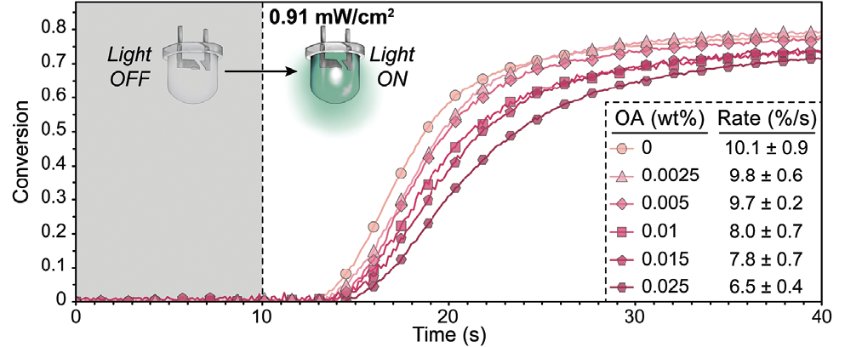
How they measured DoC: FTIR
Uzcategui 2018 (mode?) use real-time FTIR to measure acrylate monomer conversion.
Stevens 2023 fig 3ab: it doesn’t go to full?
Wydra (??), Mason, Kiker (100umTRANS) also not full
Page 2024 (50 or 100umTRANS), Gao 2024 (??) yes full
So do you care that it goes to 100% conversion?

Slide 13
How they measured DoC
Schroeder: Absorbance spectra
Create various samples, arrested at 5s, 10s, 15s, etc.
Shine the entire IR – Vis – UV range, see which absorbances change
I guess we rely on the fact (hope) that absorbance spectra change at all
Hoppe: Raman instead
About half of them don’t even measure DoC! E.g. Caplins, Rudenko, Li, Rau, Shusteff
Other methods? Atomic Force Microscopy, bulk rheology, bulk tensile/compressive testing?

Slide 14
Conclusion on DoC
Frankly, the only pixel-by-pixel data that we can get, in real time, is: AIE
AIE is when you shine a UV light, it fluoresces red light out
We can use a physical narrowband filter on the camera to grab the red light (with some tiny spillover of the UV light)
Note: AIE is known to start fluorescing when it’s already partially cured
Units = red light videoframe intensity (0~255 or 0~65535)
We will henceforth only use AIE results, and disregard all other results

Slide 15
Q3: unit area or unit volume?
VPP is 3D, but assumes each layer requires some intensity that is applied throughout that layer
We know that using Beer-Lambert law, light will attenuate (like sunlight propagating through seawater onto the seabed)
Blah blah, I don’t care until we set up the 3D

Slide 16
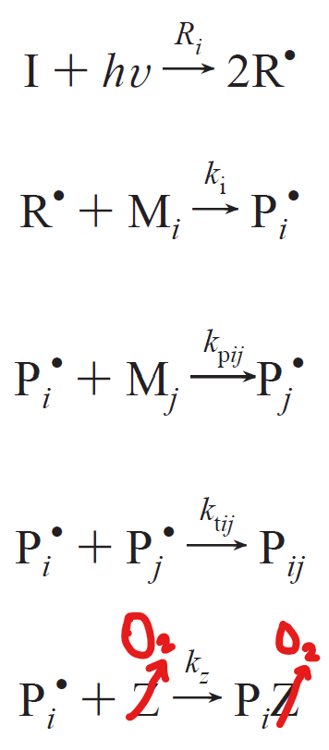
Q4: what happens before critical dose?
Bowman (UC Boulder), Taki (Kanazawa) groups check ALL chemical equations
Photo-Radicals● have a choice to either 2a. convert/polymerize or 2b. turn into peroxides (eat oxygen)
At least two papers suggest that 2a. occurs at a rate “two or more orders of magnitude” faster than 2b.
I.e. that 6.8mJ/cm² wait time is just to eat up all oxygen
1. Photo-initiation
2a. Conversion / polymerization
2b. Oxygen-eating

Slide 17
Q4: how we will model this
Calculate light incident per pixel
1. Radicals try to convert oxygen
2. Any leftover radicals try to increase cure
Cure
Radicals
Radicals
Cure
O₂
O₂
t
t
Next timestep
3. Any leftover light just goes to waste

Slide 18

Q5: Diffusion
Zak’s original idea was to model oxygen diffusion, and the assumption is that it causes blur
2 ways to model oxygen:
Fick’s Laws
$$φ_{new}=φ+\frac{D∆t}{∆x^{2}}\left(φ_{right}−2φ+φ_{left}\right)$$
≤½ per Courant’s FEA Law :- if you violate this, it goes negative, it doesn’t make physical sense, and would be unstable.
Or ≤¼ if in 2D
my left neighbor
me
my right neighbor
Due to the extremely small timesteps needed to fulfil Courant’s Law, this approach is NOT favored

Slide 19
Diffusion
2nd way to model oxygen: Gaussian convolutions, favored by Orth and the Swiss
https://en.wikipedia.org/wiki/Kernel_(image_processing)#Convolution
It gives the exact same results (to 8-bit accuracy) while running 10x faster

Slide 20
Diffusion
Any other diffusion? Photoradicals, photoinitiators, monomers
Much larger molecules, so technically the effects will be much smaller
So technically these are facilitators, in the sense that if a pixel has zero light, it’s possible for it to still cure if the neighbors have light.
We define oxygen as inhibitive diffusion, in the sense that if a pixel has light, it’s possible for it to NOT cure if the neighbors have zero light.
Hence, the inhibitive effect should be bigger than the facilitative effect
I.e., the effect for external corners is much bigger than internal corners (e.g., in an L-shape)

Slide 21
“Diffusion”
Any other contributors to blur?
Yes, light easily scatters / diverges during propagation through air, through the air-resin interface, etc.
We model it simply as a Gaussian kernel convolution (again)
For light, we blur light ONCE per simulation.
For oxygen, we blur oxygen every time step in each simulation.
This results in both facilitative and inhibitive effects

Slide 22
Setting up a simulation for VPP (2D at first), and comparing to experimental results

Slide 23
Model setup
Import original shape as the projected image
Light scattering
Oxygen is diffused by Fick’s Laws
Assume light = radicals
Next time-step
1. Radicals try to convert oxygen
2. Any leftover radicals try to increase cure
Cure
Radicals
Radicals
Cure
O₂
O₂
t
t
Chemical model in each pixel

Slide 24
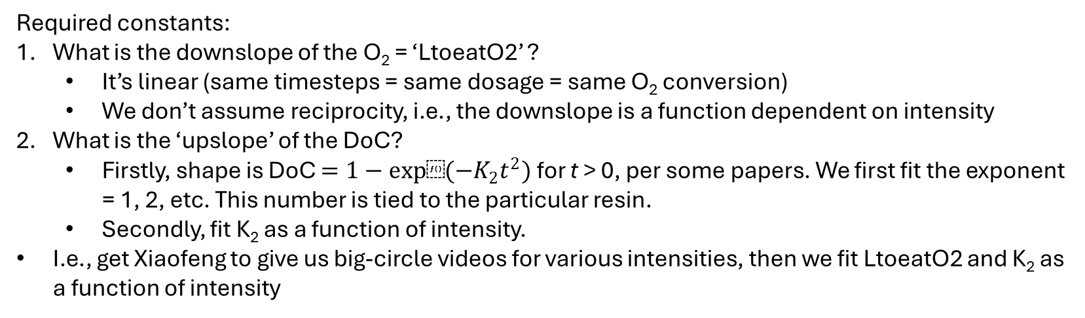
All required constants (for bulk curing)
Notes:
We change x-axis to ‘dosage’, assuming each timestep will receive the same amount of light
The DoC curve must come from AIE fluorescence units (0~255), nothing else
We have to disregard blurring effects, simply by asking Xiaofeng to do AIE videos on big circles, and we analyze only the middle of the circle (far away from diffusing edges)
DoC
O₂
Dosage
Required constants:
What is the downslope of the O₂ = ‘LtoeatO2’ ?
It’s linear (same timesteps = same dosage = same O₂ conversion)
We don’t assume reciprocity, i.e., the downslope is a function dependent on intensity
What is the ‘upslope’ of the DoC?
Firstly, shape is DoC $=1−exp⁡(−K_{2}t^{2})$ for t > 0, per some papers. We first fit the exponent = 1, 2, etc. This number is tied to the particular resin.
Secondly, fit K₂ as a function of intensity.
I.e., get Xiaofeng to give us big-circle videos for various intensities, then we fit LtoeatO2 and K₂ as a function of intensity

Slide 25
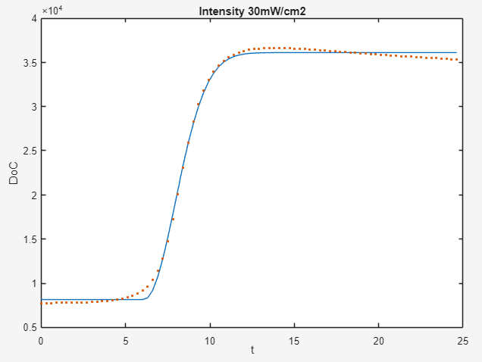

Bulk curing video example
Fitting C & D, ignore A & B which depend on camera
Repeat for all videos
B
Fit $y=A+\frac{B}{1−e^{−D{(\max_{}\left[t−C;0\right])}^{2}}}$
16-bit grayscale
D
C
A

Slide 26
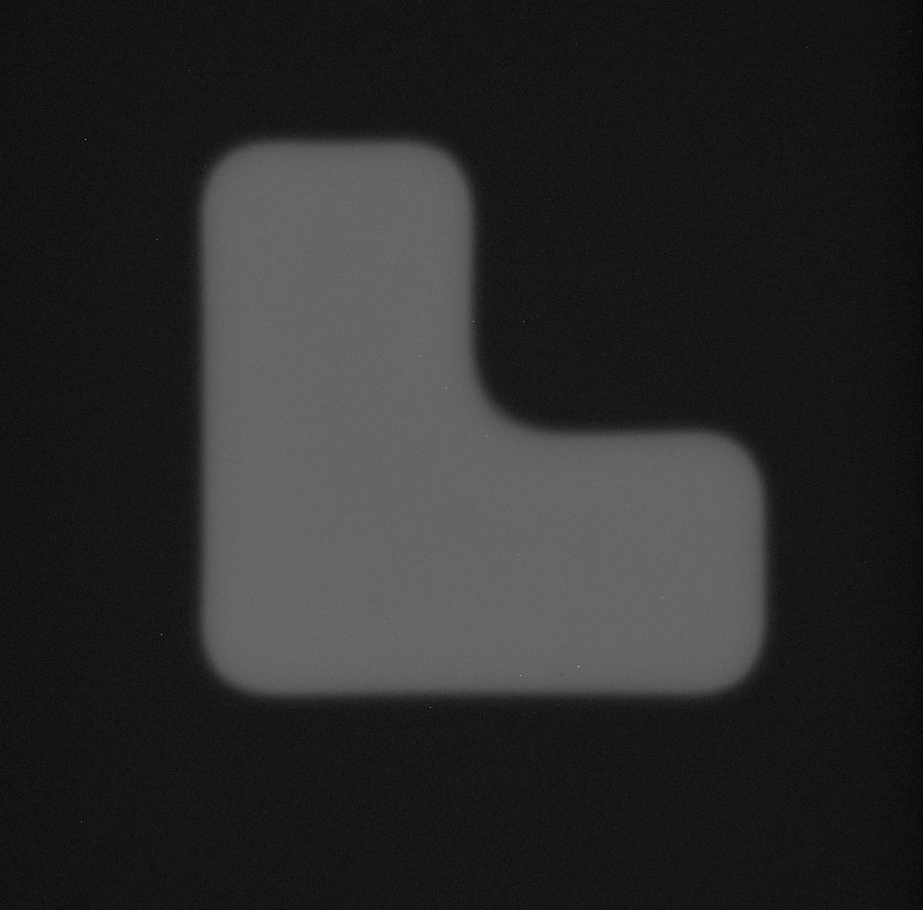



All required constants (for diffusive effects)
As before, get Xiaofeng to take some L-shape videos
Experimentally, we find that all blurring effects, when eyeballed to simulation results, give a very large error bar
Also, we find facilitative blurring effects ~ inhibitive, meaning, chemical effects are near zero. Most blurring comes from light scattering
Experimentally, she’s done two intensities: blurring doesn’t change a lot
Example experimental, t=2.8s
Simulation if kernel size is: 300um 500um 600um

Slide 27
Note for her videos
Technically, it’s fluorescence. Meaning, if no UV, then no red light
Which means, whenever we are interested in timestep t=?, we will STOP the UV light at that timestep, and then do a big blast of UV across the ENTIRE SETUP.
Note: any time the setup / resin changes, ask her to redo all videos

Slide 28
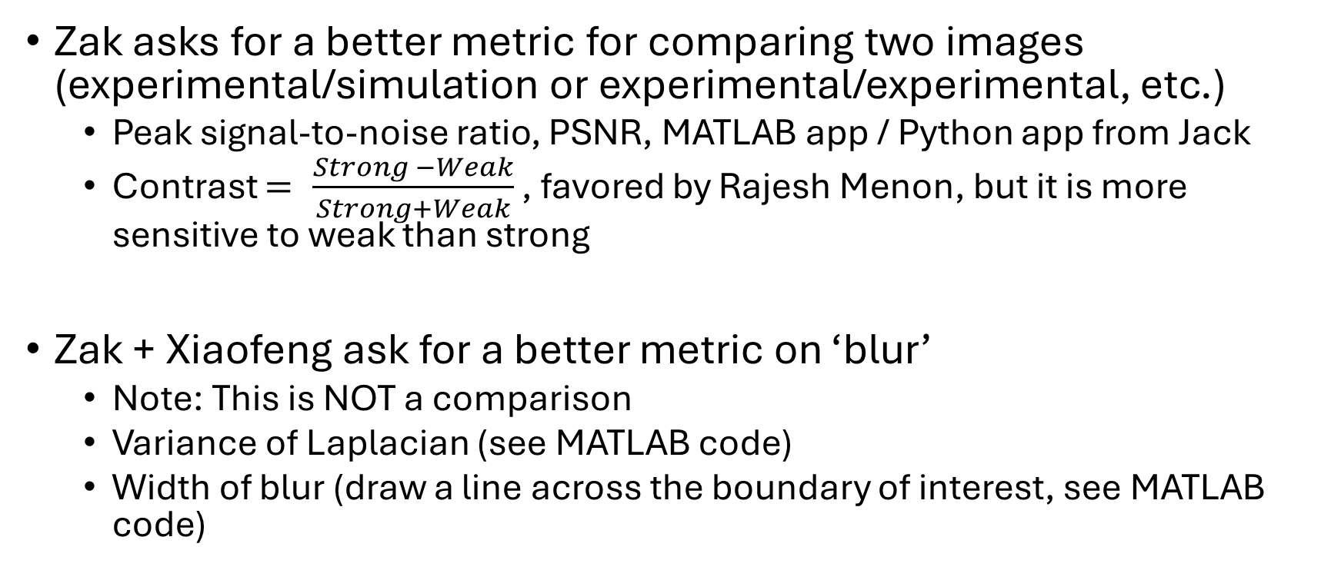
What are we really checking? ‘Blur’?
Zak asks for a better metric for comparing two images (experimental/simulation or experimental/experimental, etc.)
Peak signal-to-noise ratio, PSNR, MATLAB app / Python app from Jack
Contrast $= \frac{Strong −Weak}{Strong+Weak}$ , favored by Rajesh Menon, but it is more sensitive to weak than strong
Zak + Xiaofeng ask for a better metric on ‘blur’
Note: This is NOT a comparison
Variance of Laplacian (see MATLAB code)
Width of blur (draw a line across the boundary of interest, see MATLAB code)

Slide 29
Setting up the optimization

Slide 30
Machine learning to find minimum
y
How to find minimum, i.e., vary x until you get desired y?
Human way = trivial
Machine way, if we know the function:
Choose any one starting point
Calculate gradient
Take a small step rightwards to go downwards
Reach another point
Calculate gradient
Take a small step rightwards to go downwards
Reach another point
Calculate gradient
Take a small step rightwards to go downwards
…
Gradient is 0 = no further improvement
1,2,3
4,5,6
7,8,9
10
x
Caveats that we are not interested in:
Local minima
‘Small’er step = reduce learning rate ‘lr’

Slide 31
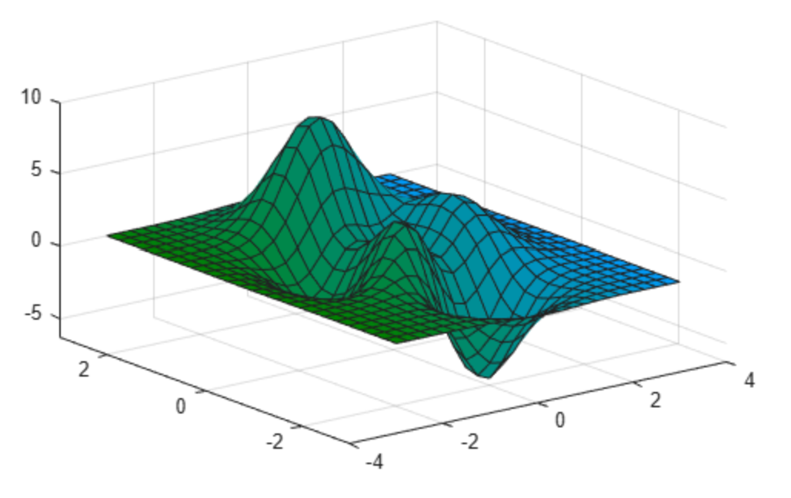
Machine learning as applied to us: x
The toy example only varies one x to find minimum y.
We can have multiple x-axes
Gradient is described in terms of x1, x2, …
Direction to move is therefore described in the same x1, x2, …
So obviously, we can vary all 300×300 pixels = we can vary 90,000 x-variables
y
x2
x1

Slide 32
Machine learning as applied to us: y
Can we have multiple y axes? NO, instead:
y = Σ(cure-target)² for all pixels, this is our ‘loss’
Think of loss as ‘wrong’ness:
If cure is 1 but target is 0, then wrongness = (1)² = 1
If cure is 0 but target is 1, then wrongness = (-1)² = 1
If cure is 1 and target is 1, then wrongness = 0
If cure is 0.5 and target is 1, then wrongness = 0.25
…
Hence sum up all the wrongness for the y

Slide 33
Machine learning as applied to us: y
Technically, in the loss, we have to specify the timestep
If we specify an intensity of 25mW/cm² and the target shape at t=1s, then the optimizer probably fails (duh)
So choose a reasonable timestep please
Choose multiple timesteps? Why not? Sum up each loss
We can target zero cure at t=13s, partial cure at t=16s, full cure at t=19s
All this is easy to do by converting numpy variables to PyTorch variables

Slide 34
Machine learning as applied to us: y
Taking a closer look: algorithm records the DoC
It requires a gradient! Zero gradient = doesn’t know where to move = optimizer stalls
DoC
O₂
Dosage
We simply add a tiny upslope so the optimizer knows where to move
DoC
O₂
Dosage

Slide 35
Side question
Is there always an answer? Assume one time-step: you have 300×300 inputs and 300×300 outputs, surely you always solve it?
Deconvolutions run into high-frequency noise issues
Even so, negative intensities will result
So no
To get better results, use smaller light-scattering blur values

Slide 36
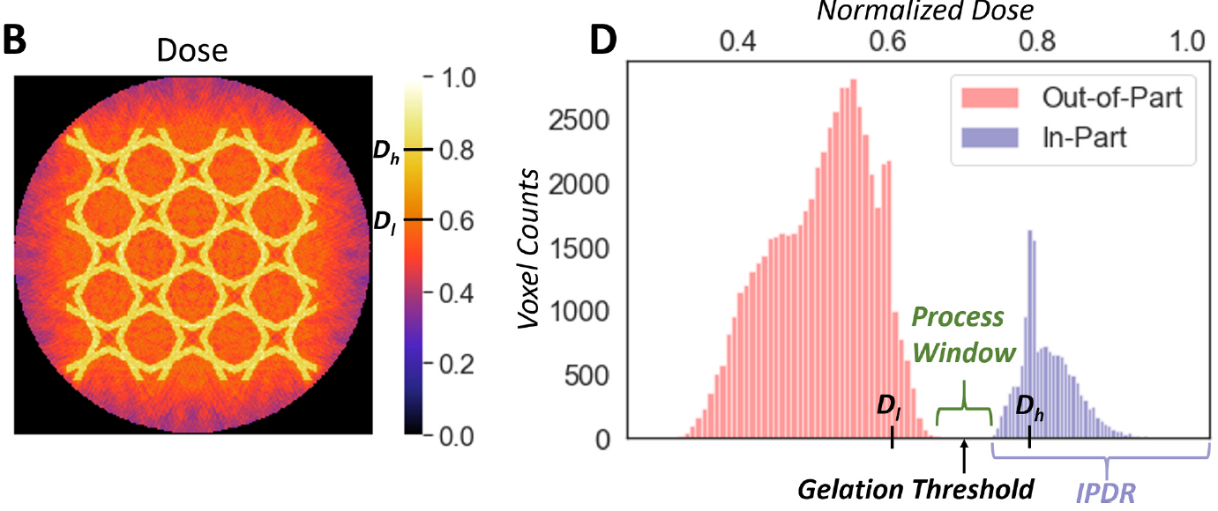
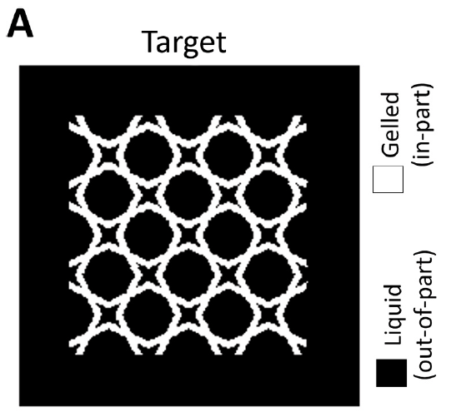
Side note: Rackson2021
Great idea from UCB’s Hayden Taylor: process (anti-)window
It works for CAL (not VPP exactly); no idea how to implement to us

Slide 37
Future work

Slide 38
Future work
Modeling TEMPO (another inhibitor) and PI diffusion?
Relatively (?) simple to add into the simulation
3D
The setup: take a picture of the top layer – do the bottom layers affect it?
nth layer’s light will affect n-1th layer – Beer-Lambert
Open-loop video
Both simulation and optimization will need tweaking
Closed-loop video
A. is it even possible? How many frames we talking about? Computer fast?
B. Control system

