Slide 1

US Oil markets volatility forecasting to make market decisions
Michael Obajemu

Slide 2
Agenda
Summary of the problem, approach, and findings
How the classification models were built
How the models were evaluated
How the models performed
Demo the chosen model to make market decisions
Conclusion

Slide 3
Introduction
This presentation addresses predicting the volatility changes for the West Texas Intermediate (WTI) crude oil index futures contract (ticker: CL=F)
The training data used in this experiment were the daily open, high, low, close, and volume (OHLCV) values from CY24
Notes:
Volatility forecasting is an important component of asset risk management and derivatives pricing in todays
financial markets. It serves as a useful gauge for assessing how much risk an investor is willing to tolerate
and how assets can be combined to diversify a portfolio and maximize returns
From these inputs, we
compute features such as log returns, the mean and standard deviation of returns, price range volatility
estimators, and volume dynamics.

Slide 4
Features selected
Features
Parkinsons estimator
Garman-Klass estimator
Rogers-Satchell estimator
Yang-Zhang estimator
Realized volatility
Rolling mean
Rolling standard of deviation
Volume change
Prior day log returns & volume
Five and ten day moving average of log return
Five and ten day unannualized volatility
Change in log return over five days
Five day rolling standard deviation
Notes:
The Yang Zhang estimator tries to address all the prior models limitations by combining overnight volatility
with a weighted average of open-to-close and Rogers-Satchell volatility. This results in a more robust
estimator than the ones previously mentioned
Realized volatility of log returns over the past window of annualized trading day. Which indicates how
bumpy the price has been on an annual basis
2. Rolling mean, an average log returns over the last window of days. It is a short-term volatility indicator
3. Rolling standard deviation, the standard deviation of log returns over the last window
4. Volume change, the day-over-day percentage change in trading volume. Often a indicator or confirma-
tion of price moves
5. The prior days log return and volume to add predictive power in the time series model
6. Five and ten day moving averages of log returns as a short term trend indicator
7. Five and ten day un-annualized volatility
8. The change in log return over five days to track momentum
9. Five day rolling standard deviation of log returns as a short-term volatility measure

Slide 5
Features ranked
Features | Coefficients
std_10 | 0.818186
rolling_std | -0.814477
std_5 | -0.814477
volatility_5 | -0.814477
yang_zhang | 0.788453
ma_10 | 0.293861
log_return | 0.196096
momentum_5 | 0.182764
Features | Coefficients
garman_klass | 0.171577
parkinson_vol | -0.152569
volume_lag1 | 0.150323
ma_5 | -0.106306
rolling_mean | -0.106306
rogers_satchell | -0.068182
volume_change | 0.053894
return_lag1 | 0.039189
Features chosen for training
Features | Coefficients
std_10 | 0.818186
rolling_std | -0.814477
std_5 | -0.814477
volatility_5 | -0.814477
yang_zhang | 0.788453
Notes:
Because there are so many predictor features, not all will be useful in predicting volatility, in fact some might
be extra noise for the algorithms to parse through. So, a Logistic regression model is trained to measure
which predictors contribute the greatest to predicting volatility
From the executed code to rank the coefficients: the features with the greatest predictive coefficients were
Rolling standard deviation, Yang Zhang volatility estimator, five and ten moving averages of log returns,
and five day rolling standard deviation of log returns.
Yang-Zhang volatility estimator being one of the highest contributors is in line with expectations as its key
feature is addressing the shortcoming of the Parkinson, Garman-Klass, and Roger-Satchell estimator of not
having overnight volatility as part of its computation

Slide 6
Models selected
Algorithm | Parameters choices
Decision tree | Max depth
Random forest | N-estimators
Logistic regression | Regularization strength C
K-nearest neighbor | Neighbors
Support vector machines | Regularization strength C , gamma
XGBoost | Learning rate, Max depth, N-estimators
LightGBM | Learning rate, N-estimators, number of leaves
Best parameter
{'max_depth': 3}
{'n_estimators': 200}
{'C': 1}
{'n_neighbors': 10}
{'C': 1, 'gamma': 0.01}
{'learning_rate': 0.1, 'max_depth': 3, 'n_estimators': 50}
{'learning_rate': 0.01, 'n_estimators': 500, 'num_leaves': 31}
Baseline models
Algorithm
Naïve bayes
Linear discriminant analysis
Notes:
To conduct the classification of volatility in the US oil markets, seven models were considered:
XGBoost or extreme and LightGNM gradient boosting is a gradient boosting algorithm that builds strong learners by
sequentially adding decision tree models to correct previous errors.
Since each classification tool have different parameters to optimize for, it is best to approach the experimen-
tation with which parameter maximize classification performance.
To accomplish this, a grid of parameter combinations was created. Firstly, the possible parameters were
specified in a grid and then GridSearchCV was used to take every possible parameter combination from the
grid and evaluates it to maximize its area under curve score. Since the data is time sensitive (meaning the
sequence of the data is important in the classification), a time series split was used to respect this ordering
for the cross validation evaluation.
The selected parameters from the grid search suggests that the default setting for models performed best
on the given dataset. For the Decision Tree, a shallow depth of 3 was best, indicating that a small number
of splits was sufficient and deeper trees likely led to overfitting. The Random Forest performed best with
the highest number of estimators tested (200), more trees typically reduce overfitting. Logistic Regression
model performed best with default regularization (C=1). The K-Nearest Neighbors chose 10 neighbors,
showing that mores neighbors helped reduce sensitivity to noise. For the Support Vector Machine, the
default regularization parameter (C=1) combined with a low gamma (0.01) resulted in a smoother decision
boundary. The dataset is likely reasonably linear or have simple non-linear separation. XGBoost performed
best with a small tree depth (3), a moderate learning rate (0.1), and fewer boosting rounds (50). LightGBM
selected a very slow learning rate (0.01), more boosting rounds (500), and a smaller number of leaves (31),
meaning that incremental learning with simple structures generalized better. Overall, the results point to a
dataset with enough data to classify well.
Na¨ıve bayes is a classifier based on Bayes theorem. It assumes conditional independence between features. It
is extremely fast to train and predict, handles high-dimensional data well, and requires comparatively little
training data.

Slide 7
Evaluating the algorithms
`getScore`: Plots a confusion matrix and build a classification report on each model
`plotAuc`: Plots all models on an ROC AUC to compare their performance to one another
`getFit`: Score the models on a fitting graph and output its cross validation per fold, mean, and standard deviation scores

Slide 8
Evaluating the algorithms
`getScore`: Plots a confusion matrix and build a classification report on each model
`plotAuc`: Plots all models on an ROC AUC to compare their performance to one another
`getFit`: Score the models on a fitting graph and output its cross validation per fold, mean, and standard deviation scores
Notes:
The ROC AUC plot curve is created by plotting the true positive rate against the false positive rate at
different threshold levels. The shape of the ROC curve provides insight into the performance of each model,
and the area under this curve (AUC) summarizes this performance.

Slide 9
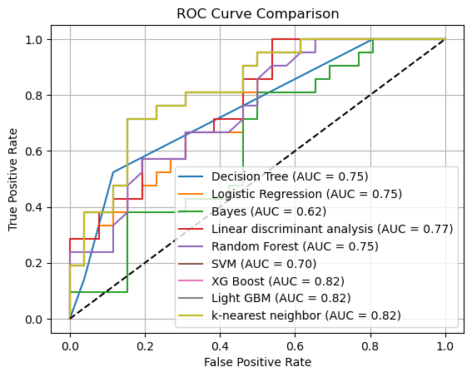
Evaluating the algorithms
Notes:
The AUC value is interpreted as the probability that a randomly chosen positive instance is ranked higher
than a randomly chosen negative instance, which is a useful metric for understanding model performance.
An AUC of 0.5 suggests that the model has no classification power, while an AUC of 1.0 indicates perfect
classification. Values between these extremes indicate varying levels of performance, with higher values
representing better model performance
The best performing models are
KNN (AUC: 0.822), XGBoost (0.82), and LightGBM (0.82). These scores indicate suggest these models
are capturing important patterns in the data.

Slide 10
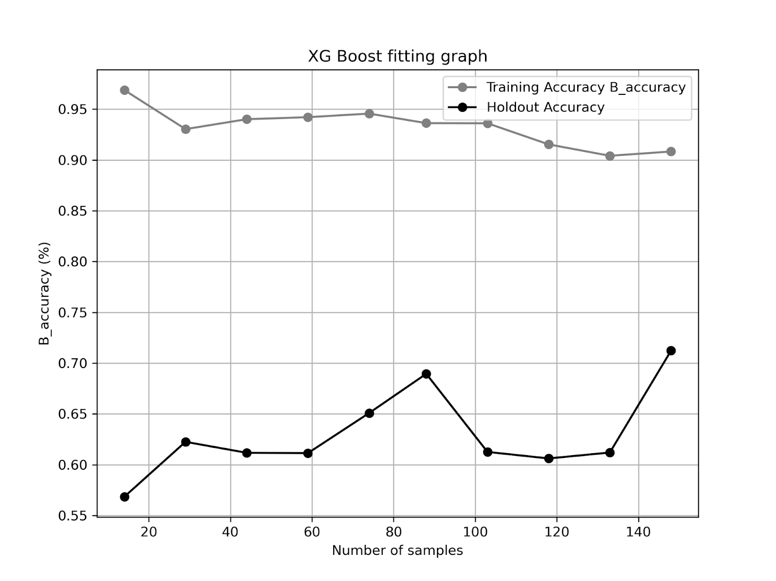
Evaluating the algorithms
Model | Mean balanced accuracy | Standard deviation | Cross validation scores
KNN | 0.6505 | 0.0246 | 0.618421052631579, 0.6710526315789473, 0.6228070175438596, 0.672514619883041, 0.6681286549707602
LightGBM | 0.6768 | 0.0536 | 0.6198830409356726, 0.7529239766081872, 0.72953216374269, 0.6432748538011696, 0.6388888888888888
XGBoost | 0.7123 | 0.1033 | 0.5423976608187134, 0.7529239766081872, 0.7032163742690059, 0.7002923976608187, 0.8625730994152047
Model | Accuracy | Macro precision | Macro recall
KNN | 0.55 | 0.28 | 0.50
LightGBM | 0.70 | 0.70 | 0.70
XGBoost | 0.74 | 0.74 | 0.74
Notes:
Balanced accuracy is used
for imbalanced datasets to account for class distributions
It compares the training
data to the holdout data (testing data) across each fold. If training and holdout scores are close and high, the
model generalizes well. If they are both low, the model under-fits. If training accuracy is high but holdout
is low, the model overfits. The mean and the standard deviation across scores are calculated as well. High
variance in fold score means the model performance is unstable. Consistently high scores signify a reliable
model. A low mean score indicates a poor performing model.
Accuracy: Indicates overall correctness
• Precision: Measures the accuracy of positive predictions, reflecting a models reliability
• Recall: Reflects the model’s sensitivity in identifying all actual instances of a class
• F1-score: Provides a balanced measure between recall and precision, especially useful in scenarios
with imbalanced datasets
KNN significantly underperformed, especially with a poor accuracy score, despite its decent AUC score. In
addition, though it has a low standard deviation across cross validation scores, it consistently underperformed
across each of its folds. LightGBM provided a stronger balances between precision and recall, indicating
better generalization and more reliable classification for both classes.
XGBoost has the highest mean balanced
accuracy, indicating it correctly identifies both classes. Though it has a higher standard deviation, it churned
out better accuracy. The cross validation results showed a mean balanced accuracy of 0.71, with some
variability across folds, suggesting that while performance can fluctuate slightly depending on the data split,
the model remains generally strong.

Slide 11
Deploy XGBoost in simulated environment
Capture testing data from January through April 2025
Recalculate new predictors and target
Get confusion matrix of testing data to track performance
Output a table of predicted volatility movement and confidence

Slide 12
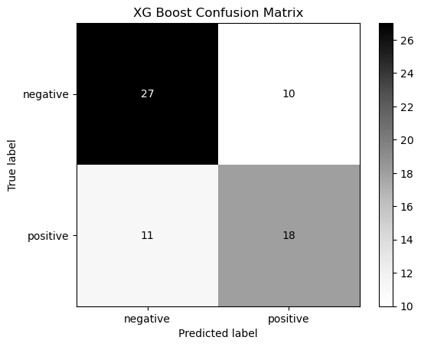
XGBoost performance in simulated environment
 | precision | recall | f1-score
Volatility down | 0.71 | 0.73 | 0.72
Volatility up | 0.64 | 0.62 | 0.63
Accuracy | 0.68
Precision | 0.68
Recall | 0.68
Notes:
The confusion matrix shows that the model performs well in separating between volatility down and volatility
up. Out of 66 total predictions, it correctly classified 27 instances of volatility down and 18 instances of
volatility up. There were 10 cases where volatility down was misclassified as up and 11 where volatility up
was incorrectly predicted as down.
The model demonstrates slightly better precision and recall when predicting volatility down compared to
volatility up. However, the number of misclassifications is fairly even between both classes. On the January
to April 2025 new data, it achieved an average accuracy, precision, and recall of 0.68, demonstrating some
reliability in generalization.

Slide 13
Deploy XGBoost in simulated environment
Consider the following scenario:
  It is December 2024 and we are employees in a small hedge fund.
  The fund wants to adjust its options exposure to West Texas Intermediate (WTI) by monitoring the corresponding futures contracts.
  We have a maximum budget of $100,000 per day of trading, scaled according to the confidence of the volatility prediction using Kelly-type sizing.
  We've set our threshold for going long (+1) or short (–1) if the predicted probability of a volatility increase/decrease exceeds 0.8 and 0.7 accordingly.

Slide 14
Deploy XGBoost in simulated environment
Date | Volatility down | Volatility up | Max Prob | Volatility pred | Signal | Order size
18/03/2025 | 0.560455 | 0.43954498 | 0.560455 | Down | No Trade | No trade
19/03/2025 | 0.19774407 | 0.8022559 | 0.8022559 | Up | Buy | 60451.18570327759
20/03/2025 | 0.2408874 | 0.7591126 | 0.7591126 | Up | No Trade | No trade
21/03/2025 | 0.09110236 | 0.90889764 | 0.90889764 | Up | Buy | 81779.52766418457
24/03/2025 | 0.17945278 | 0.8205472 | 0.8205472 | Up | Buy | 64109.4446
25/03/2025 | 0.05263597 | 0.94736403 | 0.94736403 | Up | Buy | 89472.80645370483
26/03/2025 | 0.04036707 | 0.95963293 | 0.95963293 | Up | Buy | 91926.5866
27/03/2025 | 0.04036707 | 0.95963293 | 0.95963293 | Up | Buy | 91926.5866
28/03/2025 | 0.04036707 | 0.95963293 | 0.95963293 | Up | Buy | 91926.5866
31/03/2025 | 0.31573945 | 0.68426055 | 0.68426055 | Up | No Trade | No trade
01/04/2025 | 0.774837 | 0.22516295 | 0.774837 | Down | Sell | 54967.403411865234
02/04/2025 | 0.20688105 | 0.79311895 | 0.79311895 | Up | No Trade | No trade
03/04/2025 | 0.9490281 | 0.05097191 | 0.9490281 | Down | Sell | 89805.6149
04/04/2025 | 0.96998173 | 0.0300183 | 0.96998173 | Down | Sell | 93996.34599685669
07/04/2025 | 0.96998173 | 0.0300183 | 0.96998173 | Down | Sell | 93996.34599685669
08/04/2025 | 0.96998173 | 0.0300183 | 0.96998173 | Down | Sell | 93996.34599685669
09/04/2025 | 0.96998173 | 0.0300183 | 0.96998173 | Down | Sell | 93996.34599685669
10/04/2025 | 0.96998173 | 0.0300183 | 0.96998173 | Down | Sell | 93996.34599685669

Slide 15
Conclusion
Short-term volatility indicators like 5-day and 10-day rolling std deviations, and Yang-Zhang estimator, were the strongest predictors for near term volatility.
Nonlinear boosting models (XGBoost, LightGBM) outperformed traditional linear models.
Volatility forecasting with machine learning is a key for enabling investors to trade and price options more effectively.
Possible future improvements include adding macro factors and high-frequency data to enhance the model.

