Slide 1
Big data project presentation
Matija Bažec, Matic Zadobovšek

Slide 2
Completed tasks so far
T0: Data preparation
T1: Data processing
T2: Data quality
T3: Exploratory data analysis
T5: Data augmentation
T6: Streaming
T8: FHVHV market impact

Slide 3


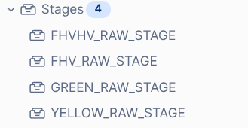

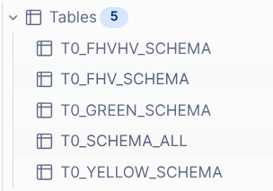
T0: Data preparation (BRONZE layer)
Get missing parquet files
2. Upload to Snowflake BRONZE stage
3. Tables with info about column names and data types
Notes:
First, we used missing_data.py on the Arnes HPC cluster to download parquet files that were missing from the provided dataset. Then snowflake.py uploaded all raw parquet files into Snowflake internal stages in the BRONZE layer. Finally, t0.sql created schema overview tables, so we could compare column names and data types across years and datasets.

Slide 4
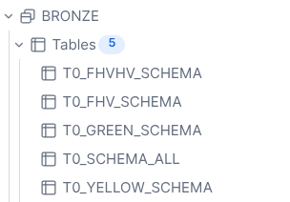
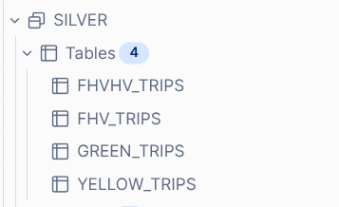
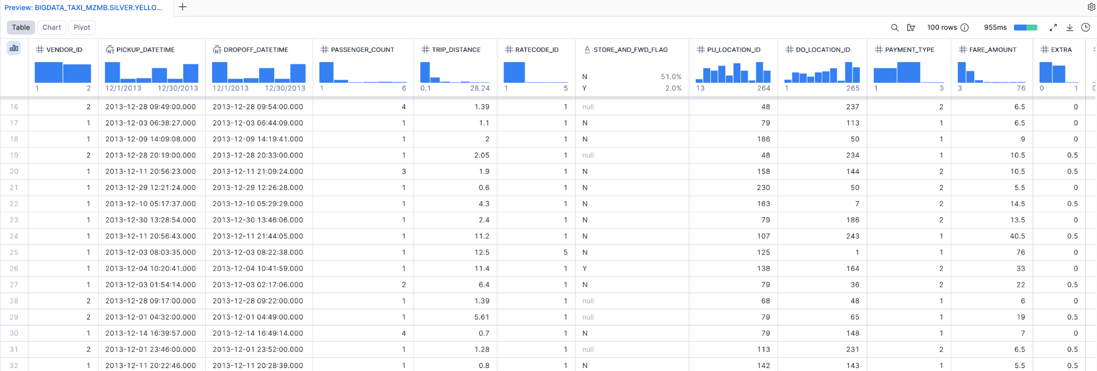
T1: Data processing (SILVER layer)
Schema unification
Standardize column names and data types
Add pickup_year, pickup_month
Notes:
In T1 we moved from the raw BRONZE layer into the SILVER layer. The main problem was that the parquet files are not perfectly consistent across years, so in t1.sql we unified schemas, standardized column names and converted changing data types. We also added pickup_year, pickup_month and source_file, which makes later filtering and quality checks easier. The result is four clean structured SILVER tables: Yellow, Green, FHV and FHVHV trips. At this stage we did not remove bad rows yet; that is done in T2.

Slide 5
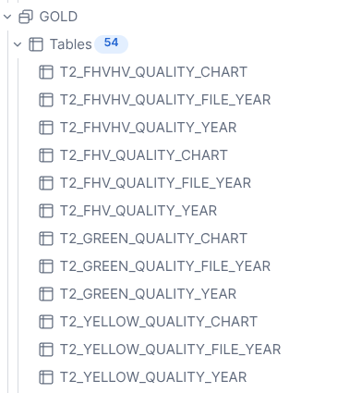
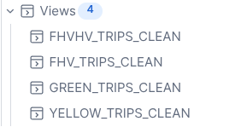
T2: Data quality (GOLD layer summaries)
- invalid pickup year
- pickup outside source month
- dropoff before pickup
- zero/nonpositive distance
- negative fare/amount
- invalid passenger count
Notes:
In T2 we checked the quality of all four Silver datasets. For each dataset we calculated file-year level quality statistics and then aggregated them by year in the Gold layer. We checked things like impossible years, pickup outside the expected source month, dropoff before pickup, zero distance, negative fares, and invalid passenger count. Based on these results we created reusable clean views in the Silver layer. These clean views are now the base for later exploratory analysis and augmentation.

Slide 6
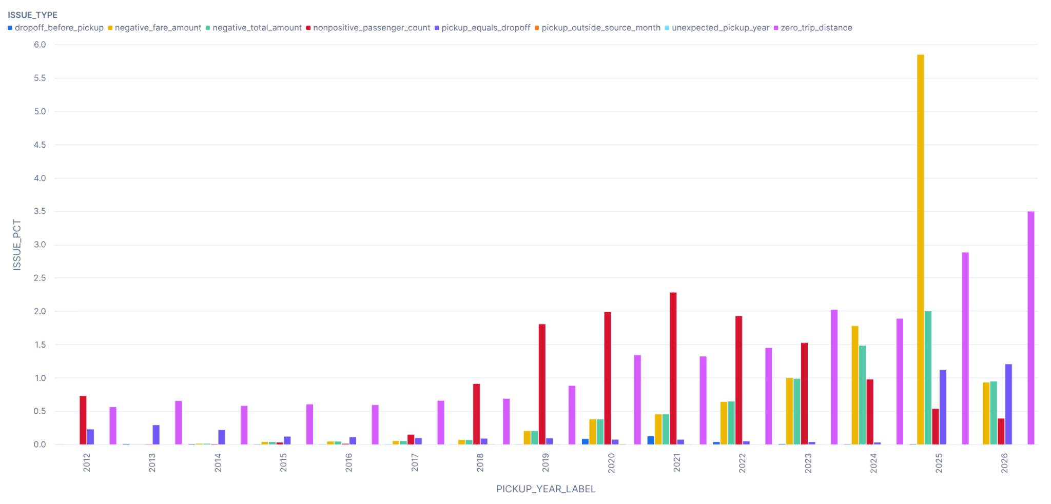
T2: Data quality (GOLD layer)
Notes:
The chart here is an example for Yellow Taxi. It shows the percentage of rows with each issue by pickup year.

Slide 7
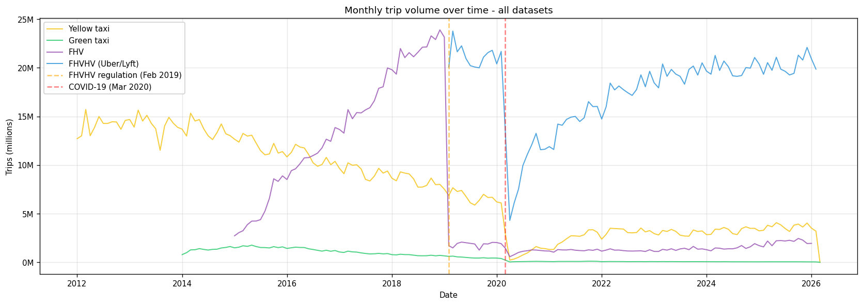
T3: Exploratory data analysis

Slide 8
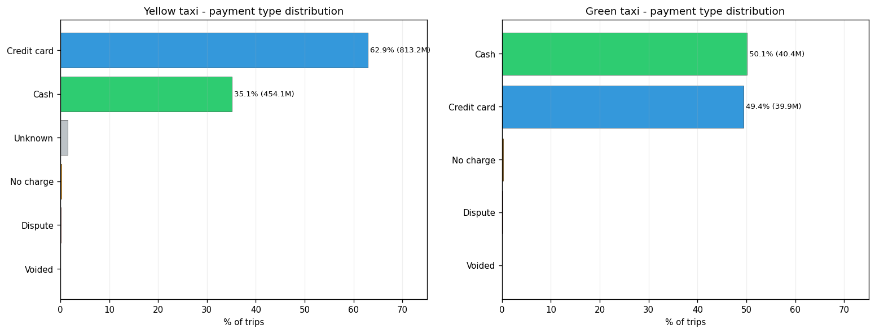
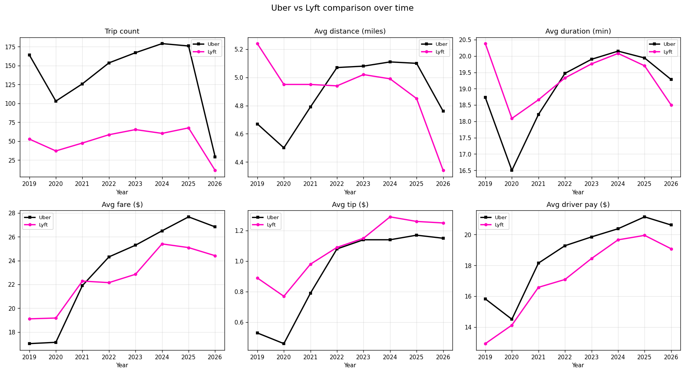
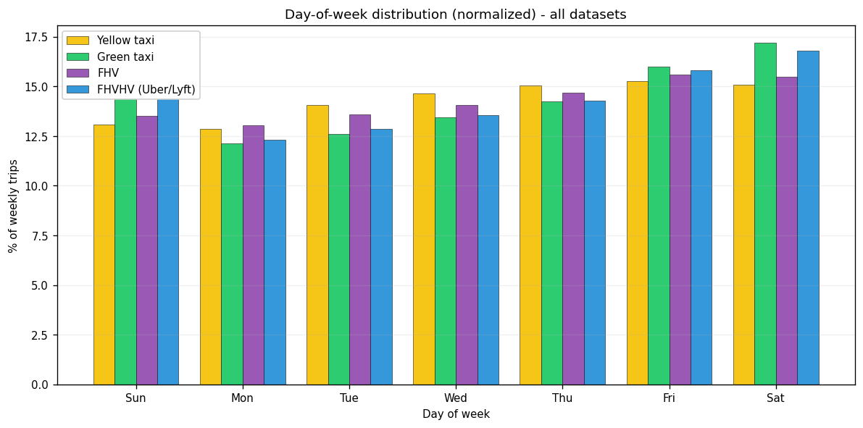
T3: Exploratory data analysis

Slide 9
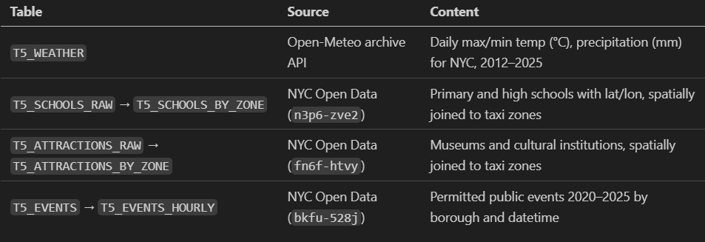
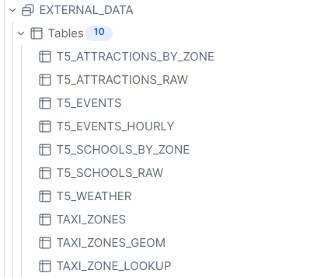
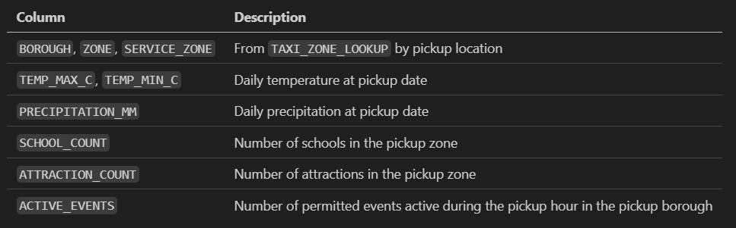
T5: Data augmentation

Slide 10





T6: Streaming
Kafka topics: t6-yellow-2021 / t6-fhvhv-2021
Combined Yellow + FHVHV trips for 2021
Replay ordered trips into Kafka
ingested messages into GOLD
Snowflake Kafka connector
Rolling 24h stats: boroughs + top 10 locations
BIRCH clustering algorithm = builds a clustering-feature tree and clusters rows
Notes:
For T6, we implemented the streaming task. We combined Yellow and FHVHV trips for 2021 into one source table, then a Python producer replayed ordered trips into two Kafka topics: one for Yellow and one for FHVHV. From Kafka, we had two paths. The Snowflake Kafka Connector ingested messages into a Gold landing table, where we computed rolling 24-hour statistics for boroughs and top 10 locations: count, mean and standard deviation for distance, duration and fare. The second path was a custom Python consumer using BIRCH. It consumed the Kafka stream in batches, converted trips into numeric features, and incrementally built a clustering-feature tree. At the end, we summarized it into 6 clusters.

Slide 11
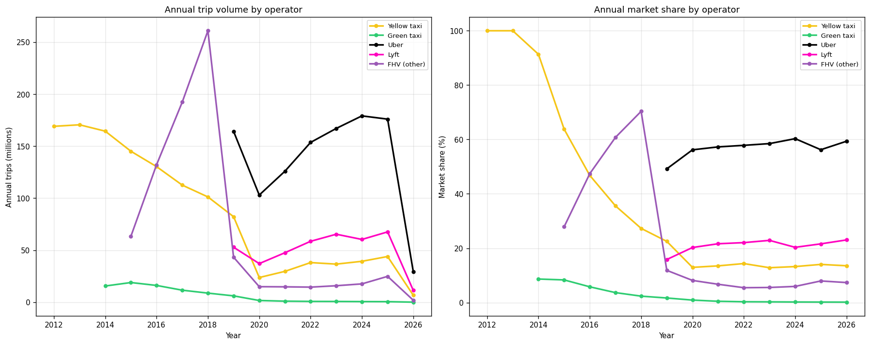
T8: FHVHV market impact

