Slide 1

Social Engineering
Olfsen Valones, 220274X
Module Group: IT1653-02

Slide 2



Content
Introduction
Nature of Social Engineering
Threat Mitigation
Case Study
References & Sources
Notes:
Brief Introduction
Nature of the threat: Factors considered in a social engineering attack
Measures taken to counter social engineering
Case Study of social engineering in action

Slide 3
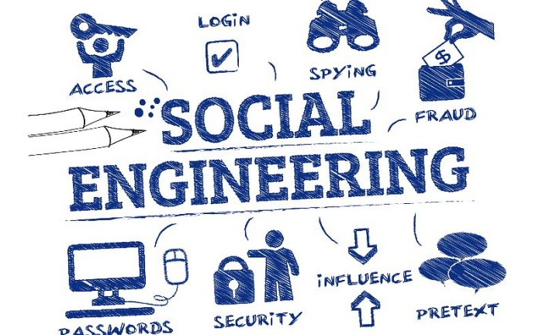
Introduction
The exploitation of human psychology to gain access to personal information and protected systems
Social engineering is an easier vector of attack than hacking into a system
Kenton, W. (2022, March 28). What is social engineering? Investopedia. Retrieved July 7, 2022, from https://www.investopedia.com/terms/s/social-engineering.asp
Notes:
Social engineering relies on human interaction and targets human psychology by gaining trust and influencing them
Compared to hacking attacks like brute-forcing or port scanning, social engineering has shown to be an easier method of attack

Slide 4

Factors & Targets
Nature of Social Engineering

Slide 5
Factors & Targets
How?
When?
Who?
Information gathering
Selecting an attack method
Phishing, Vishing, etc.
Engaging the target
Obtaining sensitive information from the target
Exit, remove all traces of interaction
Individuals are tempted with offers that seem too good to be true
Information is leaked through conversations
Data stored through unsecure means
Passwords stored in plaintext
Written on pieces of paper
Doing confidential work in public
Prone to shoulder surfing
Individuals
Organizations
Notes:
Information gathering: names, job position, current activities,
Selected method: email, call etc.
Engaging target with gathered information to appear legitimate
Obtaining internal information through interaction
Exiting with no trace once they’re satisfied
Too good to be true: promotion for item on ecommerce
Leaked through conversations

Slide 6
Impact of Social Engineering
LLP, F. & L. (2022, February 25). No surprise that phishing & spearphishing (BEC) attacks are increasing!: Foley & Lardner LLP. Blogs | Internet, IT & e-Discovery Blog | Foley & Lardner LLP. Retrieved July 7, 2022, from https://www.foley.com/en/insights/publications/2022/02/no-surprise-phishing-spearphishing-increasing#:~:text=The%20study%20shows%20that%20in,startling%2046%25%20increase%20over%202020.
Notes:
A report done in 2022 found out that 37% of organizations reported to be a victim of a phishing attack. While in 2021 that number is now at 83%
2022 is expected to have a much higher figure with an expected of 6 billion additional phishing attacks expected to occur throughout the year

Slide 7
Countermeasures
Threat Mitigation

Slide 8
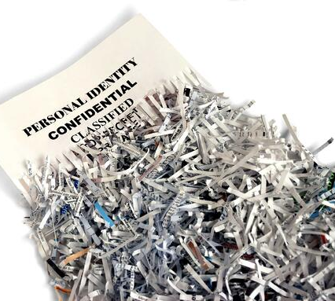
Shred Documents
Notes:
Prevents Dumpster diving, a non-technical way of reconnaissance attacks
Prevents attackers from obtaining system documentation and diagrams
Notes of passwords in post-it notes

Slide 9

Ask questions
Notes:
Ask questions about the individual:
Get proof of their identity
Am I pressured to act on something that could have negative consequences?
Reasons for the interaction
Be skeptical of their intentions
Just as they ask questions about you, you can do the same and piece things together about a possible attack

Slide 10

Be aware of your surroundings
Notes:
Attackers can gather information on you by just observing you from a distance:
Seeing how you type passwords to the contents that you are working on in public
Be aware of your surroundings from any eyes that seem too interested in what you’re doing

Slide 11
Case Study
Twitter phishing attack
July 15th , 2020

Slide 12
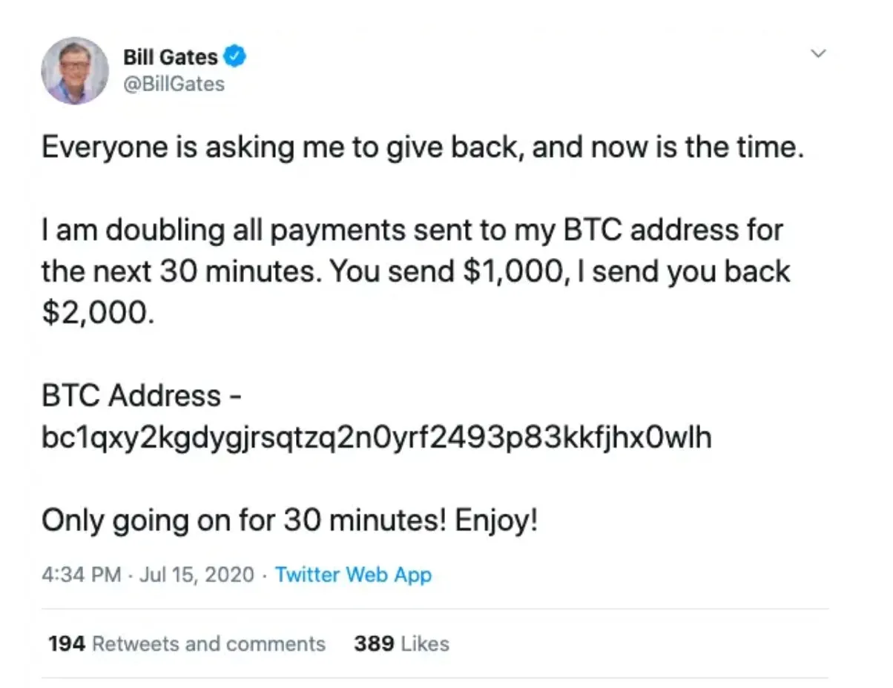
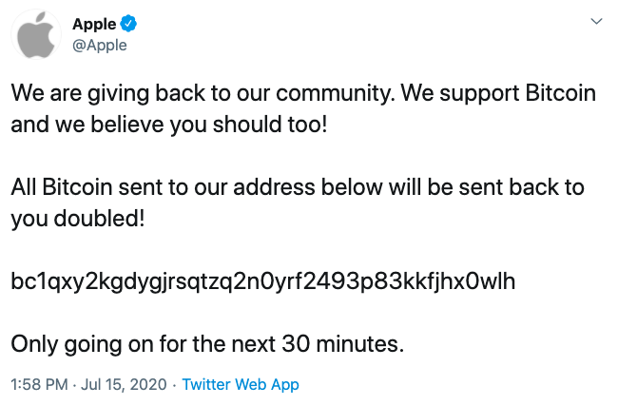
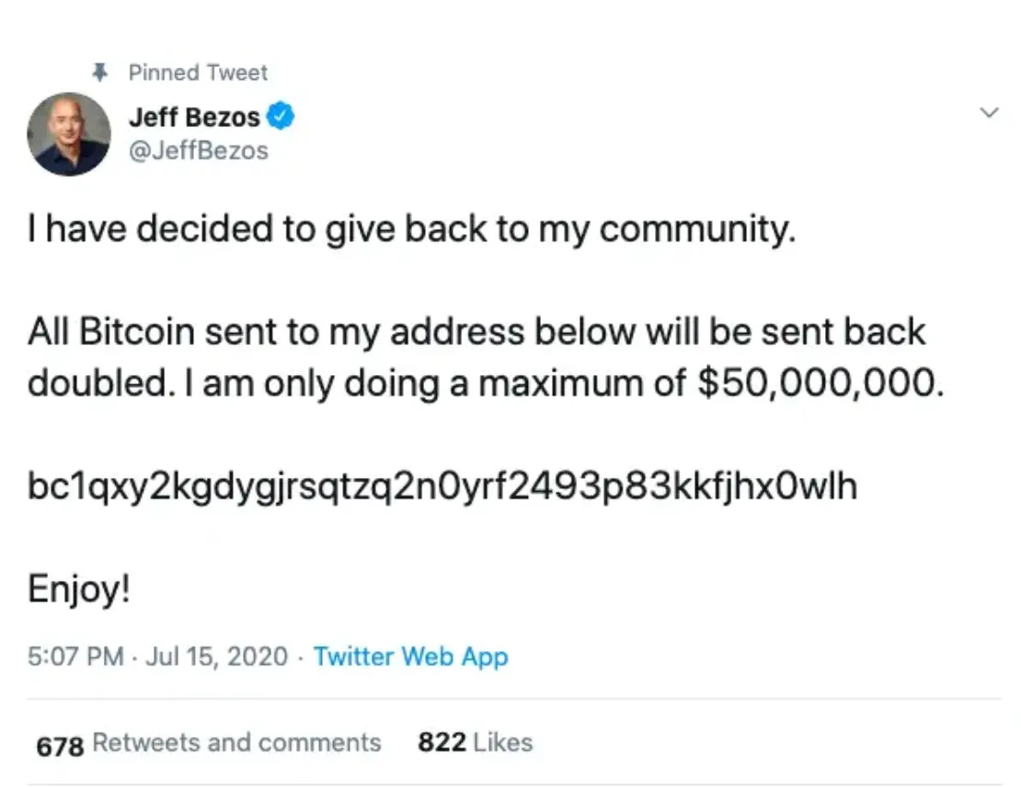
Republic World. (2020, July 16). From Elon Musk to Apple: Here is a list of all verified twitter profiles hacked on July 16. Republic World.
Retrieved July 9, 2022, from https://www.republicworld.com/technology-news/social-media-news/twitter-jack-dorsey-bitcoin-scam-twitter-hacked-barack-obama-elon-musk.html

Slide 13
Context
What happened?
Consequences
Action taken
A spear-phishing attack
Mastermind posed as a Twitter employee, selling accounts while 3 others carried out Bitcoin scams
U.S agencies among targeted
45 accounts tweeted from
High profile accounts
12.86 BTC (USD$117,000 at the time) stolen from victims
USD$277,000 (as of July 9th, 2022)
Programs to educate staff
Detect phishing emails
Improving security with:
2-Factor Authentication
Preventing inappropriate access
Least Privileges
What happened during the Twitter Spear-phishing attack? TeamPassword. (n.d.).
Retrieved July 9, 2022, from https://teampassword.com/blog/what-happened-during-the-twitter-spear-phishing-attack
Notes:
A target-phishing attack

Slide 14


Thank You

Slide 15
Sources:
https://www.foley.com/en/insights/publications/2022/02/no-surprise-phishing-spearphishing-increasing#:~:text=The%20study%20shows%20that%20in,startling%2046%25%20increase%20over%202020.
https://www.imperva.com/learn/application-security/social-engineering-attack/
https://octopus-office.co.uk/shoulder-surfing-how-to-avoid-it/
https://www.techtarget.com/searchsecurity/definition/shoulder-surfing
https://www.flickr.com/photos/wingedwolf/5471047557
https://www.gilmoreservices.com/blog/the-dangers-of-being-careless-about-document-shredding-in-medical-offices
https://en.wikipedia.org/wiki/Social_engineering_(security)
https://www.social-engineer.com/download/105311/
https://www.youtube.com/watch?v=YVqurfWzB-Q
https://www.youtube.com/watch?v=JraHV1ai9eQ
https://journals.sagepub.com/doi/full/10.1177/20552076221081716
https://www.investopedia.com/terms/s/social-engineering.asp
https://teampassword.com/blog/what-happened-during-the-twitter-spear-phishing-attack
https://www.imperva.com/learn/application-security/social-engineering-attack/

