Slide 1
SNSP Project
Team Members: Olfsen, Mark Joseph, Jiun Jie

Slide 2
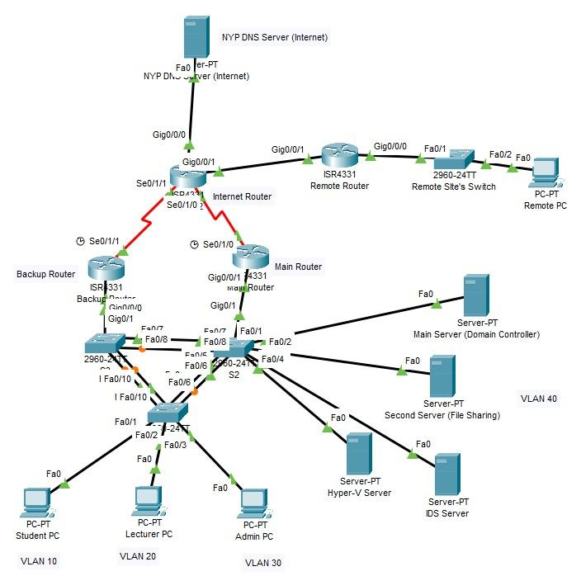
Network Topology

Slide 3
Security Features
Olfsen: IDS, HSRP Authentication, Zone-Based Firewall
Mark: GPO, Bitlocker, Site-to-Site VPN, AAA, Port Security
JiunJie: SSH, OSPF Type 2 authentication, DNSSEC

Slide 4
Penetration Testing
Olfsen: NMAP, SMBClient, Reverse Shell, Remote Desktop
Mark: GPO (RBAC)

Slide 5
OSPF Authentication (Type 2)
Type 2 authentication uses the MD5 algorithm to compute a hash value from the outgoing OSPF packet contents and the password configured on the interface.

Slide 6
SSH
Secure Shell (SSH) protocol is a method for securely sending commands to a computer over an unsecured network.
SSH uses cryptography to authenticate and encrypt connections between devices.

Slide 7
DNSSEC
The Domain Name System Security Extensions (DNSSEC) is a feature of the Domain Name System that authenticates responses to domain name lookups

Slide 8
IDS (Intrusion Detection System)
A dedicated server used that monitors received traffic by a router
Looks at TCP, UDP, and ICMP traffic
Logs archived into a pcap file for a manual review

Slide 9
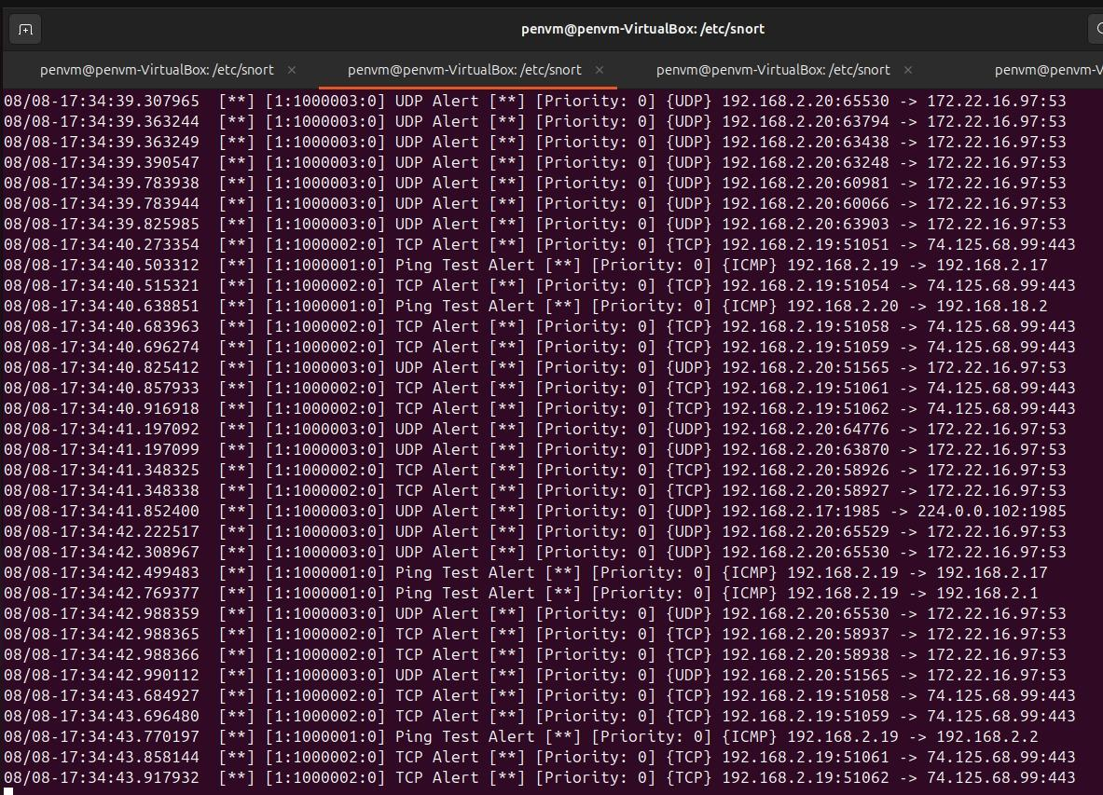
IDS (Intrusion Detection System)

Slide 10
HSRP Authentication
HSRP authentication ensures that Hello packets sent from a router is not spoofed
Protects altering records that could result in a change of the active router and sends it to a bad actor instead
Configured on sub-interfaces of Main and Backup Router

Slide 11
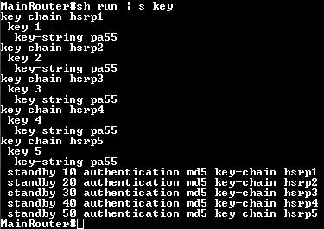
HSRP Authentication

Slide 12
Zone-Based Firewall
Stateful firewall
Tracks connection to and from the router
Sets zones and enforce ACLs on it
Inspects packet either based on all entries in an ACL or one (all or any)

Slide 13
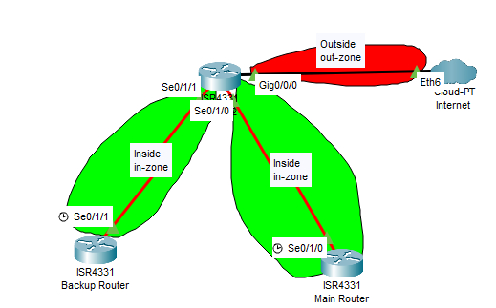
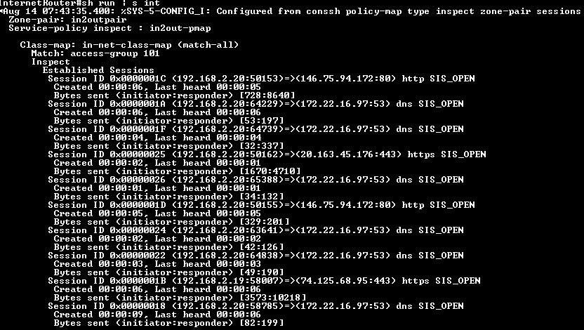
Zone-Based Firewall

Slide 14
Reverse Shell (Pentesting)
SMBClient was used to drop malicious payload that initiates connection to attacker
Attacker listens on set port and establishes connection
Attacker has full control over victim PC through a terminal

Slide 15
Remote Desktop (Pentesting)
XFreeRDP was tested against credentials to remotely create a session from outside the domain
Can cause similar damage to Reverse Shell exploit

Slide 16
Port Security
Layer 2 security for access ports and trunk ports
Limits are set to number of devices that can connect to the interface
If limit is met, a violation condition triggers
Storm control sets a threshold to prevent switches from being overwhelmed by broadcast packets

Slide 17
STP (Spanning Tree Protocol)
Created to prevent Layer 2 loops within the network
Portfast reduces the time for end devices to join the network
BPDUGuard is enabled prevents BPDUs from being sent to unintended places (e.g end devices)

Slide 18
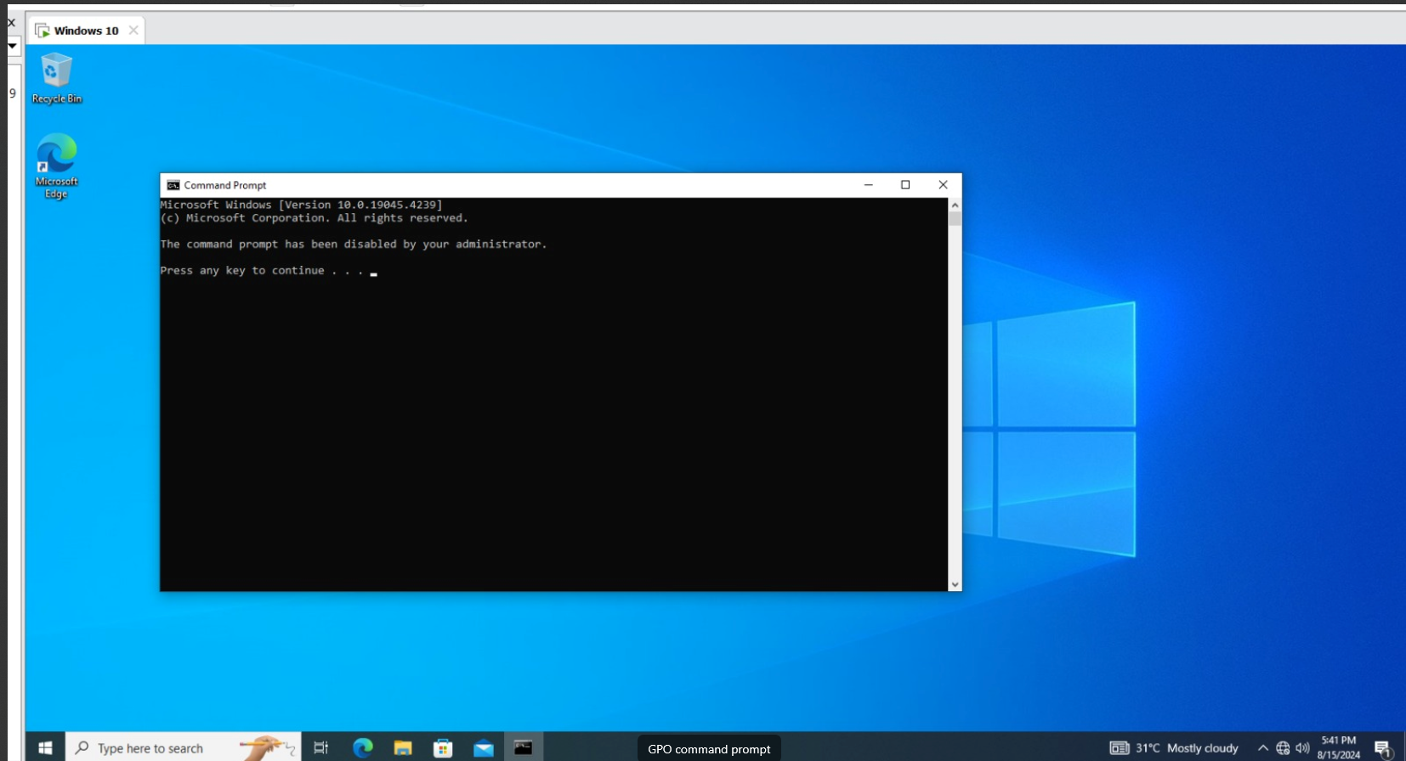
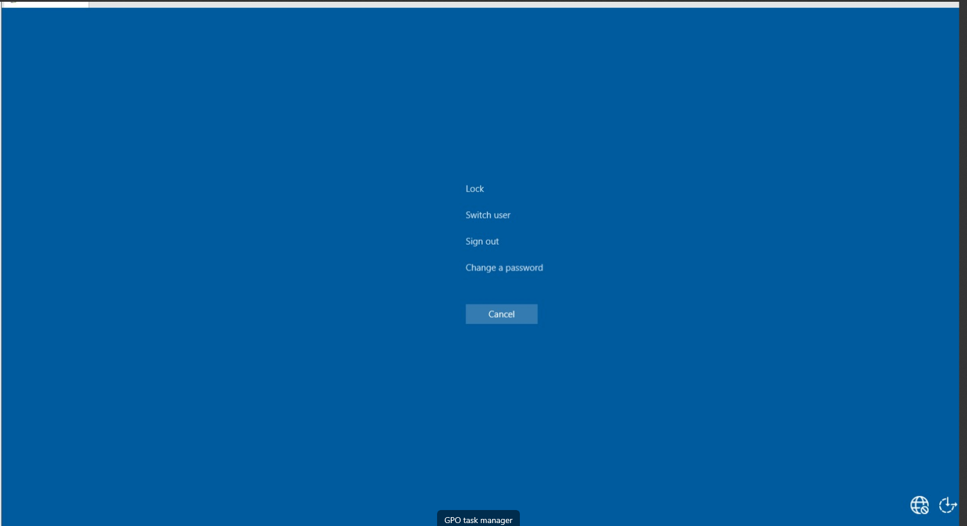
GPO RBAC (Student’s POV)

