Slide 1
Chapter 1: Introduction
Overview of Operating Systems

Slide 2
Definitions of Operating Systems
Many definitions
An OS is a program that is an intermediary between the hardware and the user and enables user to execute programs conveniently and efficiently.
An OS is a resource allocator that manages all the resources of the system and decides between conflicting requests for efficient and fair resource use.
An OS is a control program that controls execution of programs that prevents errors and improper use.

Slide 3
Computer System Structure
Computer system can be divided into four components:
Hardware: basic computing resources e.g. CPU, memory, I/O devices
Operating system: controls and coordinates use of hardware among various applications and users
Application programs: use system resources when executed to solve the computing problems of the users, e.g. word processors, compilers, web browsers, database systems, video games
Users: e.g. people, machines, other computers

Slide 4
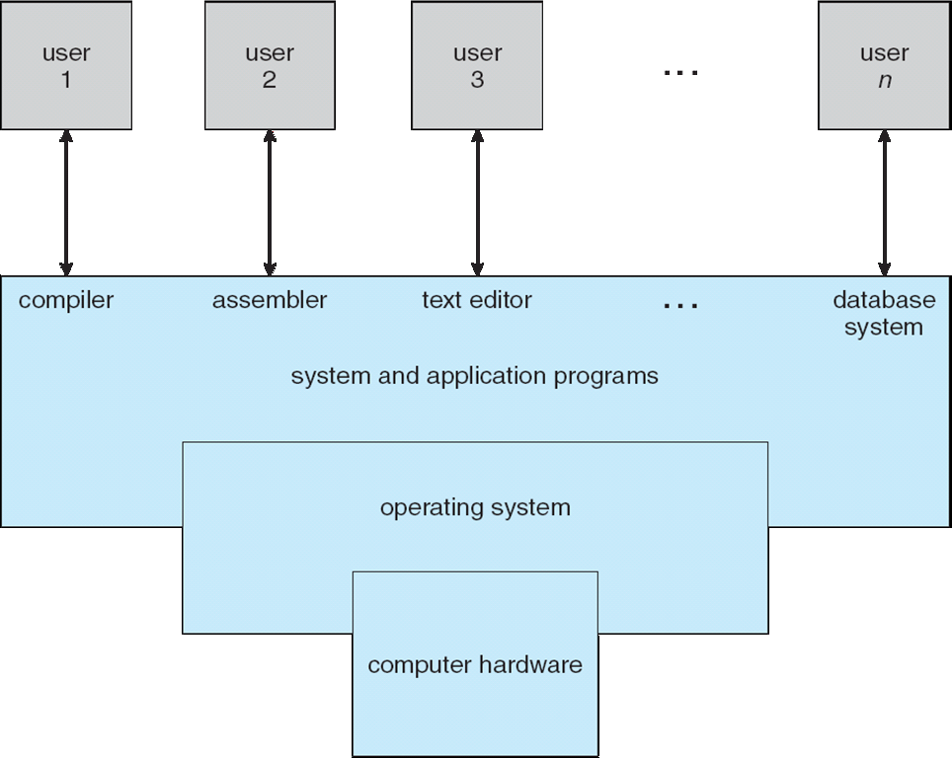
Four Components of a Computer System

Slide 5
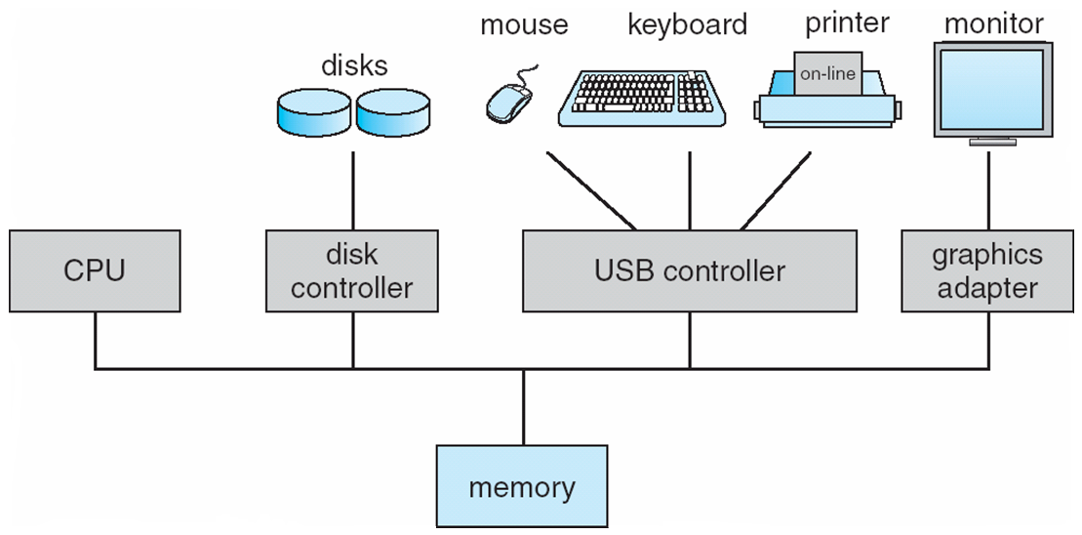
Computer System Organization

Slide 6
Computer System Organization
The system components are connected to each other and data, addresses and control signals flow along these connections.
The connecting lines are grouped together into groups called buses. So we have a data bus, an address bus and a control bus.
All the electrical signals in the computer system are digital in nature. Not analog.
A binary 1 is represented by +5 V and a binary 0 by 0 V voltage signal.

Slide 7
Computer System Organization
All computer systems in use have von Neumann architecture – the system follows an fetch-execute cycle as soon as it is turned on.
Fetch-execute cycle – instructions are fetched from the memory (RAM) into the CPU, decoded and executed…
See animations: http://ib-computing.net/FlashMovies/FE_Cycle2.swf OR http://www.hartismere.com/staticvle/ictskills/FetchExecute.swf
The first instruction is fetched from address 0 (usually) because contents of PC (program counter) at reset are set to 0 …

Slide 8
Computer System Organization
In such a computer system – think how would you execute your program without an OS, without a high-level language compiler.
How would you put your program (written in binary machine code) into the RAM? At what address?
Would you be able to run more than one program at a time?
What about input and output?

Slide 9
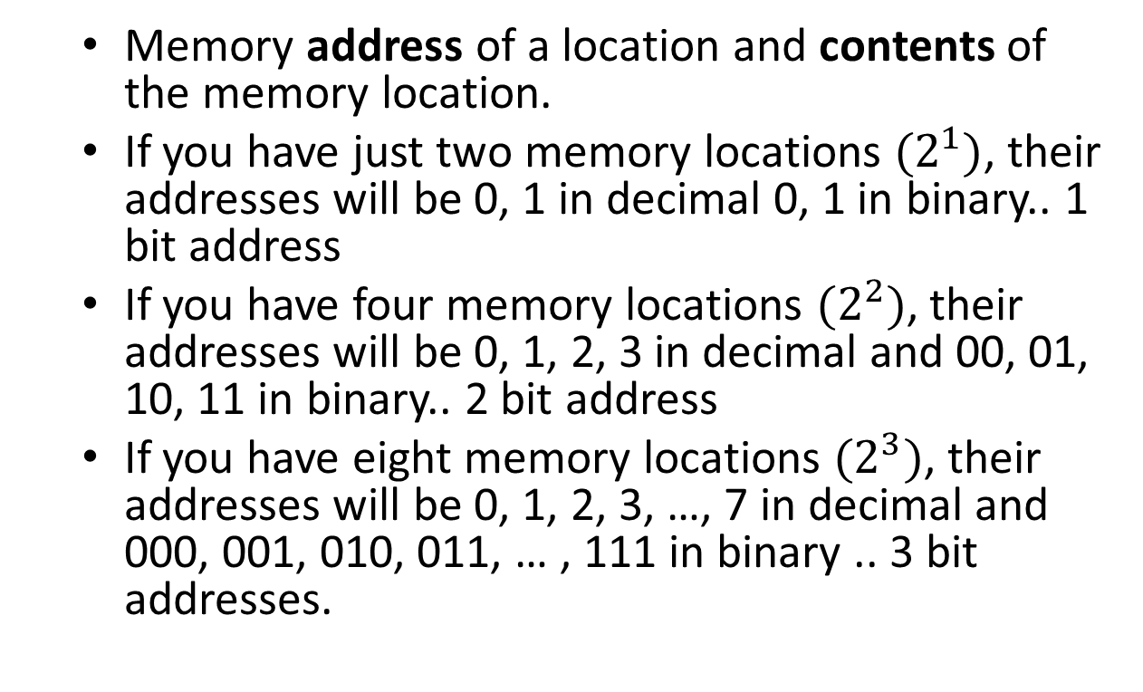
Memory and Memory Addresses
Memory address of a location and contents of the memory location.
If you have just two memory locations $(2^{1})$, their addresses will be 0, 1 in decimal 0, 1 in binary.. 1 bit address
If you have four memory locations $(2^{2})$, their addresses will be 0, 1, 2, 3 in decimal and 00, 01, 10, 11 in binary.. 2 bit address
If you have eight memory locations $(2^{3})$, their addresses will be 0, 1, 2, 3, …, 7 in decimal and 000, 001, 010, 011, … , 111 in binary .. 3 bit addresses.

Slide 10
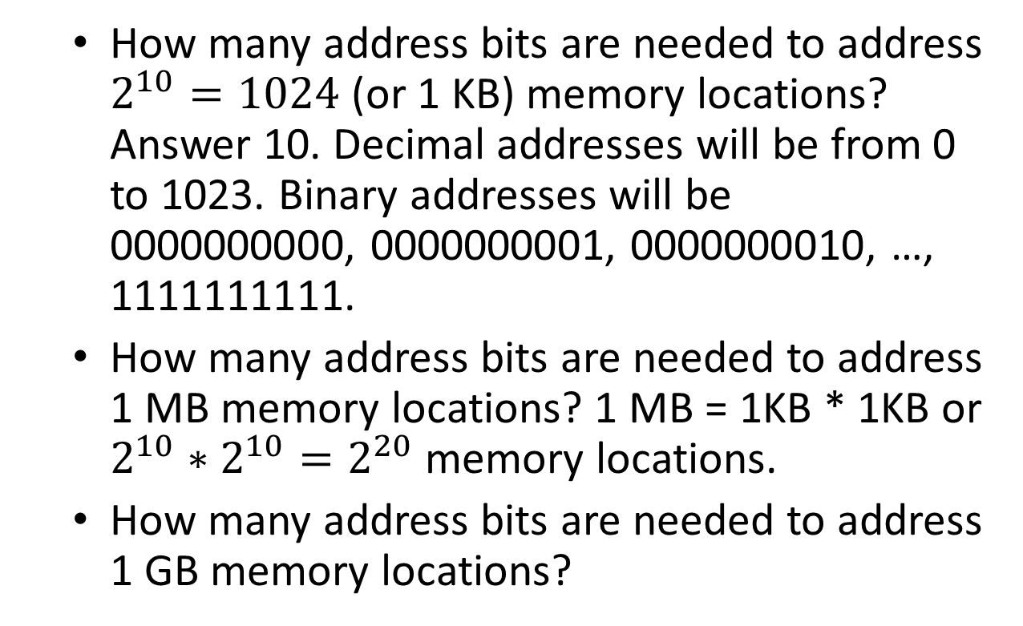
Memory and Memory Addresses
How many address bits are needed to address $2^{10}=1024$ (or 1 KB) memory locations? Answer 10. Decimal addresses will be from 0 to 1023. Binary addresses will be 0000000000, 0000000001, 0000000010, …, 1111111111.
How many address bits are needed to address 1 MB memory locations? 1 MB = 1KB * 1KB or $2^{10}∗2^{10}=2^{20}$ memory locations.
How many address bits are needed to address 1 GB memory locations?

Slide 11
Memory and Memory Addresses
GiB and GB?
Instead of dealing with long binary numbers it is easier to deal with equivalent but shorter hexadecimal numbers.
How can binary numbers be converted to hexadecimal numbers? Convert each nimble in the binary number to corresponding hexadecimal digit. Thus, 0101011110101111 in binary is 57AF in hexadecimal, written as, 0x57AF or 0x57af.

Slide 12
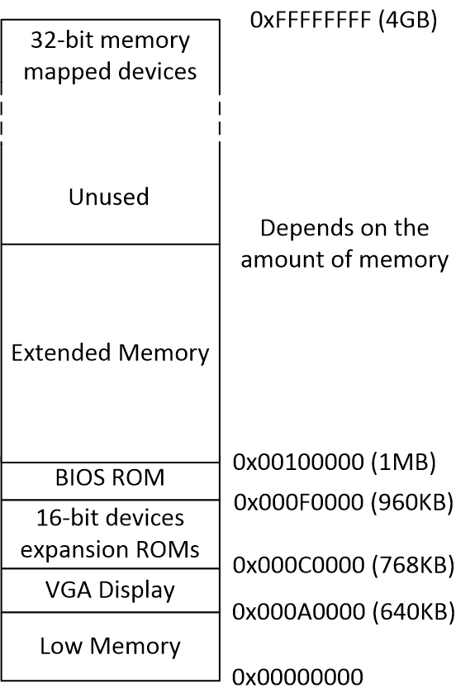
IBM PC’s Address Space

Slide 13
Boot-up Process – IBM PC
Cold Boot or a Warm Boot
Execution starts at RAM address 0x000FFFF0 (top of 64KB BIOS area) – first instruction is a backward jump to 0x000FE05B
BIOS first disables interrupts, initializes various devices, and searches for a bootable device such as, a hard-drive or a CD-ROM or a floppy disc.
Next BIOS reads boot loader from the disc and transfers control to it.

Slide 14
Boot-up Process – IBM PC
Boot loader is in 512-byte boot sector of the disc. BIOS loads this boot loader into physical addresses from 0x00007C00 to 0x00007DFF and uses a jump instruction to transfer control to it.
Boot loader executes and loads the OS kernel.

Slide 15
Boot-up Process – IBM PC
Here is the summary of the boot-up process:
Step 1: execution starts at 0x000FFFF0 in the BIOS area (backward jump to 0x000FE05B). BIOS executes and initializes devices and next searches for a bootable device.
Step 2: BIOS reads boot loader from the bootable device boot sector – loads boot loader into RAM locations 0x7C00 to 0x7DFF
Step 3: Boot loader executes and loads the OS kernel.

Slide 16
Interrupts
An OS is interrupt-driven.
After boot-up an OS waits in an infinite loop for an interrupt to occur.
// Initialization
while (true) {
// Wait for an interrupt
}
Interrupt is a signal or an instruction that interrupts the normal sequence of execution.
A real world example: you are reading a book and a phone rings. The ringing of the phone is an interrupt. When you answer the phone you service the interrupt or handle the interrupt.
Why or what for is an interrupt?

Slide 17
Interrupts
Two types of interrupts: hardware interrupt – electrical signal e.g. from device controller; software interrupt – an instruction is executed e.g. INT 11.
Where do interrupts originate? May originate during program execution, from a timer, from I/O device controllers, or due to hardware failure.
What happens when an interrupt occurs? An interrupt handler or interrupt service routine for the interrupt gets executed.

Slide 18
Interrupts: Interrupt cycle

Slide 19
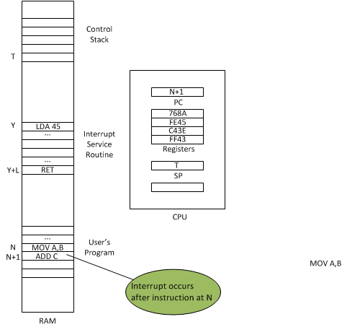
Interrupts

Slide 20
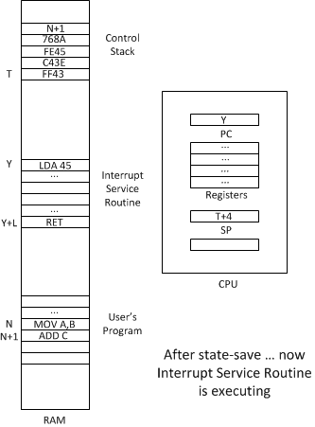
Interrupts

Slide 21
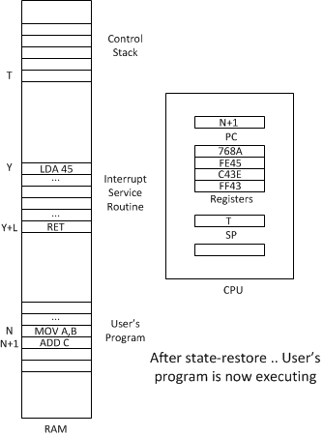
Interrupts

Slide 22
I/O Operations
Computer system has ports and ports have addresses like memory locations. Associated with a port is a buffer register.
How many ports? Varies from CPU to CPU. For example, Intel 8085 had 256 input and 256 output ports.
Execution of input or output instructions (e.g. IN 23 or OUT 11. Note 23 and 11 are port addresses) reads and writes into the buffer.

Slide 23
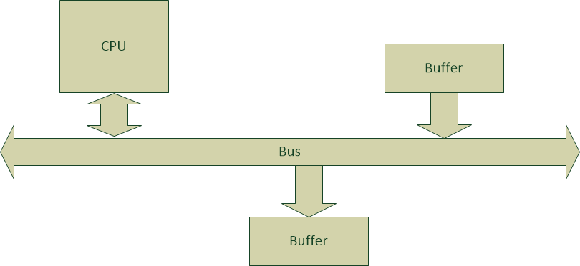
I/O Operations

Slide 24
I/O Operations
Parallel and serial I/O.
I/O devices are connected through device controllers (DCs) to a common bus. DC controls the devices and I/O is performed through DC. DC have data buffers.
A device controller may have more than one device attached to it.
OS has a device driver for each device controller; presents a uniform interface to the rest of the OS.

Slide 25
I/O Operations

Slide 26
Three Types of I/O Operations
Programmed I/O (or Synchronous I/O or Blocking I/O)
Interrupt-Driven I/O (or Asynchronous I/O or non-blocking I/O)
Direct Memory Access (DMA) transfer

Slide 27
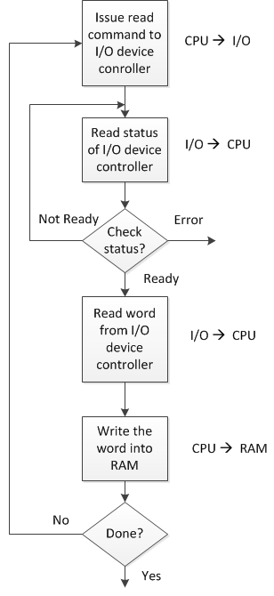
Programmed I/O

Slide 28
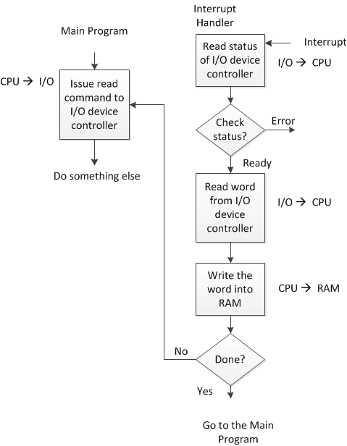
Interrupt-Driven I/O

Slide 29
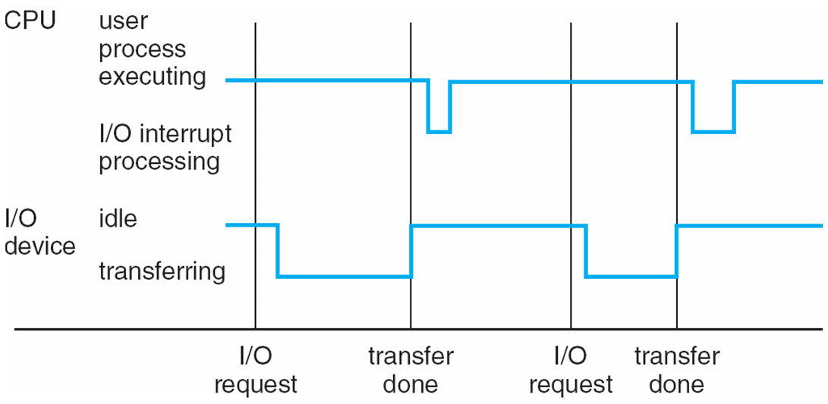
Interrupt-Driven I/O

Slide 30
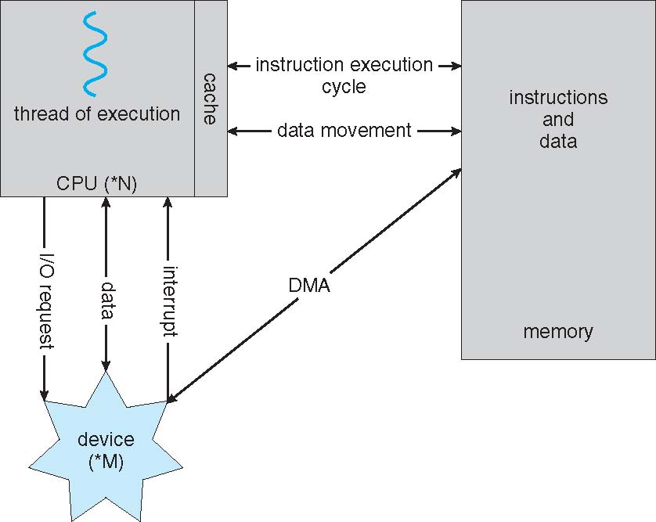
Direct Memory Access (DMA)

Slide 31
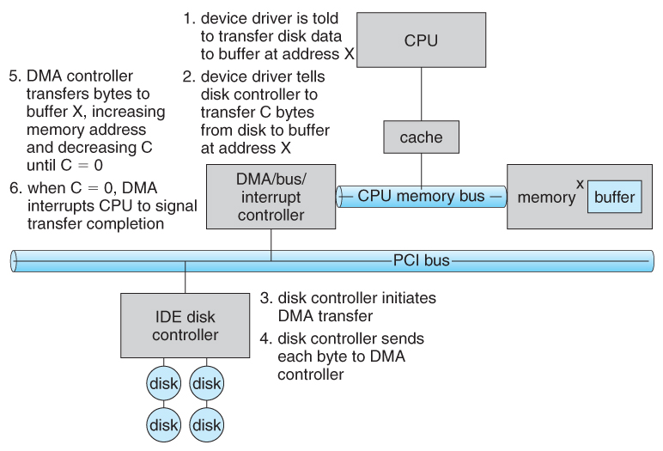
Direct Memory Access (DMA)

Slide 32
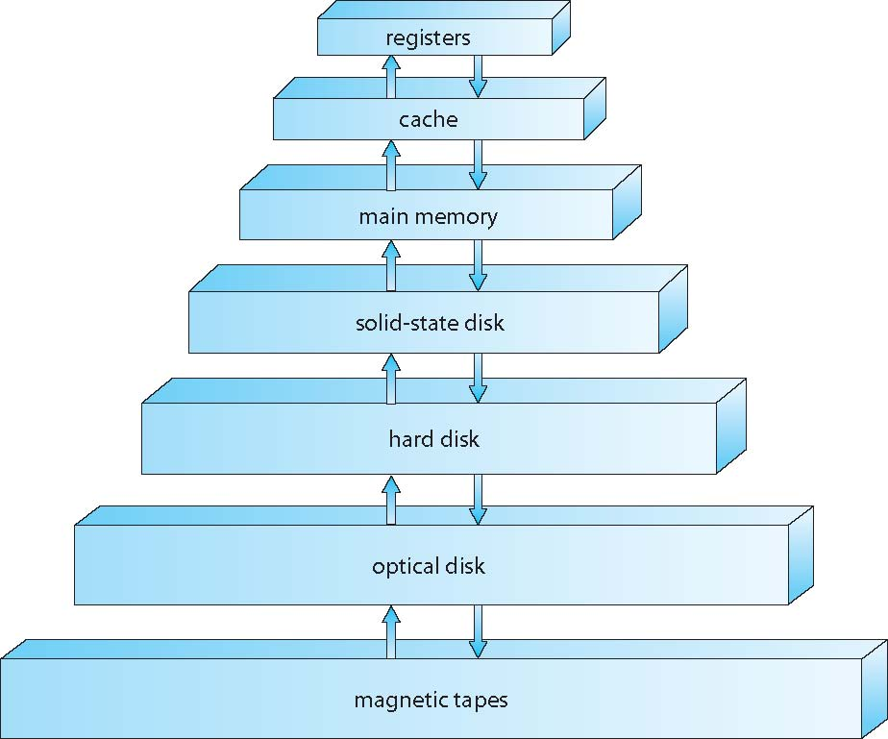
Storage-device Hierarchy

Slide 33
Computer System Architecture
Single-processor systems
have a single processor and may also have specialized processors e.g. for I/O
Multi-processor systems
have more than one processors, in close communication, sharing a common bus, clock, memory and I/O devices.
Two main types: asymmetric multiprocessors and symmetric multiprocessors (SMPs)
Multi-core processors: they are multiprocessor IC chips

Slide 34
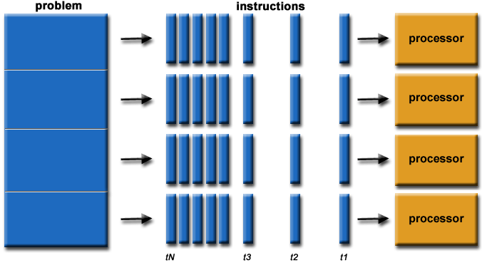
Parallel Processing

Slide 35
Symmetric/Asymmetric Multi-Processor
Symmetric Multiprocessor
Each processor performs all tasks within OS
No master-slave relationship exists between processors
Asymmetric Multiprocessor
Master processor controls and allocates work to the slave processors
More common in extremely large systems

Slide 36
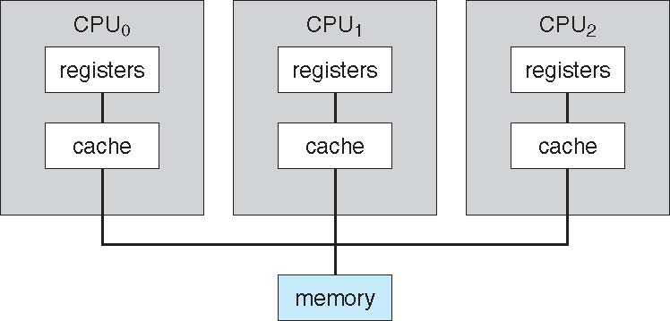
Symmetric Multiprocessor

Slide 37
Computer System Architecture
Computer clusters?
Advantages of Multi-processor systems
Increased throughput – more work done in less time.
Economy of scale – cost less because resources are shared. Which resources?
Increased reliability – work is distributed; if a processor fails system continues to function with degraded performance (graceful degradation).

Slide 38
Operating System Structure
Different OSes vary greatly internally but have many common features.
First computer systems were batch systems. Disadvantage – low CPU utilization. Why?
Next came multi-programming – more than one program is kept in the main memory (RAM). Better CPU utilization but multi-programmed systems are not interactive.

Slide 39
Operating System Structure
With multi-tasking also known as time sharing, multi-programmed systems became interactive – users could run their programs interactively, many users can share the computer (multi-user system).
In time sharing, system also has more than one program in the memory but CPU is made to switch between them after executing each for a short time interval (time slice).

Slide 40
Operating System Structure
OS is interrupt driven – after initializing various hardware registers and data structures OS waits in an infinite loop for service requests, which are signalled by interrupts (e.g. user logging in, I/O requests, error handling, etc.)
OS makes its services available to the users through system calls, e.g. printf() when executed results in a system call.
A system call is treated as a software interrupt resulting in the execution of an interrupt service routine that provides the requested service.
This interrupt driven nature defines OSes structure and most of the OSes code is for handling the interrupts.

Slide 41
Operating System Operations
In a multi-user system users share hardware and software – many issues arise?
How to ensure one user program does not interfere with other user’s programs e.g. by modifying code and data?
How to ensure user programs do not interfere with the OS programs?
How to ensure a user program does not grab a system resource and not let other programs have it, e.g. by going into an infinite loop?

Slide 42
Operating System Operations
These issues are dealt with by providing: dual-mode operation, timers, ..
System has two modes: kernel mode and user mode.
In the kernel mode, OS kernel code is executed while as in the user mode user code is executed.
Hardware support in the form of a mode bit is provided to distinguish between the modes. Mode bit = 0 in kernel mode; mode bit = 1 in user mode.

Slide 43
Operating System Operations
Certain instruction whose execution can harm the system are designated as privileged instruction. These can be executed only in the kernel mode by the OS kernel and not in the user mode.
A system call executed in a user program results in change in the mode bit.
Note: Every interrupt or exception causes the CPU to switch from its current mode into kernel mode. Why? This ensures that the operating system, and never a user process, will catch the event. This ensures that user processes cannot hijack the operation of the system. (Added 19/03/2020)
Timers – set a limit on the time a program can have CPU. Causes an interrupt if the time is exceeded.

Slide 44
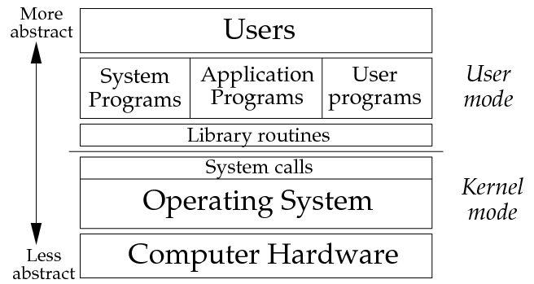
Operating System Operations

Slide 45
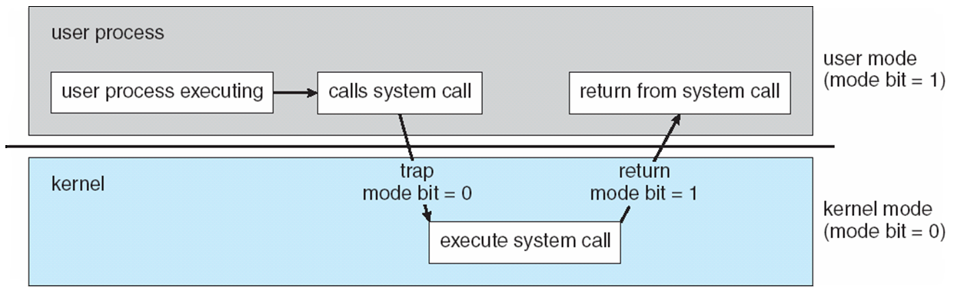
Transition from User to Kernel Mode

Slide 46
Process Management
A process is a program in execution. It is a unit of work within the system. Program is a passive entity, process is an active entity.
Process needs resources to accomplish its task
CPU, memory, I/O, files
Initialization data
Process termination requires reclaim of any reusable resources
Typically system has many processes, some user, some operating system running concurrently on one or more CPUs
Concurrency by multiplexing the CPUs among the processes / threads

Slide 47
Process Management
The operating system is responsible for the following activities in connection with process management:
Scheduling processes on the CPUs
Creating and deleting both user and system processes
Suspending and resuming processes
Providing mechanisms for process synchronization
Providing mechanisms for process communication
Providing mechanisms for deadlock handling

Slide 48
Memory Management
A program’s instructions and data must be in the main memory for it to be executed by the CPU.
To improve speed of execution and CPU utilization many programs must reside in the memory at the same time i.e. multi-programming.
Memory management done by the OS involves the following activities:
Keeping track of which parts of memory are currently being used and by whom
Deciding which processes (or parts thereof) and data to move into and out of memory
Allocating and deallocating memory as needed.

Slide 49
Storage Management
Users do not see bits and bytes. OS enables them to see data/programs as files and folders.
File management systems:
A file is a collection of related information e.g. program files, data files.
OSes file management activities involve.
Creating, deleting and manipulating files and directories
Mapping files onto secondary storage
Backing up files on to storage media.

Slide 50
Storage Management
Mass storage management
Secondary storage – hard disks
Need hard disks as main memory is too small and volatile.
Programs and data are loaded from the hard disk and results stored back on the hard disk.
Disk management involves: free space management, storage allocation and disk scheduling.
Tertiary storage – tape drives, CDs, DVDs

Slide 51
Cache Memory
Fetching instructions from the RAM is time consuming – slows down the system.
Idea of caching is to copy instructions and data into the cache for faster access, when a process needs data it first checks and tries to access the cache otherwise it accesses data from the source.
Cache memory is under hardware control. Cannot be controlled by the OS.
Cache coherency.

Slide 52
I/O Systems
OS hides the low-level details of an I/O device and provides a layer of abstraction by a general device driver interface.
Drivers for specific hardware devices implement this interface.
Manufacturers of a device usually implement the drivers for the device.

Slide 53
Protection and Security
Protection concerns mechanism for controlling the access of processes or users to resources. For example: (a) a process must not access memory outside its own address space (b) a process must not access device control registers
Security – even after adequate protection a system is prone to inappropriate access, failure. For example: viruses and worms, denial of service attacks, identity theft, theft of service.

Slide 54
Computing Environments – Traditional
Traditional computing – mainframe computers, or a network of computer in an office.
Mainframe computer had single processing unit and had many terminals connected to it.
Remote access, portability of data was difficult.

Slide 55
Computing Environments – Distributed
Distributed computing – a collection of physically separate, heterogeneous, computer systems that are networked to provide the users with access to the various resources.
Networks vary by the protocols used (TCP/IP, ATM, etc.), distances between nodes (LANs, WANs, MANs) and transport media (copper wires, optical fibres, wireless)

Slide 56
Computing Environments – Distributed
Network Operating Systems (NOS) – has features that provide a common file system, application sharing, database sharing, printer sharing.
Example – Windows Server, Novell Netware.
Computer clusters run NOS and provide an illusion of a single system.

Slide 57
Computing Environments – Mobile
Mobile computing – refers to computing on smartphones and tablets.
Portable.
Have features like mobile phones, GPS, etc.

Slide 58
Computing Environments – Client-Server
Client-Server computing system – basically a distributed system with some systems acting as servers and some as clients.
Servers could be:
Compute servers – perform computation tasks (database server is an example of a compute server)
File servers – provides a file system interface where clients can create, update, read and delete files.

Slide 59
Computing Environments – Peer-to-Peer
Peer-to-peer computing – another type of distributed system that does not distinguish clients and servers. A computer can be a server a one time and a client at some other time.
Examples: Napster, Skype,

Slide 60
Computing Environments – Embedded Real-time
Embedded real-time systems exist in car engines, robots, DVD-players, microware ovens, etc.
No user-interface or a limited one.
Run a real-time operating system.
Real-time OS has well-defined fixed time constraints
Processing must be done within the constraints
Correct operation only if constraints met

Slide 61
Open Source Operating Systems
Open-source OS are available in source-code rather than as compiled binary code.
Example: Linux.
Microsoft Windows is an example of closed-source OS
Advantages:
learning OSes by examining source is better
Such systems tend to be more secure, have less number of bugs

Slide 62
Introduction
Program Compilation

Slide 63
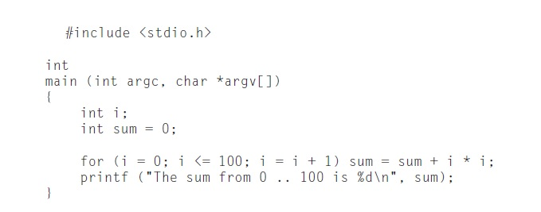
Program in High-Level Language (C)

Slide 64
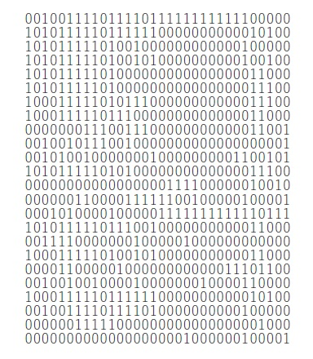
Program in Machine Language (MIPS Processor Machine Language)

Slide 65
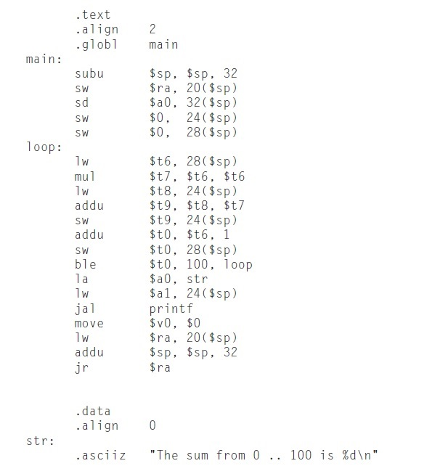
Program in Assembly Language

