Slide 1

SMART INDIA HACKATHON 2026
Problem Statement ID – SIH26139
Problem Statement Title- Hybrid Quantum Machine Learning Platform for Early Disease Detection .
Theme- HealthTech
PS Category- Software
Team ID-
Team Name- AlgoX

Slide 2

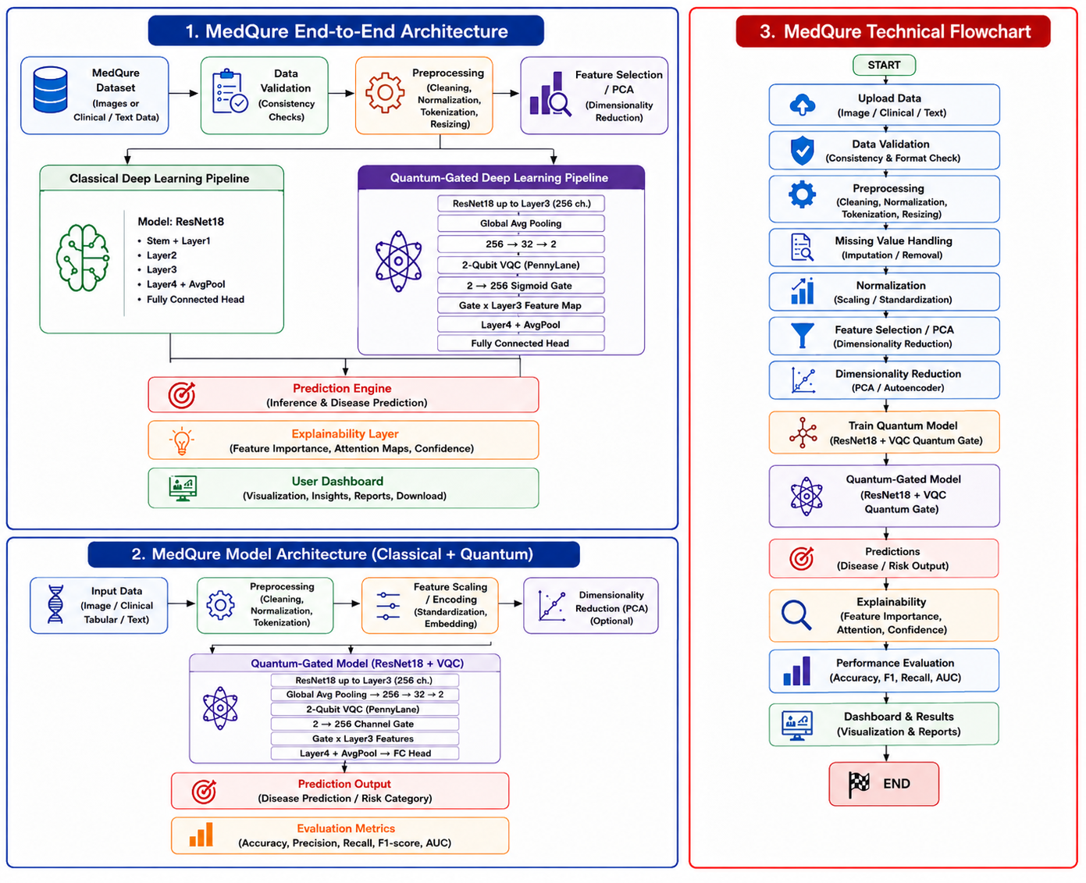
MedQure Proposed Solution
Innovation and Uniqueness
• Hybrid Quantum-Classical AI: Combines classical preprocessing with Quantum Machine Learning for practical early disease detection.
• Adaptive Feature Reduction: Reduces high-dimensional biomedical data before quantum encoding to work within limited qubit availability.
• Quantum-Classical Benchmarking: Compares quantum and classical models using the same processed dataset and evaluation metrics.
• Explainable Prediction: Provides prediction confidence and feature-level insights to make model outputs easier to understand.
• Hardware-Ready Architecture: Supports quantum simulators during development and can be extended to near-term quantum hardware.

Slide 3
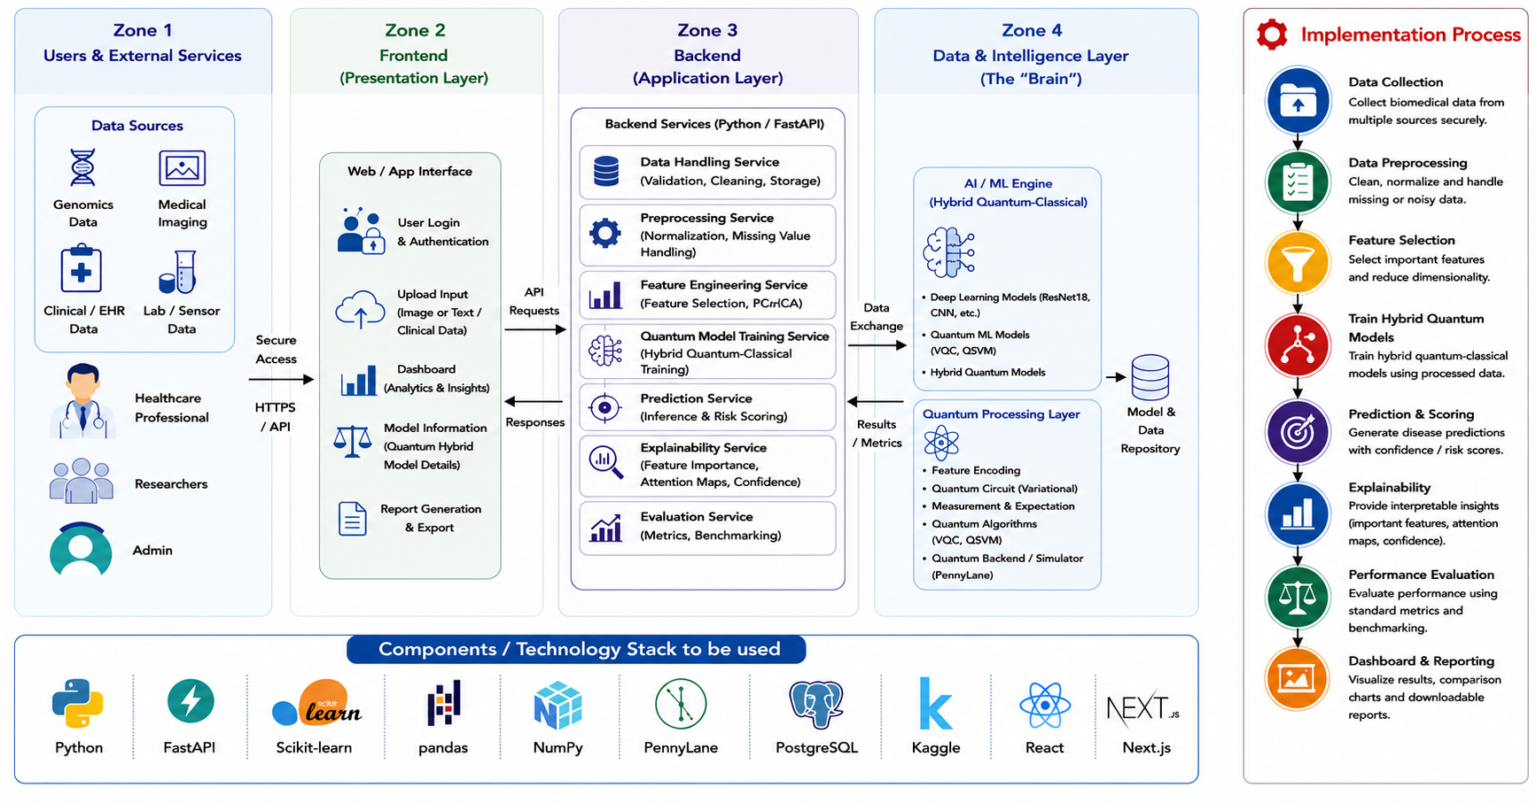
TECHNICAL APPROACH

Slide 4
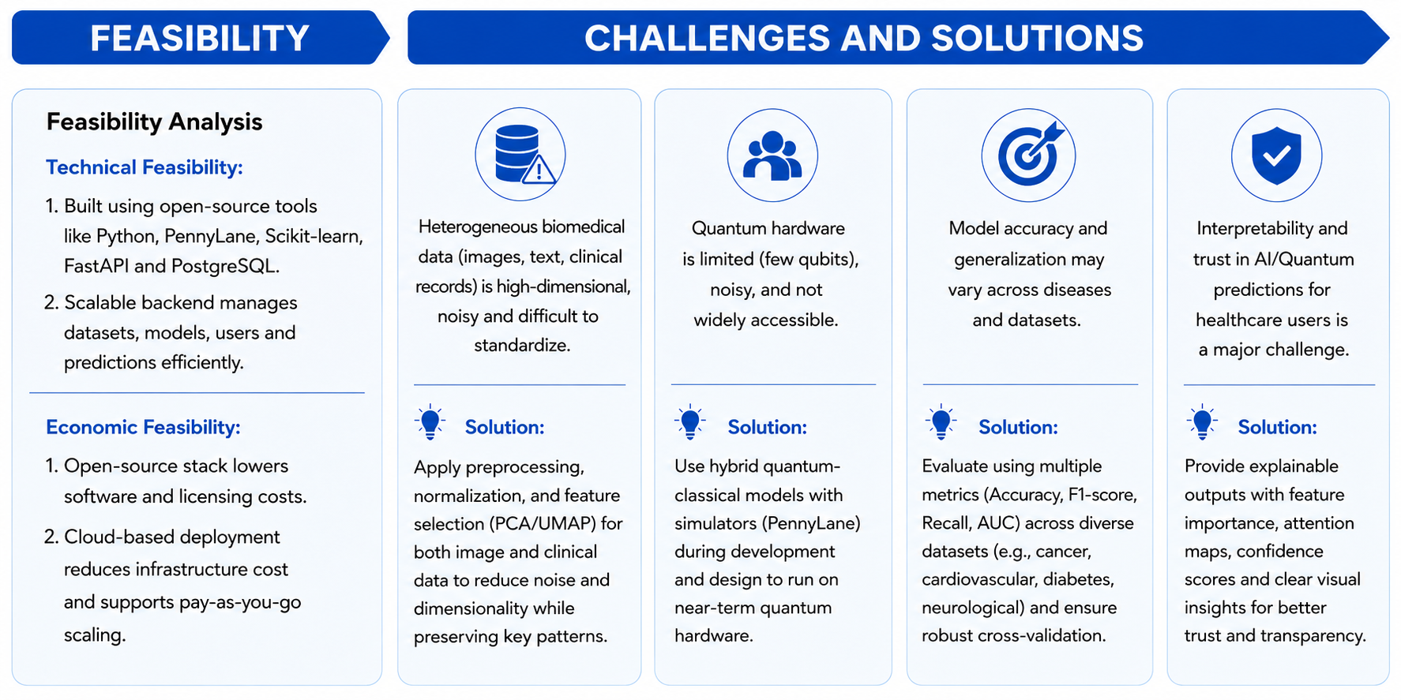
FEASIBILITY AND VIABILITY

Slide 5
IMPACT AND BENEFITS
• Early Disease Detection – Supports identification of potential disease risks at an earlier stage, enabling timely clinical attention and follow-up.
• Improved Diagnostic Support – Provides AI-assisted predictions that can help healthcare professionals analyze complex biomedical data more efficiently.
• Explainable Predictions – Shows confidence scores and important features behind predictions, improving transparency and user trust.
• Research Advancement – Provides researchers with a platform to experiment with and benchmark Quantum Machine Learning on biomedical datasets.
• Data-Driven Healthcare – Enables visualization of prediction results, model performance and comparative insights through an interactive dashboard.
• Hybrid & Practical – Combines classical ML with Quantum ML, making the solution usable with current quantum simulators and adaptable to near-term quantum hardware.
• Handles Complex Data – Uses preprocessing, feature selection and dimensionality reduction to manage high-dimensional biomedical datasets efficiently.
• Quantum-Classical Comparison – Provides direct benchmarking of classical and quantum models using common evaluation metrics.
• Transparent & Trustworthy – Provides explainability, confidence scores and feature-level insights instead of only presenting a final prediction.
• Scalable Research Platform – Supports multiple biomedical datasets, ML/QML algorithms and future integration.

Slide 6
RESEARCH AND REFERENCES
Field & Applied Research
• Studied Quantum Machine Learning (QML) approaches for healthcare and disease detection using medical and biomedical datasets.
• Reviewed hybrid quantum-classical models, quantum transfer learning, CNN-based diagnosis, feature extraction and classification techniques relevant to early disease detection.
Academic & Research Sources
• IEEE Reference Paper 1: A Hybrid Quantum-Classical Approach for Multi-Class Skin Disease Classification Using a 4-Qubit Model – Proposes a hybrid quantum-classical framework using a 4-qubit quantum system to classify multiple skin diseases.
https://ieeexplore.ieee.org/stamp/stamp.jsp?arnumber=11039626
• IEEE Reference Paper 2: Exploring Quantum Machine Learning for Enhanced Skin Lesion Classification: A Comparative Study of Implementation Methods – Compares different QML implementation approaches for skin-lesion classification.
https://ieeexplore.ieee.org/stamp/stamp.jsp?arnumber=10613907
• IEEE Reference Paper 3: Optimized DenseNet121 and Quantum PennyLane Fusion for Explainable Skin Disease Recognition and Classification – Integrates DenseNet121 with quantum PennyLane for explainable skin disease recognition and classification.
https://ieeexplore.ieee.org/stamp/stamp.jsp?arnumber=11155089
• Histopathological Cancer Detection Using Hybrid Quantum Computing – Reek Majumdar, Biswaraj Baral, Bhavika Bhalgamiya and Taposh Dutta Roy; studies hybrid quantum-classical learning and quantum transfer learning for cancer detection.
https://arxiv.org/pdf/2302.04633
• Enhanced Skin Disease Diagnosis through Convolutional Neural Networks and Data Augmentation Techniques – Muddasar Abbas et al.; evaluates CNN, DenseNet-121 and ResNet-50 models using the HAM10000 dataset for skin disease classification.
https://doi.org/10.56979/701/2024

Slide 7
DATASETS & MODEL PERFORMANCE
Datasets Used
Field & Applied Research
• Studied Quantum Machine Learning (QML) approaches for healthcare and disease detection using medical and biomedical datasets.
• Reviewed hybrid quantum-classical models, quantum transfer learning, CNN-based diagnosis, feature extraction and classification techniques relevant to early disease detection.
Academic & Research Sources
• IEEE Reference Paper 1: A Hybrid Quantum-Classical Approach for Multi-Class Skin Disease Classification Using a 4-Qubit Model – Proposes a hybrid quantum-classical framework using a 4-qubit quantum system to classify multiple skin diseases.
https://ieeexplore.ieee.org/stamp/stamp.jsp?arnumber=11039626
• IEEE Reference Paper 2: Exploring Quantum Machine Learning for Enhanced Skin Lesion Classification: A Comparative Study of Implementation Methods – Compares different QML implementation approaches for skin-lesion classification.
https://ieeexplore.ieee.org/stamp/stamp.jsp?arnumber=10613907
• IEEE Reference Paper 3: Optimized DenseNet121 and Quantum PennyLane Fusion for Explainable Skin Disease Recognition and Classification – Integrates DenseNet121 with quantum PennyLane for explainable skin disease recognition and classification.
https://ieeexplore.ieee.org/stamp/stamp.jsp?arnumber=11155089
• Histopathological Cancer Detection Using Hybrid Quantum Computing – Reek Majumdar, Biswaraj Baral, Bhavika Bhalgamiya and Taposh Dutta Roy; studies hybrid quantum-classical learning and quantum transfer learning for cancer detection.
https://arxiv.org/pdf/2302.04633
• Enhanced Skin Disease Diagnosis through Convolutional Neural Networks and Data Augmentation Techniques – Muddasar Abbas et al.; evaluates CNN, DenseNet-121 and ResNet-50 models using the HAM10000 dataset for skin disease classification.
https://doi.org/10.56979/701/2024
Dataset | Description
Skin Cancer | Image dataset – 7 classes – ~10K images
Diabetic Retinopathy | Image dataset – 5 classes – retinal images
Diabetes Health Indicators | Tabular dataset – 253,680 rows × 22 columns – diabetes classification
Cardiovascular Disease | Tabular dataset – 70,000 rows × 13 columns – cardiovascular classification
Model Performance
Dataset | Model | Accuracy | F1-score | Precision | Recall
Skin Cancer-8qub | Resnet | 0.82 | 0.82 | 0.81 | 0.82
Skin Cancer-4qub | Resnet | 0.834 | 0.821 | 0.824 | 0.834
Skin Cancer-2qub | ConvNext_TIney_V2 | 0.8831 | 0.8791 | 0.8799 | 0.8831
Skin Cancer-2qub | classical baseline_rsenet18 | 0.84 | 0.751 | 0.77 | 0.741
Skin Cancer-2qub | late_fusion_hybrid | 0.841 | 0.836 | 0.833 | 0.841
Skin Cancer-2qub | quantum_gated_branch(zoom+rotate) | 0.847 | 0.845 | 0.848 | 0.847
Skin Cancer-2qub | quantum_gated_branch(rotation) | 0.86 | 0.858 | 0.859 | 0.86
Diabetiic Retinopathy | baseline | 0.795 | 0.791 | 0.797 | 0.795
Diabetiic Retinopathy | quantum_gated_branch(rotation) | 0.807 | 0.797 | 0.796 | 0.807
CardioVascular Disease | Baseline | 0.7244 | 0.7243 | 0.7248 | 0.7244
CardioVascular Disease | Gated quantum | 0.7302 | 0.7302 | 0.7303 | 0.7302
Diabetes Health Indicators Dataset | Baseline | 0.7487 | 0.7484 | 0.7499 | 0.7487
Diabetes Health Indicators Dataset | Gated quantum | 0.749 | 0.7485 | 0.7508 | 0.749
Notes:
Performance values transcribed exactly from Final - Sheet1.pdf.
Dataset source links: Skin Cancer https://www.kaggle.com/datasets/farjanakabirsamanta/skin-cancer-dataset | Diabetic Retinopathy https://www.kaggle.com/datasets/sovitrath/diabetic-retinopathy-224x224-gaussian-filtered/data | Diabetes Health Indicators https://www.kaggle.com/datasets/alexteboul/diabetes-health-indicators-dataset | Cardiovascular Disease https://www.kaggle.com/datasets/sulianova/cardiovascular-disease-dataset

