Slide 1
Angular 101: Angular from Start to Finish
Nick Hodges
nick@nickhodges.com
http://anglesandtypes.io
@nickhodges

Slide 2
About Me
Former Naval Intelligence Officer
Software Development Manger at Gateway Ticketing Systems
We are hiring!
Long-time Delphi Developer, Former Delphi Product Manager
Author of three Delphi books (Ask me about self-publishing….)
http://www.codingindelphi.com
Extensive Conference Speaking Experience
Self-taught Angular Developer

Slide 3
http://www.arrayofdevelopers.com
Twitter: @anarrayof
Please subscribe and submit your wisdom!

Slide 4

Prerequisites
You have to know nothing about Angular beyond “it’s some kind of web framework….”

Slide 5
Pre-requisites
Be hooked up to the Internet
The latest version of Git
Google: ‘git’
https://git-scm.com/downloads
Visual Studio Code
Google: ‘visual studio code’
https://code.visualstudio.com/Download
Node.js
Google: ‘node.js’
https://nodejs.org/en/download/

Slide 6
Agenda
History & Information
Why Angular
TypeScript
Get Installed
Anatomy of an Angular application
Build a ToDo Application
Conclusions

Slide 7
Why Angular
Single Page Application
Solid community
Backed by Google
Open source
Separation of Control
Highly scalable

Slide 8

History of Angular Framework
Started out as AngularJS
20% Project at Google started by Miško Hevery and Adam Abrons
Completely re-written as Angular 2
Current version is 7.3
Backed by Google
https://angular.io/
https://www.madewithangular.com/

Slide 9
Angular Parts
Modules: Provide structure to application
Components: Provide views into page
Templates: HTML-like tags to layout application
Metadata: Decorators to define how modules/components work
Data binding: Allow code and HTML to interact (two-way)
Directives: Manipulate the DOM with in-HTML code
Services: APIs to get data and other information
Dependency Injection: Automatically get fully formed classes/services

Slide 10
Angular Topics
Components
Modules
Data-binding
@Input and @Output
Services and HTTP
Routing
Material Design

Slide 11
Hello TypeScript
TypeScript is a JavaScript that adds classes (OOP)
All JavaScript is TypeScript
Transpiles (compiles) to JavaScript
Open source project run by Anders Hejlsberg and Microsoft
Hosted on (surprise!) GitHub
Purpose is to:
Make large scale JavaScript applications manageable and maintainable
Provide tooling and ease of development around code

Slide 12
Important TypeScript Constructs
Modules
Classes
Decorators
Interfaces

Slide 13
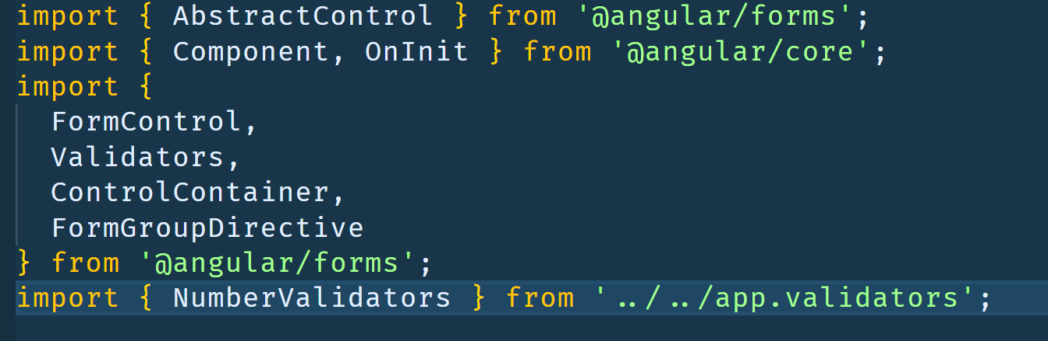
Modules
Modules hold code and only expose explicitly exported code to the outside world
Code from a Module must be explicitly imported
Any file containing a top-level import or export is considered a module.

Slide 14
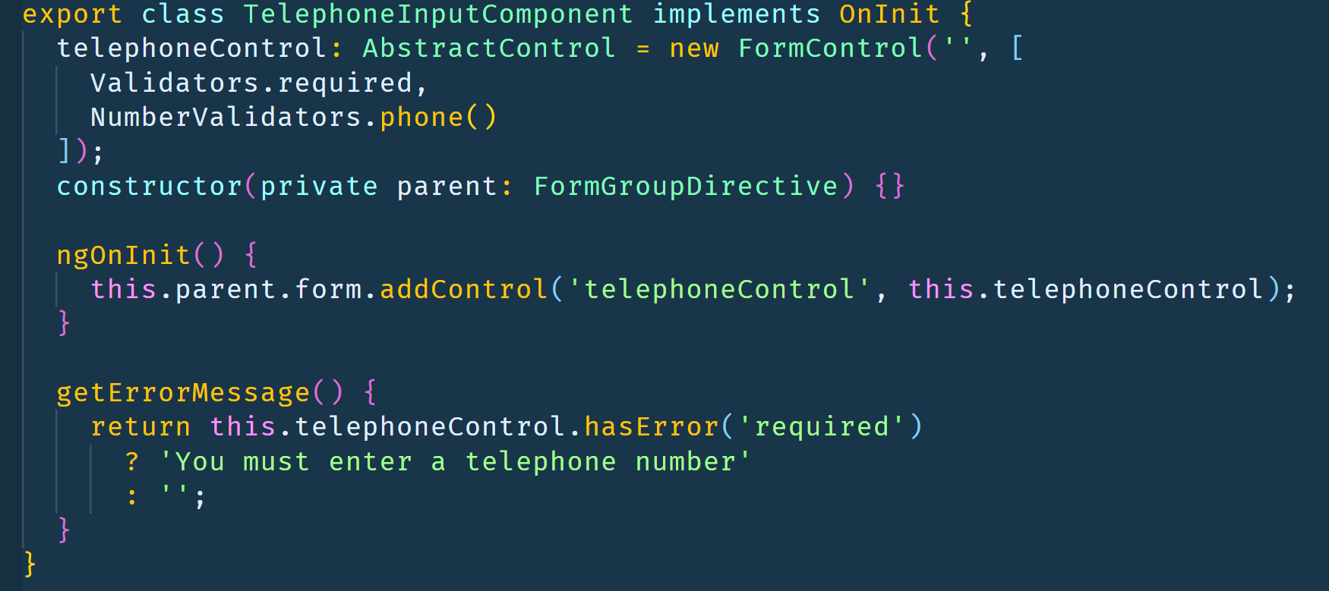
Classes
Provide Encapsulation, Inheritance, Polymorphism
Can implement Interfaces

Slide 15
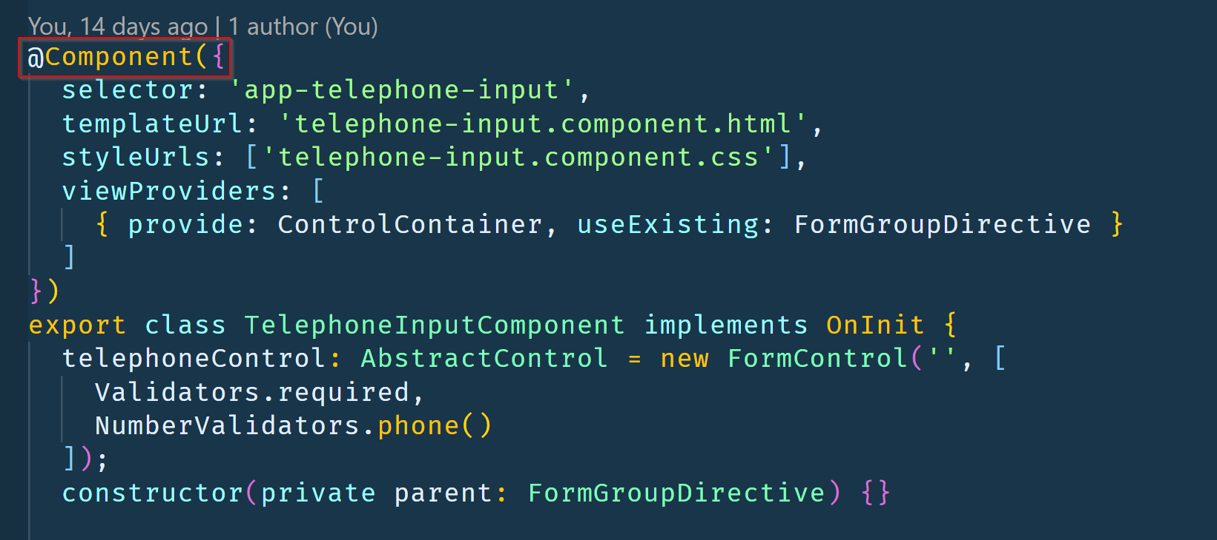
Decorators
Meta-data to provide information about a given class
In Angular, used to define components

Slide 16
Interfaces
Define the “shape” of a class
No associated Javascript code
Purely a TypeScript construct to enforce code functionality
interface ClockInterface {
currentTime: Date;
}
class Clock implements ClockInterface { currentTime: Date;
constructor(h: number, m: number) {}
}

Slide 17
Install json-server
npm install –g json-server
Get a full fake REST API with zero coding in less than 30 seconds (seriously)
Created for front-end developers who need a quick back-end for prototyping and mocking.

Slide 18

Install TypeScript
npm install -g typescript

Slide 19

Install Angular
npm install -g angular

Slide 20
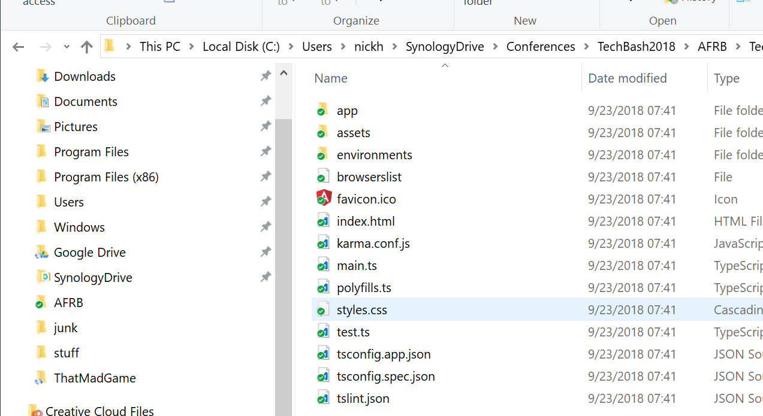
Install Angular CLI
npm install -g @angular/cli
Angular Command Line Interface
Good for starting and scaling applications

Slide 21
Angular Extensions for VS Code
Search for:
“Angular Essentials” by John Papa

Slide 22
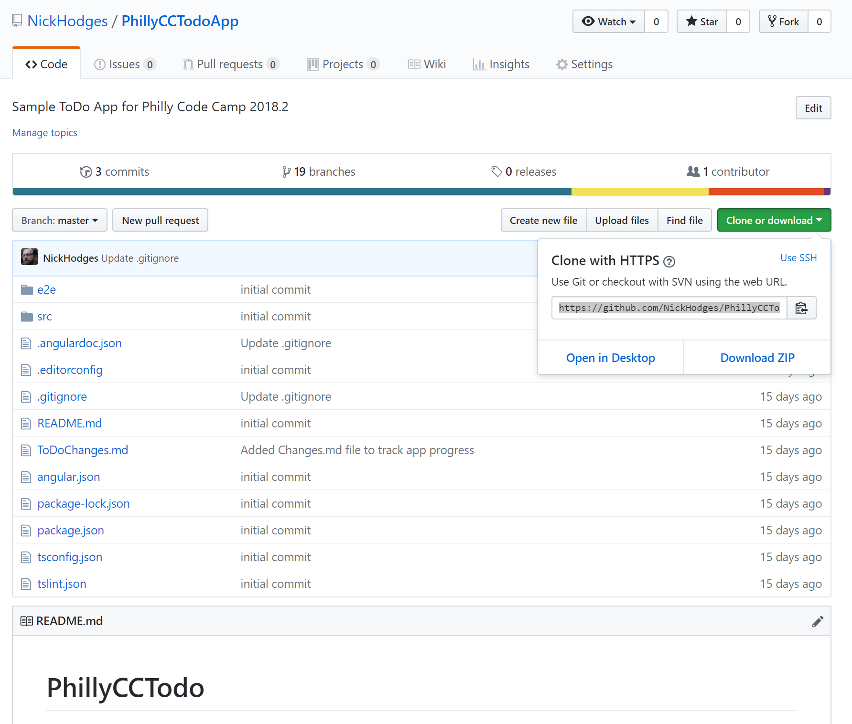
Install Todo Application Code
git clone https://github.com/NickHodges/PhillyCCTodoApp.git

Slide 23
A Look at a Basic Angular Application

Slide 24
Let’s Build a ToDo App in Angular

Slide 25
Resources
Main Page: http://angular.io
Official Docs: https://angular.io/docs
Project on Github: https://github.com/angular
My Blog: http://www.anglesandtypes.io
Best VS Code Plugins:
http://bit.ly/VSCAngular
http://bit.ly/NGExtensions

Slide 26
Questions
Nick Hodges
nick@nickhodges.com
http://anglesandtypes.io
http://www.arrayofdevelopers.com
@nickhodges

