Slide 1

PhishNet
Diamond Hacks 2025
April 6, 2025
Kevin Tran
LOGO HERE

Slide 2
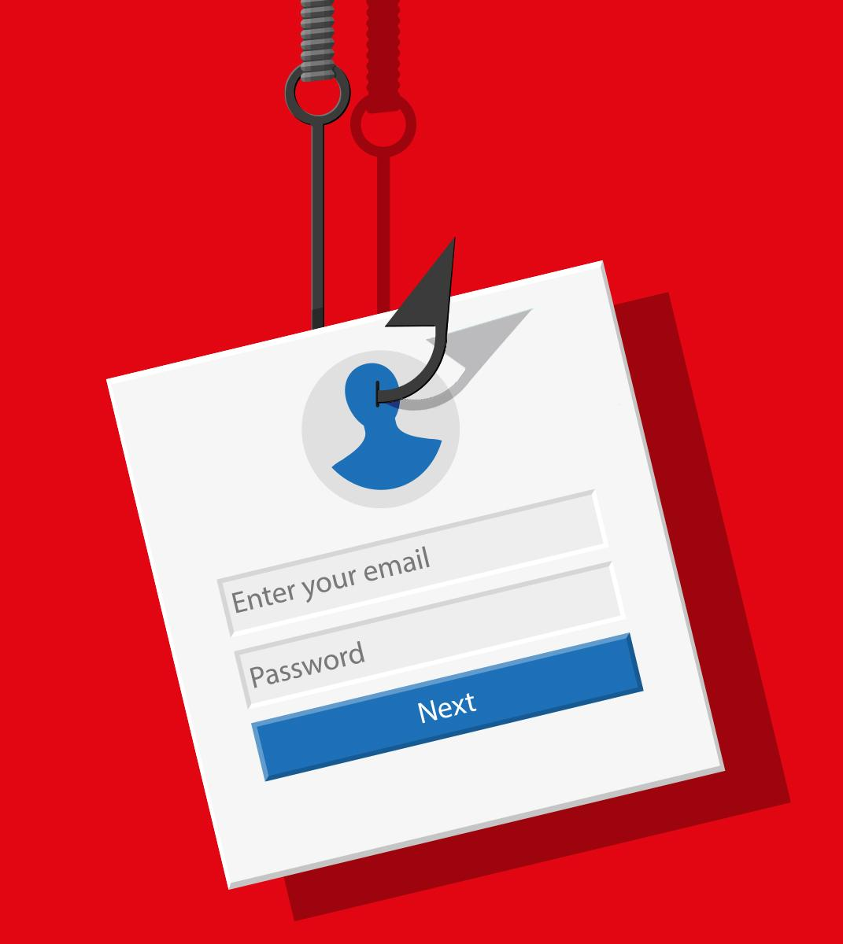
Inspiration
Purpose, Influence, Ideation

Slide 3
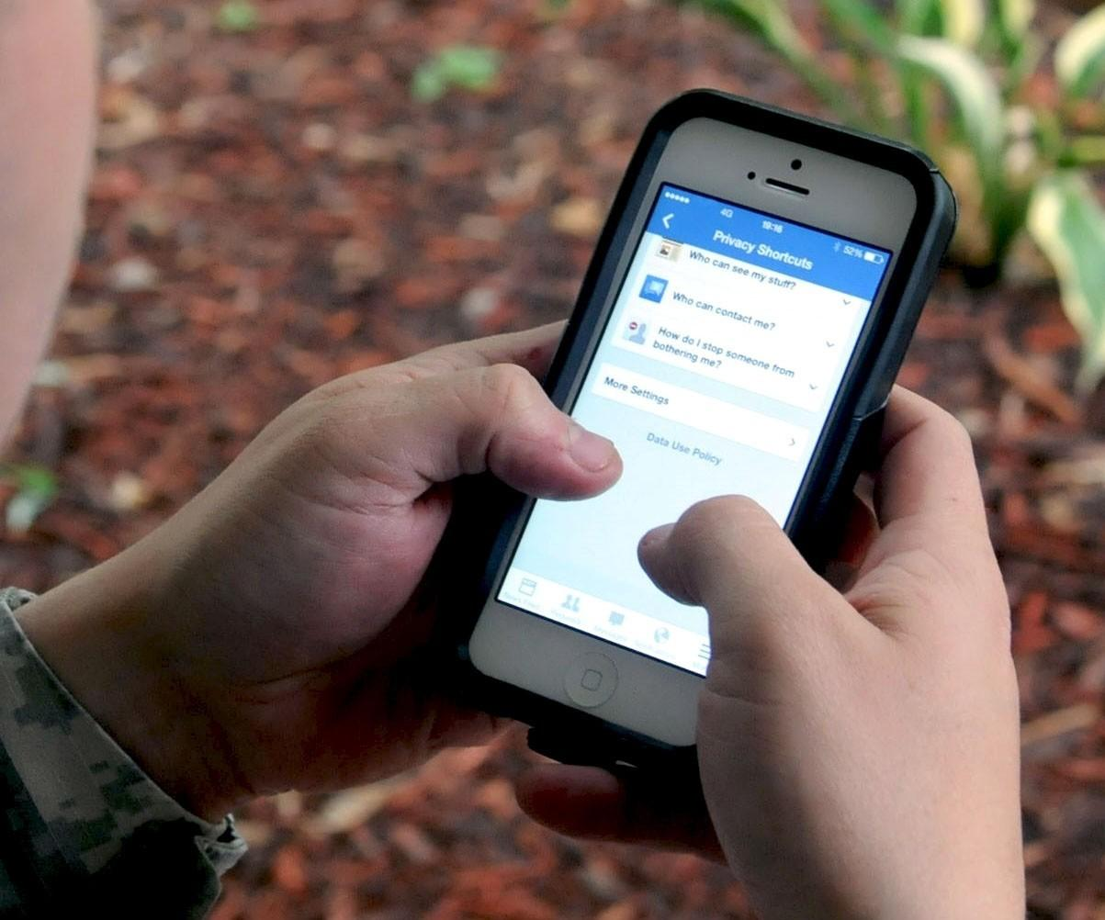
Influence
My parents would always ask me if a link or message that they received via email and social media is legit; what does it say? What does it want? Why am I getting this?
Rise in technology (More AI!)
Scary, hard to distinct real vs. fake
“Thispersondoesnotexist”
TTS -> use of AI “human-like” speech
Victims are generally those who are not technologically experienced/knowledgeable

Slide 4
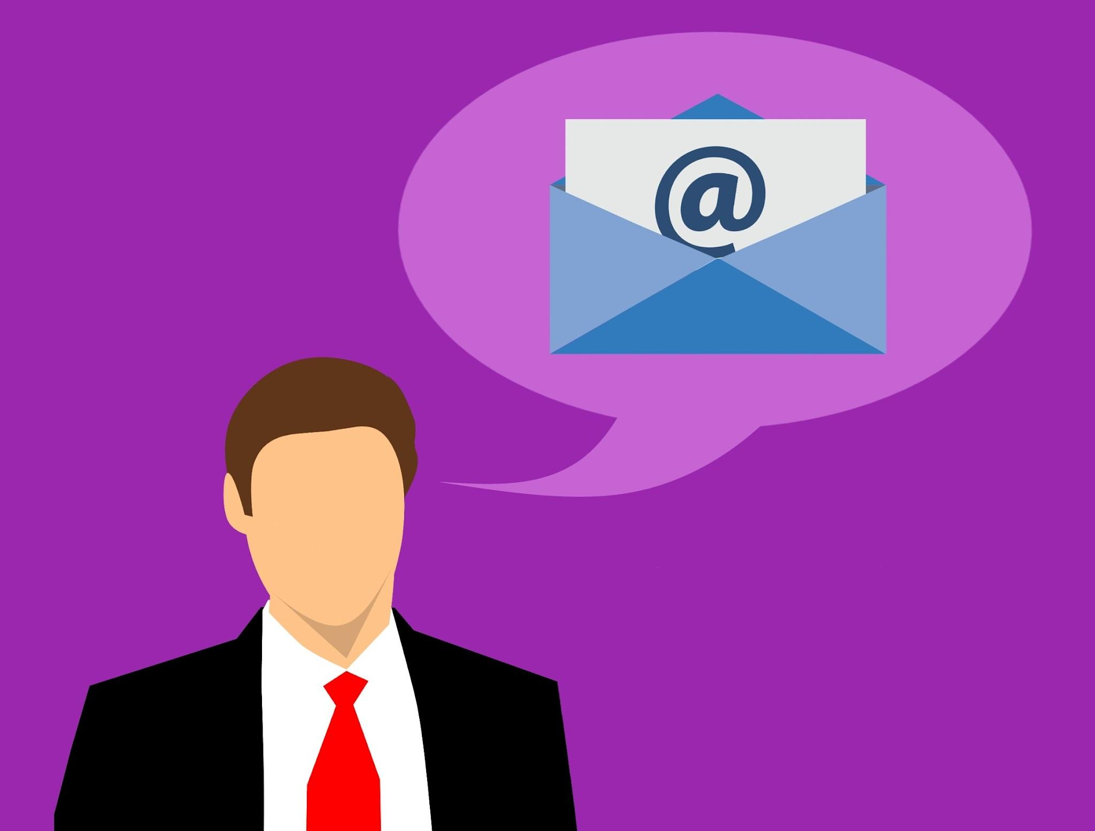
Purpose
The Federal Trade Commision (FTC) reported that there were 358,000 reports of emails that attacked individuals in 2023. This does not account for those who were affected and did not report this to the FTC.
Highest per person reported losses of an average of $1,480.
Who are the victims?
In an article by a survey report from Experian in 2023, people from 35 to 44 year olds are most likely to be exposed and fall victim (Experian).
Median losses were 18-24 year olds

Slide 5
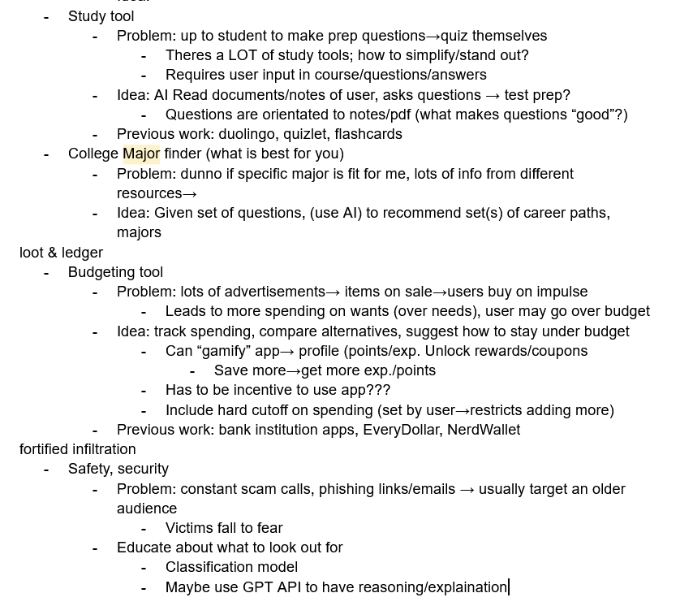
Ideation
Background:
ML, Reinforcement Learning, Python, Data Analysis
Basic web dev
HTML, CSS
Design, HCI
How can I implement this idea?
Required:
Front-end/back-end
Nodejs, React, Flask
API key/token
Run a local server
Letta Documentation

Slide 6
PhishNet Demo

Slide 7
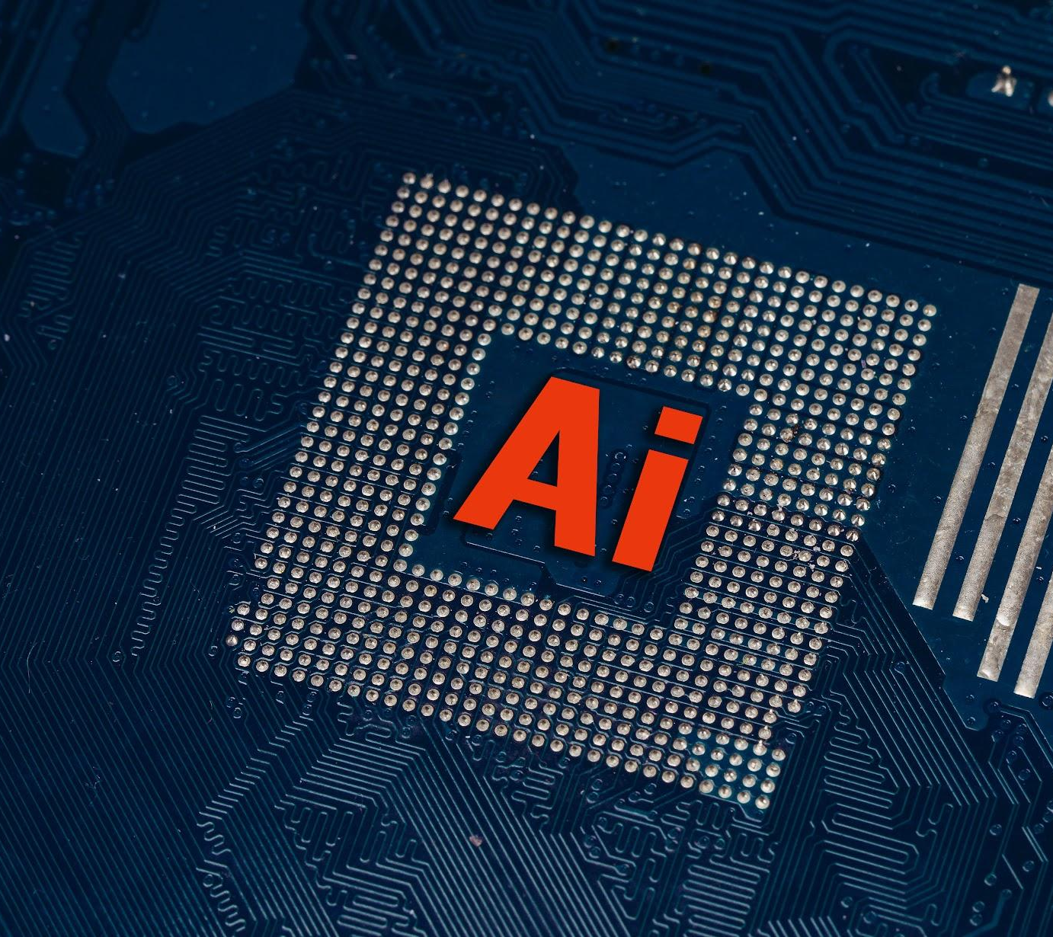
PhishNet in the future?
Although this project is simple, I hope to expand this by:
Interactive chatbot with Letta’s framework
Similar to Grammarly (possible browser extension?)
Train more datasets
Generate real/fake data and train itself (possible bootstrapping)
Use voice transcription documentation
Work with real-time scenarios

Slide 8
Thank You!

Slide 9
Questions?

Slide 10
Sources
https://www.ftc.gov/business-guidance/blog/2024/02/facts-about-fraud-ftc-what-it-means-your-business
https://www.experian.com/blogs/ask-experian/who-gets-scammed-most/
https://www.kaggle.com/datasets/naserabdullahalam/phishing-email-dataset

