Slide 1
The process of the creation an infrastructure and deployment of a web application on AWS using Terraform
Student:
Serhii Malko

Slide 2

Used technologies

Slide 3
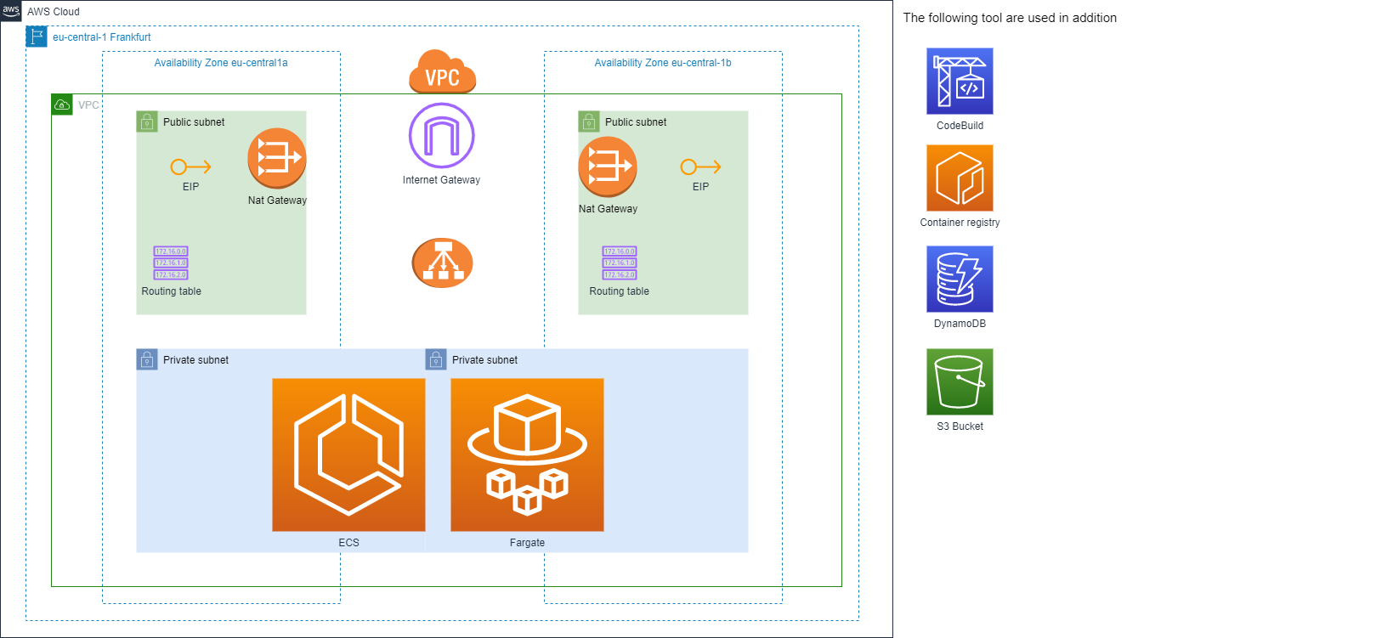
AWS Infrastructure of the project

Slide 4
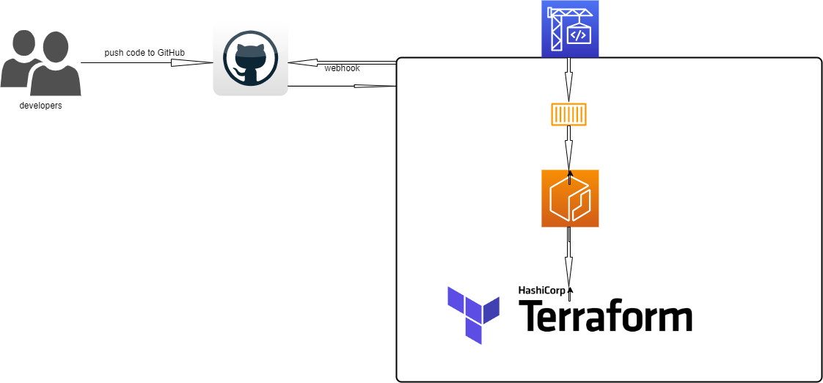
CI/CD pipeline

Slide 5
Should you have any questions, feel free to ask?
Thank you for your time!
Student: Serhii Malko

