Slide 1
The process of the creation an infrastructure by means of terraform
Student:
Serhii Malko

Slide 2
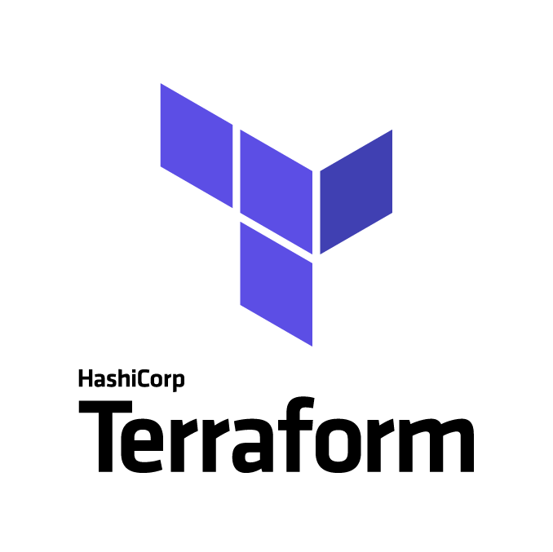
Used technologies

Slide 3
Description of the infrastructure
Creation of the infrastructure using terraform.
VPC and everything that is related to Networking.
(Subnets, IGW NGW, Routing tables)
Security Groups
EC2 Instances (Bastion instances in the public subnets in 2 different Azs)
EC2 Instances (Web-servers in the private subnets)
ALB.
Please refer to the link below in order to find the initial code
https://github.com/7serg/terraform_demo2

Slide 4
Scheme
IGW
AZ-1
AZ-2
Public Subnet
Public Subnet
Bastion
NGW
ALB
NGW
Bastion
Private Subnet
Private Subnet
Web-server
Web-server

Slide 5
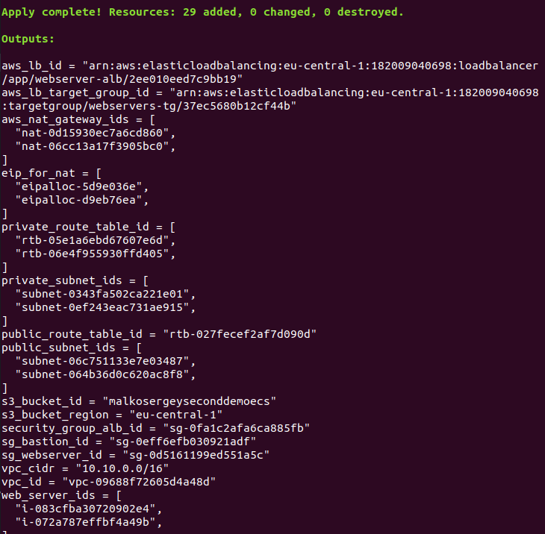
Outputs

Slide 6
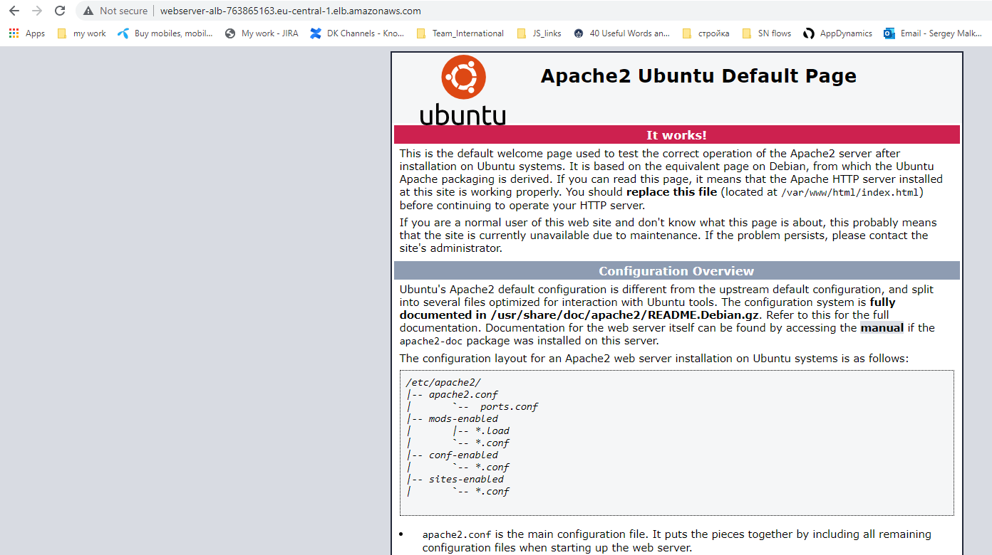
Workflow

Slide 7
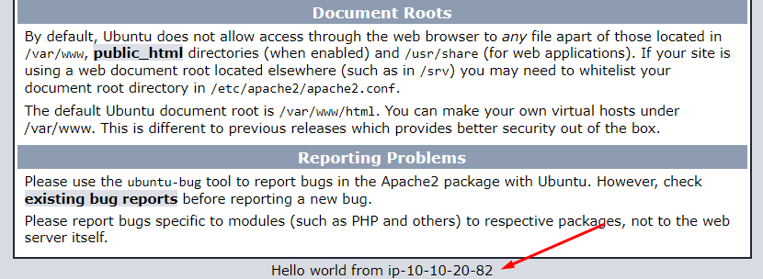
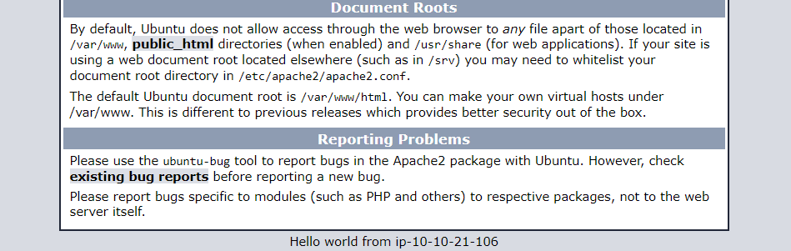
Results

Slide 8
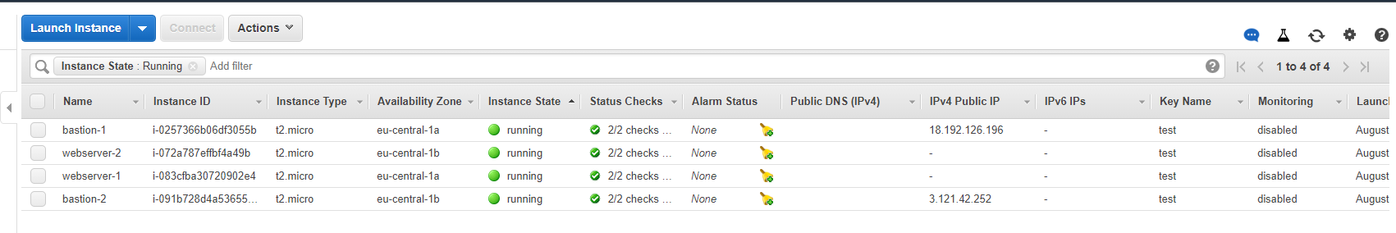
Terraform main.tf

Slide 9
Should you have any questions, feel free to ask?
Thank you for your time!
Student: Serhii Malko

